Slide 1
Slides for Ch 1 Discussion MSMB
10/28 BUG

Slide 2
The Goal for Today
We want to do 3 things:
Acquaint ourselves with simulating discrete events
Get a little more familiar with the flexibility + power of R functions and Rmarkdown
Do some cool visualizations with ggplot2
(Secondary goal: maybe do some github demo)

Slide 3
What is a simulation?

Slide 4
What is a discrete event?
Discrete vs. Continuous

Slide 5
What is a discrete event?
Discrete vs. Continuous
The three ingredients to having a notion of probability

Slide 6
What is a discrete event?
Discrete vs. Continuous
The three ingredients to having a notion of probability
Sample space

Slide 7
What is a discrete event?
Discrete vs. Continuous
The three ingredients to having a notion of probability
Sample space
List of events (sigma algebra)

Slide 8
What is a discrete event?
Discrete vs. Continuous
The three ingredients to having a notion of probability
Sample space
List of events (sigma algebra)
Probability measure (function on sigma algebra -> numbers)

Slide 9
What are discrete events in biology?

Slide 10
Our example today – substitution mutations
We say a base pair either mutates or does not (note: the outcome doesn’t need to be binary to be discrete, we could also say A->G, A->C, A->T, A->A etc are the sample space of discrete events)
We can only have whole base pairs

Slide 11
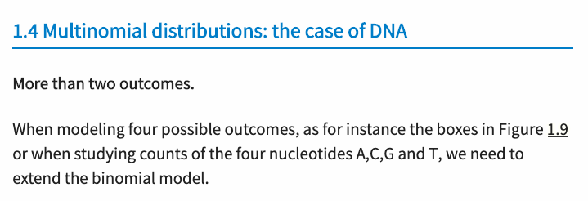
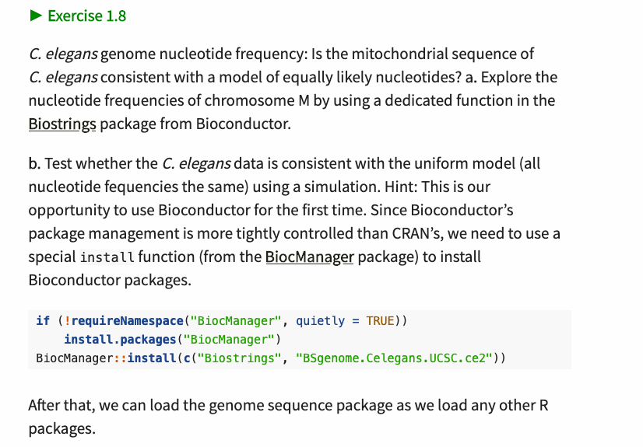
For Next Time: Try This

