Slide 1
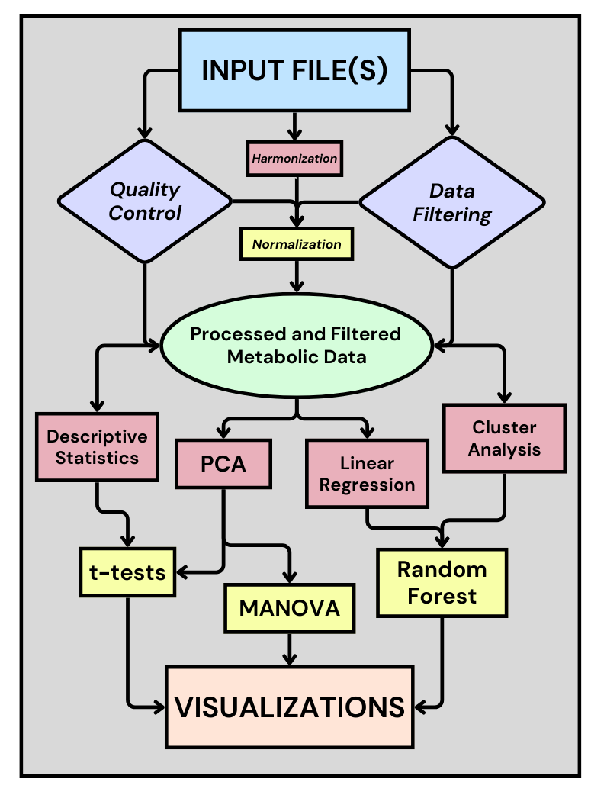
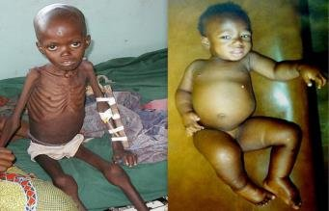
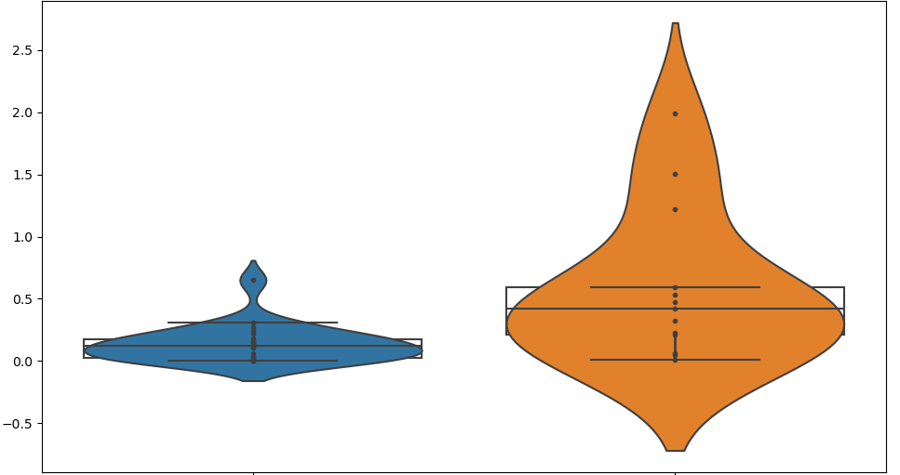
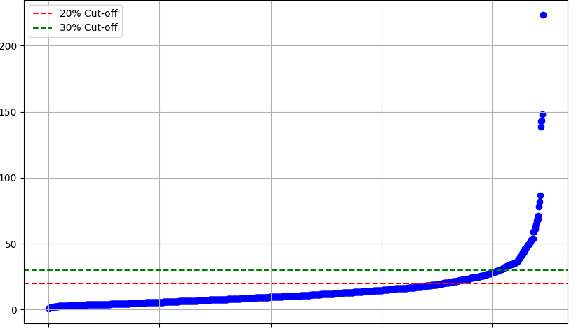
A Python-Based Data Pipeline for Visualizing Metabolic Differences in Severe Childhood Malnutrition
Daniel Musachio¹, Qing Li¹, Thalia Billawala¹, Neil Hanchard¹
¹Childhood Complex Diseases Genomic Section, Center for Precision Health Research, NHGRI, NIH
Childhood Complex Diseases Genomics Section
ABSTRACT
Childhood severe acute malnutrition (SAM) remains a significant health challenge, contributing to over 5 million deaths annually among children under the age of five. SAM manifests in two primary forms: non-edematous SAM (marasmus) and edematous SAM (kwashiorkor), with the latter characterized by bilateral pitting edema and liver complications. This study aims to elucidate the metabolic differences across these phenotypes, particularly between edematous and non-edematous forms, to uncover underlying etiological factors and potential therapeutic targets.
We collected metabolic data from serum blood samples of 35 patients suffering from malnutrition in Malawi, encompassing three groups: Kwashiorkor, Marasmus, and Marasmic-Kwashiorkor. The data underwent rigorous preprocessing, including harmonization, normalization, and filtering based on variance and quality control thresholds. Principal Component Analysis (PCA) and other statistical methods, including linear regression, cluster analysis, and Multivariate Analysis of Variance (MANOVA), were employed to analyze the processed metabolic data.
The developed data pipeline not only facilitates detailed metabolic analysis but also offers a customizable tool for ongoing and future studies. By integrating advanced statistical techniques and ensuring intuitive data visualization, this pipeline supports broader research efforts aimed at mitigating the impacts of severe acute malnutrition in children. Future directions include expanding the sample size and incorporating additional features into the data pipeline to enhance its analytical capabilities.
No clear etiological differences and no cellular model to study them in
Aim: Examine metabolic differences across phenotypes
WORKFLOW
Processing:
Dimensionality reduction via Principal Component Analysis
Ranked matrix generation
Shapiro-Wilk test for normality
RESULTS
Significant Metabolites
Across groups, there are 67 metabolites with p-values less than .05 (via t-tests)
11 metabolites with p-values less than .01
A number of Bile Acids are significantly lower in Edematous group compared to Non-Edematous group
Deoxycholic Acid
Marasmus Kwashiorkor
micromoles per liter (normalized)
OBJECTIVES
Examine potential metabolic differences across phenotypes, with a particular focus on Edematous (Kwashiorkor and Marasmic-Kwashiorkor) compared to Non-Edematous (Marasmus)
Developing a Python-Based data pipeline to analyze metabolic data
Expanding the data pipeline to be highly intuitive and customizable so that it can be used by any NIH staff with metabolic data interested in visualization
Edematous Non-Edematous
Preprocessing (Optional):
Harmonizing multiple data sheets into one csv file
Filtering out outliers and rows and columns above “missing rate” threshold
Removing metabolites with low variance
Removing metabolites that do not pass the Quality Control threshold
Normalizing data to allow parametric tests
Graph 2: Violin Plot shows the level of Deoxycholic Acid across groups. Running a t-test yields a p-value of .002.
CONCLUSION
This work utilized the computational resources of the NIH HPC Biowulf cluster (https://hpc.nih.gov)
Generation of Bile Acid is currently believed to be impaired in people in Edematous group
Metabolic data from our study strongly support this hypothesis
This data pipeline can be used for any metabolic data
The pipeline will generate a collection of useful graphs from various statistical methods
METHODS
BACKGROUND
RSD across all metabolites
Metabolic data was collected from a number of patients suffering from malnutrition via a serum blood sample, with more data expected to be available soon
Childhood severe acute malnutrition (SAM) is associated with > 5 million deaths in children under the age of 5 each year.
SAM has two forms:
• Non-edematous SAM (marasmus): presents with severe wasting.
• Edematous SAM (kwashiorkor): presents with bilateral pitting edema & multi-organ dysfunction & hepatic steatosis (fatty liver).
Marasmic-Kwashiorkor: presents with features of both marasmus and kwashiorkor.
Lower DNA methylation levels & one carbon metabolite levels (OCM) in kwashiorkor.
RSD (%)
FUTURE DIRECTIONS
Serum Samples Collected in Malawi | n = 35 patients
Kwashiorkor | 13
Marasmus | 13
Marasmic-Kwashiorkor | 9
Aim to allow even more customization in terms of preprocessing
As more serum samples are collected, features of the data pipeline that require higher patient counts (Linear Regression, Random Forest) will potentially reveal new information
Variable Index (sorted by RSD)
Graph 1: 711 of the 892 metabolites (79.71%) were below the 20% RSD threshold based off 5 quality control samples

