Slide 1
Programming Skills Workshop
Lesson 1 - Introduction

Slide 2

Course Background
Problem:
Too many ICT students lack fundamentals, struggle through first semesters and never catch up.
Not knowing at first is okay (really!) – but you’ll need to work a little harder to keep up.
This course is designed to get everyone ready for ICT studies

Slide 3
Course Schedule
Tues 22nd – Intro
Wed 23rd – Windows Intro
Thu 24th – Computer Administration
Wed 30th – Programming Tips & Tricks
Thu 31st – Programming Tools
Wed 6th – Linux
Thu 7th – More Linux & Languages
Wed 13th – Group Work & More Tools
Thu 14th – Open

Slide 4
Course Expectations
Attendance is tracked and mandatory
Some lessons will be fast and discussion-based
Others will be slow and technical

Slide 5

Questions? Comments? Speak up!

Slide 6

Who am I?
Kristofer Carta
224197@via.dk
Likes:
Databases
Web
Languages
VR/AR
Dislikes:
Embedded
Crazy Math

Slide 7
Today’s Lesson
A little shorter than usual
A little of what you’ve been hearing already
Lots of time for discussion – please disagree with me!
Questions to ask:
What exactly do you mean by X?
Why X? Why not Y?

Slide 8
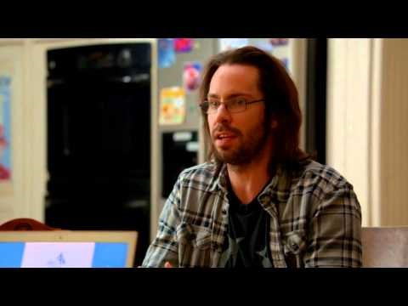

Skills for Success
Real-world programming requires two skillsets:
Social
Technical
To be successful, you’ll need to balance both

Slide 9
Programming as a Social Practice
In the real world, about 20% of a typical work day is spent coding.
The other 80% is spent on:
Meetings
Project Management (Politics!)
Dealing with Customers
Training
Coffee breaks
Programmers don’t have to be cool, but they do have to be socially competent.
If you don’t work on your social skills, you could be falling short at 80% of the job!

Slide 10
Skills Checklist - Social
I feel comfortable:
Interacting in English
Working in groups
Participating in class
Studying (reading in English)
Writing reports in English
Asking for help
Helping/teaching others
Being a nerd outside of class

Slide 11
Programming as a Technical Practice
Coding may only be 20% of the job (most of the time).
But it’s by far the most important part - and the hardest.
Real-life programming requires constant learning and growth.
The skills you’ll need to learn programming now are the same you’ll be using throughout your entire ICT Engineering career.

Slide 12
Skills Checklist - Technical
I feel comfortable:
Problem solving
Administering Windows
Using the command line
Understanding programs & tools
Using Linux (basics)
Typing (without looking)
Troubleshooting
Googling

Slide 13
Break!

Slide 14
Discussion - VIA
Why did you choose VIA?
What’s your goal from studying here?
What do you think so far?

Slide 15
What’s Easy at VIA?
Access to teachers
Making things
Passing classes
Finding work

Slide 16
What’s Hard at VIA?
Staying motivated
Working with others
Digging deep
Finding work

Slide 17

How do I learn to Program?
Programming is mostly applied problem solving
The more experience you have, the more problems you’ll recognize, and the easier it will be to come up with solutions to apply to them
The only way to gain experience is through doing
VIA merely puts you on a path, it’s up to you to walk it

Slide 18
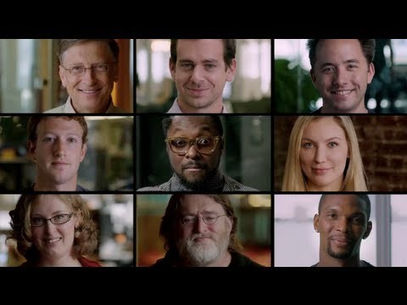

Slide 19
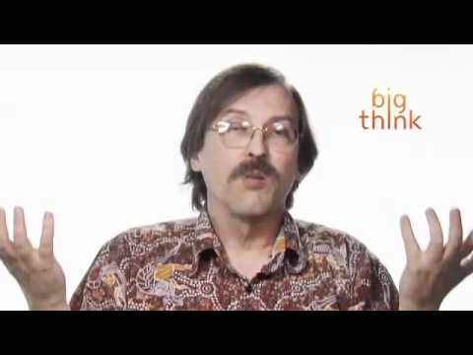

Slide 20
Break!

Slide 21
Learning
“Learning is the active acquisition of skills, knowledge, and values that results in changed behavior”
You won’t learn by just being told something (even if you’re listening)
You aren’t learning something unless you apply it (changed behavior)
Real, continuous learning is essential to being an ICT Engineer

Slide 22
Learning Process
The more purposeful and structured your learning, the better
You will learn more if you know:
That you are learning
What you are learning
How you are learning

Slide 23
