Slide 1
Programming Skills Workshop
Lesson 7 – Linux & Programming Languages

Slide 2
Course Schedule
Tues 22nd – Intro
Wed 23rd – Windows Administration
Thu 24th – Windows Command Line
Wed 30th – Cancelled
Thu 31st – Programming Tips & Tricks
Wed 6th – Programming Tools
Thu 7th – Linux
Wed 13th – More Linux & Languages
Thu 14th – Group Work & More Tools

Slide 3
Course Resources
Course items up on GitHub
https://github.com/kcarta/programming-workshop
These will be updated weekly

Slide 4
Today’s Lesson
Linux and Programming Languages
So much text! We promise it will be worth it!
What you’ll learn:
Skills: Doing easy things in Linux. But mostly listening.
Knowledge: Everything you ever wanted to know about programming languages.
Values: Seeing the programming ecosystem as a seasoned IT Engineer does.

Slide 5
Linux Revisited

Slide 6
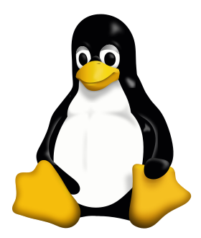
Linux in review
Linux is the common name for any operating system built on top of the Linux kernel.
Linux is often used in a command line interface.
Any Linux installation should come with a large number of tools for installing programs, configuring the operating system, and working with code.

Slide 7
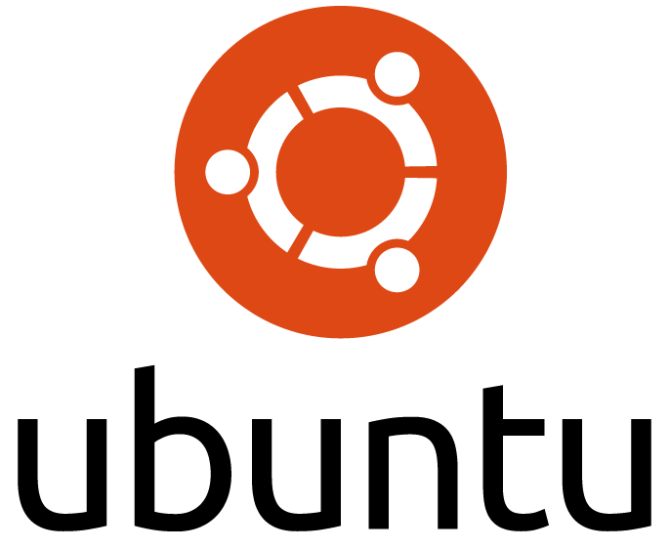
Exercises: Let’s do stuff in Linux!
Linux makes IT tasks easy.
In the following exercises, we’ll learn how to:
Write and run scripts
Set up a web server

Slide 8
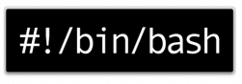
Walkthrough: Bash
Your command line interface is actually a programming environment!
The language is called bash, and it’s both weird and powerful.
You’ve actually been using bash already, just one command at a time.
Bash commands can be written together in a shell script (.sh extension), and then run from the command line.
Millions of server administrators have used bash to script everything from little home servers to supercomputers.
(jitbit.com/alexblog/249-now-thats-what-i-call-a-hacker/)

Slide 9
Walkthrough: Bash
The simplest (not best!) way to write and run bash scripts is:
Open a text editor: > nano myscript.sh
Write any series of commands, one line at a time
Save the file (In nano: Ctrl + X, then y, then Enter)
Go to where the file is, and enter: > bash myscript.sh
For more, http://guide.bash.academy/ is a great place to start

Slide 10

Walkthrough: Hosting Websites
Linux is the preferred platform for hosting websites. Most* websites run on a Linux server (*estimates vary widely).
It is very easy to start a basic web server!
> sudo apt-get update
> sudo apt-get install –y nginx
> sudo service nginx restart
Go to localhost in your browser for the result!

Slide 11
Programming Languages - Discussion

Slide 12
Programming Revisited
What is programming?
- Was what we just did in Linux programming?
- Is what you’re doing in SDJ programming?
Why? Why not?

Slide 13
Programming Revisited
Programming can be many things!
But let’s try some simple definitions:
Programming is writing instructions for a computer to follow.
We want to control computers to solve problems.
A language is a standardized way of writing instructions to a computer, usually for a platform that executes code written in the language.

Slide 14
Programing languages
How many programming languages are there?

Slide 15
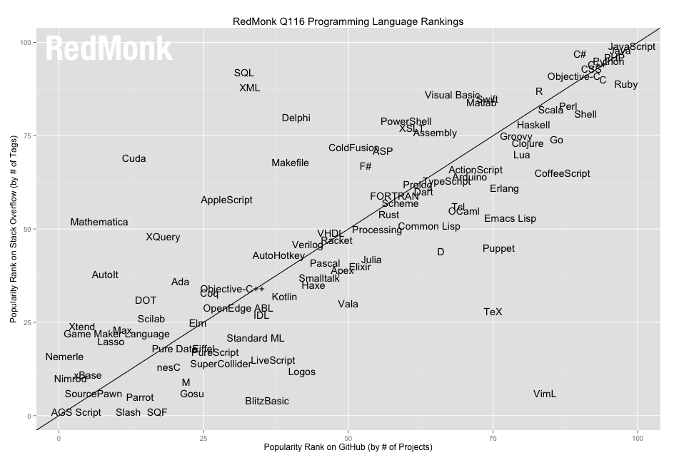
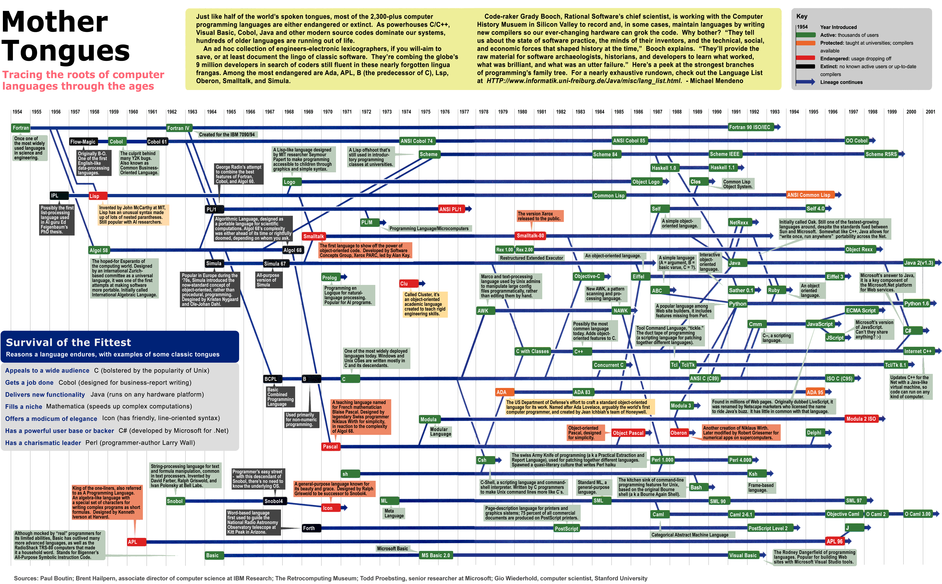
There are many

Slide 16
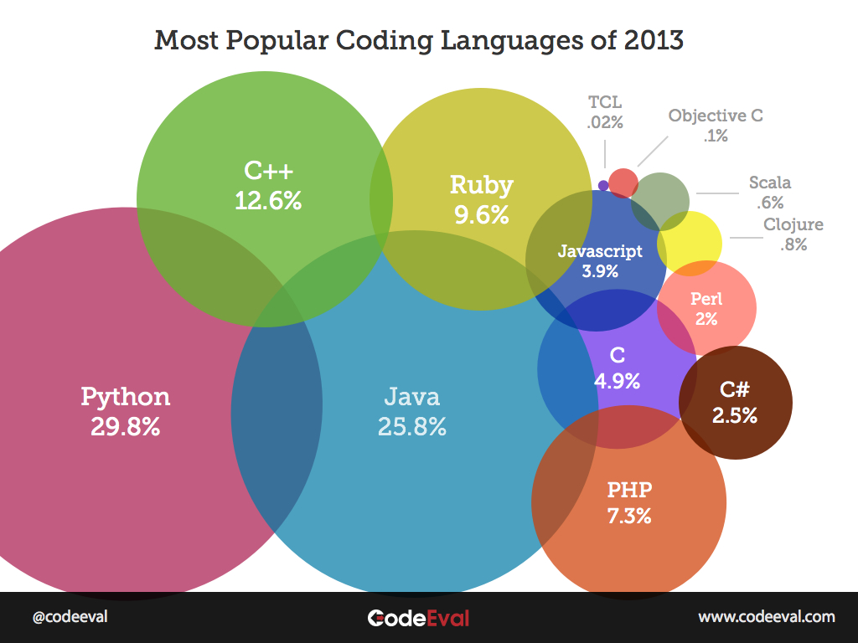
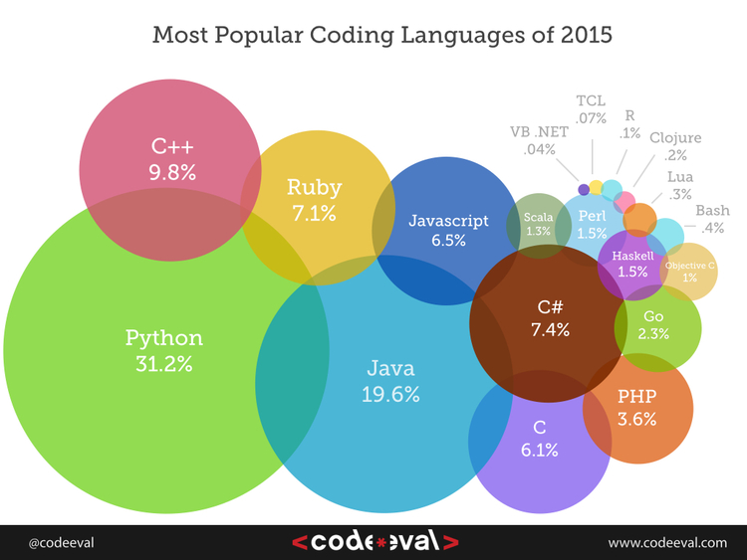

Slide 17
Programing languages
Why are there so many languages?
How different can they be?
How many do you need to know?

Slide 18
Why are there so many?
The only correct answer to “what language is best?” is “it depends!”
A programming language is a tool for solving problems.
Each language offers a different approach.
Often, languages are better at solving certain problems:
- How do I access data in a database? -> SQL
- How do I manage payroll for my employees? -> Excel
- How do I make sure my rover works on Mars? -> C
The language you choose should fit the problem you want to solve.

Slide 19
How do languages differ?
A classic difference between languages is verbosity.
These two programs do the same thing:
“Hello world” in Java:
public class HelloWorld {
public static void main(String[] args) {
System.out.println("Hello, World!");
}
}
“Hello World” in Python:
print("Hello, World!")
Let’s discuss!
- What benefits do we get from each version?

Slide 20
Programming Languages - History

Slide 21
Machine Code
A digital computer can only understand binary – 1s and 0s.
In the early days, programming was done entirely in binary*.
* Eventually hexadecimal!
Machine code is a set of instructions executed directly by the CPU.
The exact instructions to write depend on CPU architecture.
Thankfully, no one hand-writes code in machine language anymore.

Slide 22
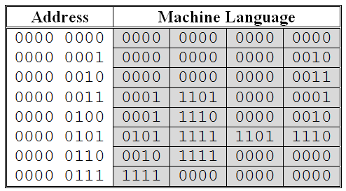
Machine Code Example
“Add two numbers and store the result”

Slide 23
Assembly Language
Assembly code is a set of human-readable CPU instructions.
- A tool called an assembler translates these to machine code.
There are many different assembly languages.
- The instruction set available to program with depends on the CPU.
Assembly is still used today in embedded projects.
github.com/chrislgarry/Apollo-11 – assembly code for the first lunar mission!

Slide 24
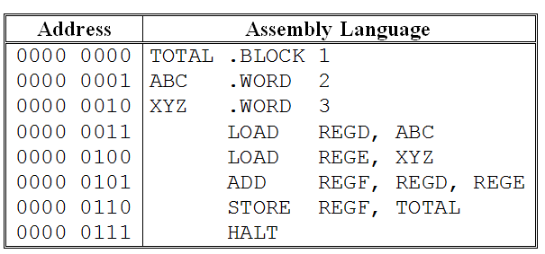
Machine Code Example
“Add two numbers and store the result”

Slide 25
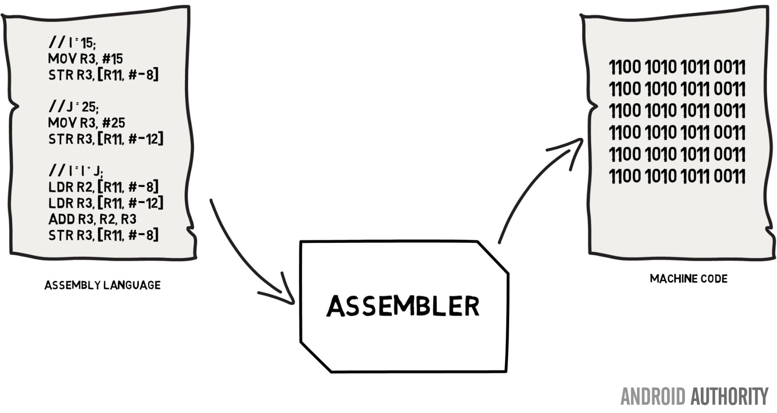
Assembly Language

Slide 26
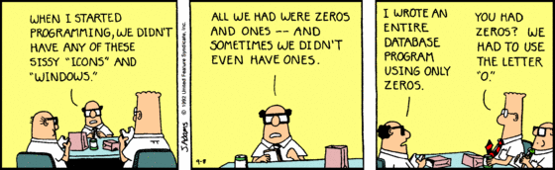
Languages for Humans
Assembly is the classic low-level language.
Anything you can do in Java, you can do in Assembly.
So why didn’t we stop there?

Slide 27
Languages for Humans
To start making a higher-level language, you need to answer:
What abstractions should the language use?
What paradigms should the language follow?
How does the language run on an actual computer?

Slide 28
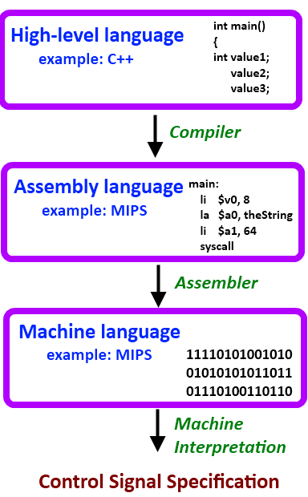
Levels of Abstraction
A core concept in programming is abstraction.
“The essence of abstractions is preserving information that is relevant in a given context, and forgetting information that is irrelevant in that context.”
– John V. Guttag
Modern programming languages tend to offer high levels of abstraction.

Slide 29
Programming Paradigms
All languages can be (roughly) divided into a set of paradigms.
A paradigm is a way of organizing code.
Usually to take a specific approach to solving problems.
Depending on the problem you need to solve, different paradigms will offer different abstractions to help you.

Slide 30
Imperative and Structured Programming
In an imperative paradigm, a program is a set of commands that are followed top to bottom, until none are left.
Think of this like a simple recipe.
This is the most primitive way to organize code.
Most programming languages support imperative programming.
In structured programming, imperative code is given structure by things like loops (while/for), and conditional statements (if/else, switch)
Non-structured programs rely on “jumps” to line numbers in code
This is “considered harmful”

Slide 31
Compilation
For code written in a high-level language to run on a computer, it must be translated into machine code instructions.
This is traditionally done using one of two programs:
A compiler, that translates the code all at once, so it can be run later.
An interpreter, that translates and runs the code one line at a time.

Slide 32
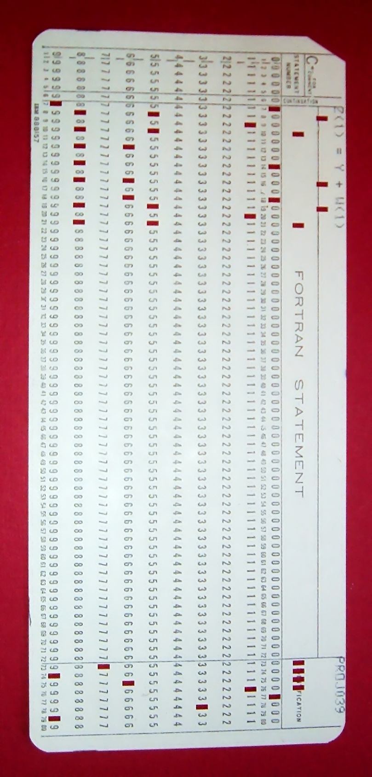
FORTRAN
Fortran stands for “Formula Translation”.
Fortran is:
Compiled
Compiler theory improved dramatically because of Fortran.
Imperative
Later evolved to include other paradigms.
High-level
At least compared to assembly.
Fortran became very popular for scientific computing.
It’s still used for that purpose today!

Slide 33
FORTRAN Example
program add
implicit none
real a,b,s
print *, ' This program adds 2 real numbers'
print *, ' Type them in now separated by a comma or space'
read *, a,b
s = a + b
print *, 'The sum of ', a,' and ' , b
print *, ' is ' , s
stop
end

Slide 34
Algol/COBOL
Algol and COBOL were two immensely influential high-level imperative languages, both released in the late 50s and improved throughout the 60s.
COBOL was developed for use by businesses, using English-like syntax.
ALGOL was a more academic language.
The evolution of ALGOL led to many influential features:
Simple if/else statements
User-defined types
Structured programming
Recursion

Slide 35
COBOL Example
$ SET SOURCEFORMAT"FREE"
IDENTIFICATION DIVISION.
PROGRAM-ID. Multiplier.
AUTHOR. Michael Coughlan.
* Example program using ACCEPT, DISPLAY and MULTIPLY
DATA DIVISION.
WORKING-STORAGE SECTION.
01 Num1 PIC 9 VALUE ZEROS.
01 Num2 PIC 9 VALUE ZEROS.
01 Result PIC 99 VALUE ZEROS.
PROCEDURE DIVISION.
DISPLAY "Enter first number (1 digit) : " WITH NO ADVANCING.
ACCEPT Num1.
DISPLAY "Enter second number (1 digit) : " WITH NO ADVANCING.
ACCEPT Num2.
MULTIPLY Num1 BY Num2 GIVING Result.
DISPLAY "Result is = ", Result.
STOP RUN.

Slide 36
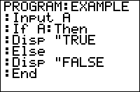
BASIC
BASIC is an imperative language, made for beginners.
Before BASIC, programming was a task for scientists and mathematicians.
Inspired by FORTRAN, COBOL, and ALGOL, BASIC was distributed for free and became widely used by hobbyists and lay programmers.
Microsoft started in 1975 writing BASIC interpreters.
Many middle-age programmers today started on BASIC.
Flavors of BASIC are still used, in niche roles such as Excel macros.

Slide 37
BASIC Example
FOR x = 99 TO 1 STEP -1
PRINT x; " bottles of beer on the wall"
PRINT x; " bottles of beer"
PRINT "Take one down, pass it around"
PRINT x-1; " bottles of beer on the wall"
PRINT
NEXT x

Slide 38
Functional Programming
In the 1930s, a type of mathematics called Lambda Calculus was created.
Lambda calculus expresses computation using functions.
It’s okay if this doesn’t make sense, it’s not easy to relate to.
Functional languages usually start with lambda calculus as a base.
A typical functional program is built up of functions that evaluate, like:
+ 1 4 ---> 5
Functional programming is declarative:
You tell the computer what to accomplish, not how to accomplish it.
This is the opposite of imperative programming.

Slide 39

LISP
Specified in 1958, Lisp is second-oldest high-level programming language.
Lisp was heavily influenced by lambda calculus.
Lisp follows simple rules, like:
Everything in Lisp is a list of some kind.
These are expressions that evaluate to produce some value.
Lisp lists are surrounded by parentheses ().
This makes Lisp instantly recognizable.
There is not one Lisp, but rather a whole family of implementations.
Some died out long ago, while others are still used.

Slide 40
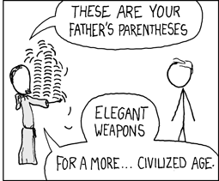
LISP Example
(defun factorial (N)
"Compute the factorial of N."
(if (= N 1)
1
(* N (factorial (- N 1)))))

Slide 41
Object-Oriented Programming
The object-oriented programming paradigm relies on a bold idea:
You can model your program after the problem you want to solve.
In an OOP language, data is packaged together with the functions that use it.
Common OOP principles include:
Inheritance
A duck is a type of bird, so it should naturally have wings and be able to fly.
Polymorphism
If you just need a bird but don’t care which one exactly, you can use a duck.
SOLID
A well-crafted OOP program is easy to test and maintain.

Slide 42

Simula & Smalltalk
Simula, developed in Norway in the late 60s, was the first OOP language.
Simula was meant for simulations of real-life scenarios.
It had classes, objects, inheritance, coroutines, and garbage collection, all features used in modern languages.
Smalltalk was developed later, but was heavily inspired by Simula.
A research language, it never took widespread hold, but inspired modern languages like Objective-C, Python, Java, Ruby, JavaScript, etc.
Smalltalk also inspired modern practices like Agile, Rapid Application Development (RAD), and Software Patterns.

Slide 43
Halfway Point
We just looked at nine classic programming languages.
By the late 1960s, there were already hundreds of languages.
What problems were these languages trying to solve?
Why don’t we use any of these anymore?

Slide 44
Modern Programming Languages

Slide 45
Multi-Paradigm
We have seen a few programming paradigms so far:
Imperative: Program is a series of statements, run one-by-one.
Functional: Program is a series of evaluating functions.
Object-Oriented: Data and functionality are paired together in objects.
Modern languages like Java are considered multi-paradigm because they contain elements of multiple paradigms at once.

Slide 46
SQL
SQL (“Structured Query Language”) is used with databases.
It is a declarative language (state what should happen, not how).
Based on Relational Algebra concepts.
Many SQL implementations use additional paradigms.
Since the 80s, SQL is one of the most used languages in the world.
It hasn’t been very influential though.
SELECT Name, PhoneNumber FROM Customer WHERE Age > 30;

Slide 47
C
C is one of the most widely-used, important, and influential programming languages of all time.
Developed in 1972 by Ken Ritchie at Bell Labs as a general purpose language that could easily be compiled to machine code.
C strikes a balance between abstraction and performance.
C is the preferred language for projects where performance is crucial, like embedded devices, language runtimes, and operating systems.

Slide 48
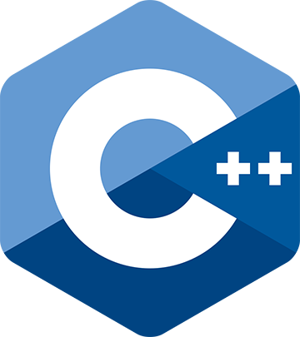

C++
C++ started as an object-oriented superset of C
It promises the performance of C, on a higher level of abstraction.
C++ was developed by Bjarne Stroustrup (a Dane!) in 1983.
C++ is widely used (a top-three language)
Extremely popular for systems programming
New language versions come out every few years.

Slide 49
Memory Management
Imagine a banking app, where one person sends money to another.
In this program, many items might be tracked:
Data on the people involved (names, addresses, phone numbers, etc.)
Account data (banks, balances, etc.)
Data on the money being sent (amount, time sent, etc.)
To process this transaction, the program must keep this data in memory.
When the program finishes the transaction, where does the memory go?
Is it deleted? If so, how?

Slide 50
Memory Management
Memory has to be cleared when it is no longer used.
When this doesn’t happen like it should, it’s a bug called a memory leak.
Old bank transaction data is no longer used*, so it should be deleted.
* it may be stored in a database, but that’s different.
Unused items in memory need to be cleared manually by a programmer, or automatically by a Garbage Collector.
Older languages (like C++) require manual memory management.
Newer languages (like Java) tend to have garbage collection as a feature.

Slide 51

Java
The first popular object-oriented, garbage-collected language.
Java was released in 1995 by Sun (now owned by Oracle).
Java looks like C/C++, but is a higher-level language.
Java’s killer two features were:
Portability - “Write once, run anywhere”
The same Java code can be run on a huge number of platforms.
Easy OOP
- Java is object-oriented with classes, and offers automatic garbage collection.

Slide 52
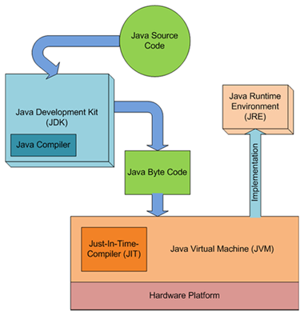
Java - Portability
You write this
Java really does “run everywhere”
From your phone’s SIM card to your bank’s mainframes.
The same Java code is guaranteed* to run anywhere the Java runtime can be installed.
The rest is taken care of for you!

Slide 53
Java - Typing
Java enforces static type checking.
This means you must state exactly what type something is when you declare it:
Person person = new Person();
Static typing is a double-edged sword:
It helps guarantee program correctness even before the program is run.
It can be distracting and repetitive:
AbstractBinaryStreamReader reader = new ConcreteBinaryStreamReader();

Slide 54
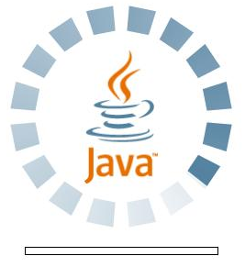
The Web (and Java’s big failure)
In the 90s, the Web was the “next big thing”.
But web pages were static – just a bunch of text with images.
Java’s first big opportunity was in making the web interactive.
Java Applets ran inside a web browser, via the JVM.
Combined with the rapid rise of the World Wide Web in the 90s, applets made Java ridiculously popular.
Applets failed, however, to security issues and competition.

Slide 55

Enter JavaScript
JavaScript is the language for writing interactive web applications.
Literally being made for this sole purpose, it thrived where Java failed.
JavaScript is a bastard language with many hobbled-together features.
Even its name is a misleading result of fad-following.
It was thrown together in a few weeks by a single person working alone.
Despite all this, JavaScript has beautiful parts, and has quickly become one of the most-used and influential modern programming languages.

Slide 56
JavaScript Example
Number.prototype.times = function(action) {
var counter = this.valueOf();
while(counter-- > 0) {
action();
}
};
var sayHello = function () {
console.log("Hello!");
};
(4).times(sayHello);
Notes:
This probably still compiles

Slide 57
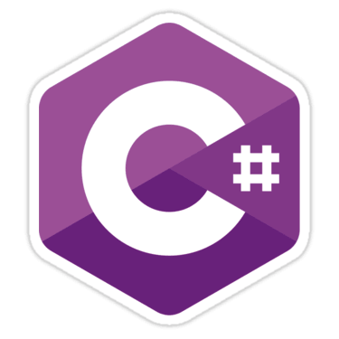
C#
Microsoft tried to jump on the Java bandwagon in the mid-90s with J++.
When Sun sued them for this, Microsoft made their own language, C#.
C# is extremely similar to Java, but is most heavily influenced by C++.
C# is multi-paradigm like Java and runs on a Java-like runtime.
It is also used in similar places, from web servers to desktop applications.
But C# is not “write once, run anywhere” like Java.
C# and Java are in many ways direct competitors, but C# has arguably evolved to include new features at a faster pace than Java.

Slide 58

Python
Released in 1991, developed by Guido Rossum.
Named after Monty Python's Flying Circus
Multi-paradigm, but mostly imperative and object-oriented.
Python’s power is its simplicity (expressiveness) and community.
Dynamically typed and garbage-collected.
Not the fastest language or the most “safe” for large projects.
But it is incredibly easy to learn and read.
Python is one of the top-used languages in the world, and growing.

Slide 59
Python Example
prices = {'apple': 0.20, 'banana': 0.50}
my_purchase = {'apple': 1, 'banana': 6}
grocery_bill = sum(prices[fruit] * my_purchase[fruit]
for fruit in my_purchase)
print 'I owe the grocer $%.2f' % grocery_bill
2.7 4evah
Notes:
This probably still compiles

Slide 60

Others
There are many other languages we haven’t covered:
PHP
Ruby
Objective-C
Swift
Go
R
Literally thousands of others!

Slide 61
Teaching Programming

Slide 62
The Million Dollar Question
What programming language is best for teaching?
C/C++ for classic programming (Too hard!)
Python for modern programming (Too unfamiliar!)
C# for enterprise programming (Too Microsoft!)
JavaScript for web/hipsters (Too JavaScript!)
Java

Slide 63
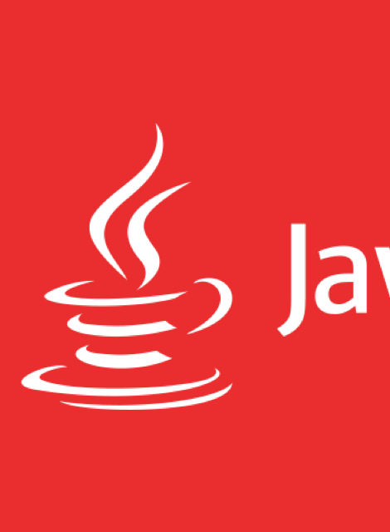
The winner is...Java!
Java is:
Widespread
On billions of devices, from embedded to Android to big data.
Mature
20+ years as a top-three language.
Robust
The Java SDK libraries are sprawling and easy to use.
Core programming principles are easy to learn in Java.
Beginner-friendly
Learning to program with Java is a smooth, gradual process.
Especially with tools like Eclipse.
Scalable
Java works equally well for simple class exercises and gigantic open-source projects.

Slide 64

Conclusion
In the real world, there are thousands of programming languages.
Each language fills a niche – some small, some large.
Instead of feeling like you need to know all of them, remember:
In any field there will be a small set of languages you’ll need to learn.
A language is a tool, for a purpose. Once you understand the problem to solve, you can pick the right tool for solving it.

