Slide 1
Programming Skills Workshop
Lesson 8 – Group Work & More Tools

Slide 2
Course Schedule
Tues 22nd – Intro
Wed 23rd – Windows Administration
Thu 24th – Windows Command Line
Wed 30th – Cancelled
Thu 31st – Programming Tips & Tricks
Wed 6th – Programming Tools
Thu 7th – Linux
Wed 13th – More Linux & Languages
Thu 14th – Group Work & More Tools

Slide 3
Course Resources
Course items up on GitHub
https://github.com/kcarta/programming-workshop
These will be updated weekly

Slide 4
Today’s Lesson
Working in teams and using source control
What you’ll learn:
Skills: Using git and other tools for team management.
Knowledge: Group work practices, source control and Git.
Values: Working with others is a lot easier if you use the right tools and processes.

Slide 5
Team Work Processes & Tools

Slide 6
Team Work in general
Team work is at the core of every software project.
No software is simple enough to be built by a single person.
Humans aren’t perfect, and many humans are really imperfect.
Many methodologies, or practices, have been made to try to solve the “human problem” in software development.
The two most common are Waterfall and Agile.

Slide 7
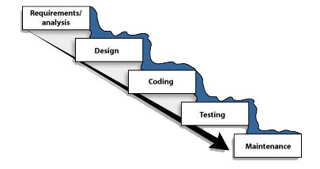
The Waterfall Method
Waterfall is the standard and most common software development process.
The following activities happen in order:
Requirements
Find out what to code
Analysis
Find out what is needed to code it
Design
Plan how to code it
Implementation
Code it
Testing
See if the code works
Maintenance
Continue fixing the code forever
Looks great!

Slide 8
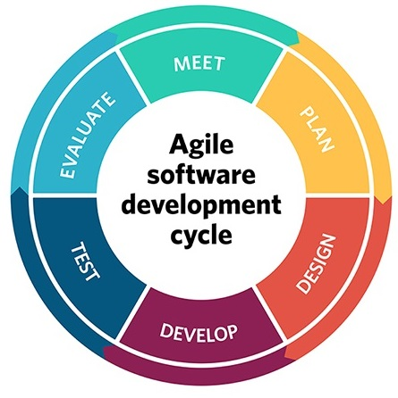
Agile
Agile is a family of methodologies and processes.
A set of beliefs and values instead of hard rules.
Agile processes tend to be iterative:
Design, Build, Test, Repeat.
Change is embraced, even late in product development.
We (and our customers) never know what we want at the start
What was valuable yesterday may not be valuable anymore
The two most used Agile methodologies right now are: Scrum and Kanban
Scrum is about following a process and using specific tools
Kanban is about visualizing work

Slide 9
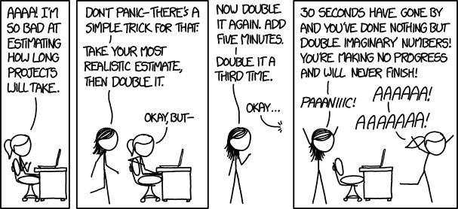
Time estimation
Estimating how much time a task will take sounds easy, but it isn’t!
Estimation is critical to software planning, but most estimates are wrong. Almost all software overruns deadlines.
Common reasons include:
Feature creep
Unrealistic expectations
Unforeseen problems

Slide 10
Estimation and Deadlines
Following an iterative process helps minimize the pain of missing deadlines.
Also, tools and processes (Agile estimation) exist to simplify estimation.
It is important to keep in mind:
An unfinished product is not always a bad product*
Your project (at VIA) won’t lose points if it’s unfinished, as long as you document this.
In real life, you can usually negotiate this with your customer.
Under promise and overdeliver*
It’s better than the opposite, but don’t overdo it

Slide 11
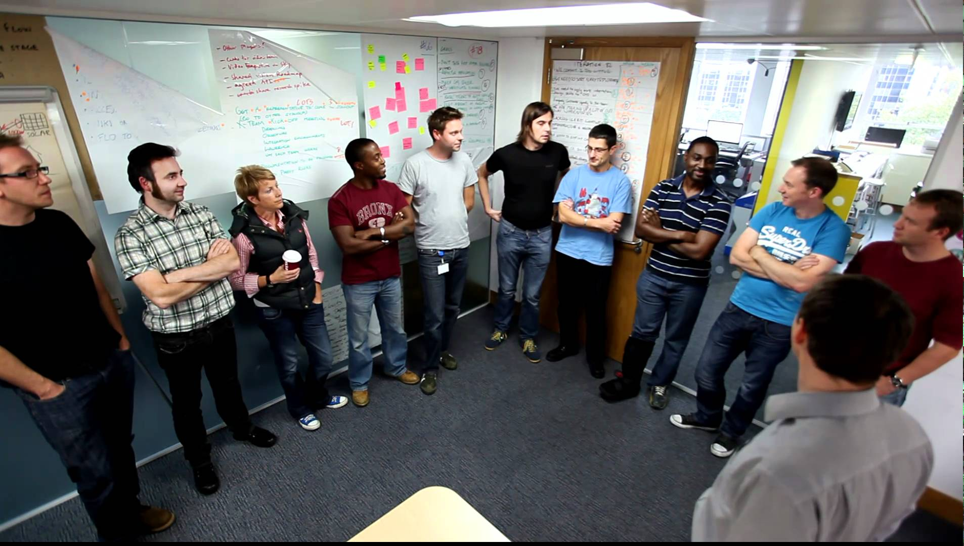

Standup meeting
Meetings suck, and most developers hate them.
In Agile, developer-oriented meetings are a good thing.
Brief (< 10 minutes) daily “standup” meetings
Review meetings to discuss how things have gone
You can’t learn from your devs if you don’t talk to them!
In a typical Agile meeting:
Devs talk about what they did and plan on doing
Devs share knowledge on common issues
See if anyone is falling behind or has difficulties
Managers and devs discuss how things can be improved

Slide 12



Boards
Boards are a commonly used Agile tool.
Visualization is key for quickly answering:
What is being done right now?
What has been done so far?
What still needs to be done?
Useful tools for this:
Trello (best for students)
Github Projects (great if you’re already using GitHub)
Jira (best for modern workplaces)
Visual Studio Team Services (If in Microsoft ecosystem)

Slide 13

Boards

Slide 14
<GitHub Projects or Trello demo>

Slide 15
Version control and Git

Slide 16
VCS Introduction
Imagine you’re working in a team.
How do you:
Share code with each other?
Especially offline
Back up your code?
Track history of your code?
Who wrote what, when?

Slide 17
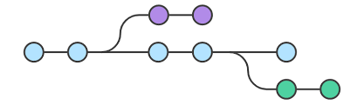
VCS Introduction
The (hopefully obvious) answer is:
You use a tool.
Version control (aka source control) tools do all these things and more.
VCS has been around since the late 1970s.
These tools help you safely share and backup code.
There is no other reliable way to do this!
Every time you share code over Dropbox, God kills a kitten!
And deletes a random line in your code.

Slide 18

What is Git?
Git is a distributed version control system.
In a distributed system every developer keeps their own copy of the code.
In a centralized system the code is stored in one central place.
Referred to by its creator, Linus Torvalds, as a “stupid content tracker”.
Created in 2005 to help develop the Linux kernel.
Nothing else was fast enough or suitable for distributed teams.
It is extremely powerful, but the core features are simple.
Git is by far the most popular VCS tool today.
It is free, and open source under the GNU General Public License.

Slide 19
Let’s install Git!
Download from git-scm.com/
1
Install it (Check Add to path)
Read all of the other options. Most of them can be left at default but it’s up to you
2

Slide 20
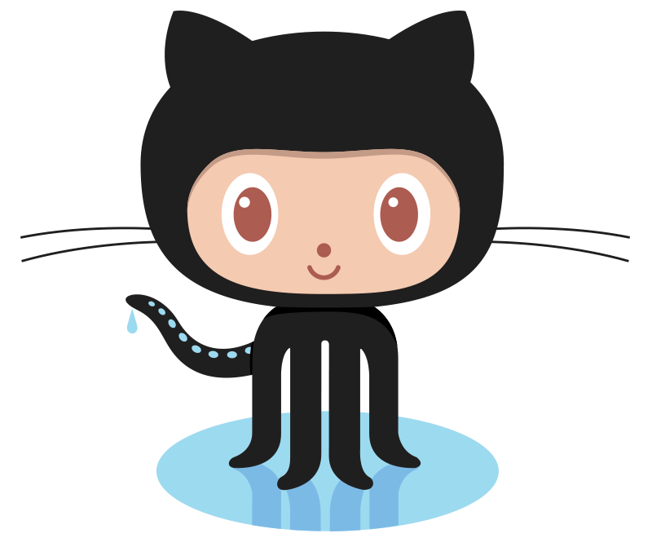
What is GitHub?
GitHub is the most popular Git repository hosting service.
One of many (BitBucket, GitLab,…)
Git does not belong to GitHub!
GitHub focuses on open source.
Repositories are public by default.
Private repositories are paid (free for students!).
Many other features beside Git
Feature planning, bug tracking,…
Hosting your portfolio for free (GitHub Pages)

Slide 21

GitHub Student Developer Pack
Great free resources for students!
Lasts as long as you are a student.
Has to be renewed every few years
https://education.github.com/pack

Slide 22
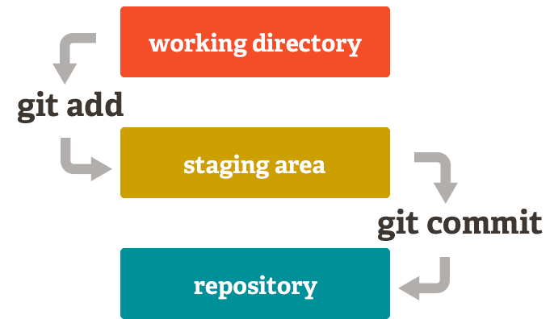
Basic terms
Repository
Staging area
Commit
Remote
Branch
Collaborator

Slide 23
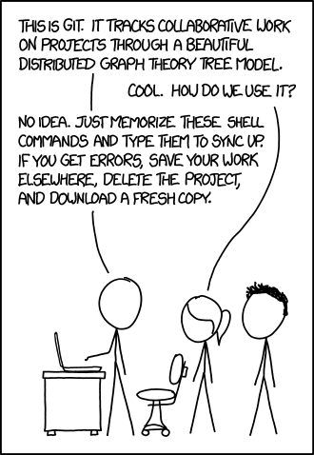
Git Commands
git init
git status
git add <filename> | -A
git commit –m
git pull
git push

Slide 24
git init
Starts a git repository in current directory
First command you use when creating a new repository
You’ll never need it again after the first time

Slide 25
git clone
git clone <link to remote repo>
Creates a local copy of the remote repository
Copy is placed in a folder with the name of the repository
If you want to work in it you have to cd into it

Slide 26
git status
Shows the current status of the repository
Prints exactly what’s in the staging area and which files have changed
It is best to type this obsessively!

Slide 27
git add
git add <filename>
Will add a single file to the staging area and prepare it for committing
git add –A
OR
git add *
Will add all changed or new files to the staging area

Slide 28
git reset
Will remove all files from staging area
git reset --hard
Will throw out all of your uncommitted changes! Dangerous!

Slide 29
git diff
git diff <filename>
Will print out what exactly has changed in that file

Slide 30
git commit
git commit
Creates a new commit with all changes that are added to the staging area
If you only type this, a text editor will open and you will have to write a commit message and then save and exit the editor.
git commit –m “commit message”
This makes the commit immediately with the message you’ve written.
This is what you will normally use

Slide 31
git pull
git pull
Will fetch all of the changes from the linked remote repository and try to merge them with your own files
If your files have been changed and conflict with the remote files, this might cause a merge conflict. Don’t worry, this is normal!

Slide 32
git push
“Uploads” all of your committed changes to the remote repository.
Only works when you are up to date with the remote repository.

Slide 33
<Basic example – repo creation>

Slide 34
Push and Pull
push – takes the local branch and “upload” it to the remote repo.
Push only uploads committed changes.
Push only uploads current branch.
There is an argument that will push all branches.
You always want to pull before pushing.
pull – downloads all changes from remote and merges them with local.
This may give you a merge error if there are conflicting changes on remote.

Slide 35
.gitignore
You don’t want to store nonsense Eclipse files in your code repository!
Git lets you specify files that should be ignored.
All you have to do is place a .gitignore file in the root of your repository.
A collection of ready-made .gitignore files is here: github.com/github/gitignore
Some IDEs (Visual studio, IntelliJ,…) create a .gitignore for you.
If you are creating a .gitignore file on windows you have to name it “.gitignore.”

Slide 36
Merge conflicts
They will happen!
They are not bad!
A merge conflict means that there were two different changes done that are incompatible and you are trying to merge them.
To resolve this, go into the conflicting files, edit them to the version you’d like, and then make a new commit.

Slide 37
<Merge conflict demo>

Slide 38
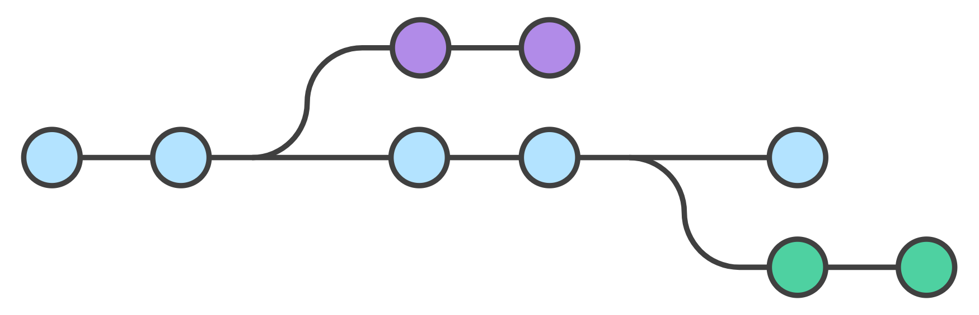
Branching
Branching and merging in Git is simple
As opposed to other VCS systems
Merge conflicts are not something you avoid at all costs
They are easy to resolve
Common names for branches:
Master
Develop
Release
In low level terms, a branch is a pointer to the latest commit
Git branching in a nutshell

Slide 39
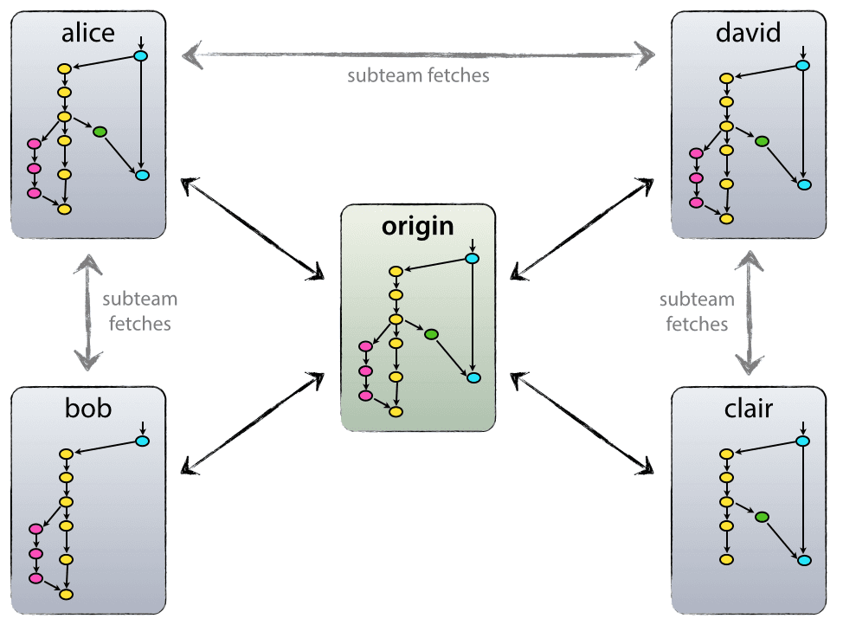
Remotes
Git is decentralized by default.
It can also act centralized:
origin is the True Repository
origin/master is branch master at remote origin
Local version of a remote branch is a separate branch

Slide 40
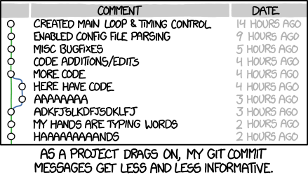
Commit messages
Important because they create history
Short and concise
In active voice
“Do this thing”
If applied, this commit will…
“Fix typo in introduction to user guide”
Great blog post: chris.beams.io/posts/git-commit/

Slide 41
Commit messages
Subject and body separated by a blank line
Subject
In imperative style
Starts with capital letter
No period at the end
No more than 50 characters
Body
Wrap after 72 characters
Explain What and Why rather than how

Slide 42

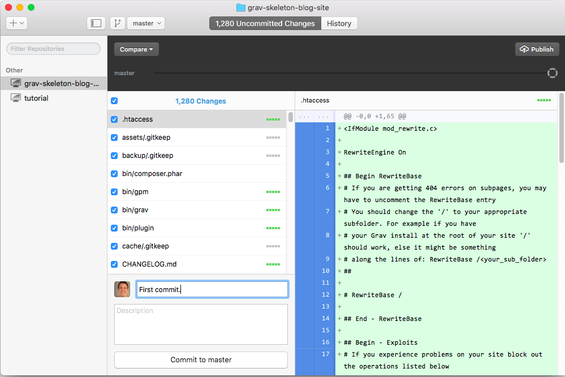
GitHub Desktop
If you hate the command line, there are many applications for Git.
GitHub Desktop is the easiest to use:
On Windows and Mac
Comes in two versions
Old version is really good
New version is in beta
Links with GitHub account
Works with non GitHub repositories too
https://desktop.github.com/

Slide 43
Git Resources
Git command line tutorial – Best starting place.
https://try.github.io
Pro Git – Perfect (and free!) e-book about Git.
Pro Git
First-Aid Git - Great place to look for quick solutions.
http://firstaidgit.io/#/
Git fix Um - Great place to search for solutions.
sethrobertson.github.io/GitFixUm

Slide 44
Practical part
We are going to:
Create a GitHub account
Create a repository for our SDJ code
Push our workspace folder to the repo on GitHub

Slide 45
GitHub
Go to https://github.com/
1
Create an account
2
Create an empty new repository
3

Slide 46
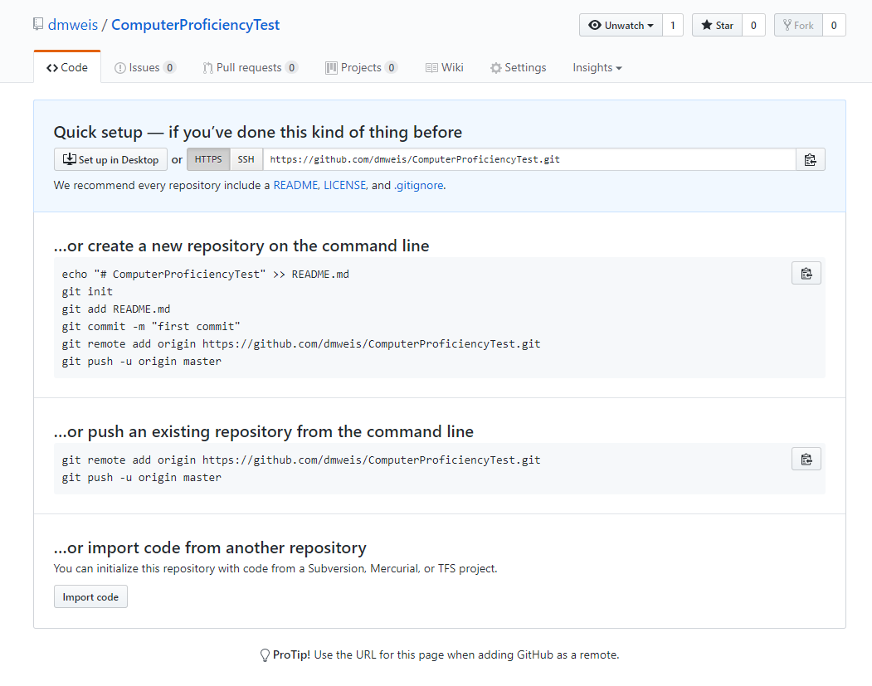

Slide 47
Git local
Create a git repository in your eclipse workspace
1
Add a .gitignore file (hint: you can find them on GitHub)
2
Add all code to the staging area
3
Commit all code in staging area to the repository
4
Add the GitHub repository as a remote (Instructions can be found in the empty repository)
5
Push!
6
Make sure all changes are on the GitHub repository
7

