Slide 1
Programming Skills Workshop
Course Summary

Slide 2
Programmer Skills (Lesson One)

Slide 3
Programming as a Social Practice
In the real world, about 20% of a typical work day is spent coding.
The other 80% is spent on:
Meetings
Project Management (Politics!)
Dealing with Customers
Training
Coffee breaks
Programmers don’t have to be cool, but they do have to be socially competent.
If you don’t work on your social skills, you could be falling short at 80% of the job!

Slide 4
Skills Checklist - Social
I feel comfortable:
Interacting in English
Working in groups
Participating in class
Studying (reading in English)
Writing reports in English
Asking for help
Helping/teaching others
Being a nerd outside of class

Slide 5
Programming as a Technical Practice
Coding may only be 20% of the job (most of the time).
But it’s by far the most important part - and the hardest.
Real-life programming requires constant learning and growth.
The skills you’ll need to learn programming now are the same you’ll be using throughout your entire ICT Engineering career.

Slide 6
Skills Checklist - Technical
I feel comfortable:
Problem solving
Administering Windows
Using the command line
Understanding programs & tools
Using Linux (basics)
Typing (without looking)
Troubleshooting
Googling

Slide 7
Learning
“Learning is the active acquisition of skills, knowledge, and values that results in changed behavior”
You won’t learn by just being told something (even if you’re listening)
You aren’t learning something unless you apply it (changed behavior)
Real, continuous learning is essential to being an ICT Engineer

Slide 8
Windows & Command Line (Lessons Two & Three)

Slide 9
Windows File System Hierarchy
C:\
Users\
Username\
Other user directories
Program Files\
Program directories
Windows\
System files and directories
Desktop\
Documents\
Downloads\
OneDrive\
Various personal files and directories
The primary hard drive is usually named C:\

Slide 10
Customizing your file system
Common directories for programmers to create:
C:\bin\
For programs that run on the command line
C:\src\
For your code
Keep your folders organized!
Nothing is more tedious than watching someone stumble through their file system looking for a file ☹

Slide 11
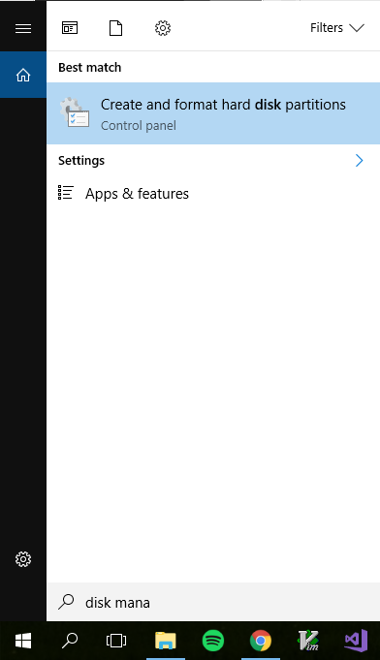
Finding and Opening Tools
In older versions of Windows, tools were accessed through Run or in the Control Panel.
In Windows 10, the search bar is your friend.
Any Windows tool can be opened by just hitting the Windows key and typing in the name of the tool.

Slide 12
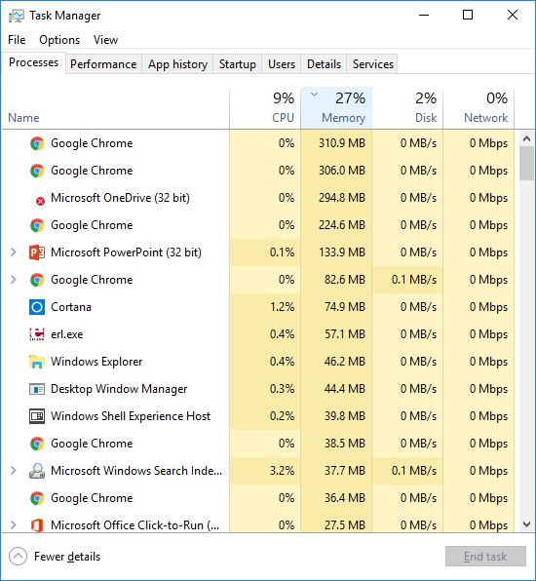
Task Manager
When troubleshooting and debugging wayward programs, Task Manager is your best friend.
Task Manager is useful for viewing performance stats and closing frozen programs.
In a pinch, you can reach Task Manager by pressing Ctrl+Shift+Esc

Slide 13
Using the Command Line
Working on the command line couldn’t be simpler:
Just write a command, hit enter, then read the response!
You’ll see example commands written like this:
> command argument1 argument2
‘>’ Tells you where you should start writing. In your case, there will be some text before the >. This is your current location.
‘command’ is the actual command to write exactly as shown.
‘argument1’ and ‘argument2’ may or may not be shown, and can (usually) be up to you.

Slide 14
Navigating on the Command Line
Anything you can do in File Explorer can be done on the command line
In Command Prompt:
List the contents of the current directory:
> dir
Change to a different directory:
> cd directory-name

Slide 15
Tips – Tab completion
Typing full filenames is a pain in the butt. How can we be lazier?
The Tab key is your new best friend! It auto-completes based off the files and folders in your current directory.
Test this! (This time, don’t hit enter just yet)
> cd
Press tab, and see what happens.
What happens if you type the beginning of a file name, then hit tab?

Slide 16
Tips – Exiting Programs
It’s easy to run into frozen or long-running programs in the command line.
Pressing Ctrl+c sends an ”abort” signal to the currently running program and will return you to the command interface.
Test this!
> find ”a” war_peace.txt
Let’s get out of here! Press Ctrl+c to return to the console.

Slide 17
The PATH
The PATH is a simple variable that tells Windows where to look to find programs that run on the command line.
To check your current PATH, type:
> path
To change the PATH, go to :
System -> Advanced System Settings -> Environment Variables
In the System variables box, click on Path and then select Edit...
Note that you must separate directory paths by using a ; character

Slide 18
Using Command Line Programs
To run a program on the command line, it either needs to be in the current directory or listed in the PATH variable.
In both cases, running a program is as simple as typing the name of the program, followed by any options or arguments that it might need.
Examples:
> ping www.google.com
> ipconfig

Slide 19
Command line Java
You don’t need to use Eclipse to compile and run your Java programs!
The programs you want to use are simply called javac and java. If these programs are included in your PATH variable, you can use them from your command line.
To compile a .java file:
Create a file containing a valid Java program.
Run javac on the file. The Java compiler will create a new .class file.
To run a compiled Java program:
Run java on the .class file. Be sure to omit the .class extension.

Slide 20
Coding, Troubleshooting, and Learning (Lesson Four)

Slide 21
Clean Code
“Any fool can write code that a computer can understand. Good programmers write code that humans can understand”
Martin Fowler
Code is meant to be read and understood by humans.
For this reason alone, it is important to keep you code clean and organized.

Slide 22
Naming
“There are only two hard things in Computer Science: cache invalidation and naming things.”
Phil Karlton
Handy rules for naming things:
Follow conventions for your language/platform (Google it!)
Avoid repetition (String nameString -> String name)
Use full words, not single letters or abbreviations
Unless it’s convention, like i for iterators and T for generics
When in doubt, clarity wins over simplicity
Ask “does this name fully describe what this does?”

Slide 23
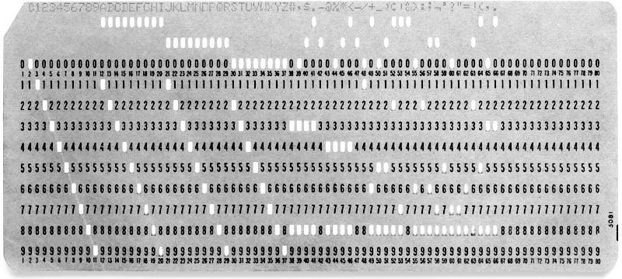
Code Length
Longer code is harder to understand.
Code should be kept short and sweet.
Follow principles instead of worrying about exact numbers:
Classes and methods should do one thing
Don’t Repeat Yourself
Don’t write code that you “might” need eventually
- Separate high-level and low-level code with abstractions

Slide 24
Helpful Resources
Codecademy – Guided coding lessons
www.codecademy.com/learn/learn-java
Derik Banas – The only good Java tutorial videos
www.youtube.com/watch?v=TBWX97e1E9g&list=PLE7E8B7F4856C9B19
Computer Science Crash Course – Great videos for explaining programming concepts
www.youtube.com/watch?v=tpIctyqH29Q&list=PL8dPuuaLjXtNlUrzyH5r6jN9ulIgZBpdo

Slide 25
The Impostor Syndrome
Since programming is difficult, you’ll find that every programmer struggles with confidence from time to time.
Even expert programmers with decades of experience can feel like they aren’t good enough, and that they don’t belong. Even when they’re writing code, they feel like at any time their peers will “reveal them” to be a fraud.
This lack of confidence is so common that it has a name – the Impostor Syndrome.
The best remedies for this are (once more) persistence and curiosity.

Slide 26
Asking Questions
Many IT professionals, especially software developers, are afraid to ask questions, in fear of exposing gaps in their knowledge.
This is a terrible mistake.
Programmers are always facing new challenges, and nobody can possibly be expected to know everything.
All programmers get lost and feel stupid from time to time – the best know when and how to get help!
Asking good questions will help you keep pace, and shows others that you are interested, disciplined and motivated.

Slide 27
Solving Problems
Programming is essentially applied problem solving.
It is not enough to rely on hacking around or following tutorials.
To be a good ICT Engineer, you will have to learn how apply a process:
Understand the Problem
Break it into pieces if you need to
Devise a Plan
Carry out the Plan
Review

Slide 28
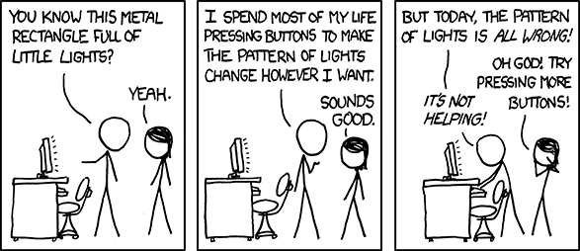
Troubleshooting
As an IT student, you should be able to work through most computer-related problems on your own.
Source:
http://xkcd.com/722/
The Secret of IT Troubleshooting:
You’ll almost never know the answer to a problem before it comes up.
Instead, a simple algorithm can be used to solve virtually any IT problem.

Slide 29
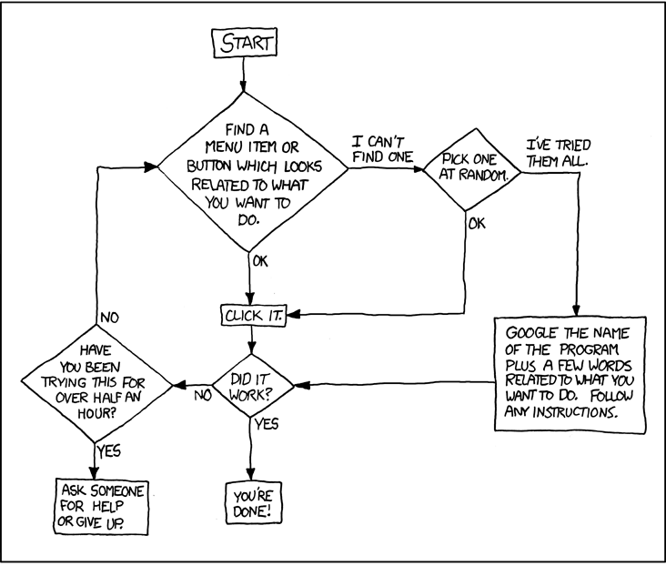
Troubleshooting Cheat Sheet
Source:
http://xkcd.com/627/

Slide 30
Using high-quality sources
Not all sources of information are equal!
The Reference Hierarchy:
Official documentation and source code (Oracle Java API, MSDN docs)
Up-to-date books
Peer-reviewed documentation (Mozilla Developer Network)
Blog posts by expert professionals (Microsoft MVPs, CSS Tricks, etc.)
Stackoverflow (most of the time)
Forum threads (on reputable sites)
Blog posts on personal (non-ad) sites

Slide 31
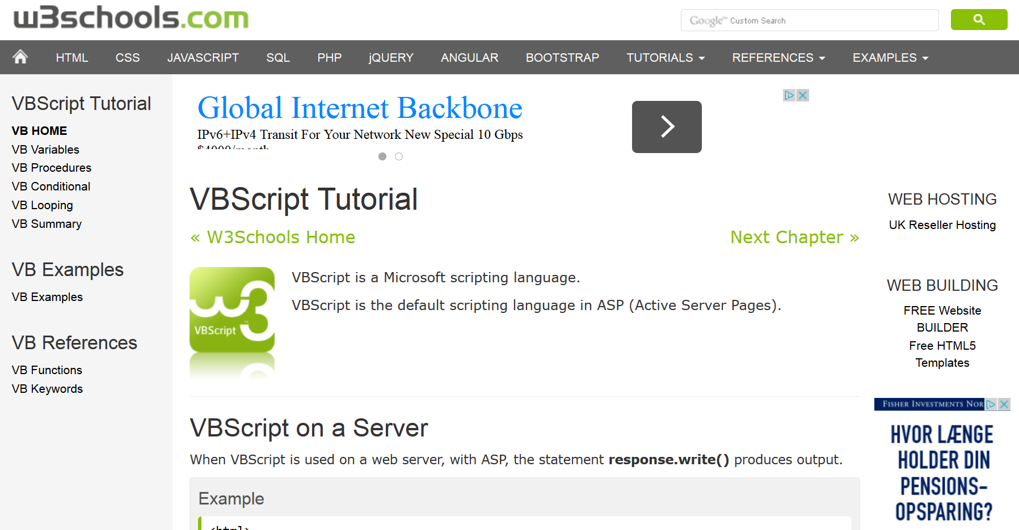
Avoiding low-quality sources
Not all sources of information are equal!
Poor sources include:
Ad-based ”tutorial” sites (W3Schools, About.com, WikiHow, etc.)
Make sure you can see who wrote the content, when they wrote it, and what their qualifications are!
Out-of-date books and documentation
Anything on a site that has too many ads, is outdated, or just plain looks bad

Slide 32

Source Quality Checklist
For every source, ask:
Who wrote this? Why should you trust them?
When was this written?
Is the information provided still relevant?
Why was this written?
What sources are provided? Are they relevant and up-to-date?
Apply the same process to all major sources!
Who paid for this to exist? Why?
Are there ads? Do they distract from the content?

Slide 33
Textbooks – The Skimming Method
Textbooks exist for a reason – they are the first place you should go to learn more about topics that you couldn’t fully understand during course lectures.
However, textbooks should not be read completely, from top to bottom!
Textbooks contain more details than you’ll ever need or be able to remember.
Learn to skim textbooks for the information you actually need:
Find the relevant section (using the Table of Contents or Index).
Read completely the opening and closing paragraphs in the section.
Read the first sentence(s) in each paragraph.
Write a brief summary of each in your own words.
If you still don’t understand something, re-read the relevant paragraphs completely and write a detailed summary of each.

Slide 34
Text Editors & IDEs (Lesson Five)

Slide 35
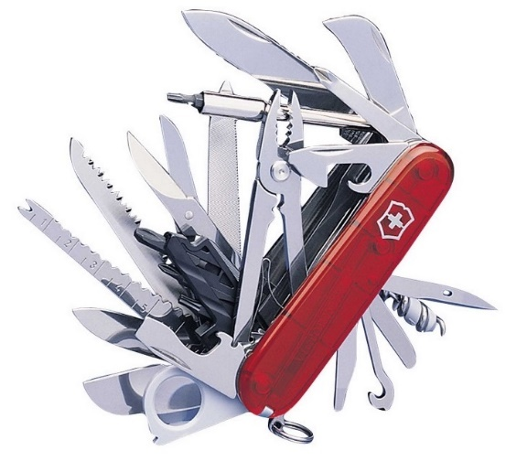

Text Editors vs. IDEs
The humble text editor is a developer’s best friend. Try them all, find one you like the most, and configure it to your heart’s desire.
An IDE, on the other hand, will often be made for a specific language or platform.
A .NET developer, for example, will use Visual Studio for most coding tasks.
Text editors can be used to edit all types of text files, but IDEs should be used for their specific purpose. It is common to use a text editor and IDE together in a project.
Make sure you are using the right tool for the job!

Slide 36

What a Text Editor isn’t
A text editor is not an IDE, even if it can “become” like one
Text editors are for single files and short scripts
IDEs are for projects
For any platform there is usually a better IDE
Text editors can be great companions to IDEs
You really don’t want to use Brackets for Java!

Slide 37
Eclipse Autoformating
Do you like to type sloppy and clean up later? Eclipse can help!
Type Ctrl + Shift + F to have Eclipse autoformat (“pretty print”) your code.
In Window -> Preferences -> Java -> Code Style - > Formatter you can change and add code styles
Google’s style guide (github.com/google/styleguide/blob/gh-pages/eclipse-java-google-style.xml) is a good standard to follow.
If you want to autoformat code in a whole project, you can right-click on the project and select Source -> Format

Slide 38
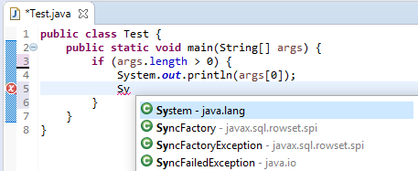
Eclipse Autocomplete
Be lazy! Don’t type long words manually!
Using Ctrl + Space, Eclipse will finish words for you.
This is a great way to write easily-misspelled class and variable names.

Slide 39
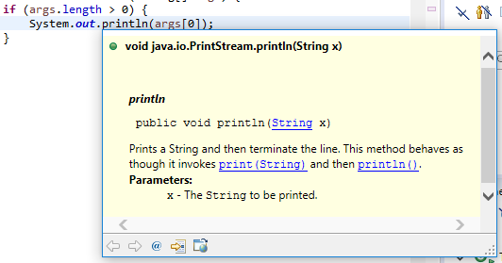
Eclipse Code Completion
Code Completion (“intellisense”) is a common feature in IDEs. It is your new best friend.
Eclipse tells you what a class or method does - without you having to look it up in documentation!
To activate this feature, simply hover your mouse over a class, method or variable.
Javadoc comments combined with code completion make it easy to code with Java libraries!

Slide 40
Using a debugger
Print statements are a very primitive technique, and aren’t interactive.
A modern debugger will literally pause your program while it is running, and let you view and even change the current values.
Using a debugger, you can step through code one line at a time to see exactly where bugs occur.
A debugger is not magic! It just feels like it.

Slide 41
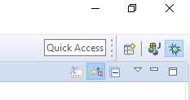
Debugging in Eclipse
Tools like the Eclipse debugger make debugging an intuitive process.
To open the debugger, choose Run -> Debug, hit F11, or use the debug perspective button.
Eclipse has a weird “perspective mode” for its debugger.
When done debugging, you can switch back to normal mode with the perspectives button in the upper-right of the program.

Slide 42
Debugging Process
The normal debugging process is simple (and the same in most IDEs):
Place breakpoints in your code
Run the program in debug mode
The program will pause at each breakpoint
Use the inspector to view the values of variables
Use Step Into or Step Over to advance to the next line (and repeat step 3).
Step Into will enter into any method that is called on the current line
Step Over will skip over any method that is called on the current line
Use Resume to continue your program (until the next breakpoint).
Alternatively, you can pause a running program at any time.

Slide 43
Linux Background (Lesson Six)

Slide 44

Linux in review
Linux is the common name for any operating system built on top of the Linux kernel.
Linux is often used in a command line interface.
Any Linux installation should come with a large number of tools for installing programs, configuring the operating system, and working with code.

Slide 45
Much ado about licenses
Licensing is a big deal in software.
A software license allows software to be legally used and distributed.
Billions of dollars are made by selling licenses, and billions of dollars are won in legal courts over software license disagreements.
Source code is also a big deal. Most software is closed source (secret).
Open source software (OSS) licenses allow for the source code to be read and changed (depending on license). OSS can be sold or given away for free.
The big problem with Unix, in the beginning, was its unclear licensing rules. Nobody wants to touch software with unclear licenses.

Slide 46
Navigating on the Linux Terminal
> cd [target]
Changes directory to the target.
If no target provided, goes to your user home directory.
> pwd
Tells you where you are.
> ls
Lists all folders and files in your current directory.
Same as dir from windows.

Slide 47
File manipulation on the Linux Terminal
To create a directory:
> mkdir [directoryName]
To remove a file:
> rm [fileName]
To remove a directory and all its files (dangerous!!!):
> rm –rf [directoryName]

Slide 48
Linux File Structure
/ - is the root directory of the file system
~ - is your home directory. Its an alias for /home/<username>
To see the full hierarchy run man hier or read wikipeida page about FHS
Interesting files
/dev/null – everything written here is imediatly lost
/bin – contains all programs used by user or system during run
/tmp – temporary directory that may be randomly erased
/media – this is where devices get mounted (USB, DVD,…)

Slide 49
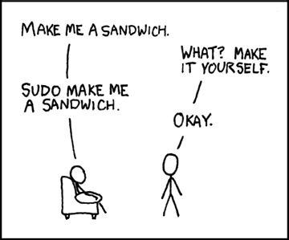
Root & Privileges
Root is a Unix term for SuperUser.
(Same as administrator in Windows).
Root can do anything and change anything on a computer (including breaking it!)
To execute program as root you can:
Use the sudo prefix before a command:
> sudo [command]
Login with the root account

Slide 50
Programming Languages (Lesson Seven)

Slide 51
Why are there so many?
The only correct answer to “what language is best?” is “it depends!”
A programming language is a tool for solving problems.
Each language offers a different approach.
Often, languages are better at solving certain problems:
- How do I access data in a database? -> SQL
- How do I manage payroll for my employees? -> Excel
- How do I make sure my rover works on Mars? -> C
The language you choose should fit the problem you want to solve.

Slide 52
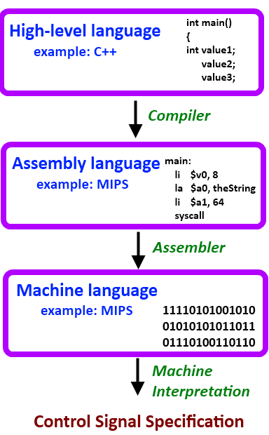
Levels of Abstraction
A core concept in programming is abstraction.
“The essence of abstractions is preserving information that is relevant in a given context, and forgetting information that is irrelevant in that context.”
– John V. Guttag
Modern programming languages tend to offer high levels of abstraction.

Slide 53
Programming Paradigms
All languages can be (roughly) divided into a set of paradigms.
A paradigm is a way of organizing code.
Usually to take a specific approach to solving problems.
Depending on the problem you need to solve, different paradigms will offer different abstractions to help you.

Slide 54
Imperative and Structured Programming
In an imperative paradigm, a program is a set of commands that are followed top to bottom, until none are left.
Think of this like a simple recipe.
This is the most primitive way to organize code.
Most programming languages support imperative programming.
In structured programming, imperative code is given structure by things like loops (while/for), and conditional statements (if/else, switch)
Non-structured programs rely on “jumps” to line numbers in code
This is “considered harmful”

Slide 55
Compilation
For code written in a high-level language to run on a computer, it must be translated into machine code instructions.
This is traditionally done using one of two programs:
A compiler, that translates the code all at once, so it can be run later.
An interpreter, that translates and runs the code one line at a time.

Slide 56
Multi-Paradigm
We have seen a few programming paradigms so far:
Imperative: Program is a series of statements, run one-by-one.
Functional: Program is a series of evaluating functions.
Object-Oriented: Data and functionality are paired together in objects.
Modern languages like Java are considered multi-paradigm because they contain elements of multiple paradigms at once.

Slide 57

Java
The first popular object-oriented, garbage-collected language.
Java was released in 1995 by Sun (now owned by Oracle).
Java looks like C/C++, but is a higher-level language.
Java’s killer two features were:
Portability - “Write once, run anywhere”
The same Java code can be run on a huge number of platforms.
Easy OOP
- Java is object-oriented with classes, and offers automatic garbage collection.

Slide 58
The Million Dollar Question
What programming language is best for teaching?
C/C++ for classic programming (Too hard!)
Python for modern programming (Too unfamiliar!)
C# for enterprise programming (Too Microsoft!)
JavaScript for web/hipsters (Too JavaScript!)
Java

Slide 59

The winner is...Java!
Java is:
Widespread
On billions of devices, from embedded to Android to big data.
Mature
20+ years as a top-three language.
Robust
The Java SDK libraries are sprawling and easy to use.
Core programming principles are easy to learn in Java.
Beginner-friendly
Learning to program with Java is a smooth, gradual process.
Especially with tools like Eclipse.
Scalable
Java works equally well for simple class exercises and gigantic open-source projects.

Slide 60
Team Work Processes & Tools (Lesson Eight)

Slide 61
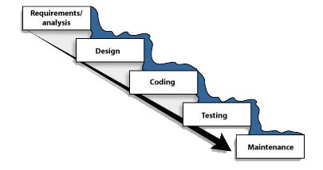
The Waterfall Method
Waterfall is the standard and most common software development process.
The following activities happen in order:
Requirements
Find out what to code
Analysis
Find out what is needed to code it
Design
Plan how to code it
Implementation
Code it
Testing
See if the code works
Maintenance
Continue fixing the code forever
Looks great!

Slide 62
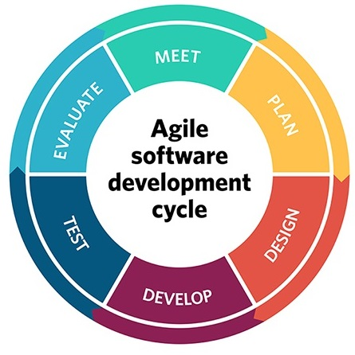
Agile
Agile is a family of methodologies and processes.
A set of beliefs and values instead of hard rules.
Agile processes tend to be iterative:
Design, Build, Test, Repeat.
Change is embraced, even late in product development.
We (and our customers) never know what we want at the start
What was valuable yesterday may not be valuable anymore
The two most used Agile methodologies right now are: Scrum and Kanban
Scrum is about following a process and using specific tools
Kanban is about visualizing work

Slide 63

What is Git?
Git is a distributed version control system.
In a distributed system every developer keeps their own copy of the code.
In a centralized system the code is stored in one central place.
Referred to by its creator, Linus Torvalds, as a “stupid content tracker”.
Created in 2005 to help develop the Linux kernel.
Nothing else was fast enough or suitable for distributed teams.
It is extremely powerful, but the core features are simple.
Git is by far the most popular VCS tool today.
It is free, and open source under the GNU General Public License.

Slide 64
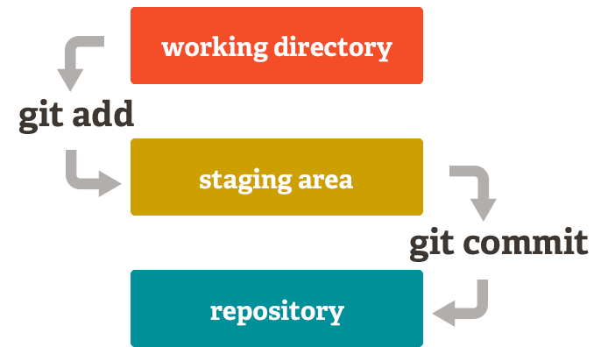
Basic terms
Repository
Staging area
Commit
Remote
Branch
Collaborator

Slide 65
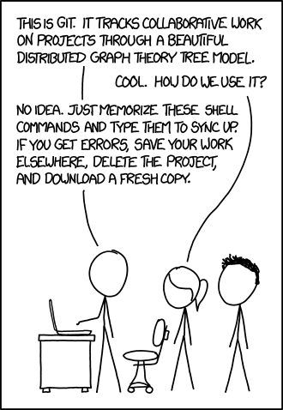
Git Commands
git init
git status
git add <filename> | -A
git commit –m
git pull
git push

Slide 66
.gitignore
You don’t want to store nonsense Eclipse files in your code repository!
Git lets you specify files that should be ignored.
All you have to do is place a .gitignore file in the root of your repository.
A collection of ready-made .gitignore files is here: github.com/github/gitignore
Some IDEs (Visual studio, IntelliJ,…) create a .gitignore for you.

Slide 67
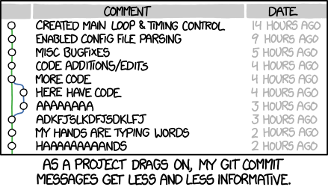
Commit messages
Important because they create history
Short and concise
In active voice
“Do this thing”
If applied, this commit will…
“Fix typo in introduction to user guide”
Great blog post: chris.beams.io/posts/git-commit/

Slide 68

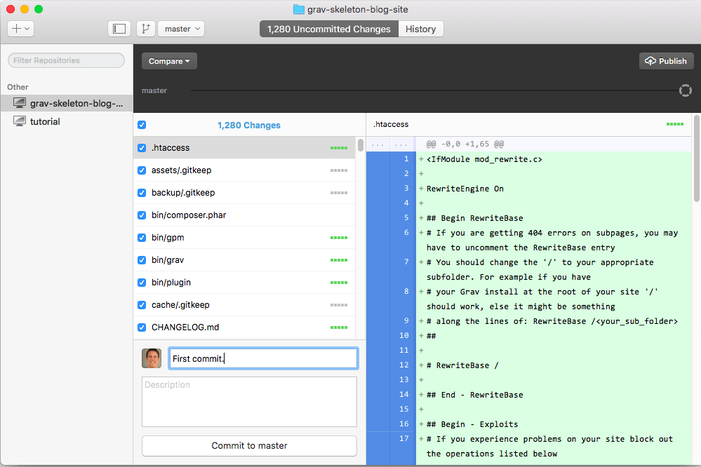
GitHub Desktop
If you hate the command line, there are many applications for Git.
GitHub Desktop is the easiest to use:
On Windows and Mac
Comes in two versions
Old version is really good
New version is in beta
Links with GitHub account
Works with non GitHub repositories too
https://desktop.github.com/

Slide 69
Git Resources
Git command line tutorial – Best starting place.
https://try.github.io
Pro Git – Perfect (and free!) e-book about Git.
Pro Git
First-Aid Git - Great place to look for quick solutions.
http://firstaidgit.io/#/
Git fix Um - Great place to search for solutions.
sethrobertson.github.io/GitFixUm

