Slide 1
Dylan’s Update
26 June 2019

Slide 2
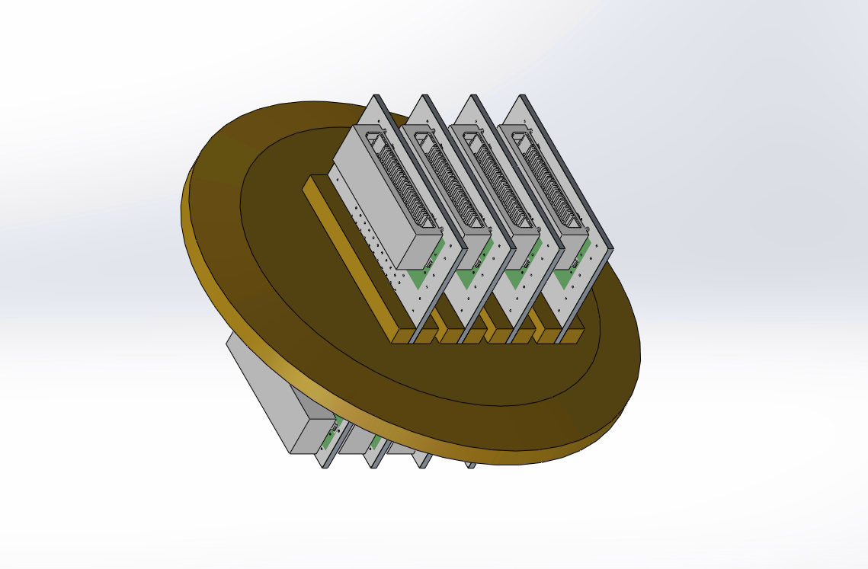
Vacuum Feedthrough Original Design
Slot design allows for customisation of connectors
Mechanically strong
Great signal isolation and ground coupling
Assembly
External connectors attached with high-temp solder
PCBs inserted, internal connectors attached with high-temp solder
Boards and brass rods fixed in place with low-temp solder
Epoxy applied

Slide 3
Vacuum Feedthrough “Problems”
Long assembly time, many steps in procedure
Complex design
Prone to mistakes: solder bridges, misalignment, component slipping
Most impossible to fix
Doesn’t fit in conventional KF adapters
Many potential points of entry for air

Slide 4
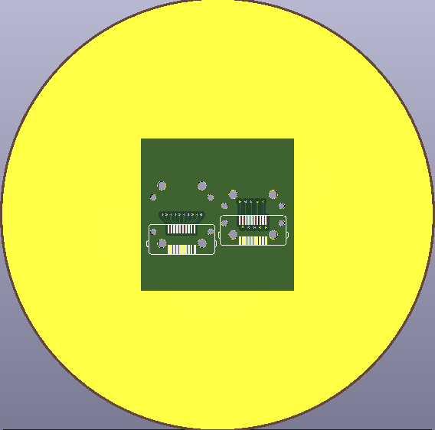
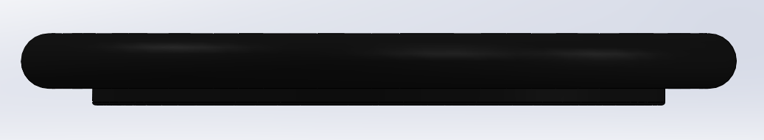
New Feedthrough Design
All components mounted directly on board
Reduces assembly time and cost
Fewer opportunities for leaks
Shorter trace length to cross barrier
Smaller connector, same # of pins
More signals in same space
S-S-S as opposed to G-S-G
Two designs on developmental version
Vias in a row vs vias alternating
Needs modified o-ring to work
Clipped top section, 3d printed

Slide 5
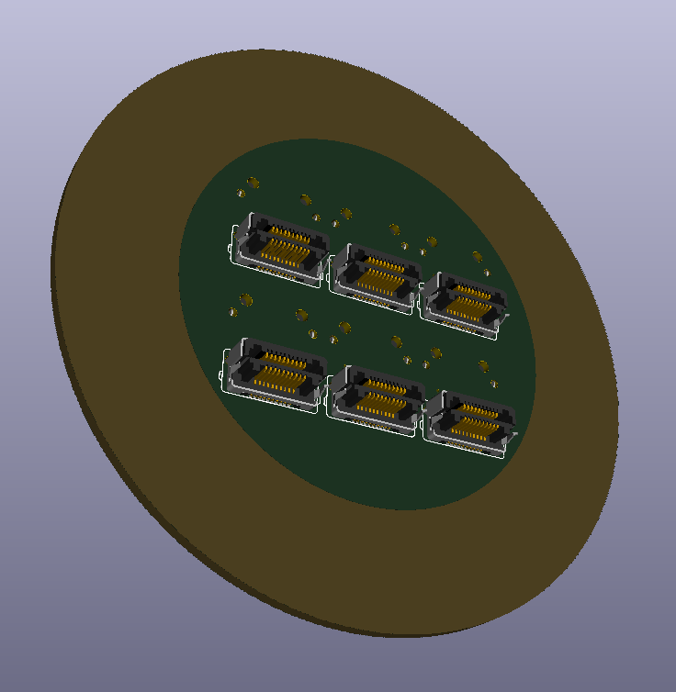
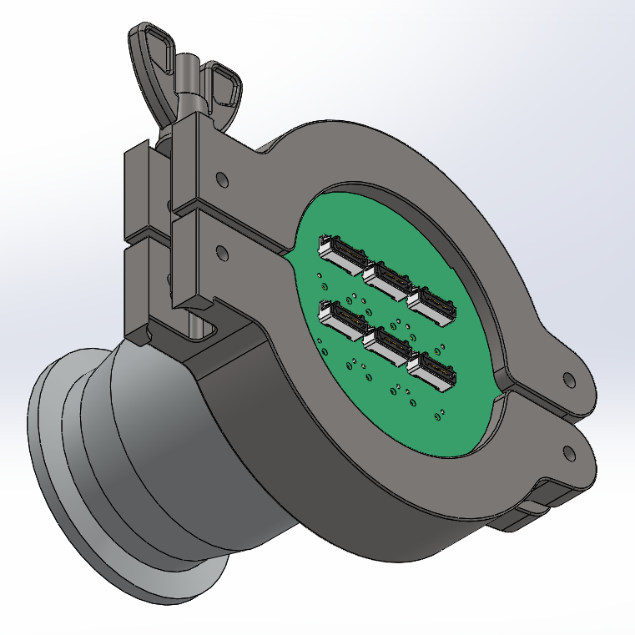
PCB Feedthrough Goals
Add as many connectors as physically possible
Achieve higher vacuum/tighter seal
Spacers, two boards, better o-ring
Keep it as simple as possible
Things still left to do:
Perform leak check
Ensure that there’s more than a superficial seal
Measure crosstalk
See if S-S-S config is tenable in full setup

