Slide 1
Hi, we are
Group 2

Slide 2
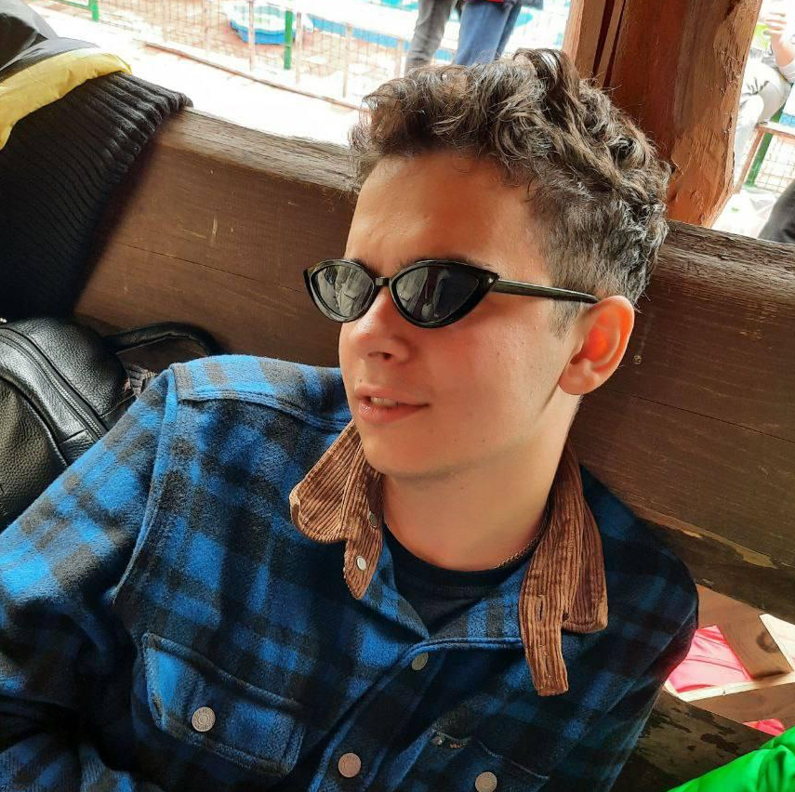
Hovda Bohdan
student of IT STEP University
Hobby: playing videogames, watching Ragulivna and sleeping
Movie: The Wave(2008)
“
Батько наш – Бандера, Україна – мати!
“

Slide 3

Yankiv Dzvinka
student of IT STEP University
Hobby: playing piano, singing, travelling
Movie: Three Steps Above Heaven
“
“
Follow your heart

Slide 4

Pryimak Roman
student of IT STEP University
Hobby: to be a armchair analyst, to sarcastically joke, to draw
Song: Take on me – A-ha
“
Between greater and lesser evil, I would prefer not to choose anything.
“
Andrzej Sapkowski

Slide 5
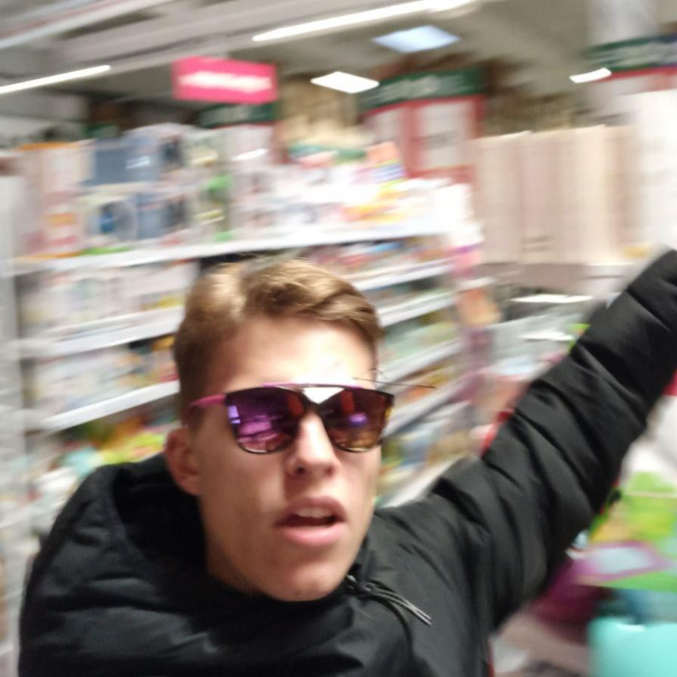
Dubina Dima
student of IT STEP University
Hobby: sport, making money, girls
Movie: The Shawshank Redemption
Music: Earth, Wind & Fire - September
“
“
Make sense.
Andrew Sedler

Slide 6

Iskiv Mykhailo
student of IT STEP University
Hobby: cycling, jogging, watching movies and TV series
Movie: Venom 2: Carnage
“
Don’t be afraid to fail. Be afraid not to try
“
Michael Jordan

Slide 7


Slide 8






Nova Poshta is "Delivery of the future"
every third Ukrainian uses Nova Poshta
more than 32,000 workers
more than 8,700 branches throughout Ukraine
NovaPoshta Global
more than 300 million parcels and cargoes were shipped in 2020

Slide 9

In 2020, Nova Poshta’s net profit grew by 26.6% - up to
16 903 000 000
UAH
Paid in taxes and fees to state and local budgets:
5 000 000 000 UAH

Slide 10
Now we’ll talk more about:
SDLC
Target audience
Stakeholders
Requirments

Slide 11
Systems evelopment Life Cycle (SDLC)
the systems development life cycle concept applies to a range of
hardware and software configurations, as a system can be composed
of hardware only, software only, or a combination of both. There are
usually six stages in this cycle: requirement analysis, design,
development and testing, implementation, documentation, and
evaluation.

Slide 12
How we understand that:
determine the stages
distribute people in stages
definition of requirements
What it gives us:
clearly define the work plan
correctly distribute the roles for maximum efficiency
determining which product we need
what is needed for this

Slide 13
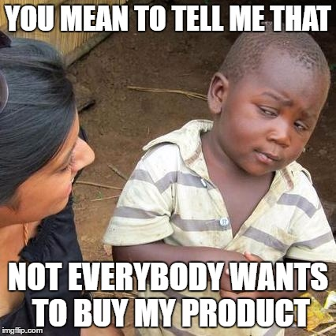
TARGET AUDIENCE are people who can become potential buyers of a product / service.
Identifying your target audience as a business can help craft marketing strategies and define your core customers. Instead of spending money and resources trying to cater to every consumer, defining a target audience allows for more intentional and personal outreach to those most likely to purchase your product or service.

Slide 14

Target audience of Nova Poshta
Age: 14+;
Gender: male, female;
Profit level: sufficient;
Main customers: small business, online stores, shipping companies, sellers of goods on the Internet, individuals.
Needs and desires: delivery (to the branch, post office, address), international partner delivery network, money transfers, storage of goods in warehouses, picking and sending orders to the recipient;
Geolocation: Ukraine (cities, towns, urban-type settlements, villages); online shopping: USA, Germany, China, Poland, Great Britain, Turkey (amazon, ebay, etc.);

Slide 15

Stakeholder
a term that describes a
person, group of individuals or
individual organizations whose
actions, behaviors or decisions may
affect the success of the system.

Slide 16
Stackholders
External
Internal
various public organizations and associations that are not used in the education system (political parties, ethnic and other social groups, creative unions, scientific institutions, etc.), but which are interested in social partnership.
different categories of people receiving education (students) and their parents; - research and teaching staff, teaching and support and administrative staff.

Slide 17
Our stackholders
1)Buyer's side
2)Customer
3)Developer
4)Provider
5)User
6)Producer
7)Accompanying party
8)Liquidator
9)Accreditor, or inspector
10)Regulatory body
11)Support staff
12)Instructors
13 )Operators

Slide 18
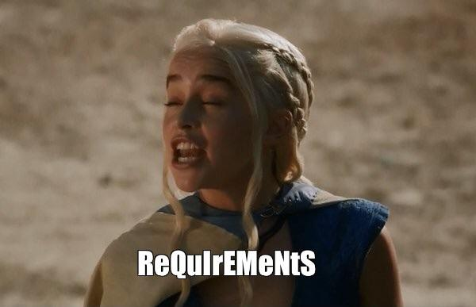
Requirements
statements that indicate what a system needs to do in
order to provide a capability (i.e. utility or benefit.)
Two types of requirements:
Functional - product features or functions that developers must implement to enable users to accomplish their tasks.
Non-functional - a specification that describes the system’s operation capabilities and constraints that enhance its functionality(speed, security, reliability, etc.)

Slide 19
MoSCoW
prioritization scheme
Must: The requirement must be satisfied for the solution to be considered a success.
Should: The requirement is important and should be included in the solution if possible, but it’s not mandatory to success.
Could: It’s a desirable capability, but one that could be deferred or eliminated. Implement it only if time and resources permit.
Won’t: This indicates a requirement that will not be implemented at this time but could be included in a future release

Slide 20

Key requirements
My parcels
Personal cabinet
Сreate a parcel
Map of branches

Slide 21
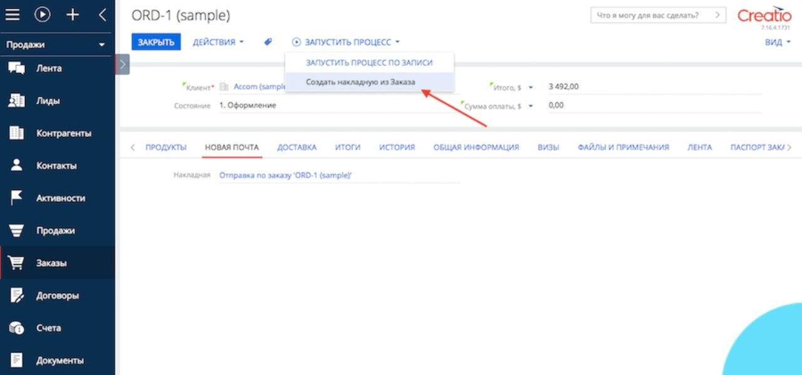

Features or bugs?
CRM + Nova Poshta

Slide 22
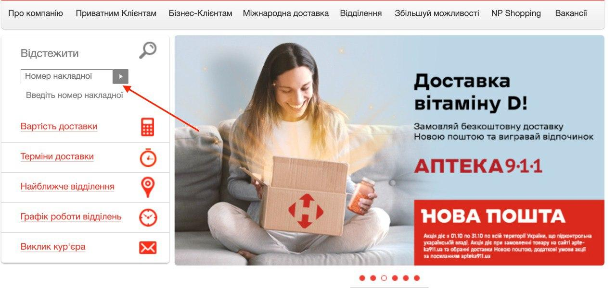
Tracking of the parcel

Slide 23
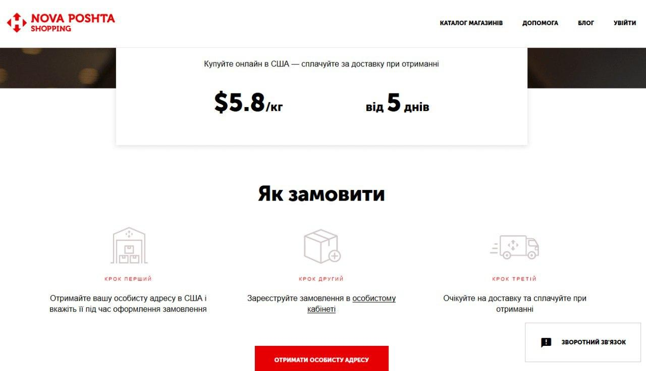
Nova Poshta Shopping

Slide 24
Питаннячка
.Нема

Slide 25

Thank for your attention!

