Slide 1
CSS 3
by Dmytro Furtas

Slide 2
Agenda
What is CSS ?
How to connect CSS to HTML ?
Selectors
Pseudo classes & elements
Elements flow
Box model

Slide 3
What is CSS ?
CSS (Cascading Style Sheet) is a style sheet language used for describing the presentation of a document written in a markup language such as HTML

Slide 4

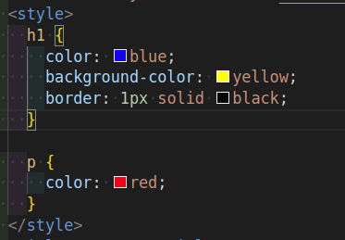
How to connect CSS to HTML ?
Inline CSS
External stylesheet
Internal stylesheet

Slide 5
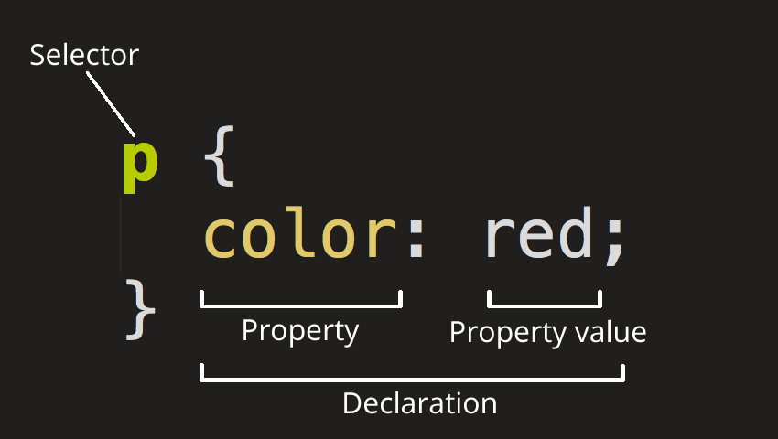
What is CSS selector ?
In CSS, selectors are patterns used to select the element(s) you want to style.

Slide 6
Selectors
Name | What does it select | Example
Universal selector | Everything in the document. | *
Element selector | All HTML elements of the specified type. | p, div, h1, h2
Class selector | The element(s) on the page with the specified class. | .my-class, .wrapper, .container
ID selector | The element on the page with the specified ID. | #my-id, #unique
Attribute selector | The element(s) on the page with the specified attribute. | img[src], [href]

Slide 7
Attribute selectors
Selector | Example | Description
[attr] | a[title] | Matches elements with an attr attribute (whose name is the value in square brackets).
[attr=value] | a[href="https://example.com"] | Matches elements with an attr attribute whose value is exactly value — the string inside the quotes.
[attr~=value] | p[class~="special"] | Matches elements with an attr attribute whose value is exactly value, or contains value in its (space separated) list of values.
[attr|=value] | div[lang|="zh"] | Matches elements with an attr attribute whose value is exactly value or begins with value immediately followed by a hyphen.
[attr^=value] | li[class^="box-"] | Matches elements with an attr attribute (whose name is the value in square brackets), whose value begins with value.
[attr$=value] | li[class$="-box"] | Matches elements with an attr attribute whose value ends with value.
[attr*=value] | li[class*="box"] | Matches elements with an attr attribute whose value contains value anywhere within the string.

Slide 8
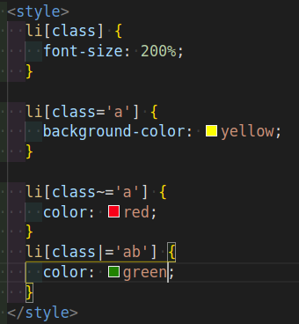
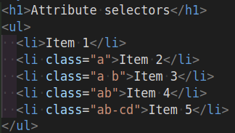
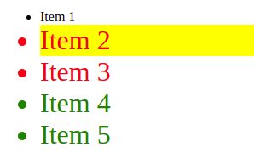
Examples

Slide 9
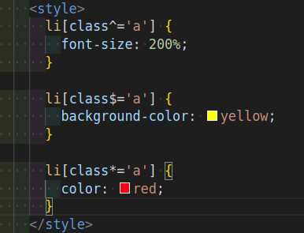
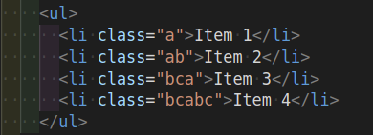
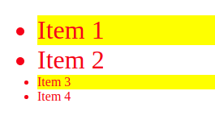
Examples

Slide 10
Pseudo classes & elements
A pseudo-class is a selector that selects elements that are in a specific state, e.g. they are the first element of their type, or they are being hovered over by the mouse pointer. Pseudo-classes start with a colon :
Pseudo-elements behave in a similar way, however they act as if you had added a whole new HTML element into the markup, rather than applying a class to existing elements. Pseudo-elements start with a double colon ::

Slide 11
Pseudo classes
Selector | Description
:link | Matches unvisited links.
:visited | Matches visited links.
:focus | Matches when an element has focus.
:hover | Matches when the user hovers over an element.
:active | Matches when the user activates (for example clicks on) an element.
:invalid | Matches an element, such as an <input>, in an invalid state.
:required | Matches form elements that are required.
:nth-child() | Matches elements from a list of siblings — the siblings are matched by a formula of the form an+b (e.g. 2n + 1 would match elements 1, 3, 5, 7, etc. All the odd ones.)
:last-child | Matches an element which is last among its siblings.

Slide 12
Pseudo elements
Selector | Description
::after | Matches a stylable element appearing after the originating element's actual content.
::before | Matches a stylable element appearing before the originating element's actual content.
::first-line | Matches the first line of the containing element.
::first-letter | Matches the first letter of the element.

Slide 13
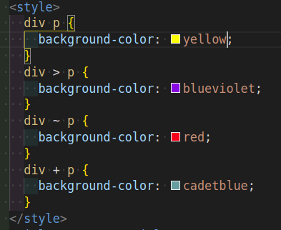
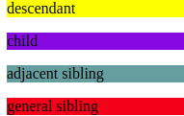
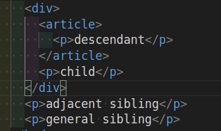
Combinators
Name | Example
descendant combinator | div p
child combinator | div>p
adjacent sibling combinator | div+p
general sibling combinator | div~p

Slide 14
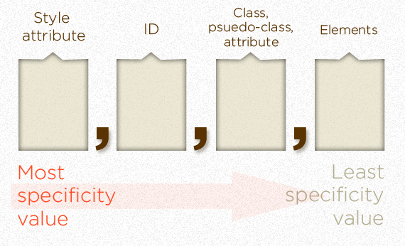
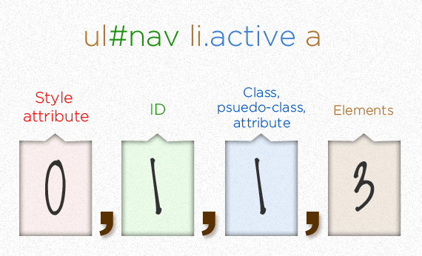
CSS specificity

Slide 15


Elements flow
Inline flow
Block flow

Slide 16
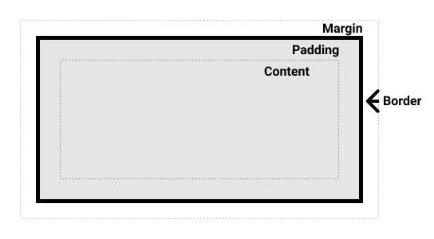
CSS box model

Slide 17
The standard css box model
In the standard box model, if you give a box a width and a height attribute, this defines the width and height of the content box. Any padding and border is then added to that width and height to get the total size taken up by the box

Slide 18
The alternative box model
In the alternative box model, if you give a box a width and a height attribute, this defines the width and height of the entire box.

Slide 19
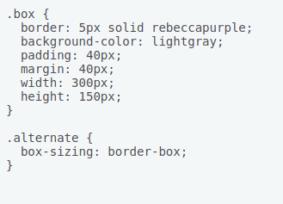
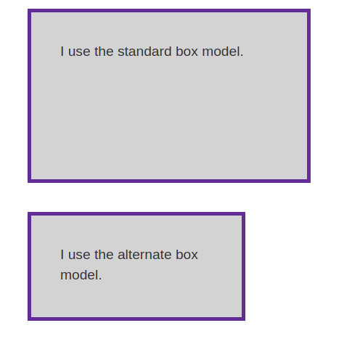
Box model

Slide 20


