Slide 1
Functional Approach to write code
by Dmytro Furtas

Slide 2
Functional programming
Functional programming is a programming paradigm — a style of building the structure and elements of computer programs — that treats computation as the evaluation of mathematical functions and avoids changing-state and mutable data

Slide 3
FP principles:
Purity
Immutability
Higher order functions
Function composition
Currying

Slide 4
Pure function:
It returns the same result if given the same arguments
It does not cause any observable side effects. (Side effects may include I/O (e.g., writing to the console or a log file), modifying a mutable object, reassigning a variable, etc.)

Slide 5
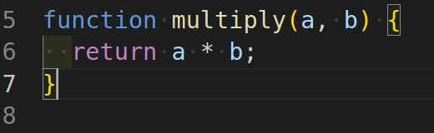
Pure function

Slide 6
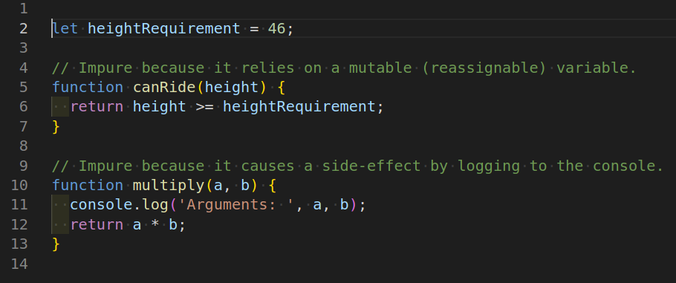
Impure function

Slide 7
Benefits of pure functions
They're easier to debug because they don't depend on mutable state.
The return value can be cached to avoid recomputing it in the future.
They're easier to test because there are no dependencies (such as logging, Ajax, database, etc.) that need to be mocked.

Slide 8
Immutability
There are no “variables” in functional programming- all “variables” should be considered as constants

Slide 9
JS is not a pure functional programming language- it allows for mutable structures. We need to tweak it...

Slide 10
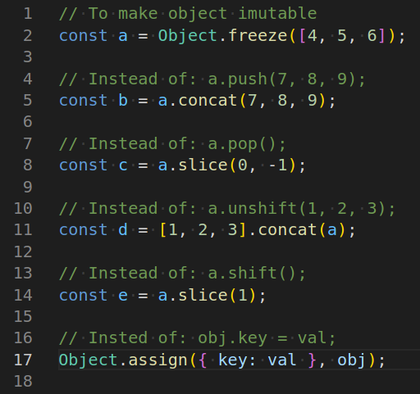
Simple immutable tweaks

Slide 11
Higher Order Functions
Take Functions as parameters
Return function
Both

Slide 12
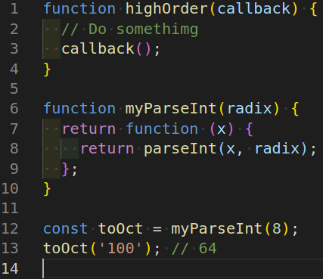
Higher Order Functions

Slide 13
Function composition
In computer science, function composition is an act or mechanism to combine simple functions to build more complicated ones. Like the usual composition of functions in mathematics, the result of each function is passed as the argument of the next, and the result of the last one is the result of the whole.

Slide 14
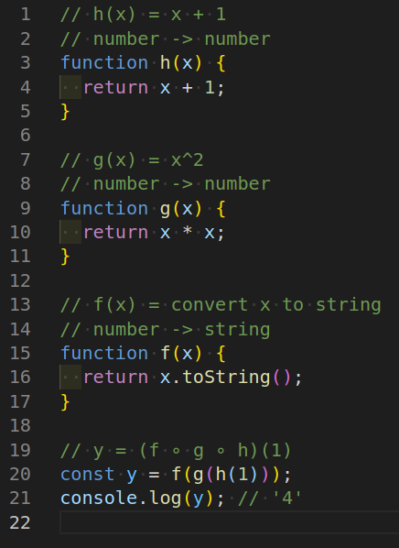
Function composition

Slide 15
Currying
Currying is a transformation of functions that translates a function from callable as f(a, b, c) into callable as f(a)(b)(c).

Slide 16
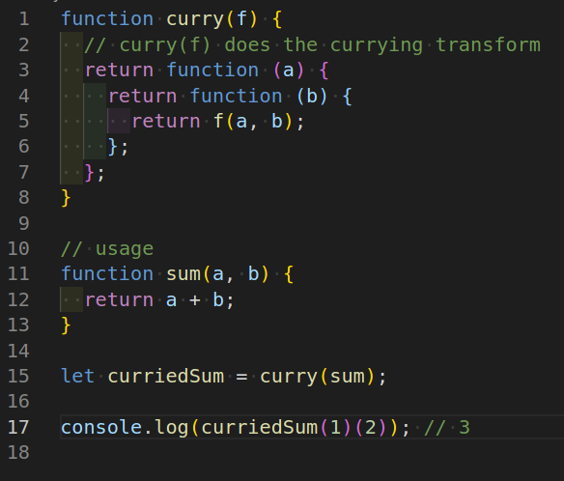
Currying

Slide 17


