Slide 1


RapidSure Managed Sevices:
Enabling TMNAS Growth, Speed, and Product Expansion
MARCH, 2026

Slide 2
TMNAS Objectives:
Modernize RapidSure in a phased approach to enable Personal Lines administration while launching committed new products, enhancing platform functionalities which aligns with business and technology goals and drivers
Modernize RapidSure:
Assess RS to see if it can be used for Personal Lines
Improve time to market for new PL products
Run cost friendly modernization
Create Modernization Roadmap
Eliminate Technical Debts
Ensure system Compliance with regulations
Launch committed Products and Enhancements:
SV product launch across all the states in 2026
Integrate CCD into RapidSure in 2026
Address compliance backlog

Slide 3


Enabling Personal Lines: Assessment framework
To achieve Growth, Speed, and Product Expansion RapidSure must be assessed from multiple perspectives:
Analyzing difference in business capabilities of Commercial Lines and Personal Line to current/future product stack;
Governance, process maturity and right team composition to find bottlenecks, areas to improve throughput to support growth goals;
Capabilities and limitations of RapidSure platform to accommodate Personal Line products with reasonable investment;
Getting maximum benefits and acceleration from using modern AI tools, technologies and approaches integrated into right places of the solution.

Slide 4
Progress Snapshot
Context & Baseline
Activities Completed
Key Outputs & Results
Governance & SDLC
Existing governance & communication
Current delivery approach
Team composition approach
Lesson-learned from recent implementations
Suggested improvements and their history of implementation
Existing SV implementation plans
Existing Modernization plans to support SV
Architecture & Platform
Top-level architecture documentation
Guided demonstrations of source code
Activities of RS Development team
Other platforms with the focus on Personal products
RS Performance reports
AI adoption
CodeMie adoption PoC
GitHub Copilot adoption
Governance & SDLC
Reviewed and documented existing governance structures and communication channels to ensure alignment with project objectives.
Assessed current and past delivery and team composition frameworks, identifying strengths and areas for optimization.
Mapped out existing SV implementation plans, highlighting progress and dependencies.
Examined modernization initiatives designed to support SV, ensuring integration with ongoing and future projects.
Architecture & Platform
Technologies analysis performed
Matching of Business logic to RS platform
RS Technical assessment as PL-ready Platform
External Challenges analysis performed
Scalability & Performance Analysis
AI adoption
Analysis of the scope for AI adoption
Governance & SDLC
Current team issues cause communication breakdowns and responsibilities gaps, impacting timelines and quality.
Following standard development practices is crucial to improve efficiency and speed.
Architecture & Platform
Dispersed business logic slows delivery and lowers quality.
Current RS architecture and database will limit performance, especially for Personal Line Products.
External technical factors affect delivery predictability and must be managed.
UI technology refresh must be done to close existing gap and create a basis for business & technical scalability.
AI adoption
AI efforts are fragmented; alignment with strategy and continuous improvement are key.

Slide 5
Enabling Personal Lines: Changes in Business capabilities
CAPABILITY | COMMERCIAL LINES (CURRENT STATE) | PERSONAL LINES(TARGET STATE) | KEY DIFFERENCE
Policy life-cycle transactions | Complex, multi‑location policies; batch‑driven processes and support for out‑of‑sequence changes. | High‑volume real‑time updates (vehicle, driver, small changes) with fast quotes and conversions. | Shift from batch + account‑centric → real‑time consumer transactions.
Amendments/endorsements STP | Manual referrals common; agent-driven | High straight‑through processing for routine changes; only exceptions escalate. | More automation with fewer manual touchpoints.
Configuration (low-code/no-code) | Medium; IT-heavy for rules/forms in legacy cores | High agility for state and coverage changes; low-/no-code common | Faster, business-led changes required
Product definition & versioning | Multiple LOBs; class/schedule heavy; bureau updates | Niche personal auto variant; simpler product tree; state variants | Narrower scope, deeper vehicle-level rules
Coverage basis & valuation | ACV and commercial endorsements | Agreed/Guaranteed Value; specialty endorsements (restoration, spare parts, lay-up) | Shift from ACV to agreed value with evidence
Eligibility & appetite | Business class rules; revenue/operations thresholds | Storage/garaging, limited use, driver eligibility, vehicle age/condition | Consumer criteria replace business class
Rating engine (real-time/batch/experience) | Complex rules/tables; experience rating in some lines; batch runs | Real-time quoting and rerating; telematics/experience inputs for auto | From batch/experience focus to real-time per-quote recalculation
Product cloning & state/timeline versioning | Configurable; cloning for variants | Rapid state-specific versions and effective dating | Faster cadence and more variants
Rules & underwriting integration | Manual referral rules; complex commercial criteria | Real-time rules for credit/telematics/MVR; risk scoring | Tighter coupling of rules and data feeds
Integrations: VIN, MVR, credit, telematics, address | Basic validations; limited real-time | Critical for auto: VIN decode/prefill, MVR, credit (where allowed), telematics re-rating | Broader, latency-sensitive data footprint
Valuation evidence workflow | Rare; schedules/invoices in niches | Photos/appraisals; valuation tool integration for agreed value | New valuation lifecycle
Document generation & forms | Robust contracts; ISO/ACORD forms; certificates common | High-volume PDFs for policies, amendments, ID cards; dynamic state-dependent forms | Volume and variability increase; different artifacts
Distribution & channels | Broker/agent-centric; agent portal | Direct-to-consumer web/mobile plus agents; comparative raters | Add D2C and rater connectivity
Customer self-service | Limited; agent-led | Portal/mobile for quotes, payments, ID cards, simple endorsements | New omnichannel front door
Billing & payments | Agency/direct bill mix; batch billing; equity billing | Predominantly direct bill; monthly/bi-weekly; refunds/prorations; wallets/autopay | Higher frequency, smaller transactions
Premium audit | Common for auditable lines | Not applicable for collector personal auto | Eliminated in this product
Renewals & re-underwriting | Exposure updates; audits; complex | Straightforward; agreed value revalidation cadence | Replace audits with valuation checks
Cancellations/reinstatements & dunning | Agency bill nuances; producer impacts | Consumer-centric non-pay; quick reinstatements | Different norms and timelines
Analytics & data export | Embedded BI; batch exports; exposure/risk views | Real-time dashboards; quote-to-bind, retention, channel attribution; batch rerating for insights | From batch to near-real-time operational analytics
Security, roles, user management | Role-based; LDAP/AD; producer hierarchies | Omnichannel access; prevent concurrent modification | More users/channels; concurrency risks

Slide 6
Enabling Personal Lines: Changes in Business capabilities
Commercial Lines (Current state)
Personal Lines (Target state)
Key Differences / Critical Changes
Transactions: Batch‑heavy, account‑centric; complex policy & OOS flows; stable throughput.
Transaction Volume: High‑throughput, straight-through processing (STP), real‑time APIs; clean API layer; stateless processing; low‑code lifecycle.
1) Operations: From batch/account‑centric → stateless, API‑first, service‑oriented.
Change Agility: IT‑driven edits; effort tied to change complexity.
Change Agility: Business‑owned configuration; medium effort for transforms; highest for data modeling.
2) Change Agility: From IT‑led → business‑owned low/no‑code (rules → lifecycle → actions).
Coverage: ACV, property schedules, commercial endorsements.
Coverage: Agreed/guaranteed value; specialty endorsements; configuration‑driven.
Integrations: VIN search, Accounts/Producer/LDAP, Salesforce/CV Portal ingestion, streaming to Apps/Path/ImageRight.
3) Data Ecosystem: From basic checks → real‑time VIN/MVR/credit/telematics + expanded ingestion & streaming.
Integrations: Real‑time VIN/MVR/credit, telematics rerating, expanded ingestion & streaming.
Document generation: ImageRight feed; performance depends on data transformation.
Document generation: High‑volume, optimized feeds; dynamic PDFs/ID cards; e‑sign for faster bind.
4) Documents: From internal schedules → valuation evidence + optimized external doc feeds + e‑sign.
Analytics: Batch exports, embedded BI, exposure/risk reports.
Analytics: Real‑time dashboards; export formats for external tools.
5) Insights & Control: From batch BI → near‑real‑time dashboards, exportable datasets, stronger security & auditability.
Security: LDAP/AD roles; MFA handled by enterprise IAM.
Security: Stronger LDAP expansion, entity locking, concurrency control, audit logging.
*Billing will change from Agency/direct bill mix; batch billing; equity billing to predominantly direct bills; monthly/bi‑weekly; refunds/prorations; wallets/autopay changes. The changeis out of scope for RapidSure analysis as handled by external application

Slide 7




RapidSure Operating Model
TMNAS
EPAM
Business stakeholders define business priorities and product changes. IT management Packaged Apps owns Release Plans and system‑level changes and integrations. Provides governance for shared platforms. EPAM Account Management supports implementation of initiatives and remove technical blockers related to RapidSure.
Business stakeholders
IT management Packaged Apps
Account Management
Strategy
& Planning
Product Owners & BA Team collaborate with stakeholders to refine requirements, prioritize features, and manage dependencies. They partner with architects and EPAM Project Leadership for design, oversees delivery, coordinates teams, resolves issues, and manages risks.
Product Owners & BA Team
Project Leadership
BRM Team
Delivery Manager
Solutioning & Estimation
BA Team
Tech Leads
Enterprise Solution Architect
System Architect
The Integration, App Dev, and Document & Configuration teams work with Capex and Opex streams to deliver features and changes through a coordinated release, aligning dependencies, testing, and environment readiness for seamless development and deployment.
Integration
Team
App Dev
Teams
RapidSure Opex (Core)
Team
Document & Configuration Team
RapidSure Capex (Flex)
Team
Implementation
QA teams collaborate with EPAM developers to validate functionality, identify defects early, and support regression. EPAM provides development fixes, and technical triage, while Performance QA conducts risk-based targeted checks.
Manual QA Team
Automation QA Team
Quality Assurance
Performance QA Team
Performance QA Team
*
Role‑Aligned Channels
Asymmetric Channels
Ad-hoc resources

Slide 8

RapidSure Operating Model Analysis & Recommendations
As TMNAS aims to accelerate growth and launches new products, strong Governance & PM becomes critical to ensure predictable delivery, early eliminate up- and downstream dependency, build a resilient team by expanding skillsets and sharing critical knowledge, and modernize RapidSure without disruption. Disciplined governance allows to turn investment into faster time‑to‑market, scalable execution, and confident expansion into new business lines.
Areas for Improvement
Proposed Solutions
Aligning deadlines with feasibility assessments will help ensure timely delivery.
Strengthening strategic planning and maintaining consistent priorities can enhance project focus. This must include wider program planning for whole eco-system of applications.
Standardizing processes across teams and vendors will improve collaboration and efficiency.
Implementing formal estimation frameworks can increase accuracy and predictability.
Pragmatic and business-driven change-control procedures will help manage scope and expectations.
Supporting leadership with realistic planning tools can foster achievable commitments.
Enhancing governance by defining key phase milestones to improve project tracking.
Clarifying ownership and responsibilities will streamline accountability.
Establishing capacity planning and load management practices will optimize resource utilization.
Strategic Planning & Roadmap Implementation
Set direction, align priorities, and enable effective downstream governance. Develop program level approach and toolset to plan, monitor and control execution, track risk and changes integrated with multi-level reporting.
Unified Delivery Framework Rollout
With strategic alignment in place, standardize processes and clarify roles for all teams. This must include contracts and clear definition of ready to mitigate issues during transitions between different phases or teams.
Estimation & Change Control Enhancement
Improve estimation accuracy and control scope changes. Use AI to analyze historical data, draft plans and suggest improvements based on best practices.
Phase-Gate Governance & Milestone Management
Embedding milestone discipline and monitoring, leveraging the new frameworks and controls.
Governance & PM

Slide 9

RapidSure Operating Model Analysis & Recommendations
To accelerate product delivery, reduce rework, and safely scale RapidSure for new business lines, TMNAS must strengthen its requirements and solutioning practices. Clear, complete, and early‑validated requirements are essential to reducing time‑to‑market, minimizing dependency on scarce experts, and ensuring the platform can evolve without disruption.
Areas for Improvement
Proposed Solutions
Ensuring requirements are comprehensive and detailed will support smoother project execution.
Deepening product and system knowledge among business analysts can enhance requirement quality.
Early identification of state and product customizations will help minimize rework.
Managing requirement changes proactively and maintaining stable priorities will reduce project disruptions.
Adopting standardized templates and improving documentation practices will increase clarity and consistency.
Defining clear readiness and acceptance criteria will streamline project delivery and sign-off.
Strengthening end-to-end product ownership will foster holistic understanding and accountability.
Building a catalog of historical estimates and reference patterns will improve future planning and estimation.
Requirements Quality Improvement
Ensure requirements are clear, complete, and BAs are upskilled. AI-powered tools can help to standardize, accelerate and increase quality of documentation.
Documentation & Standards Centralization
Standardize and centralize documentation for consistency. AI tools adoption wll benefit from presence of such Knowledge Libraries.
Early Impact Analysis
Review Product ideation and business requirement gathering process to proactively analyze and log customizations to prevent late surprises.
Readiness, Acceptance, and Estimation Catalog
Formalize readiness/acceptance criteria and build a repository for continuous improvement. AI usage for clustering past requirements and estimates will help to make efficient project planning.
Requirements and Solutioning

Slide 10

RapidSure Operating Model Analysis & Recommendations
To achieve faster product launches and scale RapidSure for new business growth, TMNAS must evolve its development and QA practices toward higher parallelization, automation, and stability. Strengthening these areas reduces bottlenecks, improves delivery predictability, and enables the team to deliver more with limited resources—while ensuring that modernization efforts do not compromise platform stability.
Areas for Improvement
Proposed Solutions
Increasing parallelization and minimizing dependencies during the initial phases can enhance project progression.
Fostering stronger collaboration among vendors will help dismantle silos and reduce delays.
Beginning quality assurance earlier and expanding automation and test coverage will improve overall quality control.
Ensuring build stability and proactively managing late-stage modifications will decrease defect leakage.
Implementing a standardized development process with consistent sprint schedules will promote alignment and predictability.
Monitoring technical debt and evaluating reduction strategies will contribute to the platform’s long-term sustainability.
Expanding architectural knowledge and estimation skills across the team will lessen reliance on key personnel.
Structuring task sequencing and clearly defining the critical path will optimize delivery efficiency.
Modularization & Parallelization Enablement
Refactor for modularity to reduce dependencies and enable parallel work.
Cross-Functional Team Integration
Integrate teams for better collaboration and faster delivery. This might include changes in Program level planning and ceremonies.
QA Shift-Left & Automation
Involve QA early and automate testing to catch defects sooner. AI can generate test cases, predict defects, and identify likely failure points early.
Technical Debt & Knowledge Management
Systematically address technical debt and institutionalize knowledge sharing. AI-tools scan codebases to detect technical debt patterns and recommend refactoring opportunities.
Development & QA

Slide 11

RapidSure Operating Model Analysis & Recommendations
To support faster product rollout and ensure RapidSure can scale for new business lines, TMNAS must strengthen its deployment and infrastructure capabilities. Streamlined environments, stable CI/CD pipelines, and early integration planning are critical to reducing release delays, preventing late‑stage failures, and enabling safe, continuous modernization—even with limited engineering capacity.
Areas for Improvement
Proposed Solutions
Proactive integration planning and consistent environment management will help prevent late-stage failures.
Streamlining release cycles and managing feature toggles effectively can reduce complexity.
Implementing automated, stable environments will enable faster deployments and more reliable pipelines.
Developing a clear environment strategy for multi-transaction workflows will enhance operational efficiency.
Establishing unified integration deployment and robust dependency management will improve system stability.
Strengthening quality gates and ensuring comprehensive regression testing will support higher product quality.
Early Integration & Environment Strategy
Define integration points and environment needs to avoid late-stage issues.
Automated Environment & CI/CD Implementation
With strategy in place, automate environment provisioning and deployments for consistency. Use AI to optimize CI/CD pipelines and auto-scale environments.
Release & Feature Management Optimization
Optimize release cycles and feature management for smoother production flow.
Quality Gates & Dependency Management
Enforce quality gates and manage dependencies to ensure robust, reliable releases. Use AI to analyze deployment logs and test results.
Deployment & Infrastructure

Slide 12
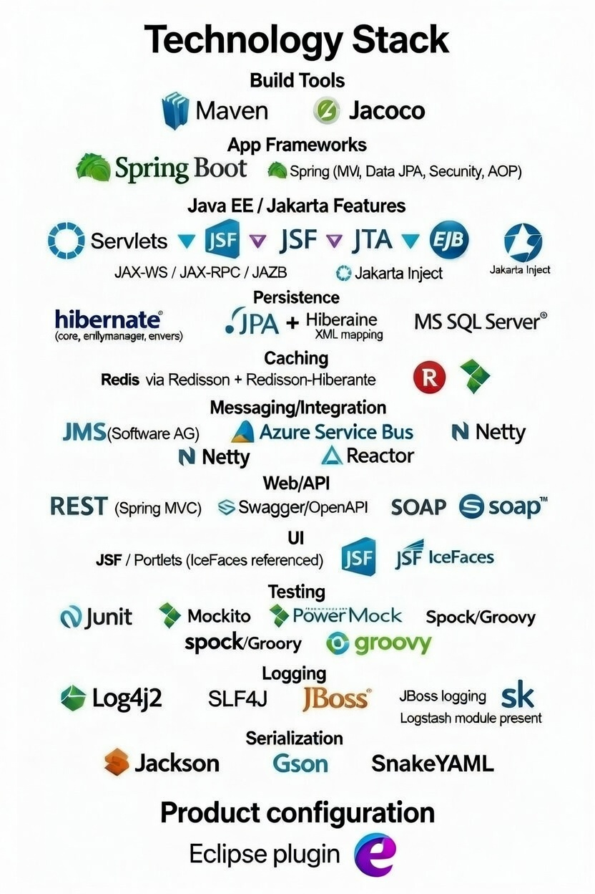
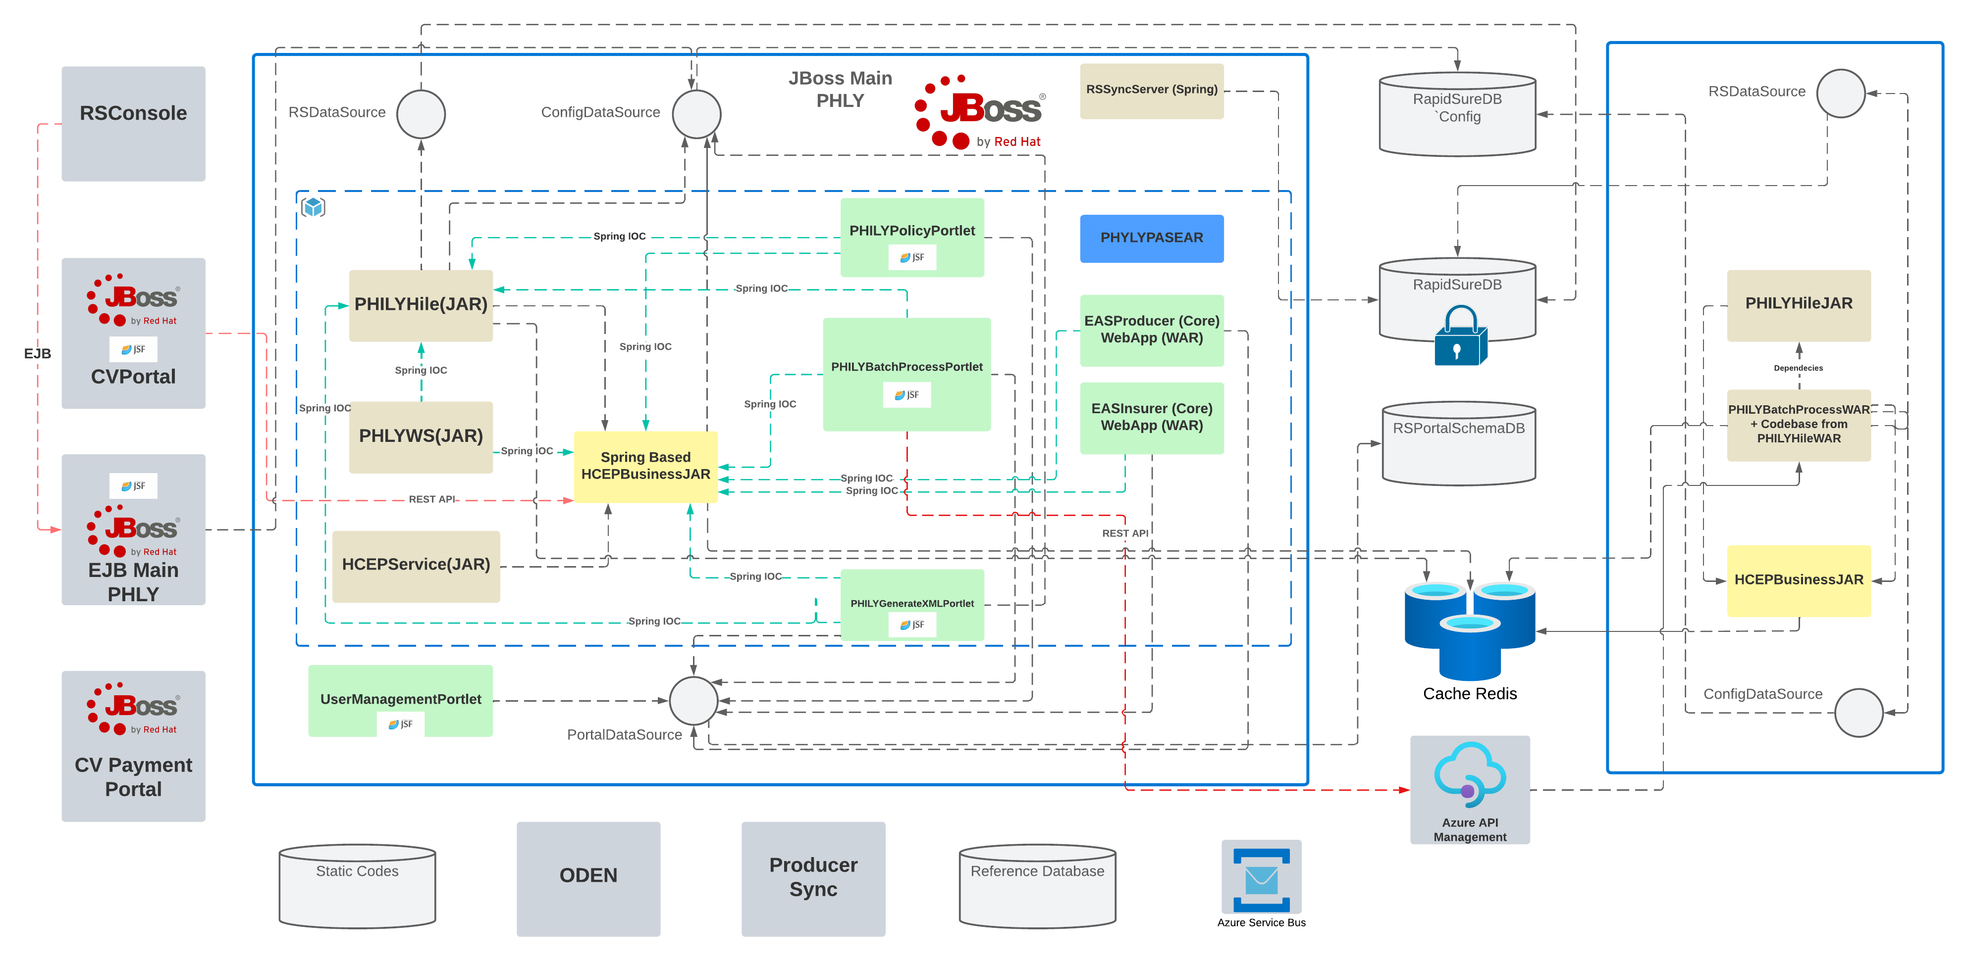
High Level Architecture (current state)

Slide 13






Technical Assessment Summary
System Metrics
Currently system handles:
~155,000 active policies (~132,000 (85%) are CV policies)
~500 manual transactions per business day
~150 automated renewals per day (background jobs)
Note: We assume increase of above Metrics by 3-5 times
Challenges for Personal Line Policy System
Increased load require vertical scalability or deploying new instance of RS.
Horizontal scalability requires sticky sessions due to technology limitations.
Technologies
Business logic
Database
System Design
Performance
External Factors
At first introduced the technologies were modern and appropriate.
However, key presentation technologies such as JavaServer Faces (JSF) and ICEfaces have not had major updates for nearly 10 years and are no longer actively developed.
While some parts of the system were upgraded over time, the core UI technology is outdated, which limits further improvements and modernization.
Business logic is spread across the presentation layer, business components, and data access layer. This distribution means that even small changes in one product or Line of Business (LoB) often require updates across multiple system areas, possibly affecting other products.
For example, accessing or modifying a single policy may involve interacting with numerous related tables, making changes complex, risky, and time-consuming.
The database structure is highly decomposed (data is split across many tables).
This works well under low system load and when there are limited simultaneous updates.
However, under higher load and when multiple transactions happen at the same time, this structure becomes inefficient and impacts performance.
The system was suitable initially, but since then, user numbers, functional needs, integrations, and transaction volumes have all increased significantly. Its UI-driven architecture tightly couples functionality to the interface, limiting flexibility and independent development. Moreover, the absence of an entity locking mechanism in both business logic and database makes concurrent operations unsafe and inconsistent.
When system load increases fivefold, processing and response times slow significantly. While the system remains operational, performance drops notably. The current architecture lacks scalability, requiring "sticky sessions" that bind users to their original server instance, preventing session sharing across instances. This complicates scaling and load balancing efforts.
Producer Management: Relies on external systems like Salesforce, leading to frequent, duplicated updates. Internal management is hindered by a poorly adaptable configuration area.
Limited Document Storage (ImageRight): Few system instances cause conflicts during development and testing.
Direct Database Updates: Common but risky practice due to integration issues, with no tracking.
VDI Performance: build time increased from 15 minutes to 1 hour.

Slide 14


Strategic Technical Direction to Consider…
Project Rambo
Migration to a vendor insurance platform
Incremental modernization of the existing system
PROS
Modern architecture & vendor support (cloud-ready, API-driven, scalable)
Faster time-to-market using prebuilt insurance capabilities
Improved user experience (UX, workflow automation, analytics)
Reduced technical debt and dependency on outdated technologies
CONS
High and variable licensing costs (revenue-based or large fixed fees)
Vendor lock-in risk and limited control over roadmap
Migration complexity (data conversion, integrations, business rules)
ROI uncertainty
Based on Split & Modernization outcome there are recommended steps for iterative improvements:
Introduce Business Layer API that operates on business-level objects (e.g., a full policy transaction as a single entity rather than multiple atomic components).
Build API required for lifecycle, rating, and integration layers to have them aligned with further system extensions.
Standardize Product Configuration API based on the current product experience and further extensions.
Select an appropriate business validation approach that works independently in both the presentation and backend layers. Design a standalone Rule API subsystem.
Enhance security layer to meet modern standards, deployment models, and service capabilities.
Adopt the appropriate UI architecture for future development.
Migrate common components to the new approach

Slide 15

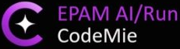
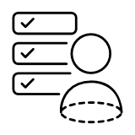
AI Adoption
There are different AI Adoption initiatives running in TMNA. RapidSure stream must benefit from them.
AI suggestions made for Modernization
AI suggestions made for SV enablement
Intelligent Code & Dependency Analysis​
AI agents in CodeMie can inspect codebases and inter-dependencies, helping teams understand structure and surface insights for refactoring or design improvements — with automation woven into the workflow
AI-Enabled Onboarding
AI-powered codebase indexing reduces developer onboarding time. Frees experienced developers from repeated knowledge transfer, keeping them focused on delivery.
Code Analysis Agent
Knowledgebase Agent
Automated Code Generation & Refactoring​
CodeMie assistants can generate new code, suggest improvements to existing modules, and perform automated refactoring within IDE integrations and automation pipelines, boosting developer productivity
AI-Enhanced Coverage and Rating Analysis
Analyzes and highlights the differences between the current (implemented) Coverage/Rating logic and the new version (new State), enabling faster planning
Code Agents (Claude Code)
Coverage and Rating Analysis Agent
AI-Supported Coverage and Rating Code Implementation
Implementation of additional States Coverage/Rating logic accelerated by an AI agent
Coverage and Rating Implementation Agent
AI-Driven Test Support​
Automated generation of unit tests, integration tests, and even test case suggestions helps accelerate QA activities, reduces manual effort, and improves test coverage
Test Cases Agent
AI-Generated Unit Tests
Increases test coverage and code quality across all states, ensuring consistent validation standards while freeing developers to focus on business logic.
Unit Testing
Implementation Agent
Intelligent Documentation Support​
AI agents can assist in producing technical documentation, design guidelines, and migration guides to support knowledge transfer and onboarding
Documentation Agent
AI use-cases to explore additionally
AI-Enabled SDLC - Integrating AI tools into SDLC to boost efficiency. This involves automating requirement documentation, thoroughly reverse-engineering project documents, streamlining workflows etc.

Slide 16



Prioritization of use cases based on Efficiency Gains and Effort
EXPECTED EFFICIENCY GAIN
Foundational
Priority 3
XL
Coverage and Rating Implementation Agent
Code Analysis Agent
L
Knowledgebase Agent
CodeMie Code
Agents
Coverage and Rating Analysis Agent
Potential Low Hanging Fruits
Priority 2
Documentation Agent
Priority 4
We recommend prioritizing the AI agents to implement and pilot based on the impact and benefit the agents will provide, as well as the AI agents' complexity and development effort.
M
Test Cases Agent
Unit Testing
Implementation Agent
S
S
M
L
XL
EFFORT & COMPLEXITY
Notes:
Expected efficiency gain X time for task X ppl in the role
More agents:
Perf Test Analysis
Integration Tests Writing
OpenAPI Contract Generation
Smart Regression Agent
Compliance Code Review
PO Acceptance
Hybris Impact Analysis

Slide 17

Projected Road Map
Planned
Under Finalization
Recommended
TBC
 |  | Mar ‘26 | Apr ‘26 | May ‘26 | Jun ‘26 | Jul ‘26 | Aug ‘26 | Sep ‘26 | Oct ‘26 | Nov ‘26 | Dec ‘26 | Jan ‘27 | Feb ‘27 | Mar ‘27
Products enablement | SV G1,G2,G4 states R1
 | SV G3 states (R2)
 | SV G5+G6 states (R3)
 | A&H PAS
 | ССD
 | Next PLP (R3+) TBD
Platform & Technology Enhancement | Strategic Platform Improvement | Finalize Assessment: CIO approval |  | Business Layer API |  |  | Lifecycle API | Rating API |  | Integration API |  |  | Product Configuration API
 | SV Release support |  | R1 Tactical improvements (scalability & performance) |  |  | R2 Tactical improvements (Performance)
 | RS Foundation (Modernization) | Phase 1. Core Separation |  |  |  | Phase 2: Product Separation
SDLC acceleration & AI enrollment | BA track | Requirements Quality Improvement & Documentation & Standards Centralization |  |  | Early Impact Analysis |  |  |  |  | BA framework enrollment for new Product
 | PM track | CI process setup | EngX asmt |  | Change Control | Milestone Governance | Readiness, Acceptance & Estimation |  |  | New PM framework
 | Development track | Modularization & Parallelization Enablement |  |  |  |  |  |  |  | New Dev. guidelines
 | QA track |  | QA Shift-Left & Automation |  |  |  |  |  |  | New QA guidelines
 | Infrastructure track |  | Integration & Environment Strategy |  |  | Automated Envs & CI/CD | Release Mgmt
Next Technical Roadmap Items for 2027-2028: Business rule engine, Security layer improvements, UI technology refresh

Slide 18



Assumptions & Open Questions
Products Enablement
Platform & Technology Enhancement
SDLC Acceleration & AI Enrollment
Assumptions:
The product enablement roadmap is finalized and locked for significant changes by the end of the year.
The Improvement Roadmap and the ongoing Improvement process will receive Client approval.
​Outstanding questions:
What are the detailed business use cases for personal lines, including target users and specific use case scenarios?
What are the business growth projections for the coming years (e.g., expected user numbers, policy volumes, and geographic expansion)?
What is the defined change implementation cycle for the System (who is responsible, how frequently are changes made, and what is the typical scale of these changes)?
Assumptions:
This review is based on team presentations, live sessions, and onboarding recordings, with no access to source code, requirements, task tracking, or the live system.
System metrics are expected to increase by 3 to 5 times compared to current levels.
Outstanding questions:
What is the current composition of the client ecosystem and its integrations, and what changes are planned by the end of the year?
What are the details regarding the integration and notification registry, as well as the associated data mappings?
Assumptions:
Analysis was based on team presentations, live sessions, and onboarding recordings.
Access to issue-tracking systems will be provided to introduce measurable metrics.
RapidSure stream will be the part of ongoing AI adoption initiatives.
Outstanding questions:
What is preferred management approach?
Why Agile adoption failed in the past?
How Program level communication and reporting is done now?
What historical data is available for AI-driven estimation?
What is included into the current test strategy?

Slide 19


Next steps
Project Rambo
Propose to TMNAS a SWAT team to complete workshops and confirm immediate project
Team structure: 1 DM, 1 Architect, 1 Business Analyst, 1 AI Dev Lead
Expected Outcomes
Finalize Assessment
Plan for feature and configuration phases
Complete building of the technical roadmap
Assessment contracts in Apps Eco-system
Define improvement areas, prioritize, estimate and plan them
Continous improvement process definition and setup
EngX assessment of SDLC
Measuring an impact and ROI
Execution framework
Identify AI initiatives/project to start for next phase
EPAM Proprietary & Confidential.
19

Slide 20



RapidSure Operating Model Suggested Improvements
Project rambo
Governance & PM
Requirements and Solutioning
Development & QA
Deployment & Infrastructure
Strategic Planning & Roadmap Implementation
Set direction, align priorities, and enable effective downstream governance.
Unified Delivery Framework Rollout
With strategic alignment in place, standardize processes and clarify roles for all teams.
Estimation & Change Control Enhancement
Improve estimation accuracy and control scope changes. Use AI to analyze historical data.
Phase-Gate Governance & Milestone Management
Embedding milestone discipline and monitoring, leveraging the new frameworks and controls.
Requirements Quality Improvement
Ensure requirements are clear, complete, and BAs are upskilled. AI-powered tools can help to standardize, accelerate and increase quality of documentation.
Documentation & Standards Centralization
Standardize and centralize documentation for consistency.
Early Impact Analysis
Proactively analyze and log customizations to prevent late surprises.
Readiness, Acceptance, and Estimation Catalog
Formalize readiness/acceptance criteria and build a repository for continuous improvement. AI usage for clustering past requirements and estimates will help to make efficient project planning.
Modularization & Parallelization Enablement
Refactor for modularity to reduce dependencies and enable parallel work.
Cross-Functional Team Integration
Integrate teams for better collaboration and faster delivery.
QA Shift-Left & Automation
Involve QA early and automate testing to catch defects sooner. AI can generate test cases, predict defects, and identify likely failure points early.
Technical Debt & Knowledge Management
Systematically address technical debt and institutionalize knowledge sharing. AI-tools scan codebases to detect technical debt patterns and recommend refactoring opportunities.
Early Integration & Environment Strategy
Define integration points and environment needs to avoid late-stage issues.
Automated Environment & CI/CD Implementation
With strategy in place, automate environment provisioning and deployments for consistency. Use AI to optimize CI/CD pipelines and auto-scale environments.
Release & Feature Management Optimization
Optimize release cycles and feature management for smoother production flow.
Quality Gates & Dependency Management
Enforce quality gates and manage dependencies to ensure robust, reliable releases. Use AI to analyze deployment logs and test results.

Slide 21
TMNAS Drivers
Guys can you populate the below table?
2026
2028+
All these elements need to be listed on the roadmap slide
Modernize Policy Administration in an intelligent way that balances Enterprise Vision and smart business investment
Evaluate RapidSure to determine if components can be split to segregate duties and increase the chance for horizontal scalability
Increase capacity and optimize support for quicker time to market
Technology Value | Business Value | Process Value | Application Environment Value
Remove Obsolete Technology Stack Integration Readiness as provider and consumer of services Breaking the monolith! | Modernize UI Decrease the release cycle time Increase scalability Reporting/Import capabilities Performance improvements | Automate Deployment using CI/CD Pipelines Azure DevOps for Task Management Targeted Test Coverage Increase Unit Test Coverage Decrease and Manage Tech Debt | Standardize and improve Logging with ELK Add Application Monitoring (App Insights) Dynamic infrastructure provisioning/containerization Enable Cloud Readiness

Slide 22
Enabling Personal Lines: Changes in Business capabilities
Project Rambo
Capability
Commercial Lines (Current state)
Personal Lines (Target state)
Key Differences / Critical Changes
Transaction Volume | Batch‑heavy, account‑centric; complex policy & OOS flows; stable throughput | High‑throughput STP; real‑time APIs; clean API layer; stateless processing; low‑code lifecycle
Change Agility | IT‑driven edits; effort tied to change complexity | Business‑owned configuration; priority on rules/lifecycle/actions; medium effort for transforms; highest for data modeling
Coverage | ACV, property schedules, commercial endorsements | Agreed/guaranteed value; specialty endorsements; configuration‑driven
Integrations | VIN search; Accounts/Producer; LDAP user provisioning; policy ingestion (Salesforce/CV Portal); streaming to Apps/Path/ImageRight; OOS Resolution | Real‑time VIN/MVR/credit; telematics re‑rating; expanded ingestion & streaming; validate new LoB integrations
Document generation | External engine (ImageRight) feed; performance depends on data transformation | High‑volume, optimized feeds; dynamic PDFs/ID cards; e‑sign for faster bind
Analytics | Batch exports; embedded BI; exposure/risk reports | Real‑time dashboards; export formats for external tools; propose ratebook/rating analytics
Security | LDAP/AD roles; MFA handled by enterprise IAM | Stronger LDAP expansion; entity locking; concurrency control; audit logging
1) Operations: From batch/account‑centric → stateless, API‑first, service‑oriented.
2) Change Agility: From IT‑led → business‑owned low/no‑code (rules → lifecycle → actions).
3) Data Ecosystem: From basic checks → real‑time VIN/MVR/credit/telematics + expanded ingestion & streaming.
4) Documents: From internal schedules → valuation evidence + optimized external doc feeds + e‑sign.
5) Insights & Control: From batch BI → near‑real‑time dashboards, exportable datasets, stronger security & auditability.
*Billing will change from Agency/direct bill mix; batch billing; equity billing to predominantly direct bills; monthly/bi‑weekly; refunds/prorations; wallets/autopay changes. The changeis out of scope for RapidSure analysis as handled by external application

Slide 23
Progress Snapshot
Context & Baseline
Activities Completed
Key Outputs & Results
Governance & SDLC
Existing governance & communication
Current delivery approach
Team composition approach
Lesson-learned from recent implementations
Suggested improvements and their history of implementation
Existing SV implementation plans
Existing Modernization plans to support SV
Architecture & Platform
Top-level architecture documentation
Guided demonstrations of source code
Activities of RS Development team
Other platforms with the focus on Personal products
RS Performance reports
AI adoption
CodeMie adoption PoC
GitHub Copilot adoption
Governance & SDLC
Reviewed and documented existing governance structures and communication channels to ensure alignment with project objectives.
Assessed current and past delivery and team composition frameworks, identifying strengths and areas for optimization.
Mapped out existing SV implementation plans, highlighting progress and dependencies.
Examined modernization initiatives designed to support SV, ensuring integration with ongoing and future projects.
Architecture & Platform
Technologies analysis performed
Matching of Business logic to RS platform
RS Technical assessment as PL-ready Platform
External Challenges analysis performed
Scalability & Performance Analysis
AI adoption
Analysis of the scope for AI adoption
Governance & SDLC
Current team issues cause communication breakdowns and responsibilities gaps, impacting timelines and quality.
Following standard development practices is crucial to improve efficiency and speed.
Absence of Data-driven decisions and strong change management caused project failure in the past.
Architecture & Platform
Dispersed business logic slows delivery and lowers quality.
Current RS architecture and database will limit performance, especially for Personal Line Products.
External technical factors affect delivery predictability and must be managed.
UI technology refresh must be done to close existing gap and create a basis for business & technical scalability.
AI adoption
AI efforts are fragmented; alignment with strategy and continuous improvement are key.

Slide 24
Enabling Personal Lines: Key Capability Differences
Policy Lifecycle: From batch to real-time.
Rating & Rules: Real-time scoring and telematics.
Integrations: VIN/MVR/Credit/Telematics expanded.
Customer & Distribution: Add D2C and Self-service.
Documents & Analytics: Dynamic PDFs, real-time dashboards.

