Slide 1


Bioinformatics Research Lab Network Design
Dania Zein
CSC 435

Slide 2

Network Overview
I created a network for an undergraduate bioinformatics research lab using Cisco Packet Tracer
Goal:
Implement multiple VLANs for traffic separation
Assign static and dynamic IP addresses
Configure wired and wireless connectivity
Plan for security, reliability, and future scalability

Slide 3
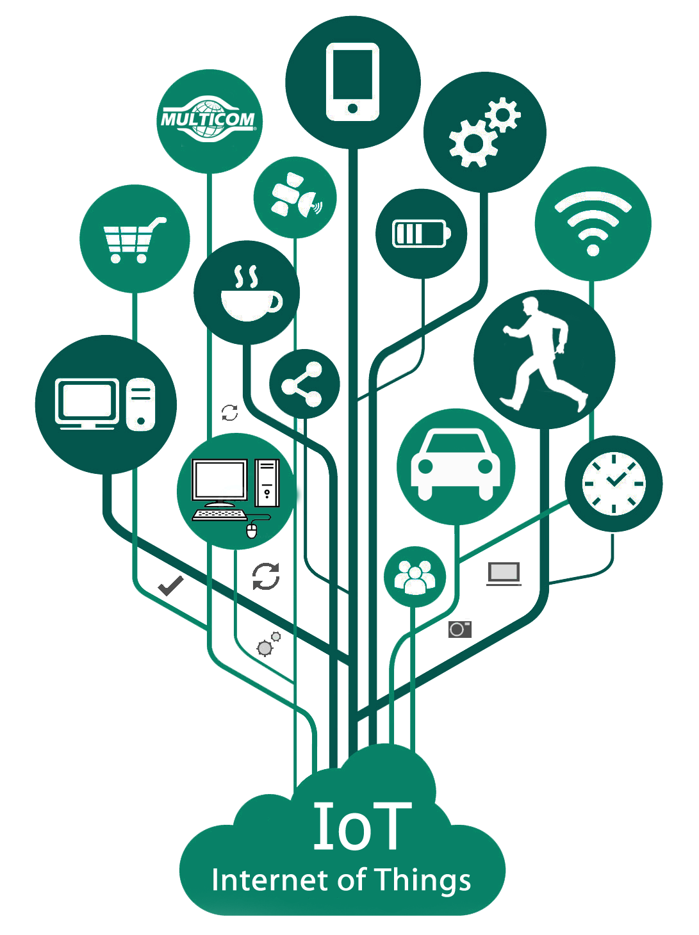
Lab Setup
Lab Type: Small research lab with
Research computers and a server
Laptops and tablets for students
IoT devices like a thermostat and smoke detector
Main goals:
Protect the server
Separate device types using VLANs
Add wireless access and internet connection

Slide 4
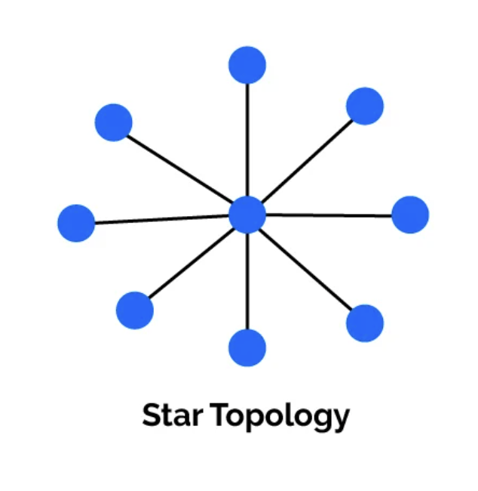
Network Design
Star Topology is the most common network topology in an office/lab
I started with a basic star topology and expanded it to fit the needs of the lab:
Separating devices into three VLANs (Wired, Wireless, IoT) for better organization and security
Including a wireless router and an access point for wireless access
Connecting to the internet through a second router and cloud

Slide 5

VLAN Setup
VLANs help keep lab traffic organized and secure
Routing between VLANs is done by the switch
VLAN 10: For wired devices and research server
VLAN 20: For laptops and tablets using Wi-Fi
VLAN 30: For IoT devices (like sensors)

Slide 6
Network Devices
Internet (Cloud)
2 Routers
1 Multilayer Switch
VLAN 10
1 Server
4 PCs
VLAN 20
Access Point
2 Tablets
3 Laptops
VLAN 30
Home Gateway DLC100
Thermostat
Humiture Monitor
Air Conditioner
Smoke Detector
Coffee Pot

Slide 7
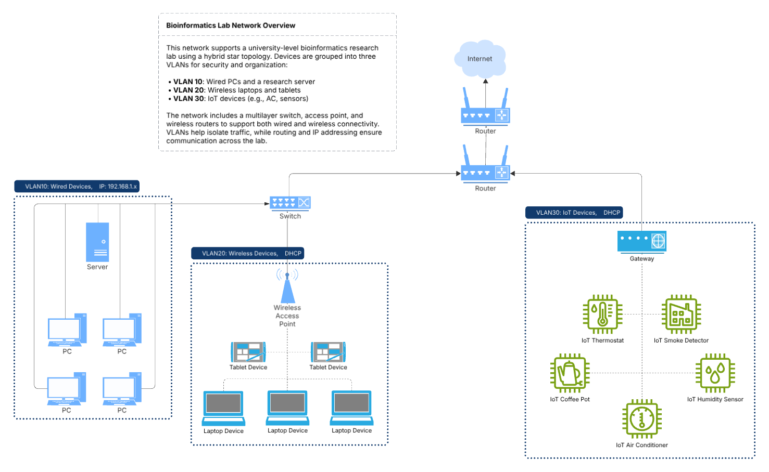
Network
Topology
Diagram

Slide 8
IP Addressing
Mix of static and dynamic addressing to ensure critical devices are secure and easily managed, while allowing flexibility for wireless devices
VLAN 10 (Wired - PCs and Server)
Static IPs assigned for stability and security
Range: 192.168.1.2 – 192.168.1.6
Default gateway: Router (192.168.1.1)
Subnet used: 255.255.255.0 - simple and sufficient for this lab size
VLAN 20 (Wireless - Laptops & Tablets)
DHCP enabled for flexible and dynamic IP assignment
IPs automatically assigned by the router
VLAN 30 (IoT Devices)
Also use dynamic IPs for ease of connection
Keeps setup simple and scalable

Slide 9

Security Measures
VLANs used to isolate device groups and reduce attack surface
Server placement: The research server is isolated in VLAN 10 to reduce exposure to wireless or IoT traffic
Important to protect classified research data
Static IPs for critical devices: The server and wired PCs use static IP addresses for stability and easier monitoring
IoT devices isolated in their own VLAN for safety
WPA2 Encryption on the wireless network

Slide 10
Testing & Troubleshooting
Pinging PC's to each other worked
Used "tracert" to verify paths from PCs to other devices
While testing connection between VLAN10 and VLAN20:
Tried pinging laptop0 from PC0 and received "Request Timed Out"
Indicated that laptop0 had a dynamic IP address, but was not properly connected wirelessly
Had to use laptop's "PC Wireless" GUI to connect to the Access point with WPA2 password
Retried ping and worked! - Laptops are now connected through the Access Point (AP-PT)
Tablets are not connected to the access point as intended
They are still connecting to the Wireless Router instead of VLAN 2

Slide 11
Limitations & Challenges
Firewall not implemented (for securing VLAN 10/server)
Initial inter-VLAN communication failed, later resolved
DHCP setup was limited due to router constraints
Tablets not connecting to Access Point, still linked to Wireless Router
Only IPv4 addressing used – IPv6 could improve security and portability
Better documentation – difficult to remember IP addresses

Slide 12
Conclusion
Designed and implemented a functional research lab network
Applied VLANs, static & dynamic IP addressing, and basic wireless security
Faced and documented challenges in inter-VLAN routing and external access
The network works well for basic lab needs and can be improved in the future

