Slide 1
CSC350
Final Project Presentation
Patient Directory
By: Dania Zein

Slide 2


Introduction
This project is a Patient Directory System for a small clinic manage patient records efficiently
The system supports basic CRUD operations (Create, Read, Update, Delete) on patient records
GOAL: To improve organization and accessibility of patient data for doctors and clinic staff

Slide 3

Purpose
Many times, small clinics don’t have enough resources to manage sensitive electronic medical data
Real-world relevance
More features can be added to account for security and privacy concerns

Slide 4
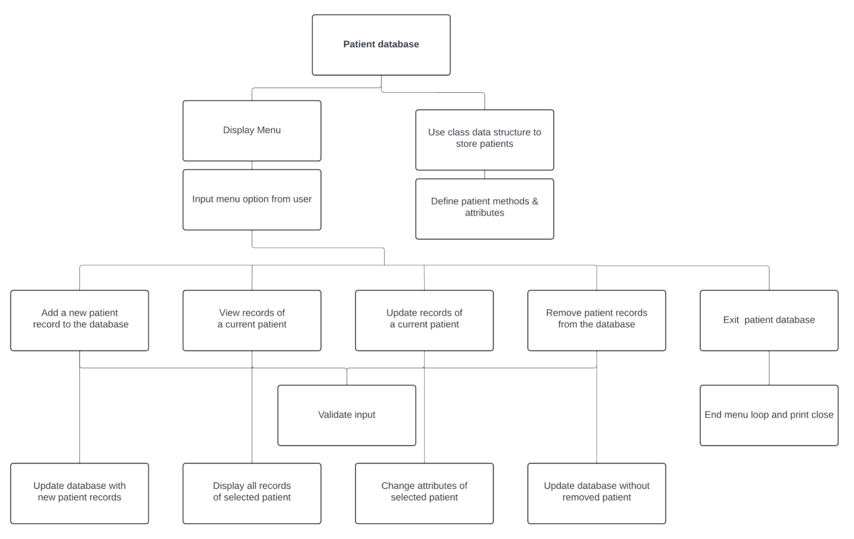
Top-Down Design

Slide 5
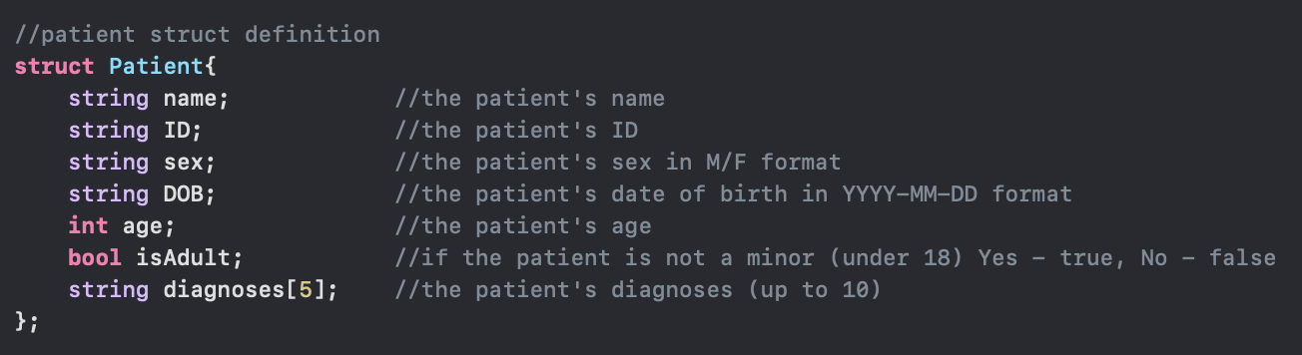
Design
Defining the Patient Struct:
Name, ID, Sex, DOB, Age, Adult status, Diagnoses
Why Structs? —> Familiar, and easy to extend!

Slide 6
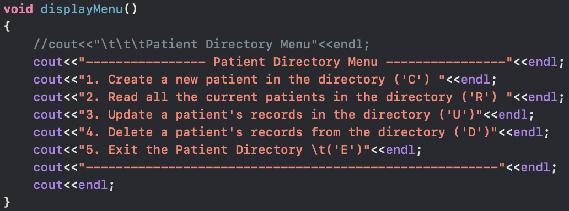
Implementation
Core data structure: Vector of Patient structs to store the data.
D
Dynamic (easy to remove/add patients)
Menu via displayMenu()
CRUD or Exit operation selected with letter choice

Slide 7
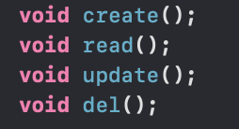
CRUD Implementation
Each operation had its own function call
Used many multiple way selectors and iterative statements
Input Validation and Error Handling
Only valid menu options able to be selected
Provides user feedback for invalid inputs

Slide 8
Challenges
PROBLEM SOLUTION
User could type anything with menu as first letter and program would continue
Some patients would have less than 5 diagnoses
User could enter new DOB with improper format
User could enter age as string
Implemented if else if else statement to handle input
Printed only written diagnoses
Checked that DOB had “-” present in YYYY-MM-DD format
Use stoi() and exception handler to check age as integer

Slide 9

Future Extensions
Change struct to class
Allows for private attributes and methods
Add GUI
Read patients from a file
Better security and portability
Provide authentication and authorization
Add medical history, medications, and allergies

Slide 10
Conclusion
Very fun and eye-opening project
Reinforced the importance of data organization and accessibility
Time consuming
Input validation
Constantly checking for errors
Required lots of planning
New skills: vectors, exception handlers, structs, stoi(), string::npos

