Slide 1
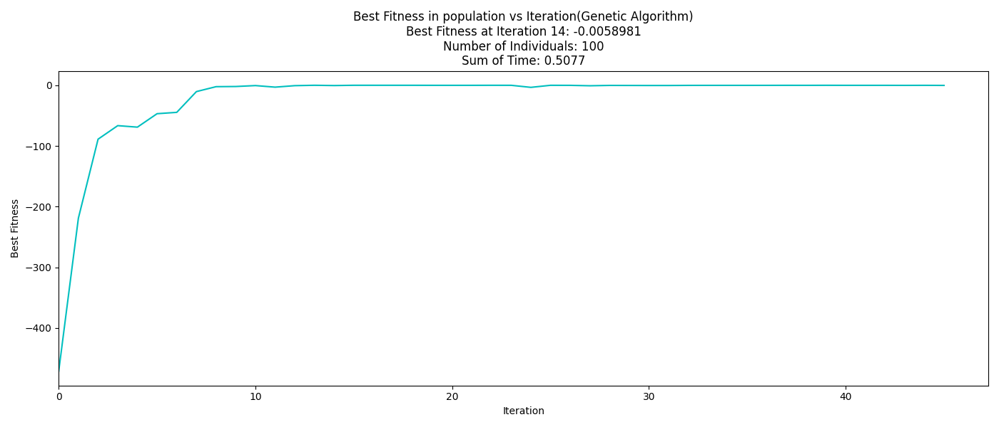
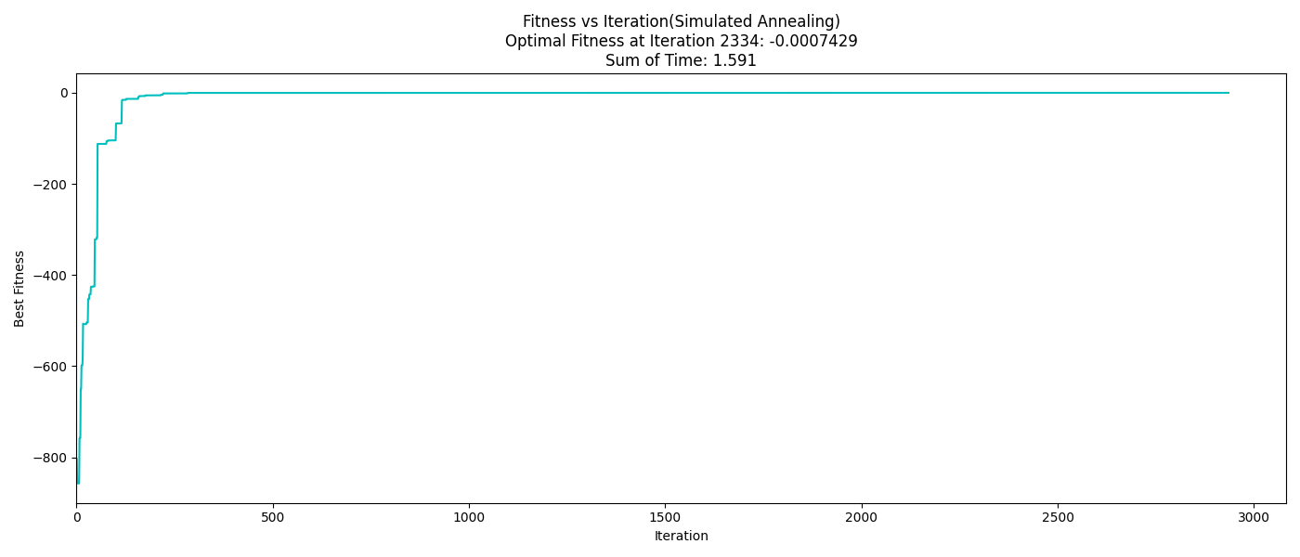
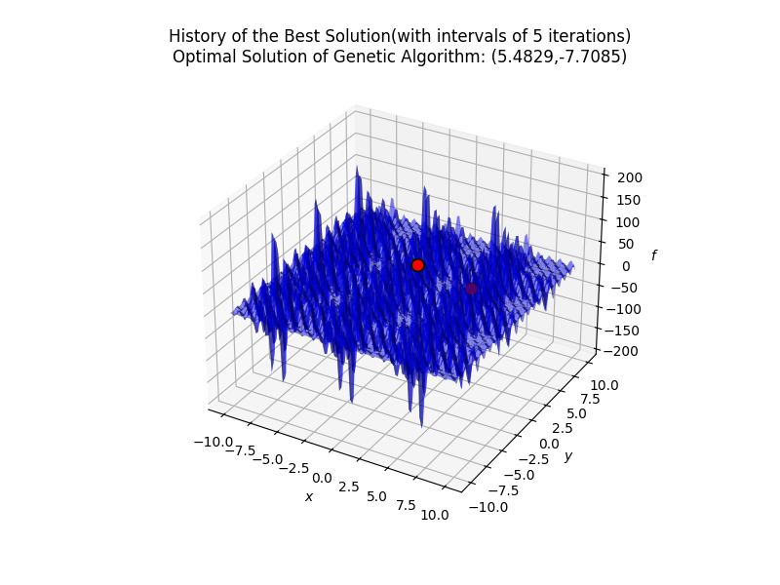
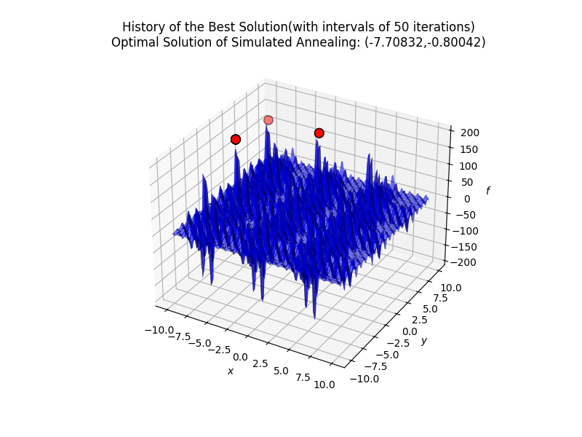
A Testbed for Global Optimization of Multimodal Functions: Implementing and Comparing Genetic Algorithm and Simulated Annealing
Dingming Zhong
Jinan University
Abstract
Method
Result
Conclusion
This project constructs an extensible optimization solver test platform that integrates genetic algorithm (GA) and simulated annealing algorithm (SA) to solve complex function optimization problems with multiple local minima. The Schwefel Function and Shubert Function were selected as the benchmark test functions to compare the performances of the two algorithms in terms of convergence speed, solution accuracy and robustness under a unified framework. The experimental results show that the GA converges faster in the early search stage and is suitable for rapid approximation. SA demonstrates a stronger ability to escape local optima in high-dimensional or strongly nonlinear problems, and the final solution is closer to the theoretical global optimum.
Test function description:
Schwefel Function(dim(x)=3):
Shubert Function:
Details of algorithm implementation:
GA: It adopts binary coding (100 bits per variable), with a population size of 100. Tournament selection (ratio 0.25), single-point crossover (probability 1.0), bit flip mutation (probability 0.1), and a maximum iteration of 1000 generations. If there is no improvement for 30 consecutive generations, it will be prematurely terminated.
SA: Using same binary coding, the initial temperature is 500 degrees, the cooling coefficient is 0.8, and 10 independent chains are run in parallel. The process is stopped when the temperature drops to 1e-5 or after 600 consecutive iterations without improvement.
All experiments have a fixed random seed (random_state=69) to ensure the reproducibility of the results.
The code makes the minimization problem applicable to the maximization framework by taking a negative sign.
Schwefel Function:
The image shows that SA reaches the optimal fitness of -0.0007429 in approximately 2334 iterations, and the convergence process shows the characteristics of a rapid decline followed by a stabilization. GA achieved the optimal fitness of -0.0058981 within 14 iterations.
Shubert Function:
The image shows the historical trajectory of the best solution during the optimization process of GA and SA. It is recorded every 5 generations or 50 generations. The blue surface represents the terrain of the objective function, and the red points indicate the optimal solution positions found by each algorithm. Among them, SA discovered candidate solutions in multiple areas, while GA concentrated in a single area.
The experimental results demonstrate that GA exhibits faster initial convergence on low-dimensional multimodal functions, making it suitable for preliminary searches where computational efficiency is prioritized. In contrast, SA, despite its slower convergence, shows superior global exploration capability on high-dimensional or highly multimodal functions with dense local minima, yielding solutions closer to the theoretical global optimum. The complementary strengths of the two algorithms across different problem settings corroborate the "No Free Lunch" theorem—no single optimization algorithm universally outperforms all others. The developed testbed features a clear architecture and configurable parameters, enabling rapid integration of new algorithms and providing a reproducible experimental foundation for future research. Future work will incorporate adaptive parameter control mechanisms to further enhance algorithmic performance.
Objectives
Build a universal test platform that supports multiple meta-heuristic algorithms;
Realize and compare the performance of GA and SA on multimodal functions
Analyze the differences among various algorithms in terms of convergence behavior, final accuracy and operational efficiency;
Provide a visual convergence curve to assist in understanding the dynamic process of the algorithm.
Reference
Schwefel Function. (n.d.). Retrieved February 10, 2026, from https://www.sfu.ca/~ssurjano/schwef.html
Shubert Function. (n.d.). Retrieved February 10, 2026, from https://www.sfu.ca/~ssurjano/shubert.html
Acknowledgements
I would like to sincerely thank Professor Jason Hou for his invaluable guidance and support throughout this project. I am also deeply grateful to his Ph.D. student, Cole Howard, for his generous assistance with algorithm implementation and experimental design.

