Slide 1
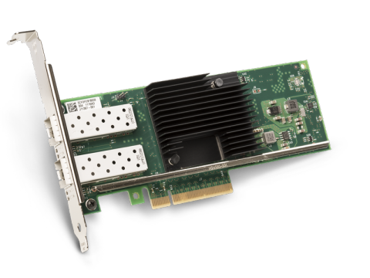
2 x 25gb
2 x 25gb
DPDK WORKLOAD
DPDK WORKLOAD
DPDK WORKLOADS
DPDK WORKLOADS
Noisy neighbour
DPDK WORKLOADS
DPDK WORKLOADS
[
]
[
]
cores
0
1
2
…
19
cores
0
1
…
15
16
…
19
HT
HT
HT
HT
HT
HT
HT
HT
HT
HT
HT
HT
HT
HT
HT
HT
HT
HT
HT
HT
HT
HT
HT
HT
isolated pool
un-isolated POOL
Noisy neighbour

