Slide 1
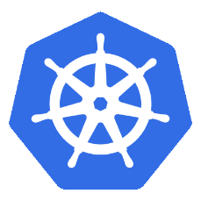
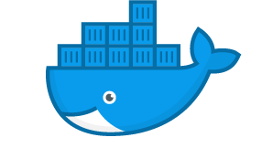

multi-network kubernetes pods
Docker container #1
Docker container #2
Docker container #3
HOST

