Slide 1
Envisioning Group Policy
1
for a GNU heterogeneous environment
Final year project 2011/2012 David O Neill

Slide 2
Project Description
2
The concept of this project is to provide a Linux port of the Windows Group Policy Object (GPO) editor and a means to deploy these policies to a multitude of Gnus not Unix (GNU) systems through a common non-ambiguous domain specific language (DSL).

Slide 3
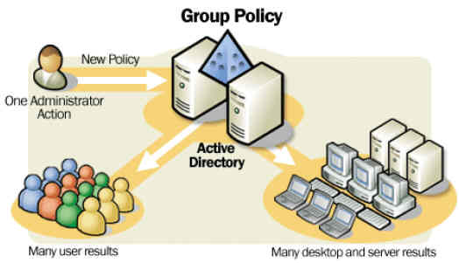
What is Group Policy?
3
Group Policy is a set of rules which control the working environment of user and computer accounts
Picture source : Coolpctips.com

Slide 4
What of the Windows Environment?
4
Windows machines employ a central place for management and configuration known as the Windows Registry.
The Windows Registry is a hierarchy of Key / Value pairs that represents software settings on the computer, from low level Operating System settings to desktop settings.
The Local Group Policy Object (GPO) Editor ‘gpedit.msc’ allows users to control these settings through an easy interface.
These settings can be overridden by Group Policies defined and associated with an Organizational Units (OU) in Active Directory.
When a computer is joined to a domain and part of this OU, these polices are enforced on the client machine.

Slide 5
What of the Linux Environment?
5
Each GNU Linux implementation employs comparable characteristics, but different tools to control these characteristics.
No local registry comparable to the Windows Registry, settings are stored in files.
No server comparable to Active Directory for application of environment policies.
LDAP (lightweight directory access protocol) concerned with authentication.
Software installation is controlled by varying tools, for example. Debian ‘apt’, Redhat based ‘yum’, Gentoo based ‘emerge’.
No General User Interface (GUI) for controlling the environments machine settings in a common way.

Slide 6
Why?
6
apply this to a GNU heterogeneous environment

Slide 7
GNU Environment
7
Given the plethora of GNU distributions and their different implementation philosophies, the tools provided to control computer settings vary from distribution to distribution.
Server VS client / GUI VS no GUI / Gnome VS KDE / Security VS Usability
This requires administrators to be knowledgeable in all these tools and distribution specific abstractions.
Furthermore distribution variety in the environment increases the size of automation scripts that might already be implemented.
Clones ( and or if Debian do this, If Ubuntu do then )
No group policy implementation exists that abstracts distribution specific knowledge from the administrator, requiring highly skilled technicians, nor any General User Interface (GUI) .
Implementations via script automation are not only cumbersome but require constant upkeep and retention of the skilled employees.

Slide 8
Implication
8
Reduce costs
Mitigate the need for highly skilled technicians
Abstract distribution specific knowledge
Central management area to reduce configuration time
Enforcement of settings over time, without constant administration auditing

Slide 9
How?
9
Group policy in a GNU heterogeneous environment

Slide 10
Components
10
A visual Policy Editor to reduce the need for highly skilled technicians by empowering them with a GUI Interface
A Intermediate Domain Specific Language (DSL) produced by either the schema or by administrators for the server side abstraction and greater speed in specification of policy settings
A client-server implementation as a means to deploy the settings to the clients where the DSL is translated to distribution specific commands

Slide 11

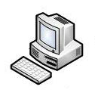
Overview DSL / Modules Designing for extensibility
11
Add new modules, introducing new ‘hooks’
3
6
“software install” hook
Software Provisioning Module
distribution specific command
1
DSL ….. Software install : apache
2
Interpreter
4
Parse DSL with hook
5

Slide 12
Directory Services Schema
12
Integration and management

Slide 13
Directory Services
13
Identify the basic elements of directory services schema and how these elements can be comprised to facilitate the specification of policies, such as attributes, attribute instances, classes, class instances, content rules etc.
Identify the Key domain abstractions, such as configuration files, service control, permissions, package management etc. and how these can be represented via the preceding terms.
Hierarchy of groups and associated policies with inheritance, overriding etc.
Translating of policies into a domain specific language(DSL) and how new grammar provided by DSL can be imported into the schema. (translation)

Slide 14
Policy Editor
14
Administration Frontend

Slide 15
Policy Editor
15
Creation of organizational units for the grouping of computer objects
Ability to move computers between these OU’s
Ability to create new policies introducing new domain specific abstractions with key/value pairs
Application of policies to the OU’s and the visualization of the inherited polices.

Slide 16
Domain Specific Languages
16
P => Q Q being distribution specific

Slide 17
What is a DSL?
17
"A domain-specific language (DSL) is a programming language or executable specification language that offers, through appropriate notations and abstractions, expressive power focused on, and usually restricted to, a particular problem domain.” - Arie van Deursen
Domain specific languages are not a new concept. They have been around since Unix and lisp.
DSL examples, JSON, XML, HTML, SQL

Slide 18
Client / Server
18
Deployment

Slide 19
Client / Server
19
Written is Perl for high portability
Server : Accepts connections and sends polices in the form of DSL
Client : An interpreter / filter will hand the DSL tokenization
Client : Modular, modules will handle the interpretation and extension of the filter grammar
Client : Interpretation will result in distribution specific actions

Slide 20
Project Plan
20
Overview

Slide 21
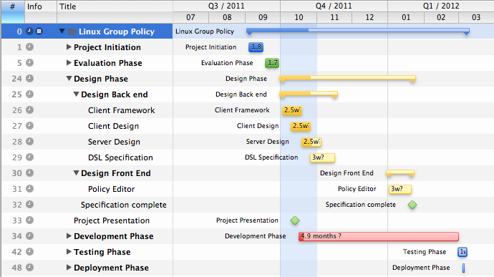
Project Gantt Chart
21

Slide 22
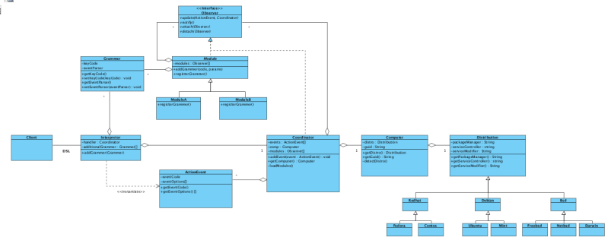
Client Class Diagram
22

Slide 23
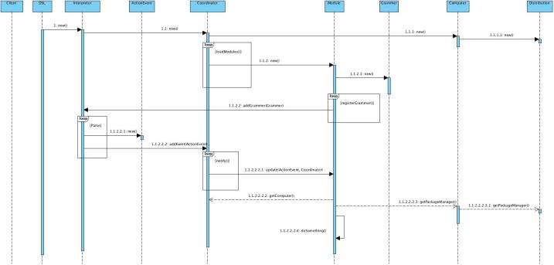
Client Sequence Diagram
23

Slide 24
Questions
24
A challenging project for which the intention is to create a light weight proof of concept, which has the ability to make significant impact to the problem domain

