Slide 1
Kinsale
Mizen
Hook
Wicklow
Kerry
Galley
Derg
L
Bray
Brandon
Carnsore (telepresence)
Loop
Howth
Achill
Erris
Bennett

Slide 2
Heaney
Yeats
Joyce
Shaw
Wilde
Beckett
Behan

Slide 3
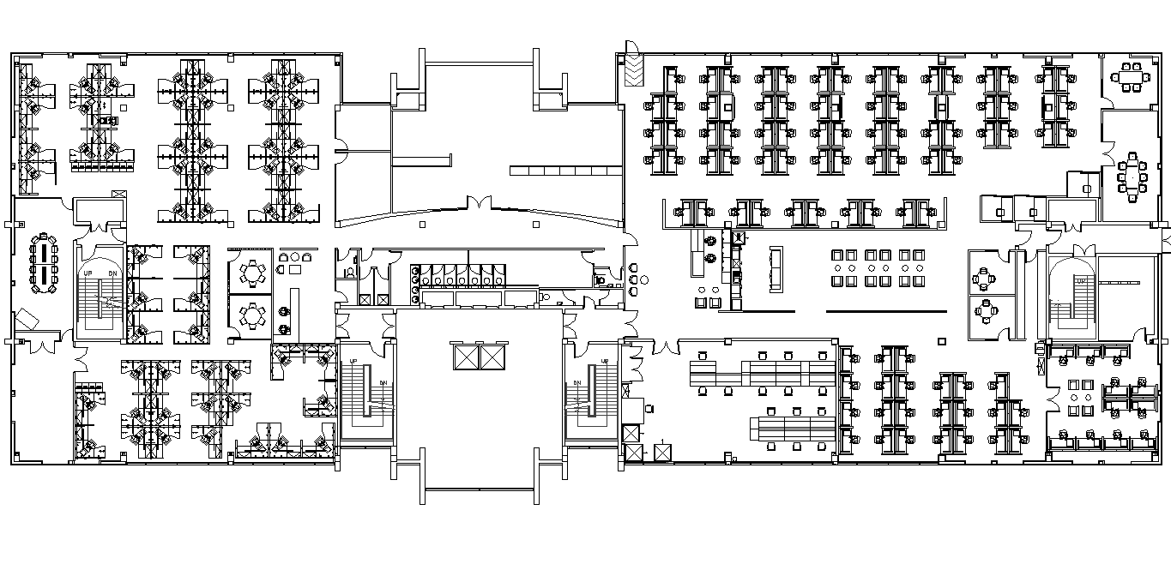
Hamilton (telepresence)
Reception
Clancy
Boole
Walton

