Slide 1
Capstone Final Report --Repeated Buyers Forecasting
By
Cody Kou

Slide 2
The Problem:
After big promotions, it’s crucial for merchant to distinguish the potential repeated buyers from the one-time deal hunters.
Notes:
It’s no great discovery that water flows into itself. The issues of one part of the harbor are not entirely isolated from the issues of another. By better understanding how this water quality network works, water quality issues can be treated systematically rather than on a case by case basis.
Understanding the system requires constant and broad monitoring which is costly and time consuming.

Slide 3
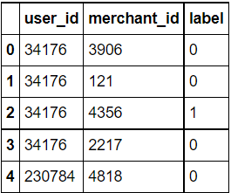
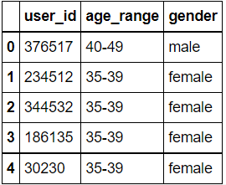
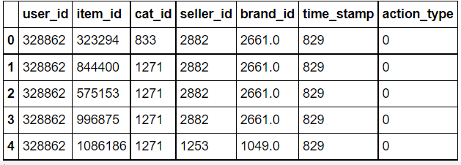
Data
Label file
Customer file
Activity file
Data Source: Alibaba website
Notes:
Dataset was 88,000 rows and 100 columns
Measurements from 1909
250 total sites

Slide 4
Data Wrangling
Joint 3 files into 1 table
Grouped by user_id & merchant id
Created new features
One-hot encoding for categorical features
Target Variable: Label
Joint table has 260,864 rows and 22 columns
Notes:
Wanted a large enough time span to capture multiple climate anomalies
Wanted to focus on sites actively being sampled
Reduced the size and scope considerably by dumping redundant data
Imputed values based on old measurements
Chose chlorphyll as my target vairable because it has far reaching and tangible, immediate effects on an ecosystem such as fish death and drops in dissolved oxygen

Slide 5
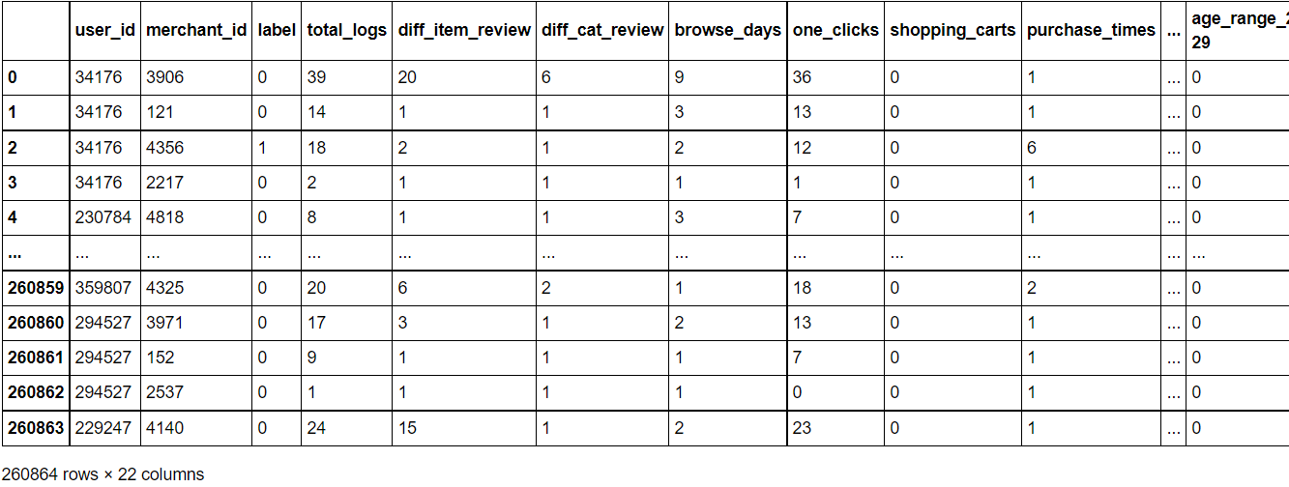
Dataset after wrangling
Notes:
Dataset was 88,000 rows and 100 columns
Measurements from 1909
250 total sites

Slide 6
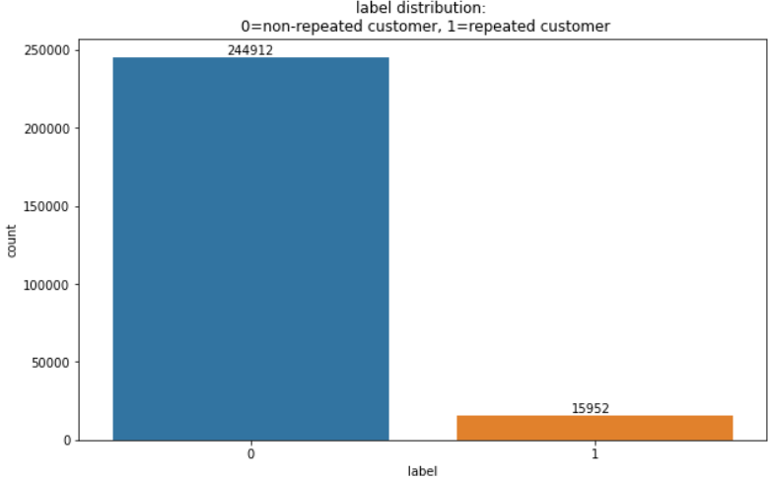
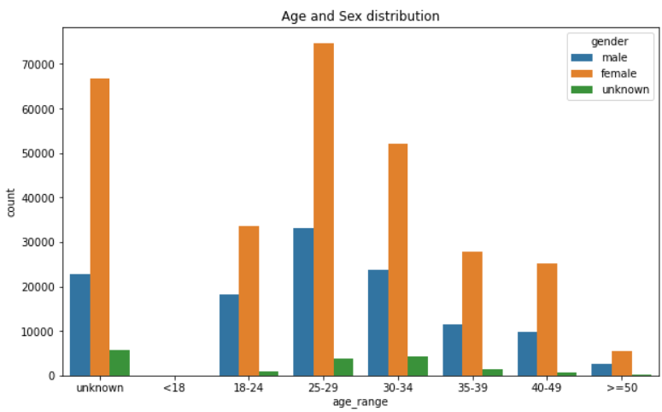
Exploratory Data Analysis
Value counts of label
Customer distribution by age & gender
Findings: highly imbalanced dataset
Findings: majority between 18-34, much more female
Notes:
Top left: Scatter plot of chlorophyll and pH. There’s a slight correlation, but overall it’s very difficult to tell. This was common for a lot of the measurements.
Top right: Multigraph representation of overlapping failed tests. If two sites had overlimit readings in the same month, an edge was drawn between the nodes
Bottom left: geographic representation of probability of failed chlorophyll test at each site. Circles are arranged by lat/long and their size is their probability of failing a test.
Bottom right: Inverse Weighted Distance map. Sites that fail tests at the same time are darker, but this graph also takes into account how far away the sites are from each other.
Using these graphs and more, I was able to narrow down my features and the sites I was going to look at

Slide 7
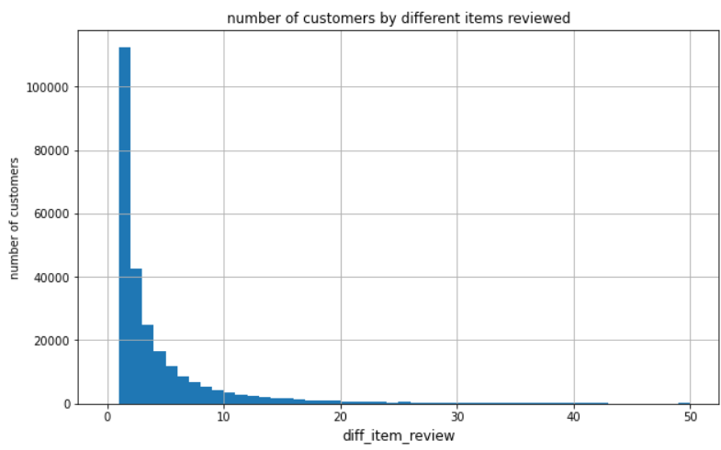
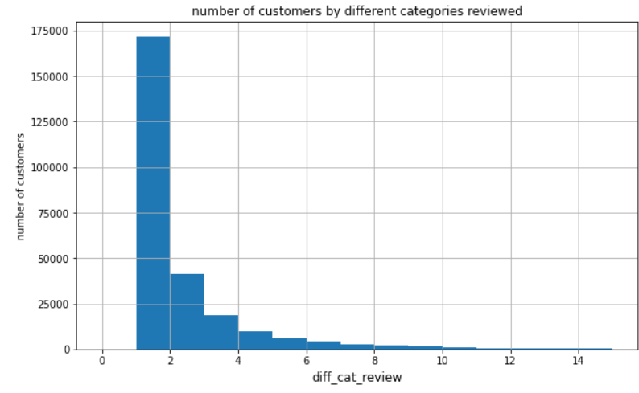
Exploratory Data Analysis
Customer by different items reviewed
Customer by different categories reviewed
Findings: most customers reviewed less than 20 items in less than 10 different categories, indicating that majority of customers have their pre-decided target items to review or purchase
Notes:
Top left: Scatter plot of chlorophyll and pH. There’s a slight correlation, but overall it’s very difficult to tell. This was common for a lot of the measurements.
Top right: Multigraph representation of overlapping failed tests. If two sites had overlimit readings in the same month, an edge was drawn between the nodes
Bottom left: geographic representation of probability of failed chlorophyll test at each site. Circles are arranged by lat/long and their size is their probability of failing a test.
Bottom right: Inverse Weighted Distance map. Sites that fail tests at the same time are darker, but this graph also takes into account how far away the sites are from each other.
Using these graphs and more, I was able to narrow down my features and the sites I was going to look at

Slide 8
Preprocessing
Drop redundant columns
Visualize feature importance
Up-sampling for imbalanced dataset
Heatmap
Train set / test set split
Notes:
Wanted a large enough time span to capture multiple climate anomalies
Wanted to focus on sites actively being sampled
Reduced the size and scope considerably by dumping redundant data
Imputed values based on old measurements
Chose chlorphyll as my target vairable because it has far reaching and tangible, immediate effects on an ecosystem such as fish death and drops in dissolved oxygen

Slide 9
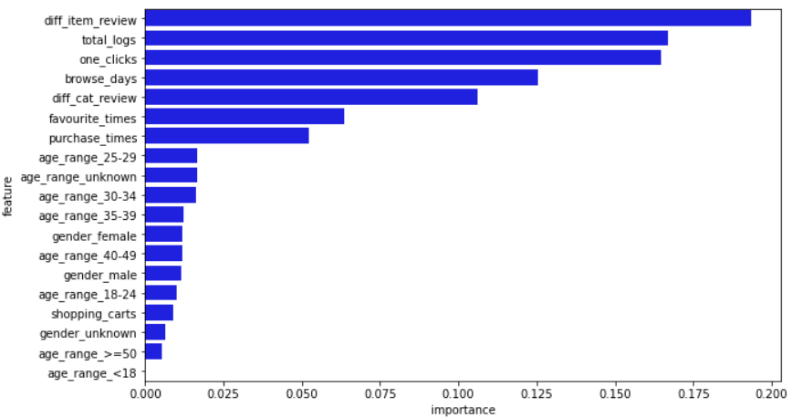
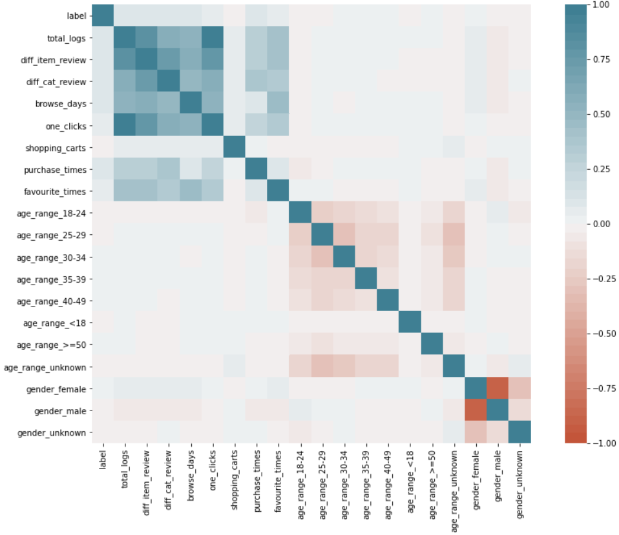
Feature importance plot
Heatmap
Findings: activity features > age & gender
Findings: no highly correlated features to label

Slide 10
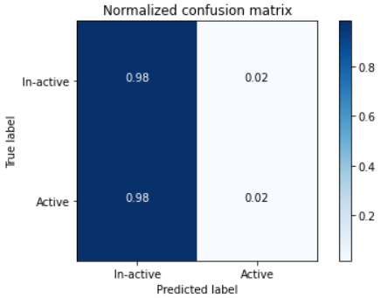
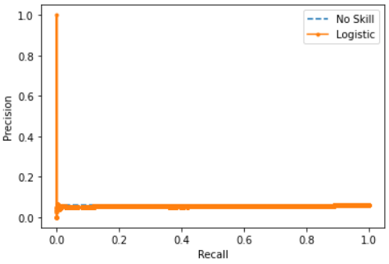
Model 1: Logistic regression
Normalized confusion matrix
Precision-recall curve
Notes:
Here are the precision recall curves for two distinct sites.
The one on the left is one with good predicatability and the one on the right is one with poor.
I looked at 6 sites and found 3 with good predictability. Those are the ones that I developed models for.

Slide 11
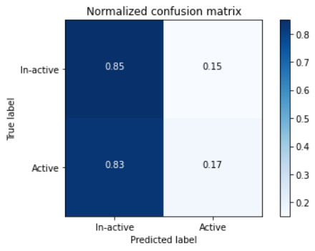
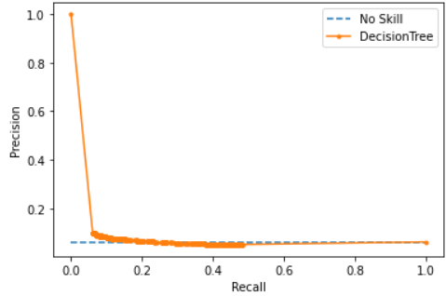
Model 2: Decision tree
Normalized confusion matrix
Precision-recall curve
Notes:
Here are the precision recall curves for two distinct sites.
The one on the left is one with good predicatability and the one on the right is one with poor.
I looked at 6 sites and found 3 with good predictability. Those are the ones that I developed models for.

Slide 12

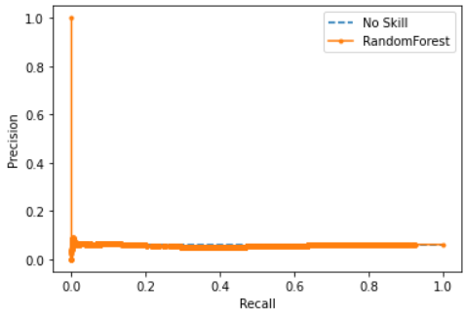
Model 3: Random forest
Normalized confusion matrix
Precision-recall curve
Notes:
Here are the precision recall curves for two distinct sites.
The one on the left is one with good predicatability and the one on the right is one with poor.
I looked at 6 sites and found 3 with good predictability. Those are the ones that I developed models for.

Slide 13
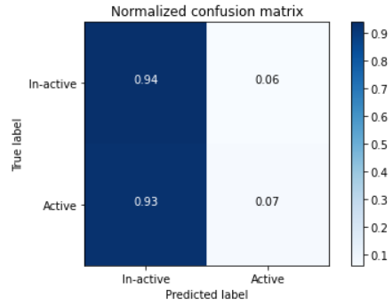
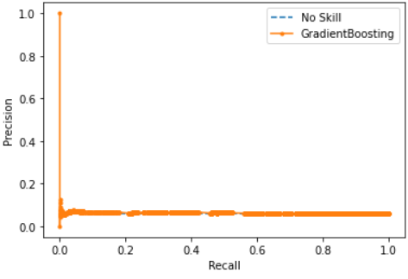
Model 1: Gradient boosting trees
Normalized confusion matrix
Precision-recall curve
Notes:
Here are the precision recall curves for two distinct sites.
The one on the left is one with good predicatability and the one on the right is one with poor.
I looked at 6 sites and found 3 with good predictability. Those are the ones that I developed models for.

Slide 14
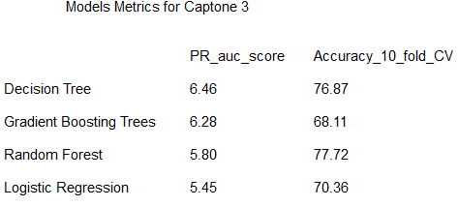
Result Summary
Metrics
1. Precision recall score
2. Accuracy (10-fold CV)
Optimal Model
Decision Tree

Slide 15
Future Research
Expand more features
- Price - Discount rate
Try more models
- SVM - Nerual Network
Tune more on parameters

Slide 16
Thank You!
Questions?

