Slide 1
Capstone Final Report --Weekly Stock Price Prediction
By
Cody Kou

Slide 2
The Problem:
Stock market prediction has been one of the most challenging tasks financial analysts eager to achieve.
Notes:
It’s no great discovery that water flows into itself. The issues of one part of the harbor are not entirely isolated from the issues of another. By better understanding how this water quality network works, water quality issues can be treated systematically rather than on a case by case basis.
Understanding the system requires constant and broad monitoring which is costly and time consuming.

Slide 3
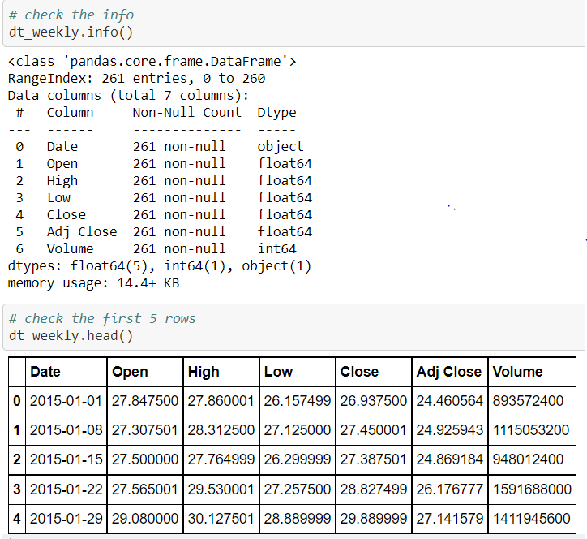
The Data
Data Source: Yahoo Finance
Notes:
Dataset was 88,000 rows and 100 columns
Measurements from 1909
250 total sites

Slide 4
Data Wrangling
Weekly stock trading records for Apple. Inc
Only consider data from Jan 1, 2015 to Dec 26, 2019
Drop redundant columns
Target Variable: Adjusted Closing Price
Original dataset had 261 rows and 7 columns
Notes:
Wanted a large enough time span to capture multiple climate anomalies
Wanted to focus on sites actively being sampled
Reduced the size and scope considerably by dumping redundant data
Imputed values based on old measurements
Chose chlorphyll as my target vairable because it has far reaching and tangible, immediate effects on an ecosystem such as fish death and drops in dissolved oxygen

Slide 5
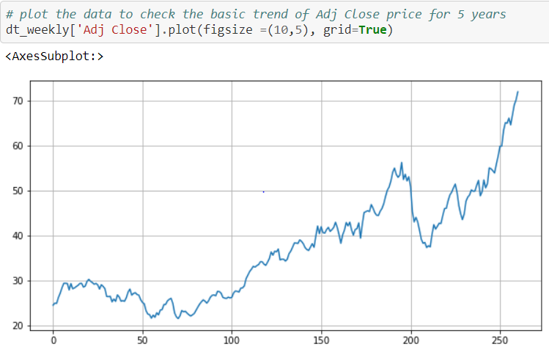
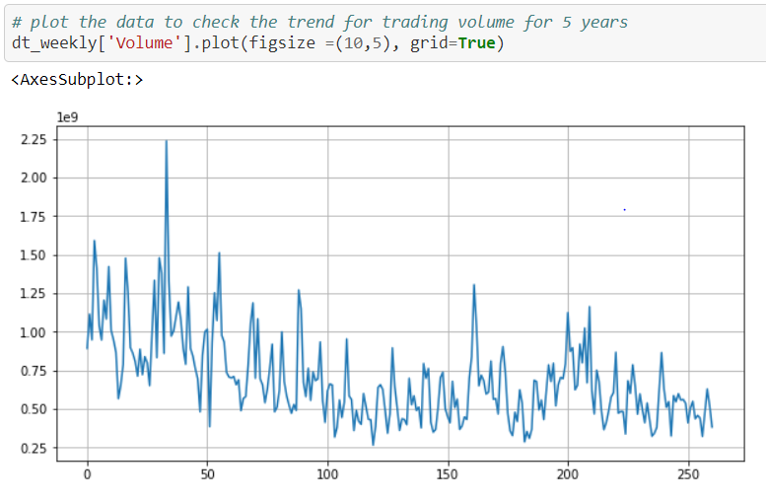
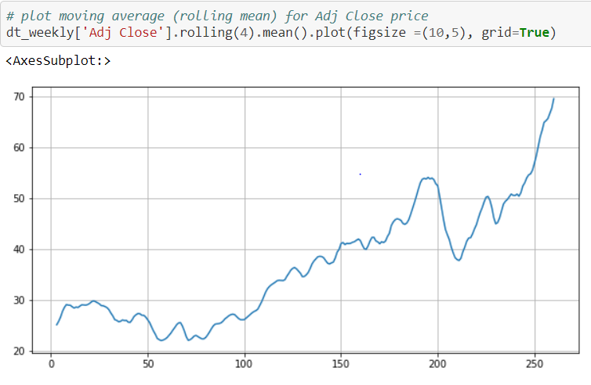
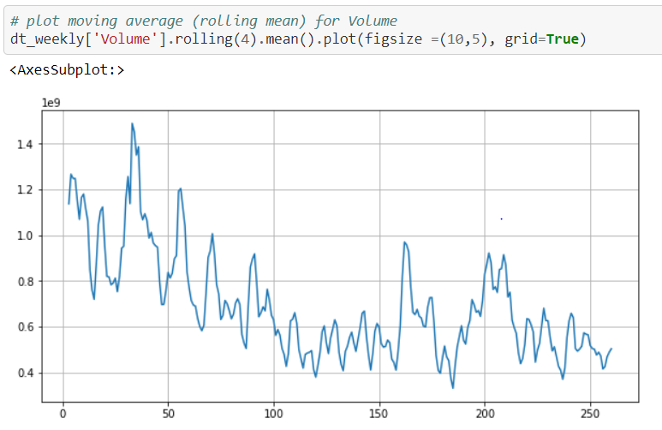
Exploratory
Data Analysis
Notes:
Top left: Scatter plot of chlorophyll and pH. There’s a slight correlation, but overall it’s very difficult to tell. This was common for a lot of the measurements.
Top right: Multigraph representation of overlapping failed tests. If two sites had overlimit readings in the same month, an edge was drawn between the nodes
Bottom left: geographic representation of probability of failed chlorophyll test at each site. Circles are arranged by lat/long and their size is their probability of failing a test.
Bottom right: Inverse Weighted Distance map. Sites that fail tests at the same time are darker, but this graph also takes into account how far away the sites are from each other.
Using these graphs and more, I was able to narrow down my features and the sites I was going to look at

Slide 6
Preprocessing
Confirm the data set is stationary not a random walk
Perform augmented Dickey-Fuller test
Difference the timeseries dataset
Analyze the autocorrelation plots
Timeseries dataset preprocessing has its unique format and method
Notes:
Wanted a large enough time span to capture multiple climate anomalies
Wanted to focus on sites actively being sampled
Reduced the size and scope considerably by dumping redundant data
Imputed values based on old measurements
Chose chlorphyll as my target vairable because it has far reaching and tangible, immediate effects on an ecosystem such as fish death and drops in dissolved oxygen

Slide 7
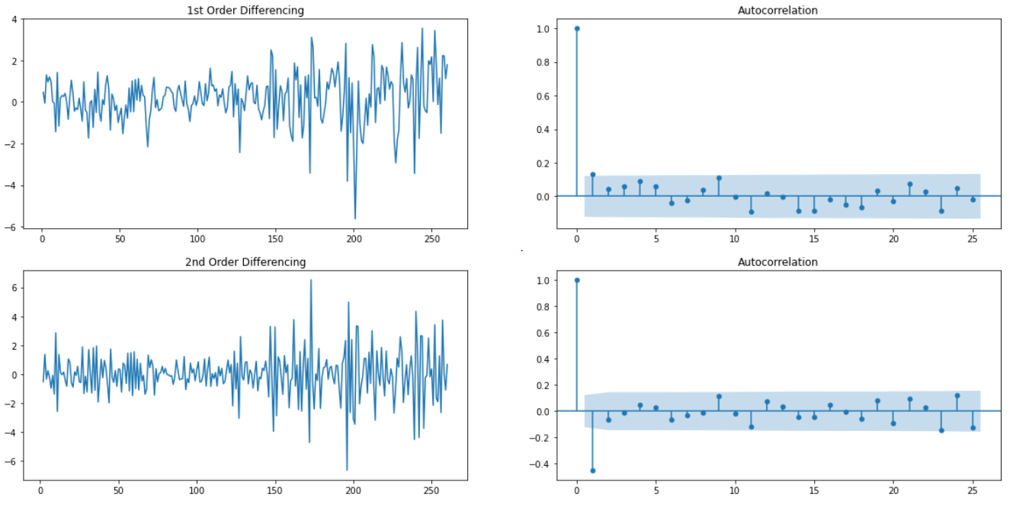
Differencing Order Selection
1st differencing shows week stationary
2nd differencing goes into the far negative zone fairly quick indicating over differenced
Choose 1st differencing for now

Slide 8
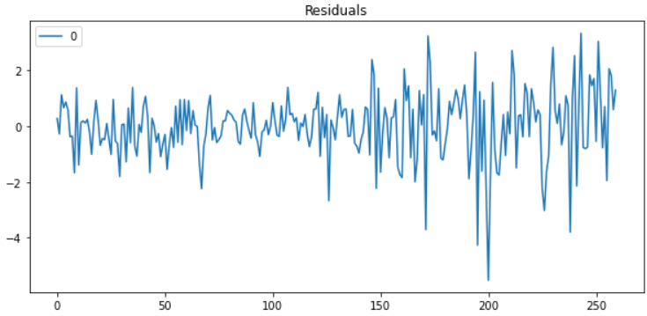
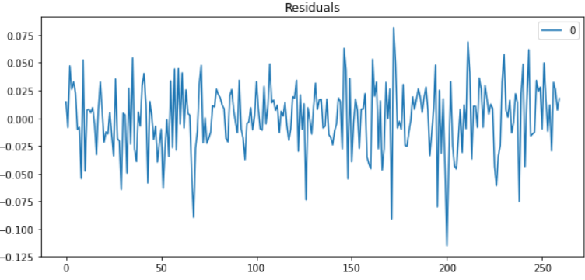
Original dataset residual error
Logged dataset residual error
variance spreading over time indicating heteroskedastic bias
variance not spreading over time indicating no heteroskedastic bias

Slide 9
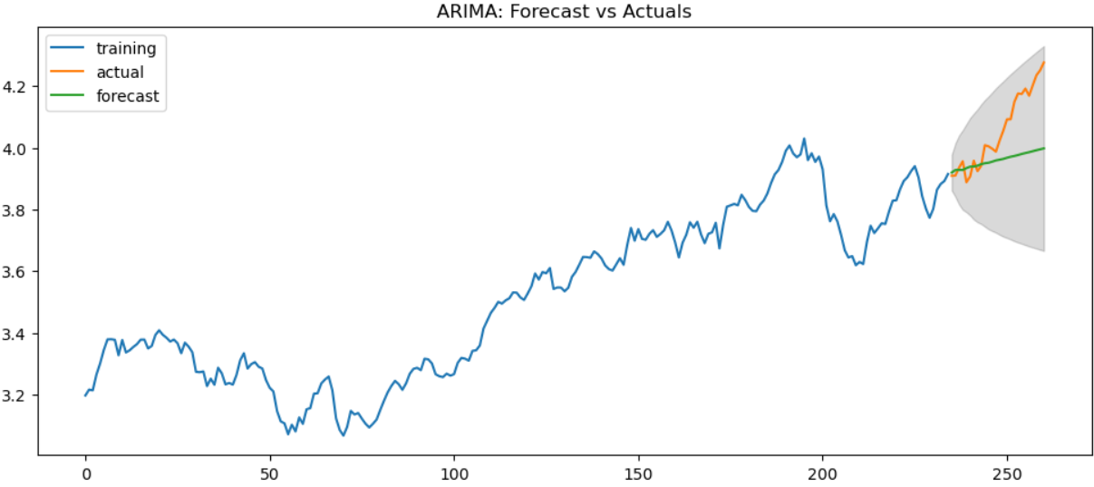
Model 1: ARIMA
Prediction plot
Metrics
MAPE: 2.52%
MAE: 10.46%
MPE: 2.26%
RMSE: 13.74%
CORR: 96.30%
MINMAX: 2.52%
Notes:
Here are the precision recall curves for two distinct sites.
The one on the left is one with good predicatability and the one on the right is one with poor.
I looked at 6 sites and found 3 with good predictability. Those are the ones that I developed models for.

Slide 10
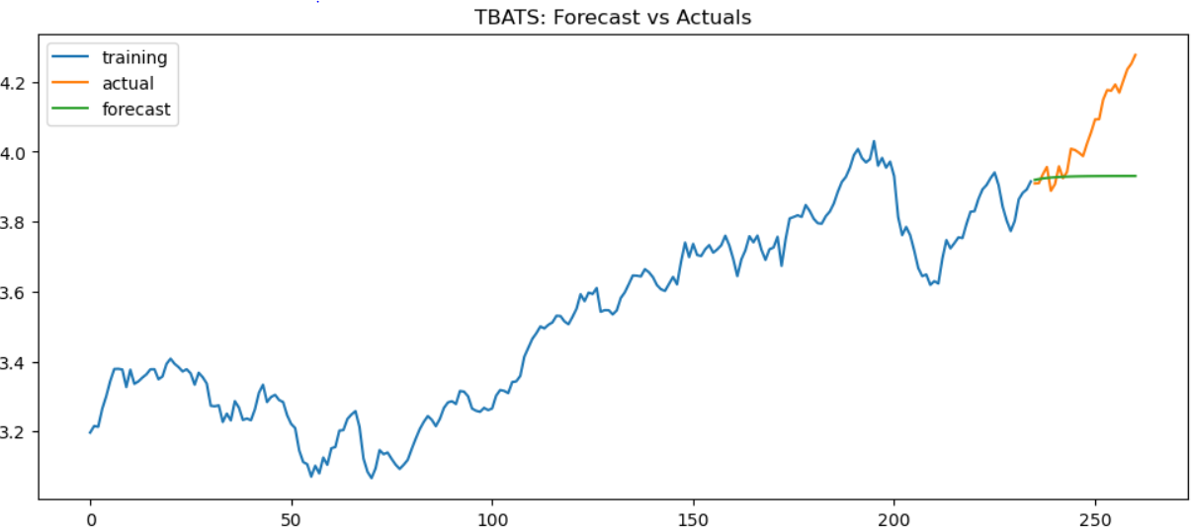
Model 2: TBATS
Prediction plot
Metrics
MAPE: 3.19%
MAE: 13.26%
MPE: 3.03%
RMSE: 17.37%
CORR: 69.81%
MINMAX: 3.19%
Notes:
Here are the precision recall curves for two distinct sites.
The one on the left is one with good predicatability and the one on the right is one with poor.
I looked at 6 sites and found 3 with good predictability. Those are the ones that I developed models for.

Slide 11

Model 3: HWES
Prediction plot
Metrics
MAPE: 2.56%
MAE: 10.63%
MPE: 2.35%
RMSE: 13.97%
CORR: 96.62%
MINMAX: 2.56%
Notes:
Here are the precision recall curves for two distinct sites.
The one on the left is one with good predicatability and the one on the right is one with poor.
I looked at 6 sites and found 3 with good predictability. Those are the ones that I developed models for.

Slide 12
Takeaways
ARIMA: overall best model
All models are highly accurate and low biased
ARIMA and HWES: predicted values are highly correlated to the actual values
TABATS: predicted values are less correlated to the actual values

Slide 13
Future Research
Select mutilple stocks
Expand more features
Try more models
Tune more on parameters

Slide 14
Thank You!
Questions?

