Slide 1
Phenotype-agnostic gene co-elimination screen
• Status report, 2026-10-12
• 162 Zoonomia mammals, TOGA gene-loss calls, 19,464 genes
• Positive control: left-right asymmetry module (MMP21, DAND5, PKD1L1, CIROP, CIROZ)

Slide 2
Approach
• Genotype-first: find genes with shared loss patterns without knowing the phenotype
• Build a gene x species status matrix from TOGA calls (162 species x 19,464 genes)
• Score all 25.9 million gene pairs for excess shared loss; keep the top 100
• Filter histone and physically linked pairs; test the known LR module as a positive control
• Next: phylogenetic correction, artifact checks, reverse functional validation

Slide 3
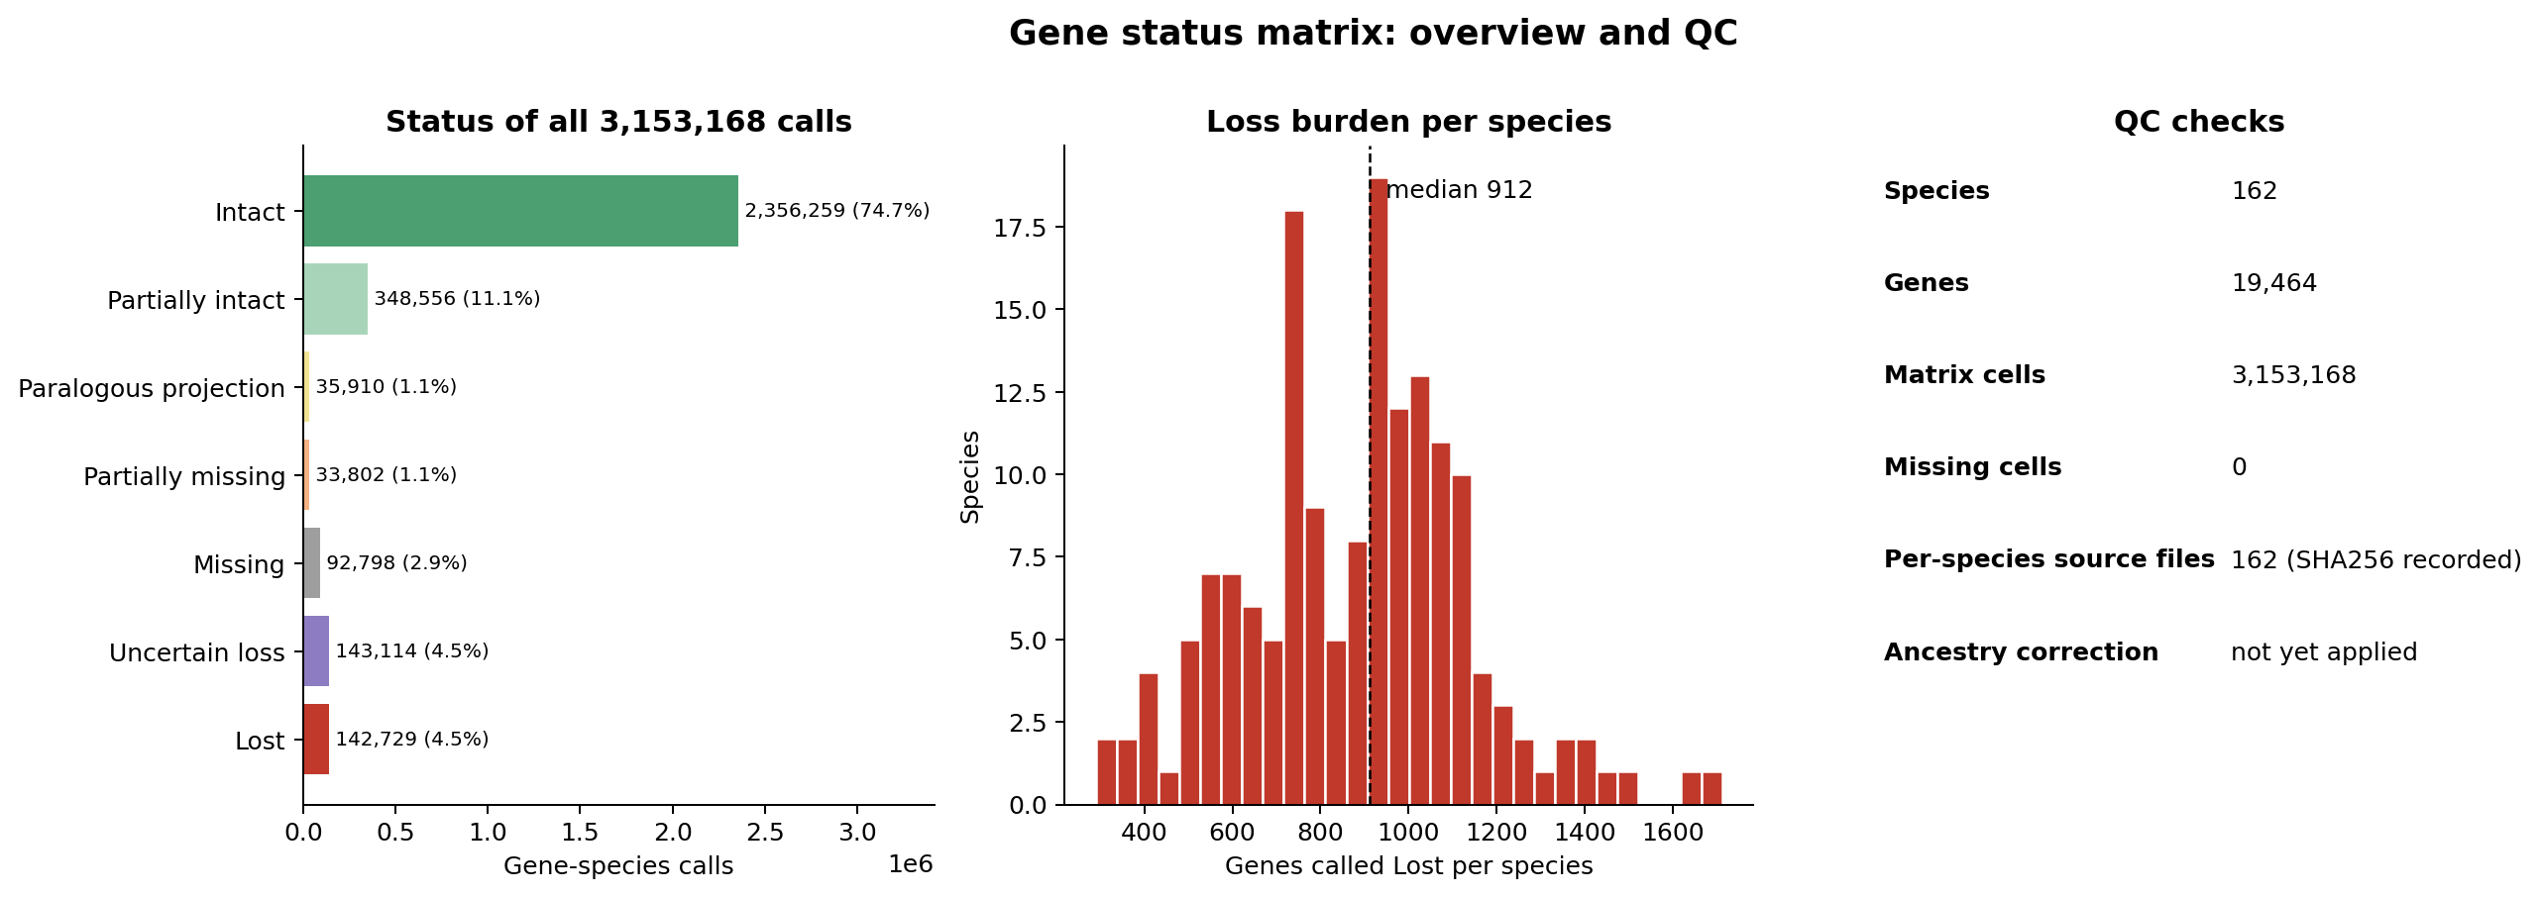
Data quality: matrix and QC
3,153,168 calls, 0 missing cells, source hashes recorded. Ancestry correction not yet applied.

Slide 4
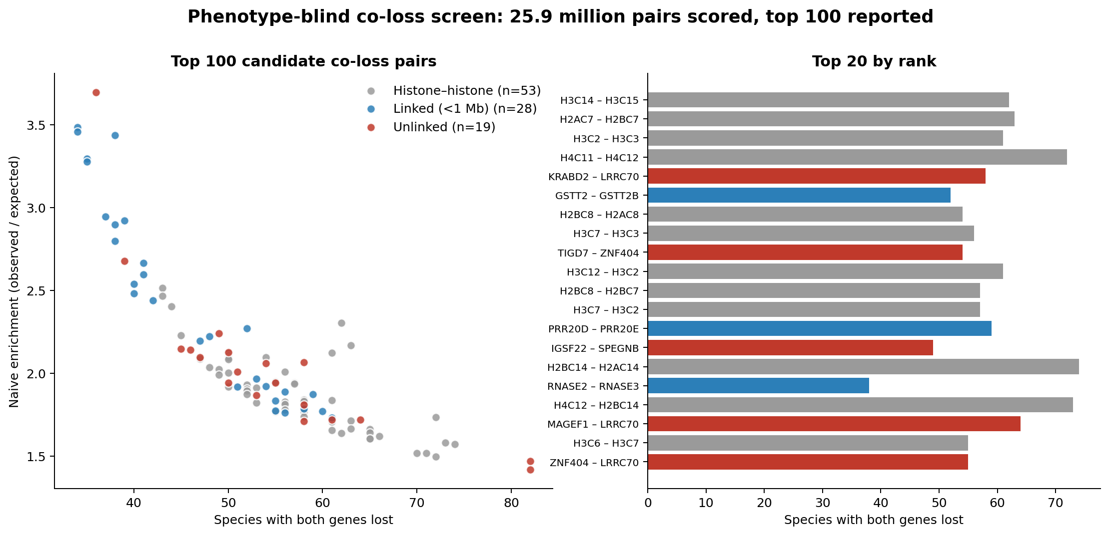
Screen output: top 100 candidate pairs
53 histone-histone, 28 physically linked, 19 unlinked pairs. Unlinked pairs are unvalidated.

Slide 5
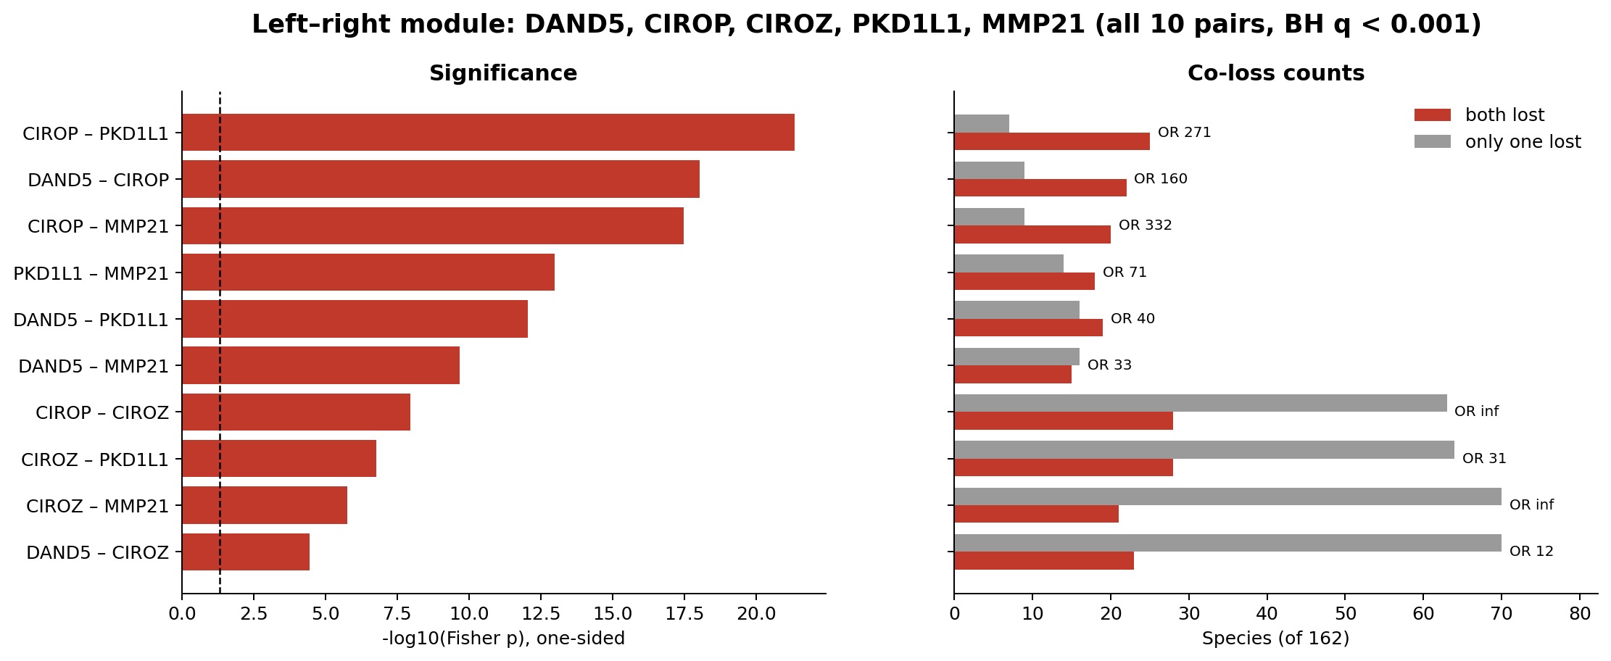
Positive control: the LR module co-lost
All 10 pairs significantly co-lost (BH q < 0.001). P-values ignore shared ancestry (exploratory).

Slide 6
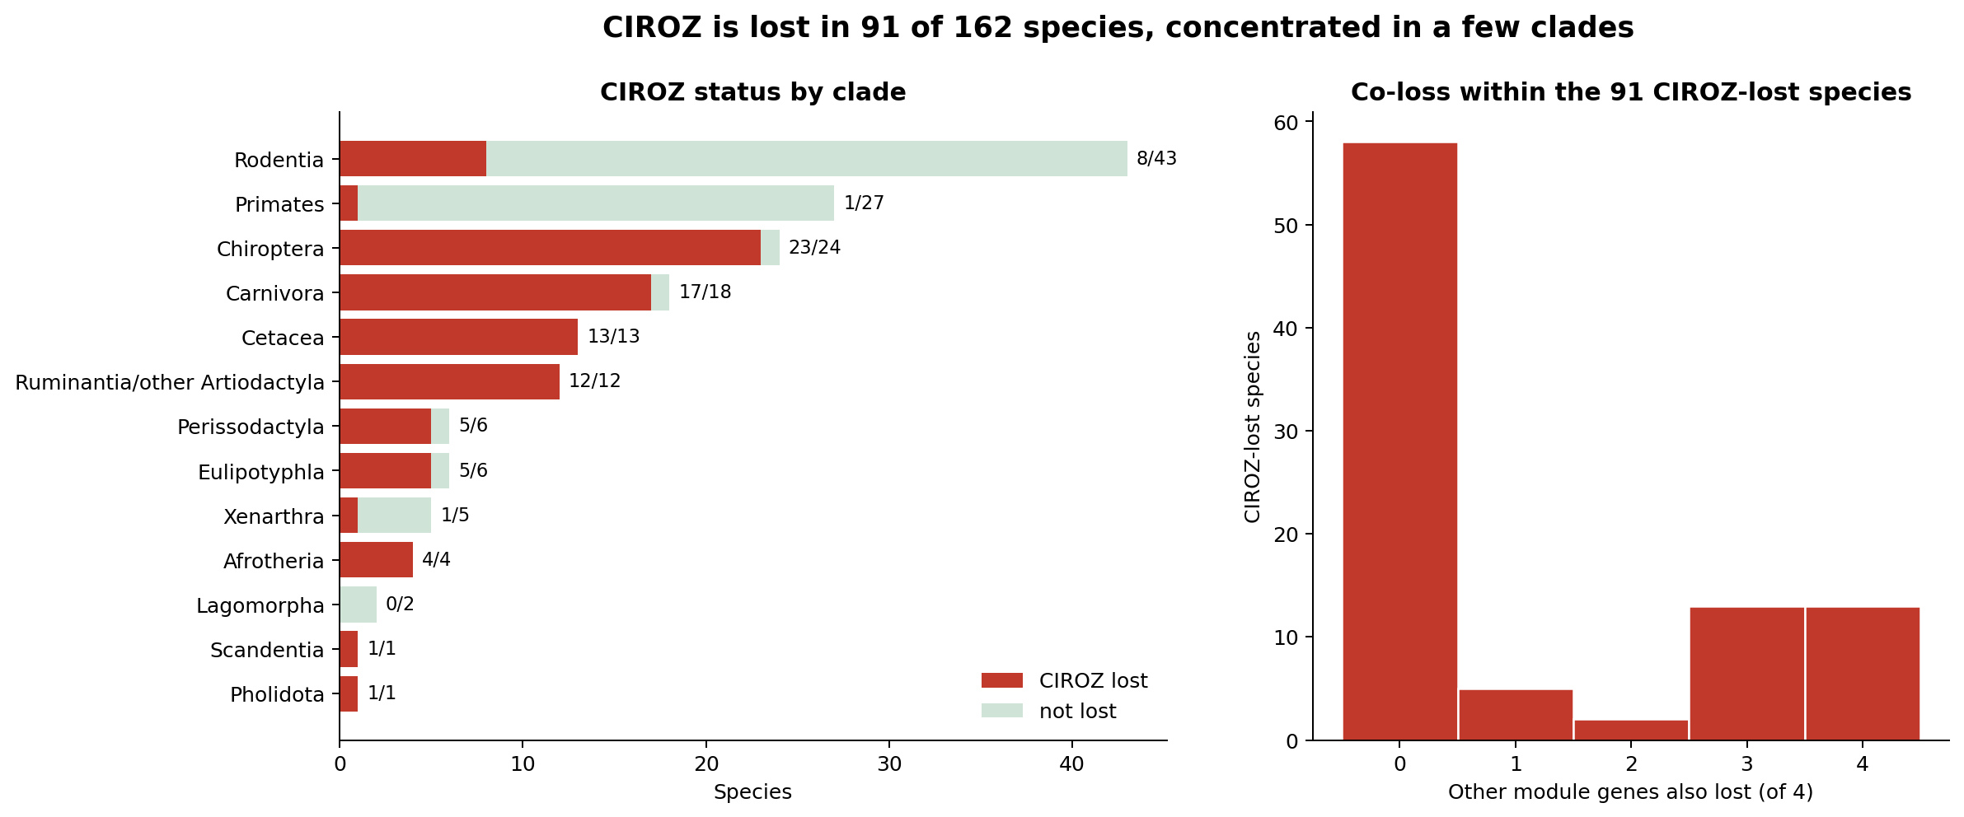
CIROZ loss is clade-clustered
Lost in all cetaceans and ruminants, 23/24 bats, 17/18 carnivorans; 1/27 primates.

Slide 7
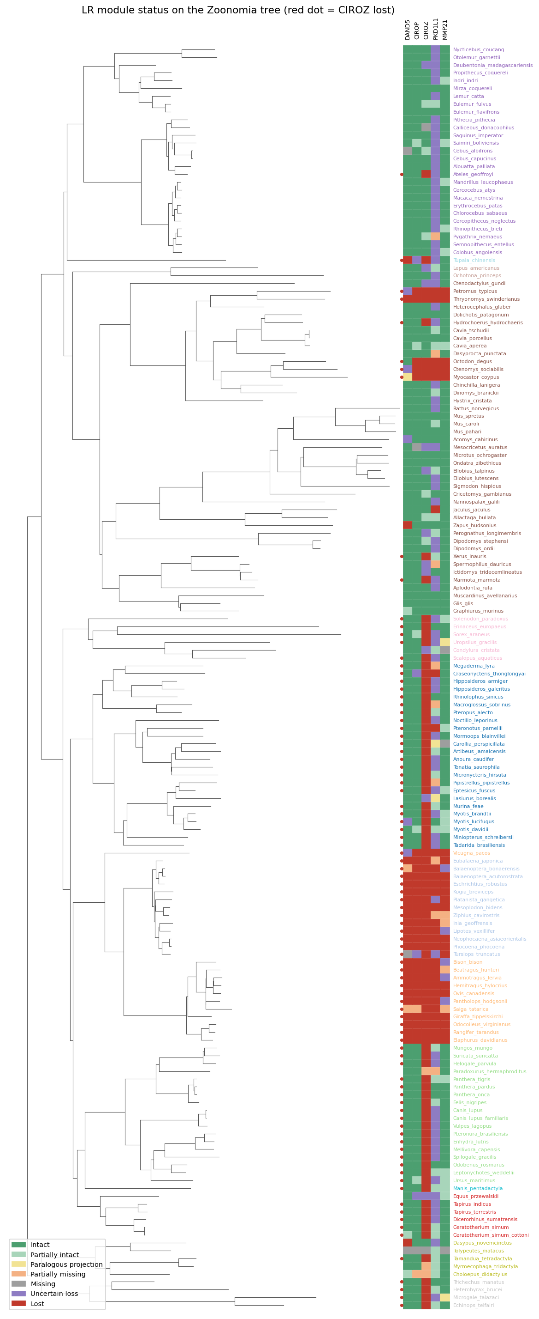
Module loss on the species tree
The five LR genes are lost together in cetaceans and ruminants and intact in most primates and rodents. Red dot = CIROZ lost. Clade colours assigned by genus.

Slide 8
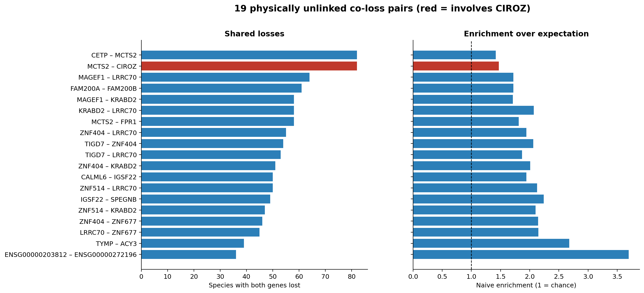
19 unlinked candidate pairs
Candidates for pathway-coherence follow-up (red = involves CIROZ). Not yet validated.

Slide 9
Caveats and next steps
• Blind screen alone recovered only CIROZ; DAND5, CIROP, MMP21 are intact in ~70-75% of species and PKD1L1 has 71 uncertain calls
• LR test is a positive control with literature-chosen genes, not a discovery
• Check CIROZ/PKD1L1 calls for TOGA over-calling and assembly artifacts
• Test whether the 19 unlinked pairs are pathway-coherent
• Apply phylogenetic correction, then reverse validation (clinical genetics, model organisms)

