Slide 1
Insurance Company Performance Overview
Dashboard Insights and Key Takeaways(Group_4)

Slide 2
Meet the Team
Divya Nadar | Avanti Joshi | Feroz Shaikh
Oversees project execution . Ensures milestones are met . Prepares reports and Manages team communication. | Analyses data trends. Provides insights for decision-making. | Demonstrated strong attention to detail resulting in errors. Develops Dashboard

Slide 3
Executive Summary
Mission and Vision: Providing comprehensive and affordable insurance solutions to clients.
Key Areas of Operation: Life Insurance, Health Insurance, Auto Insurance.
Sales Performance:
Total Premium: 143 M Average:2.92M
Breakdown By Income Class
Cross sell:12.6M
Renewel:18.5M
New:3.4M

Slide 4
Key Performance Indicators (KPIs)
Total Invoice (count)
Divya Dhingra: 82
Ankita Shah :36
Shloka Shelat :30
Vidit Shah:27
Shobhit Agarwal:14
Nishant Sharma:10
Gautam Murkunde:4
Neel Jain:1
Number of Invoice By Account Executive

Slide 5
New
Target:4.1 M
Achieved:3.4M
Invoice:0.6 M
Propose Solution(60K)
Negotiate(899K)
Stage Funnel By Revenue
Qualify Opportunity(592K)
Cross Sell
Target:7.3M
Achieved:12.6M
Invoice:2.9M
Renewal
Target:9.5M
Achieved:18.5M
Invoice:8.2M

Slide 6
Yearly meeting count
2019(31)
2020(3)

Slide 7
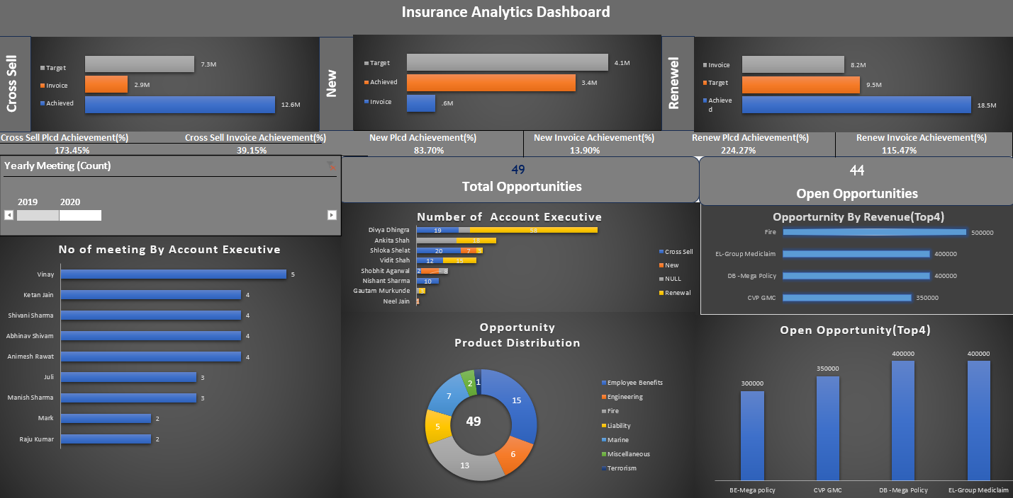
Excel Insurance Dashboard

Slide 8
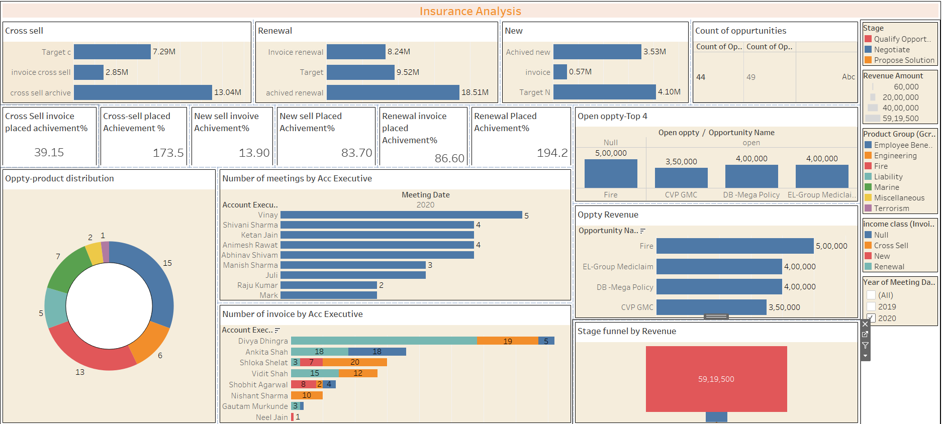
Tableau Insurance Dashboard

Slide 9
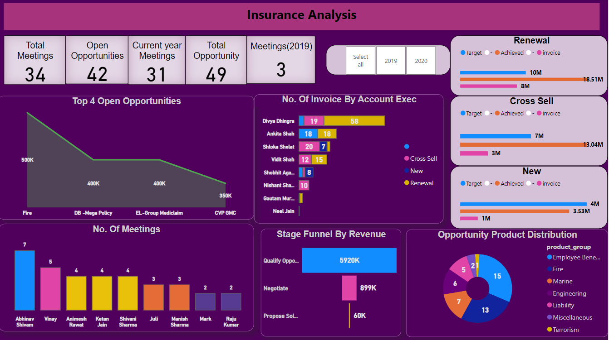
Power BI Insurance Dashboard

Slide 10
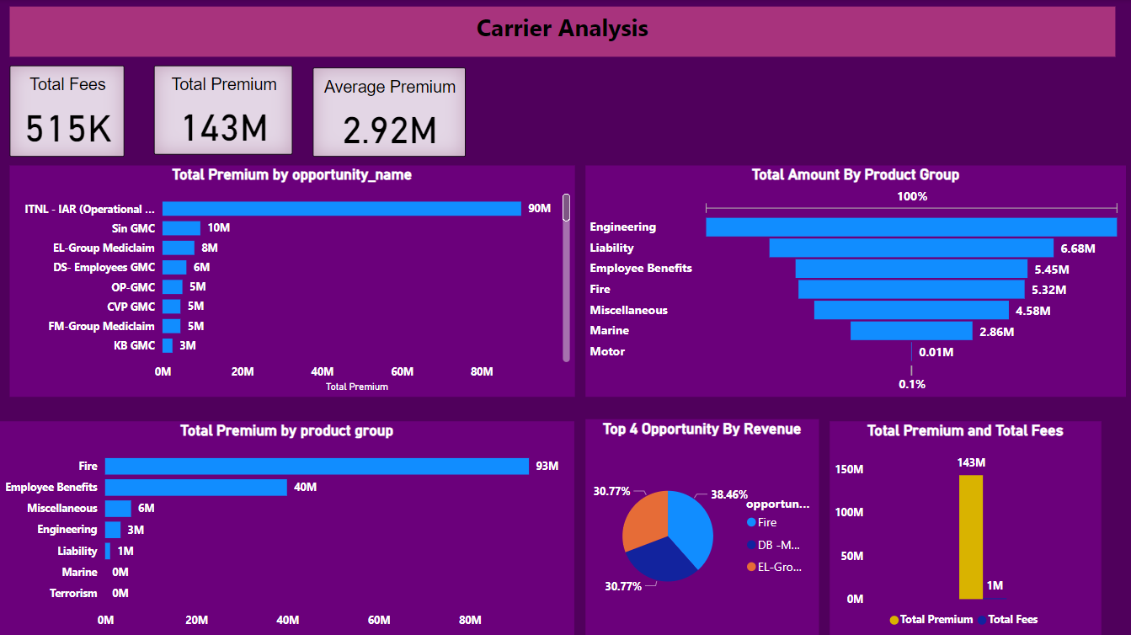

Slide 11
Key Takeaways
Performance Analysis:(Cross Sell)
The Target metric was set at 7.3M, representing the goal for performance.
The Achieved metric indicates the actual performance, which is 12.6M, significantly exceeding the target.
The Invoice metric stands at 2.9M, which is below both the target and achieved metric.
The Achieved metric demonstrated the best performance, surpassing the target by a substantial margin. This indicates strong operational success and efficiency.
However, the Invoice metric's low value suggests a need to align invoicing processes with the actual performance achievements to maximize financial gains.

Slide 12
Performance Analysis:(New)
The Target metric was set at 4.1M, representing the goal for performance.
The Achieved metric indicates the actual performance, which is 3.4M, falling short of the target.
The Invoice metric stands at 0.6M, which is significantly below both the target and achieved metrics.
While the Achieved metric did not meet the target, it performed significantly better than the Invoice metric, demonstrating a higher level of operational success.
It reached approximately 83% of the target, indicating relatively strong performance despite not fully meeting the goal.
The large discrepancy between Achieved and Invoice suggests a need to improve invoicing processes to better capture and reflect performance outcomes

Slide 13
Performance Analysis:(Renewal)
The Target metric was set at 9.5M, representing the goal for performance.
The Achieved metric indicates the actual performance, which is 18.5M, significantly exceeding the target.
The Invoice metric stands at 8.2M, which is slightly below the target but substantially lower than the achieved performance.
The Achieved metric demonstrated the best performance, surpassing the target by a substantial margin. This indicates strong operational success and efficiency.
However, the Invoice metric, while closer to the target, highlights a need to better align invoicing with actual performance to maximize financial returns.

Slide 14
Key Achievements
Number of Invoice By Account Executive
Divya Dhingra Renewal 58 invoices Cross-Sell is19 invoices, Ankita Shah Renewal: 18 invoices
Shloka Shelat Renewal is 3 invoices, New-7 invoices ,Cross-Sell: 20 invoices, Vidit Shah Renewal is15 invoice Cross-Sell-12 invoices
Shobhit Agrawal in Null-8 invoices, Cross-sell invoices , Nishant Sharma in Cross-Sell- 10 invoices , Gautam Murkunde Renewal -3 invoices, Null-1 invoice
Neel Jain in Null only 1 invoice
Divya Dhingra has the most invoices, with 82, while Neel Jain has the fewest, with just 1.

Slide 15
Thank you

