Slide 1
HIGH –CLOUD AIRLINE ANALYSIS
Dashboard Insights and Key Takeaways(Group 4)

Slide 2
Meet the Team
Divya Nadar
Feroz Shaikh
Karan Shetty
Pruthvi

Slide 3
Overview
The airline industry is a complicated sector that operates globally and compassing major region and low cost career . These Airline manages various fleets prices and operate within a complex ecosystem shaped by economic conditions.
It is the dynamic industry influenced by various factors required in strategic planning,adaptibilty and a commitment to safety and customer satisfaction for a long term success.
Airline industry serves as a fundamental tool in improving efficiency, making informed decisions in a dynamic and challenging business environment ,it helps airline navigate operational complexities enhance over all performance.
Data analyzed in the form of relational graphs and document data models using tools like Excel(Pivot table ,PowerBi and MySQL.
Let us examine the dashboards where we have used load factor as the key for the performance of the airline.

Slide 4
Key Performance Indicators (KPIs)
Load Factor is the key metric used for benchmarking an airline performance against competitors.
Airlines uses load factor data for strategic planning , route optimization and fleet management.
Globespan Airways Limited, doing business as Flyglobespan, has the highest load factor of 94.8 percentage compared to other carriers.
Overall increasing trend from 2008 to 2013 .
Also among the data analyzes, Delta Airlines is best carrier among all with 8271 transported passengers followed with South-west airlines Co. (8019) .
Regarding the load factor, we observed that the airline capacity is higher on weekdays compared to weekend, indicating passenger travel is high during weekdays.

Slide 5
Key Performance Indicators (KPIs)
Based on the available data ,we have analyzed that a total of 1548 Airlines spanning across 6 regions, serving 1296 cities .
Passengers often associate crowed flights with popular routes and may choose carriers with high load factor for sense of reliability.
USA: Increase in the flight operation within USA where demand is high but competition is low. Business can be increased by Identify regions or routes. Expansion can be achieved by identifying strategic regions or routes .
The second position is of Canada and least is of Mexico.

Slide 6
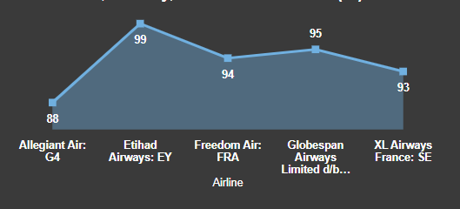
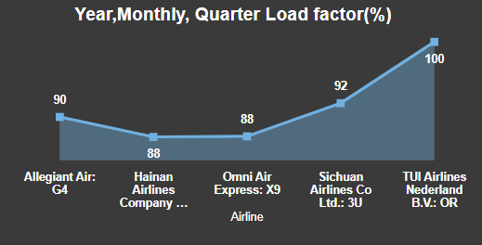
Top 5 Airline based on Load factor(%)
Etihad Airways: EY airline has the highest load factor of (99%) in the year 2008 while TUI airlines Nederland B.V:OR has 99.9% in the year 2013.

Slide 7
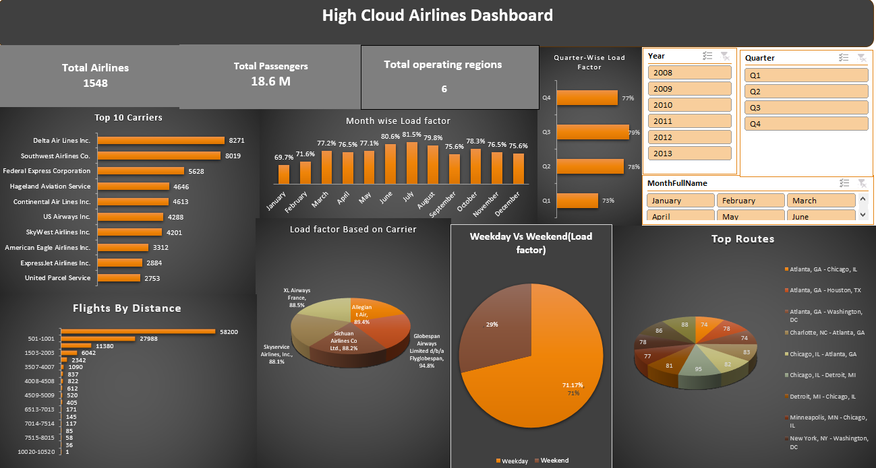
Excel Dashboard

Slide 8
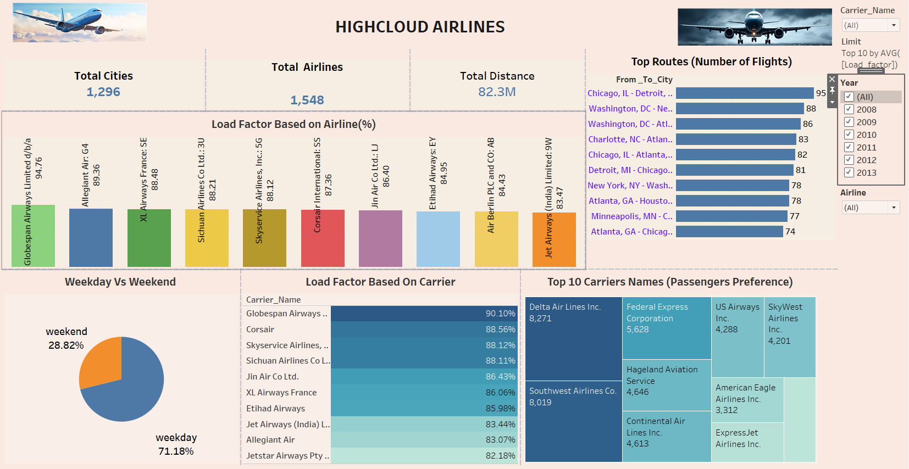
Tableau Dashboard

Slide 9
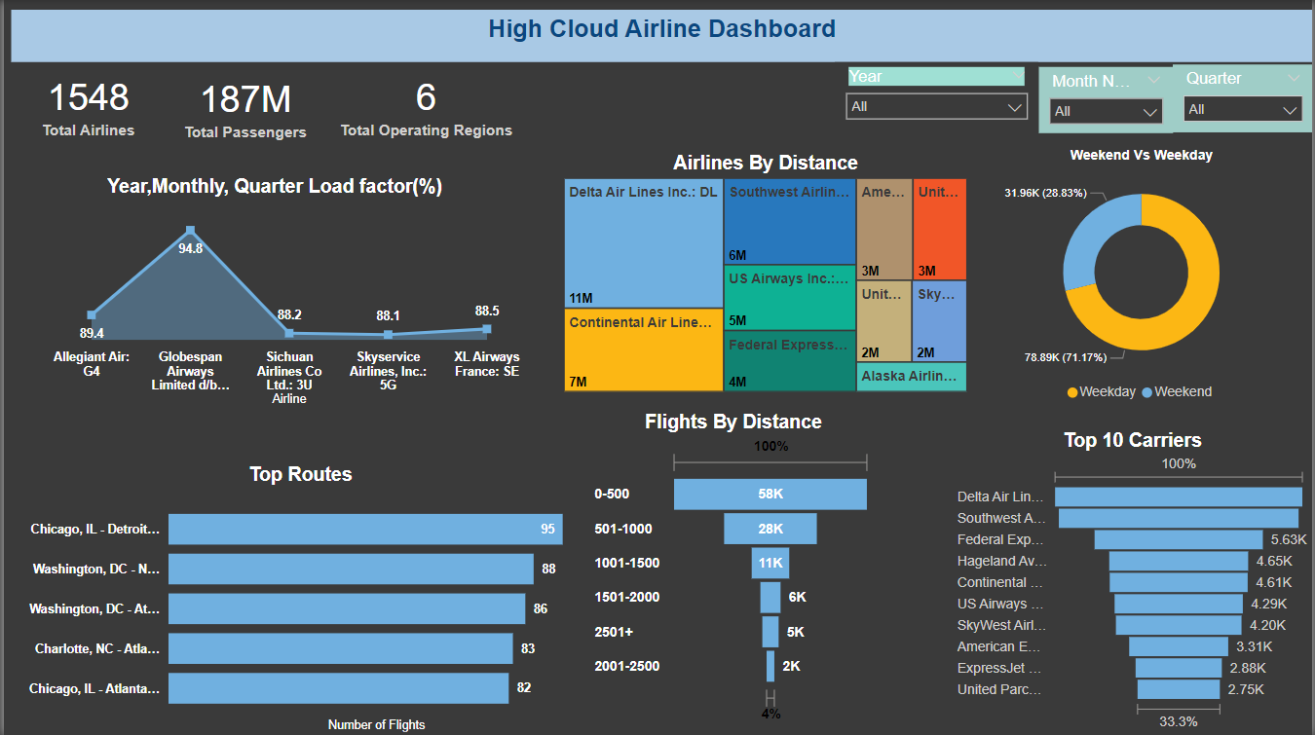
Power Bi Dashboard

Slide 10
Recommendations
Optimize Flight Routes: Utilize insights from top routes and flights to optimize schedule and resource allocation.
Enhance Load Factor: Leverage Load factor analysis to identify trends and implement strategies for increased efficiency.
Strategic Carrier Partnerships: Collaborate with top carriers to maximize passenger transportation and enhance overall performance.
Resource Allocation: Allocate resource strategically based on flight schedules and passenger volume data. This ensures efficient operations and minimizes wait times at airports with high passenger traffic.

Slide 11
Conclusion
Financial Stability: High Cloud Analysis exhibit solid financial performance, with healthy revenue growth.
Operational excellence: The airline has demonstrated operational excellence in terms of aircraft utilization, on-time performance and capacity management.
Market Positioning: High Cloud Analysis enjoys a favorable market position with strong route network and competitive fares.
Technology Adoption: Embracing innovative technologies such as predictive maintenance systems and data analytics can drive operational efficiencies and improve customer service delivery.

Slide 12
Thank you

