Slide 1
Kahikinaokala Summer Bridge 2014
Computer Science Track

Slide 2
Computer Science Technology
The Computer Science track introduces students to web-based applications. Students will learn to use current web technologies such as HTML5, CSS3, & Javascript as well as common Data APIs such as Google Maps & Google Earth, to develop a interactive and dynamic webpages. The information will be from publicly available sources, e.g. government or educational institutions, and from data collected during field trips. The information will be timely, interactive, and relevant to the theme of the project.

Slide 3
The Technology Used…
Web Technology
Students used Web Development technology (e.g. Hypertext Markup Language (HTML), Cascading Style Sheets (CSS) and Javascript) to develop dynamic webpages.
Application Programming Interfaces (APIs)
Students used Google Maps and Google Earth APIs to integrate geo-spatial visualization into their webpages.
Raspberry Pi
Students used the Raspberry Pi, smartphone-size computer, to experiment with streaming real-time video across the UH Maui College campus network.
Digital Cameras & GPS
Students used digital video cameras & Global Positioning System (GPS) hand-held devices to collect video & geo-spatial data during field surveys.

Slide 4
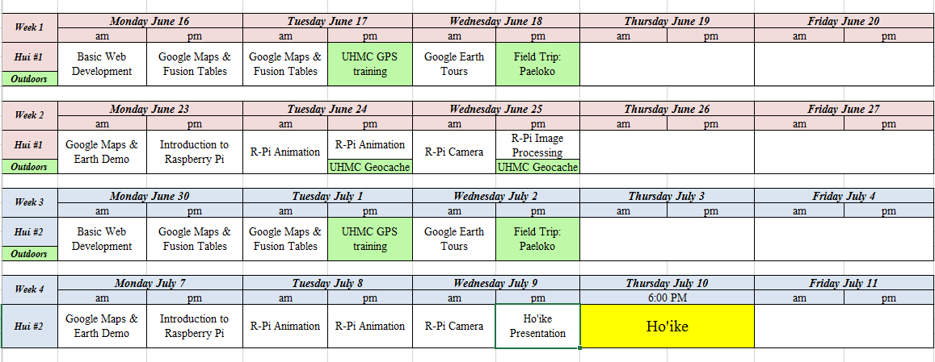
Our Schedule…

Slide 5
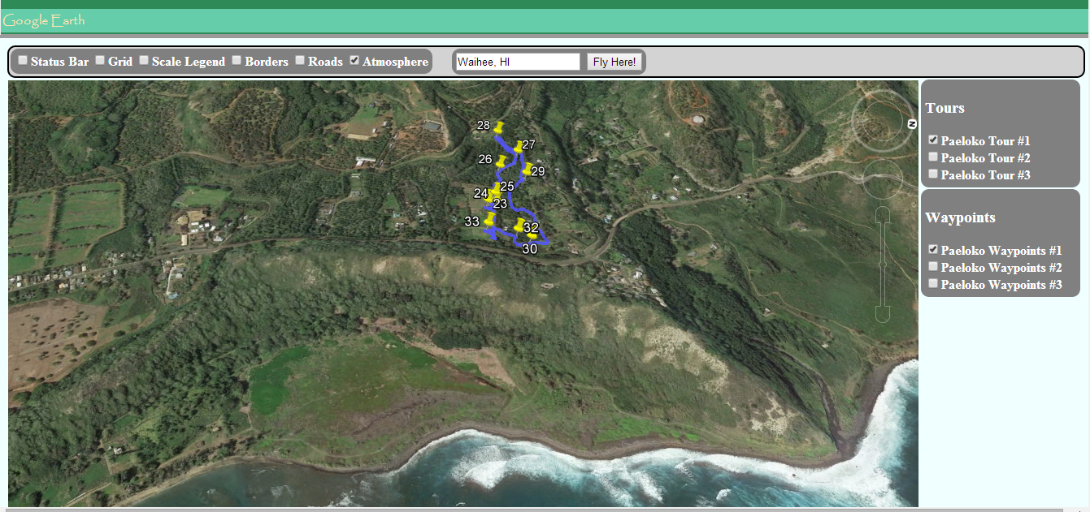
Waihe’e Site Survey

Slide 6
Waihe’e Site Survey
Students performed a site survey of native Hawaiian plants being cared for by native Hawaiian cultural practitioners at a location in Waihe’e, Maui.
Students collected video, images, and location data of the native plants and used the Google Earth API to visualization the data in their webpage.
Students were asked to identify the plants they encountered and its use in native Hawaiian cultural practices.

Slide 7
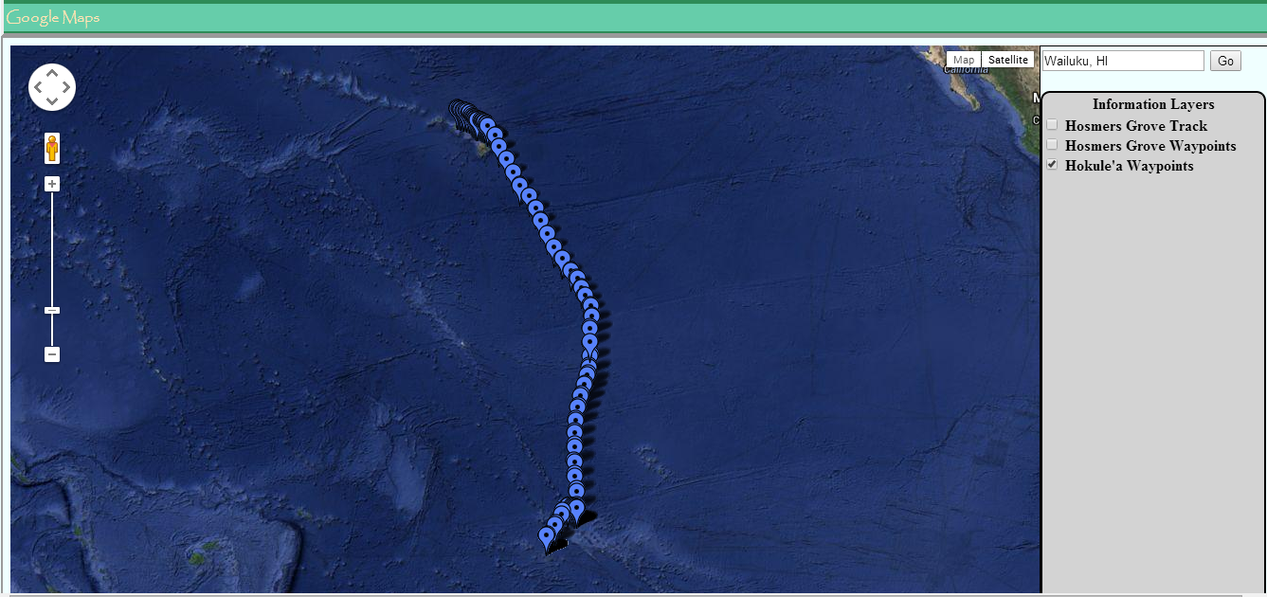
Hokule’a World Wide Voyage: 1st leg

Slide 8
Hokule’a World Wide Voyage: 1st leg
Students collected track data for the official Hokule’a website of the Hawaiian voyaging canoes, Hokule’a and Hikianalia, during the 1st leg of their world wide voyage.
Students used the Google Maps API to visualization the data in their webpage.
Students augmented track points with video, images, and narratives found on the Hokule’a website.

Slide 9
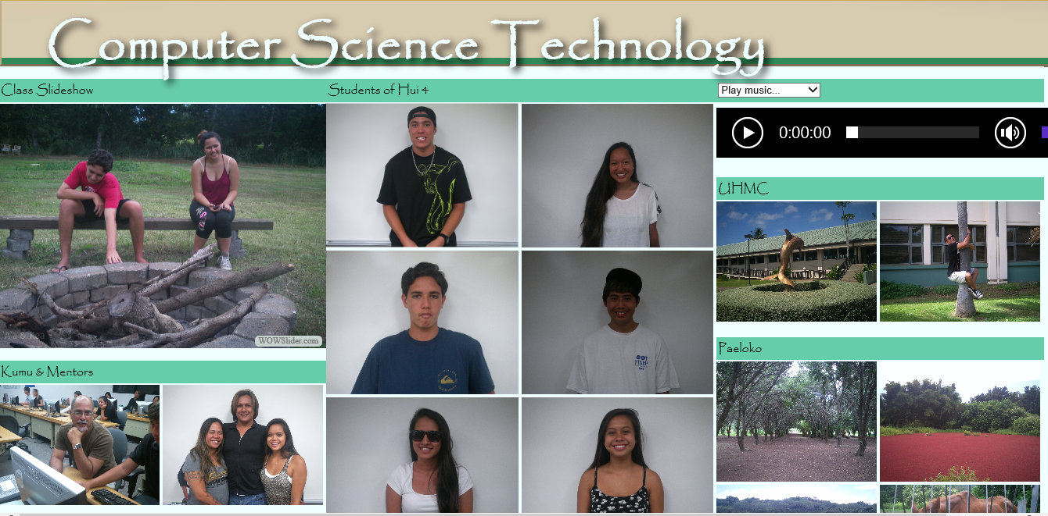
Student Website…

Slide 10
Student Website…
Here is a link to the website created by the students:
https://51070ff1625c5358b050c33a1721c0cfaf52806b.googledrive.com/host/0B7wcpcDhycieS2ZWaEU2OE8tQkk/basic.html

