Slide 2
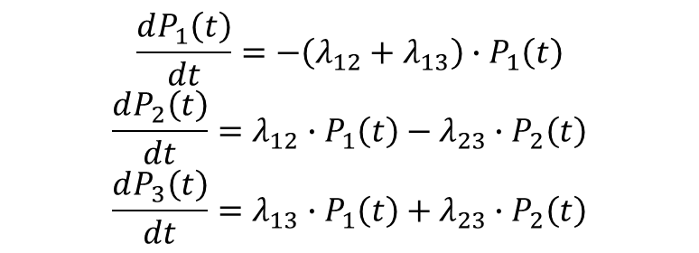
We wish to compute the probability of transition during
some interval t, using the pairwise instantaneous rates of transition
λ₁₂
Well
Sick
λ₁₃
λ₂₃
Dead
$$\frac{dP_{1}\left(t\right)}{dt}=−\left(λ_{12}+λ_{13}\right)∙P_{1}\left(t\right)$$
$$\frac{dP_{2}\left(t\right)}{dt}=λ_{12}∙P_{1}\left(t\right)−λ_{23}∙P_{2}\left(t\right)$$
$$\frac{dP_{3}\left(t\right)}{dt}=λ_{13}∙P_{1}\left(t\right)+λ_{23}∙P_{2}\left(t\right)$$

Slide 3


λ₁₂
Well
Sick
λ₁₃
λ₂₃
Dead
$$\frac{d}{dt}\left[\begin{matrix}P_{1\left(t\right)} \\ P_{2\left(t\right)} \\ P_{3\left(t\right)}\end{matrix}\right]=\left[\begin{matrix}−\left(λ_{12}+λ_{13}\right) & 0 & 0 \\ λ_{12} & −λ_{23} & 0 \\ λ_{13} & λ_{23} & 0\end{matrix}\right]∙\left[\begin{matrix}P_{1\left(t\right)} \\ P_{2\left(t\right)} \\ P_{3\left(t\right)}\end{matrix}\right]$$
P’ = GP
P = e^{Gt}P₀
$$\begin{matrix}1 \\ 0 \\ 0\end{matrix}$$
Where P₀ =

Slide 4
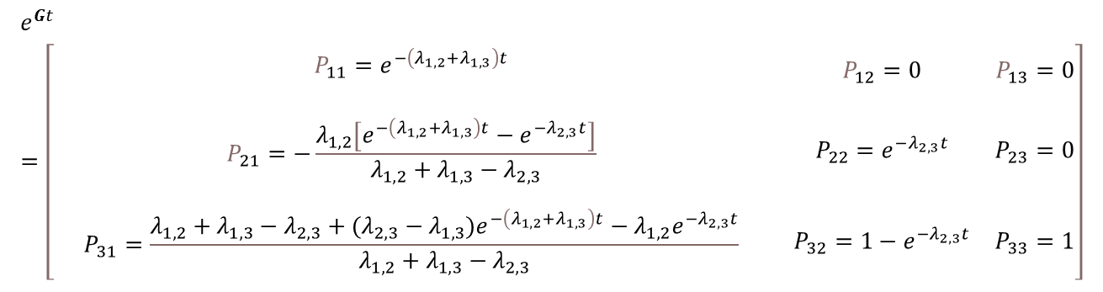
$$e^{Gt}=\left[\begin{matrix}\begin{matrix} & & \\ & P_{11}=e^{−\left(λ_{1,2}+λ_{1,3}\right)t} & \\ & & \end{matrix} & P_{12}=0 & P_{13}=0 \\ \begin{matrix} & & \\ & P_{21}=−\frac{λ_{1,2}\left[e^{−\left(λ_{1,2}+λ_{1,3}\right)t}−e^{−λ_{2,3}t}\right]}{λ_{1,2}+λ_{1,3}−λ_{2,3}} & \\ & & \end{matrix} & P_{22}=e^{−λ_{2,3}t} & P_{23}=0 \\ \begin{matrix} & & \\ & P_{31}=\frac{λ_{1,2}+λ_{1,3}−λ_{2,3}+(λ_{2,3}−λ_{1,3})e^{−\left(λ_{1,2}+λ_{1,3}\right)t}−{λ_{1,2}e}^{−λ_{2,3}t}}{λ_{1,2}+λ_{1,3}−λ_{2,3}} & \\ & & \end{matrix} & P_{32}={1−e}^{−λ_{2,3}t} & P_{33}=1\end{matrix}\right]$$

Slide 5
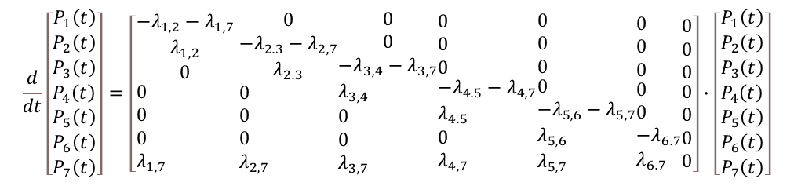
$$\frac{d}{dt}\left[\begin{aligned}&\begin{matrix}P_{1}\left(t\right) \\ P_{2}\left(t\right) \\ P_{3}\left(t\right)\end{matrix} \\ &P_{4}\left(t\right) \\ &P_{5}\left(t\right) \\ &P_{6}\left(t\right) \\ &P_{7}\left(t\right)\end{aligned}\right]=\left[\begin{aligned}&\begin{matrix}−λ_{1,2}−λ_{1,7} \\ λ_{1,2} \\ 0\end{matrix} \\ &0 \\ &0 \\ &0 \\ &λ_{1,7}\end{aligned} \begin{aligned}&\begin{matrix}0 \\ −λ_{2.3}−λ_{2,7} \\ λ_{2.3}\end{matrix} \\ &0 \\ &0 \\ &0 \\ &λ_{2,7}\end{aligned}\begin{aligned}&\begin{matrix}0 \\ 0 \\ −λ_{3,4}−λ_{3,7}\end{matrix} \\ &λ_{3,4} \\ &0 \\ &0 \\ &λ_{3,7}\end{aligned}\begin{aligned}&\begin{matrix}0 \\ 0 \\ 0\end{matrix} \\ &−λ_{4.5}−λ_{4,7} \\ &λ_{4.5} \\ &0 \\ &λ_{4,7}\end{aligned}\begin{aligned}&\begin{matrix}0 \\ 0 \\ 0\end{matrix} \\ &0 \\ &−λ_{5,6}−λ_{5,7} \\ &λ_{5,6} \\ &λ_{5,7}\end{aligned}\begin{aligned}&\begin{matrix}0 \\ 0 \\ 0\end{matrix} \\ &0 \\ &0 \\ &−λ_{6.7} \\ &λ_{6.7}\end{aligned}\begin{aligned}&\begin{matrix}0 \\ 0 \\ 0\end{matrix} \\ &0 \\ &0 \\ &0 \\ &0\end{aligned}\right]∙\left[\begin{aligned}&\begin{matrix}P_{1}\left(t\right) \\ P_{2}\left(t\right) \\ P_{3}\left(t\right)\end{matrix} \\ &P_{4}\left(t\right) \\ &P_{5}\left(t\right) \\ &P_{6}\left(t\right) \\ &P_{7}\left(t\right)\end{aligned}\right]$$
This system of differential equations did not converge to a solution in Matlab after 3 hours

Slide 6
P = e^{Gt}P₀
What does it mean to take ‘e’ to the power of a matrix??

Slide 7

P = e^{Gt}P₀
Recall that ‘e^{x}’ can be represented by a Taylor series:
$$e^{x}=\sum_{n=0}^{∞}{\frac{x^{n}}{n!}=\frac{x^{0}}{0!}}+\frac{x^{1}}{1!}+\frac{x^{2}}{2!}+\frac{x^{3}}{3!}+\frac{x^{4}}{4!}+…$$

Slide 8

P = e^{Gt}P₀
‘e^{xt}’ can also be represented by a Taylor series:
$$e^{xt}=\sum_{n=0}^{∞}{\frac{x^{nt}}{n!}=\frac{x^{0}}{0!}}+\frac{x^{t}}{1!}+\frac{x^{2t}}{2!}+\frac{x^{3t}}{3!}+\frac{x^{4t}}{4!}+…$$

Slide 9


P = e^{Gt}P₀
‘e^{xt}’ can also be represented by a Taylor series:
$$exp⁡(xt)=\sum_{n=0}^{∞}{\frac{x^{nt}}{n!}=\frac{x^{0}}{0!}}+\frac{x^{t}}{1!}+\frac{x^{2t}}{2!}+\frac{x^{3t}}{3!}+\frac{x^{4t}}{4!}+…$$
Now substitute ‘x’ with the rate matrix, G:
$$G=\left[\begin{matrix}a & 0 & 0 \\ b & c & 0 \\ d & e & 0\end{matrix}\right]=\left[\begin{matrix}−\left(λ_{12}+λ_{13}\right) & 0 & 0 \\ λ_{12} & {−λ}_{23} & 0 \\ λ_{13} & λ_{23} & 0\end{matrix}\right]$$

Slide 10
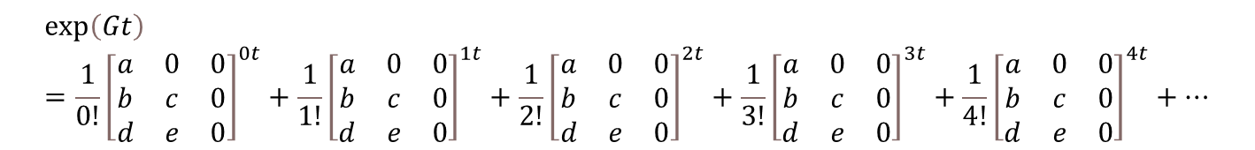
P = e^{Gt}P₀
Recall that ‘e^{x}’ can be represented by a Taylor series:
$$exp⁡(xt)=\sum_{n=0}^{∞}{\frac{x^{nt}}{n!}=\frac{x^{0}}{0!}}+\frac{x^{t}}{1!}+\frac{x^{2t}}{2!}+\frac{x^{3t}}{3!}+\frac{x^{4t}}{4!}+…$$
Now substitute ‘x’ with the rate matrix, G:
$$\exp\left(Gt\right)=\frac{1}{0!}{\left[\begin{matrix}a & 0 & 0 \\ b & c & 0 \\ d & e & 0\end{matrix}\right]}^{0t}+\frac{1}{1!}{\left[\begin{matrix}a & 0 & 0 \\ b & c & 0 \\ d & e & 0\end{matrix}\right]}^{1t}+\frac{1}{2!}{\left[\begin{matrix}a & 0 & 0 \\ b & c & 0 \\ d & e & 0\end{matrix}\right]}^{2t}+\frac{1}{3!}{\left[\begin{matrix}a & 0 & 0 \\ b & c & 0 \\ d & e & 0\end{matrix}\right]}^{3t}+\frac{1}{4!}{\left[\begin{matrix}a & 0 & 0 \\ b & c & 0 \\ d & e & 0\end{matrix}\right]}^{4t}+⋯$$

Slide 11
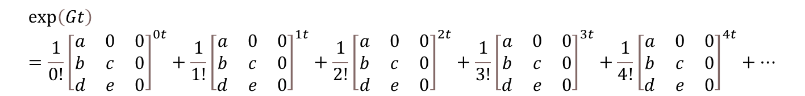
$$\exp\left(Gt\right)=\frac{1}{0!}{\left[\begin{matrix}a & 0 & 0 \\ b & c & 0 \\ d & e & 0\end{matrix}\right]}^{0t}+\frac{1}{1!}{\left[\begin{matrix}a & 0 & 0 \\ b & c & 0 \\ d & e & 0\end{matrix}\right]}^{1t}+\frac{1}{2!}{\left[\begin{matrix}a & 0 & 0 \\ b & c & 0 \\ d & e & 0\end{matrix}\right]}^{2t}+\frac{1}{3!}{\left[\begin{matrix}a & 0 & 0 \\ b & c & 0 \\ d & e & 0\end{matrix}\right]}^{3t}+\frac{1}{4!}{\left[\begin{matrix}a & 0 & 0 \\ b & c & 0 \\ d & e & 0\end{matrix}\right]}^{4t}+⋯$$
Note that 0! = 1 and a matrix to the power of
0 is defined as the identity matrix
Also if the cycle length of the Markov model is 1 unit of time
(t=1) and the instantaneous rates are expressed in the same units,
the numerical computation of exp(Gt)
using a finite value of n is straightforward.

Slide 12
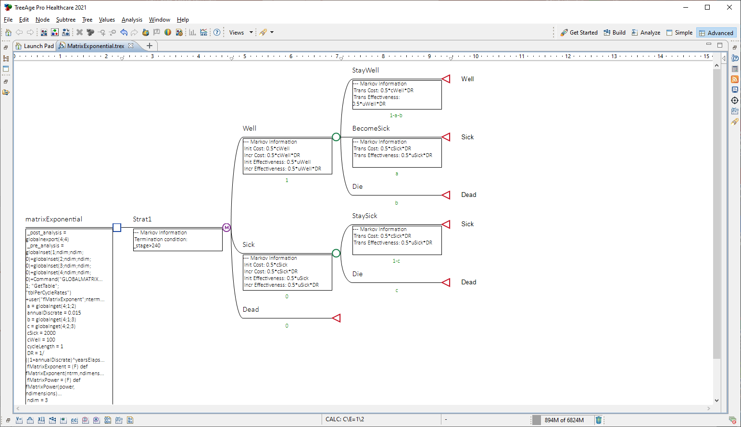
This tou mode takes in the pairwise instantaneous transition rates
and uses the Taylor series approximation to the matrix exponential with 20 terms

