Slide 1
Bootstrap101

Slide 2
Bootstrap
is an open-source Javascript framework developed by the team at Twitter. It is a combination of HTML, CSS, and Javascript code designed to help build user interface components. Bootstrap was also programmed to support both HTML5 and CSS3.
Also it is called Front-end-framework.
Bootstrap is a free collection of tools for creating a websites and web applications.
Bootstrap was developed by Mark Otto and Jacob Thornton at Twitter, and released as an open source product in August 2011 on GitHub.
In June 2014 Bootstrap was the No.1 project on GitHub!

Slide 3
To do List
From simple html file
Add header
Add navbar
Add grid system
How to get creative template

Slide 4
How to install
Downloading Bootstrap
If you want to download and host Bootstrap yourself, go to getbootstrap.com, and follow the instructions there.
Bootstrap CDN
If you don't want to download and host Bootstrap yourself, you can include it from a CDN (Content Delivery Network).

Slide 5
Create a index.html file
<!DOCTYPE html>
<head>
<title>Twitter Bootstrap Tutorial - A responsive layout tutorial</title>
<style type='text/css'>
body {
background-color: #CCC;
}
</style>
</head>
<body>
</body>
</html>
Browser: file:///Users/grace/desktop/index.html

Slide 6
Go to bootstrap get started http://getbootstrap.com/getting-started/
Scroll down, find Bootstrap CDN
Copy first two lanes into the head
<!-- Latest compiled and minified CSS -->
<link rel="stylesheet" href="https://maxcdn.bootstrapcdn.com/bootstrap/3.3.6/css/bootstrap.min.css" integrity="sha384-1q8mTJOASx8j1Au+a5WDVnPi2lkFfwwEAa8hDDdjZlpLegxhjVME1fgjWPGmkzs7" crossorigin="anonymous">
<!-- Optional theme -->
<link rel="stylesheet" href="https://maxcdn.bootstrapcdn.com/bootstrap/3.3.6/css/bootstrap-theme.min.css" integrity="sha384-fLW2N01lMqjakBkx3l/M9EahuwpSfeNvV63J5ezn3uZzapT0u7EYsXMjQV+0En5r" crossorigin="anonymous">
<!-- Latest compiled and minified JavaScript -->
<script src="https://maxcdn.bootstrapcdn.com/bootstrap/3.3.6/js/bootstrap.min.js" integrity="sha384-0mSbJDEHialfmuBBQP6A4Qrprq5OVfW37PRR3j5ELqxss1yVqOtnepnHVP9aJ7xS" crossorigin="anonymous"></script>
The last one will be in the body type

Slide 7
Bootstrap 3 is mobile-first
Bootstrap 3 is designed to be responsive to mobile devices. Mobile-first styles are part of the core framework.
To ensure proper rendering and touch zooming, add the following <meta> tag inside the <head> element:
<meta name="viewport" content="width=device-width, initial-scale=1">
The width=device-width part sets the width of the page to follow the screen-width of the device (which will vary depending on the device).
The initial-scale=1 part sets the initial zoom level when the page is first loaded by the browser.

Slide 8
Containers
Bootstrap also requires a containing element to wrap site contents.
There are two container classes to choose from:
The .container class provides a responsive fixed width container
The .container-fluid class provides a full width container, spanning the entire width of the viewport

Slide 9
<!DOCTYPE html>
<head>
<title>Twitter Bootstrap Tutorial - A responsive layout tutorial</title>
<style type='text/css'>
body {
background-color: #CCC;
}
</style>
<!-- Latest compiled and minified CSS -->
<link rel="stylesheet" href="https://maxcdn.bootstrapcdn.com/bootstrap/3.3.6/css/bootstrap.min.css" integrity="sha384-1q8mTJOASx8j1Au+a5WDVnPi2lkFfwwEAa8hDDdjZlpLegxhjVME1fgjWPGmkzs7" crossorigin="anonymous">
<!-- Optional theme -->
<link rel="stylesheet" href="https://maxcdn.bootstrapcdn.com/bootstrap/3.3.6/css/bootstrap-theme.min.css" integrity="sha384-fLW2N01lMqjakBkx3l/M9EahuwpSfeNvV63J5ezn3uZzapT0u7EYsXMjQV+0En5r" crossorigin="anonymous">
</head>
<body>
<!-- Latest compiled and minified JavaScript -->
<script src="https://maxcdn.bootstrapcdn.com/bootstrap/3.3.6/js/bootstrap.min.js" integrity="sha384-0mSbJDEHialfmuBBQP6A4Qrprq5OVfW37PRR3j5ELqxss1yVqOtnepnHVP9aJ7xS" crossorigin="anonymous"></script>
<div class="container">
<div class="page-header">
<h1>Chapter 1</h1>
</div>
</div>
</body>
</html>
Put the blue code before the </body>
Try changing page-header to Jumbotron or "jumbotron jumbotron-fluid"
Open your browser to see the html file:
Browser: file:///Users/grace/desktop/index.html

Slide 10
Change header to two different Jumboton styles
Open http://v4-alpha.getbootstrap.com/components/jumbotron/
<div class="jumbotron">
<h1 class="display-3">Hello, world!</h1>
<p class="lead">This is a simple hero unit, a simple jumbotron-style component for calling extra attention to featured content or information.</p>
<hr class="m-y-2">
<p>It uses utility classes for typography and spacing to space content out within the larger container.</p>
<p class="lead">
<a class="btn btn-primary btn-lg" href="#" role="button">Learn more</a>
</p>
</div>
<div class="jumbotron jumbotron-fluid">
<div class="container">
<h1 class="display-3">Fluid jumbotron</h1>
<p class="lead">This is a modified jumbotron that occupies the entire horizontal space of its parent.</p>
</div>
</div>

Slide 11
Add navbar
Before header, add navbar
Try changing invese to Default
<div class="container">
<nav class="navbar navbar-inverse">
<div class="container-fluid">
<div class="navbar-header">
<a class="navbar-brand" href="#">MyBlog</a>
</div>
<ul class="nav navbar-nav">
<li class="active"><a href="#">Home</a></li>
<li><a href="#">Page 1</a></li>
<li><a href="#">Page 2</a></li>
</ul>
</div>
</nav>
</div>
<div class="container">
<div class="page-header">
<h1>Chapter 1</h1>
</div>
</div>
More navbar style, please check
http://v4-alpha.getbootstrap.com/components/navbar/

Slide 12
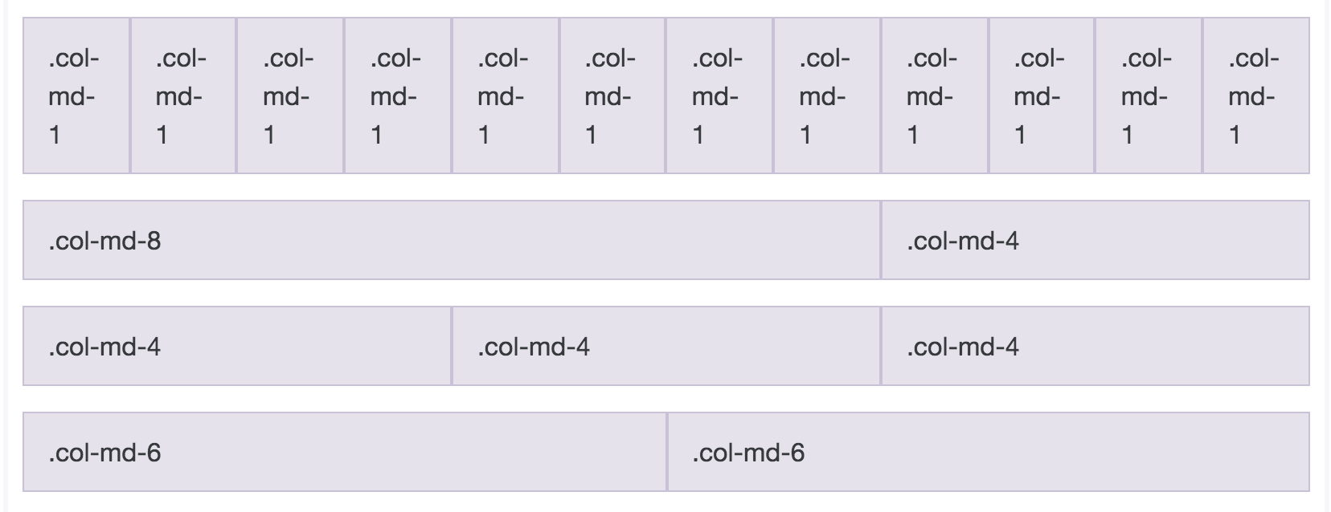
Bootstrap Grid System
http://v4-alpha.getbootstrap.com/layout/grid/

Slide 13
Add middle content and the sidebar
<div class="middle">
<div class="container">
<div class="col-md-9 content">
<h2>Forget The iPhone 7. Next Apple Sensation Revealed</h2>
<p>Twitter bootstrap allows web developers and designers to quickly create attractive and responsive website templates. This tutorial provided by <a href="http://www.revillweb.com/">w3schools.com</a> will show you how to use Twitter Bootstrap 3 to create this responsive website template.</p>
<p>Tech experts are predicting huge success for the Apple Watch, a stunning 78% growth rate in shipments every year through 2018, but what they're not telling you is the real winner behind Apple's newest gadget.
Our analysts have uncovered a little-known, roundabout way to invest in what could be the real vision of Steve Jobs. Because the real story behind this stock isn't the watch - it's the explosive new technology inside Apple's latest device. This investment comes at a fraction of the price of Apple stock... but it won't stay a secret for long.</p>
<div class="to-tutorial">
<p><strong>Visit the tutorial now to learn more:</strong></p>
<a href="http://www.w3schools.com/bootstrap/" class="btn btn-success">TO THE TUTORIAL</a>
</div>
</div>
<div class="col-md-3">
<h2>Sidebar</h2>
<ul class="nav nav-pills nav-stacked">
<li><a href="http://getbootstrap.com/" target="_blank">Download Twitter Bootstrap</a></li>
<li><a href="http://www.w3schools.com/bootstrap/" target="_blank">Bootstrap 3 Tutorial</a></li>
</ul>
</div>
</div>
</div>
Try changing col-md-numbers
http://v4-alpha.getbootstrap.com/components/buttons/
To change button color

Slide 14
How to get template
https://getbootstrap.com/examples/theme/
http://startbootstrap.com/template-overviews/creative/

Slide 15
Thanks.

