Slide 1
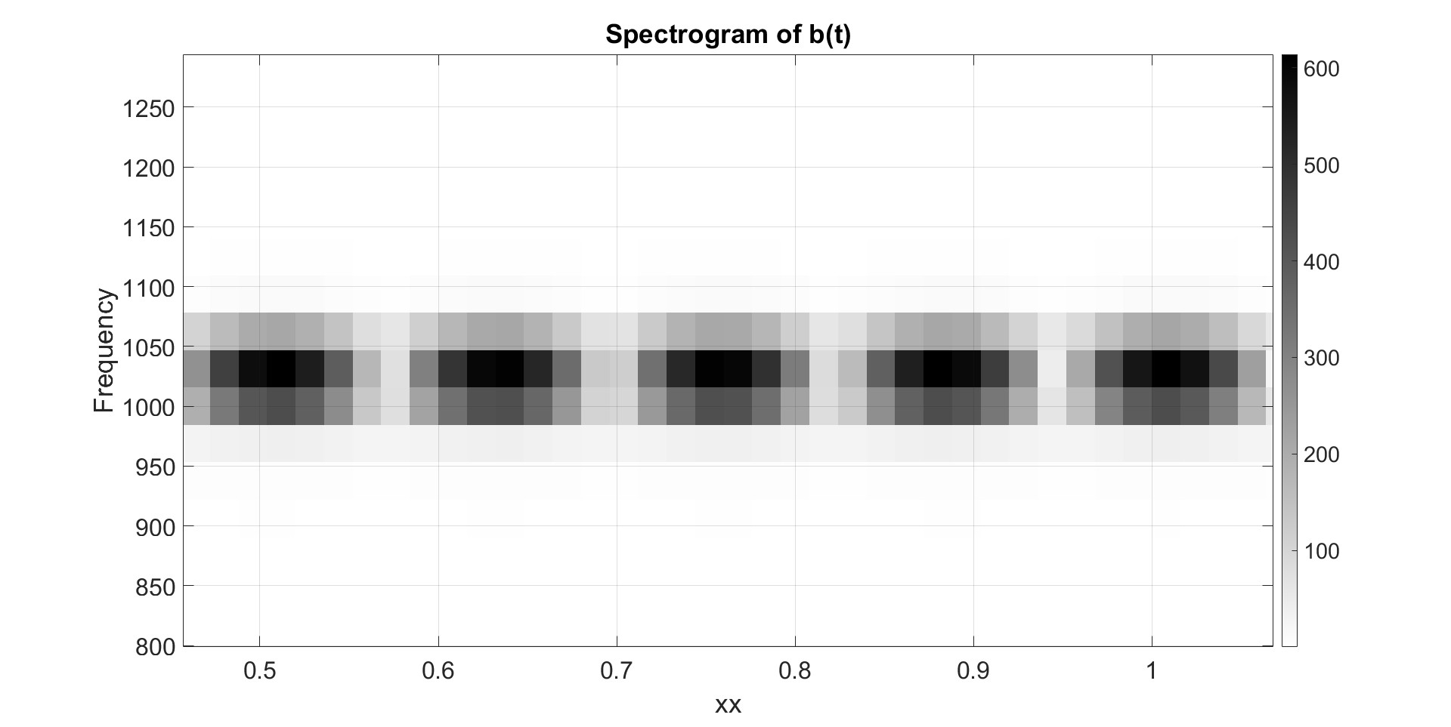
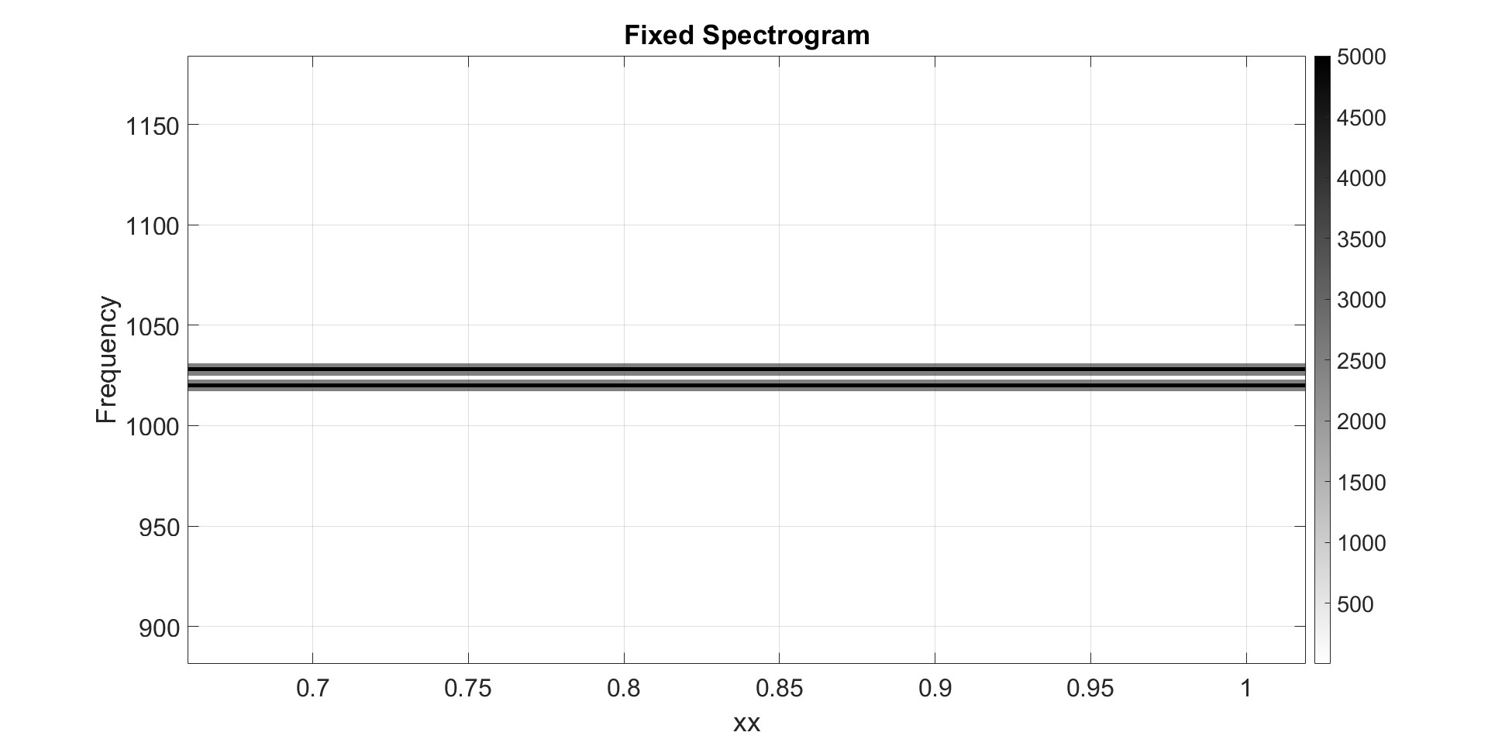
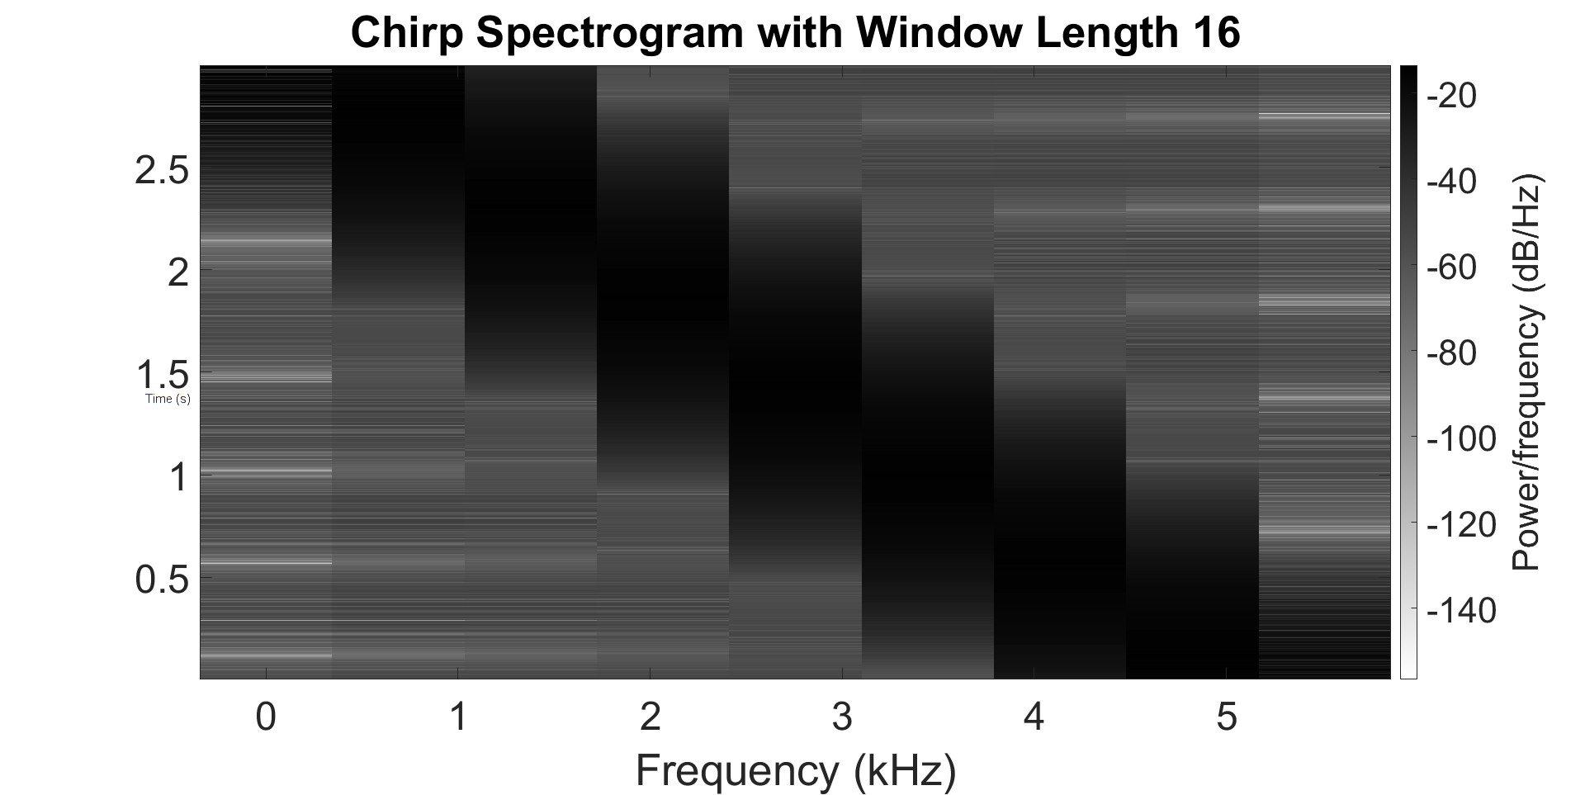
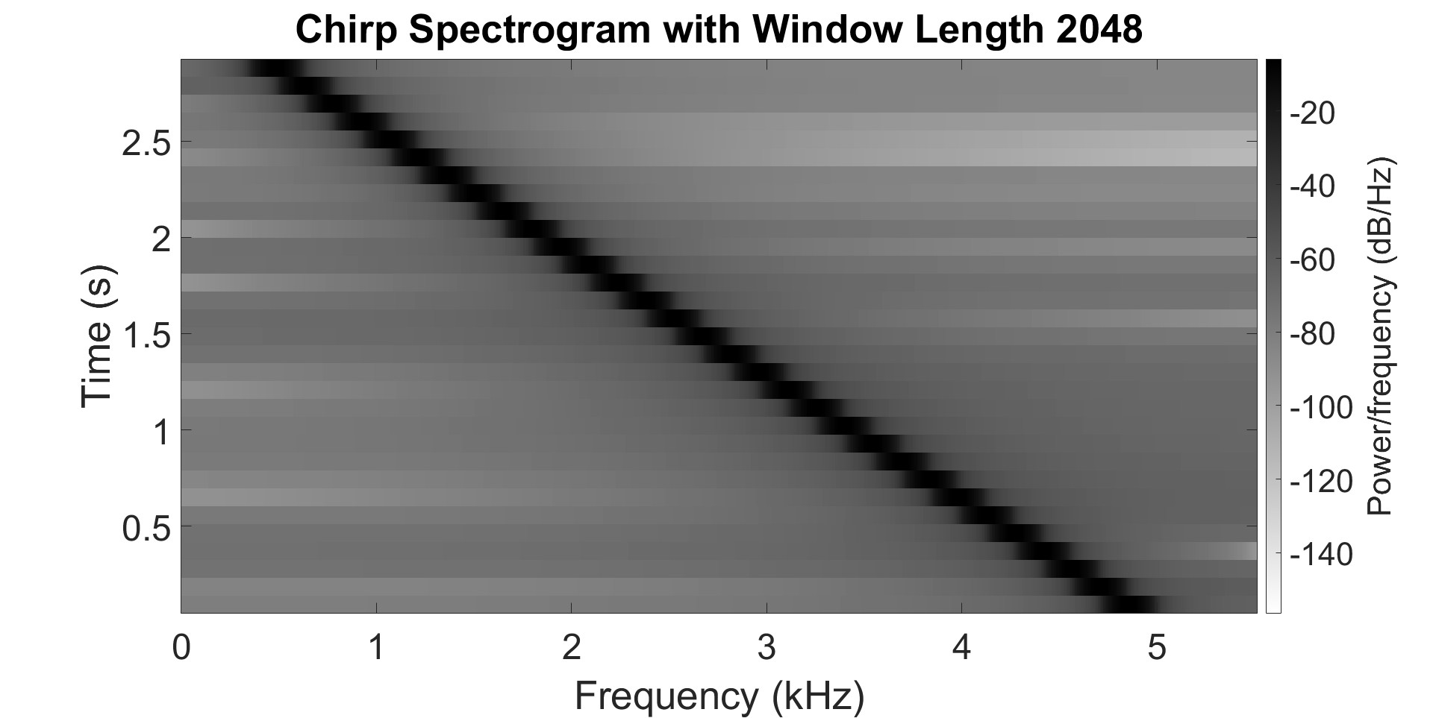


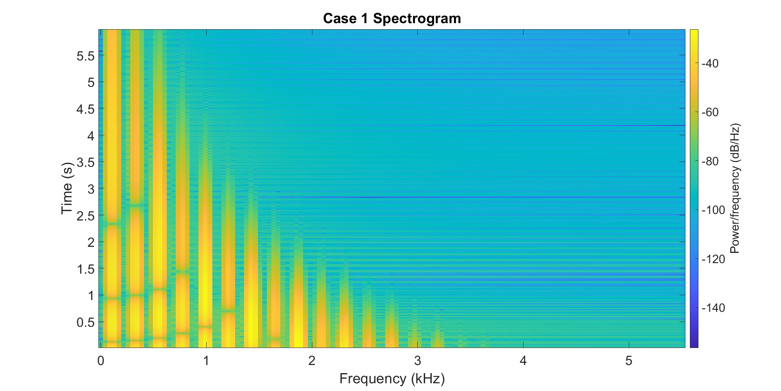
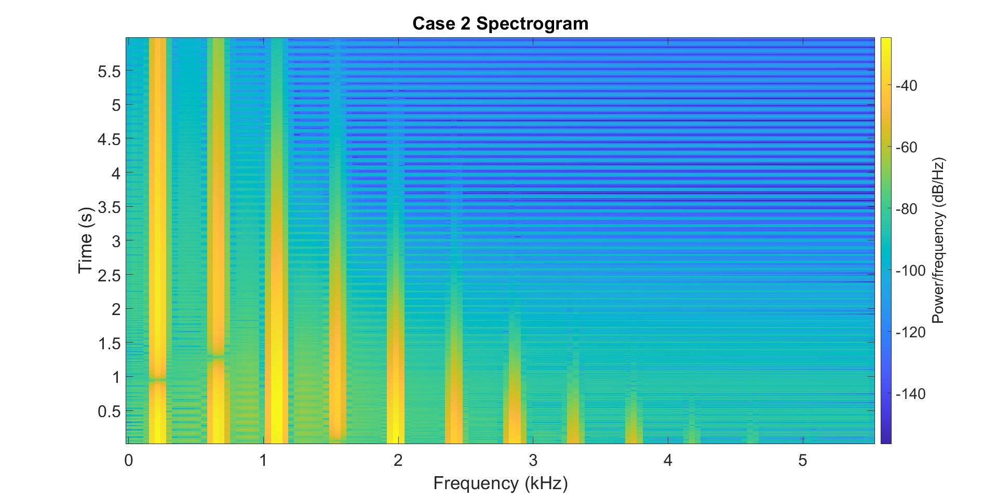
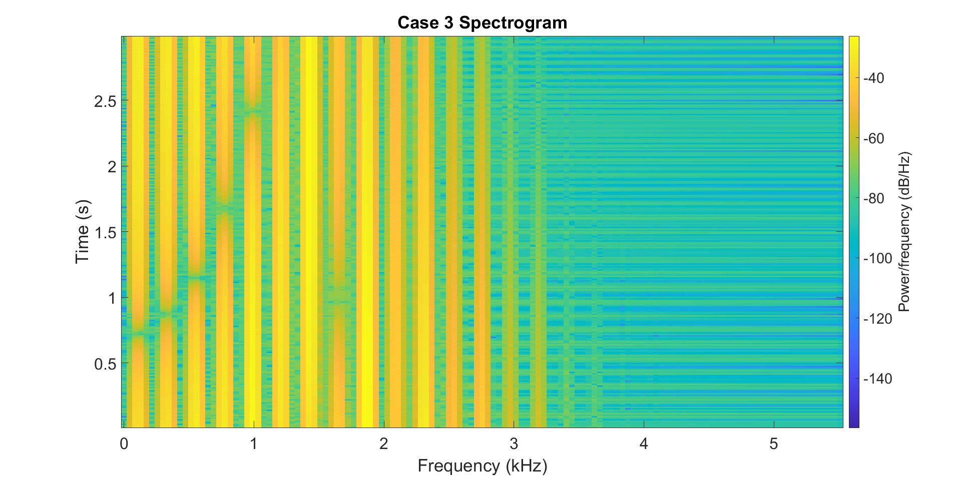
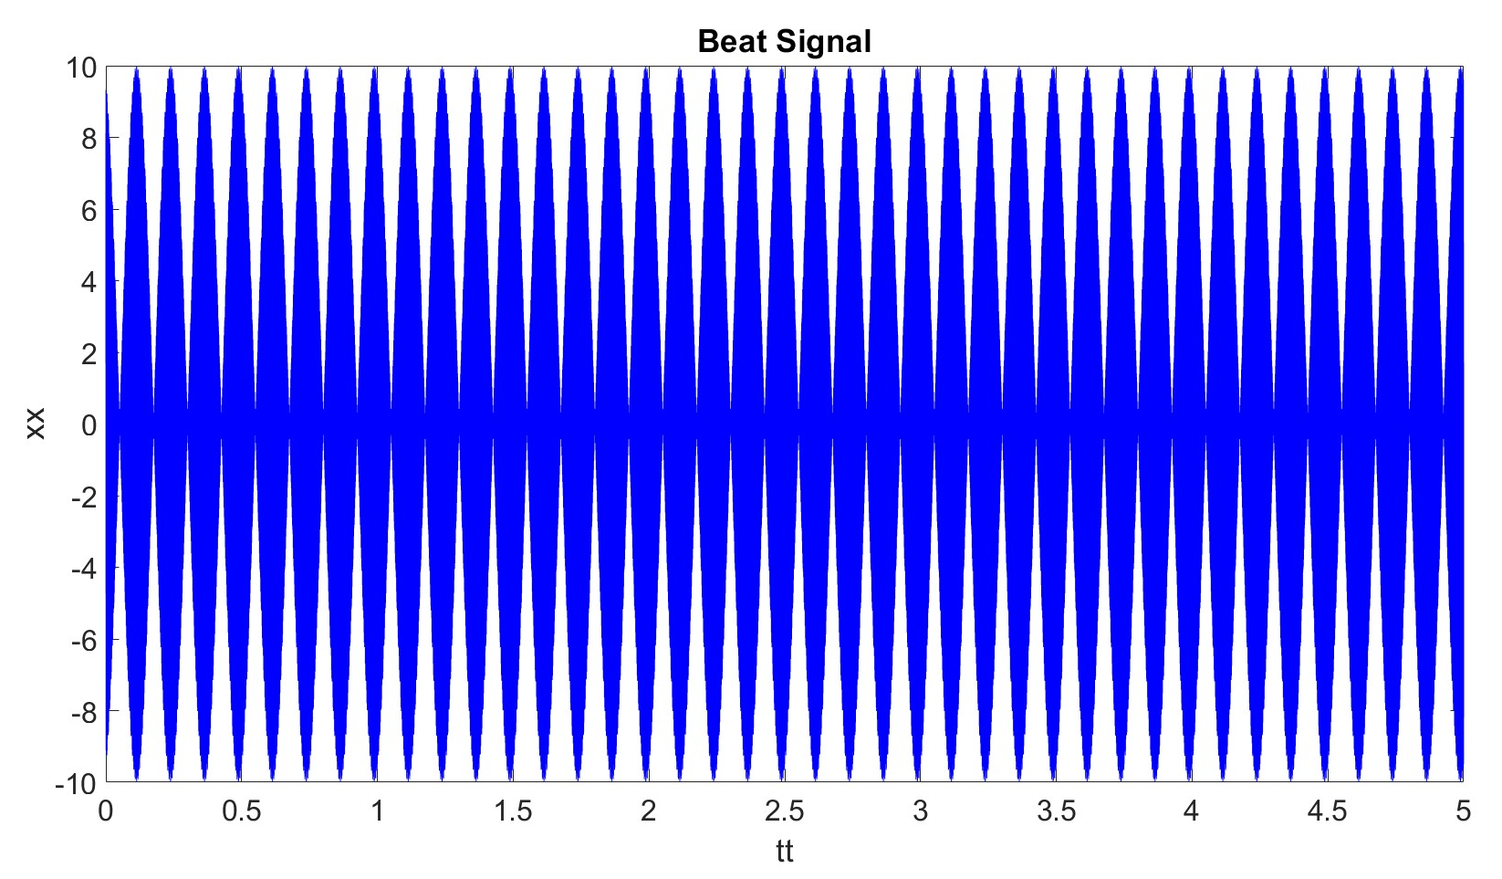
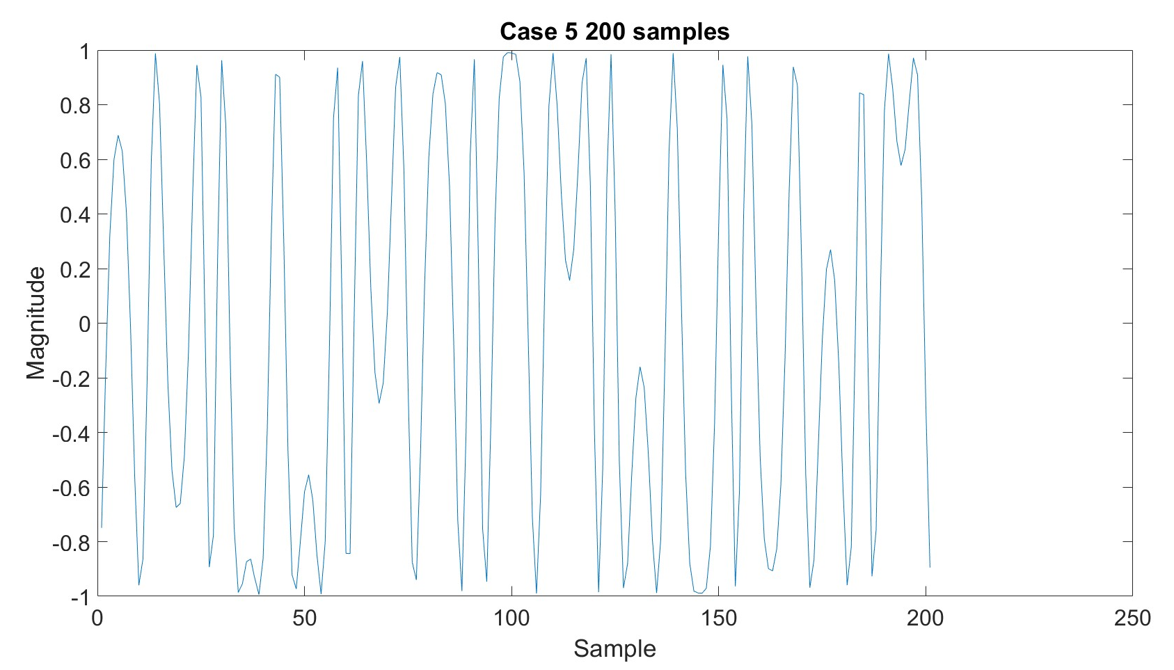
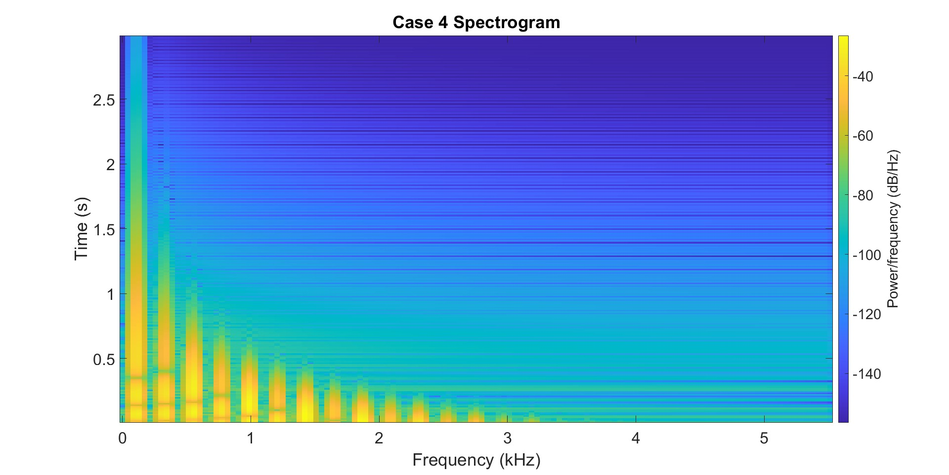
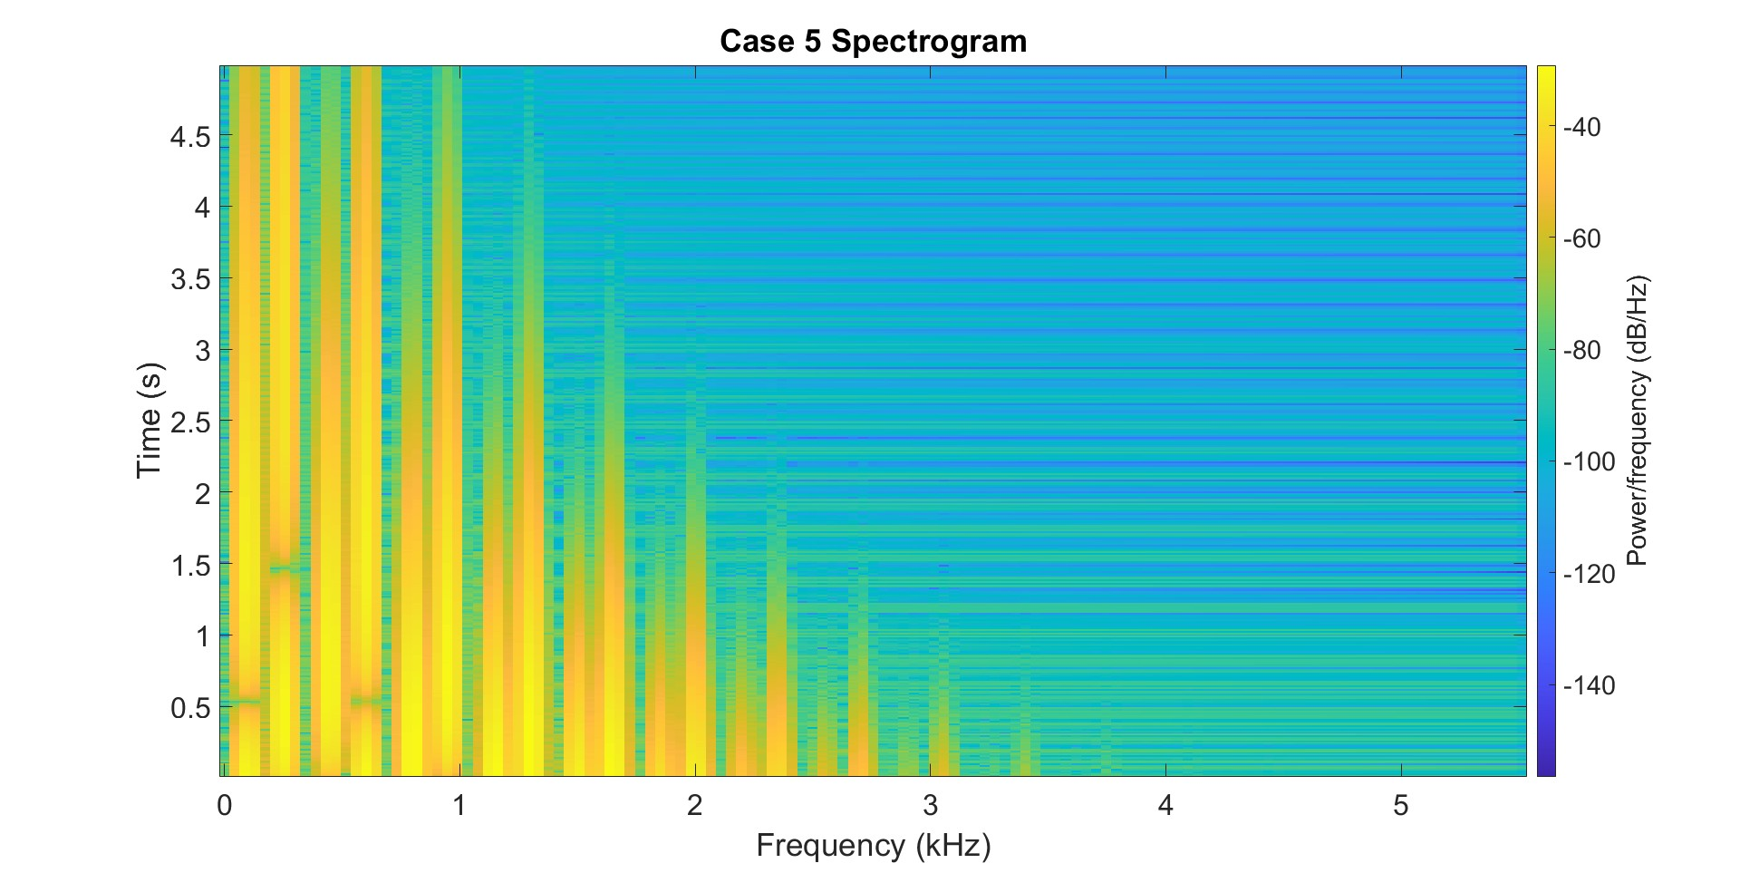
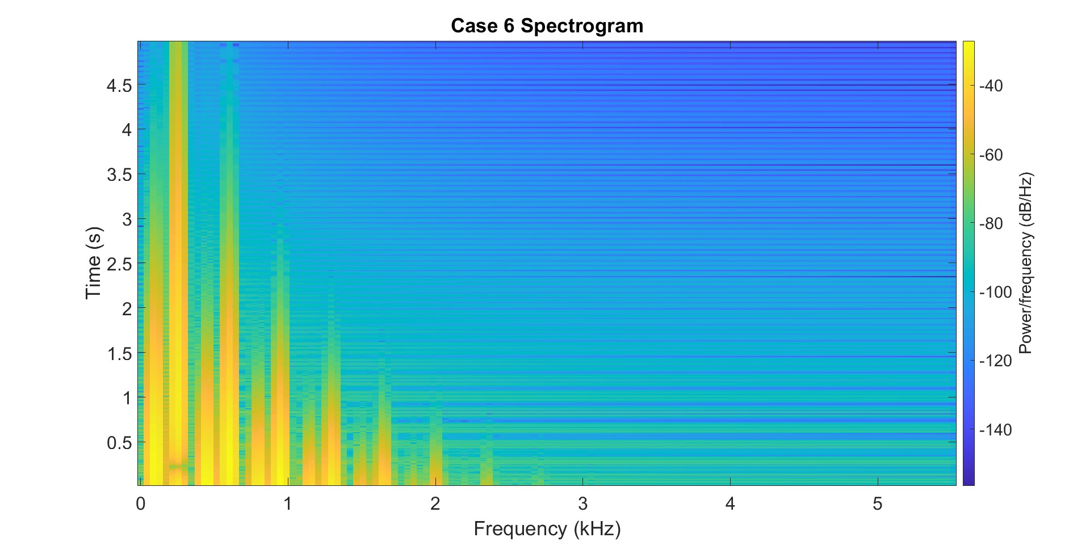
Amplitude/Frequency Modulation Synthesis and Analysis
Derek Anderson, Braden Brown, Thomas Crowne, and Kevin Duplisea Graduate Electrical Engineering Program, University of Utah
Introduction
Results
Conclusions
Amplitude and frequency modulation are important and common methods for transmitting data. This report demonstrates how to synthesize such signals and how to analyze them using a spectrogram. Details concerning spectrograms are also explored.
Window = 256 Beat Signal Spectrograms Window = 4000
For proper analysis of the frequency content of a signal the spectrogram needs to be given a proper window size. Increased window size increase accuracy in the frequency domain and decreasing the window size increases accuracy in the time domain.
When generating sound for musical instruments the parameters of the frequency modulation scheme require careful selection. Critically F_{m} needs to be an integer multiple of F_{c} for a pleasant sounding tone.
Beats Discernible
Frequencies Discernible
Chirp Spectrograms
Problem Definition
AM and FM signals will be explored through the following examples:
Beat Signal (AM):
Chirp (FM):
,
Bell (FM):
Spectrograms are a sliding window short-time Fourier transform. Effects of altering window length will be explored.
Bell Spectrograms
Base
F_{c}×2, I/2
τ×6, dur/2
Contributions
Spectrograms of AM and FM Signals:
Derek Anderson
AM and FM Sinusoidal Signals:
Thomas Crowne
FM Synthesis for Musical Instruments:
Braden Brown and Kevin Duplisea
τ×0.15, dur/2
F_{c}×2.3, F_{m}×3.2, I/2, dur×0.83
F_{c}×2.3, F_{m}×3.2, I×0.3, τ/2, dur×0.83

