Slide 1
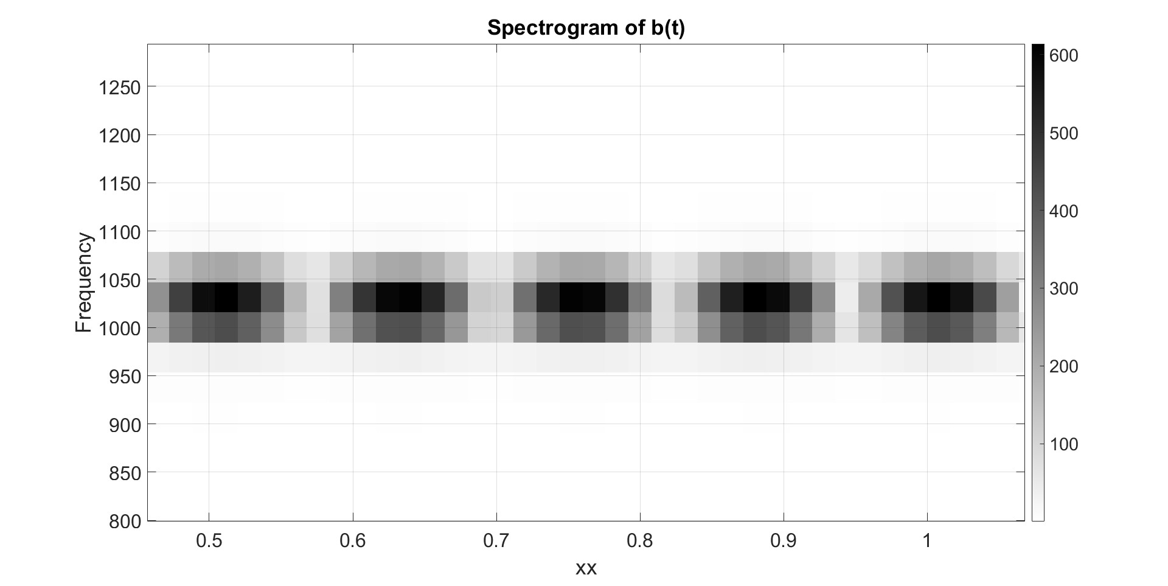
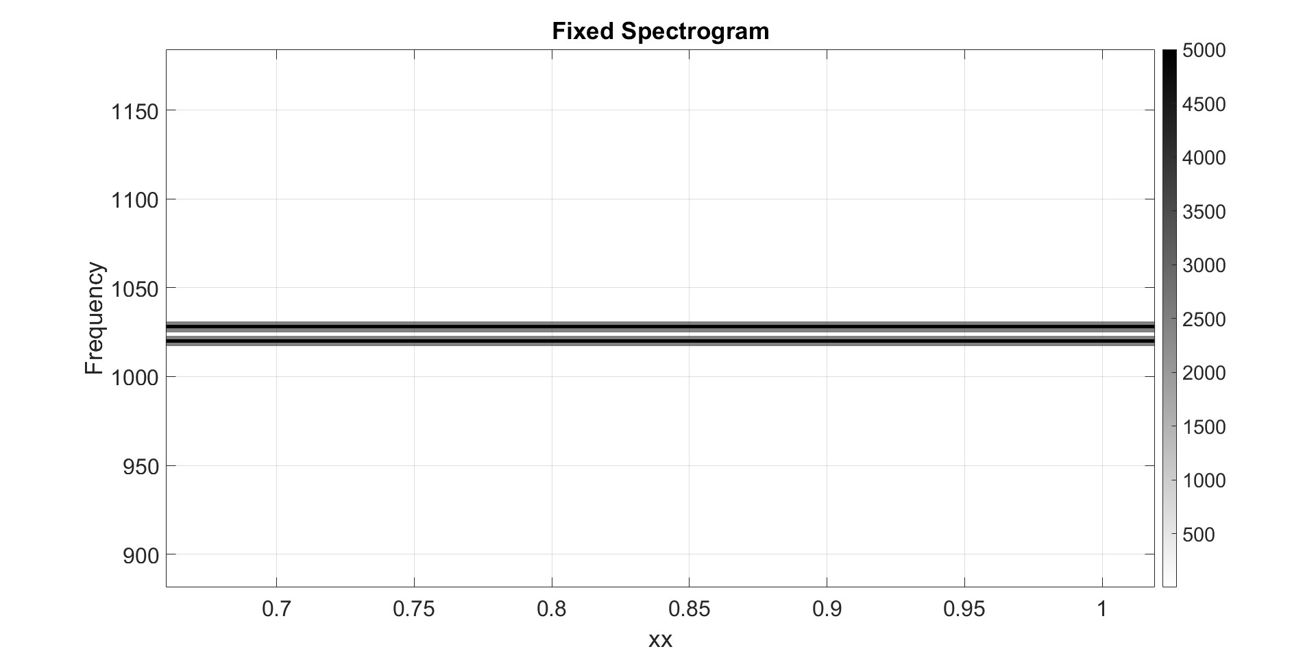
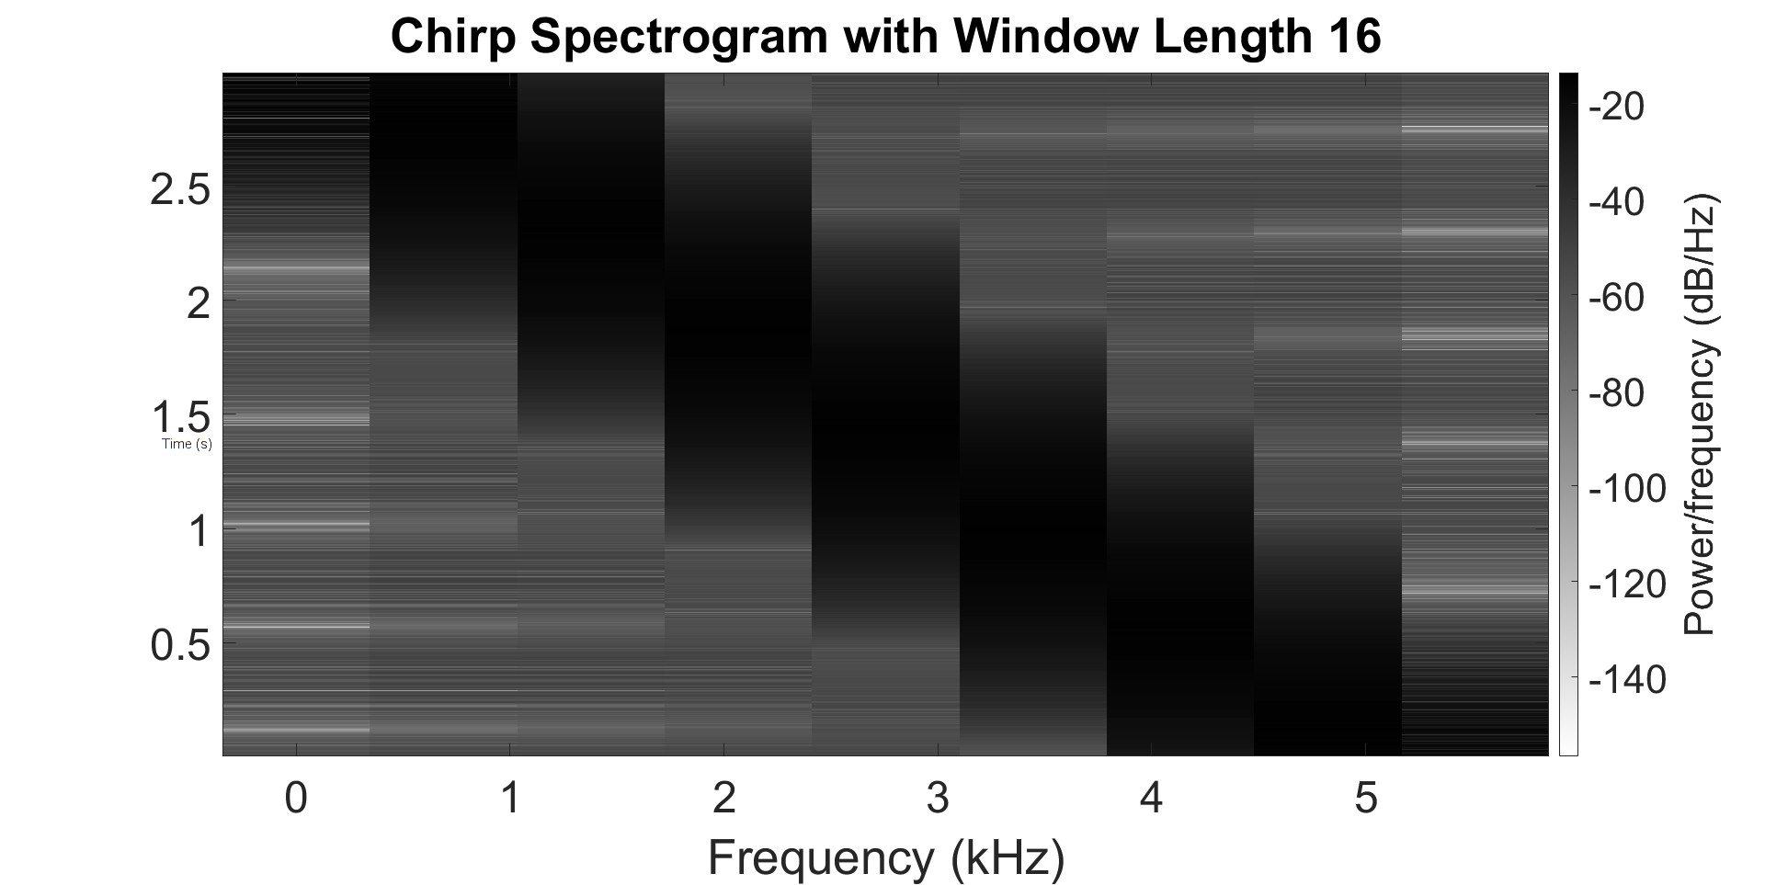
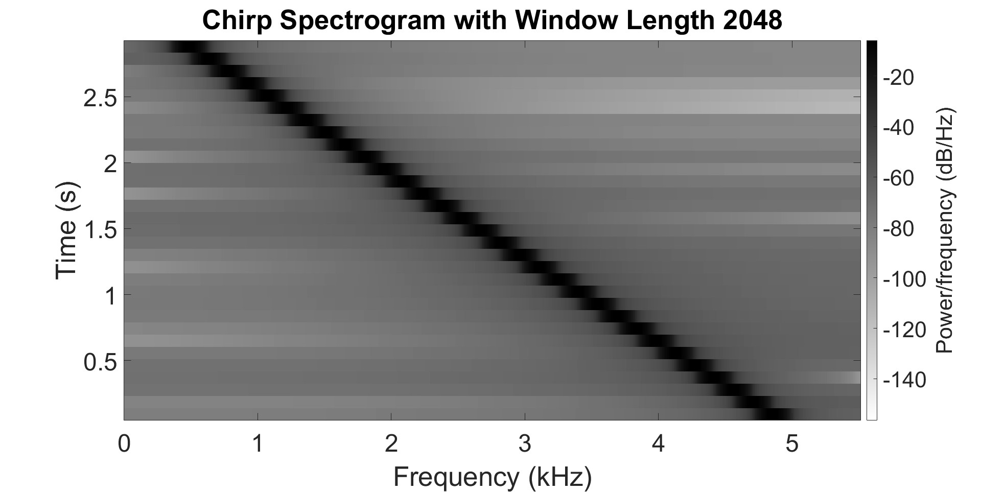


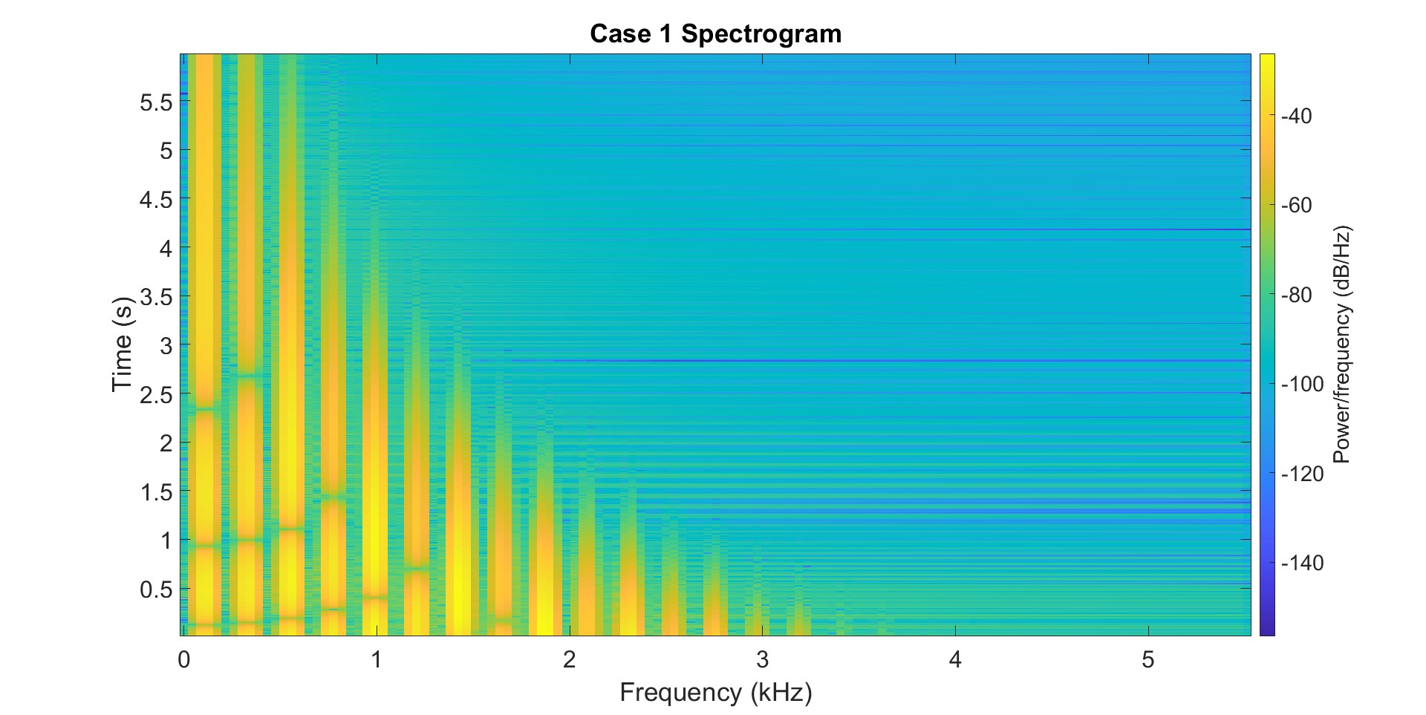
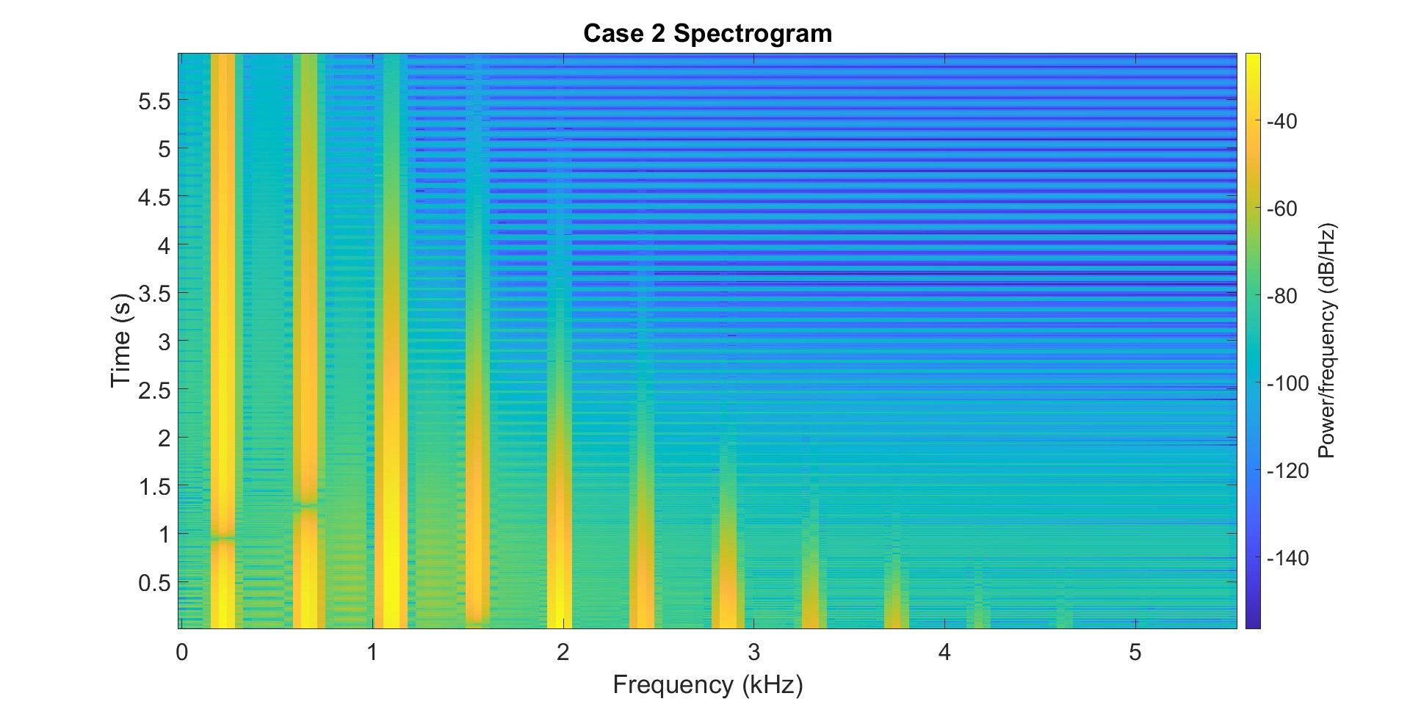
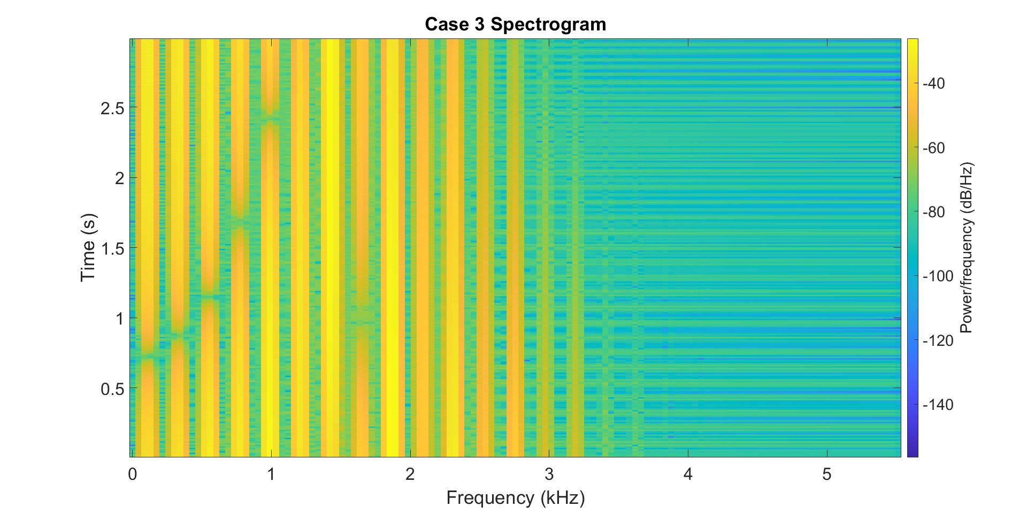
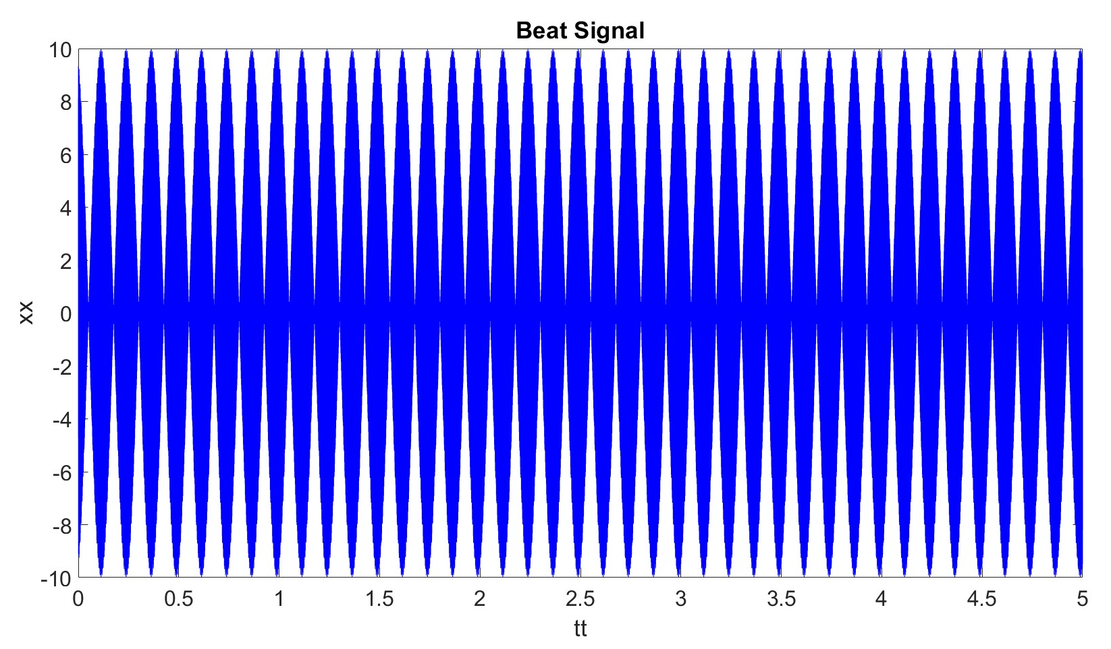
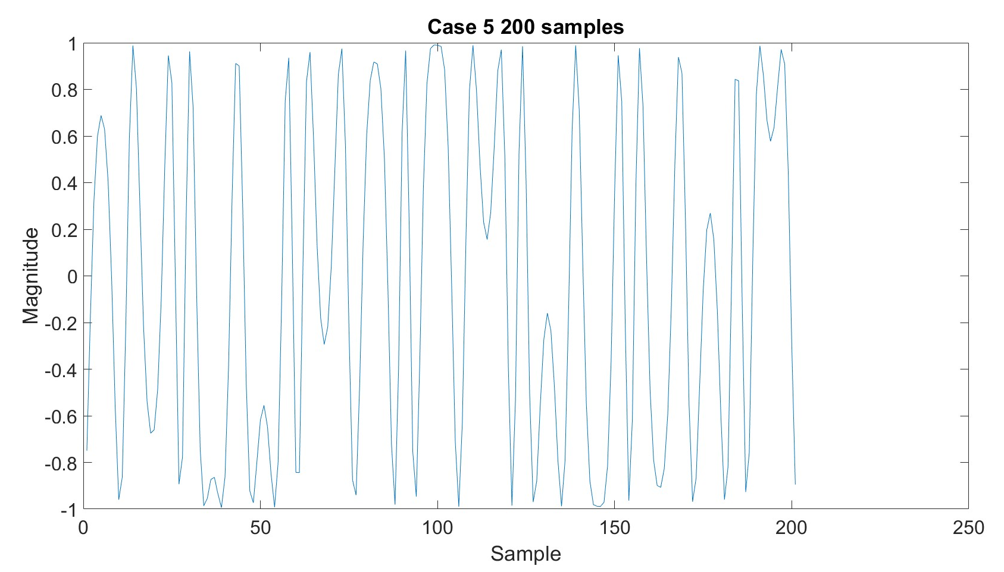
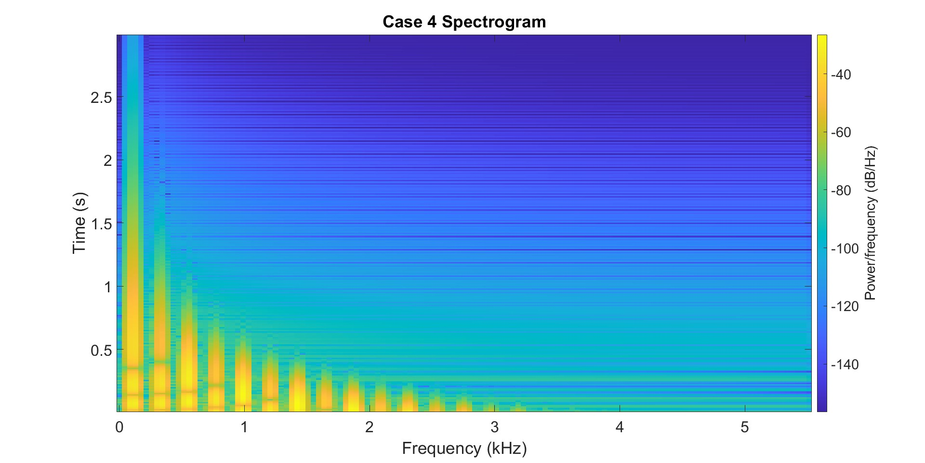
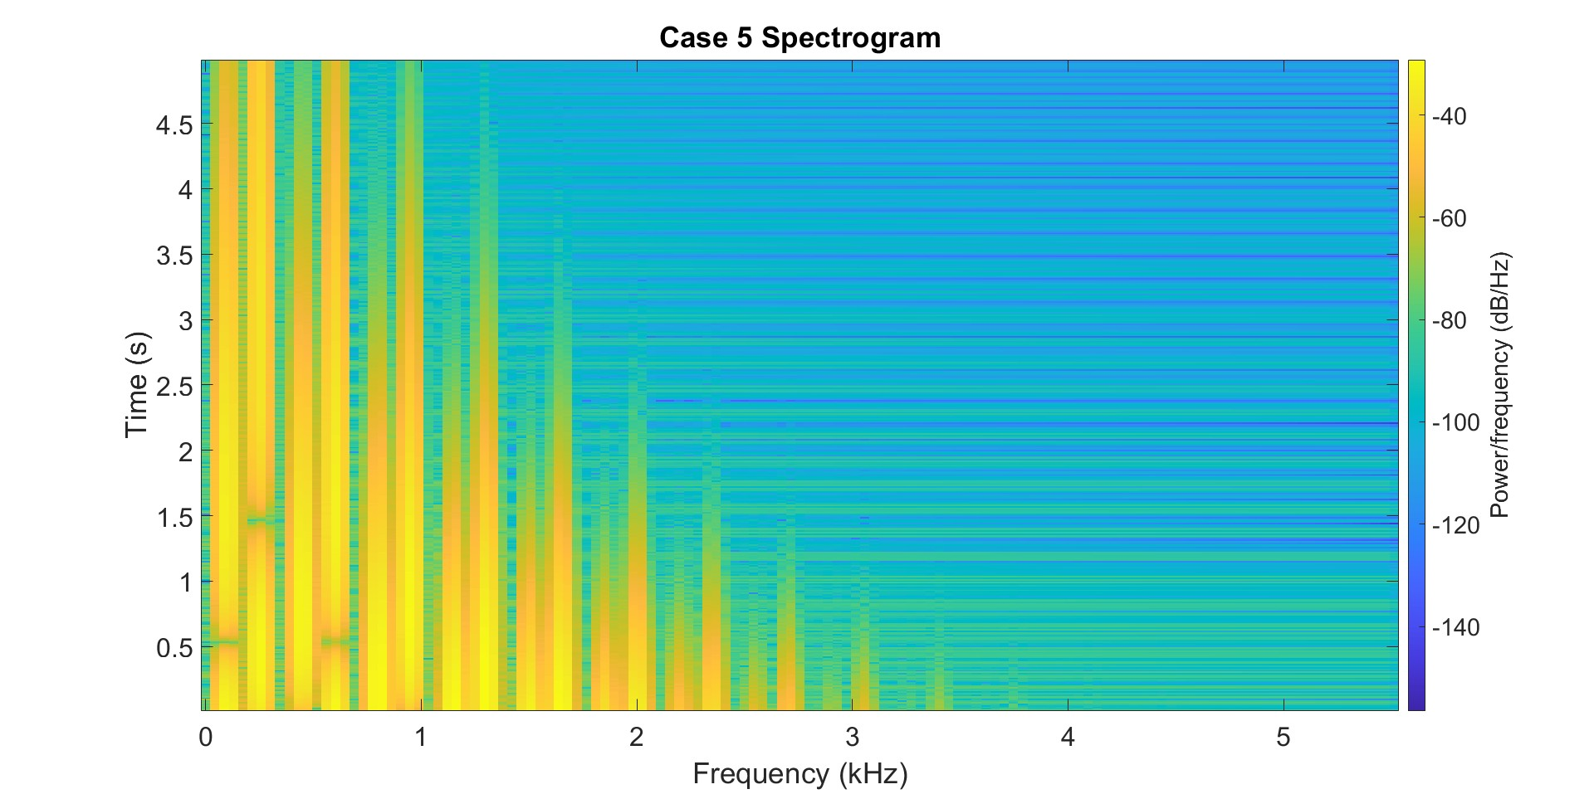
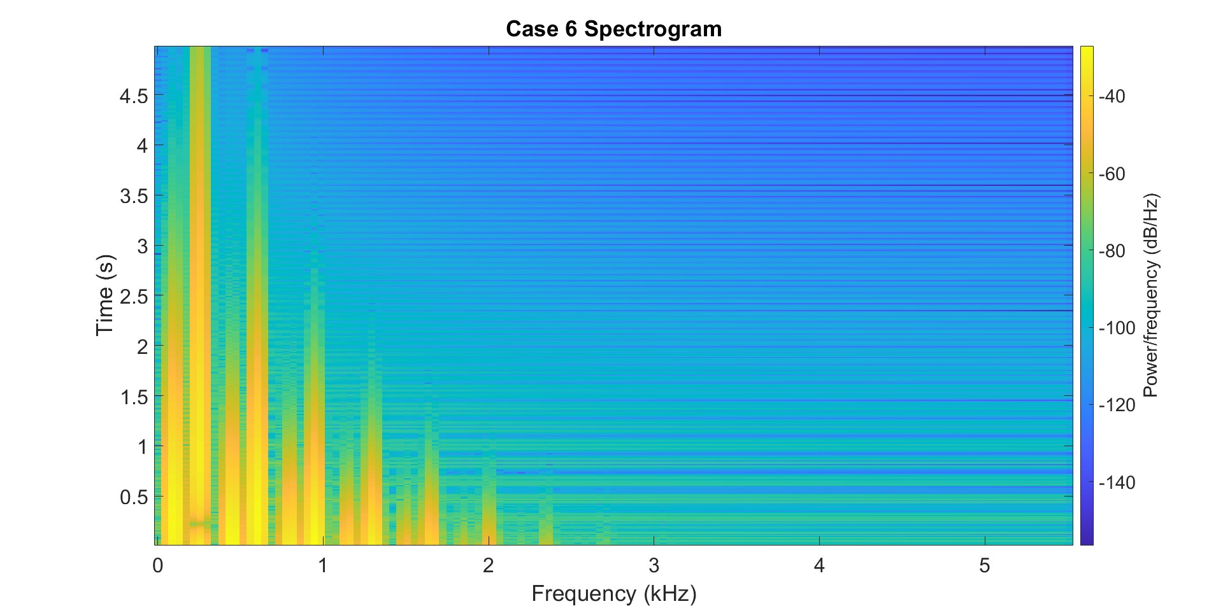
Spectrum Representation: AM and FM Signals and Synthesis
Derek Anderson, Braden Brown, Thomas Crowne, and Kevin Duplisea Graduate Electrical Engineering Program, University of Utah
Introduction
Results
Conclusions
Amplitude and frequency modulation are important and common methods for transmitting data. This report demonstrates how such signals are synthesized but also how to analyze them using a spectrogram. Details about spectrogram usage and implementation is also explored.
Window = 256 Beat Signal Spectrograms Window = 4000
For proper analysis of the frequency content of a signal using a spectrogram, it needs to be given a proper window size. Increased window size increase accuracy in the frequency domain and decreasing the window size increases accuracy in the time domain.
Using spectrograms to analyze musical instruments allows for convenient methods of empirically measuring the purity of musical tones. Harmonics needs to align for a pleasant sounding tone it was found that F_{m} needs to be an integer multiple of F_{c}.
Spectrograms have many uses beyond musical analysis.
Beats Discernible
Frequencies Discernible
Chirp Spectrograms
Problem Definition
AM and FM signals will be explored through the following examples:
Beat Signal (AM):
Chirp (FM):
,
Bell (FM):
Spectrograms are a sliding window short-time Fourier transform. Effects of altering window length will be explored.
Bell Spectrograms
Base
F_{c}×2, I/2
τ×6, dur/2
Contributions
Spectrograms of AM and FM Signals:
Derek Anderson
AM and FM Sinusoidal Signals:
Thomas Crowne
FM Synthesis for Musical Instruments:
Braden Brown and Kevin Duplisea
τ×0.15, dur/2
F_{c}×2.3, F_{m}×3.2, I/2, dur×0.83
F_{c}×2.3, F_{m}×3.2, I×0.3, τ/2, dur×0.83

