Slide 1



Loudoun county Community Schools project - Progress Tracker DSGP’22
Team: Chanita Holmes,
Nandini Das,
Leonard-Allen Quaye,
Amanda Ljuba,
Jontayvion T. Osborne,
Chaudhry Abdullah Rizwan

Slide 2
Objectives
Identify the availability of services in the Community Schools
Find out the service and opportunity gaps
Suggest and explore probable services which can address the gaps

Slide 3
Weekly updates

Slide 4
Goals accomplished this week 10 June
Stakeholders’ meeting
Better understanding of Sterling, Community Schools and our objectives
Draft of Overview
Defining Sterling

Slide 5
Challenges? Oh, the necessary evils!

Slide 6
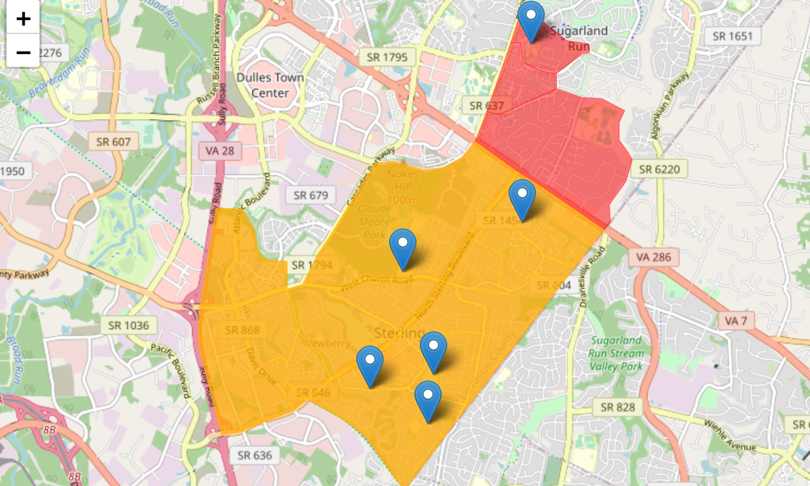
Finding Sterling

Slide 7
Missing Data

Slide 8
Targets for next week 17 June
Demographics
Summary
Visualization

