Slide 1
Predicting Credit's Default Payment
Vivian Phan
Alexandr Pimikov
Thilini Panagoda
Aalto University

Slide 2
Control of default risk
Accurate prediction of default payments enables banks and credit issuers to effectively mitigate lending risks, manage their credit portfolios more efficiently, and minimize potential financial losses.
Predictive models aid in identifying consumers at high risk of default, facilitating early intervention strategies like debt restructuring and financial counseling, which can help consumers avoid defaulting on their loans.

Slide 3
Introduction
This report presents a comparative study of two statistical models designed to predict credit default.
Logistic regression model
Hierarchical model
Our goal is to determine whether the consumers' education affect their ability to make payments
We examine whether the hierarchical model has any added benefit in predicting the ability of making default payments.

Slide 4
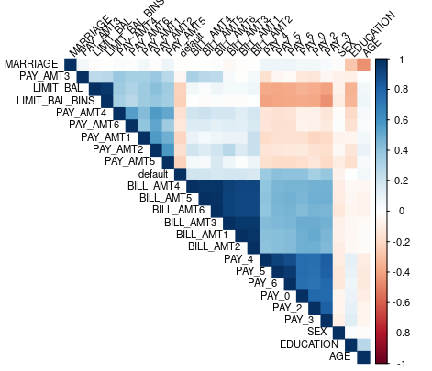
Description of the data and the analysis
Relationships between
different features in
the dataset.
The attribute of interest, ’default’,
which represents the outcome
we aim to predict
It exhibits a significant correlation with the ’PAY’ attributes,
We consider first two months behavior of the clients PAY_0, PAY_2, and ’EDUCATION’

Slide 5
Description of the data and the analysis
Our analysis focuses on a small sampled subset of the data, according to different educational backgrounds
1 - graduate school,
2 - university,
3 - high school
4 - others
default outcomes
0 - no default
1 - default.
For each category within education and default status, we sampled 40 data points
Original data fitted data
30000 * ( 22 + 1) -> 240 * ( 3 + 1)

Slide 6
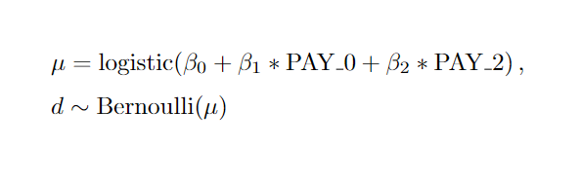
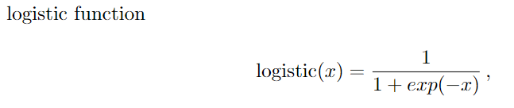
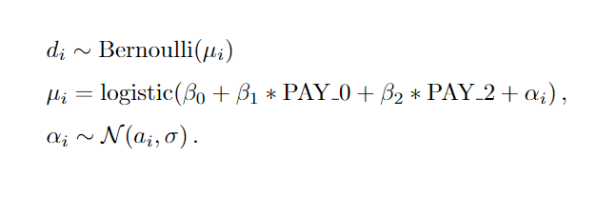
Description of two models
Pooled model for default d
Hierarchical model
has one extra layer for intercept grouped by education

Slide 7
Description of two models
Pooled model
4 chains 2000 iterations and 1000 warm-up iterations
Hierarchical model
4 chains 5000 iterations and 2500 warm-up iterations

Slide 8

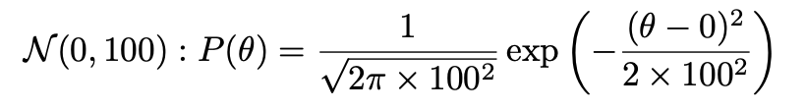
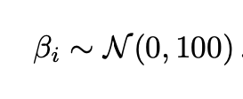
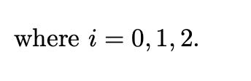
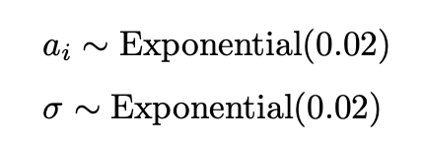
Prior Selection
Non informative prior –
The PDF for this prior is:
For the Hierarchical model additional parameters

Slide 9
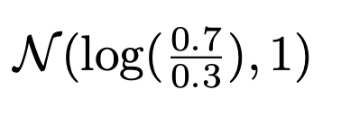
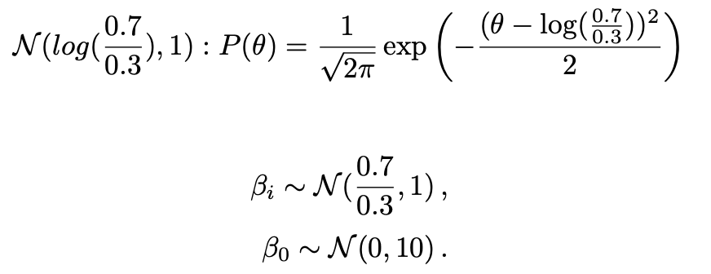
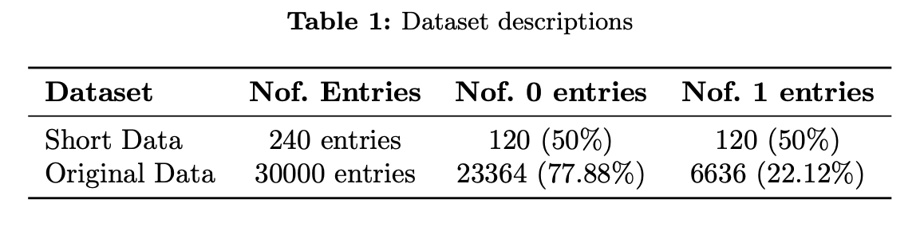
Prior Selection
Weakly informative prior –
The PDF for this prior is:

Slide 10
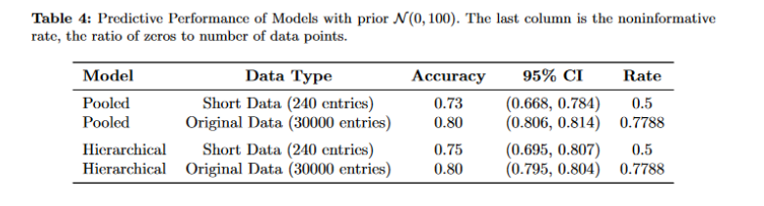
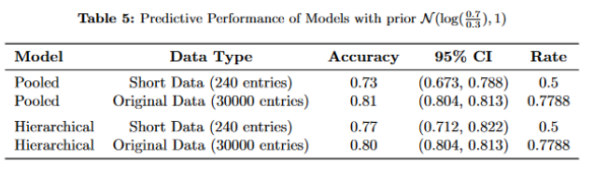
Sensitivity Analysis

Slide 11
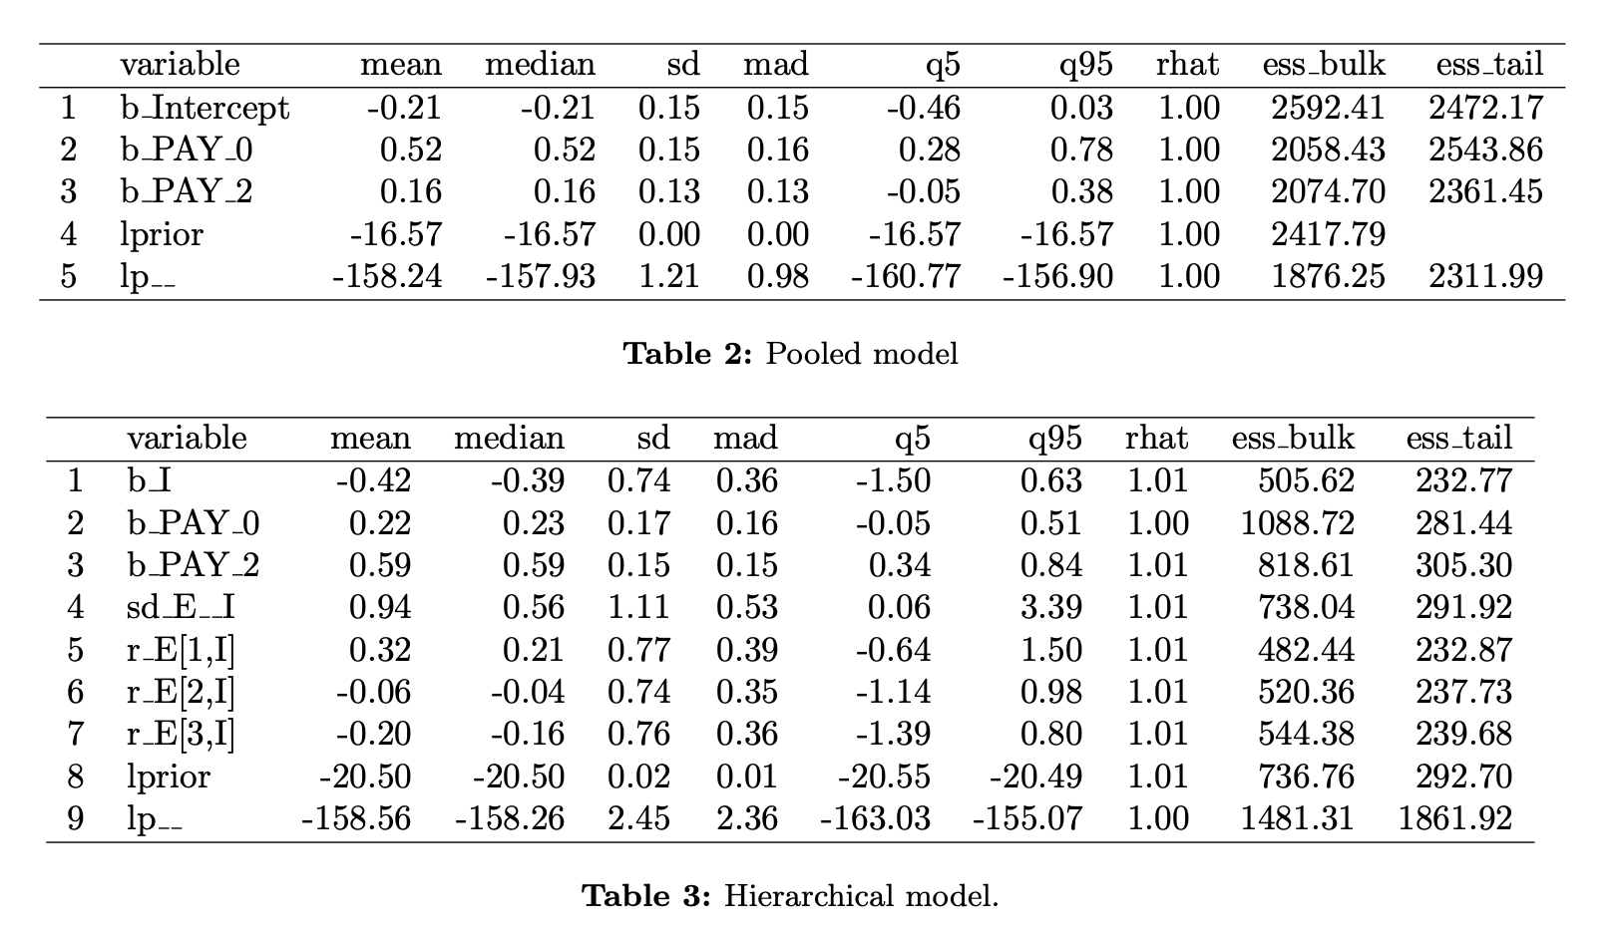
Rhat and ESS value for convergence diagnostic

Slide 12
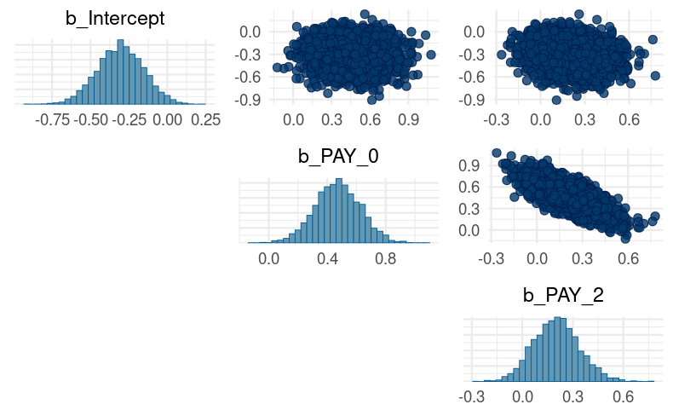
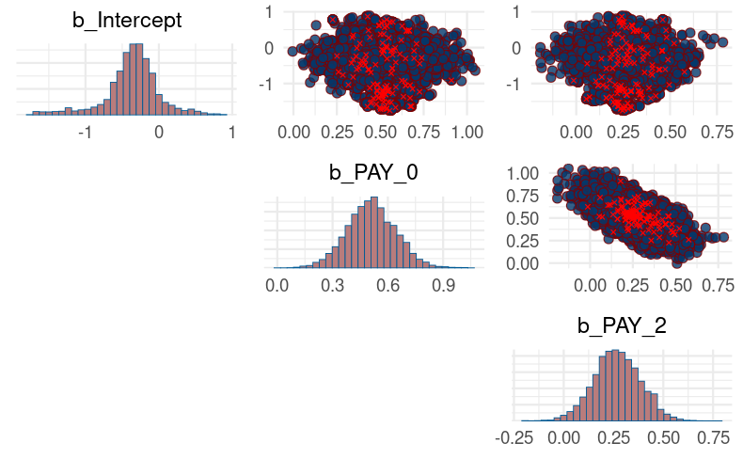
Comparative MCMC diagnostics for pooled and hierarchical models
Diagonal histograms-marginal posterior distributions
Red points- divergent transitions

Slide 13
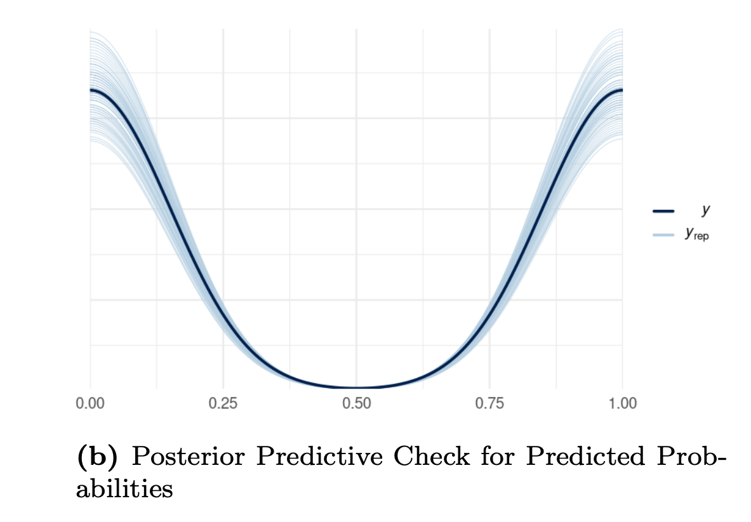
Posterior predictive checks- Pooled model
Dark line represents-observed proportions(y)
Lighter lines represents- densities of predicted proportions (y_rep)

Slide 14
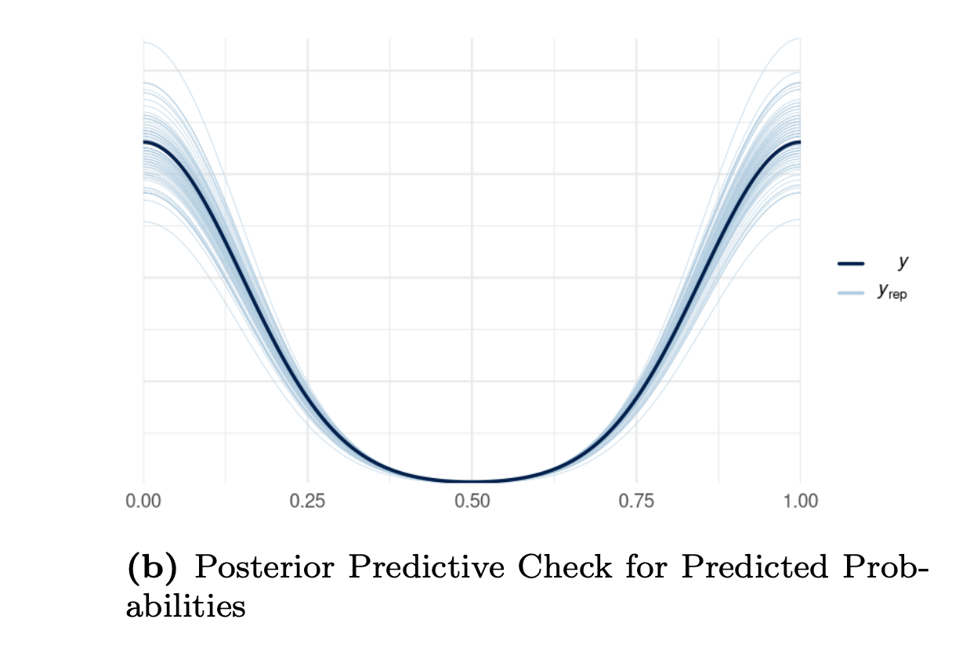
Posterior predictive checks- Hierarchical model
Hierarchical model behave similarly as pooled model

Slide 15
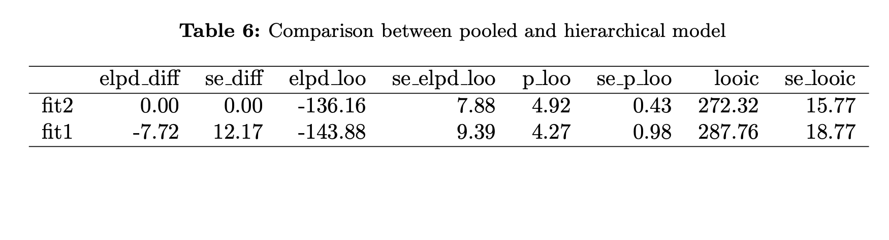
Model Comparison
The hierarchical model performs slightly better
However, the standard error indicates that the elpd difference between two models are not significant.

Slide 16
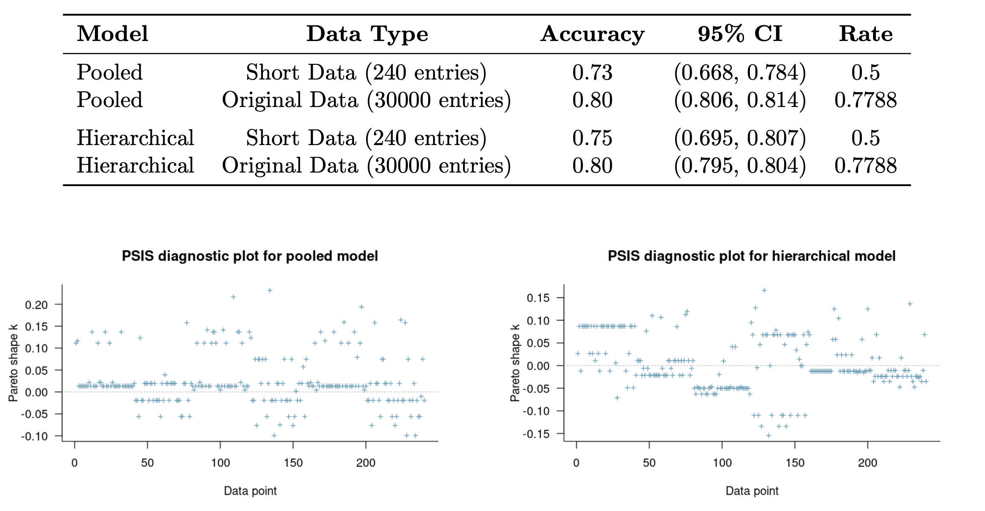
Predictive performance assessment
Predictive Performance of Models with prior

Slide 17
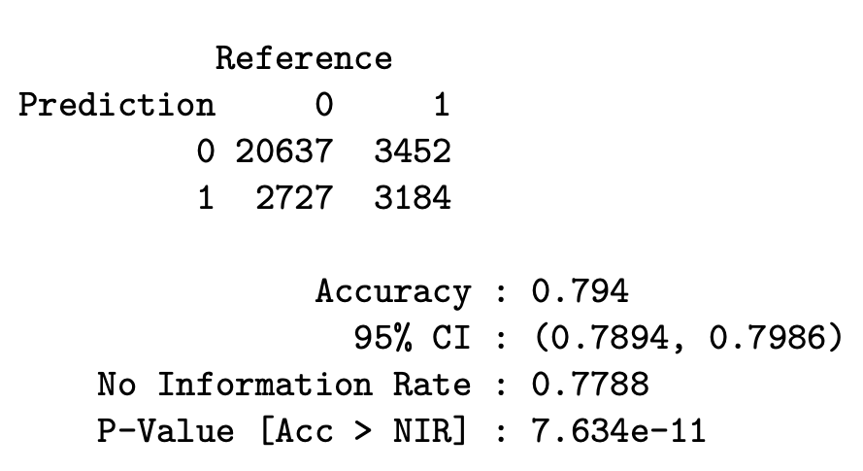
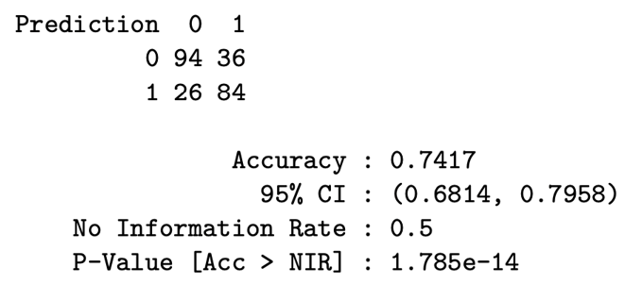
Confusion Matrix - Stan model PAY_0 + PAY_2
False negative: 0.15
False positive: 0.11
False negative: 0.12
False positive: 0.09

Slide 18
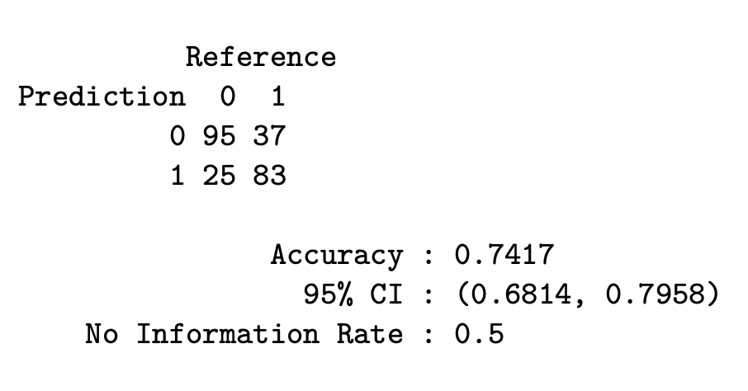
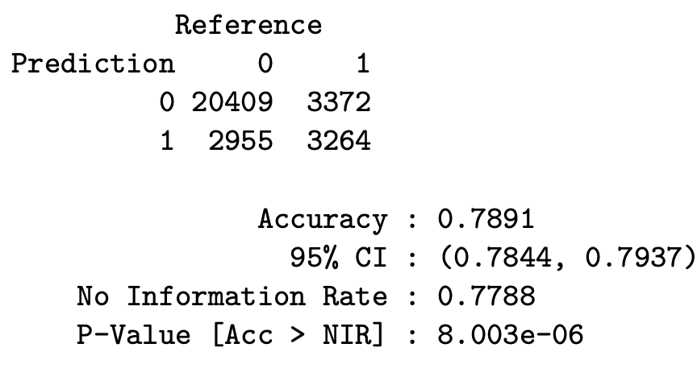
Confusion Matrix -Stan model EDUCATION Hierarchical
False negative: 0.15​
False positive: 0.10
​
False negative: 0.11​
False positive: 0.10

Slide 19
Predictive performance assessment
Pareto Smoothed Importance Sampling (PSIS) diagnostics for pooled and hierarchical models
All the Pareto k-values seem to be well below 0.7, which is generally considered good.
LOO diagnostics -> how well IS perform for LOO posterior.

Slide 20
Discussion
Model Accuracy vs. No Information Rate:
Both models’ accuracies do not significantly outperform the no information rate.
Divergences in the Hierarchical Model:
The presence of divergent transitions in the hierarchical model
Comparative Performance of Models:
hierarchical model does not significantly outperform the pooled model in terms of accuracy

Slide 21
Thanks!
Take away
Considered models perform comparably in terms of accuracy.
In the hierarchical model, presence of divergent transitions during the sampling process.
Education does not influence on credit default.
BDA allows to learn from small dataset
vivian.phan@aalto.fi
pimikov@gmail.com
thilini.panagodaarachchige@aalto.fi

Slide 22
Stan code for pooled model
fit1 <- brm(default ~ PAY_0 + PAY_2,
data = data_credit,
refresh = 0,
prior=c(
prior(normal(0,100), class="Intercept"), prior(normal(0, 100), class = b)),
family = bernoulli(),
file = "pooled",
backend = "cmdstanr",
seed = 123
)

Slide 23
Stan code for hierarchical model
fit2 <- brm(
default ~ PAY_0 + PAY_2 + (1 | EDUCATION),
data = data_credit,
prior=c(
prior(normal(0,100), class="Intercept"),
prior(normal(0,100), class="b"),
prior(exponential(.02), class="sd")),
family = bernoulli(),
backend = "cmdstanr",
iter = 5000, warmup = 2500,
seed = 123
)

