Slide 1
SQL Programming Overview
Dot Net Team - TDG – Injazat
ahmed.elbaz@injazat.com

Slide 2
Agenda
History of SQL
SQL Fundamentals
Data Definition
Data Modifications
Single Table SELECT Statements
Joins
Set Operators
Aggregate Functions
Subqueries
Views
Stored Procedures & Functions
Triggers
The Mechanics of Query Processing

Slide 3
History of SQL
During the 1970s(IBM), Structured English Query Language(SEQUEL)
Select Query Language (SQL), which included commands allowing data to be read only for reporting and record look-up.
Structured Query Language
American National Standards Institute and officially called the ANSI SQL standard, established in 1986

Slide 4
History of SQL (cont’d)
In 1987, SQL became an international standard and was registered with the International Organization for Standardization (ISO) using its previously copyrighted title, ANSI SQL

Slide 5
SQL revisions
Year | Name | Comments
1986 | SQL-86 | First published by ANSI. Ratified by ISO in 1987.
1989 | SQL-89 | Minor revision, adopted as FIPS 127-1.
1992 | SQL-92 | Major revision (ISO 9075), Entry Level SQL-92 adopted as FIPS 127-2.
1999 | SQL:1999 | Added regular expression matching, recursive queries, triggers, support for procedural and control-of-flow statements, non-scalar types, and some object-oriented features.
2003 | SQL:2003 | Introduced XML-related features, window functions, standardized sequences, and columns with auto-generated values (including identity-columns).
2006 | SQL:2006 | ISO/IEC 9075-14:2006 defines ways in which SQL can be used in conjunction with XML. It defines ways of importing and storing XML data in an SQL database, manipulating it within the database and publishing both XML and conventional SQL-data in XML form.
2008 | SQL:2008 | Defines more flexible windowing functions

Slide 6
History of SQL Server
SQL Server was originally a Sybase product created for IBM's OS/2 platform.
The SQL Server team eventually rewrote the product from scratch.
In late 1998 , SQL Server 7.0 was released.
In 2000, SQL Server 2000 was released with many useful new features.
SQL Server 2005, The storage and retrieval engine has been completely rewritten, the .NET Framework has been incorporated.

Slide 7
Transact SQL(T-SQL)
T-SQL is Microsoft's implementation of a SQL.
T-SQL is the language used to talk to SQL Server.
SQL Server 2000 implements ANSI-92.
SQL Server 2005 implements ANSI-99.
T-SQL does not fully conform to any of the more recent ANSI versions, but it does implement many of the selected features.

Slide 8
SQL Fundamentals
SQL is the only way to build, manipulate and access a relational database.

Slide 9
What is a Relational Database?
In simple terms, a relational database is a set of tables
a relational database is a set of relations
Each table keeps information about aspects of one thing, such as a customer, an order, a product, or a team.
It is possible to set up constraints on the data in individual tables and also between tables.
For example, when designing the database, we might specify that an order entered in the Order table must exist for a customer who exists in the Customer table.
A data model provides us with information about how the data items in the database are interrelated

Slide 10
The first step to write good query is the database design

Slide 11
Table
Columns and Rows
Each row must be able to stand on its own, without a dependency to other rows in the table.
The row must represent a single, complete instance of the entity the table was created to represent.
Each column in the row contains specific attributes that help define the instance

Slide 12
Relationships
A relationship is a logical link between two entities
Relationships can be defined as follows:
One-to-zero or many
One-to-one or many
One-to-exactly-one
Many-to-many
The many-to-many relationship requires three tables because a many-to-many constraint would be unenforceable

Slide 13
Relationships (cont’d)
Entity Relationship Diagram (ERD). The ERD allows the database designer to conceptualize the database design during planning.
Primary keys (unique column or combination of columns)
Foreign keys (a column that references primary key of another table)
To efficiently manage the data in your table you need to be able to uniquely identify each individual row in the table.
The concept of maintaining foreign keys is known as "referential integrity".

Slide 14
Primary key
A non-data key that has a more efficient or smaller data type associated with it
A non-descriptive key doesn't represent anything else with the exception of being a value that uniquely identifies each row or individual instance of the entity in a table.
Simplify the joining of tables and provide the basis for a "Relation."
Primary keys can never be NULL and they must be unique
Primary keys can also be combinations of columns

Slide 15
Normalization
Each table describes one thing only

Slide 16
Normalization
Normalization is the process of efficiently organizing data in a database.
There are two goals of the normalization process:
eliminating redundant data (for example, storing the same data in more than one table)
ensuring data dependencies make sense (only storing related data in a table).
Both of these are worthy goals as they:
reduce the amount of space a database consumes
ensure that data is logically stored.

Slide 17
First Normal Form — 1NF
Eliminate duplicative columns from the same table.
Create separate tables for each group of related data and identify each row with a unique column (the primary key).

Slide 18
Second Normal Form — 2NF
Remove subsets of data that apply to multiple rows of a table and place them in separate tables.
Create relationships between these new tables and their predecessors through the use of foreign keys.
2NF attempts to reduce the amount of redundant data in a table by extracting it, placing it in new table(s) and creating relationships between those tables.

Slide 19
Third Normal Form — 3NF
The uniqueness of a row depends on the key, the whole key, and nothing but the key.
Already meet the requirements of both 1NF and 2NF
Remove columns that are not fully dependent upon the primary key.
Fourth and Fifth Normal Form

Slide 20
Normalization Example
we will take the classic example of an Invoice and level it to the Third Normal Form.
We will also construct an Entity Relationship Diagram (ERD) of the database as we go.
Just memorize the 3 normal forms them for now:
No repeating elements or groups of elements
No partial dependencies on a concatenated key
No dependencies on non-key attributes

Slide 21
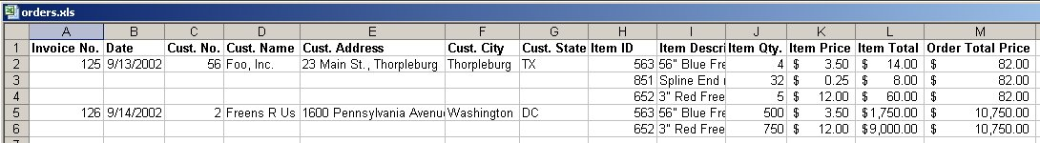
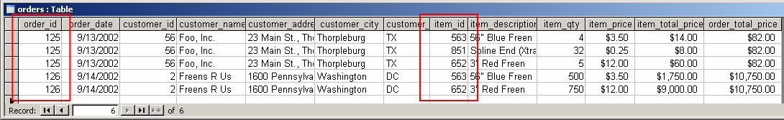
Normalization Example (cont’d)

Slide 22
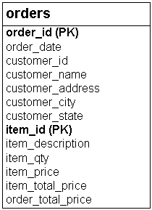
1NF: No Repeating Elements or Groups of Elements
NF1 addresses two issues:
A row of data cannot contain repeating groups of similar data (atomicity).
Each row of data
must have a unique identifier
(or Primary Key).

Slide 23
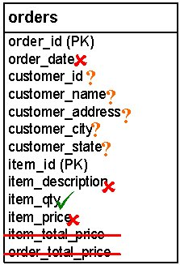
2NF: No Partial Dependencies on a Concatenated Key
NF2 analysis of the orders table:

Slide 24
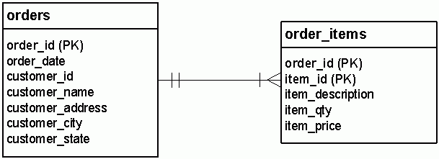
2NF (cont’d)
each order can be associated with any number of order-items, but at least one;
each order-item is associated with one order, and only one.

Slide 25
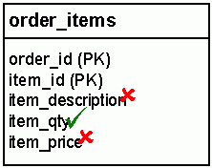
2NF (cont’d)
Remember, NF2 only applies to tables with a concatenated primary key.
Now orders table has a single-column primary key, it has passed 2NF.
order_items still has a concatenated PK.

Slide 26
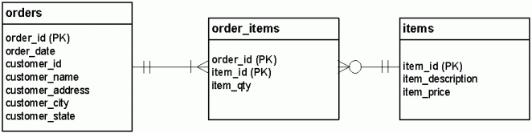
2NF (cont’d)
Each order can have many items; each item can belong to many orders.

Slide 27
3NF: No Dependencies on Non-Key Attributes
the repeating Customer information.
if a customer places more than one order then we have to input all of that customer's contact information again.
each order is made by one, and only one customer.
each customer can make any number of orders, including zero.

Slide 28
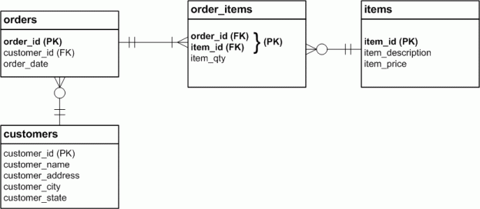
3NF (cont’d)

Slide 29
To Normalize or to De-normalize?
Depending on how a database is to be used.
data input or reporting.
fully normalized databases require complex queries to support reporting and business analysis requirements.
If you are designing a new database system to support a typical business process, you will usually want to follow these rules completely and normalize all of your data structures.
when you have a large volume of data to extract and analyze through reports and business intelligence tools, you will strategically break the rules of normal form, creating redundant values in fewer, larger tables.
OLAP vs. OLTP

Slide 30
Connections and Transactions
SQL architecture important pieces
need to be understood

Slide 31
Connections
A connection is created anytime a process attaches to SQL Server.
The connection is established with defined security and connection properties.
For example, a connection can specify which database to connect to on the server and how to manage memory resident objects.
Connection pooling.

Slide 32
Transactions
Transaction is a collection of dependent data modifications that is controlled so that it completes entirely or not at all.
For example, bank transfer from an account to another account.
database objects designed to maintain data integrity in a transactional environment
Locks
Constraints
Keys
Indexes

Slide 33
Query operations are divided into three different categories
Data Definition Language (DDL) — DDL statements are used to create and manage the objects in a database. They can be used to create, modify, and drop databases, tables, indexes, views, stored procedures, and other objects.
Examples include CREATE, ALTER, and DROP.
Data Control Language (DCL) — DCL statements control the security permissions for users and database objects. Some objects have different permission sets. You can grant or deny these permissions to a specific user or users who belong to a database role or Windows user group.
Examples include GRANT, REVOKE, and DENY.
Data Manipulation Language (DML) — DML statements are used to work with data. This includes statements to retrieve data, insert rows into a table, modify values, and delete rows.
Examples include SELECT, INSERT, UPDATE, and DELETE.

Slide 34
Data Definition
Data Types
Each database column has to have a valid data type
Data types are only partially standardized
Numbers:
TinyInt, Int, BigInt,Numeric, Decimal, Float, Real, money
Characters
Char(length), Nchar, Varchar,Nvarchar
Character Large Object (CLOB)
Varchar(Max),Nvarchar(Max), Text, Ntext
Separated data pages
Large Object (LOB)
Varbinary(max), Varbinary, Binary, Image
Stream operations

Slide 35
Data Types (cont’d)
Large Value Types (LVT)
Varchar(max), Nvarchar(max), or Varbinary(max)
Used with parameters
Date and Time
Smalldatetime, datetime, date, time, timestamp
XML Data Type
store complete XML documents or well-formed XML fragments
Object-Relational Database Management System (ORDBMS)
Table, uniqueidentifier , cursor, sql_variant Data Types
User-Defined Type

Slide 36
Create Tables
Defines the structure of the table
CREATE TABLE Divisions
(DivisionID INT NOT NULL,
DivisionName Varchar(40) NOT NULL);

Slide 37
Alter Tables
Modifies the structure of the table
ALTER TABLE Divisions
ADD DivisionCity Varchar(40) NOT NULL;
or ALTER COLUMN DivisionNameVarchar(80) NOT NULL;
or DROP COLUMN DivisionCityVarchar(40) NOT NULL;

Slide 38
Data Definition (cont’d)
DROP Tables
DROP TABLE Divisions;
Constraints
Used to enforce valid data in columns
NOT NULL (the column will not allow null values)
CHECK (value is checked against constants or other columns)
PRIMARY KEY (enforces uniqueness of primary key)
UNIQUE (enforces uniqueness of alternate keys)
FOREIGN KEY (specifies a relationship between tables)

Slide 39
Data Definition (cont’d)
Indexes (like a virtual table with pointers to physical table)
In general, rows are unsorted
Indexes are sorted on the indexed value
Indexes are created on a single column or combination of columns
NOTE: Null means unknown or missing value, not blank or zero

Slide 40
Data Modification
INSERT
Adds new rows to a table
INSERT INTO Departments
(DivisionID, DepartmentID, DepartmentName)
VALUES (1, 100, ‘Accounting’);

Slide 41
Data Modification (cont’d)
UPDATE
Modifies the column values in existing rows
UPDATE Employee
SET CurrentSalary = CurrentSalary + 100
WHERE Employee = 4;

Slide 42
Data Modification (cont’d)
DELETE
Removes rows from a table
DELETE FROM Employees
WHERE Employee = 7;

Slide 43
TRANSACTIONS
A set of INSERT/UPDATE/DELETE operations that belong together as a logical unit of work
COMMIT (ends the transaction with success and makes updates permanent)
ROLLBACK (ends the transaction with failure and undoes the updates)

Slide 44
TRANSACTIONS (cont’d)
BEGIN TRAN T1;
UPDATE table1 ...;
UPDATE table2 ...;
INSERT INTO table3 …;
COMMIT TRAN T1;

Slide 45
SELECT
SELECT select_list (describes the columns of the result set.)
[ INTO new_table_name ] (specifies that the result set is used to create a new table)
FROM table_list (Contains a list of the tables from which the result set data is retrieved)
[ WHERE search_conditions ] (filter that defines the conditions each row in the source tables must meet)
[ GROUP BY group_by_list ] (partitions the result set into groups based on the values)
[ HAVING search_conditions ] (an additional filter that is applied to the result set)
[ ORDER BY order_list [ ASC | DESC ] ] (defines the order in which the rows in the result set are sorted)

Slide 46
Single Table SELECT
SELECT EmployeeID, FirstName, LastName
,CurrentSalary*12 AS YearlySalary
FROM Employees
WHERE EmployeeID = 3;
DISTINCT can be used to suppress duplicates

Slide 47
WHERE
The WHERE clause specifies a filter condition
Conditional Operators
= <> > < >= <=
IN , NOT IN (test for several values)
BETWEEN, NOT BETWEEN (intervals)
IS NULL, IS NOT NULL
LIKE, NOT LIKE ( % or _ )
EXISTS, NOT EXISTS (sub queries)
Conditions can be combined with NOT AND OR

Slide 48
ORDER BY
The ORDER BY statement defines the sort order of the rows
SELECT LastName,FirstName,CurrentSalary
FROM Employees
ORDER BY CurrentSalary DESC
,LastName ASC
,FirstName ASC;

Slide 49
NULL
NULL is not the same as blank
NULL is not the same as zero
NULL is not the same as the text ‘NULL’
NULL is not equal to any value
NULL is not different to any value
NULL is not equal to NULL
In SQL Server, NULL sorts as the lowest value

Slide 50
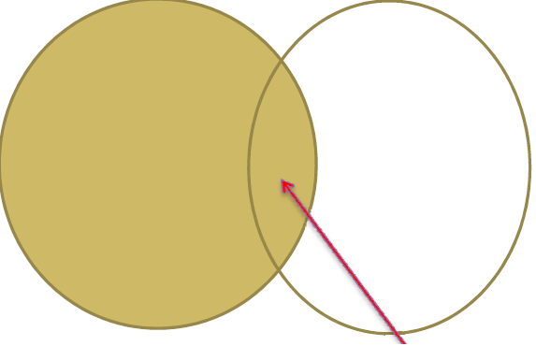
Joins (INNER)
Joins are used to combine information from multiple tables
Basic Syntax of an INNER Join (excludes data that does NOT satisfy the join)

Slide 51
Joins (INNER) (cont’d)
SELECT column_name(s)
FROM table_name1 INNER JOIN table_name2
ON table_name1.column_name = table_name2.column_name
Inner joins are default, so the word Inner can be omitted

Slide 52
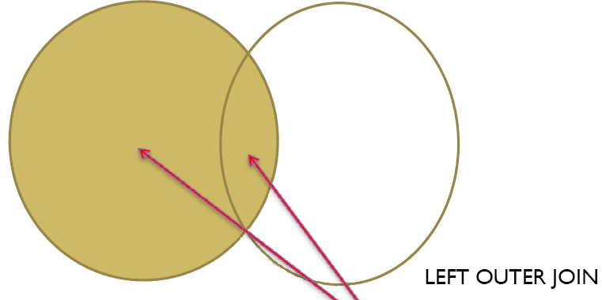
Joins (OUTER)
Basic Syntax of an OUTER Join (include rows from one table that have no matching row)

Slide 53
Joins (OUTER) (cont’d)
table1 LEFT OUTER JOIN table2
all rows from table 1 will be included
table1 RIGHT OUTER JOIN table2
all rows from table 2 will be included
table1 FULL OUTER JOIN table2
all rows from each table will be included
SELECT column_name(s) FROM table_name1
LEFT OUTER JOIN table_name2
ON table_name1.column_name =
table_name2.column_name

Slide 54
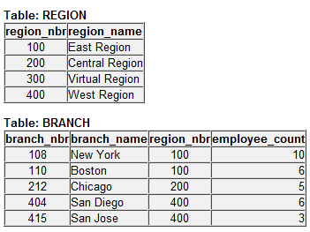
Outer Join Example
SELECT region.region_nbr, region.region_name, branch.branch_nbr, branch.branch_name FROM region LEFT OUTER JOIN branch ON branch.region_nbr = region.region_nbr ORDER BY region.region_nbr

Slide 55
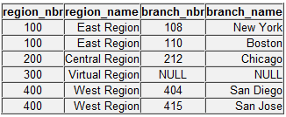
Outer Join Example (cont’d)
Here is the result. Note that the "Virtual Region" is included in the results even though it has no rows in the branch table. This is the difference between the INNER JOIN and OUTER JOIN.

Slide 56
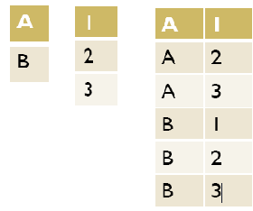
Joins (CROSS) Cartesian Product
Each row in one table is paired to every row in the other table
SELECT * FROM employee
CROSS JOIN department

Slide 57
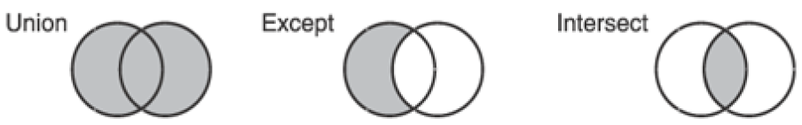
Set Operators
UNION, INTERSECT and EXCEPT

Slide 58
UNION
SELECT zip FROM hotel.customer
WHERE zip > '90000‘
UNION [ALL]
SELECT zip FROM hotel.hotel
WHERE zip > '90000‘
Creates one table with rows from both SELECTs
Suppresses duplicate rows

Slide 59
INTERSECT
SELECT zip FROM hotel.customer
WHERE zip < '30000'
INTERSECT
SELECT zip FROM hotel.hotel
WHERE zip < '30000‘
Returns the rows that occur in both queries

Slide 60
EXCEPT
SELECT zip FROM hotel.hotel
WHERE zip < '30000'
EXCEPT
SELECT zip FROM hotel.customer
WHERE zip < '30000‘
Returns the rows from one query except those that occur in the other basically a minus

Slide 61
Row Functions
Row functions take input parameters and return a value
Math Functions
String Functions
Date and Time Functions
Data Type Conversions
CASE Statements
NULL Functions

Slide 62
Row Functions - Math
ABS, DEGREES, RAND, ACOS
EXP, ROUND, ASIN, LOG, SIN
ATN2, LOG10, SQRT, CEILING
FLOOR, SIGN, ATAN,PI
SQUARE, COS, POWER
TAN, COT, RADIANS
SELECT ROUND(123.9994,3)
Here is the result set. 123.9990

Slide 63
Row Functions - String
ASCII, NCHAR, SOUNDEX, CHAR, PATINDEX
SPACE, CHARINDEX, DIFFERENCE, REPLACE
STUFF, LEFT, REPLICATE, SUBSTRING
QUOTENAME, STR,LEN, REVERSE
UNICODE, LOWER, RIGHT
UPPER, LTRIM, RTRIM
SELECT LEFT('abcdefg',2)
Here is the result set. ab

Slide 64
Row Functions – Date & Time
DATEADD, DATEDIFF
DATENAME, DATEPART
DAY, MONTH, YEAR
GETDATE, GETUTCDATE
SELECT GETDATE()
Here is the result set: July 7 2009 4:20 PM

Slide 65
Row Functions – Data Type
SELECT CAST( 'abc' AS varchar(5) )
SELECT
SUBSTRING(Name, 1, 30) AS ProductName,
ListPrice
FROM Production.Product
WHERE
CONVERT(int, ListPrice) LIKE '3%';

Slide 66
Row Functions - Case
The CASE expression enables many forms of conditional processing to be placed into a SQL statement.
SELECT title, price,
Budget = CASE price
WHEN price > 20.00 THEN 'Expensive‘
WHEN price BETWEEN 10.00 AND 19.99 THEN 'Moderate'
WHEN price < 10.00 THEN 'Inexpensive'
ELSE 'Unknown'
END,
FROM titles

Slide 67
Row Functions - Null
A null value in an expression causes the result of the expression to be null
Testing for NULL in a WHERE clause
ISNULL(check_expression, replacement_value)
NULLIF(@Value1, @Value2)
SELECT Name, Weight
FROM Production.Product
WHERE Weight IS NULL;

Slide 68
Aggregate Functions
SUM, AVG, MAX, MIN, COUNT
SELECT AVG (UnitPrice * Quantity) As AveragePrice
FROM WidgetOrders
WHERE Continent = “North America”
SELECT COUNT(*) AS 'Number of Large Orders'
FROM WidgetOrders
WHERE Quantity > 100
SELECT MAX(Quantity * UnitPrice) As 'Largest Order'
FROM WidgetOrders

Slide 69
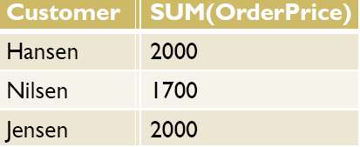
Aggregate Functions – GROUP BY
The GROUP BY statement is used in conjunction with the aggregate functions to group the result-set by one or more columns.
SELECT Customer, SUM(OrderPrice)
FROM Orders
GROUP BY Customer

Slide 70

Aggregate Functions – HAVING
The HAVING clause was added to SQL because the WHERE keyword could not be used with aggregate functions.
SELECT Customer, SUM(OrderPrice)
FROM Orders
GROUP BY Customer
HAVING SUM(OrderPrice)<2000

Slide 71
Subqueries
A SELECT statement embedded into another statement is called a subquery
SELECT SUM(Sales) FROM Store_Information
WHERE Store_name IN
(SELECT store_name FROM Geography
WHERE region_name = 'West')
IN or NOT IN will handle extra lists returned by the sub query Operators (>, <, =, etc.) can be used when single values are returned

Slide 72
Correlated Subqueries
If a subquery may reference columns from the main query table, this is called a correlated
SELECT DISTINCT c.LastName, c.FirstName
FROM Person.Contact c
JOIN HumanResources.Employee e
ON e.ContactID = c.ContactID
WHERE 5000.00 IN
(SELECT Bonus FROM Sales.SalesPerson sp
WHERE e.EmployeeID = sp.SalesPersonID) ;

Slide 73
Views - Inline
A view is a virtual table based on the result-set of an SQL statement
An inline view is a table within the
SELECT height
FROM
(SELECT height FROM test WHERE id = @id
ORDER BY id DESC, acc_date DESC, height DESC)
WHERE ROWNUM = 1;

Slide 74
Views - Stored
CREATE VIEW [Current Product List] AS
SELECT ProductID,ProductName
FROM Products
WHERE Discontinued=No
A view does not store data
If you do insert, update, delete on a view the data values in the underlying tables will be updated
This is not possible on all views
Computed columns cannot be updated
Not permitted on aggregate views or views with set operators
Join views may or may not be updateable

Slide 75
Stored Procedures & Functions
Precompiled execution.
Reduced client/server traffic.
Efficient reuse of code and programming abstraction.
Centralize maintenance.
Enhanced security controls. You can grant users permission to execute a stored procedure independently of underlying table permissions.

Slide 76
Stored Procedures
CREATE PROCEDURE sp_GetInventory @location varchar(10) AS SELECT Product, Quantity FROM Inventory WHERE Warehouse = @location
EXECUTE sp_GetInventory 'FL'

Slide 77
User Defined Functions
CREATE FUNCTION whichContinent
(@Country nvarchar(15))
RETURNS varchar(30)
AS BEGIN
declare @Return varchar(30)
select @return = case @Country
when 'Argentina' then 'South America‘
when 'Belgium' then 'Europe'
when 'Brazil' then 'South America‘
else 'Unknown'
End
return @return
end

Slide 78
Stored Procedures VS Functions
Stored procedures are called independently, using the EXEC command, while functions are called from within another SQL statement.
Stored procedure allow you to enhance application security by granting users and applications permission to use stored procedures.
Functions must always return a value (either a scalar value or a table). Stored procedures may return a scalar value, a table value or nothing at all.

Slide 79
Triggers
A special kind of stored procedure that executes automatically when a user attempts the specified data-modification statement on the specified table.
Microsoft® SQL Server™ allows the creation of multiple triggers for any given INSERT, UPDATE, or DELETE statement.

Slide 80
Triggers (cont’d)
CREATE TRIGGER trigger_name ON table [WITH ENCRYPTION] { {{ FOR | AFTER | INSTEAD OF } { [DELETE] [,] [INSERT] [,] [UPDATE] } [NOT FOR REPLICATION] AS sql_statement [...n] } | {{FOR | AFTER | INSTEAD OF }{ [INSERT] [,] [UPDATE] } [NOT FOR REPLICATION] AS { IF UPDATE (column) [{AND | OR} UPDATE (column)] [...n] | IF (COLUMNS_UPDATED() {bitwise_operator} updated_bitmask) { comparison_operator} column_bitmask [...n] } sql_statement [ ...n] } }

Slide 81
Triggers (cont’d)
CREATE TRIGGER trigAddStudents ON Students FOR INSERT AS DECLARE @Newname VARCHAR(100) SELECT @Newname =(SELECT Name FROM INSERTED) PRINT 'THE STUDENT ' + @Newname + ' IS ADDED.';

Slide 82
The Mechanics of Query Processing
Query processor
Complex queries are broken down into individual steps / smaller queries
This list of steps is known as an execution plan.
The query's syntax may actually be rewritten by the query optimizer into a standard form of SQL.
Before SQL Server can send instructions to the computer's processor, these commands must be compiled into low-level computer instructions, or object code.

Slide 83
Query Processing (cont’d)
The optimized, compiled query is placed into an in-memory cache. Depending on how the query is created
View or stored procedure, the execution plan and cache are saved with that object in the database, called procedure cache.
Ad-hoc queries, the cached compiled query and execution plan is held into memory as buffer cache and reused until the user and client application's connection is closed.
If the same query is executed multiple times, it should run faster and more efficiently after the first time

Slide 84
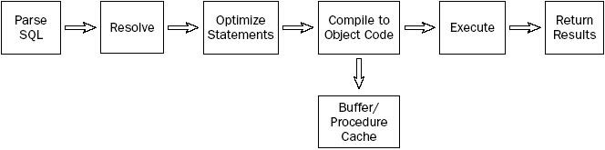
Query Processing (cont’d)

Slide 85
Thanks & Happy Coding

