Slide 1
Chapter 4 Serial Communication Protocols
Shahnam Mirzaei, PhD
California State University, Northridge
Spring 2020
ECE 520 (System on Chip Design)

Slide 2
Introduction
When two devices such as a microcontroller and a sensor, or display are connected to each other, how do they talk to each other?
Communication between electronic devices is like communication between humans. Both sides need to speak the same language. In electronics, these languages are called communication protocols.
Some serial communication protocols such as SPI, I2C, and UART are quite a bit slower than protocols like USB, Ethernet, Bluetooth, and WiFi, but they’re a lot more simple and use less hardware and system resources.
We will discuss the basics of the three most common protocols that are ideal for microcontroller and peripheral components:
Serial Peripheral Interface (SPI)
Inter-Integrated Circuit (I2C)
Universal Asynchronous Receiver/Transmitter (UART) driven communication.
csun-ece520-Mirzaei

Slide 3
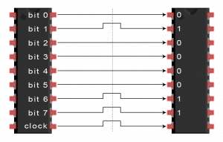

Serial Vs. Parallel Communication
The bits of data can be transmitted either in parallel or serial form.
In parallel communication, the bits of data are sent all at the same time, each through a separate wire.
In serial communication, the bits are sent one by one through a single wire.
The letter “C” in binary (01000011) is being transmitted!
Parallel Communication
Serial
Communication
csun-ece520-Mirzaei

Slide 4
Serial Interfaces
CPU
ISA
Software
Hardware
INT#
interrupts
System Buses
AHB/APB
Interrupts
GPIO/INT
Timers
USART
DAC/ADC
Internal &
External
Memory
Internal
External
Input
I2C
SPI
ADC
DAC
EMC
Output
Capture
UART
Interrupt
Compare
csun-ece520-Mirzaei

Slide 5
Serial Bus Interface Motivations
Motivation
Connect different systems together
Two embedded systems
A desktop and an embedded system
Connect different chips together in an embedded system
MCU to peripheral
Connection without using a lot of I/O lines
I/O lines require I/O pads which cost $$$ and size
I/O lines require PCB area which costs $$$ and size
Connection at
Often at relatively low data rates
But sometimes at higher data rates
So, what are our options?
Universal Synchronous/Asynchronous Receiver Transmitter (USART), Serial Peripheral Interface (SPI), Inter Integrated Circuit (I2C), …

Slide 6
Serial Interface Design Space
Number of wires required?
Asynchronous or synchronous?
How fast can it transfer data?
Can it support more than two endpoints?
Can it support more than one master (i.e. txn initiator)?
How do we support flow control?
How does it handle errors/noise?

Slide 7
Serial I/O Types
Serial communication
Transmit Data (TxD), Receive Data (RxD), and Signal Ground (SG) implement duplex communication link
Both communicating devices must operate at the same bit rate
Full duplex
Half duplex
Simplex
csun-ece520-Mirzaei

Slide 8
Asynchronous Transmission
One definition of asynchronous: transmitter and receiver do not explicitly coordinate each data transmission
Transmitter can wait arbitrarily long between transmissions
Used, for example, when transmitter such as a keyboard may not always have data ready to send
Asynchronous may also mean no explicit information about where data bits begin and end
E.g. when we send individual ASCII characters

Slide 9
Serial Peripheral Interface (SPI)

Slide 10
Introduction
A synchronous serial communication protocol
Full duplex communication at very high speeds
The best choice in short distance communication (communication within a device or between the devices on the same PCB).
Master-slave relationship
Master is the controlling device (usually a microcontroller or FPGA), while the slave (usually a sensor, display, or memory chip) takes instruction from the master.
The simplest configuration of SPI is a single master, single slave system, but one master can control more than one slave (more on this below).
csun-ece520-Mirzaei

Slide 11
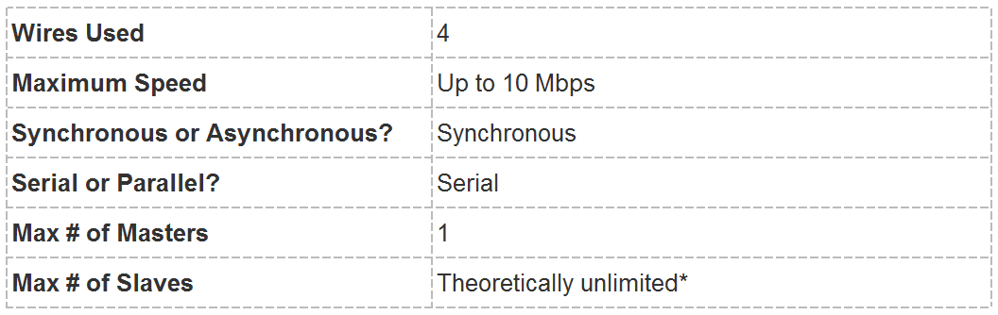
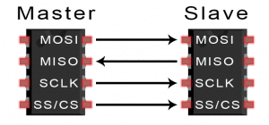
Protocol
MOSI (Master Output/Slave Input) – Line for the master to send data to the slave
MISO (Master Input/Slave Output) – Line for the slave to send data to the master
SCLK (Clock) – Line for the clock signal
SS/CS (Slave Select/Chip Select) – Line for the master to select which slave to send data to
csun-ece520-Mirzaei

Slide 12
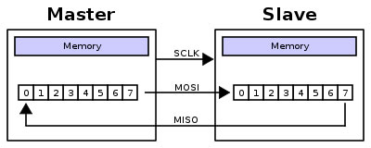
Shifting Protocol
Master shifts out data to Slave, and shift in data from Slave
csun-ece520-Mirzaei

Slide 13
How SPI Works!
Clock
The clock signal (SCLK) synchronizes the output of data bits from the master to the sampling of bits by the slave.
One bit of data is transferred in each clock cycle
Speed of data transfer is determined by SCLK frequency.
SPI communication is always initiated by the master.
The clock signal in SPI can be modified using the properties of clock polarity (CPL) and clock phase (CPH).
These two properties work together to define when the bits are output and when they are sampled.
Clock polarity can be set by the master to allow for bits to be output and sampled on either the rising or falling edge of the clock cycle.
Clock phase can be set for output and sampling to occur on either the first edge or second edge of the clock cycle, regardless of whether it is rising or falling.
csun-ece520-Mirzaei

Slide 14
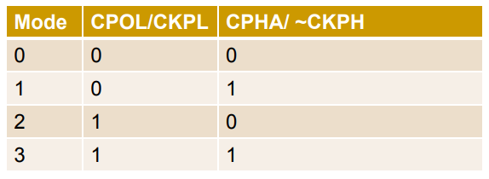
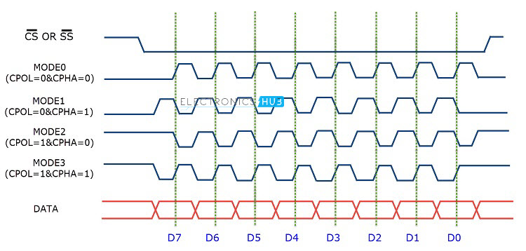
How SPI Works!
Configuration Detail to Watch for!
CPHA (Clock PHase) aka ~CKPH
= 0 or =1, determines when data goes on bus relative to clock
CPOL (Clock POLarity) aka CKPL
=0: Clock idles low between transfers
=1: Clock idles high between transfers
This leads to 4 SPI clock modes
csun-ece520-Mirzaei

Slide 15
How SPI Works!
Slave Select
The master can choose which slave it wants to talk to by setting the slave’s CS/SS line to a low voltage level.
In the idle, non-transmitting state, the slave select line is kept at a high voltage level.
Multiple CS/SS pins may be available on the master, which allows for multiple slaves to be wired in parallel.
If only one CS/SS pin is present, multiple slaves can be wired to the master by daisy-chaining.
csun-ece520-Mirzaei

Slide 16
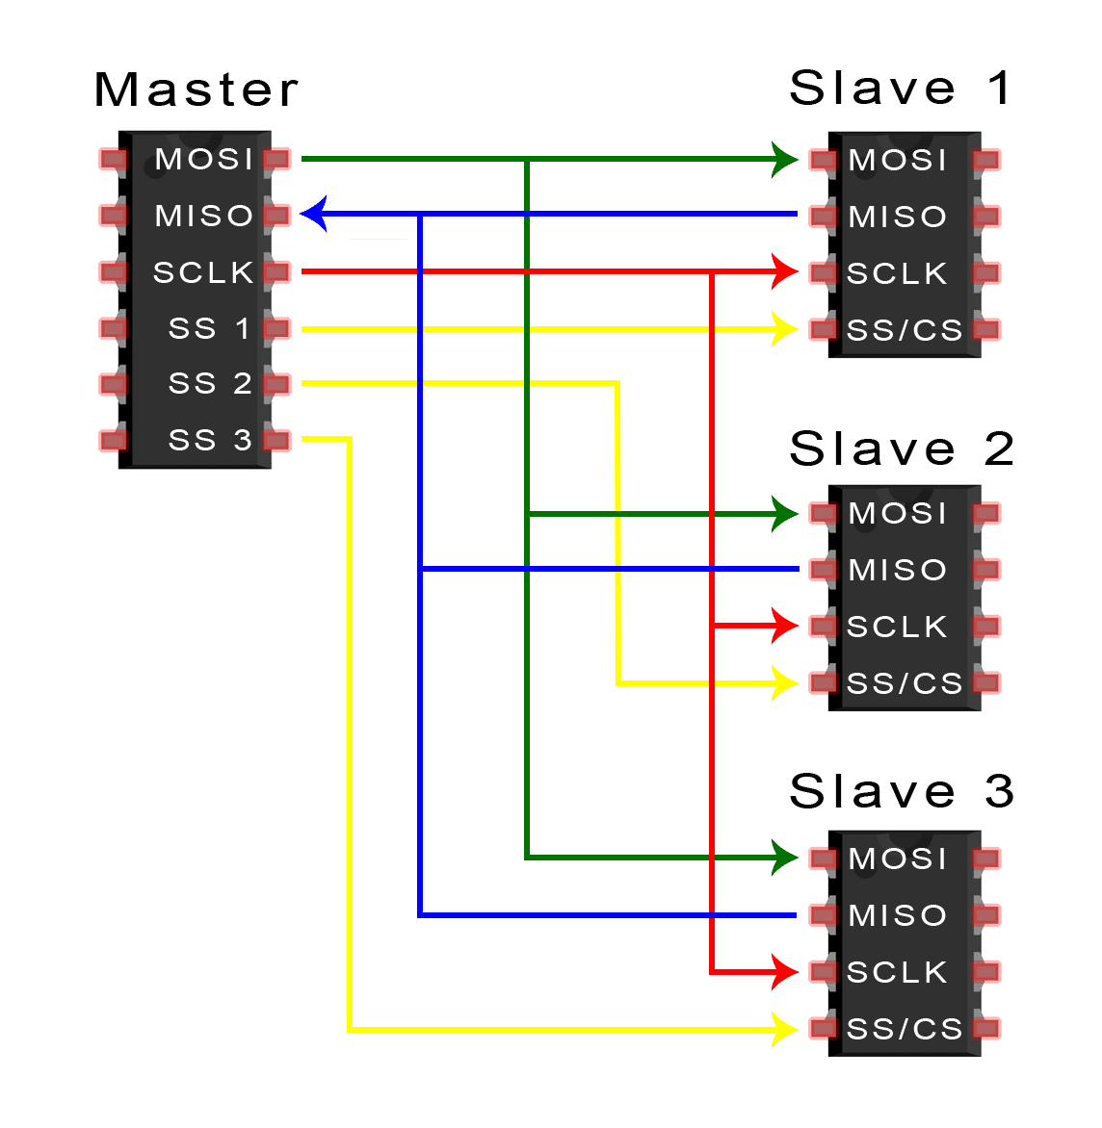
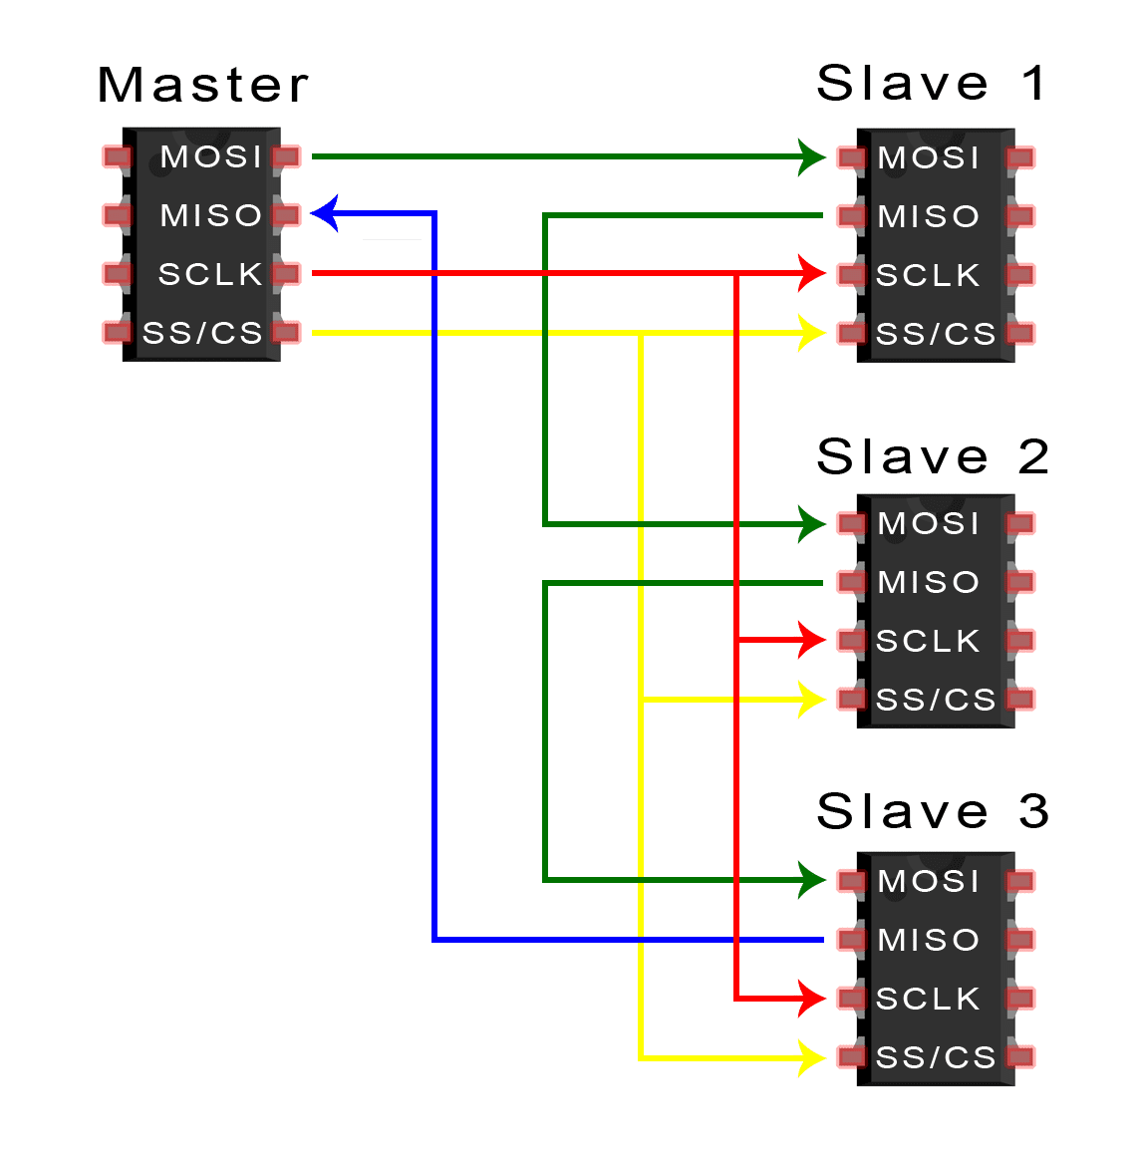
How SPI Works!
Multiple Slaves
SPI can be set up to operate with a single master and a single slave, and it can be set up with multiple slaves controlled by a single master.
Master with multiple slave select pins
Master with one slave select pins (Daisy chain)
csun-ece520-Mirzaei

Slide 17
How SPI Works!
MOSI and MISO
The master sends data to the slave bit by bit, in serial through the MOSI line.
The slave receives the data sent from the master at the MOSI pin.
Data sent from the master to the slave is usually sent with the most significant bit first.
The slave can also send data back to the master through the MISO line in serial.
The data sent from the slave back to the master is usually sent with the least significant bit first.
csun-ece520-Mirzaei

Slide 18
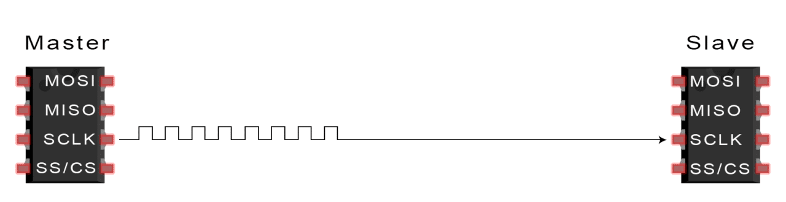
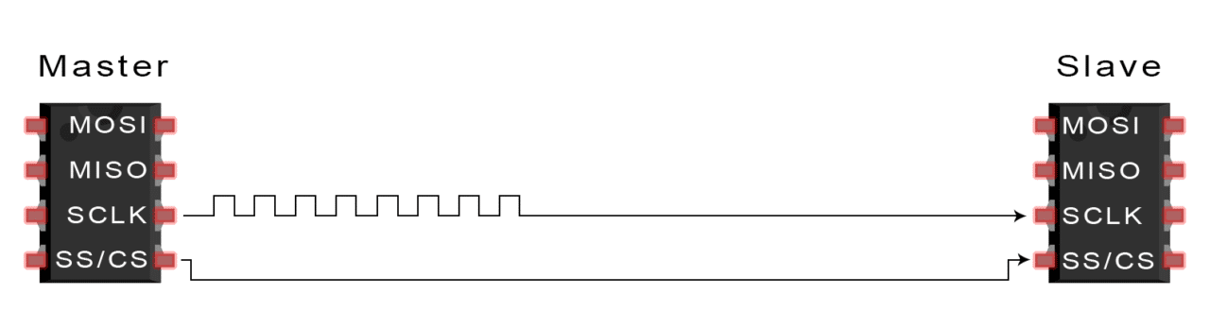
Data Transmission
❶ The master outputs the clock signal:
❷ The master switches the SS/CS pin to a low voltage state, which activates the slave:
csun-ece520-Mirzaei

Slide 19
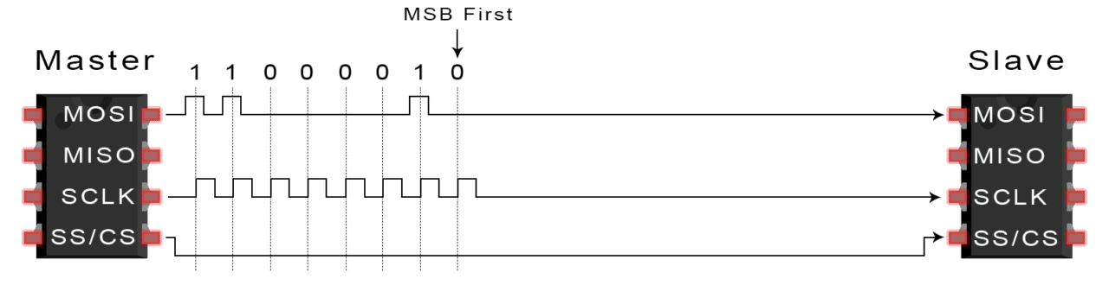
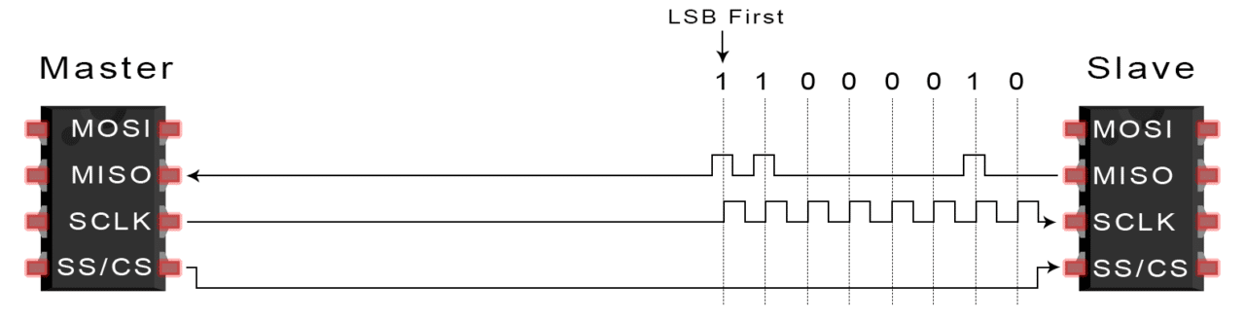
Data Transmission
❸ The master sends the data one bit at a time to the slave along the MOSI line. The slave reads the bits as they are received:
❹ If a response is needed, the slave returns data one bit at a time to the master along the MISO line. The master reads the bits as they are received
csun-ece520-Mirzaei

Slide 20
Pros/Cons
Pros:
Fast for point-to-point connections
Easily allows streaming/Constant data inflow
Everyone supports it
No start and stop bits, so the data can be streamed continuously without interruption
No complicated slave addressing system like I2C
Higher data transfer rate than I2C (almost twice as fast)
Separate MISO and MOSI lines, so data can be sent and received at the same time (Full duplex)
Cons:
SS makes multiple slaves very complicated
Uses four wires (I2C and UARTs use two)
No acknowledgement that the data has been successfully received (I2C has this)
No form of error checking like the parity bit in UART
Only allows for a single master
csun-ece520-Mirzaei

Slide 21
UART

Slide 22
Introduction
Universal Asynchronous Receiver/Transmitter
Hardware that translates between parallel and serial forms
Commonly used in conjunction with communication standards such as EIA, RS-232, RS-422 or RS-485
The universal designation indicates that the data format and transmission speeds are configurable and that the actual electric signaling levels and methods (such as differential signaling etc.) typically are handled by a special driver circuit external to the UART.
UARTs transmit data asynchronously, which means there is no clock signal to synchronize the output of bits from the transmitting UART to the sampling of bits by the receiving UART.
csun-ece520-Mirzaei

Slide 23
Introduction
In UART communication, two UARTs communicate directly with each other.
The transmitting UART converts parallel data from a controlling device like a CPU into serial form, transmits it in serial to the receiving UART
The receiving UART converts the serial data back into parallel data for the receiving device.
Only two wires are needed to transmit data between two UARTs.
Data flows from the Tx pin of the transmitting UART to the Rx pin of the receiving UART
csun-ece520-Mirzaei

Slide 24
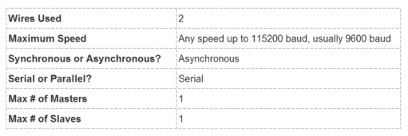
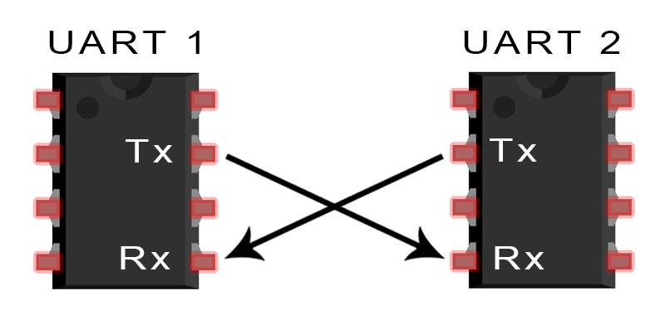
Protocol
Instead of a clock signal, the transmitting UART adds start and stop bits to the data packet. These bits define the beginning and end of the data packet so the receiving UART knows when to start reading the bits.
When the receiving UART detects a start bit, it starts to read the incoming bits at a specific frequency known as the baud rate.
Baud rate is a measure of the speed of data transfer, expressed in bits per second (bps).
Both UARTs must operate at the same baud rate. The baud rate between UARTs can only differ by about 10% before.
Both UARTs must also must be configured to transmit and receive the same data packet structure
csun-ece520-Mirzaei

Slide 25
Protocol
The UART that is going to transmit data receives the data from a data bus.
The data bus is used to send data to the UART by another device like a CPU, memory, or microcontroller.
Data is transferred from the data bus to the transmitting UART in parallel form.
After the transmitting UART gets the parallel data from the data bus, it adds a start bit, a parity bit, and a stop bit, creating the data packet.
Next, the data packet is output serially, bit by bit at the Tx pin. The receiving UART reads the data packet bit by bit at its Rx pin.
The receiving UART then converts the data back into parallel form and removes the start bit, parity bit, and stop bits.
csun-ece520-Mirzaei

Slide 26
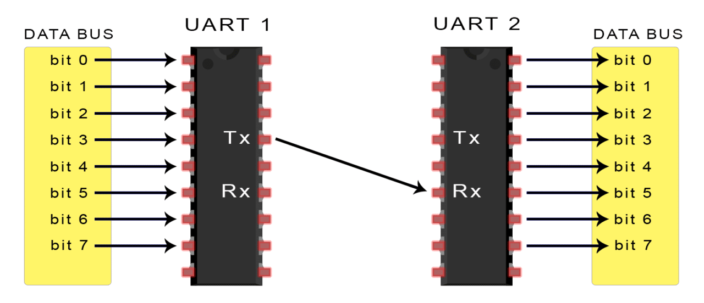
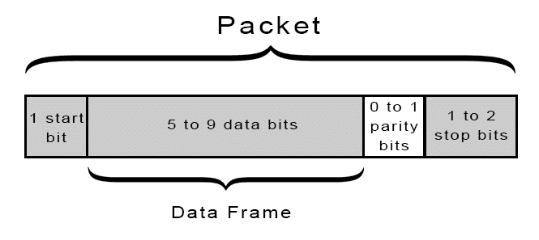
Protocol
Finally, the receiving UART transfers the data packet in parallel to the data bus on the receiving end:
UART transmitted data is organized into packets. Each packet contains 1 start bit, 5 to 9 data bits (depending on the UART), an optional parity bit, and 1 or 2 stop bits:
csun-ece520-Mirzaei

Slide 27
How UART Works!
Start Bit/Stop Bit
Start Bit
The UART data transmission line is normally held at a high voltage level when it’s not transmitting data.
To start the transfer of data, the transmitting UART pulls the transmission line from high to low for one clock cycle.
When the receiving UART detects the high to low voltage transition, it begins reading the bits in the data frame at the frequency of the baud rate.
Stop Bit
To signal the end of the data packet, the sending UART drives the data transmission line from a low voltage to a high voltage for at least two bit durations.
csun-ece520-Mirzaei

Slide 28
How UART Works!
Data Frame
The data frame contains the actual data being transferred.
Data frame can be 5 bits up to 8 bits long if a parity bit is used.
If no parity bit is used, the data frame can be 9 bits long.
In most cases, the data is sent with the least significant bit first.
csun-ece520-Mirzaei

Slide 29
How UART Works!
Parity Bit
Parity describes the evenness or oddness of a number.
The parity bit is a way for the receiving UART to tell if any data has changed during transmission.
Bits can be changed by electromagnetic radiation, mismatched baud rates, or long distance data transfers.
After the receiving UART reads the data frame, it counts the number of bits with a value of 1 and checks if the total is an even or odd number.
If the parity bit is a 0 (even parity), the 1 bits in the data frame should total to an even number.
If the parity bit is a 1 (odd parity), the 1 bits in the data frame should total to an odd number.
When the parity bit matches the data, the UART knows that the transmission was free of errors. But if the parity bit is a 0, and the total is odd; or the parity bit is a 1, and the total is even, the UART knows that bits in the data frame have changed.
csun-ece520-Mirzaei

Slide 30
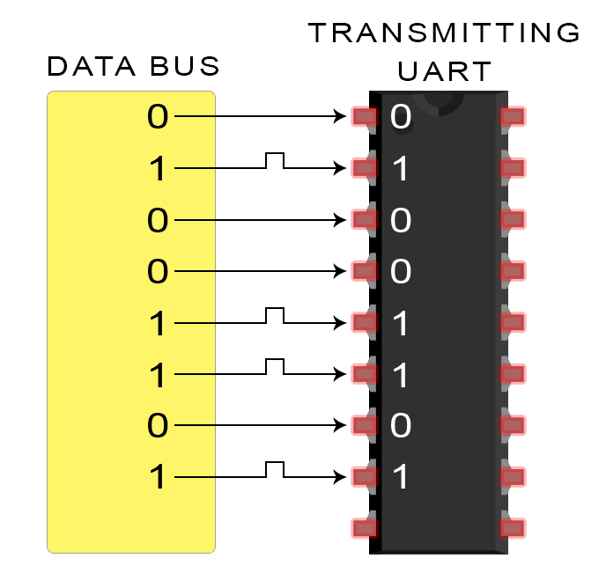
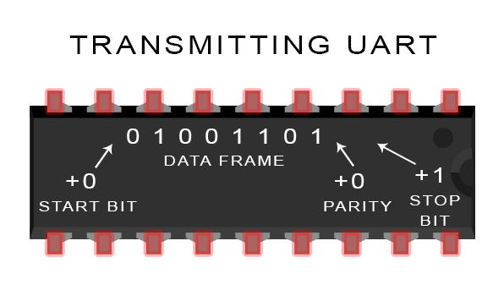
Data Transmission
❶ The transmitting UART receives data in parallel from the data bus:
❷ The transmitting UART adds the start bit, parity bit, and the stop bit(s) to the data frame
csun-ece520-Mirzaei

Slide 31
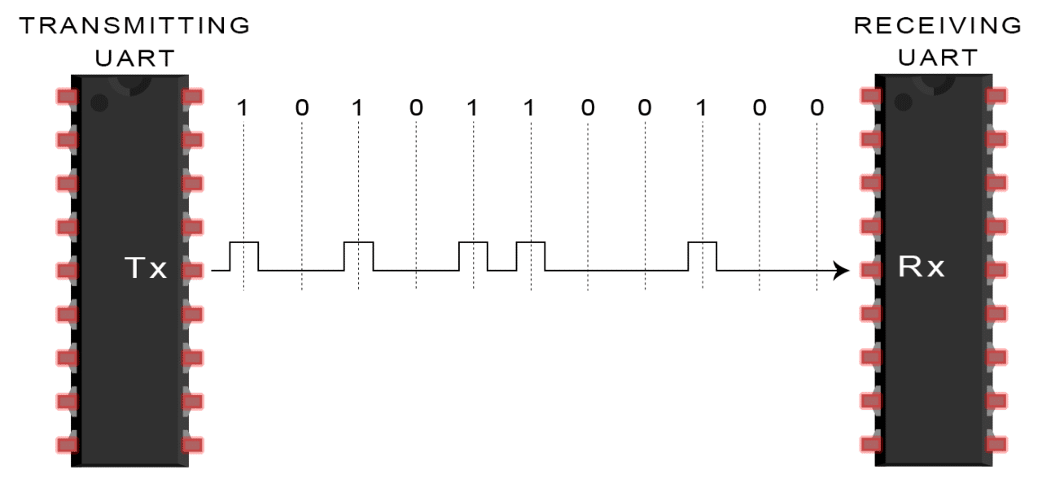
Data Transmission
❸ The entire packet is sent serially from the transmitting UART to the receiving UART. The receiving UART samples the data line at the pre-configured baud rate:
csun-ece520-Mirzaei

Slide 32
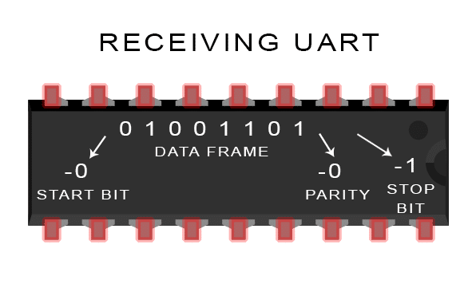
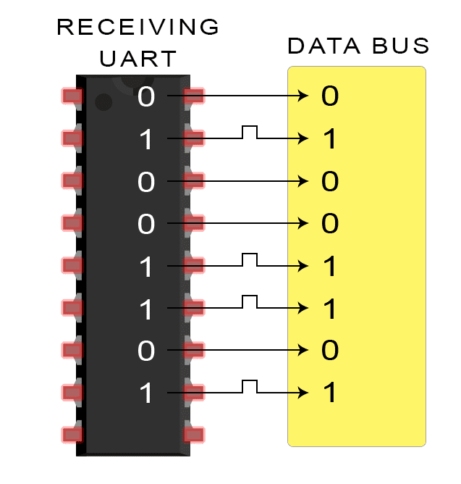
Data Transmission
❹ The receiving UART discards the start bit, parity bit, and stop bit from the data frame:
❺ The receiving UART converts the serial data back into parallel and transfers it to the data bus on the receiving end:
csun-ece520-Mirzaei

Slide 33
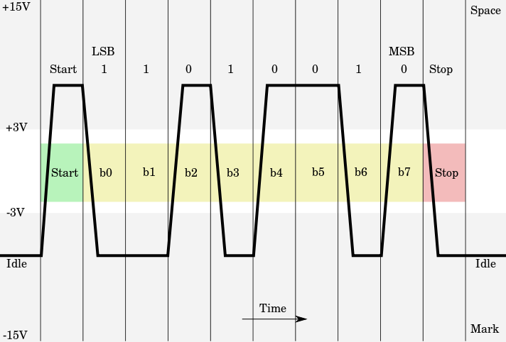

UART and RS232
Most of the time RS-232 and UART come together in serial communication theories. Are they both the same? No
UART is responsible for sending/receiving a sequence of bits. At the output of a UART these bits are represented by logic level voltages.
These bits can become RS-232, RS-422, RS-485, …
RS-232 specifies voltage levels.
Larger voltage swing makes RS-232 more resistant to interference.
A microcontroller UART can not generate such voltages levels by itself. This is done with help of an additional component: RS-232 line driver.
Diagrammatic trace of voltage levels for an ASCII "K" character (0x4B) with 1 start bit, 8 data bits, 1 stop bit.
csun-ece520-Mirzaei

Slide 34
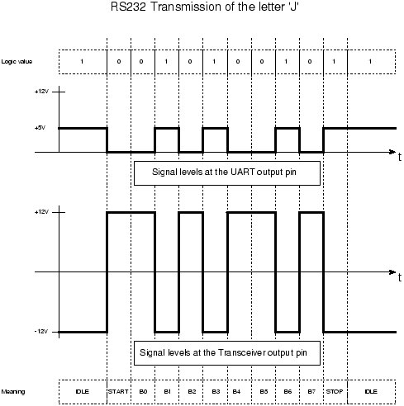
UART and RS232 Transmission Example
UART
RS-232
RS-485
RS-232
RS-485
UART
UART
RS
-
232
UART
(TL16C550C)
(
SN75LV4737A)
(TL16C550C)
8 bit parallel
signal
Serial Signal
8 bit parallel
signal
Diagrammatic trace of voltage levels for an ASCII “J" character (0x4A) with 1 start bit, 8 data bits, 1 stop bit.
csun-ece520-Mirzaei

Slide 35
Rate of Data Transfer
The standard UART clock-frequency for PCs equals 1,843,200 cycles-per-second
Each data-bit consumes 16 clock-cycles
So the fastest serial bit-rate in PCs would be 1843200/16 = 115200 bits-per-second
With one ‘start’ bit and one ‘stop’ bit, ten bits are required for each ‘byte’ of data
The ‘Divisor Latch’ may be used to slow down the UART rate of data-transfer
Clock-frequency gets divided by the value programmed in the ‘Divisor Latch’ register
csun-ece520-Mirzaei

Slide 36
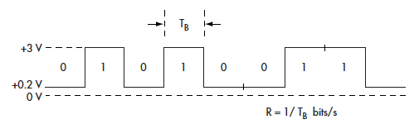
Bit Rate and Baud Rate
Data bits transmit one at a time over some communications channel, such as a cable.
The speed of the data is expressed in bits per second (bps).
The data rate R is a function of the duration of the bit or bit time (T_{B}) : R = 1/T_{B}
Rate is also called channel capacity C. If the bit time is 10 ns, the data rate equals:
R = 1/10 x 10^{–9} = 100 Mbits/s.
For most serial transmissions, the data represents part of a more complex protocol frame or packet format
This includes bits representing source address, destination address, error detection and correction codes, and other information or control bits.
In the protocol frame, the data is called the “payload.” Non-data bits are known as the “overhead.”
Overhead may be substantial—up to 20% to 50% depending on the total payload bits
csun-ece520-Mirzaei

Slide 37
Pros/Cons
Pros:
Only uses two wires
No clock signal is necessary
Has a parity bit to allow for error checking
The structure of the data packet can be changed as long as both sides are set up for it
Well documented and widely used method
Cons:
The size of the data frame is limited to a maximum of 9 bits
Doesn’t support multiple slave or multiple master systems
The baud rates of each UART must be within 10% of each other
csun-ece520-Mirzaei

Slide 38
Inter-Integrated Circuit (I²C)

Slide 39
What is I²C?
I²C Stands for Inter-Integrated Circuit
Two-wire serial bus protocol (like UART) with addressing capability
Invented by Phillips in early 1980’s
Very common in peripheral devices in embedded systems
Also used in PC world
Real time clocks
Temperature sensors
Speeds up to 3.4 Mbps
Multi-master/ Multi-slave
I²C combines the best features of SPI and UARTs. With I²C, you can connect multiple slaves to a single master (like SPI) and you can have multiple masters controlling single, or multiple slaves. This is really useful when you want to have more than one microcontroller logging data to a single memory card or displaying text to a single LCD.
csun-ece520-Mirzaei

Slide 40
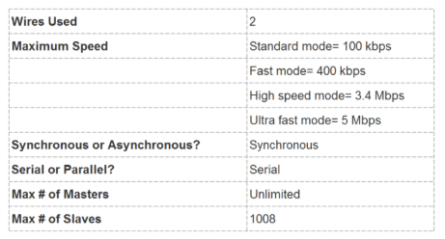
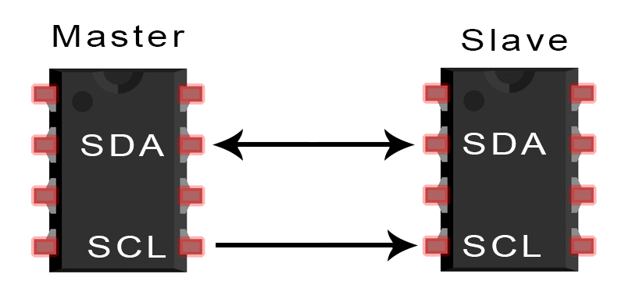
I²C Wiring
SDA (Serial Data) – The line for the master and slave to send and receive data.
SCL (Serial Clock) – The line that carries the clock signal.
csun-ece520-Mirzaei

Slide 41
I²C Wiring
I²C is a serial communication protocol, so data is transferred bit by bit along a single wire (the SDA line)
Like SPI, I²C is synchronous, so the output of bits is synchronized to the sampling of bits by a clock signal shared between the master and the slave. The clock signal is always controlled by the master.
Open collector
Simple interfacing between different voltage levels
Clock
Not a traditional clock
Normally high
Pulsed by the master during data transmission (Whether the master is transmitted or receiver)
Slave device can hold clock low if it needs more time
csun-ece520-Mirzaei

Slide 42
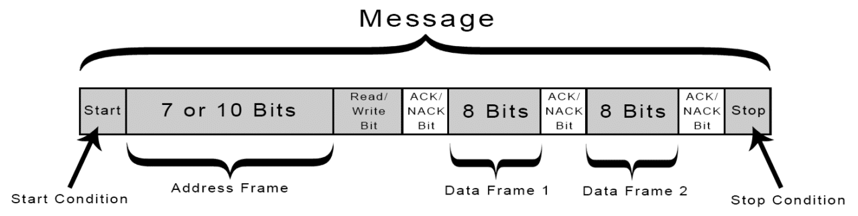
How I²C Works!
Data Frames
With I²C, data is transferred in messages. Messages are broken up into frames of data.
Each message has an address frame that contains the binary address of the slave, and one or more data frames that contain the data being transmitted.
The message also includes start and stop conditions, read/write bits, and ACK/NACK bits between each data frame:
csun-ece520-Mirzaei

Slide 43
How I²C Works!
Data Frames
Start Condition
The SDA line switches from a high voltage level to a low voltage level before the SCL line switches from high to low.
Stop Condition
The SDA line switches from a low voltage level to a high voltage level after the SCL line switches from low to high.
Address Frame
A 7 or 10 bit sequence unique to each slave that identifies the slave when the master wants to talk to it.
Read/Write Bit
A single bit specifying whether the master is sending data to the slave (low voltage level) or requesting data from it (high voltage level).
ACK/NACK Bit
Each frame in a message is followed by an acknowledge/no-acknowledge bit. If an address frame or data frame was successfully received, an ACK bit is returned to the sender from the receiving device.
csun-ece520-Mirzaei

Slide 44
How I²C Works!
Addressing
I2C doesn’t have slave select lines like SPI
This is done by addressing. The address frame is always the first frame after the start bit in a new message.
The master sends the address of the slave it wants to communicate with to every slave connected to it.
Each slave then compares the address sent from the master to its own address.
If the address matches, it sends a low voltage ACK bit back to the master.
If the address doesn’t match, the slave does nothing and the SDA line remains high.
csun-ece520-Mirzaei

Slide 45
How I²C Works!
Read/Write Bit
The address frame includes a single bit at the end that informs the slave whether the master wants to write data to it or receive data from it (Read).
If the master wants to send data to the slave, the read/write bit is a low voltage level.
If the master is requesting data from the slave, the bit is a high voltage level
csun-ece520-Mirzaei

Slide 46
How I²C Works!
Data Frame
After the master detects the ACK bit from the slave, the first data frame is ready to be sent.
The data frame is always 8 bits long, and sent with the most significant bit first.
Each data frame is immediately followed by an ACK/NACK bit to verify that the frame has been received successfully.
The ACK bit must be received by either the master or the slave (depending on who is sending the data) before the next data frame can be sent.
After all of the data frames have been sent, the master can send a stop condition to the slave to halt the transmission.
The stop condition is a voltage transition from low to high on the SDA line after a low to high transition on the SCL line, with the SCL line remaining high.
csun-ece520-Mirzaei

Slide 47
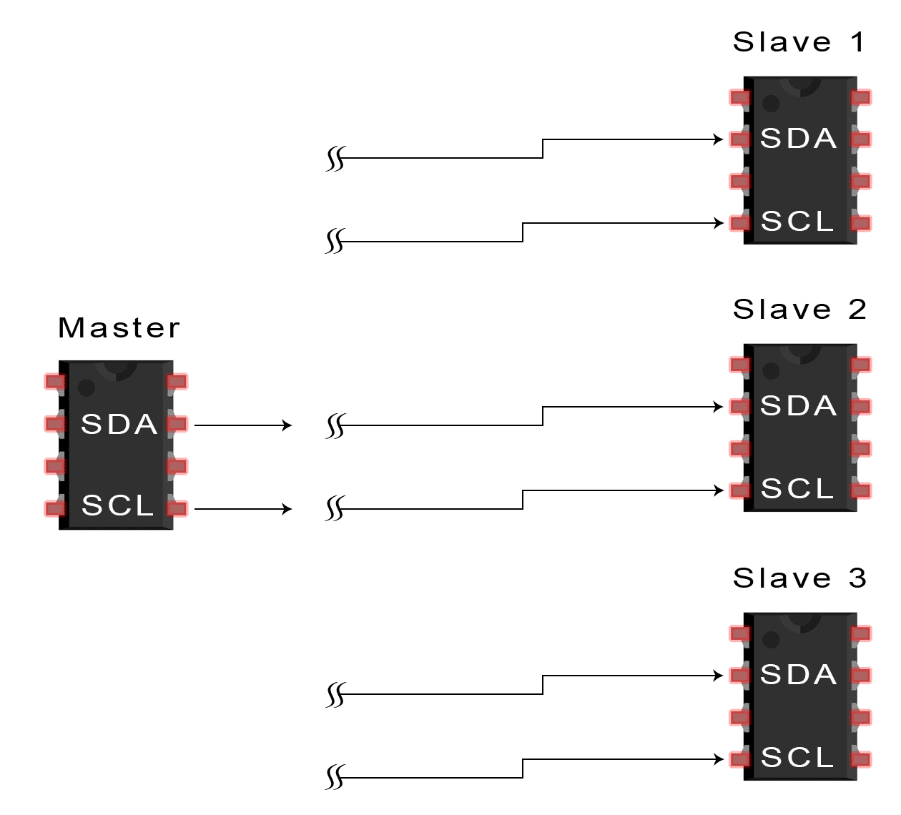
Data Transmission
❶ The master sends the start condition to every connected slave by switching the SDA line from a high voltage level to a low voltage level before switching the SCL line from high to low:
csun-ece520-Mirzaei

Slide 48
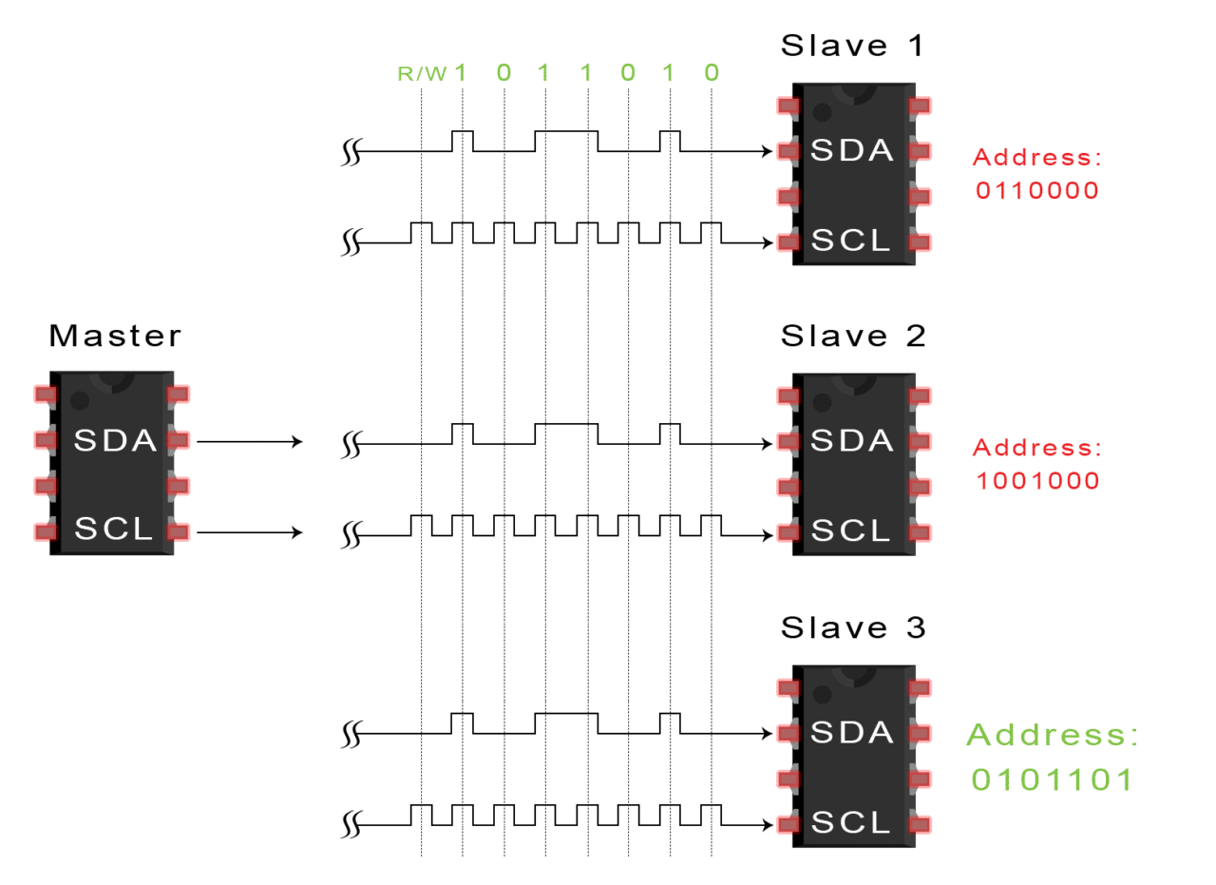
Data Transmission
❷ The master sends each slave the 7 or 10 bit address of the slave it wants to communicate with, along with the read/write bit:
csun-ece520-Mirzaei

Slide 49
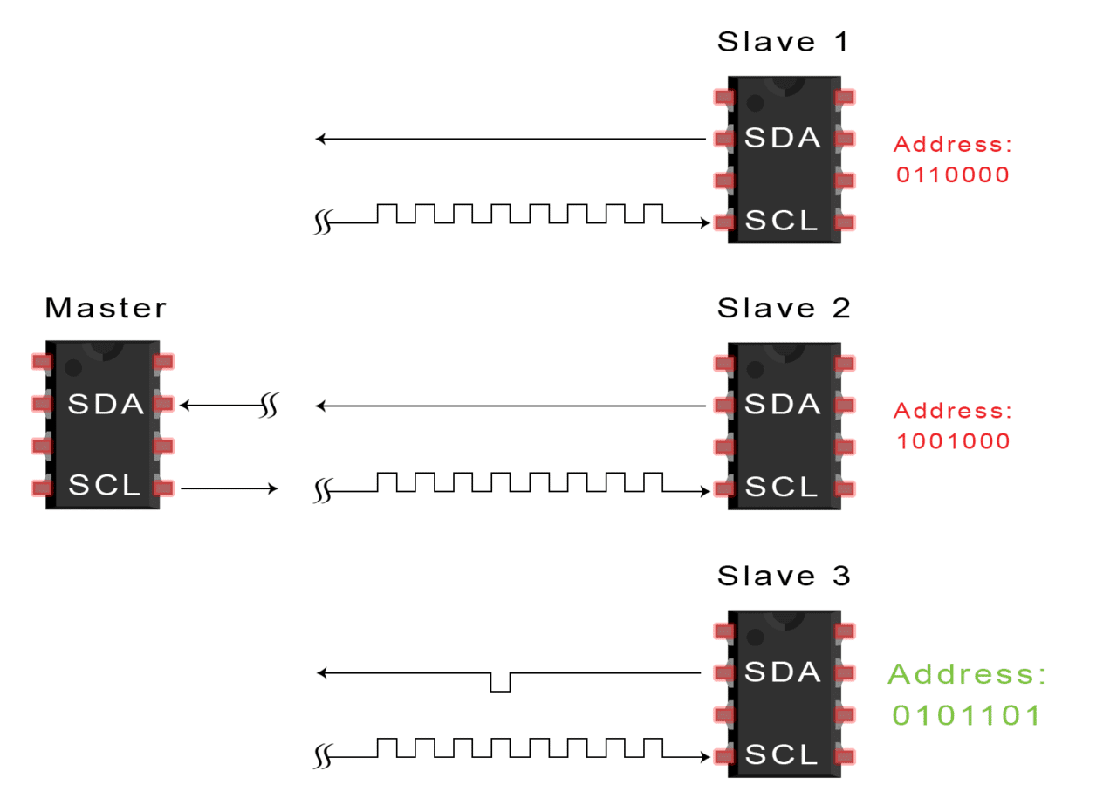
Data Transmission
❸ Each slave compares the address sent from the master to its own address. If the address matches, the slave returns an ACK bit by pulling the SDA line low for one bit. If the address from the master does not match the slave’s own address, the slave leaves the SDA line high.
csun-ece520-Mirzaei

Slide 50
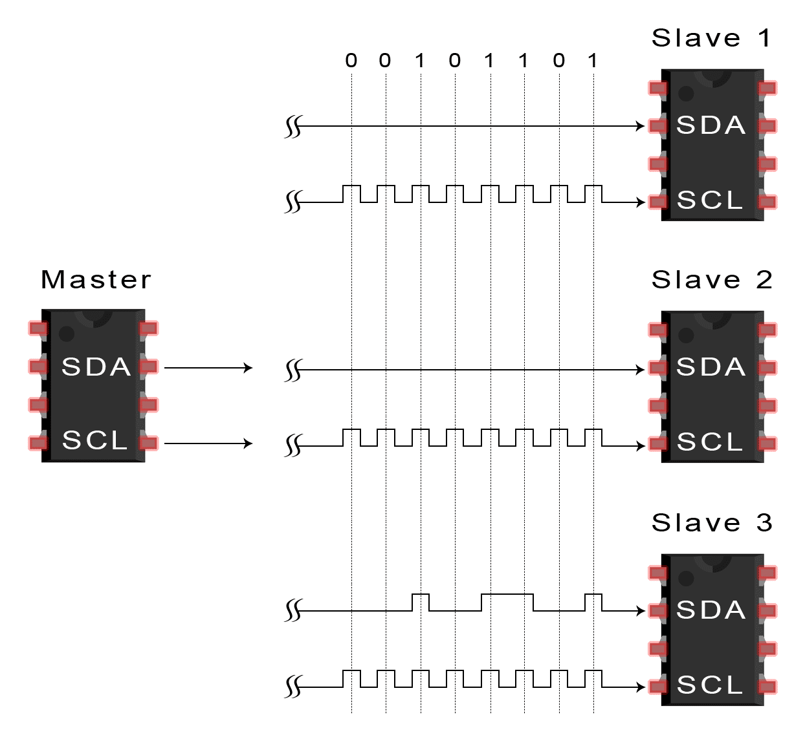
Data Transmission
❹ The master sends or receives the data frame
csun-ece520-Mirzaei

Slide 51
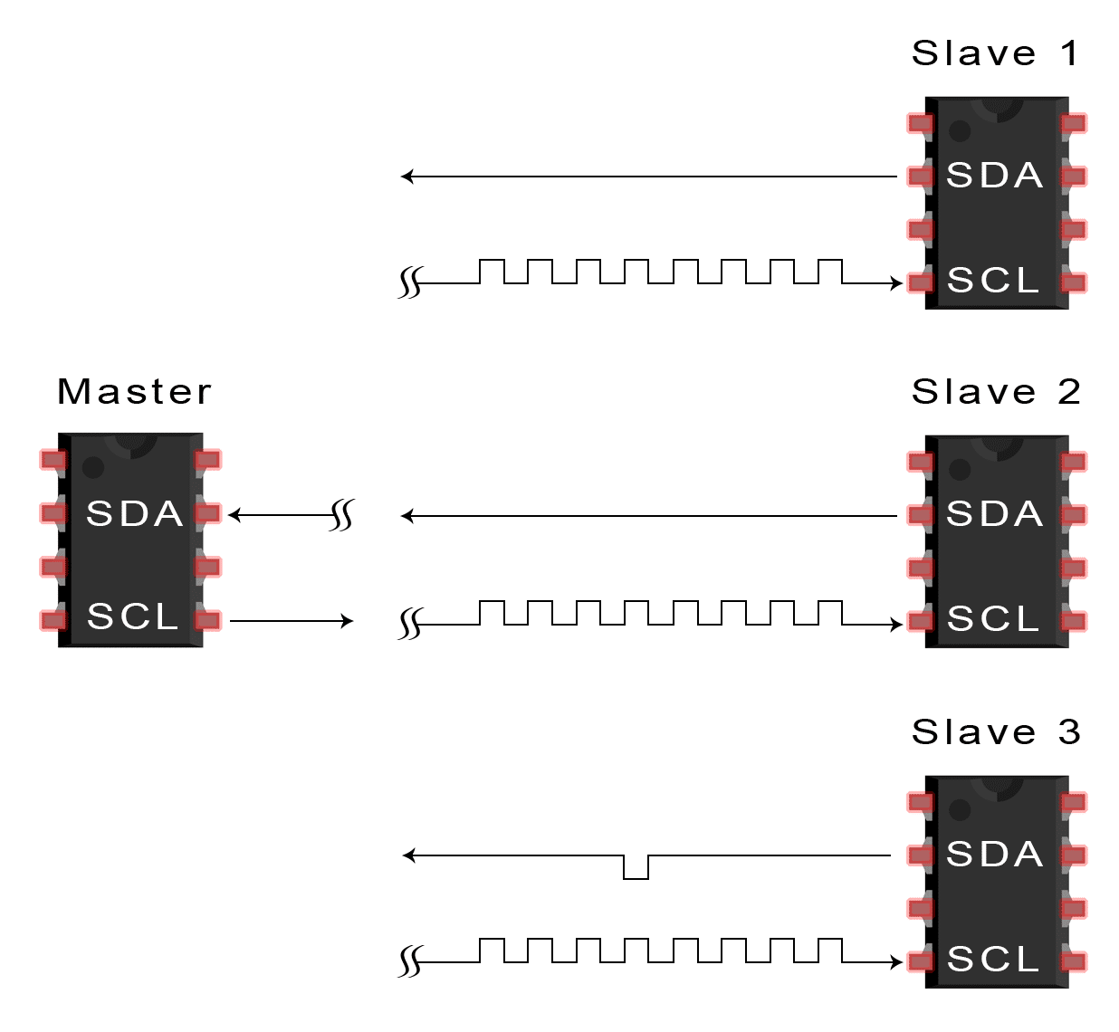
Data Transmission
❺ After each data frame has been transferred, the receiving device returns another ACK bit to the sender to acknowledge successful receipt of the frame:
csun-ece520-Mirzaei

Slide 52
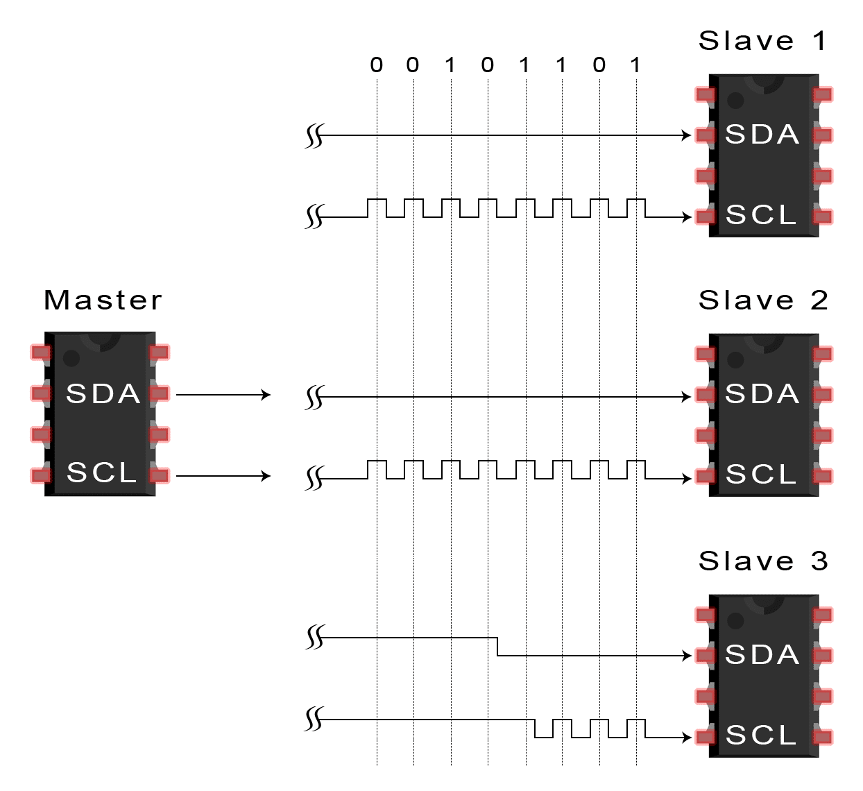
Data Transmission
❻ To stop the data transmission, the master sends a stop condition to the slave by switching SCL high before switching SDA high:
csun-ece520-Mirzaei

Slide 53
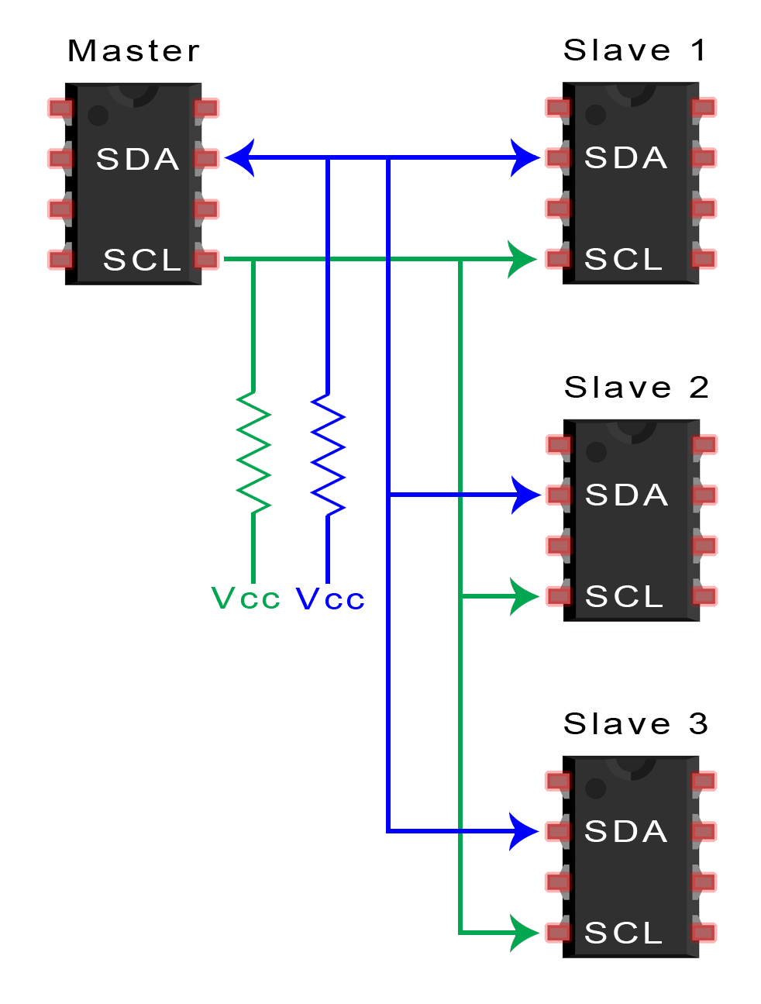
Single Master with Multiple Slaves
Because I²C uses addressing, multiple slaves can be controlled from a single master. With a 7 bit address, 128 (27) unique address are available. Using 10 bit addresses is uncommon, but provides 1,024 (210) unique addresses. To connect multiple slaves to a single master, wire them like this, with 4.7K Ohm pull-up resistors connecting the SDA and SCL lines to V_{cc}:
csun-ece520-Mirzaei

Slide 54
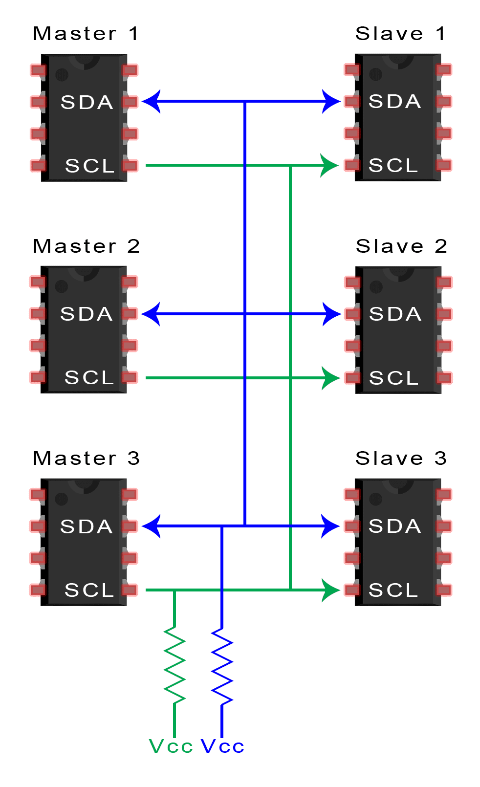
Multiple Masters with Multiple Slaves
Multiple masters can be connected to a single slave or multiple slaves. The problem with multiple masters in the same system comes when two masters try to send or receive data at the same time over the SDA line. To solve this problem, each master needs to detect if the SDA line is low or high before transmitting a message. If the SDA line is low, this means that another master has control of the bus, and the master should wait to send the message. If the SDA line is high, then it’s safe to transmit the message. To connect multiple masters to multiple slaves, use the following diagram, with 4.7K Ohm pull-up resistors connecting the SDA and SCL lines to V_{cc}:
csun-ece520-Mirzaei

Slide 55
Pros/Cons
Pros:
Only uses two wires
Supports multiple masters and multiple slaves
ACK/NACK bit gives confirmation that each frame is transferred successfully
Hardware is less complicated than with UARTs
Well known and widely used protocol
Cons:
Slower data transfer rate than SPI
The size of the data frame is limited to 8 bits
More complicated hardware needed to implement than SPI
csun-ece520-Mirzaei

