Slide 1
WinServerOps Studio
Operational Efficiency Enhancement for Windows Server Management

Slide 2
Operational Challenges & Solution Overview
!
Operational Challenges
Solution Overview (WinServerOps Studio)
• Manual, siloed processes: RDP + ad-hoc PowerShell on each server
• Time-intensive: 30–100 min per task; 8–12 hrs per 10-server cycle
• Inconsistent & error-prone: human scripts, manual consolidation
• Slow detection: post-deployment/patching issues caught late
• Tool gaps: Splunk/Dynatrace lacked real-time Windows control
• Centralised dashboard (FastAPI + React/Tailwind)
• Parallel checks via secure WinRM collectors
• Unified interface for execution, filtering & Excel exports
• Near-instant results: seconds for most checks; minutes for heavy tasks
• Broad coverage: IIS, services, patches, certificates, logs, registry, software, disk
• Live feedback during patching, restarts & connectivity tests

Slide 3
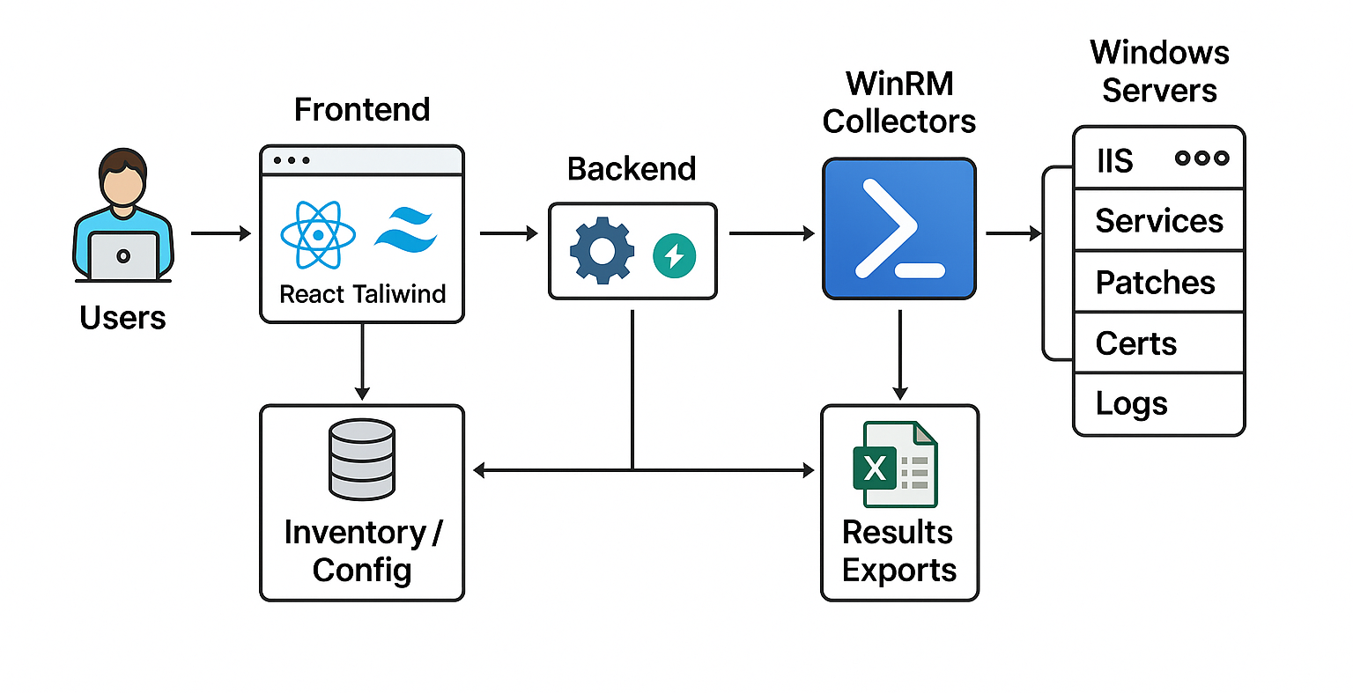
Technical Architecture

Slide 4
Impact & Savings (10-Server Example)
Net Impact: From 8–12 hrs → seconds/minutes, delivering 95–99% faster execution with consistent results. Similar savings across certificates, registry, software, connectivity, disk, restarts.

Slide 5




Key Capabilities & Impact
95–99% faster execution
Hours reduced to seconds/minutes
Audit-ready evidence
Consistent reports & Excel exports for compliance
Extensible platform
Easily add new checks & integrations, vendor-agnostic
Real-time visibility
Live progress for patching, restarts & connectivity

Slide 6




Strategic Value of WinServerOps Studio
Vendor independence
No reliance on Splunk/Dynatrace for operational checks
Reusable APIs
Integrate with automation pipelines & other tools
Foundation for expansion
Scalable to synthetic monitors, custom app health checks, and wider automation ecosystem
Future-proof
Consistent, cross-platform approach to server operations

Slide 7



Conclusion
Eliminates repetitive manual effort, enabling consistent, near real-time server checks
Provides governance-ready evidence for faster release sign-off & compliance confidence
Lays the groundwork for future automation—new checks and tools can be added without rework

