Slide 1
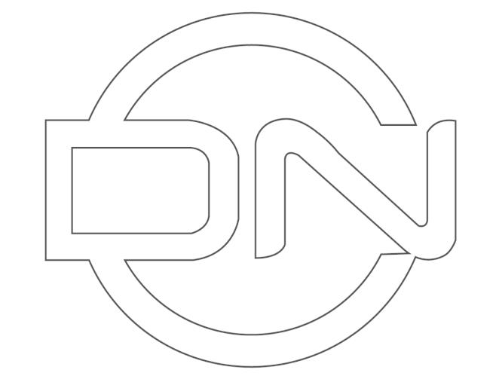

Domain Name Chain - A Fast & Stable Blockchain Technology
DNC
DOMAIN NAME CHAIN
Project White Paper
dnchain.io
1 / 163

Slide 2
01 Project background and goals
2 / 163

Slide 3
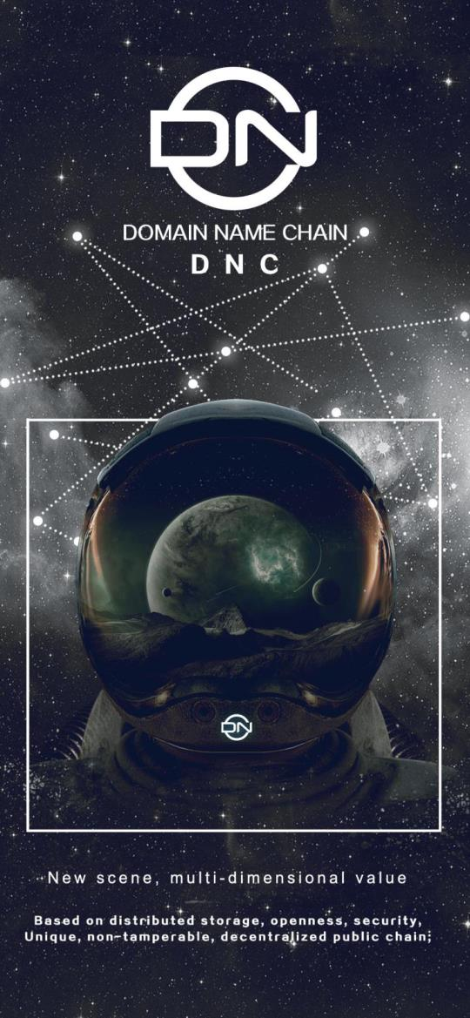
A new generation of fully functional public chain project based on
distributed storage
3 / 163

Slide 4
Summary
In the 1960s, ARPAnet (predecessor of the Internet) appeared in the
United States. In 1983, Paul Mockapetris (Paul Mockapetris) invented the
DNS system, which is a distributed database to solve the problem of IP
addresses difficult to remember. In 2009, a self-proclaimed SATOSHI
NAKAMOTO guy released the BTC node code, and then the concept of
blockchain appeared, which affected the entire financial world. In 2020,
DNC (Domain Name Chain) emerged, 88 versions of the world's top
communities synchronously launched version 1.0, participated in the
DNC super node election, used the massive USDT fund pool as a
guarantee for exchange, and cooperated with many overseas listed
companies. Realize the free exchange of the same rights of currency
stocks, reserve multi-country DCEP ports, serve 1 billion-level end users,
and expand the application field of blockchain to e-commerce, games,
tourism, and finance.
DNC is the basic currency of the DNC chain. It can be composed of a
series of names separated by dots. It circulates throughout the DNC
ecosystem. The total number is 1 billion, and it gradually decreases
(incends) as transactions increase. DNC ’s The operating company is
Starlink (Starlink is a new company independent from SpaceX in the
United States), provided security by the IMB, SpaceX invested 1 billion US
dollars to support DNC global broadband Internet access satellite
4 / 163

Slide 5
network.
DNC and US SpaceX successfully launched 400 Starlink satellites. In
the live webcast about the launch, SpaceX revealed a series of upgrade
details for these satellites, including increased bandwidth and complete
decomposition. DNC inherited the initial design ideas of the Internet,
creating a personal free communication platform, resisting oligopoly and
creating a private and safe Cyber Space. The domain name is unique, and
the personal identity of the blockchain is also unique, connecting online
and offline, and on-chain and off-chain.
DNC will be a cross-chain hybrid structure, covering DPOS + PBFT +
POW consensus algorithms, perfectly docking transaction sharding and
storage sharding, and providing 2 stable cloud VMs at the bottom to
developers worldwide.
The general trend of the future development of the Internet is from
centralized to distributed development. The emergence of blockchain has
greatly promoted the cooperation of distributed resource providers to
provide storage, bandwidth, payment and other services. Due to the lack
of readable and writable distributed storage and scalable distributed
accounting, current blockchain applications are greatly limited in their
application scope. The current blockchain is mainly used in transfers,
deposits, gambling, etc. In addition to the inefficient function of world
state (transaction data saved by all miners), storage and accounting
5 / 163

Slide 6
cannot handle large-scale transactions and big data storage. This greatly
limits the popularity of blockchain applications.
DNC planning is the integration of distributed ledger, distributed
storage and distributed communication.
Any user can use the private key to control their own distributed
cloud space, and build their own file system and file-based database
system on it, so as to provide the "missing hard disk" for the blockchain
system and make the distributed system Developers can use it to build a
variety of practical DApps. This may also be a major change to the
Internet's infrastructure, which will have a profound impact on the
Internet.
Distributed communication is also a function that distributed
systems must have. Information exchange, whether it is a two-person
conversation or a multi-person conversation, whether it is text, voice or
video, is extremely important for various types of transactions before,
during and after the event. The traditional blockchain lacks a readable
and writable distributed storage space, which makes it difficult to
establish a distributed communication system. The project has a
distributed storage function. Communication data can be used as a relay
through a distributed cloud to achieve a true point-to-point distributed
communication function. .
Bitcoin, which implements the peer-to-peer transfer function, is the
6 / 163

Slide 7
first-generation blockchain. It mainly builds a distributed system through
an incentive mechanism; Ethereum, which implements smart contract
functions, is the second-generation blockchain, which mainly uses
Turing-complete virtual The machine realizes programmable transfer;
and the DNC-like public chain has functions such as distributed storage,
infinitely scalable transactions, and distributed communication. It is a
fully functional blockchain. A fully functional DApp can be built on it and
can be considered It is the third generation blockchain.
Starlink is a new company independent from the American space
exploration technology company SpaceX. It is an industry leader in
recycling technology, which is much higher than the industry standard.
When the service life is reached, the satellite will use the integrated
propulsion system to get out of orbit. Even in extreme cases where the
propulsion system fails, the satellite will use atmospheric friction to self-
destruct, which is much better than other high-orbit satellites. (Everyone
knows that high-orbit satellites make a lot of space junk)
Share a Russell's poem, which coincides with DNC's vision, and
worship the power admired by Pythagoras-that is, digital control of ten
thousand logistics.
I have wished to understand the hearts of men. I have wished to know
why the stars shine. And I have tried to comprehend the Pythagorean
power by which number hold sway above the flux.
7 / 163

Slide 8
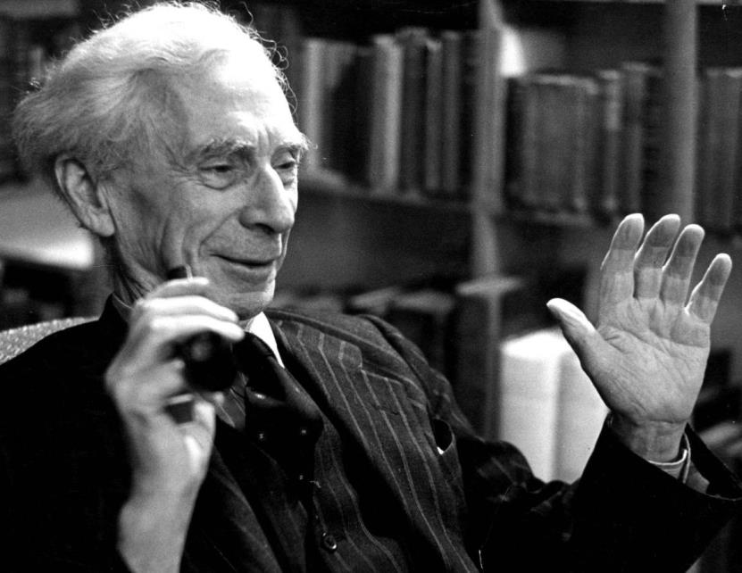
Love and knowledge, so far as they were possible, led upward toward
the heavens.
But always pity brought me back to earth. Echoes of cries of pain
reverberate in my heart.
Children in famine, victims tortured by oppressors, helpless old
people a burden to their sons, and the whole world of loneliness, poverty,
and pain make a mockery of what human life should be. I long to alleviate
this evil, but I cannot, and I too suffer.
–Bertrand Russell
Figure 1 Bertrand Russell
8 / 163

Slide 9
1: Project endorsement, goals, vision
1.1: The driving force, current situation and dilemma of the
development of human civilization
The power of a single person is insignificant, and the progress of
human civilization stems from the breadth and depth of human
cooperation. The progress of human cooperation mainly benefits from
institutional progress and technological progress. The system mainly
refers to the system related to various organizations, and the
technology mainly refers to the technology related to human exchanges
and transactions.
The basic method of human cooperation is the distributed market.
Social division of labor cooperation based on distributed markets is the
most basic and natural method of human cooperation. The ingenuity of
market mechanisms is praised by Adam Smith as "invisible hand".
However, human cooperation faces obstacles such as opaque
information, asymmetric information, conflicting concepts, and a lack of
program interfaces in the brain. The fully distributed market has limited
capabilities in solving trust issues. Therefore, society has invented
various centralized organizations to Resolve trust issues. At present, the
system of human cooperation is mainly built around centralized
organizations (states, religions, enterprises, etc.). With the development
of the Internet, more and more people can communicate and cooperate
9 / 163

Slide 10
online, and the cost of contracts is greatly reduced. Internet platforms
such as Google, Apple, Facebook, Tencent, and Ali, as the new
centralized organizations in the era of online cooperation, play an
important role in human online cooperation.
Centralized organizations have made great contributions to human
civilization, but they have also brought various resistances and major
risks to civilization. All kinds of centralized organizations are becoming
more and more centralized in terms of geography, culture, religion,
system, information system, etc., which not only cause obstacles to
exchanges and transactions, but also become the main source of
various conflicts. The stronger the centralized organization, the more
severe the gap and confrontation between the organizations, the more
obvious the pressure within the organization, and the greater the
impact of organizational failure. World wars, regional conflicts, trade
protection, and corporate monopolies have greatly affected human
cooperation and may have stalled. Centralized organizations also face
dilemmas such as single-point risk, class differentiation, and
organizational conflict when solving trust issues. The so-called single-
point risk of a centralized organization means that the more successful
the centralized organization is, the more power, capital, talents and data
are concentrated in the hands of a few institutions or a few people.
Once these institutions are breached by the outside or internally altered,
10 / 163

Slide 11
the consequences are unimaginable. . Secondly, the increasing
concentration of resources in the hands of a few people also results in
the formation of different strata within the organization. Stratum
conflicts are unavoidable and mutual squeezing is also common. Finally,
various methods of increasing cohesion within an organization are
called methods such as patriotism, corporate culture, religious belief,
etc., which just makes the conflict of ideas between organizations
difficult to avoid, and the opaque information between organizations
makes the The problem of trust is also difficult to solve, even making
brutal competition the norm.
From a large time scale, human civilization is still at a very
preliminary stage. According to the calculation of the Kardashov index,
human civilization is currently in the 0.73 type civilization (Sagan, 2000),
that is, human civilization still only belongs to the category of 0 type
civilization. It can be said that human beings are extremely vulnerable to
the vast universe, just like children in their infants. But such a child who
is in need of a long body is choked by the limitations of the centralized
organization.
It has to be pointed out that the drawbacks displayed by the
current centralization scheme continue to expand, which is particularly
obvious in the Internet era, which has caused human development to
fall into a certain dilemma. When the Internet first appeared, we saw
11 / 163

Slide 12
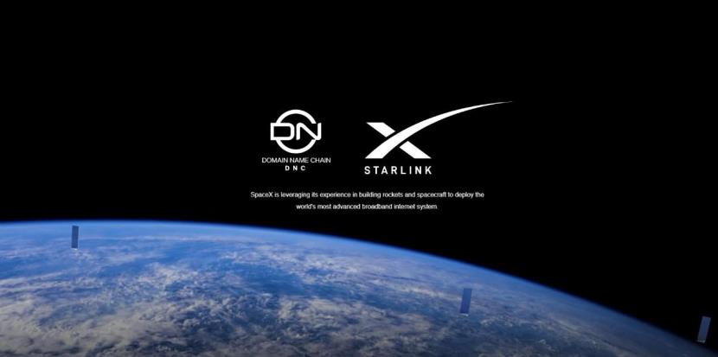
that the Internet played an important role in information dissemination
and media transparency. However, with the development of the Internet,
various centralized Internet platforms have also formed an oligopoly,
and the data of large Internet platforms is increasingly More and more
concentrated in the hands of a few centralized organizations, traffic
monopoly, data monopoly, and technology monopoly are becoming
more and more serious, so that a large number of individuals or small
businesses can only rely on a few large groups, and small startups are
increasingly difficult to succeed , This has constituted a great obstacle
to human innovation. Human cooperation based on large-scale Internet
platforms greatly promoted the progress of human civilization in the
first stage of Internet development, but with the deepening of Internet
development, the power of the Internet is becoming more and more
unequal, and the platform monopolizes resources.
Figure 1 DNC and US SpaceX successfully launched 400 Starlink satellites
12 / 163

Slide 13
1.2: The rise of blockchain and the hope it brings
The Bitcoin white paper published by Satoshi Nakamoto on
November 1, 2008 has enabled mankind to realize the pioneering
issuance of private currency through the Internet, and the blockchain
technology behind it has great potential in solving the problem of trust
between partners. This is why the blockchain is called "the machine of
trust" by the cover article of The Economist. Most of the existing
technology mainly promotes the progress of "productivity", and
blockchain is an innovation of people's "cooperation mode" and a
technological revolution of production relations. Before the advent of
the blockchain, human cooperation can only be achieved through a
centralized solution. The Internet is to use a centralized server and a C /
S or B / S architecture built on the TCP protocol. The blockchain allows
us to see the possibility of transforming a centralized transaction
matching platform into a distributed matching platform. This will not
only maximize the efficiency of the distributed market economy, but
also avoid the problems caused by the centralized organization. Earth
reduces the cost of trust in distributed markets. In fact, for the main
obstacles such as opaque human cooperation, irrationality, conflict of
ideas and lack of program interface, the blockchain can give a
reasonable distributed solution, the main reason is that the blockchain
has distributed accounting and consensus And token incentives, assets
13 / 163

Slide 14
based on address and private key control, smart contracts, trusted data,
distributed communication, etc.
The industry with the biggest changes brought by blockchain is
finance first. Bitcoin pioneered non-governmental issuance of currency
and non-intermediary electronic transfers. The ICO boom in 2017
allowed us to see the broad prospects for various assets to be digitized,
distributed bookkeeping and programmable through tokenization. It is
conceivable that various assets including securities, land, real estate,
automobiles, oil, etc. will be mapped on the chain in large numbers in
the future, so as to realize asset digitization, distributed bookkeeping
and programmable.
But in the future, if the blockchain can achieve distributed storage
and distributed communication, the blockchain has the potential to
form a distributed Internet infrastructure, thereby providing unlimited
possibilities for human-based centralized organization cooperation to
distributed organization cooperation . The first generation Internet is a
centralized information Internet, which has brought great changes to
society, and the rising distributed information Internet and value
Internet are the deepening and inevitable trends of Internet
development.
More importantly, for the first time in human history, blockchain
has given human core problems, a distributed solution to the trust
14 / 163

Slide 15
problem, that is, trust will be delivered to the code. The smart contract
based on the blockchain replaces the paper contract, which not only
makes the automatic execution of the contract possible, but also allows
strangers to conduct transactions based on the trust of the code.
Through distributed accounting and smart contracts, humans can
automate distributed market transactions without relying on centralized
institutions, allowing humans to achieve a qualitative leap in
cooperation technology for the first time since going out of Africa.
Times, that is, human organization and cooperation based on
distributed Internet. It is foreseeable that the distributed technology
based on the blockchain will gradually solve the disadvantages of the
centralized organization, open the curse of the centralized organization
on the human throat, and start a new journey of human civilization to a
more advanced stage.
15 / 163

Slide 16
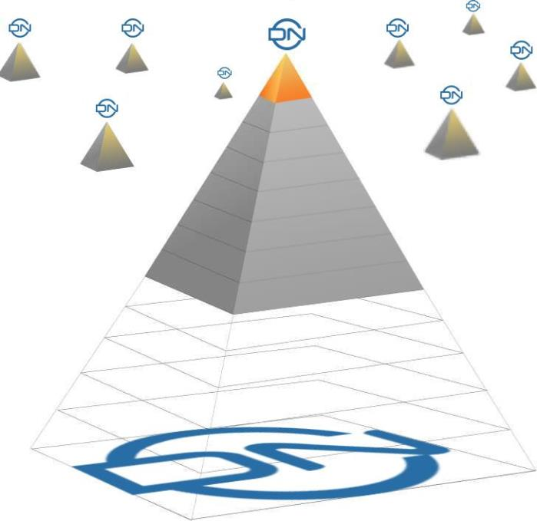
1.3: The current defects of the blockchain and the problems to be
solved: from Turing complete to complete functions
The application of blockchain in the field of payment started from
Bitcoin in 2009. The proposal of Ethereum as a Turing complete
blockchain was from 2014, but so far, except Bitcoin and Ethereum, there
are more than 100 In addition to 10,000 users, other blockchain
applications have basically not reached this order of magnitude, and daily
activities are even less, only a few hundred thousand, but centralized
application users reach 10 million everywhere, and hundreds of millions
are not uncommon. Blockchain projects not only lack killer applications,
but also have less implementation in all walks of life.
16 / 163

Slide 17
Centralized platforms generally have functions such as registration
and identity authentication, data storage, communication, and order
transactions. The platform is also superior in scalability and user
experience. The blockchain is almost vacant or incomplete in these
functions. The following lists the main imperfect aspects of blockchain
functionality.
1: Capacity expansion. Capacity expansion refers to the confirmation
efficiency of blockchain transactions. At present, the average TPS of
Bitcoin is less than 10, and the average of Ethereum is less than 20. The
speed of EOS single chain with super node capacity is only thousands. At
present, blockchain expansion is working hard through sharding, layering
and consensus mechanisms, but they are still immature.
2: Storage. The development of the Internet is accompanied by the
development of data storage technology, but the current blockchain
basically uses data blocks to broadcast to the entire network, which is not
only inefficient, but also difficult to produce various data-based
applications.
3: Communication. At present, important applications, whether
Airbnb, Uber or Taobao, have built-in communication functions, not to
mention social applications, because most transactions have
communication requirements before, during and after transactions. The
current blockchain is building a value Internet, but it has failed to
17 / 163

Slide 18
integrate the functions of the information Internet, and future blockchain
projects need systematic solutions that can efficiently integrate human
communication and transactions.
4: Cross-chain. We expect that blockchain can express a large amount
of value on the chain and form a value Internet through the blockchain,
but at present it seems that each blockchain has formed its own value
interaction, but it is difficult to value between the blockchains Interaction,
which actually forms an archipelago of blockchain, but there is no
connection between islands. To this end, there are now tens of thousands
of exchanges, but exchanges are centralized institutions that can only
exchange value, and it is more difficult to achieve multi-currency
programmable interaction, that is, multi-currency smart contracts.
5: Identity management. People's identities are closely related to their
activities, including socializing and trading, as well as self-identity
revealing and identity authentication from third parties. In addition,
identity use is related to usage scenarios, and people have different
identities in different situations. The existing blockchain lacks
comprehensiveness and depth of identity management, and lacks
integration with business scenarios.
6: User experience. When existing blockchain projects are made into
products, the user experience is often poor. For example, the
management and use of private keys and addresses are not friendly, and
18 / 163

Slide 19
lack of integration with artificial intelligence.
It can be seen that the current blockchain has not been applied on a
large scale, mainly due to the above-mentioned imperfect functions.
Melanie. Swan divides the application of blockchain into three stages in
"Blockchain: Blueprint and Guide to the New Economy" (Swan, 2015):
Blockchain 1.0 is the application of blockchain to payment, technical
characteristics It implements distributed bookkeeping; blockchain 2.0 is
the application of blockchain in finance, and the technical characteristics
are the realization of Turing complete smart contracts; blockchain 3.0 is
the application of blockchain to all aspects of society. Realize various
functions possessed by the current centralized platform. At present, the
reason why the blockchain cannot develop applications for tens of
millions of users is mainly because the existing public chain does not have
all the above-mentioned functions, and there is no way to develop
distributed applications commonly used by the public. To realize
Blockchain 3.0, it is necessary to make the public chain system evolve
from Turing completeness to complete function.
The so-called "complete function" refers to the specific key functions
required for blockchain-based applications to achieve an experience
comparable to existing centralized apps. The public chain 3.0 is similar to
the distributed version of the current centralized platform. To enable it to
develop complex distributed applications on it, it needs to have sufficient
19 / 163

Slide 20
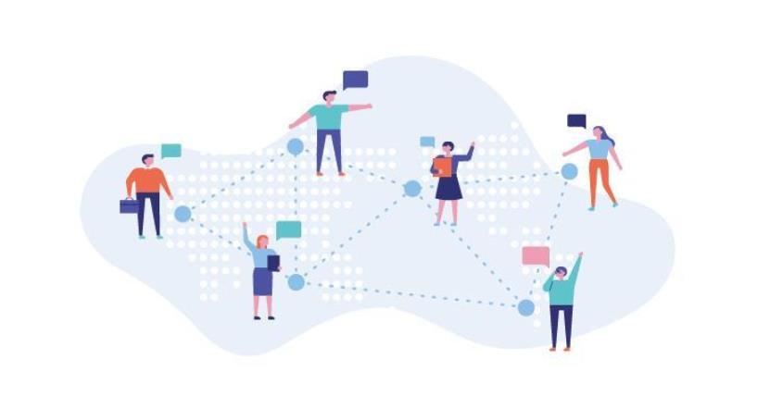
functions itself, which requires the newly emerging blockchain to be able
to specifically Features. However, when we look at almost all public chain
projects that are now appearing, it is difficult to meet the requirements
of "complete functions". They either lack communication, or lack storage,
or lack identity management functions. Therefore, at present, there is no
real public blockchain of blockchain 3.0 on the market. The real landing
and large-scale application of the blockchain is precisely the need for the
public chain platform to evolve from "Turing complete" to "function
complete", that is, to have various functions that can realize heavy
distributed applications, not just Turing complete payment. That's it.
Figure 2: DNC simulation scenario
1.3.1: Features that humans need to have in an automated
cooperation system based on blockchain
20 / 163

Slide 21
A distributed market is the most natural way for humans to
cooperate, but due to the limitations of communication technology and
automated trading technology, humans have used a large number of
centralized organizations to alleviate market failures. The centralized
solution solves a large number of problems, but it also has inherent
defects. The centralized Internet platform allows us to see the possibility
of human cooperation automation, and the blockchain allows us to see
the prospect of human distributed automatic cooperation. Internet-
based distributed automatic cooperation system will be the main
development direction of human future cooperation technology. The
automatic human cooperation system based on blockchain has its
completely different characteristics from the centralized platform. To sum
up, the human cooperation system based on blockchain needs to have
the following characteristics:
1: The public chain is sufficiently distributed. The distributed system
breaks down the cooperation partners into smaller particles, making the
cooperation granularity smaller, and has the potential to avoid various
negative problems caused by centralization and increase the number of
participants who can participate in cooperation. This requires that the
blockchain is a very distributed public chain.
2: Automation system based on code cooperation. Automation is not
only the automation of machine systems, but also the future of human
21 / 163

Slide 22
society cooperation. People cooperate based on procedures to enable
future cooperation systems to operate efficiently. The advantage of this
cooperation method is that it can reduce the problems caused by
mistrust by increasing code transparency and automatic execution. This
code-based cooperation mechanism is the most critical solution to the
obstacles in human cooperation. This requires the public chain and the
smart contracts on it to be open source systems.
3: Ability to integrate communication and transactions.
Communication is the most critical means to reduce information
asymmetry. Before, during and after the transaction, both parties must
be able to establish contact at any time, so the distributed automatic
system can integrate communication and transactions. In the Internet era,
this requires integrating the information Internet and the value Internet
on a distributed network.
4: The data is controlled by the producer, that is, distributed cloud
storage is required. A big problem with the centralized solution is that
the data is occupied by the centralized organization, which is not only
unreasonable, but also easy to leak privacy. The reasonable way is that
the data is controlled by the producer, which requires the distributed
system to solve the problem of distributed storage of data, so that once
the data is generated, there is private space and the power can be
confirmed.
22 / 163

Slide 23
5: Have identity verification and reputation proof mechanism. The
mechanism of identity verification and reputation proof is the most
important mechanism to solve the information asymmetry and the
distrust of the transaction subject. Distributed systems must integrate the
two.
6: It enables various participating subjects to enjoy services or make
money. The system enables individuals, organizations, and intelligent
programs to participate equally in transactions. At the same time, this
requires that the public chain can empower participants, including code
developers, product providers, and users, and benefit from a larger
platform than a centralized platform.
7: Ability to empower developers. The most important creativity of
mankind comes from entrepreneurs, and a system can only release
vitality if it attracts strong support from various entrepreneurs.
In summary, the existing human cooperation is mainly based on the
semi-automatic system of centralized organizations, which can be called
the first-generation cooperative system. The second-generation human
cooperative system should be mainly based on the distributed automatic
system. Such a system should have the ability to allow various trading
entities to trade more equally and efficiently.
1.3.2: Project objectives
23 / 163

Slide 24
Blockchain technology allows us to see the prospect of all human
beings building an automated society on an automated transaction
matching system, and it is possible to form a global village based on
blockchain. To upgrade human civilization as soon as possible, it is
necessary to establish a fully functional and infinitely scalable public
chain system, so that the exchanges and transactions between individuals,
individuals, organizations and organizations, and individuals and
organizations can cross geography, institutions, organizations,
Restrictions on beliefs, races, etc. promote human cooperation on a
global scale, and integrate information Internet and value Internet
through blockchain to promote human cooperation in a manner that
promotes human communication and transactions.
We see that the number of users of some apps can reach more than
1 billion, and the total number of humans is less than 10 billion. If it is an
infinitely scalable public chain, it is entirely possible that it will encourage
all humans to establish cooperation on it and promote The realization of
the global village of blockchain. Although it is not easy to achieve this
goal, we can already see the dawn of such a prospect.
With such a mission and vision in mind, the project will have the
direction of persistent efforts. But direction alone is not enough. The
project needs a specific goal. Based on the above analysis of human-
centric cooperation and the analysis of the current shortage of blockchain,
24 / 163

Slide 25
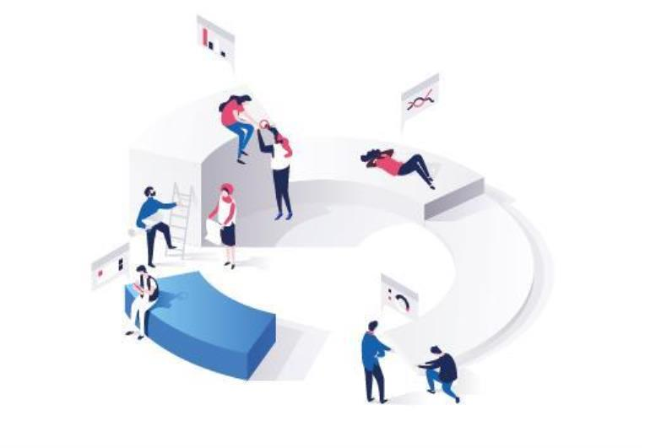
the most important thing that humans currently need is a distributed
automation cooperation system, and this system should be based on a
public chain. Our goal should be to develop a public chain that can
overcome the deficiencies of the current blockchain and establish various
DApps on it to promote human cooperation. Such a public chain should
have the following characteristics: infinitely extensible, full-featured, and
address-centric for data confirmation. Therefore, the goal of DNC is to
develop a public chain with address as the core for data confirmation,
complete functions and infinite scalability, and promote the continuous
improvement of the DApp ecosystem on it.
Figure 3 DNC simulation scenario
So the DNC project has the following goals:
1: Establish an information Internet based on a peer-to-peer network.
25 / 163

Slide 26
The data is stored in the private space of the producer, and the right is
confirmed when the data is generated. The famous scientist Professor
Zhang Shousheng put forward the following points when discussing the
development of artificial intelligence and big data: "Most big data is
related to personal information. Personal data and information often go
to the central platform. Individuals are not protected by privacy. There is
no reward for providing personal data. These two problems are solved by
the blockchain at the same time, so the blockchain and artificial
intelligence must have a complementary relationship. "And this project is
based on distributed personal data space for personal data. Confirm
power.
2: Establish a value-based Internet based on peer-to-peer networks,
with transaction scalability capable of supporting 1 billion users.
3: Establish a multi-dimensional identity and reputation system, so
that the human cooperative ecology can generate a mechanism for good
currency to expel bad currency.
4: Serve developers, so that developers can focus on data services
instead of data possession.
26 / 163

Slide 27
02 Project architecture
27 / 163

Slide 28
2. Project architecture
2.1. Project design ideas
2.1.1. Point-to-point communication, distributed information
Internet and space-based storage
Space-based storage is the key to project design. It is necessary to
meet the design conditions. Only on this basis can point-to-point
communication and distributed information Internet be realized. At
present, IPFS technology needs to do transactions every time it uploads
and downloads files, which will make the file system itself occupy a lot of
transaction resources, making it difficult to be applied to data storage
that needs to be dynamically updated, and dynamically updated data is
the most time-sensitive And the most valuable. IPFS is actually "file-
based" storage, while our traditional Internet storage is actually space-
based. Almost all cloud services are charged according to the size and
time of space usage, but the space in the blockchain world is not charged
according to the time and space used by storage space. This is what
blockchain storage needs to reverse most.
At the same time, space-based storage can enable everyone to have
their own "distributed personal cloud", which makes it possible to
establish data communication, authorization and transactions on the
personal cloud, and also allows various applications to choose to
generate applications The data is returned to the user, that is, the data is
28 / 163

Slide 29
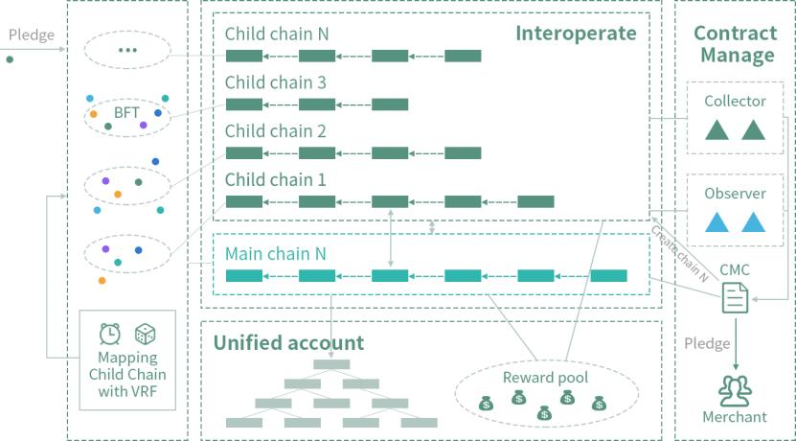
not stored on the platform, but stored in the personal cloud.
2.1.2. Settlement of transaction scalability
To enable the project to be used by a large number of people, it is
necessary to expand the existing blockchain transaction capabilities. How
to expand transaction capabilities is one of the main topics of blockchain
development.
The essence of the blockchain is a distributed ledger. It needs to
perform the next operation after the state synchronization, and then
synchronize the new state, otherwise it will be difficult to avoid the
double-spend problem. To achieve the state synchronization of the peer-
to-peer network, you need to select a trusted accounting node in each
state synchronization cycle, and then broadcast the records to all nodes,
and so on.
Parallel fast multi-chain sharding
29 / 163

Slide 30
According to this, the bottleneck of transaction ability lies in two
points: the efficiency of electing the bookkeeper; the efficiency of data
synchronization.
Efficiency of election bookkeeper: The bookkeeper selection is
mainly achieved through a consensus mechanism. At present, there are
mainly proof of work, Byzantine agreement, and proof of rights and
interests.
The proof of work of POW is the most concise and safe, but it is also
criticized because of the slow block generation speed, unfavorable
environmental protection, and monopoly of mining pool computing
power. It is a consensus mechanism that can be avoided if it is necessary.
The PBFT Byzantine agreement needs to collect the signatures of
more than two-thirds of the nodes. With the increase in the number of
nodes, it is almost impossible to do it, only through super nodes, but this
will seriously damage the decentralization.
Proof of POS equity can be produced relatively quickly, but it is
considered to widen the gap between the rich and the poor and be easily
monopolized by the rich, and problems such as finality are difficult to
prove mathematically. However, in fact, the proof of workload is also to
widen the gap between rich and poor and easy to be monopolized by
the rich, because purchasing computing power also requires more
financial resources. At the same time, proof of rights is not impossible to
30 / 163

Slide 31
contain the gap between rich and poor through new design.
Therefore, when designing a consensus mechanism, this project
hopes to absorb the strengths of various consensus mechanisms, avoid
the weaknesses of various consensus mechanisms, and adopt a hybrid
consensus mechanism will be a more reasonable choice.
Data synchronization efficiency: sharding
The synchronization efficiency is mainly related to the hardware
performance, the size of each block, the block generation cycle, and the
scale of the nodes that need to be synchronized. Hardware performance,
including broadband, needs to wait for the development of the entire
Internet hardware infrastructure. The size and block generation period of
each block are directly related to TPS and cannot be optimized. The size
of the nodes that need to be synchronized is related to security and to
decentralization, and it is in this regard that most current blockchains are
unreasonable. The current number of blockchain nodes can be infinitely
increased, but all need to synchronize a piece of data, which makes the
system performance become worse and worse as the number of
hardware increases, but the distributed level reaches a certain level and
then increases its marginal utility is decreasing of. Although the
distributed level increases security, security and distribution also require
a certain degree, and it is not necessary to expand indefinitely.
Therefore, the best way to increase synchronization efficiency is
31 / 163

Slide 32
currently sharding, which is to divide nodes into multiple groups. As the
number of nodes increases, the number of shards gradually increases,
and each shard has enough nodes to maintain "sufficient distribution"
Type ". This approach allows the size of each shard to be controlled to a
certain extent, which increases the synchronization efficiency. On the
other hand, multiple shards simultaneously produce blocks, so that there
is a realistic way out for infinitely expanding blockchain transaction
capabilities. Therefore, although the shard design has certain difficulties,
the shard design, including inter-slice transactions, split mechanism, etc.
will be an inevitable choice for this project.
2.1.3. Multi-dimensional identity verification and reputation proof
mechanism
Although the blockchain provides a way of anonymous transactions,
more transactions require the parties to continuously improve
understanding to reduce information asymmetry and transaction costs,
and facilitate more transactions. Therefore, the identity verification and
reputation proof mechanisms are necessary designs.
Because it is difficult to achieve mandatory disclosure in the
blockchain world, it is difficult to verify the authenticity of the data even
in the distributed world. However, the blockchain has the characteristics
that data cannot be tampered with. As long as the disclosure information
is provided to individuals, time stamps are added, and the data cannot
32 / 163

Slide 33
be tampered with, then voluntary disclosure or self-reputation
certification will become the choice of many people.
Since a person has multiple identities, similar to family, school,
company, country, part-time occupation, etc., there will be different
identity characteristics in different occasions, so multi-dimensional
identity verification is required. Similarly, the reputation proof mechanism
also needs multi-dimensional data to support it. Only when a person
keeps his various data on the tamper-proof network can he leave more
and more traces in time, thus presenting himself with more and more
credibility, and making identity and credibility his own assets.
Therefore, many people use the personal cloud on the blockchain for
identity verification and reputation proof.
2.1.4. Serve developers
This project is to promote the productivity of entrepreneurs, thereby
promoting the efficiency of human exchanges and transactions. This is
the fastest way to promote human exchanges and transactions, so this
project is designed for developers everywhere. Platform entrepreneurs
don't necessarily want to own user data, but they are guilty of injustice.
Platform entrepreneurs actually lack options, and current data cannot be
stored by everyone. If the blockchain can provide everyone with a cheap
personal cloud space, then the entrepreneur may have a fully functional
blockchain and establish various types of DApps to start a business.
33 / 163

Slide 34
Because the distributed network built by the fully functional blockchain
has many irreplaceable advantages, and can better provide better start-
up services under the shadow of the Internet giants.
A fully functional blockchain can better perform data confirmation,
rule making and self-certification innocence.
Most of the current entrepreneurship needs to use the Internet to
develop mobile applications or websites, but new entrepreneurs are
faced with the challenges of the huge cost of Tuoke and the replication
of their business models by large Internet platforms. Because large
Internet platforms have advantages in terms of development power and
traffic import, and Internet platforms with big data are easier to optimize
customer experience, and small entrepreneurs have higher development
costs and customer acquisition costs, so the current Entrepreneurs can
easily encounter bottlenecks in entrepreneurship. Their best way may be
to develop and sell to large Internet platforms, thereby further enhancing
the monopoly power of Internet platforms.
How to give entrepreneurs the ability to challenge large platforms?
At present, the most criticized by large platforms are the monopoly of
user data, the monopoly of trading rules, and the lack of transparency.
They claim to be innocent, but it is difficult to prove themselves innocent.
If starting a business on the blockchain allows the data produced by the
user to be authorized to the producer, the transaction rules are controlled
34 / 163

Slide 35
by the user, and the developer can prove himself innocent, then the
developer has the ability to challenge the large Internet platform.
A fully functional blockchain can make better use of development
tools and development ecology
The blockchain-based Internet is very different from the traditional
in architecture. The blockchain has a thick protocol layer and a thin
application layer, and the traditional Internet has a thin protocol layer and
a thick application layer. This makes the traditional Internet development
more difficult, and the smart contract suite can be used in the blockchain
world to start a business, even without renting a server, which allows
developers to better help each other, and better share development tools.
Development difficulty Also reduced accordingly.
Full-featured blockchain can better share traffic and reduce customer
acquisition costs
The traditional Internet platform has a lot of data, which makes the
platform more and more powerful, and it is more and more difficult for
entrepreneurs to import traffic or obtain customers. However, users on
the blockchain platform can use the address as the ID of any application,
which makes it possible to share traffic between DApps on the blockchain
and greatly reduce the cost of customer acquisition.
A fully functional blockchain can better perform data sharing and
customer portraits.
35 / 163

Slide 36
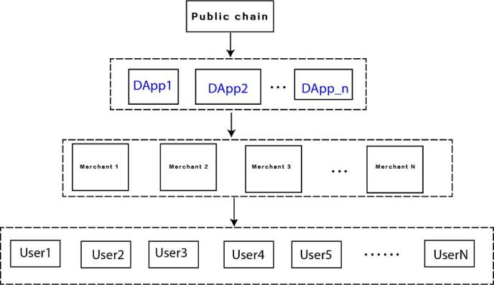
The biggest feature of a fully functional blockchain is that data is stored
in personal space, and these data can be selectively opened. Therefore,
most people have open data that can be used by new entrepreneurs on
the blockchain, thus achieving data sharing and providing convenience
for customer portraits and targeted recommendations for the first time
using an application platform.
2.2. Features of the project
2.2.1. Serving developers: Empowering entrepreneurs as
the main entry point for ecological construction
DNC strives to become a human-based blockchain-based
automated cooperation system, which consists of a basic public chain,
Pyramid structure composed of DApps, merchants and customers. as
the picture shows:
Figure 1. Blockchain ecological pyramid
36 / 163

Slide 37
It can be seen from the above figure that the direct service object of
DNC is DApp. If DApp is mainly regarded as a developer (D end), and D
end will be an entrepreneur in a human automation cooperation system,
so the main service object of DNC is an entrepreneur. For this reason,
DNC mainly accomplishes the following:
1: Provide the necessary functions for developers: For this, the
blockchain needs to be fully functional and infinitely scalable.
2: Reduce the cost of developers: To this end, it is necessary to
establish perfect support, including multi-language support, good
documentation, test network, and a lot of open source code.
3: Importing traffic for developers: This requires users to be able to
share. For this purpose, user information needs to be placed on the public
chain.
4: Storage space can be subject to object management: the function
of the database is the most basic function of various applications, and the
readable and writable, space-based storage function will be necessary for
developers.
5: Avoid developers from forming unfair competition: This requires
that the data is not attributed to the developers, so that the developers
can truly provide algorithm services. For this, the data needs to be placed
on the public chain.
6: Add transaction objects that can enter smart contracts: This
37 / 163

Slide 38
requires the blockchain to have cross-chain functions.
7: Make the smart contract smart enough: This requires the smart
contract to have the function of a prophet.
2.2.2. Space-based data storage: readable and writable storage space
The traditional Internet is based on the TCP protocol and C / S or B /
S architecture, and has various vertical applications. However, because
the server is at the core, and there is a lack of communication
mechanisms between servers in different organizations, there is no way
to establish intelligent and automated cooperation across organizations.
The blockchain is built on the P2P network. Due to the equal status of the
nodes, intelligent and automated cooperation across subjects (including
individuals and organizations) is possible. The traditional Internet has a
complete database system on which large-scale applications can be built.
However, the blockchain system lacks a database system that can support
large-scale applications, which makes it difficult to establish even large-
scale cross-subject cooperation on the blockchain. . Therefore, the
function that DNC must do is the function stored on the chain. In addition,
in order for the data producer to become the controller of the data, the
data needs to be stored in the storage space owned by the address.
Therefore, the address needs to have the ability to apply for data storage
space.
38 / 163

Slide 39
From the perspective of developers' data storage needs, these spaces
need to be managed based on objects rather than files, so that the data
can be defined differently when it is generated, and the management
method is designed. A large number of applications need to update data
at any time, such as communication, social networking, self-media and
online stores, etc., and need to establish a readable and writable storage
space in the background. Therefore, the readable and writable, space-
based, object-managed storage sub-chain will be the first technical
problem that DNC needs to break through.
At present, a large number of storage-oriented blockchain projects
are based on IPFS and are managed on a file basis. They upload text
encrypted and the public chain manages it in slices. The main purpose is
to store certificates, not for developers. In this file-based management
system, it is difficult to implement storage management based on
storage space with high availability, readability, and objectification, and it
is also difficult to implement a database system on it. Of course, space-
based management requires space contribution management, space
application management, and space read-write management. The
complexity of setting up such a cloud service on a distributed system can
be imagined, but it is based on space distribution. The storage system is
a difficult problem that the blockchain must break through.
In the distributed cloud world, the space contributed by all the space
39 / 163

Slide 40
contributors will form a "world hard disk", which will be a large cloud
space for the public chain, and the applicant only applies to use part of
it, which requires design. A set of incentive mechanism, payment
mechanism and management method make the reading and writing of
data achieve high security and high availability.
The basic function of the blockchain in the future should be
distributed storage, and distributed computing is not the most important
part of the blockchain (although multiple calculations have a check
function). A large amount of data can only allow individuals to master the
data by using distributed storage, and the real realization of data is
owned by the data producer when it is produced, and the real
empowerment of individuals is realized. On the contrary, the centralized
data storage makes the centralized platform occupy all kinds of data,
which not only enables them to obtain benefits through the data, but is
also at a single point of risk. Establishing a personal file system on a
distributed cloud service not only allows the data rights to be generated
by the generator, but also makes it possible for individuals to propose
authentication and data transactions based on this space, and makes the
social communication and transaction granularity smaller. For
entrepreneurs, it is easier to build large DApps on it, which may lead to
major changes in the way human society is organized. DNC needs to
develop its own storage subnet, using space as the management object
40 / 163

Slide 41
and files as the object management, so that each user can easily establish
his own data system, identity reputation system, communication system
and transaction system on it.
2.2.3. Data confirmation based on address: Address is at the core
The blockchain system makes it possible for an address to have
various functions. In the traditional world, when people want to interact
with each other, they need to apply for accounts on different Internet
platforms, and for value interaction, they need to apply for bank accounts.
On the blockchain, people can have not only information interaction but
also value interaction. Not only that, but also can easily publish various
smart contracts for programmable value interaction. In addition, people
can also bind their identities and addresses to assist in biometrics and
establish their own identity system. However, in various centralized
systems, people need to register multiple accounts, and the data is also
divided and occupied by each centralized service organization. The
interaction between organizations is difficult to achieve. Such a
cooperative system is neither efficient nor reasonable, and There is a
single point of risk.
In DNC, users can register their real-name addresses, such as
michael.lin, and can also register some anonymous addresses such as
john.smith for some anonymous social activities. We can make the
41 / 163

Slide 42
address be used as a communication account, social account, bank
account, and personal cloud account, and use the immutability of the
blockchain to make the blockchain data facilitate the establishment of
identity and reputation certificates. Therefore, as long as the distributed
storage and communication of address-based data can be realized, all
these functions can be integrated into one address, so that the address
plays a central role in human communication and transactions.
Address-based data storage and control also makes data
authentication and flow sharing extremely convenient. Because the
addresses of different DApps and the data related to the addresses are
distributed storage based on the addresses, that is, these data can be
stored in the user's own space. In this way, the data generated when the
user uses the DApp can be confirmed when it is generated, which not
only makes the value of the address more and more big, but also allows
different DApps to read the data of the other user, which makes traffic
sharing possible. Doing so also gives DApp the ability to challenge
centralized platforms. The original center
The platform continues to occupy data through the "overlord clause"
to enable itself to earn income mainly from data rather than services, and
the new DApp can provide traffic for the original DApp when it is
developed on DNC, and the new DApp It can also bring traffic to the
original DApp. The data sharing about DApp is shown below:
42 / 163

Slide 43
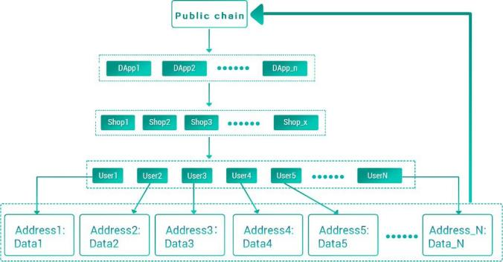
Figure 2. Customer and data sharing between DApps
DNC, on the basis of implementing distributed data storage, enables
any DApp to have the ability to give address data storage, information
exchange, value interaction, and identity verification, etc., so that any
individual, organization, or even intelligent program, as long as there is
an address Conveniently establish communication and transaction
relationships with any other subject. Not only that, with the
accumulation of data with the address as the core, it is also possible to
establish a credible proof system of "good money drives out bad
money" to make human cooperation move toward a virtuous circle.
From the perspective of the subject of communication and transaction,
as long as they have the ability to operate addresses, any subject can
participate in the DNC system for communication and transactions.
They may be individuals, organizations, or intelligent programs. The
current world is a world dominated by various centralized organizations.
43 / 163

Slide 44
Blockchain is making individuals rise, and in the future intelligent
programs will become more and more important subjects, but in fact it
is not necessary to distinguish between people or intelligent programs
behind the address, whether they are individuals or Organizations, as
long as they apply for and own an address, they can achieve equal
exchanges and transactions between these subjects.
According to Metcalfe's law, the more participants participate in a
system, the more progress can be promoted. Participants, whether they
are individuals, businesses, or smart programs, through the underlying
blockchain code, they can freely express their views, sell products, and
purchase products without restrictions from geography, institutions,
and organizations, and make transactions more automated through
smart contracts And intelligent, so that humans gradually establish
large-scale, automated and deep cooperation.
2.2.4: Data sharing based on data routing: information exchange is
fully supported by the protocol
The storage function of DNC enables data to be stored on the
chain, and data routing is required when data is acquired. DNC designs
a special data routing function that allows data to be accessed at any
time and also enables information exchange between any addresses. In
order to be able to achieve a smooth chat experience, current solutions
44 / 163

Slide 45
all require centralized storage or routing. DNC's distributed storage has
been specially optimized for chat. Using specially designed readable
and writable storage space and file database can achieve chat without
going through a centralized server.
Information exchange, whether it is a two-person conversation or a
multi-person conversation, whether it is text, voice or video, is
extremely important for human transactions before, during and after
the event. The characteristic of the information Internet is information
interaction, and the value Internet is characterized by value interaction,
but DNC, as a new generation of public chain, will break this boundary
and integrate information interaction and value interaction.
DNC provides protocol-level communication support for DApps, so
that everyone can encrypt and decentralize free communication with
the world through the address. The communication data will only be
owned by the producer. Anyone can establish a peer-to-peer rich media
chat, multi-person group chat, and can transfer funds and interact with
smart contracts during the exchange. It is important to integrate the
communication function into the blockchain: before the transaction,
you can contact the other party to negotiate the transaction, and you
can easily establish the smart contract of the transaction in the session;
during the transaction, the two parties can establish the transaction-
related situation Chat, communicate the delivery situation or modify the
45 / 163

Slide 46
smart contract; after the transaction, all the objects that have been
traded can be divided into different groups to facilitate customer
relationship management.
DNC will support sub-real-time chat at the protocol layer, while
DApp is based on Email and distributed storage functions, which can
establish a point-to-point or point-to-multipoint relationship and
conduct point-to-point or group chat.
2.2.5: The system is fully distributed and infinitely scalable
DNC V2.0 is completely distributed. DNC V2.0 is similar to Bitcoin
and Ethereum, does not require any election of super nodes, anyone
can participate in mining, and have the opportunity to receive mining
rewards. Participants can choose to obtain resources from each shard
participating in the consensus main chain or applying to participate in
the functional sub-chain.
Whether it is a Windows system, a Pingguo system, or an Android
system, you can share disks or participate in mining through DNC
software, which greatly expands the distribution and scalability.
DNC is infinitely scalable. The so-called infinite scalability means that
the blockchain system can continue to expand with the increase of
miners and can support more users. DNC will use a sharding
mechanism, so as the number of participating miners increases, each
46 / 163

Slide 47
function will be continuously expanded.
2.3: Address-based data system
2.3.1: Credit verification based on personal cloud space identity
verification, circle of friends and transaction records
People-to-people exchanges and transactions are inseparable from
the reputation mechanism. Because people's communication and
transactions often need to know who is the object of communication
and transactions, so that the information can be more symmetrical in
order to reach a transaction efficiently. For a well-functioning market,
credibility is the most important mechanism for "good money drives
out bad money". The blockchain should provide an interface for the
reputation mechanism, so that people's reputation can change
dynamically over time, and promote address owners to maintain their
reputation.
Reputation is actually an evaluation of information (including
identity information) of the address owner. To this end, as much
information as possible should be integrated into the address, and DNC
is based on the address as the core data storage, it is easy to pass a
variety of information Proof of reputation (PoR). People can record their
relationship with the world through voluntary information disclosure, or
they can adopt a third-party identity verification mechanism to establish
47 / 163

Slide 48
their credibility. Different ways of proving the effectiveness are different.
DNC proposes three types of proofs: weak proof, semi-strong proof and
strong proof:
1: Weak proof: By publishing information by yourself, let the virtual
world and the real world continue to establish contact, and prove
yourself through the dynamic information of your life that is
continuously deposited on the timeline. This is mainly achieved through
social functions.
2: Semi-strong proof: Prove yourself by transacting with other
addresses and providing transaction-related information (including
comments from the transaction party).
3: Strong proof: establish a credible association between your
address-related information and the real world to prove yourself. This
method is mainly achieved by publishing its relationship with the
address through a trusted channel or through third-party verification.
For example, an organization can publish its own blockchain address on
its official website, or a person can verify it by a special verification
agency, and the verification agency can publish the identity of the real
person corresponding to the address in its own information release
channel. At the same time, the address owner can publish relevant
verification information on his address to facilitate verification from
other trusted subjects.
48 / 163

Slide 49
In order to complete the credibility certification, individuals can choose
to store personal information, life dynamic databases and transaction
data in their own spaces, and authorize them to different people for
use. In the future, more and more people may deposit data in private
data identified by addresses, such as:
1: Address book data: Give the address permission to manage the
address book, one of which is to authorize relevant personnel to help
transfer the data in the address to a new address, which can be used in
emergency situations such as the loss of private keys;
2: Life dynamic data: endow the address with the ability to publish
an immutable life dynamic;
3: Multimedia data: give the address the ability to publish text,
pictures, voice, video and other media, and give the address the ability
to customize tags and custom tamperable attributes
4: Product data: Give the address the ability to publish various
products, including resources that can be shared, and store these data
in the product database;
5: File storage space: Give the address application space and the
ability to save various data. Since the file exists in the form of an object,
the address can define its own database, which paves the way for the
establishment of various DApp databases
6: Multi-currency wallet data: Give the address the ability to map
49 / 163

Slide 50
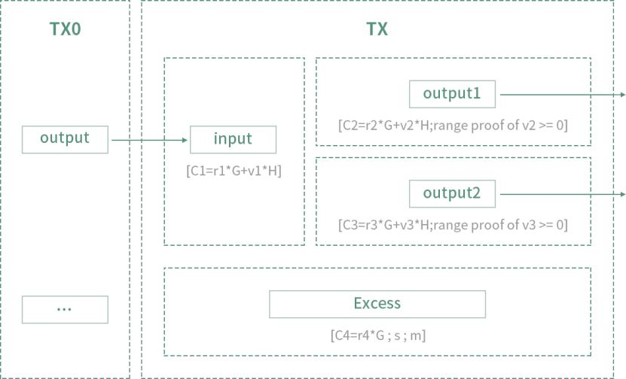
various tokens to the chain through cross-chain transactions to form its
own multi-currency wallet database;
7: Coin issuing data on the chain: giving the address the ability to
issue coins with one click and storing the relevant data in the coin
issuing database;
8: Smart contract data: Give the address the ability to generate
smart contracts, and save the relevant information in the smart contract
database.
Reliable privacy protection and permission control
Since the data is stored in a private data set after it is generated, this
solves the problems of data privacy protection and confirmation, and
also paves the way for data transactions. Only the data that the address
50 / 163

Slide 51
is willing to open will be disclosed. The address can also selectively
open the data to the specified address and form its own data sharing
circle. For example, the life dynamic data can only be seen by the
specified friends. These shares can also set the time limit of access or
pay to view, thereby forming various types of data exchanges and
transactions.
In the future, there may be specialized data second traffickers, who
are constantly acquiring various types of desensitized data from
individuals, thus making data truly a service industry.
2.3.2: Address alias, communication account and help recovery
function
The main function provided by DNC is user-oriented
communication and communication, and user communication and
communication need to bind users with a memory-friendly ID, rather
than boring binary address strings. So DNC provides address aliases as
a more friendly interface.
Since the communication requires the other party's public key
encryption, the address will also be able to apply for a special
communication account and the communication account can be in the
world state for encrypted communication of data.
If you have the private key, you will have everything, but if you lose
51 / 163

Slide 52
the private key, you will lose everything. To avoid this tragedy, DNC will
design the address to specify other addresses to join the multi-
signature, so that when the private key is lost, the private key of other
addresses will be lost after a certain period. Can help authorize the
ability to transfer data or account balances to other addresses.
2.4: Design goals
Although blockchain has been considered to have the potential to
subvert the existing business model in recent years, the underlying
technology of the public chain is not enough to support large-scale
commercial applications. The most prominent technical problem of the
blockchain is the low system performance. Taking Ethereum as an
example, all the applications running on the entire network can use
about 10 transactions per second, but for an application with a daily
activity of 10 million levels, the peak TPS requirement is generally
around 2000-3000, so now Some blockchain 1.0 and blockchain 2.0
systems represented by Bitcoin and Ethereum are completely unable to
support large-scale commercial applications.
And why is it so difficult to break through the limitation of TPS? Just
like the “impossible triangle” problem that all distributed systems will
face in design, blockchain systems will also face their own impossible
triangle: decentralization, security and high performance.
1: The decentralized design challenge is how to ensure the
52 / 163

Slide 53
decentralization of the network. This requires that the network needs to
be a peer-to-peer network. The status of the machines in the network is
equal, and there is no special central node. At the same time, in order to
ensure the decentralization of the network, the network needs to be an
open network without access, so that everyone can join the network,
and the network will not be controlled by one or more centers;
2: The design challenge of security is to ensure that the network is
secure enough to be easily destroyed by others. In an open and
economically linked network, not only will good people buy machines
to join the network, but there will also be more bad people trying to
profit by destroying the network. So, how to ensure the security of the
network when there are bad people inside the network, which has
broken through the traditional security architecture and is a challenge
for security design;
3: The high-performance design challenge lies in ensuring that the
network is adequately decentralized and secure as much as possible,
ensuring the best performance and lowest network energy
consumption.
In the impossible triangle of blockchain, Bitcoin and Ethereum have
chosen enough decentralization and security, while EOS has biased
efficiency and sacrificed some decentralization and security.
53 / 163

Slide 54
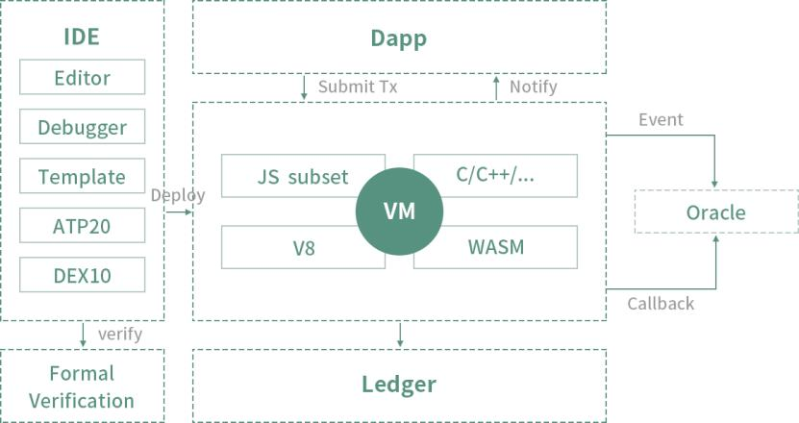
Application development friendly smart contract
The goal of DNC is to build a communication and trading platform
with blockchain technology. On this platform, data assets, multiple
tokens, goods and services can interact freely through smart contracts,
balancing the three corners of the impossible triangle in a good
balance. Under the circumstances, to realize value intercommunication.
Specifically, it includes the following technical requirements:
System functions
With infinitely scalable transactions and Turing complete smart
contract functions.
With convenient data saving function.
With convenient asynchronous communication function.
System characteristics
The system is stable and highly concurrent.
54 / 163

Slide 55
Distributed applications are easy to develop and deploy.
Can be as modular as possible to facilitate system upgrades and
maintenance.
Scalability
It can meet the needs of large-scale communication and transaction
applications.
It can maintain a reasonable energy efficiency ratio when the
system reaches a large scale.
In the case of the expansion of the system's own scale and
application scale, the block generation efficiency, storage efficiency, and
communication effect can be maintained well.
With the addition of more resources, the system can be infinitely
scalable.
Safety
Can prevent double-flower attacks.
Can prevent witch attacks.
Can prevent other attacks that reduce efficiency or system paralysis.
2.5. System architecture
Based on the above analysis, the system must have at least one
storage subnet, shard transaction sub-chain, coordinating shard main
chain, smart contracts running on each shard and address-centric user
55 / 163

Slide 56
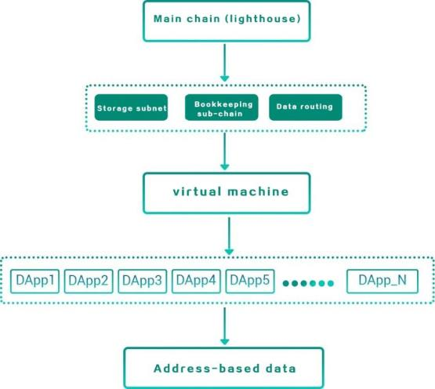
support system. The following diagram can summarize the main
architecture of this fully functional blockchain.
Figure 3. System architecture
The following chapters, in terms of technology, will mainly discuss
how to implement space-based storage, how to implement sharding,
and how to implement personal cloud-based communication. The
economic model will discuss the token economic model and the future
plan of the project.
56 / 163

Slide 57
03 Space-based storage
57 / 163

Slide 58
3. Space-based storage
3.1. Storage based on peer-to-peer network
3.1.1. Architecture of the storage chain
Traditional blockchains mostly belong to the status block chain
(Status BlockChain), from the single state of the number of bitcoins in
Bitcoin, to the state of the smart contract world of ethereum. All follow
the logic of state storage.
Starting from IPFS, a data block chain (Data BlockChain) has emerged.
The data block chain uses the attributes of data as a state to conduct
transactions and storage. From a storage perspective, IPFS implements
object storage, and its object is a file . Two kinds of miners are proposed,
one as a storage miner to save file data; one is an index miner, which is
mainly used to save file description information (file owner, number of
shards, shard hash and other attributes)
The concept proposed by DNC is not object storage, but a pure
spatial storage. It does not target specific storage objects, but provides
available storage space. Users can use the storage space like a local hard
disk and use it to store various data objects, and this space is provided
by distributed miner nodes.
58 / 163

Slide 59
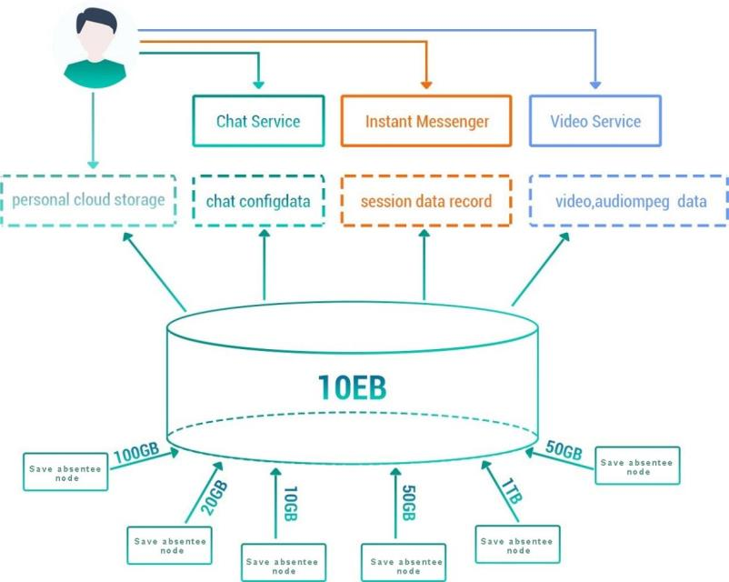
The following figure is the architecture of DNC's storage subnet:
Figure 4. DNC storage function
As shown in the figure above, storage contributors (storage miners)
provide their own hosts or nodes with free storage resources. DNC
aggregates the miners' resources to form a large-scale storage cloud.
With a large-capacity storage cloud, wallet (terminal) users can
extract a virtual storage space (such as 1GB) from the cloud to form
their own cloud disk. Users can plan to store files in the space
themselves, and can save large-volume files. For example, audio and
video data can also save a large number of small files. The uploading
and downloading, addressing, using, managing and maintaining of
59 / 163

Slide 60
these files or data are all planned by the users themselves in the virtual
cloud disk. There is no need to perform complex market transactions
like IPFS to complete the storage of a small number of files.
In addition, with the distributed storage cloud, we can construct
more complex distributed services on it, such as chat rooms, instant
messaging, audio and video services, and so on. These traditional
centralized services have the opportunity to achieve decentralization
after solving the storage pain points.
The main task of storage miners is to maintain and maintain the
physical space provided by them and the virtual space of mapping
management, so that they can continue to provide services online to
continuously obtain mining income.
The role of the storage sub-chain is shown below:
From the above figure we see four roles, Wallet means front end,
Farmers means storage space service provider (also known as landowner,
ie landowner), Miners means blockchain service provider, and there is
also an important role It is a "Data Gateway", also known as a data agent,
which provides the function of data routing.
3.1.2. Data agent
If there is no data agent, when users want to write data, they need to
take a complicated network path to establish information query before
60 / 163

Slide 61
they can start transmission. This will undoubtedly bring a very severe test
for the user experience. In order to make users take shortcuts
(Shortcut), you need to help the agent to complete in advance, and every
visit in the future will be familiar. The agent prepares various information
queries and paths for the data objects frequently accessed by the user.
When the user makes a request, the waiting time will be greatly
shortened and the experience can be greatly improved. Taking the Email
service as an example, the agent can provide reading and writing of the
mailing list space belonging to the user, thereby greatly speeding up the
delivery speed of the mail.
Therefore, a "centralized" private employment service is formed
between the user and the agent, which is equivalent to the user being
able to find a data service provider providing exclusive data services on
the network through transactions (spending DNC currency). The service
provider is mainly responsible for the construction, transmission and
simple list management of the data access path of the employer.
3.1.3. Storage miners mining
DNC divides the virtual storage space into Chunk. After the storage
miner determines to provide a certain amount of storage, he can claim
the Chunk that provides space. For example, Miner A determines to
provide 1GB, which is allocated to Chunk N by the algorithm.
61 / 163

Slide 62
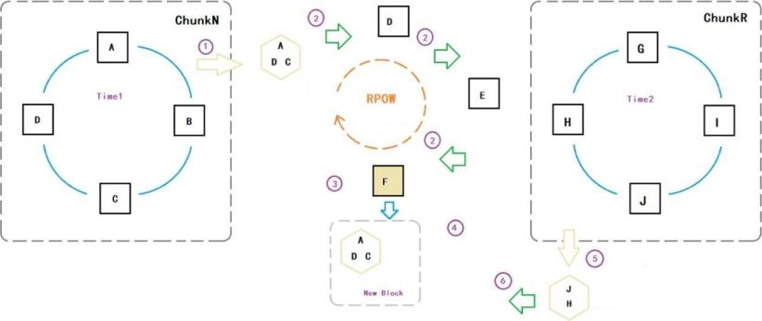
Figure 6. Schematic diagram of storage miners mining
(For example, Chunk N is 3GB 4GB range of virtual space). Miners
claiming the same Chunk form data copies with each other, which we
call a copy group (Chunk Copy Group). As shown above, claiming
storage nodes A, B, C, D and G, H, I, J in different virtual spaces form
ChunkN and ChunkR's two copy groups.
At Time1, the four nodes ABCD of the ChunkN copy group mutually
verify the data. They provide each other with the Chunk on-chip data
offset and data size calculation hash associated with their own Id and
the current block hash, and hand the hash to other nodes for
verification. , Sign and continue to pass after verification, and discard if
not passed. When the number of signatures reaches 2/3 nodes, the
authentication can be considered as passed. In the figure, three nodes
A, C, D in ChunkN pass each other's data verification and successfully
sign. So the signature was packaged into a "spatial verification
transaction". Broadcast this transaction among all miner nodes.
62 / 163

Slide 63
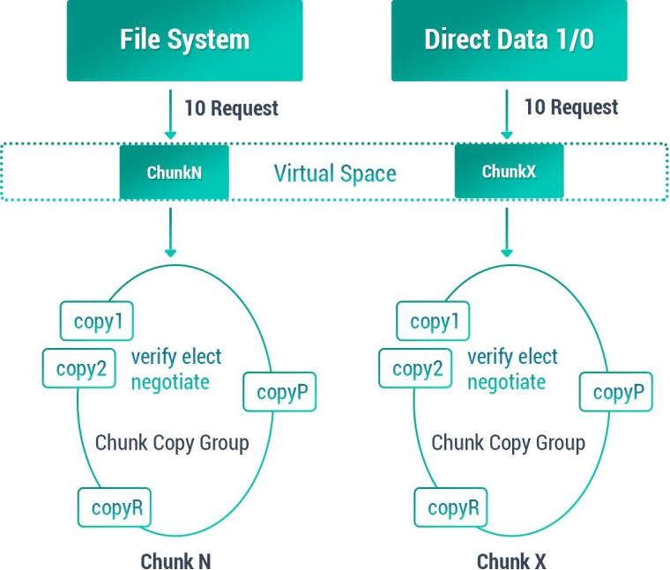
In the end, the “spatial verification transaction” is packaged by the
miner determined by RPOW in a new block. The new block packages
this verification transaction into the block and then broadcasts the
whole network. The node that receives the new block rewards tokens
based on the accounts associated with the three storage nodes A, C,
and D included in the space verification transaction in the block. So
keeping the storage space online can generate revenue.
Figure 7. Schematic diagram of storage miner verification
3.1.4. Fragmentation and encryption
The storage sharding adopts the spatial sharding mode, which is
63 / 163

Slide 64
different from the file sharding of most public chains today:
traditionally, the file is divided into several equal-length fragments and
distributed on the network. When downloading and reading, it is read
in parallel to local splicing. The advantage of this method is that it is
simple and straightforward to implement, Merkle integration of file
fragment content hash to ensure the consistency of file data. Multi-
segment downloading at the same time downloads also improves the
reading speed; The large number of large file fragments is relatively
difficult to maintain; while the file size is fixed, its storage mode is
limited to read-only. Generally, file modification is not supported, and it
can only be applied to archive scenarios. From a functional perspective,
the description is equivalent to network file storage, which is consistent
with the traditional P2P file model. The benchmarking centralized
service is similar to FTP.
DNC does not aim at files, but proposes a way to access storage
space. Storage chain miners obtain tokens by sharing the free storage
space in the disk. Different from the idea of IPFS and other storage
products, no matter whether there is file upload or not, the space can
bring value to the miners. Countless storage on the network together
builds a huge virtual disk. Divided into spatial slice Chunk collections,
the resources of the storage miners on the chain are associated with
Chunk to form a huge storage pool. Why is it providing a storage pool?
64 / 163

Slide 65
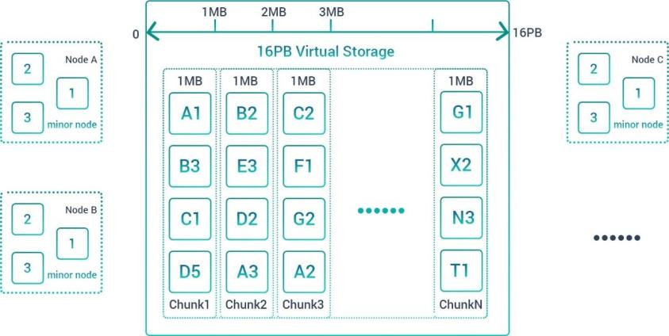
With this distributed virtual cloud storage pool, users can allocate the
space they want, and they can freely read and write files or data in
it. From this perspective, it is for users. It is more like a cloud storage
device than an FTP server. On the block storage device (Block Device) in
this chain, we can construct a simple File System on the storage
terminal and use it for storage.
Figure 8. Fragmentation and encryption
As shown in the figure above, there are many chunks in the 16PB
virtual space. Each chunk is a fixed capacity (such as 1MB). For storage
miners, the way they contribute space is to contribute block copies.
Each chunk in the figure has It is composed of block copies contributed
by multiple miners, so Chunk is a logical concept, it represents a
segment in the virtual space, for example, Chunk1 represents the 0-1MB
65 / 163

Slide 66
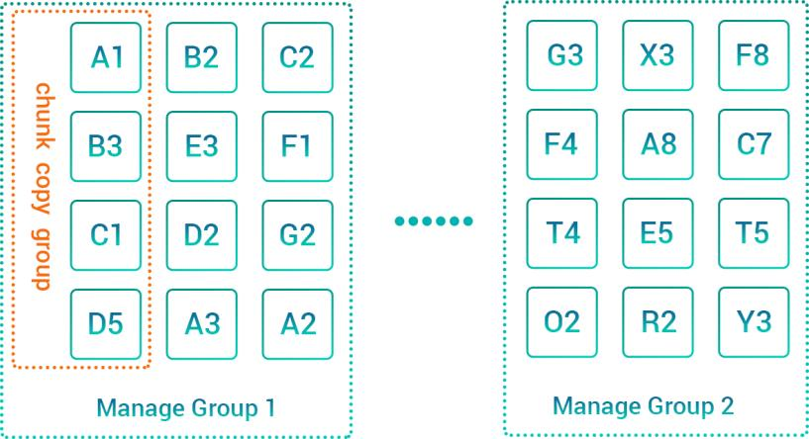
segment in the virtual space, and Chunk2 represents 1MB in the virtual
space -2MB of space ⋯; each chunk can be constructed by 1MB blocks
provided by multiple miners, the number of copies is scalable, and
different claim strategies are made according to different thresholds.
3.1.5. Grouping of miners
Storage miner grouping involves two levels:
1. Using Chunk management, gather all nodes involved in
maintaining the same data together to become a Chunk maintenance
group
2. In order to ensure high availability of data, the number of Chunk
space copies is relatively large, which means that Chunk management
information also needs to occupy a relatively large management space
(memory and storage).
Figure 9. Fragmentation and encryption
66 / 163

Slide 67
For the same miner node, it is the space carrier provider of each
chunk. It participates in all the chunk copy groups that it claims
(provides space). In this group, it synchronizes data with other nodes
participating in the same chunk. Maintain high availability of the same
chunk.
For each chunk, it is necessary to record the status of their replica
participating nodes. According to the correspondence between the
ChunkId and the NodeId of the miner node, DNC divides all the Chunks
into a number of Manage Groups, which are handed over to a group of
miner nodes for information recording and management . This allows
miners to form a management shard for Chunk and a sharding
mechanism for the storage blockchain.
The sharding mechanism of the blockchain is to improve the overall
operation efficiency of the blockchain, so that more information and
transactions can be processed in parallel.
3.1.6. Data download
For data download, user nodes request data from a group of
Chunks based on data requests (from File System, or direct data access
from the upper layer).
For all nodes in the same Chunk Copy Group, the requesting node
sends a command to request the Id and current status of the current
67 / 163

Slide 68
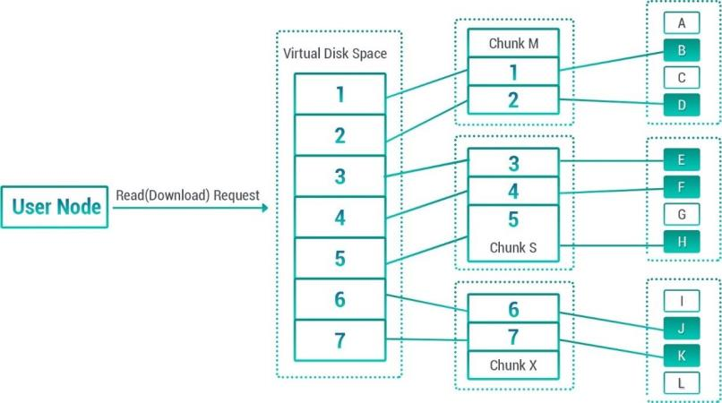
update block. After the request is successful, the nodes with the largest
and equal Id and status "status online" are classified as data The
providing node divides the download request into different fragment
requests according to the data size requested from the chunk. At the
same time initiate a data transmission connection to them.
Figure 10. Data download
3.1.7. Data upload
As shown in the figure above, there are many chunks in the 16PB
virtual space. Each chunk is a fixed capacity (such as 1MB). For storage
miners, the way they contribute space is to contribute block copies.
Each chunk in the figure has It is composed of block copies contributed
by multiple miners, so Chunk is a logical concept, it represents a
segment in the virtual space, for example, Chunk1 represents the 0-1MB
segment in the virtual space, and Chunk2 represents 1MB in the virtual
68 / 163

Slide 69
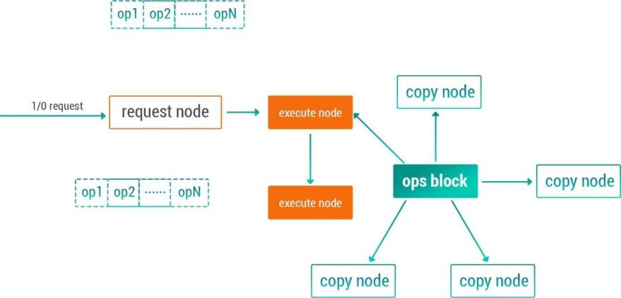
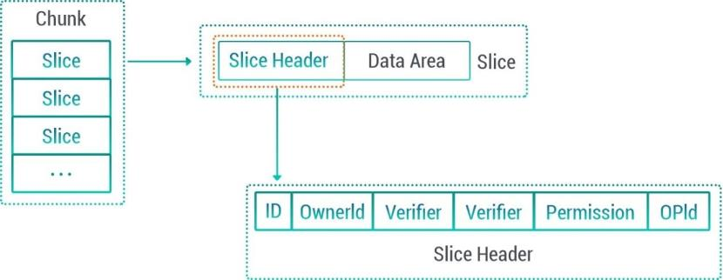
space -2MB of space ⋯; each chunk can be constructed by 1MB blocks
provided by multiple miners, the number of copies is scalable, and
different claim strategies are made according to different thresholds.
Figure 11. Data upload
Data writing process description:
We divide Chunk into several slices, and slice is the basic unit of
user-side operation. Slice's OwnerId is the tenant and user of this slice.
Only he has the authority to update and write this slice. The service
model is like this:
69 / 163

Slide 70
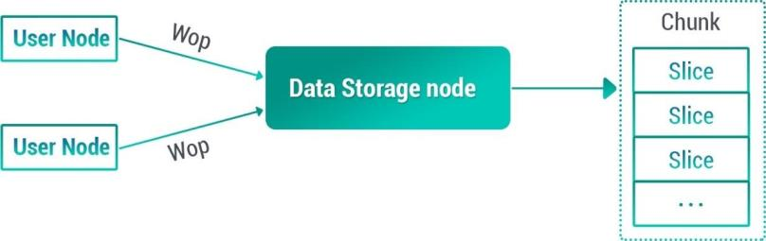
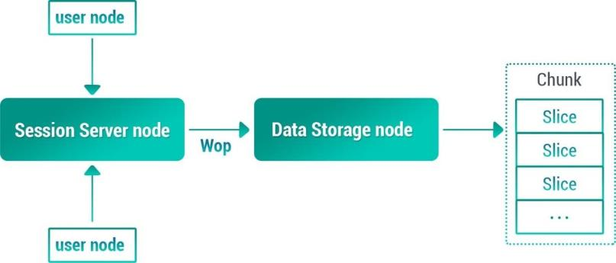
Figure 12. Data upload (continued)
Figure 13. Data writing
For Chunk, users directly access the slice on the storage node, so
there are no obstacles and deception. For session services, the service
model becomes as follows:
Figure 14. Data node access
As shown in the figure, all users must communicate and
communicate on the channel server of the session service node, and the
session file data needs to be submitted to the storage node by relying on
the session service node.
The session service node is a node randomly selected from the
channel blockchain based on dynamic routing, and its behavior is
70 / 163

Slide 71
unpredictable, so we cannot fully trust that it will not do evil. Although
the session content is transmitted encrypted, although it cannot spy on
the session content, it can maliciously destroy the session data on the
storage node when writing.
The requesting end broadcasts to the member nodes of the same
block replication group by constructing an initiating inquiry instruction
broadcast, and notifies them of the operator Id. Each node receives an
instruction, and if no one is currently using it or the most recent operation
has timed out from the current time, the signature is accepted. Send the
signed response message to the requesting end through active path
finding or return to the requesting end according to the original path of
the broadcast path. After receiving a sufficient number of signatures, the
requesting end packs all the signatures to form an Open command and
broadcasts again. Each node checks the verification signature And
confirm the quantity, if you agree with 2/3, then set the operator ID to
the memory.
Design of block copy synchronization: treat all participating nodes of
the same block data group as a micro-blockchain for this data block. The
blockchain uses a semi-cached synchronization strategy. Each group
node can be collected from each The Wop request on the requesting end,
after collection, starts broadcasting these Wops to the execution node of
the current block; after the execution node collects the request, it packs
71 / 163

Slide 72
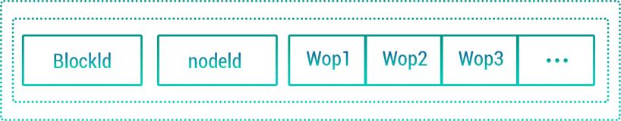
them into operation blocks according to the receiving order (using
sorting to eliminate the possibility that multiple nodes may generate the
same virtual write Conflict), packing and filtering out operations that do
not meet the shard permission setting
Each group node can be called a copy miner. It collects Wop requests
from other group nodes. When the number of Wops meets certain
requirements (N> 0) and the collection time meets certain requirements,
it sends the original Or, the Ids of the Wops received from other nodes
are packaged into block broadcasts to other nodes, and at the same time,
each Wop is executed locally according to the order of the Wops in the
block.
If a group node creates and executes its own generated block, and
then receives a broadcast block from its group node, it needs to first
determine its own priority. If a node is down, then no block can be
generated within its time window as an execution node, and all
operations will have a certain delay. Aiming at this high delay
characteristic.
Figure 15. Sequential execution
The upper-layer application should first buffer the data before
72 / 163

Slide 73
loading it, try to reduce the number of loading times, and merge most
operations together.
For the newly added group node, a data download process is
required. It selects a smooth communication node from the group node
as the data service node and starts to download the complete data of
the chunk from the beginning; at the same time, it also needs to Join
this cluster and become a quasi-cluster member node (semi group
node). It needs to save all the blocks in the download process while
downloading the data. After downloading the data, execute all the
blocks locally, so that the overall synchronization can be completed and
keep up with the rhythm of other replica nodes. .
The implementation node election rules are more particular, and all
group nodes may have a larger number, such as 32. If a simple round
robin strategy is adopted, in most cases, the node that receives the IO
operation request is a few nodes bound to the app node (a chunk may
be used by multiple tenants at the same time, and the operator is not
unique); A leader needs to be elected as the execution node of this
replica synchronization group. Election process: When the tenant writes
data to the virtual disk, it will first call an Open method. The Open
method will query all the replica node nodeIds where all participating
Chunk information is located, and send Open messages (with chunk,
slice ), The storage node finds the corresponding local storage record
73 / 163

Slide 74
from the local disk according to the (Chunk, slice) information carried in
the message and compares the owner and attributes (read and write
permission attributes, etc.). Action; if the verification is successful, add
this node to the execution node group of the (Chunk-Slice), and make
the message known to all the nodes, and the members of the execution
node group in a slice will rotate out of blocks Block success is division of
labor broadcast: the broadcast mechanism can be set to query delivery
mode, because it involves bandwidth and traffic, so communicate
before sending, instead of directly throwing data, for the group node,
try to select only 1-2 subordinate nodes Data transmission, and then
further transmission by the lower node.
From the above description, the write operation process is more
complicated, if the application layer uses synchronous waiting, it will
make efficiency
The application layer should use the cache operation method. After
submitting all the cache operations at once, on the one hand, it
continues to wait and add new operation instructions into the cache
area. Zone cleared.
3.2. Proof of space-time, proof of existence, and proof of availability
3.2.1. Proof of space-time and existence
atial synchronization is divided into three types of synchronization:
74 / 163

Slide 75
1: No space-time proof is used. In this case, the space only exists as
a resource, and it has not been rented by the user or has not been
written yet, so it cannot be verified by a certain set of data. Self-
verification mechanism.
2. The space-time certificate that is already in use indicates that the
space is already in use, indicating that the Chunk has been leased by the
user and has submitted (file) data to the space, so synchronization and
verification are based on these data.
3: The space that is being read and written proves that the group
node that is being read and written is recognized only after the majority
of the nodes are updated.
The space provided by any space provider is filled with data, which
may be user data or automatically generated fill data. The blockchain
will periodically initiate (for example, every 20 blocks) a random spot
check to allow mutual verification within a data group, and the majority
is considered to be a trusted node and can receive space rewards.
3.2.2. Proof of availability
The user of the data space will submit a service data during the use
of the data agent every time it is completed, and write it to the world
state. The mainnet will automatically blacklist the space miners with
poor service experience. The worse the service quality, the faster the
75 / 163

Slide 76
submission speed of the service quality, the quicker it is to find out the
black sheep. Over time, it is difficult for untrusted space miners to cause
harm to the system.
3.3. Incentive mechanism and payment mechanism
3.3.1. Space usage mechanism
The space usage mechanism is as follows:
1: First space usage: Users use DNC to pay for their storage objects
according to the length of time and space size according to the built-in
price formula, pay to deposit in the fund pool, and confirm the storage
object expiration time stamp when the block is packed.
2: Spatial adjustment: When the object expands or shrinks, the
timestamp is changed according to the pricing formula according to the
object change and additional DNC.
3: Space lock: After the timestamp expires, the space access right is
automatically locked, and the space will be used as an application space
mark.
4: Space reclamation: When new space is claimed, the free space
will be used first, and then the space that expires earlier will be used.
5: Space unlock: When the user applies for renewal, if the original
space is not recovered, it can be recovered again, but the space cost
from the expiration to the current time needs to be paid.
76 / 163

Slide 77
6: Landlord Reward: Multiply the price by the amount of each block
that has been purchased and used to cancel each time to obtain the
total reward, and confirm to the verified landlord through a random
verification mechanism.
3.3.2. Relevant variable conventions
All paid transactions for space purchases will be completed by
special algorithms and recorded on the main chain. The payment will go
to a special account called "fund pool". The fund pool records space
purchase behavior. The following uses mega-days (MD) as the unit of
measurement for space usage rights. Mega-days represent the usage
rights for one mega-space per day.
Variable assumptions are as follows:
1: W: Assume that the total space of the world hard disk that the
user can use is WD, and the unit is MB bytes. This data is corrected once
per block and recorded by the block header. Worlddisk first letter.
2: t and T−1: Represent the timestamp of this block and the
timestamp of the previous block, respectively.
3: T: is the total number of trillion days in the current block. Here,
the maximum storage period that a space object can apply for is within
365 days from the time of transaction, so the maximum number of
megadays that can be provided by each block cycle is 365W. We use T
77 / 163

Slide 78
to represent the right to use this space. Block correction once. T = T−1
+ (W − W−1) ∗ (t − t−1) / (24 ∗ 60 ∗ 60). T−1 is the total number of
mega days in the previous block, and W−1 is the total space of the
world ’s hard drives in the previous block. (W0 − W−1) ∗ (t − t−1) /
(24 ∗ 60 ∗ 60) adds or subtracts mega days to the current block. T is
the first letter of Total.
4: B: It is the number of mega days that the current block has been
purchased and is still usable. This data is corrected once per block and
recorded by the block header. B = B−1 − B−1 ∗ (t − t−1) / (24 ∗ 60 ∗
60) + ∆B. Where B0 is the number of mega days that have been
purchased and still available for the current block, and B−1 is the
number of mega days that have been purchased and still available for
the previous block, B−1 ∗ (t − t−1) / (24 ∗ 60 ∗ 60) indicates the used
megadays that need to be cancelled in the current block. ∆B is the
number of new purchases in the current block. B is the initial letter of
Bought.
5: R: indicates that the current block is not enough to buy trillion
days, including free space and space that has expired. Residual initials. R
= T-B
6: M: indicates the number of DNC tokens in the current block fund
pool.
7: p: indicates the current block storage unit price, the use price per
78 / 163

Slide 79
trillion days, the unit is DNC, here represents the hard disk user, that is,
"citizen" "rent" fee per trillion days.
8: r: Represents the unit rent of the current block, the rental income
per mega-day, the unit is DNC, here represents the hard disk provider,
that is, the “landlord” income of “rental” per mega-day.
3.3.3. Requirements for the price function of space use rights
Terabytes price is the key to adjust the use of storage space, the
price adjustment should be satisfied with the following conditions:
1: As the demand for use increases, prices continue to increase in a
non-linear manner, so that the space is always in a surplus state.
2: As the demand for use increases, the rewards for space-time
verification increase to encourage more landlords to stay.
3: The space rental price is within a reasonable range.
4: The space rental price is in a relatively stable state.
3.3.4. Bancor payment mechanism
If the time that each storage object can store is unlimited, it is
difficult to manage the inflow. If it is stipulated that the storage time of
each object is at most 365 days, and the excess needs to be renewed,
the total number of mega days that can be purchased is T = 365W.
Since there is a fixed total number of mega days in each block
79 / 163

Slide 80
generation cycle, it is possible to use a Bancor-like mechanism to price
mega days in each block generation cycle.
Bancor is a project of Ethereum, a currency system that provides
continuous liquidity for digital currencies through smart contracts.
Bancor solves the liquidity of digital currencies with small transaction
volume. It does not require third-party institutions or second parties,
and can buy and sell tokens through smart contracts. But at the same
time, Bancor's automatic adjustment mechanism makes automatic price
discovery and autonomous flow mechanisms possible, and also makes
it never sell out.
The following uses the Bancor mechanism to price trillion days in a
certain block generation cycle.
Bancor requires a constant term: c = M / (p ∗ T)
The price formula can be deduced by the above two formulas: p =
M / cR
When the value of parameter c is different, the price curve changes as
follows:
80 / 163

Slide 81
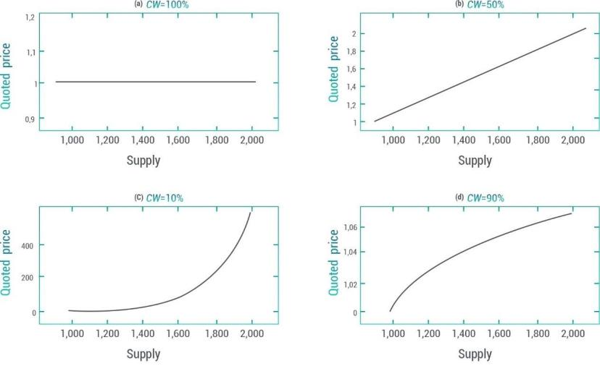
Figure 16. Price charts with different constants
Where CW represents a constant:
• When CW = 100%, it can be considered that the issued token is
an alias of the connector token. No matter how the demand changes,
the price of the issued token is always equal to the price of the
connector token.
• When CW = 50%: the issued tokens have a linear relationship
with their supply.
• When CW <50%, CW = 10% in the figure, as the supply increases,
the price increases rapidly.
• When CW> 50%, CW = 90% in the graph, as the supply increases,
the price changes little.
81 / 163

Slide 82
We can set the constant in the reference Bancor, package c to about
20%, so that when there are few people using storage, storage is cheap,
but the more users, the more expensive it is, and it increases
nonlinearly.
Since every purchase of a mega-day in the Bancor protocol will
cause price changes, we use a simplified algorithm, that is, the price is
the same every time the block is produced.
3.3.5. Landlord rent, landlord subsidy, and donation channel
Landlord rent
Since the world hard disk utilization rate is B / T, but the cost of the
entire hard disk needs to be borne by real users, it should be paid by
the fund pool.
Since each block has freely destroyed the expired right of use
according to the time stamp, these destroyed parts should be paid to
the hard disk provider. The number of mega days it needs to pay is:
r = (t − t−1)/(24 ∗ 60 ∗ 60)
For the liquidation of the previous block, the megabytes sold in the
previous block are B−1, and the tokens that have been earned are M−1,
so this part of the megabytes should be paid proportionally from the
asset pool, which should be The rental cost is:
r = M−1 ∗ ((t − t−1)/(24 ∗ 60 ∗ 60))/B−1
82 / 163

Slide 83
These fees will be distributed at each block time to reward verified l
andlord wallets.
Landlord subsidies
In order to make the space always have a certain surplus and make
the storage space in the early stage of the project relatively cheap,
within a certain period, a certain amount of capital is regularly added to
the capital pool so that the entire ecology can subsidize the landlord.
Donation channel
Distributed storage is the foundation of the project and the dream
of many people. We can add a donation channel so that currency
holders can donate funds to the fund pool.
83 / 163

Slide 84
04 Distributed communication based
on distributed storage
84 / 163

Slide 85
4. Distributed communication based on distributed storage
4.1. Asynchronous communication: Email
Distributed Email mainly uploads short messages (currently defined
as less than 1k) to the state of the world by doing transactions, and
large messages are used as attachments to be downloaded from the
personal cloud space of the recipient to the sender. The download is
divided into free and paid, and the data is encrypted and protected by
the public key of the recipient. In the case of payment, only paying the
fee can have access. In this way, data transactions can be realized.
Because of the need to know the public key, any address can apply for
an additional email address and email alias, and write the public key of
this address into the world state.
4.2. Framework of data routing
Distributed social networking, as the name implies, is mainly
manifested in the form of instant messaging. The oldest instant
messaging appeared in the 1990s. The peer-to-peer technology used by
the conversations established between users does not provide server
forwarding in the middle, which is what we often mention. To point-to-
point technology. The server only serves as a bridge between users'
computers to find and locate each other. Although most of the
functions of instant messaging will be mainly implemented by DApps
on it, DNC has the ability to provide distributed communication
85 / 163

Slide 86
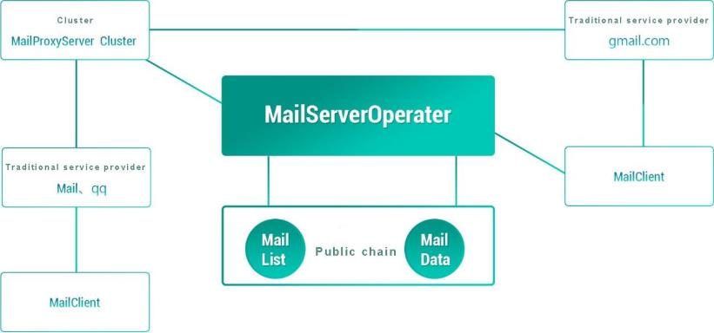
because of its distributed storage function.
As shown in the figure above, the AB node only transfers its IP: Port
to the Server by logging in to the Server. When establishing a Session
session, it obtains the address of the other party from the Server and
they establish direct communication. The advantage of this is that the
communication between the two parties of the AB is independent of
the server, and there is no privacy disclosure.
Figure 17. DNC distributed data routing framework
86 / 163

Slide 87
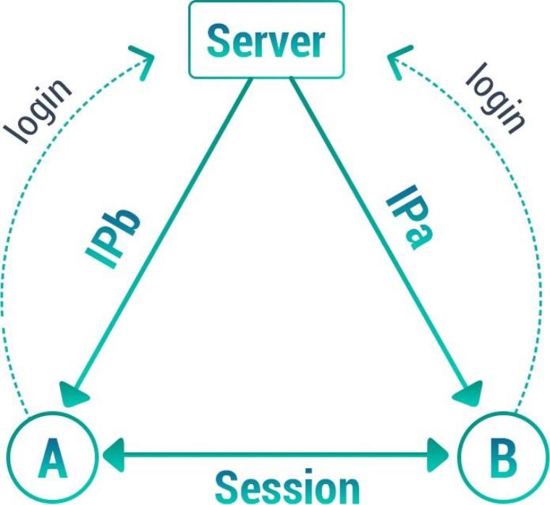
Figure 18. Point-to-point dialogue
The shortcomings of this model are also obvious, that is, it is
impossible to establish a conversation in which multiple people
participate at the same time, and the simultaneous participation of
multiple people requires the establishment of a complex mesh
structure. If a star structure with a certain user as the core is used, then
when this user goes offline, the communication connection of others
needs to be re-established. Moreover, this mode of purely relying on
user nodes is not conducive to the preservation of the list of
participants in the conversation and the preservation of conversation
87 / 163

Slide 88
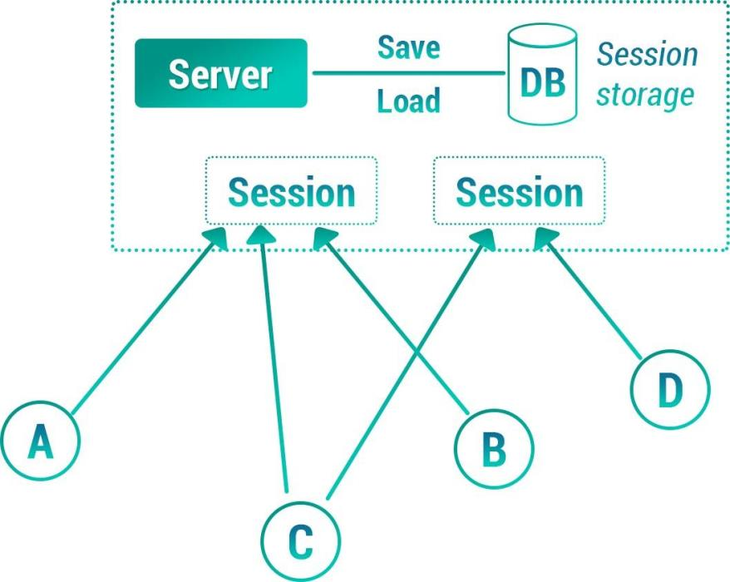
content.
So in the end instant messaging returned to the centralized chat
room model. The central node provides a stable online service, relays
the conversation content, saves, and manages the manager. These
powerful technologies and experience advantages are unmatched by
pure peer-to-peer.
Figure 19. Centralized conversation service
The session content storage service and stable channel availability
provided by the centralized node make the user session function very
reliable and powerful.
88 / 163

Slide 89
Comparing the above two modes, we can see that for the user node,
they need to experience the normal session service, there are two
necessary conditions: 1. The maintenance of the session; 2. The high
availability of the communication channel service; This On the two
conditions, pure peer-to-peer is difficult to meet, and the instability of
the node online causes the instability of the topology. Keeping the
content and configuration of the Session is more complicated for
ordinary user nodes (if they are stored in themselves, they face complex
synchronization problems) . Both of the centralized services can be
perfectly solved. Therefore, traditional IM services are all provided by
the central server. The advantages of the central server are that the
logical processing is coordinated, the storage services are uniform, the
service cluster communication is efficient, and it is easy to implement
complex and large-scale data processing.
Centralization of service clusters also has its inherent
disadvantages: 1. User data rights are in the hands of centralized
institutions and cannot be handled independently; 2. Service provision
may be affected by regional network problems and technical
maintenance issues; 3. Communication content is subject to institutional
supervision , Or even private monitoring.
DNC believes that communication is a means of communication
between the human world, it should be a free tool under its own
89 / 163

Slide 90
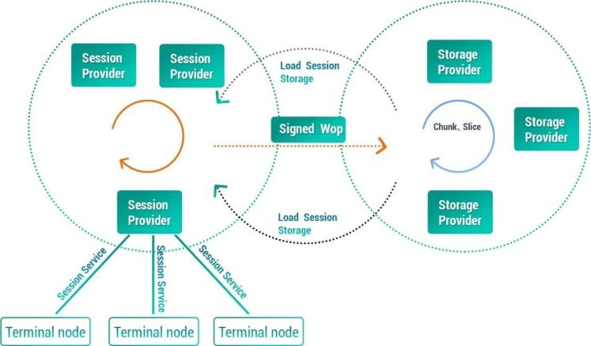
control. DNC constructs a completely distributed conversation place,
which is decentralized, so that any one or several service nodes on the
network have the opportunity to become a communication bridge
(communication routing) between user terminals. The group key
encryption of the communication content makes these service nodes
that provide routing channel services unaware of the content.
Adhering to the advantages of centralized services, DNC
conceptually separates storage and channels. Form an architecture in
which the storage blockchain and the channel blockchain cooperate
with each other:
Figure 20. DNC distributed data routing framework
Comparing the above figure with the centralized session service
diagram, we can find that DNC replaced Server and Storage in the
centralized session service diagram with two blockchains:
90 / 163

Slide 91
1: The storage blockchain is composed of highly available
distributed storage miner nodes, using the huge storage space provided
by participating miners to construct a highly available storage network;
2: The channel blockchain is composed of highly available
distributed Relay miner nodes, which mainly provide dynamic data
routing to help users construct a service node connection topology
based on Session participating members that all members can connect
to provide data Relay At the same time, the service nodes participating
in the data relay can access the Session Storage of the storage
blockchain to continuously save the session content so that the nodes
can be loaded online in the future.
For the user Terminal node (wallet terminal), the functional interface
and experience it gets are no different from the centralized session
service, and the server side has completely evolved into a decentralized
distributed system using distributed blockchain technology.
4.3. Session related storage definition
Group
Group is a concept of user conversation in our daily
communication. A group of users who communicate frequently will
maintain a public session temporarily or for a long time. This public
session body is called a group, and they are all called group members.
All users exit the group before the group is closed, otherwise it will
91 / 163

Slide 92
remain open.
The concept of maintaining groups on the blockchain is the core
content of distributed instant messaging. The elements contained in a
group are:
A. Participant list
B. Their most recent chat history
C. They provide shared files in the group
This group of elements requires that regardless of whether the
group members are online or not, they must always be able to keep the
service online when the session is established. This puts forward
storage requirements for distributed communications. And all these
need to provide encryption mechanism,
It is guaranteed that the plaintext of the content is not known by
the intermediate nodes that provide service support. In the following,
we will introduce the related designs of session establishment, session
encryption, group members and content storage.
<Jiatu represents account contact space, account conversation
list space, conversation space>
The storage blockchain mechanism is not introduced much. The
previous description is more. As shown in the figure, we cut a
predefined virtual space on this huge storage cloud to provide user
92 / 163

Slide 93
account information, session information and other data The storage is
pre-defined to facilitate DNC's distributed communication services to
be executed more quickly and managed more conveniently. If these
resources are applied dynamically, the execution efficiency will cause
user experience problems.
4.4. Dynamic routing
Completely distributed design, the service quality of
communication miner nodes has some chances. They may go offline at
any time, or affect the quality of service because of other transactions,
and even IP addresses and communication ports may not guarantee
stability. Under this condition, the terminal needs to provide dynamic
routing guarantee when requesting to establish a session service and
execute the session process.
4.5. Design of session establishment process
The user requests to establish a session. The request obtains a
miner node with service qualification by broadcasting on the channel
blockchain node network (specifically with a forward hop limit). Miners
perform shard management based on Session, and user nodes will
broadcast to several shards that match the current BlockHash at the
same time. The miner node recommends idle session resources based
on the SessionId information recorded by its local block shards, and
93 / 163

Slide 94
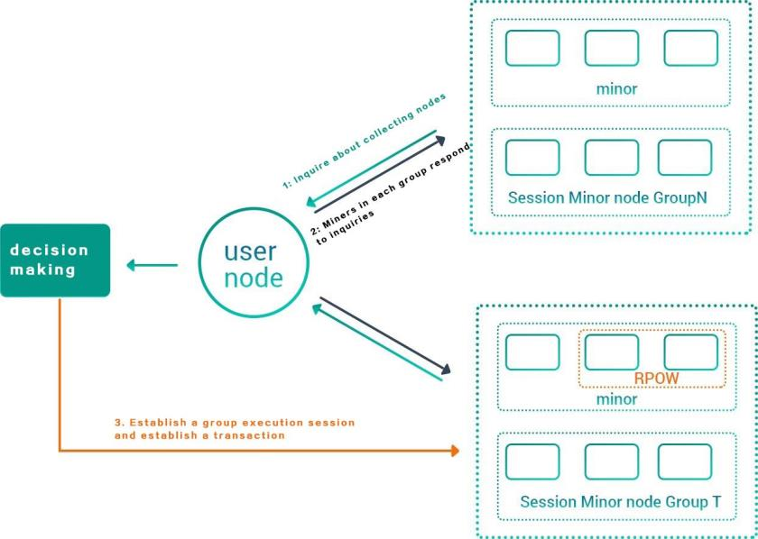
promises to be able to provide services for the session. The user node
collects a list of self-recommended miners, and selects from them the
resources that can support the same Session sharding
The miners group, package their NodeId and recommended
SessionId into a transaction TxNodeId, and broadcast the SessionId to
the group for RPOW. Decide the miners to mine to determine the final
assigned SessionId and the group of miners participating in the session
service.
Figure 21. Establishing a session
The service node group selects one of them as an Executor node
94 / 163

Slide 95
based on a random algorithm (such as (NodeId% BlockHash) & 0xff to
take the minimum value), which is responsible for the read and write
operations of the SessionId data area of the storage blockchain.
As can be seen from the above establishment process, establishing
a session, from applying for resources to determining miner sharding, to
RPOW final synchronous selection, these series of operations are
relatively time-consuming. Such steps are basically inevitable for a
distributed service .
In order not to affect the user experience. We can optimize some of
these steps.
To this end, DNC considers to select a minor node with a high score
(more self-reported resources) to communicate after selecting the
miner group in the first step. If it can communicate successfully, it is
defined as the session server (Executor node) to start providing directly.
Session Relay data forwarding service. Executor directly contacts other
nodes of this group of miners list involved in the transaction, and
simultaneously encapsulates a message broadcast with all target user
ids and service node lists to find all session participants. After all
participants (wallets) terminal nodes receive the message , Just try to
connect to each service node and participate in the conversation.
The process of constructing a transaction to apply for the RPOW of
SessionId and the process of connecting the storage blockchain are
95 / 163

Slide 96
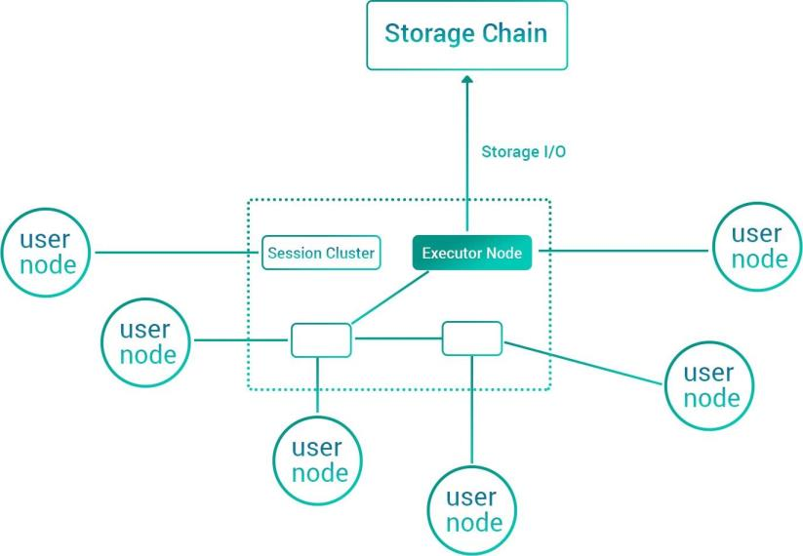
slowly completed by Executor in the background (the initial session
does not need to read the content from the storage chain, so it can be
directly at the service node Memory construction). This will greatly
improve the user experience for establishing a session.
The service topology diagram after the session is successfully
established is as follows：
Figure 22. Session service topology
There is a special design here: we must choose more than 3
conversation servers to participate in the service. Mainly one of them,
the rest of the services exist as signature supervisors. The signature
supervision proposed here is a mechanism for monitoring a centralized
96 / 163

Slide 97
function.
Blockchain 1.0 and 2.0 are basically state synchronization mechanisms.
All states are stored in nodes across the network. There is no trust
relationship between nodes. All operations must be self-calculated and
authenticated by the nodes to form a unified consensus. This
mechanism is beautiful and complete enough; and its limitations are
also very strong, that is, it is impossible to realize business scenarios
with high complexity and large data throughput; this scenario used to
be efficiently coordinated by a centralized service (cluster) The
realization is also the pain point of the blockchain application.
In order to achieve complex data storage and communication
services, DNC uses a small range of verification between nodes. A
mechanism of mutual trust between nodes is added, that is, a small
number of nodes are engaged in highly transactional and data
processing. These nodes verify and sign each other in a small range,
and the signature results are agreed to the miner nodes of the entire
network. This model is suitable for performing small-area transactions.
In order to prevent witch attacks, the members who make up this small
circle need to adopt a sufficiently random entry mechanism. It is best to
randomly change the composition of the members according to the
passage of time. If the business composition cannot be dynamically
97 / 163

Slide 98
changed due to certain business needs. Then the remuneration model
obtained by the transaction they signed together (other nodes are not
aware of ) can not be a fixed calculable (time) and quantity model.
98 / 163

Slide 99
05 Consensus mechanism
99 / 163

Slide 100
5. Consensus mechanism
5.1. Overview of consensus mechanism
Since the essence of the blockchain is a distributed ledger, how to
select the bookkeeper, how to keep accounts, and how to synchronize
and verify becomes the core problem to be solved. The consensus
mechanism refers to reaching consensus in these aspects. At present,
the mainstream consensus mechanisms of the public chain are POW,
POS and PBFT.
POW
Proof-of-work was originally proposed as a proof-of-work system.
This concept came from an academic paper published by Cynthia
Dwork and Moni Naor in 1993. It is a countermeasure against denial of
service attacks and service abuse, requiring the initiator to consume a
certain amount of computers Resources to perform calculations. The
word POW was formally proposed by Markus Jakobsson and Ari Juels in
their articles in 1999.
Bitcoin uses the POW mechanism in the process of generating
Block. A block hash that meets the requirements needs to be composed
of N leading zeros, and the number of zeros depends on the difficulty
value of the network. It takes a lot of trial and error to calculate a
reasonable block hash, and the calculation time depends on the hash
100 / 163

Slide 101
speed of the machine. When a node provides a reasonable block hash
value, it indicates that the node has indeed undergone a large number
of attempts to calculate. Of course, it cannot obtain the absolute value
of the number of calculations, because finding a reasonable hash is a
probabilistic event. When a node has n% of the computing power of the
entire network, the node has a probability of n / 100 to find a block
hash value that meets the requirements.
POS 1.0
Proof of Stake (POS) is proposed by a digital currency enthusiast
named Quantum Mechanic in the Bitcointalk forum in 2011. The POS
qualified block can be expressed as: F (Timestamp) <Target * Balance.
Compared with POW, the search space on the left side of the formula
changes from Nonce to Timestamp. The Nonce value range is unlimited,
and Timestamp is extremely limited. The block time of a qualified block
must be within the specified range of the previous block time. Blocks
that are too early or too early will not be accepted by other nodes. The
target value on the right side of the formula introduces a product factor
balance. It can be seen that the larger the balance, the larger the overall
target value (Target * Balance), and the easier it is to find a block.
Because Timestamp is limited, the success rate of POS casting blocks is
mainly related to Balance.
POS just represents a concept of a consensus mechanism, and there
101 / 163

Slide 102
are quite a few areas that can be optimized in specific implementation
methods. There are currently two classic implementation ideas, one is
Peercoin and the other is Nextcoin. They have introduced many security
mechanisms.
Peercoin was proposed by Scott Nadal and Sunny King in August
2012. In the project, the miner needs to select one from all his UTXOs as
the Kernel, construct coinstake, and calculate the hash. If it fails,
reconstruct coinstake, the timestamp Time will be changed during
reconstruction, and the Kernel can also be changed to obtain different
Coinstake , And so on, until a qualified block is found. Peercoin is
calculated in terms of currency age rather than balance. Once a UTXO is
spent, its currency days are cleared, and the new UTXO currency age
starts from 0.
Peercoin's successful operation soon attracted a group of followers,
of which more famous ones include Nova-coin (NVC), blackcoin (BLK),
etc. The black coin community believes that the coin age may be
abused by malicious nodes to obtain a higher network weight and
successfully implement a double-spend attack. So it released a POS 2.0
white paper and made several details of PPC optimization to solve some
potential security issues. One of the most important improvements is to
replace the currency age with the balance. The conditions for a qualified
block change from: F (Timastamp) <Target * coins * the age of coins, to:
102 / 163

Slide 103
F (Timastamp) <Target * coins. Because a UTXO's ability to forge blocks
remains the same no matter how long it is placed, this action can
incentivize nodes to keep more coins online, improve system security,
reduce attack paths to a minimum, and significantly improve the
network to keep running The number of nodes.
In September 2013, a user named BCNext launched a post on the
Bitcointalk forum, announcing that a new pure POS currency will be
issued, which was later named Nextcoin, or NXT for short. NXT
abandons Satoshi's UTXO design scheme and adopts an account
balance scheme, with each account corresponding to a private key. Each
block has a generation signature (generationSignature) field. Each miner
signs the generationSignature of the previous block with his own
private key, obtains his own generationSignature of the block, and
performs SHA256 operation on this field to obtain hashdata. , Take the
first 8 bytes of hashdata the unique hit variable of the miner in the
block.
NXT's POS implementation is completely different from PPC. The
qualified block judgment method is: hit <baseTarget * effectiveBalance
* elapseTime, where baseTarget is the benchmark value of the difficulty
of the entire network, this difficulty is adjusted according to a block
target per minute, and effectiveBalance is the effective balance of the
account , ElapseTime is the time interval between the current time and
103 / 163

Slide 104
the previous block. Because hit is the result of users signing with their
own private keys, it is very random for different users. Even users with
small balances, if luck is good enough and the hit value is small, it is
possible to quickly forge blocks.
Peercoin and NXT opened up ideas for the design of POS. Although
there are still shortcomings, it proves that POS works.
The DPOS bitshares (Bitshares) project started in August 2013.
Bitshares invented a new consensus mechanism-Delegated Proof Of
Stake (DPOS), which is the proof of share authorization. Its principle is
to let everyone who holds bitcoin shares vote, resulting in 101
delegates, who will rotate out of the block. If a currency holder wants to
become a representative, he must first use his public key to register on
the blockchain to obtain a unique identity identifier with a length of 32
bits. The top 101 are selected as representatives. Delegates generate
blocks in turn, and the revenue (transaction fee) is divided equally. If a
representative does not honestly produce the block, it is easy for other
representatives and shareholders to find out that he will be immediately
kicked out of the "board", and the vacant position is automatically filled
by the representative with 102 votes. From a certain perspective, DPOS
can be understood as a multi-center system, which has the advantages
of decentralization and centralization.
PBFT
104 / 163

Slide 105
PBFT (Practical Byzantine Fault Tolerance), a practical Byzantine fault
tolerance algorithm, was proposed by Miguel Castro and Barbara Liskov
in 1999, and can ensure the correctness of the system (avoiding
bifurcations) when the malicious node is less than one third. PBFT needs
to collect signatures of more than two-thirds of all nodes
The block can be confirmed, which is almost not feasible under large-
scale nodes, so the number of nodes must be limited to a few nodes
using this algorithm, which causes the problem of sacrificing
distribution. It is generally believed that it is contrary to the core feature
of the blockchain, distributed.
In order to apply PBFT to the blockchain, the NEO project
(delegated BFT, DBFT) is an improved algorithm based on PBFT. NEO
mainly designed a set of voting mechanism based on the proportion of
equity held for the generation of consensus participating nodes.
Through voting, consensus participating nodes (accounting nodes) were
determined, and digital certificates were introduced in the blockchain to
solve The authentication problem of the true identity of the accounting
node. These practices all require the intervention of centralized
institutions, and are relatively centralized.
BFT-DPOS
The EOS that appeared in 2017 combined BFT and DPOS, first
selected 21 super nodes (main witness nodes) and 100 alternative
105 / 163

Slide 106
witness nodes, and changed the original random block order to the one
determined by the witness after consultation. The order of block
generation, so that witnesses with low network connection delay can
generate blocks adjacent to each other. When 15 main 21 witnesses
confirm the transaction, the transaction is irreversible. According to the
design of EOS, the block can be produced in 0.5 seconds, and the whole
network can be confirmed in 1 second. Each witness produces 6 blocks
in a row, that is, each witness is still responsible for 3 seconds of block
production, but from the initial production of only 1 to 6.
After each block is produced, the whole network is broadcasted
immediately. The block producer waits for 0.5 seconds to produce the
next block, and will receive the confirmation result of the previous block
from other witnesses. The production of the new block and the receipt
of the confirmation of the old block take place simultaneously. In most
cases, the transaction will be confirmed within 1 second (irreversible).
This includes 0.5 seconds of block production and the time required for
confirmation by other witnesses.
Casper
Although Ethereum's POW efficiency is higher than that of Bitcoin,
and it also has a certain mechanism to resist dedicated mining
machines, its TPS averages not more than 20. In order to improve
efficiency, Ethereum developer Vlad Zamfir? Has proposed a new POS
106 / 163

Slide 107
The mechanism, Casper, is similar to Tendermint. Although Casper may
not be implemented until 2020, the security-deposit based economic
consensus protocol proposed by it is worth discussing.
The nodes in the Casper protocol, as "bonded validators", must pay a
deposit (this step is called a "locking deposit") before they can
participate in block generation and consensus formation. The Casper
consensus protocol restricts the behavior of validators through direct
control of these deposits. Specifically, if a validator does anything that
Casper considers "invalid", his deposit will be forfeited, and the right to
generate blocks and participate in consensus will be cancelled. The
introduction of margin solves the problem of "nothing at stake", which
is the low cost of doing bad things in the classic POS protocol. Now
there is a price, and the verifier who is objectively proven to do
something wrong will pay this price.
Casper's consensus is called Gambling on Consensus. Casper
requires the validator to bet most of the deposit on the consensus
result. The consensus result is formed by the bet of the validator: the
validator must guess which block others will bet on and win, and also
bet this block. If the bet is right, they can get back the deposit plus
transaction fees, and there may be some new currency issued; if the
betting is not quickly agreed, they can only get back part of the deposit.
Therefore, the verifier's bet distribution will converge after several
107 / 163

Slide 108
rounds.
The block in Casper requires a lock deposit. The vast majority of
validators who reach 67% to 90% of the validators bet on this block and
the probability reaches more than 99% to confirm. If no consensus is
reached, multiple rounds of betting are required. When all blocks
smaller than height H have been finally confirmed, it can be said that
the state of H-1 height has been finally confirmed.
In order to resist the majority alliance attack, Casper needs to
design a cooperative game mechanism to ensure that each node can
only get the maximum benefit in the alliance of all nodes, that is, if p%
of the validators participate in the consensus game, then they will get f
(p) p% of the gain, and if 100% of the validators participate, you can get
more returns. This design is the difficulty of Casper.
5.1.1. Summary of advantages and disadvantages
From the above analysis, it can be seen that BFT is mainly suitable
for alliance chains or supplementing other consensus machines. The
main choices of public chains should be POW and POS. In the long run,
especially from the perspective of blockchain applied to all aspects of
life, POW is unreasonable, and there is little room for improvement, and
POS will become the mainstream of public chain through continuous
improvement. The following compares POW and POS in terms of
decentralization, energy consumption, security, consensus speed,
108 / 163

Slide 109
transaction capacity, selling smoothness, gap between rich and poor,
and finality.
Decentralized. POW makes it possible for those with computing
power to obtain accounting opportunities. At the beginning of their
design, they hoped to achieve maximum decentralization, but the
emergence of special chips for specific hash algorithms has changed
this pattern. It makes ordinary computers It is difficult to participate in
the accounting competition, and the emergence of the mining pool has
further affected the distributed topology, which makes it even
impossible for SOLO mining even for dedicated mining machines.
Therefore, POW is not very sufficient in hardware decentralization. POS
makes it possible to obtain accounting opportunities as long as you
hold tokens, and the more opportunities you hold, the greater the
chance that randomness can be increased through a certain design to
improve decentralization.
Security The biggest advantage of POW is security. First of all, there
is a complete mathematical proof of its security. This is the unparalleled
advantage of POS and DPOS. The blockchain consensus mechanism
generally needs to consider resisting both DDOS attacks and double
payment attacks at the same time. There is a threat of 51% computing
power attack in POW. Bitcoin's current super computing power makes it
costly to destroy the system. However, for a new project, the use of
109 / 163

Slide 110
POW may be very dangerous, because the current computing power
may be used to attack, but for new projects, POS is more secure. The
NXT project can theoretically achieve fast transactions, but it needs to
forge nodes to expose their own IP, so that it is easy to be the target of
DDOS attacks, and DPOS representatives are also easy to be the targets
of DDOS attacks. Although there will be a 51% coin age attack on POS,
and DPOS security depends entirely on the honesty of the
representative, but it is not impossible to design, Casper's mortgage
opportunity can increase the cost of doing evil.
Energy consumption POW not only consumes a lot of energy, but
also requires a lot of CPU and peripherals. The waste is very large, but
POS does not have this problem.
Consensus speed POW is difficult to shorten the block time. POS
can shorten the block time relatively. In particular, NXT will be faster
than PPC. DPOS can also reach consensus in a short time. Bitshares
currently generates a zone in 30 seconds. Piece. However, POS is more
prone to forks, especially NXT, so transactions need to wait for more
confirmation to be considered safe.
Transaction capacity. This is the core problem that needs to be
solved in the future development of the blockchain. Huge transactions
easily mean huge bandwidth and storage space. The transaction
capacity of POW is difficult to expand, and NXT can predict who will
110 / 163

Slide 111
forge the next block because each node , Can directly send transactions
to the forging node, so NXT transaction capacity has great scalability.
From a certain perspective, DPOS can be understood as a multi-center
system, which has the advantages of decentralization and centralization.
If the representative nodes run powerful servers and each other has
enough bandwidth, the transaction processing capacity can
theoretically be comparable to traditional centralized Systems, such as
Visa.
Block smoothness POW Due to the characteristics of the hash
algorithm, you can get a smooth block speed, and you can adjust the
difficulty of the entire network at intervals. The block generation of POS
is mainly related to the balance, and the gradient of user balance gap is
relatively large, so POS generally Blocks have to adjust the basic
difficulty of the entire network. DPOS relies on the synergy of limited
representatives. If the representatives do not come in and out
frequently, they can almost fix the block spacing.
The gap between rich and poor. With POS, the more opportunities
to hold coins, the greater the chance of earning, and the greater the
opportunities, which will widen the gap between the rich and the poor,
so that hoarding coins can generate income. This is considered to be an
important point that POW is better than POS, but in fact, POW is richer
will hoard more machines and earn more coins. From this point of view,
111 / 163

Slide 112
POW is like POW. The more investment, the greater the opportunity, but
POW The resources invested are used for hash collision, and the
resources invested by POS are to buy coins, so POS is better in this
respect.
Finality. POW reaches consensus through competition, and there is
no finality. In theory, if there is enough computing power, the Bitcoin
blockchain can now be dug from scratch, but the finality can be
achieved by relying on detection points. NXT and DPOS are strictly
dependent on the time axis, and rely on real-time online detection of
nodes, so there is ultimateness.
The issue of nothing at stake. Casper solves the problem of
unsecured, increasing the cost of evil. But most current mechanisms still
have this problem.
Based on the advantages of all parties, when decentralization,
security, efficiency, and energy consumption cannot be achieved at the
same time, POW completely abandons the need to save energy and
maintains system security and decentralized features through huge
computing power. POS costs almost no extra power, but requires
sacrifices in two other features. POW has been proven to make
excessive sacrifices in energy consumption and efficiency for safety and
decentralization, especially when the blockchain needs to be applied to
all aspects of social life, POW is almost not feasible. The design of a
112 / 163

Slide 113
blockchain system originally needs to balance decentralization, security,
efficiency, energy consumption and other aspects, rather than only
pursuing performance on one side, but the characteristic of POW is that
once a POW is opened, It may cause a computing power war, which
makes the POW transformation space very small. POS has more space
in design, can balance the performance of various aspects through
design, and is more suitable for public chain. In addition, Casper
represents the latest achievement of POS and can be designed on the
basis of it.
5.2. POS mechanism of DNC
5.2.1. DNC requirements for POS design
The above analysis shows that POS has many advantages over
POW. DNC should choose POS as the consensus mechanism, but the
design needs to balance various aspects of performance according to
the demands of different public chains. So what are the needs of DNC in
terms of importance?
The first place is distributed. The goal of DNC is to promote human
exchanges and transactions, so that humans can cooperate with the
smallest particles, which requires any individual, organization, intelligent
program can join to provide resources or become users, they can break
through countries, systems, races Cooperation, only a sufficiently
113 / 163

Slide 114
distributed system can achieve the lowest entry and exit threshold.
The second place is security. Only with sufficient security can the system
be able to run for a long time. Security includes two categories: one is
major security, which means that the impact is global, and once the
system appears, the system faces a crash, which must be avoided; the
other is secondary security, which means that the system can continue
to operate after it appears , The impact is local. In system design, we
must eliminate major risks, eliminate secondary risks as much as
possible, and design a recovery mechanism after system risks appear.
The recovery mechanism is relatively easy to design a plan in a
centralized system, but how to recover in a distributed system is more
difficult to design. Generally, it needs to appear automatically through
community behavior and economic games.
The third place is efficiency, including consensus speed, transaction
capacity, and block smoothness. As transaction capacity is limited by
network broadband, the key need to design is consensus speed and
smooth selling. The expansion of transaction capacity can only be
carried out through sharding under certain circumstances of Internet
broadband, which will be specifically introduced in the "Sharding
Mechanism" chapter.
The fourth place is to avoid injustice. In the design, avoid the
situation of not gaining without paying and paying no gain. In addition,
114 / 163

Slide 115
the balance between pay and benefit should be balanced.
The fifth-ranked resource consumption includes equipment and
energy consumption. The elimination of POW greatly controls resource
consumption. In the design of POS, excessive search space and POS
degradation of POW should be avoided.
According to the above requirements, DNC has the following
characteristics in the design of POS:
• In terms of distribution, any willing participant will have the
opportunity to obtain contributing resources. It is possible for any
referrer to reach the most basic condition that is easy to achieve in the
block generation.
• In terms of efficiency, a certain period of time will focus on certain
nodes to generate blocks, and after a period of time, the block list will
be re-decided.
• In terms of security, special designs will be made for possible
witch attacks, 51% attacks, DDoS attacks, etc.
In addition, a well-functioning consensus needs to be optimized in the
following areas.
Randomness
To make it possible for all participants to obtain the opportunity to
produce blocks, at the same time, because each miner on the peer-to-
peer network may choose a result that is beneficial to itself, thereby
115 / 163

Slide 116
manipulating the next generation of blocks, it is necessary to introduce
some randomness.
The introduction of a random mechanism must also reach
consensus, which is the difficulty of introducing a random mechanism
on a peer-to-peer network. At the same time, there is another difficulty.
If the entire main network relies on algorithms, it is already very difficult
to have randomness. The so-called randomness generated by the
calculation itself is pseudo-random and may be cracked.
Proof of work is done by hash calculation to achieve randomness.
Proof of stake promises to be able to select bookkeepers at a lower
cost, but randomness requires special design. It may be a search space
like Peercoin, or Nextcoin is related to each miner's private key.
We found that it is difficult to reach consensus by introducing a
random number that is not proof of work, and the random number
generated by calculation is pseudo-random. If it is possible to introduce
random numbers from nature, but this requires a mechanism to collect
random numbers and send random numbers, which is difficult to
achieve with a decentralized method.
The only thing we can choose is animals with randomness, such as
humans, to obtain randomness through the uncertainty of their game
results. Since the actual operator behind each miner node operator is a
human, it is possible to achieve a goal by designing a collective decision
116 / 163

Slide 117
with randomness.
Convergence
Convergence means that the bookkeeper can be selected in the
end.
Interest relevance
If the block producer of a system has no collateral, its attack cost will be
reduced.
Finality
If there are enough resources to dig a chain from scratch, you will
get a longer chain and make other miners think that the chain is legal,
you can carry out a long-range attack, and such a chain lacks finality.
Objectivity
One goal of the consensus mechanism is to allow new entrants to
assess the current status of peer-to-peer network systems through
information received from peer nodes. This feature is more important
when resisting witch attacks.
Objectivity means that new entrants can independently obtain the
same knowledge of the current status of the system as other nodes of
the network through the protocol rules (for example, the definition of
the genesis block) and the information broadcast throughout the
network.
POW is an example of objectivity, as long as a node is connected to
117 / 163

Slide 118
at least one "honest node", it can choose an effective blockchain,
because this chain has the greatest cumulative difficulty.
Unlike PoW, the proof of rights and interests is not objective. Weakness
can only be achieved by increasing the randomness of people (Weak
Subjectivity). If a node needs the latest status information in addition to
the protocol rules (for example, the definition of the genesis block) and
the information broadcast throughout the network to judge the current
status of the system, such a consensus mechanism is weakly objective.
Although weak objectivity sacrifices decentralization and mathematical
completeness because of the randomness of introducing people, it is a
better way to combine computer and social drives (Buterin, 2014).
5.2.2. Preventing possible attacks
Based on the importance of security, a good system should be able
to prevent various attacks. This section specifically discusses the attacks
that need to be focused on.
Prevent witch attacks
Witch attacks are difficult to avoid completely in any peer-to-peer
network system. What can be done is to increase the difficulty of their
attacks. POS can prevent witch attacks by using mechanisms such as
time, randomness, and deposits.
Prevent DDos attacks
118 / 163

Slide 119
If the next or several block producers can be predicted, as long as
the DDoS attack is carried out, the system can be paralyzed. The
introduction of randomness and charging mechanisms can effectively
prevent DDoS attacks.
Pre-dig double spend attack
The double spend attack requires the attacker to privately prepare a
relatively long chain of private mining after spending a sum of money,
and after the other party 2 confirms the receipt of the funds, the private
mining chain is released. The funds on the private mining chain are Go
to another place.
2 This type of double spending requires a large sum of money to be
prepared and a place that is willing to accept it. Generally, the exchange
is willing to accept a large amount of funds through trading
The Institute is also easy to cash out.
Bribe Attack
In order to allow miners to abandon the existing chain and use the
chain prepared by themselves, the attacker only needs to provide a
greater benefit to achieve double spending.
If the attack fails, the attacker will not lose anything, as long as his bribe
is less than Shuanghua income.
Coin age accumulation double spend attack
For Peercoin or other consensus mechanisms that use coin age as a
119 / 163

Slide 120
basis instead of wealth, in theory, as long as you wait long enough, an
attacker may accumulate enough coin age to subvert the system.
If you master 5% of Peercoin's unspent output (UTXOs) and divide it
into different outputs, waiting for its coin age to be 10 times that of
other coins, it is possible to achieve a double spend attack. So in later
versions of Peercoin and BlackCoin, the age of coins will be multiplied
by a weight. Long Range Attack
In the Nxt system, chains with more than 720 blocks will not be
accepted by the system, which is about 12 hours in this system. But on
the one hand, it is more difficult for new entrants to achieve because
there is no historical knowledge for comparison.
5.2.3. DNC consensus mechanism
Reasons for choosing Casper as the basic framework
There is no absolute good or bad consensus mechanism, the key is
to be able to meet the needs of the economic model. DNC requires a
balance of distributed level, security and efficiency. The current
consensus mechanism Casper is the most suitable choice.
First of all, in terms of distribution, Casper has hundreds of
validators, which is very difficult to collude, and the entry and exit of
validators does not require human intervention and can be sufficiently
distributed.
120 / 163

Slide 121
Secondly, in terms of efficiency, Casper narrows the scope of
consensus, and it is easier to reduce network burden through directed
broadcast.
Finally, in terms of security, Casper has the following advantages:
1: Randomly select validators to be allocated to each shard through
the main chain of the lighthouse, which can make the security of each
shard consistent with the security of the entire network.
2: The deposit mechanism increases the difficulty of the attack.
3: Introduced many individuals, the combination of these
individuals formed a relatively large randomness, making various
attacks difficult.
PoW + Casper + PBFT
DNC's consensus mechanism uses a PoW mechanism similar to
Ethereum on the main chain to ensure security and randomness. The
PBFT mechanism is used on shards to ensure block generation. To
ensure the security of PBFT on shards, Casper will be used. The
mechanism of pre-selects the block producer pool, and uses PoW to
periodically rotate the block producers of each shard.
By increasing the difficulty of entering the PBFT miner pool and the
difficulty of exiting, and increasing the randomness of selection, it will
be difficult to damage the shards through witch attacks.
The following figure is the architecture of DNC's consensus
121 / 163

Slide 122
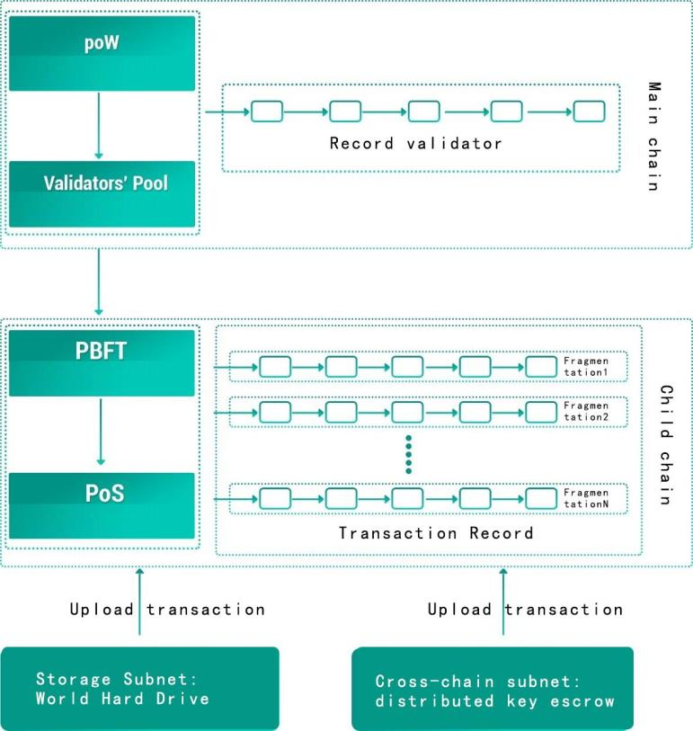
mechanism:
Figure 23. DNC consensus mechanism
122 / 163

Slide 123
06 Sharding mechanism
123 / 163

Slide 124
6. Sharding mechanism
6.1. Sharding overview
6.1.1. Overview of capacity expansion
To achieve a practical level of transaction efficiency on the blockchain,
a TPS of 10,000 transactions per second is required. This is actually just a
need. Currently Bitcoin is 5 to 10 pens per second and Ethereum is 10 to
20 pens. Even if Ethereum is upgraded to Proof of Stake, its TPS will be
difficult to exceed 500. What the blockchain needs is a plan to expand a
thousand times from the current ten.
The structure of a single chain is very difficult to reach the order of
10,000 per second, which is mainly due to the limitation of broadband.
Because 10,000 transaction packets per second must be synchronized to
the entire network in time, otherwise it will cause a large number of soft
forks and make the system tend to collapse. As the scale of the single
chain is larger, that is, the distribution is stronger, the synchronization
efficiency is lower, and the TPS is lower.
Bitcoin's efforts are still based on a single chain:
• Currently, the main effort is to increase the block size. Expanding
from 1M upwards, such as the Bitcoin Cash fork, expanding from 1M to
8M is only an 8-fold increase. The increase is 8 times and there is no
improvement in other aspects. Its application scenario can only be a large
124 / 163

Slide 125
amount of transfer. This is the key factor for the original bitcoin
computing power and everyone's recognition, so the forks have not
exceeded the original Bitcoin.
• Or by reducing the block time, this period is similar to increasing
the block size, because the block data is always broadcast throughout the
network. Whether it is increasing the block size or reducing the block
time, you will encounter synchronization efficiency bottlenecks. Litecoin
is reducing the time from 10 minutes to 2.5 minutes, but this speed
increase is limited.
• Although SegWit may reduce the broadcast volume of the same
number of transactions, this technical innovation has limited help for
capacity expansion.
• Finally, the offline expansion scheme, such as a side chain like the
Lightning Network, cannot be counted in the transaction efficiency of the
blockchain, because it is a scheme with very limited usage scenarios.
NEO uses the dBFT consensus mechanism, but its improvement in
efficiency is limited. IOTA uses DAG technology, it is no longer a
blockchain, it is difficult to prevent double spending. In comparison,
Ethereum's efforts may be more reasonable. It chose a consensus
mechanism from proof of work to proof of rights and interests, and
transformed a single-chain mechanism into a multi-chip mechanism
through sharding.
125 / 163

Slide 126
6.1.2. Ethereum sharding overview
Sharding is much more advanced than blockchain technology, and it
is widely used in optimizing commercial data to Google's global relational
database. The main part of sharding is to use some special methods to
split the data in a database in parallel. Generally speaking, these split data
are called shards.
In a blockchain distributed network, the network consists of a series
of peer-to-peer network nodes that are interconnected in a certain way.
At present, each node stores all the data of the network and transactions,
which will cause serious problems in terms of scalability.
Ethereum stores all blockchain data, including account balances,
storage, and contract codes. The limitation of the whole system comes
from the communication bottleneck that forms a consensus between
nodes. Since each node has no privileges, the speed of the entire network
node is only as fast as a single node.
The idea of Ethereum's sharding is not to shard the data but to group
the nodes, so as to eliminate the scalability bottleneck of the system by
processing the data in parallel, thereby greatly improving the transaction
performance. Ethereum even thinks that each shard can have its own
characteristics, and the shards communicate through a certain protocol.
Ethereum groups all transactions and smart contracts, and each group
will have a data header and data body. The data subject is all transactions
126 / 163

Slide 127
of this group. The data header includes:
• Shard number;
• Random sampling (random sampling) to divide the verifier into
pieces;
• Shard Meckergen.
All transactions occur between accounts within the shard, and the
consensus mechanism within the shard is proof of stake. Each block of
Ethereum will include the root of the global state and the root of the
transaction group. The former is the Merkel root of all the latter.
In order to avoid attacking other shards through a single shard, random
sampling generates that the verifier is cross-shard, so that the attacker is
difficult to carry out the cross-slice attack because the attacker is not sure
which shard the verifier will be divided into.
The difficulty of Ethereum's design is the inter-chip communication
protocol. Its design is very complicated and the cost is high, so it is only
used when necessary. When the information requested by a node is not
stored in this shard, cross-shard communication is required.
Cross-chip communication is achieved through transaction receipts.
The transaction receipt is stored in Merkel root, so it is easy to verify, but
it is not part of the state root. When one shard receives another shard's
transaction, it will check Merkel root to ensure that the receipt is not
spent. The receipt is stored in shared memory, which can be verified by
127 / 163

Slide 128
other shards, but not modified. Therefore, through the distributed
preservation of receipts, shards can communicate with each other.
The Ethereum sharding method includes a main chain and a sub-chain.
The main chain is responsible for managing the verifier, and the sub-chain
is responsible for transactions. The sub-chain contains 100 sub-chains,
and account transaction information is stored on the sub-chain. The
specific practices are as follows:
1: Participate in the main chain: deposit to the equity pool, send 32
ETH deposits to the Casper account, with a public key and a withdrawal
address. After waiting for a day, the agreement will include this
transaction information in the verifier pool.
2: The work of the main chain: track the blocks on the sub-chain,
randomly assign validators to shards, and track the information of the
verification nodes, including what shards are allocated, whether there are
rewards and penalties.
3: The work of the verification node: block generation on the main
chain; verification of block generation, transactions, rewards and fines on
the verification chain on the main chain; verification and confirmation of
transactions between shards; block generation on shards.
4: Reward: When the online normal operation status sends out the
information that should be sent, all are normal. In this case, you will find
that the other two-thirds of the nodes are normal and you can get
128 / 163

Slide 129
interest.
5: Penalty: However, at least two-thirds of the nodes are running
normally, and there will be some small penalties. However, if most of the
nodes are offline, there will be a big penalty. In the worst case, the
signature is wrong or there is conflicting information with yourself. This
may be that you want to attack the network, or you are hacked. If this
happens, you will have some punishment. This penalty is proportional to
the number of other verification nodes that make mistakes, because the
attack requires multiple nodes to participate at the same time. The cost
of attacking the system is very high. If you have a problem as a personal
verification node, the cost is not so high and it is fair. This mechanism
hopes to motivate everyone to do the verification node, and also hopes
that everyone can better protect their mechanism when setting up, and
try not to fail at the same time as the security protection of other nodes.
6: Withdraw from the main chain: withdrawal, private key or withdrawal
address can trigger the withdrawal process. Once triggered, your
verification node will be closed in about 7 days. After you exit, you need
to wait 4 months to withdraw Ether .
Because the upgrade of Casper itself is difficult, because it takes a
long transition time from PoW to PoS, otherwise many PoW mining
unions will be greatly affected, so the implementation of Ethereum's
sharding may need to wait a long time.
129 / 163

Slide 130
6.1.3. Overview of other shards
The other project that uses sharding is more famous is Zilliqa, which
currently does not implement state sharding, only transaction and
calculation sharding. It claims that it can reach thousands of transactions.
It uses the PBFT consensus mechanism in each shard. The reason is that
POS is not as important as PBFT. Zilliqa uses POW when it needs to vote
for a long time.
Because each shard performs transaction calculations to form small
blocks, and then these blocks are merged into a large block, so its state
is not divided. This approach is difficult to deal with the scalability
bottleneck of the blockchain.
6.1.4. Difficulties of sharding
So multiple chains in parallel is an inevitable design. But it also raises
the following questions:
1: How to keep the data mainly in a single piece, without
broadcasting all to multiple pieces, otherwise the main meaning of
fragmentation will be lost.
2: In the case where the data is mainly on a single chip, how the native
tokens are unanimously accepted throughout the network.
3: How to conduct inter-chip transactions.
4: How to balance the load among multiple chips.
130 / 163

Slide 131
5: How to avoid attacking the entire network from one slice.
Discussing sharding cannot but discuss the triangle paradox.
Distribution, security and efficiency constitute an impossible triangle, and
the three need to be balanced. But in the case of a public chain, the
efficiency has not improved as the number of nodes increases, and
synchronization is more difficult. There may be no more than 10,000
machines in collusion than a thousand machines. It is unreasonable to
insist on distribution. Therefore, as the number of nodes increases, the
design of splitting a chain into multiple pieces is reasonable.
Sharding includes three aspects, one is the calculated shard, the
second is the data shard, and the third is the transaction shard. Smart
contracts are distributed in different slices, which can save computing
resources, while data is placed in different shards to save broadband
resources, and transactions are placed in different shards.
6.2. DNC's sharding and splitting mechanism
DNC adopts independent block generation on-chip, and inter-chip
transactions are divided through main chain transfer. For the security of
inter-slice transactions, cross-slice transactions will introduce a "police
mechanism" to verify the data.
DNC does the sharding of transactions, data and calculations. Each
shard is independent, and mutually recognizes the data on the other
131 / 163

Slide 132
side's chain, and can initiate cross-shard transactions.
Sharding will be automatically upgraded, that is, the split mechanism.
When the number of nodes reaches a certain number, the child chain will
split, thereby forming multiple shards. The mechanism of splitting must
consider certain randomness. The data after the split will have an
inherited relationship with the data before the split.
6.3. Smart contracts
DNC is developed based on the go language version of Ethereum,
and will have and be compatible with various functions of the Ethereum
contract, and will expand its functions to have data reading and writing
and communication functions.
Such a smart contract will have the function of a prophet, that is, data
can be read in from outside, and various
Email to trigger the notification.
Smart contracts will be conducted in shards, and inter-slice
transactions can also be initiated.
6.4 Distributed File Storage Engine
132 / 163

Slide 133
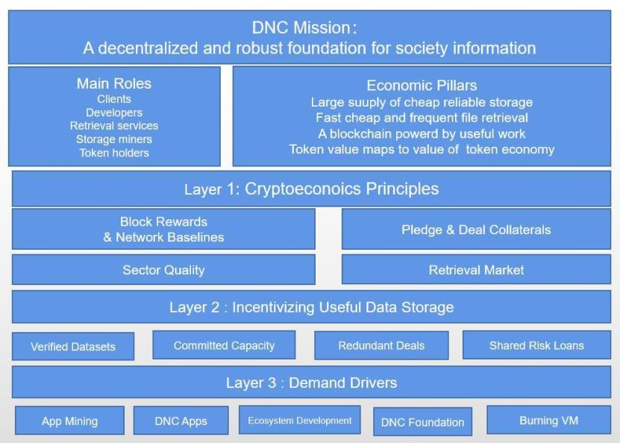
Figure 24 DNC Mission:
A decentralized and robust foundation for society information
133 / 163

Slide 134
07 Blockchain society, data service
providers and application scenarios
134 / 163

Slide 135
7: Blockchain society, data service providers and application
scenarios
7.1: From Turing completeness to functional completeness: apply
blockchain to all aspects of society
According to Melanie Swan, founder of the Blockchain Science
Institute, the development of blockchain technology is divided into
three stages: 1.0 for programmable currency, 2.0 for programmable
finance, and 3.0 for programmable society. Bitcoin and various
competing currencies belong to Blockchain 1.0. Ethereum is Turing
complete and implements Blockchain 2.0. However, because Ethereum
lacks storage, cross-chain, communication and other functions, it is not
fully functional and difficult to use in many aspects. Since other existing
blockchains do not have fully distributed, infinitely scalable,
communication, storage, cross-chain and other functions at the same
time, it is also difficult to apply to all aspects of society. Reasons for
DApp replacement.
DNC is completely distributed and infinitely scalable, and has
functions such as communication, storage, and cross-chain. This is that
DNC has the ability to be applied to all aspects of society, and it is a real
blockchain 3.0 project. DNC can be applied to almost any scenario, only
a few application scenarios are listed below for explanation.
135 / 163

Slide 136
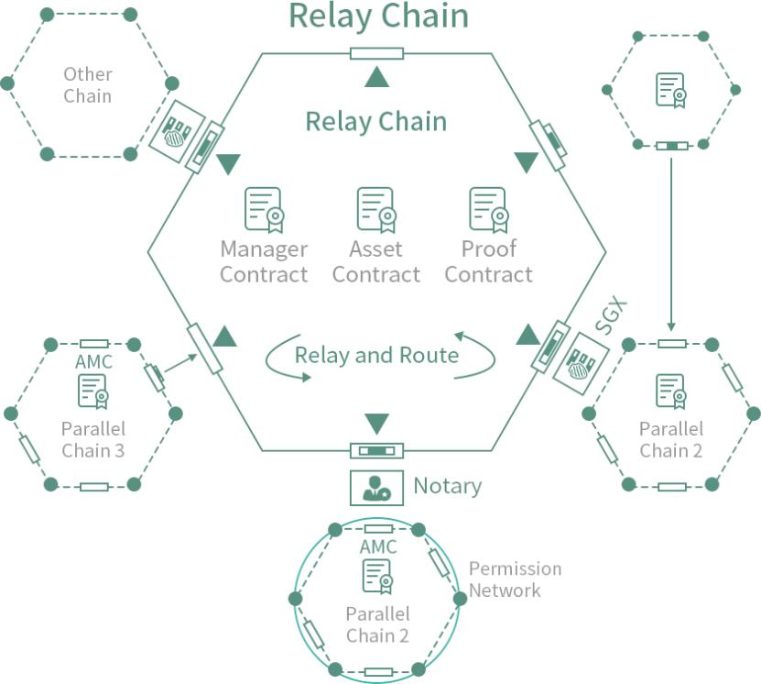
Scalable homogeneous / heterogeneous cross-chain interoperability
7.2: Data service providers
The data service provider is actually a DApp entrepreneur. Most of
the user's data is not owned by themselves. What they do is collect data
tags and instructions, analyze them, and do data mining and data push
services.
7.3: Blockchain search
The master's data will be accumulated in the distributed storage
system, and exploring these data becomes an important task.
Blockchain search refers to the search for all open data on distributed
136 / 163

Slide 137
storage.
7.4: Distributed cloud storage service
The storage sub-chain of DNC constitutes a large "world hard disk",
which is infinitely scalable and provides distributed cloud storage
services for individuals and enterprises. Users can also generate hash
uploads at any time to prove that they cannot be tampered with and
can become distributed. Dropbox. Especially for enterprises, there is a
greater demand for data security and privacy protection, DNC's
elephant storage is very attractive to them.
7.5: Distributed communication and online live broadcast
DNC gives the ability to communicate between addresses. It is
actually a distributed communication tool. The communication data will
not be reviewed or mastered by anyone other than the conversation. It
may become a distributed WeChat and provide various online live
broadcast services. Due to the convenience of blockchain payment, it is
easy to reward in the session.
7.6: Blockchain identity service
The address can upload its own identity information, including
resume, in its own space, can become a distributed Linkedin service,
137 / 163

Slide 138
and be used in various scenarios requiring identity services. Identity can
be combined with any other application, and may need to provide
corresponding data to evaluate its eligibility and payment when
participating in other services, such as the typical loan application,
lenders need to open their own identity information and private data
for credit evaluation .
7.7: Blockchain self-media, blockchain pan-entertainment and
blockchain advertising market
The address can upload articles, voices, videos and other materials
in its own space, and can become distributed Facebook, Instagram,
Himalayan, Youtube, Douyin, etc., through the recommendation system
can form a service similar to today's headline, and in DNC In the above,
all kinds of programs can be paid by users without intermediaries. In
addition, each address can publish its own advertising smart contract,
and can also embed advertising smart contracts at other addresses, so
that it can advertise itself or advertise for them.
7.8: Blockchain sharing economy, blockchain mall and blockchain
logistics
Since everyone has their own private space and can define their
own labels and descriptions, they can publish product sales information
138 / 163

Slide 139
in their own space. If there is a vacant house for rent, an Airbnb will be
formed. If there is an vacant car seat sharing and Taxi formed by
updating GPS at any time. Coupled with proof of identity and credibility,
and reviews of transactions, a virtuous circle can be formed. The
communication module allows both parties to the transaction to
communicate with each other in text, voice or video.
Since any merchant can publish and update product information in
its own data space, the merchant can settle in DNC and form a three-
party smart contract with the logistics enterprise, which can complete
the transaction very automatically. The communication module of DNC
makes bargaining and after-sales service very convenient. The digital
field of the transaction contract allows both parties to the transaction to
evaluate the transaction after the fact.
7.9: Blockchain IoT and supply chain management
Since every company or even every smart object in the supply chain
system can choose to upload its own data to its own address, these
manufacturers or smart objects can use these data to build a smart
contract system to form a complex, mutually triggered supply Chain
management system.
With the distributed cloud space of the enterprise, supply chain
dynamic maintenance and data upload, supply chain data transactions
139 / 163

Slide 140
and B2B transactions will become easier. And the data reading function
of smart contract makes the management society AI and order-driven
automation society possible.
7.10: Blockchain big data transactions, data services and artificial
intelligence training
Since each participant with an address has its own data set, these
data sets can be easily traded through smart contracts, and all
purchased and public data can be collected by the data service provider
and provide data services, if used for Artificial intelligence training these
data can play a greater role.
7.11: Blockchain games
People in the future will live in various real-life game scenarios
composed of big data, but because data is difficult to save on the chain,
blockchain games can only be used for some very simple applications.
On the DNC, by storing the data of the game developer on the chain,
storing the data of the game player in the player's private space,
running heavy calculations with a dedicated server, and conducting
transactions with the main chain, it can solve the development problem
of heavy game scenarios .
140 / 163

Slide 141
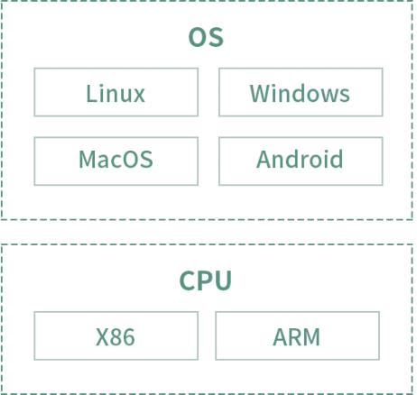
Visual O & M
Provide a comprehensive visual monitoring platform for the
blockchain
Blockchain browser providing multi-dimensional statistical analysis
Node supports local and cloud deployment
Multi-platform support: Linux / Windows / MacOS / Android
141 / 163

Slide 142
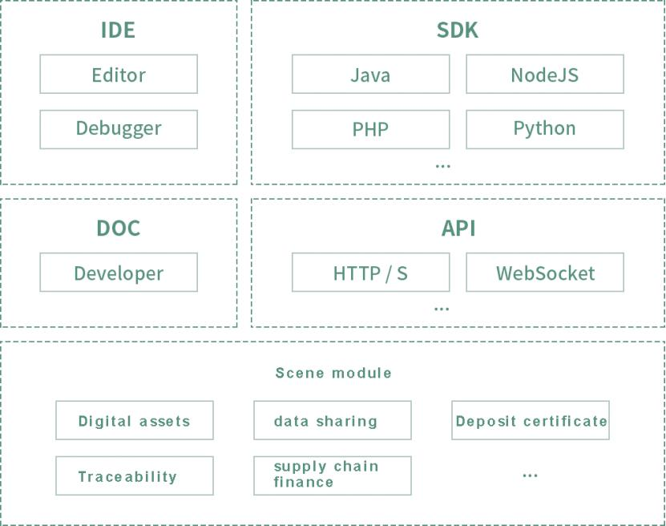
Ease of use
API supports short connection HTTP and long connection
WebSocket protocol
SDK supports development languages such as Java / NodeJs /
Python / PHP
Smart contract supports JS / C / C ++ mainstream development
language
Smart contract IDE integrating development, testing and
deployment
Complete and detailed development documentation
142 / 163

Slide 143
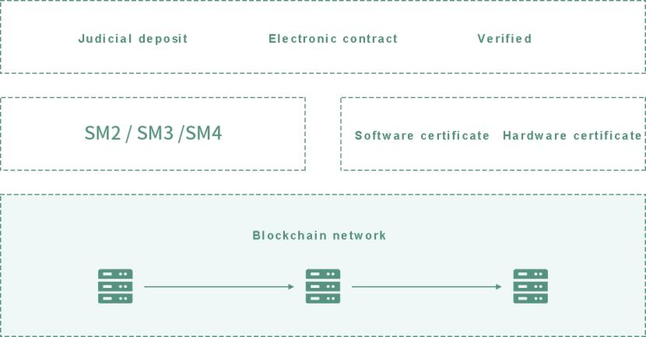
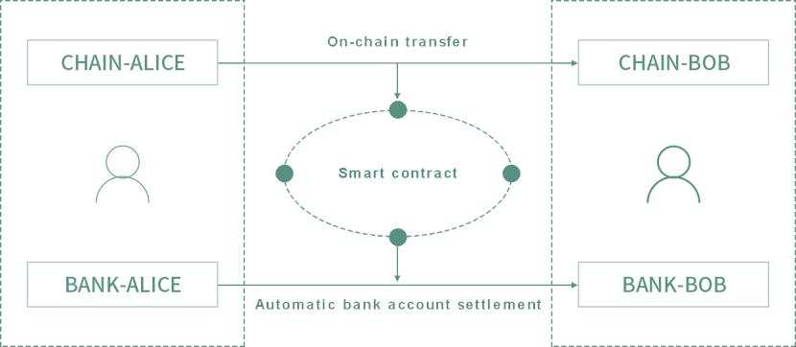
Legal effect and compliance
Support electronic contracts and judicial deposit
Support national secret algorithm SM2 / SM3 / SM4
Blockchain users use CA real-name authentication
Blockchain nodes use CA to access the network
Accounts on the chain can be linked to bank accounts
There is no "money" problem on the chain in commercial
applications
Integration of on-chain accounts and bank accounts
143 / 163

Slide 144
Smart contract realizes automatic liquidation of funds
The liquidation process depends on the signature on the chain, not
on the administrator
Global settlement via VISA debit card
144 / 163

Slide 145
08 Project governance mechanism
Project development planning and
token distribution
145 / 163

Slide 146
8: Project governance mechanism, project development planning
and token distribution
8.1: Project governance mechanism
8.1.1: Governance philosophy
Community is everything
The DNC platform is a public chain. As the initiator of the project,
the DNC Foundation is a non-profit organization. The DNC platform, as
a public chain of various token holders, developers, and users, does not
belong to any organization or individual, but belongs to the entire DNC
community. In order to realize the mission of DNC to promote efficient
human cooperation, the DNC Foundation, as the initiator, needs to
attract as many participants and resources as possible into the
community and try to condense the power of the entire community, by
continuously iterating its products and enriching its ecology to promote
DNC The system is used in real scenes and improves people's lives.
The DNC platform is a public blockchain. As the initiator of the project,
the DNC Foundation is working for a promising blockchain ecosystem,
not for the company's profit like the traditional enterprise project
operation. The DNC platform, as a basic DNC platform for all kinds of
token holders, does not belong to any organization or individual, but
belongs to the entire blockchain token community. DNC makes the use
of tokens more flexible, the circulation is more convenient, and more
146 / 163

Slide 147
importantly, it gives the function of token DNC services. Make all tokens
have greater value. In fact, the value Internet cross-chain ecology is a
big business, which needs to be initiated by the DNC Foundation, the
entire community joins and participates together, and generates more
and more perfect blockchains through continuous iterations. This is
exactly the characteristics of blockchain projects. The blockchain project
starts with an important need or a problem to be solved, which needs
constant exploration by these demanders and participants during the
development process. At the same time, more people in the community
are attracted to participate, and then the demand develops in a more
perfect direction, and further promotes technological progress.
Therefore, the idea of project operation must be community-based
from the beginning, and community operation is related to the success
or failure of blockchain.
The community consists of:
The DNC Foundation and the development team are the initiators
and promoters of the project platform.
Programmers interested in the project. They are interested in the
project or project technology and can join the foundation development
team or independently develop and optimize the DNC as a third party.
DNC participating node. Obtain revenue through bookkeeping and
maintain DNC operations.
147 / 163

Slide 148
Users of the DNC platform can obtain DNC services by using the
DNC platform.
DNC service providers on the DNC platform, such as payment
platforms, centralized or decentralized exchanges, lending platforms
and other financial service providers.
DNC token investors. Including private equity institutions, early
investors, late investors and potential investors.
Other stakeholders. Including media, government, etc.
The above persons or organizations play an important role in the
future development of DNC. The purpose of community operation is to
mobilize as much power as possible and organize it in the most
effective way, so that DNC can continue to iterate, form influence, and
serve a larger community.
The growth of the community is actually related to both the core
community and the peripheral communities, and the two are
complementary. The core community is the core, but the formation of
key communities requires the peripheral communities to continue to
attract people to enter, because the core community's people come
from external communities, but the peripheral communities also need
the support of the core community's resources. We found that the
growth of projects such as Bitcoin and Ethereum has followed this rule.
148 / 163

Slide 149
We position the core community as the initial founder, blockchain
technology community, blockchain investment community, and the
peripheral resources are other investors, users, developers, media, etc.
who are interested in the project.
Technology first
Value Internet currently has bottlenecks in usability, and needs
continuous efforts in the future to continuously promote its usability.
The DNC project is closely related to the availability of the Internet of
Value. We will launch the "Blockchain Technology Promotion
Movement" to contribute to the progress of blockchain technology in
usability. This will be a long-term work of the foundation.
The sports line will continue to gather talents and technical
materials in the form of technical salons, training camps, and seminars.
We will promote the content provided by offline participants, and
promote the content in the form of various websites and various media.
It also attracts traditional Internet personnel and other technical
personnel through irregular classes to expand the reserve force of the
technical community.
The blockchain technology promotion movement will unite all
forces that can be united, including universities, research institutes,
enterprises, institutions, governments, alliances, etc. to establish
cooperative relations, and gather resources to jointly promote the
149 / 163

Slide 150
progress of blockchain technology.
8.1.2: Foundation and decision-making committee
The members of the DNC community include foundations,
developers, participating nodes, users, service providers, token
investors, etc., among which the DNC foundation as a core community
member will operate in a completely transparent manner. The private
keys of all the tokens of the foundation will be collectively held by the
foundation's decision-making committee through multiple signatures
and managed securely. The decision-making committee is composed of
core partners, and the partners have perfect entry and exit rules to
avoid dictatorship or single-point risk, and promote the decision-
making committee to adapt to the project development.
8.2: Project development planning
8.2.1: Five stages of development
The development of DNC is divided into five stages.
1: V1.0: Complete the transaction sub-chain from 2018 to 2020. At
this stage, DNC will complete the project to start 23 transaction super
nodes + 46 transaction alternative nodes, and develop to a scale of
more than 200,000+.
2: V2.0: From 2020 to 2022, complete the social sub-chain that
150 / 163

Slide 151
supports distributed file and application deployment, develop more
than 1000+ miners, and the community size grows to more than 1
million +.
3: V3.0: From 2022 to 2024, the home robot Internet of Things sub-
chain will be completed, and the community will grow to more than 10
million +.
4: V4.0: From 2024 to 2026, complete the super node satellite on-
chain, realize global free point-to-point communication plus full
ecological upgrade of payment, and achieve a community size of 200
million +.
5: V5.0: After 2026, we will explore the in-depth evolution of DNC in
various fields, hoping to help humanity enter a new stage of civilization.
8.2.2: Project promotion methods
This project divides community operations into two areas: core
communities and peripheral communities. The former mainly adopts
offline mode, and the latter mainly adopts online mode. Plans for core
community operations are:
DNC Foundation team: We will give the team certain token rewards.
One is to compensate the resources invested in the early stage, and the
other is to enable it to become a stakeholder, hoping to continue to
invest in the future and continue to participate in the development of
151 / 163

Slide 152
DNC.
Blockchain technology community: Technology is the core and
difficulty of blockchain development. We will use the technical strength
and social resources of the founding team to explore and cultivate a
group of top-notch talents in both online and offline ways to promote
the growth of the technical community.
Blockchain investment community: Relying on the blockchain
technology community, through the form of investor meetings, we can
not only popularize blockchain knowledge to private equity and other
investment communities, but also enhance the cooperation
opportunities between the two parties.会。
8.2.3: Foundation management and token model
The project has established a non-profit organization DNC
Foundation in Singapore, whose goal is to improve the project ecology
and promote the realization of the project vision. Tokens are an
indispensable component of the public chain ecosystem. As the
incentive mechanism of the public chain economic system, it is like a
lubricant of a mechanical device, but also like the blood of the living
system. It is the token-based consensus mechanism that brings
community members together to achieve a virtuous cycle of the
blockchain ecosystem. For project starters, tokens are the necessary
152 / 163

Slide 153
compensation for them and the motivation to continue to participate in
the future; for users, tokens are passes; for investors, tokens are tickets
to the future; for developers, tokens Let them become shareholders; for
the bookkeeping node, the token is the compensation they have
worked hard for. All the people who hold tokens can be the above
multiple identities. They are closely related to the public chain project,
and become users, propagandists, developers, investors, grow together
with the project ecology, and achieve the great mission of the DNC
platform. The private keys of all foundation tokens will be held
collectively by the foundation's decision-making committee. On the one
hand, avoid dictatorship; on the other hand, avoid single points of risk.
The foundation's decision-making committee is the highest decision-
making organ of the foundation.
In order to realize the mission of the DNC platform, the DNC
project has designed DNC (DNC) tokens, and designed the distribution
structure of DNC tokens to make the project sustainable development.
The token design mainly considers five aspects:
1: Quantity. The total supply of tokens is 2 to the power of 30,
totaling 1073741824, about 1 billion. This number happens to be the
world's hard disk management unit of DNC, that is, the size of the space
maintained by a storage group is one G. This quantity can also make the
tokens have a reasonable price when they go online, and grow steadily
153 / 163

Slide 154
on this basis, and make the quantity in line with the people's habits in
the period of the global village.
2: Token issuance mechanism. There should be an upper limit on
the supply of tokens to realize the concept of non-inflation. This makes
the earlier the participants more favorable, and also makes the system
more stable.
3: Token distribution. The distribution of tokens must be well
balanced to realize the non-central concept. The DNC team needs to
make great efforts in communications, data storage, cross-chain and
cross-data sources. We allocate 10% to the core team to support
development and operations by 2030. In addition, because the DNC
accounting node task is relatively heavy, it can account for nearly one-
third. The rest will be used for ecological construction.
4: Ecological construction. More than half of the tokens will be used
for the foundation to promote the continuous growth of the project,
especially the construction of DNC publicity and application ecology
requires a lot of funds.
5: Miners and fuel. Various values will enter the DNC in the form of
distributed node control, which requires a large number of distributed
node control tokens. The more nodes, the higher the security. And the
greater the value of running on the chain, the more nodes are needed.
To maintain the number of nodes and computing power, it is necessary
154 / 163

Slide 155
to give miners a bookkeeping reward and service fee.
The distribution of tokens is as follows:
1: Partner incentive: 10%. Most of the incentives used to participate
in the creation of the project from scratch, and the partners who join
the strategic significance of the project in the next 20 years will be
locked for a long time;
2: Developer community: 5%. In the future, the project will be
transferred to community development to attract top developers to
join. This part of the token will be allocated to important developers in
the next 20 years as a reward for the continuous progress of the project,
and most of it will be locked for a long time;
3: Token swap: 5%. Allocated to participants willing to exchange
DNC for other tokens, so that the team can obtain more liquid tokens to
support early development and operation;
4: Ecological construction: 10%. It is used for cooperative
development of the foundation and ecological construction with the
blockchain community. It will be gradually released in 20 years, and the
distribution method is initially expected to be 2% in V1.0, V2.0, V3.0 and
other stages;
5: Miner reward: 70%. It will be used for resource proof incentives,
with storage mining and accounting mining accounting for 35% each.
Completed in 20 years, it is expected to adopt a gradual reduction in
155 / 163

Slide 156
inflation rate, the specific method will be determined after the public
test.
Release Notes
DNC is a universal currency for global centralized finance. The name
DNC combines the Domain Name Chain to form a new term, marking
the goal of DNC is to become a common "free and stable product" in
the future decentralized global finance
Basic Information:
Circulation: 1,000,000,000 DNC
Consensus algorithm: DPOS + PBFT
Block interval time: 3 seconds
Output per block: annualized rate (12 * 31 * 24 * 60 * 20) The
annualized rate is determined by super node voting
156 / 163

Slide 157
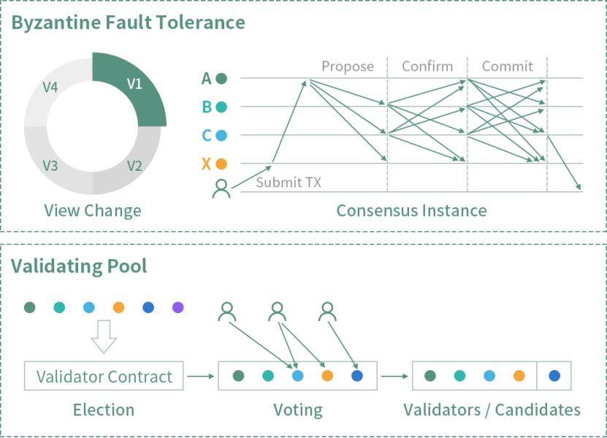
Safe and efficient consensus algorithm
Innovative two-layer consensus algorithm Validationg Pool + Bubi-
BFT
Safe and efficient verification pool election algorithm
High-performance Byzantine fault-tolerant algorithm Bubi-BFT
High throughput, second-level confirmation, provable security
157 / 163

Slide 158
09 in conclusion
158 / 163

Slide 159
9： in conclusion
Human civilization is still at a very preliminary stage, and its rapid
progress cannot be achieved without the in-depth cooperation between
the trading entities to break through the restrictions of geography,
system, country, organization, etc. The development of the Internet has
given people hope to break through these restrictions. The information
Internet has enabled people to break various restrictions for information
communication, but the increasingly centralized information Internet
needs to transform into a distributed information Internet. The Internet
of Value allows people to see the hope of breaking various restrictions
for value interaction, but the data storage, cross-link interface, and
scalability of the blockchain are not enough to support heavy
applications. complete.
DNC is committed to becoming a fully distributed, fully distributed
and infinitely scalable public chain system that can integrate the
Internet of Information and the Internet of Values with addresses as its
core. It enables the transaction to be infinitely scalable through the
main chain layered sharding, and the function is complete and infinitely
scalable through multiple functional sub-chains and its sharding. It is
based on the readable and writable storage function sub-chain, so that
any subject can publish their own identity information, social
159 / 163

Slide 160
information, rich media, products and smart contracts by establishing
their own private data sets, and build on it in this way Various
distributed applications.
DNC is a fully functional third-generation blockchain that can apply
blockchain to all aspects of society. The foundation is based on the
community and adopts a distributed governance mechanism, which will
surely prompt DNC to continue to approach its mission-to promote
human efficiency through the establishment of a fully functional, fully
distributed and infinitely scalable blockchain with address as the core
Cooperation.
DNC is an open payment network. It is a network established for
financial payments, just like an e-mail message for information transfer.
The agreement can be used to transfer money to any corner of the
world in any currency quickly and for free.
The DNC protocol is compatible with all legal currencies and virtual
currencies, and can realize the free circulation of value worldwide.
Independent systems can be interconnected like mail systems. Just
as SMTP created a shared standard environment for email, DNC also
created a shared standard for payments.
The functions of the DNC network far exceed that of Bitcoin. It
includes: bidirectional flow of real and virtual currencies, multi-currency
P2P exchange and payment, and P2P network credit personal network
160 / 163

Slide 161
clearing. The combination of these four functions has already
constituted a basically complete decentralized all-currency financial
system.
DNC is a secure payment network.
This security is not only the security of funds, but also the security
of protecting payments from power.
DNC is built on a P2P network and is different from the traditional
centralized financial network. The DNC payment system is distributed
on all nodes around the world. These nodes connected through the P2P
network constitute the entire DNC financial database. Therefore,
financial transfer payment is only a matter of seconds. DNC's
decentralization has another manifestation. Although SWIFT is
nominally an inter-bank organization, it is, after all, dominated by the
United States. The United States has a large voice in it, and DNC does
not have such a situation. DNC can minimize the impact of power on
payment.
DNC optimizes the payment system, performs distributed
processing of settlement functions, and completes instantaneous and
peer-to-peer payments and transfers. For users, DNC's instant payment
enhances the payment experience.
161 / 163

Slide 162
DNC makes payment as easy as breathing
DNC has established a shared payment network that can be used
anywhere in the world at any time. This makes DNC more approachable
and convenient. You can easily find the DNC transaction entrance on
the Internet, but with the development of DNC, you can find the
entrance anywhere in stores, hotels, gas stations, etc., which makes
people's financial payment as free as breathing. You can easily transfer
your banknotes to any corner of the world within a few seconds. You
can use the DNC entrance system to get local currency anywhere.
DNC makes your currency exchange so convenient
Because of the existence of DNC, it is not necessary for people to
get involved in the foreign exchange market when conducting global
transactions, because DNC's internal mechanism already supports
foreign exchange. Similarly, people do not need a multinational
financial institution to complete financial payments, you only need a
simple payment portal to complete everything.
For financial institutions, the settlement risk is reduced. This is the
significance of DNC innovation.
162 / 163

Slide 163
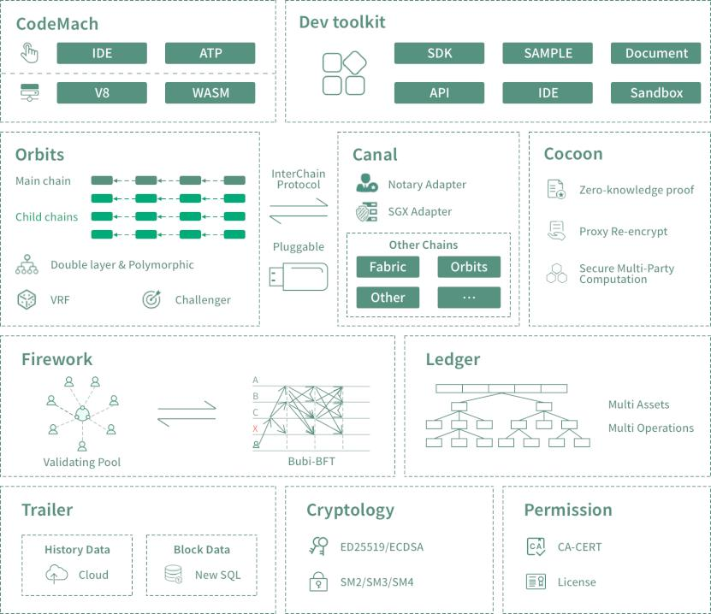
Domain Name Chain 1.0
163 / 163

