Slide 1
BALANCED STAFF ROUTING FOR MAINTENANCE
Đinh Nguyễn Công Quý - 20214927
Vũ Tuấn Minh - 20210597
Hoàng Tú Quyên - 20214929
Lê Tuấn Anh - 20214874

Slide 2
Table of contents
01.
02.
03.
Modelling
Problem Description
Proposed Algorithms
04.
05.
Experimental Result
Conclusion
Page 1
Give details about idea of the problem
Give using variables, constrains and objective function
Offer some algorithms to solve the problem
Show experimental result
Summarize project, future work

Slide 3



Page 2

Slide 4
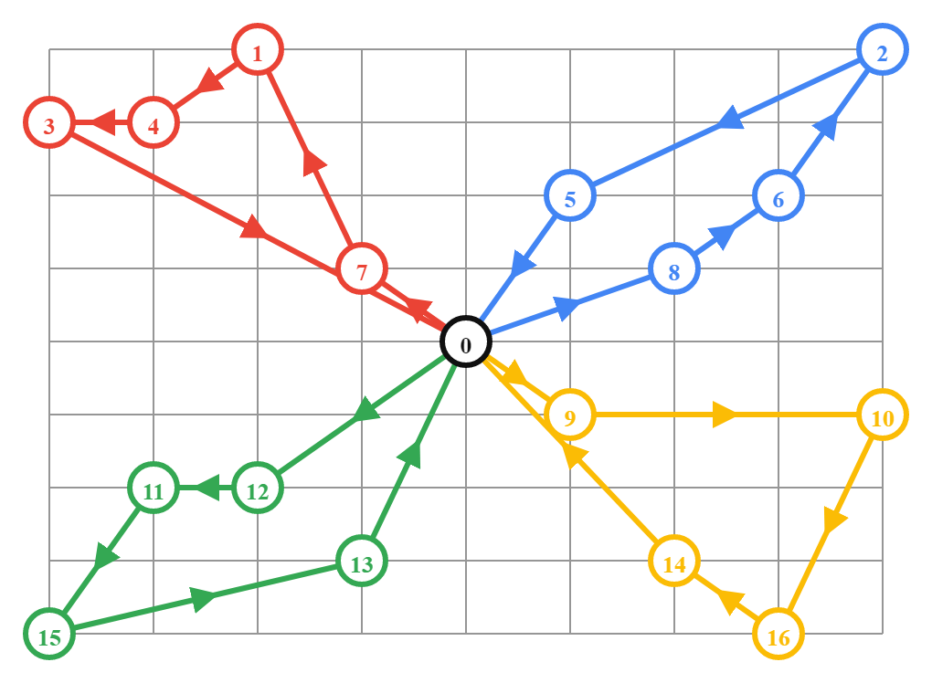


PROBLEM DESCRIPTION
Page 3
Customer
Employee
+ N customers
+Each customer
served by
only one employee
+Maintenance time (d)
+M employees
+Depot=>Customers=>Depot
+Travelling time (t)
+Working time (c) = Travelling time + Maintenance time
GOAL
Minimize the longest working time of an employee

Slide 5

Page 4

Slide 6

INTEGER PROGRAMMING
Page 5
Variables
x[i, k]$=\left\{\begin{aligned}&1, if customer i is served by employee k \\ &0, otherwise\end{aligned}\right.$
with: 1 <= i <= N; 1 <= k <= M.
y[i, j, k]$=\left\{\begin{aligned}&1, if employee k travels directly from i to j \\ &0, otherwise\end{aligned}\right.$
with: 0 <= i, j <= N; 1 <= k <= M
c[k]: positive integer variable indicate the working time of employee k with: 1<=k<=M
z: positive integer variable which represents the maximum working time among the employees

Slide 7




INTEGER PROGRAMMING
Page 6
Constraints
$$\left(1\right) \sum_{j=1}^{N}{y\left[0,j,k\right]= \sum_{i=1}^{N}{y\left[i,0,k\right]=1 (1≤k≤M)}}$$
$$\left(2\right) \sum_{j=1}^{N}{y\left[i,j,k\right]= \sum_{j=1}^{N}{y\left[j,i,k\right]=x[i,k] (1≤i≤N;i≠j; 1≤k≤M)}}$$
$$\left(3\right) \sum_{k=1}^{K}{x\left[i,k\right]=1 (1≤i≤N)}$$
$$\left(4\right) c\left[k\right]= \sum_{i=1}^{ N}{x\left[i, k\right]∗d\left[i\right]}+\sum_{i=0}^{N}{\sum_{j=0}^{N}{y\left[i,j,k\right]∗t[i][j]}} (1≤k≤M)$$
$$\left(5\right) c\left[k\right]≤z (1≤k≤M)$$

Slide 8

INTEGER PROGRAMMING
Page 7
$$(6)\sum_{\left(i,j\right)∈S}{y\left[i,j,k\right] ≥ 2 (1≤k≤K; ∀S ⊆\left\{1, 2, …,N\right\};2≤\left|S\right|≤N −2}$$
6
6
6
5
6
5
5
5
Sub-tour elimination Constraint [1]
7
7
7
7
4
4
2
4
4
Depot
Depot
Depot
Depot
8
8
8
8
3
3
3
3
11
11
11
11
11
9
9
9
9
2
9
2
2
2
10
1
10
1
10
10
1
10
1

Slide 9
INTEGER PROGRAMMING
Page 8
The objective function:
Minimizing the maximum working time among the employees:
z ➝ min

Slide 10

Page 9

Slide 11
EXACT ALGORITHMS
SCIP solver
CP-SAT solver
Page 10
Applying 2 solvers
Employ a combination of branching, cutting plane algorithms, and heuristics [2]
Utilizes SAT (Satisfiability) method [3]
=> CP-SAT gives faster performance than SCIP solver

Slide 12
HEURISTICS
Method 1
Method 2
Method 3
Page 11
Greedy algorithm
Local search algorithm
Hybrid of Greedy and Local search algorithm

Slide 13
Method 1: Greedy
Page 12
The algorithm involves the following steps:
NO
Initialize M “Centers”
YES
Construct route for each center
Consider “unrouted” point in UPL
Insert in best fit route
Update UPL
ULP empty?
Print final solution
Make “unrouted” point list (UPL)
Page 1c

Slide 14
Page 13
Method 1: Greedy
Result for sorted and unsorted maintenance time
 | f_min | f_max | f_avg | std_dev
Unsorted | 3410 | 4080 | 3750.6 | 147.8
Sorted in ascending order | 3450 | 4180 | 3788.4 | 163.6
Sorted in descending order | 3380 | 4090 | 3757.2 | 133.1

Slide 15
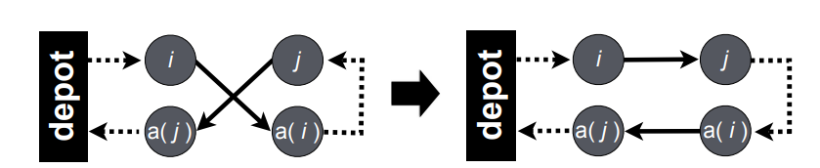
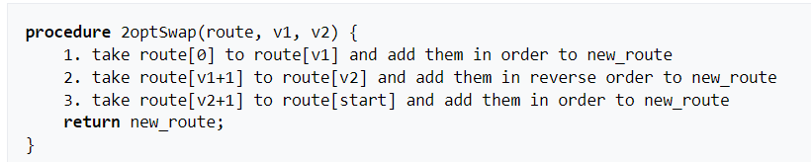
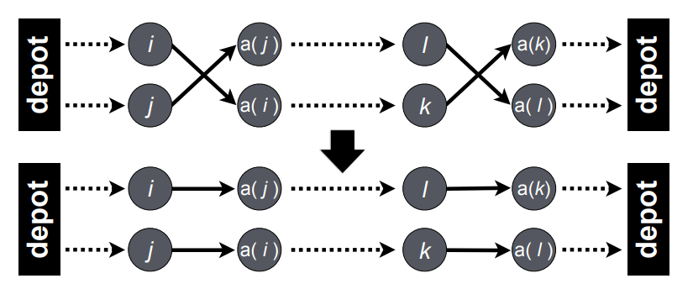
Page 14
Method 2: Local Search
Idea: Utilizes the 2-opt algorithm and its expansion (CROSS-exchange)
2-opt algorithm [4]
Swaping in 2-opt [6]
CROSS-exchange algorithm [5]

Slide 16
Page 15
Method 2: Local Search
Initialize initial solution
Optimize each tour by 2-opt
Two operators created for the initial solution:
+ Move: Move a city from the tour has maximum cost to the tour has minimum cost.
+ Swap: Swap randomly two locations from maximum tours and minimum tours to find the best neighborhood.
=> In general, local search methods cannot find optimal solutions due to the local minimum problem.
Sort in increasing order
NO
Meet stop condition?
YES
Print final solution
Select highest-cost and lowest-cost
Update new tours
Do “Swap” and “Move”
Optimize each tour by 2-opt

Slide 17
Page 16
Method 3: Greedy + Local Search
Purpose: reduce the number of times the swapping and moving operators are called
Idea:
1. Using the greedy algorithm to create initial feasible solution.
2. Once the initial solution is obtained from the greedy algorithm, the local search algorithm starts by exploring its neighbors.
3. The local search algorithm looks for a neighbor that satisfies all the constraints, and also has a higher objective function value than the current solution
4. This process is repeated until a local optimum is reached

Slide 18

Page 17

Slide 19
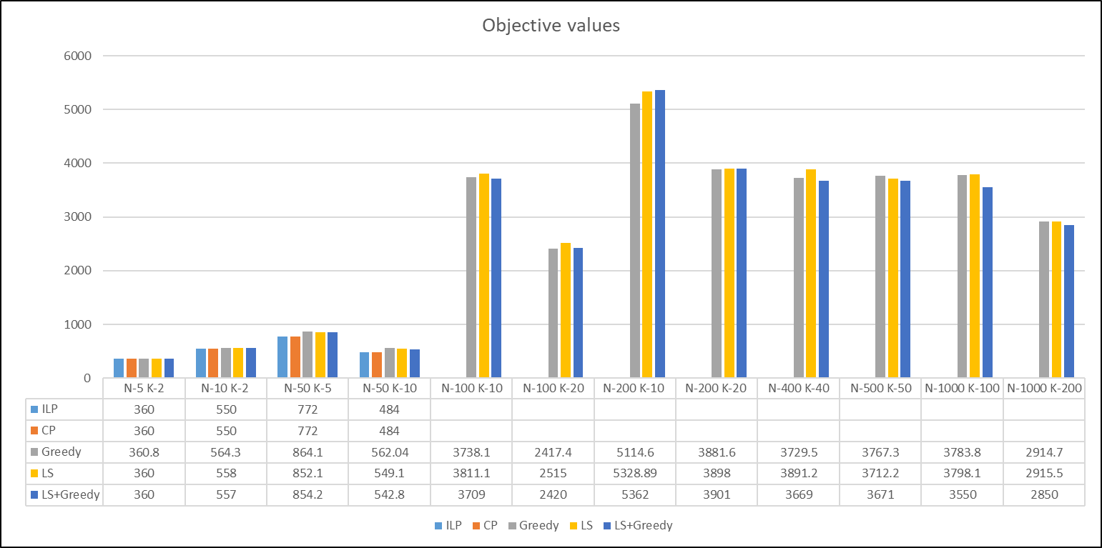
EXPERIMENTAL RESULT
Page 18

Slide 20
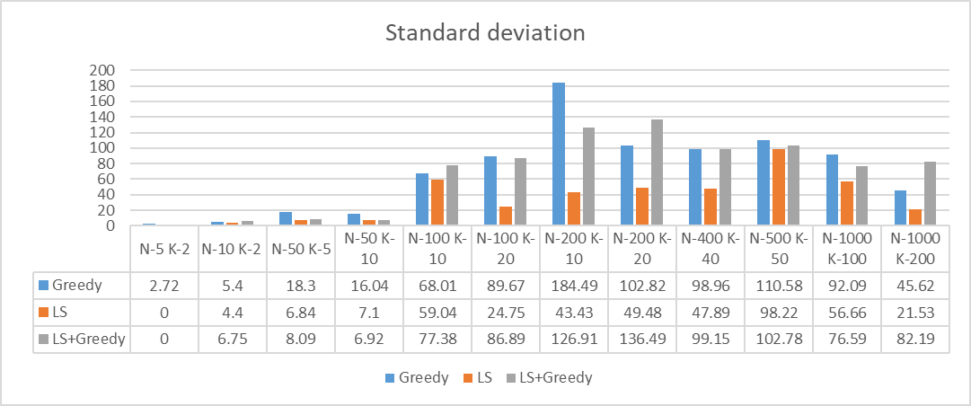
EXPERIMENTAL RESULT
Page 19

Slide 21
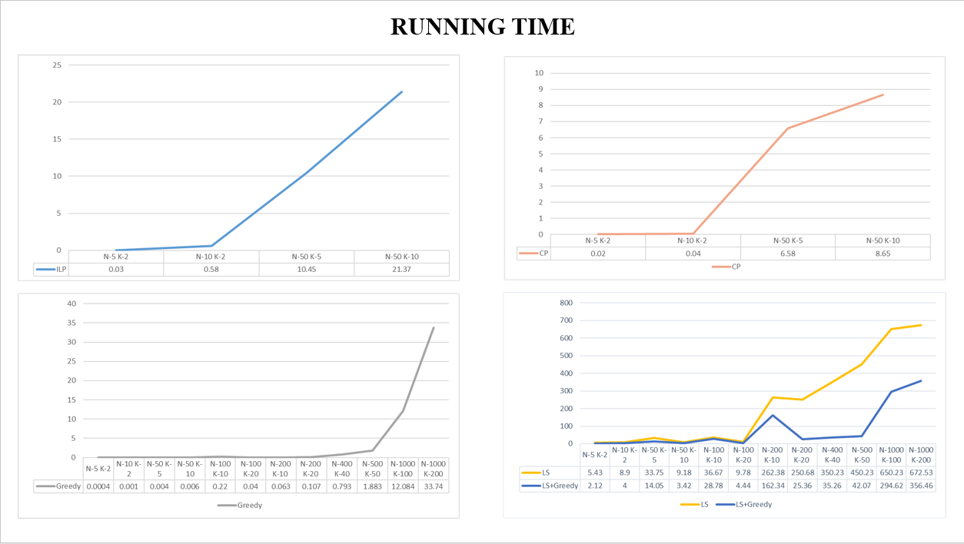
EXPERIMENTAL RESULT
Page 20

Slide 22

Page 21

Slide 23
CONCLUSION
Page 22
SHORTEST TIME; Greedy Algorithm
-> Recommended in reality, suitable for enormous datasets
-> its failure rate is high when N and M are close
to each other
Exact algorithms:
-> With small datasets: Both solvers returns the solutions in a nearly equal amount of time. The CP-SAT gives a more slow and steady increase in running time than the SCIP.
-> When N and M get larger (N > 50, M > 10), the solver cannot return the solution due to the overflow problem

Slide 24
CONCLUSION
Page 23
Local Search:
-> Gives more stable performance than Greedy Algorithm. The performance gap gets narrower when M increases
-> Depends much on the initial solution. If using the Greedy initial solution, the running time could be much faster, and the standard deviation doesn’t rise much.
-> The slow running time is probably due to the programming language.

Slide 25
REFERENCES
[1] “Explicit Dantzig-Fulkerson-Johnson formulation”
https://how-to.aimms.com/Articles/332/332-Explicit-Dantzig-Fulkerson-Johnson-formulation.html
[2], [3] “OR-Tools Guides”
https://developers.google.com/optimization/introduction
[3] Qing Guo, Jian Peng, Wenzheng Xu, “Minimizing the Longest Tour Time Among a Fleet of UAVs for Disaster Area Surveillance”
http://users.cecs.anu.edu.au/~Weifa.Liang/papers/GPXLJXYW20.pdf
[4], [5] Takafumi Matsuura, Kazumiti Numata, “Solving Min-Max Multiple Traveling Salesman Problems by Chaotic Neural Network”
https://www.ieice.org/nolta/symposium/archive/2014/articles/B1L-C1-6137.pdf
[6] https://en.wikipedia.org/wiki/2-opt
Page 24

Slide 26


