Slide 1
Balanced Staff Routing for Maintenance
Đinh Nguyễn Công Quý - 20214927
Vũ Tuấn Minh - 20210597
Hoàng Tú Quyên - 20214929
Lê Tuấn Anh - 20214874

Slide 2
Table of contents
PROBLEM DISCRIPTION
MODELLING
PROPOSED ALGORITHMS
01
02
03
EXPERIMENTAL RESULT
04
Give details about idea of the problem
Give using variables, constraints and objective function
Offer some algorithms to solve the problem
CONCLUSION
05
Show experimental result and analysis
Final conclusion for the problem

Slide 3
01
PROBLEM DISCRIPTION
Details about idea of the problem

Slide 4
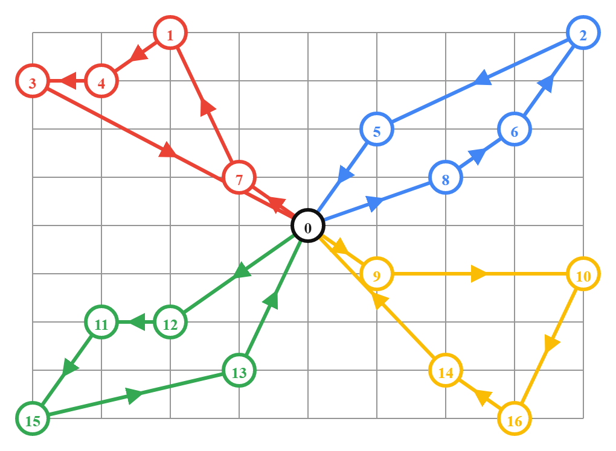
PROBLEM DISCRIPTION
*N customers at N distinct locations (L(i))
*K employees at base (L(0))
+Start from base to customers then come back to base
+Each customer serves by only one employee
+Working time of an employee is sum of travelling time (t) and maintenance time (d)
*Goal : Minimize the longest working time of an employee

Slide 5
02
MODELLING
Variables, Constraints and Objective function.

Slide 6
MODELLING
*Variables
x[i,k] = 1, if customer i is in maintenance schedule of employee k; X[i,k] = 0, if not (với 1 <= i <= N; 1 <= k <= K)
y[i,j,k] = 1, if travelling from i to j is in maintenance schedule of employee k ; Y[i,j,k] = 0, if not(với 0 <= i,j <= N ; 1 <= k <= K)
c[k]: Working time of employee k (với 1 <= k <= K)

Slide 7




MODELLING
*Constraints
Constraint of x,y,c:
K employees start from base:
K employees go back to base:
Only 1 edge to node i and 1 edge from node i in a schedule:
Each customer serves by only one employee:
Subtour elimination constraint:

Slide 8
MODELLING
*Objective function :
max{c[k]} min (1<=k<=K)

