Slide 1
PM Concentration in Some EU countries and Future work in the Topic of City Analogues in Pollutant Concentration
Cyder Chen 21.9.13

Slide 2
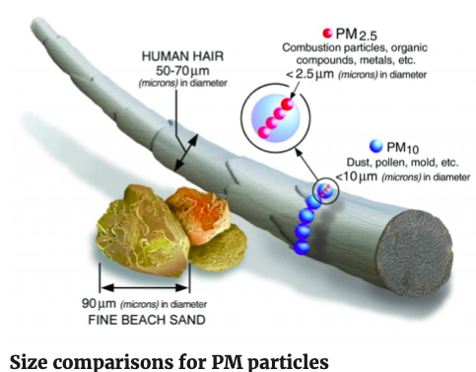
Brief introduction of PM
What is PM, and how does it get into the air?
PM stands for particulate matter :the term for a mixture of solid particles and liquid droplets found in the air.
Some particles, such as dust, dirt, soot, or smoke, are large or dark enough to be seen with the naked eye.
Others are so small they can only be detected using an electron microscope.
PM₁₀ : inhalable particles, with diameters that are generally 10 micrometers and smaller.
PM_{2.5} : fine inhalable particles, with diameters that are generally 2.5 micrometers and smaller.
Why Harmful?
Particulate matter contains microscopic solids or liquid droplets that are so small that they can be inhaled and cause serious health problems.
Some particles less than 10 micrometers in diameter can get deep into your lungs and some may even get into your bloodstream.
Of these, particles less than 2.5 micrometers in diameter, also known as fine particles or PM_{2.5}, pose the greatest risk to health.
Ref: https://www.epa.gov/pm-pollution/particulate-matter-pm-basics

Slide 3
Figure out what I should do
Collect data (city scale or countries in equivalent size)
Using a specific year (eg.2015) comparing with a specific former year (eg. 1995) with pollutant concentration (eg. PM2.5, PM10, NOx, SO₂, VOC)
Figure out cities in 2015 actually like which cities in 1995 (how much they like, give a percent, using analysis method)(eg.)
Find or estimate those cities in a specific future year (eg.2030), then do step3 again.
Choose some of the typical cities with further analysis.

Slide 4
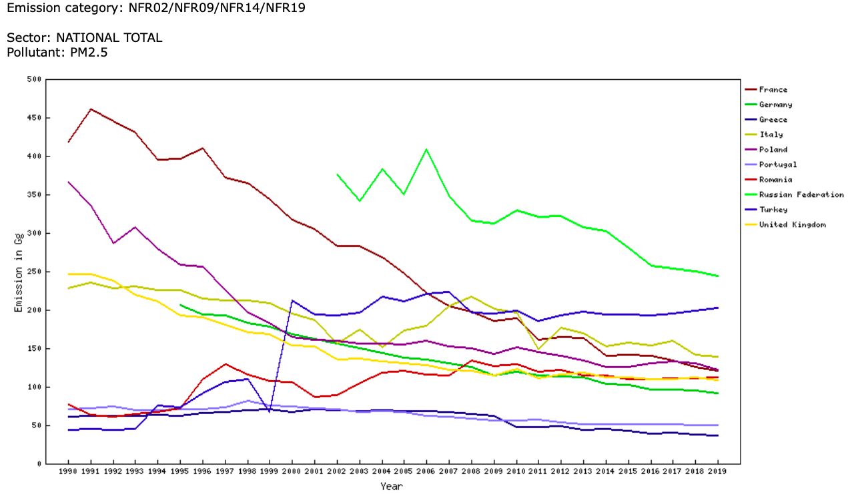

Data of PM2.5 (at a glance) (country scale)
Mostly is downward trend
Some of the countries has slightly turbulence.
The overall scale of PM2.5 in EU countries is below 500 Gg.
Ref:

Slide 5
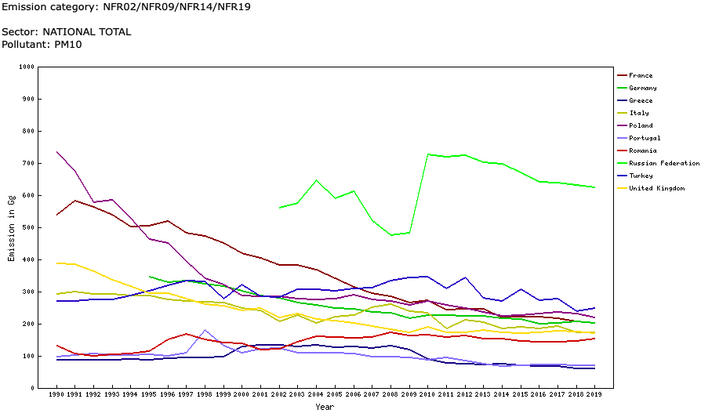
Data of PM10 (at a glance) (country scale)
Mostly is downward trend
Some of the countries has slightly turbulence.
The overall scale of PM10 in EU countries is below 800 Gg.
The reason Russia has a higher trend may because
1: the country area (change scale to city will help to solve)
2: climate?
Ref:

Slide 6
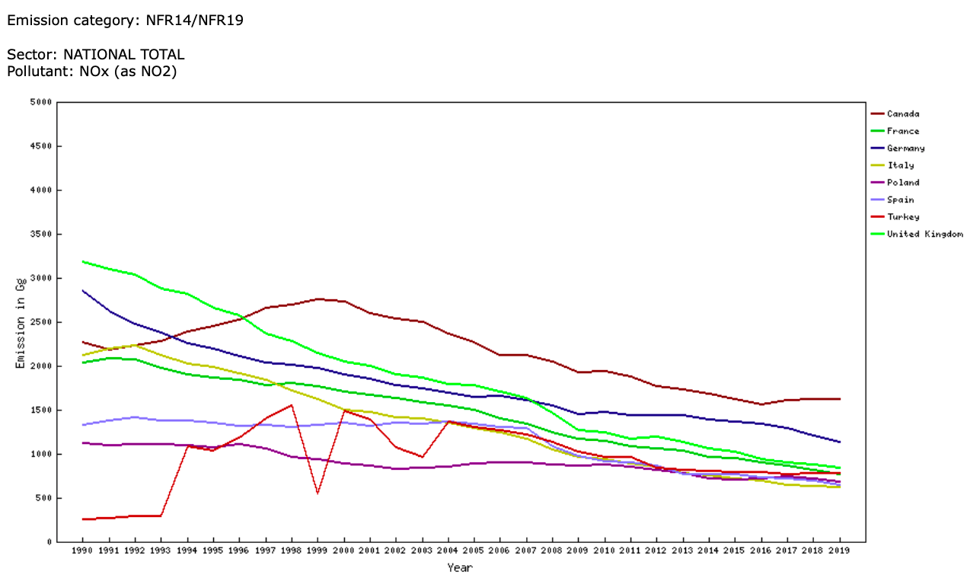
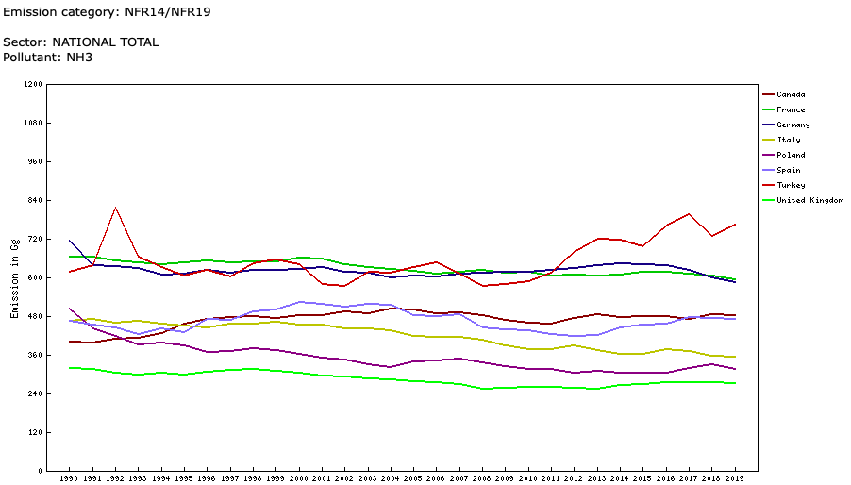
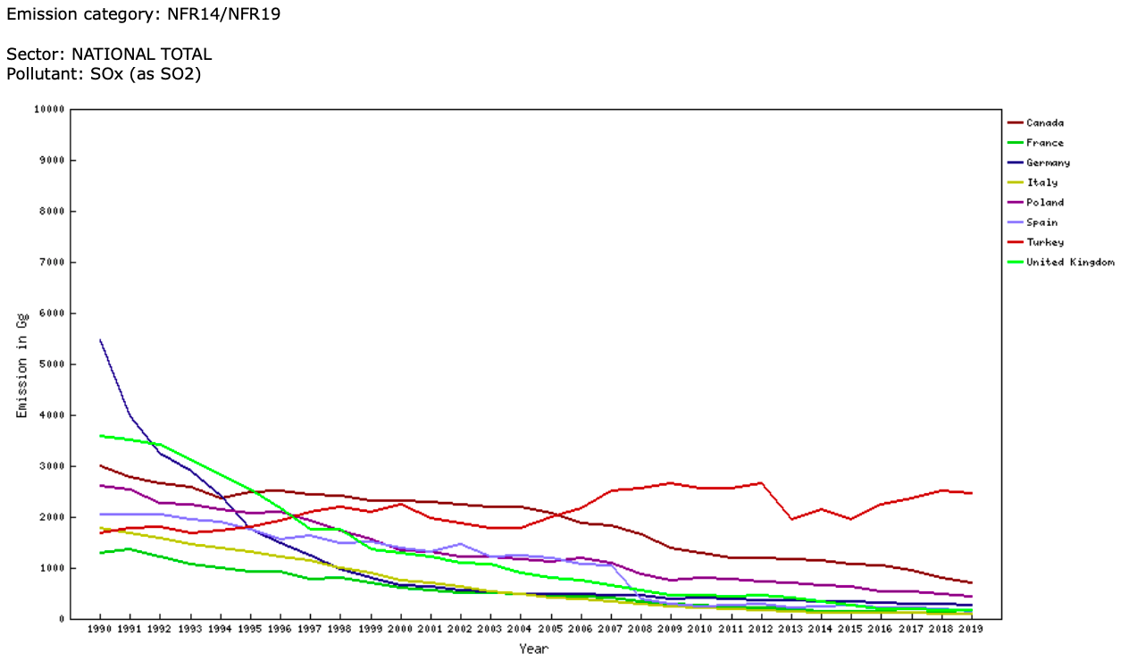
Interesting or weird finding
Such a big country like Canada has the same country pollutant level when comparing with NOx, SO2, NH3
But when it comes to PM……

Slide 7
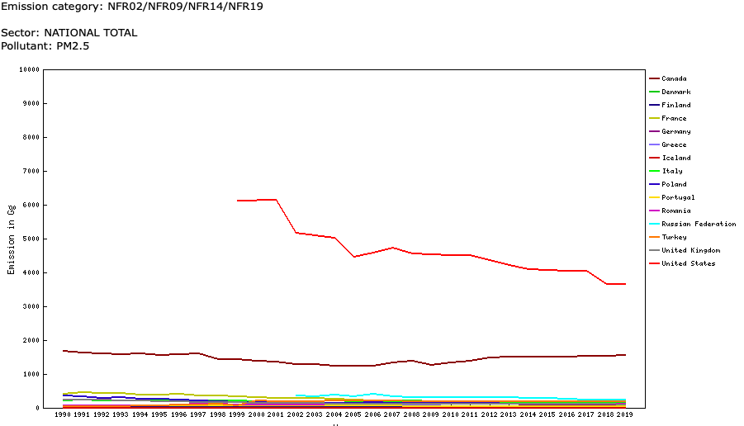
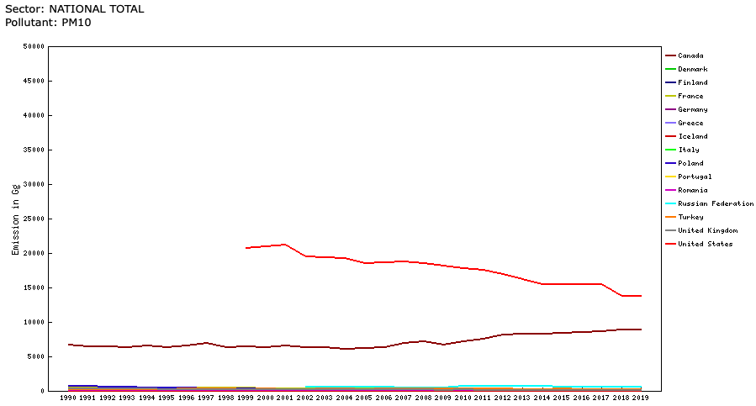
Huge difference
PM2.5
不同国家污染物浓度尺度不一样
why
国家尺度导致大面积国家积累不具有可比性，也不能称为判断的先行标准
气候原因，EU国家大多为温带海洋气候降水偏多且平均，导致整体污染物浓度变低
可能城市尺度就大不一样了（question 城市大小也是一个问题）
PM10

Slide 8
NEED FURTHER COMPARING…

