Slide 1


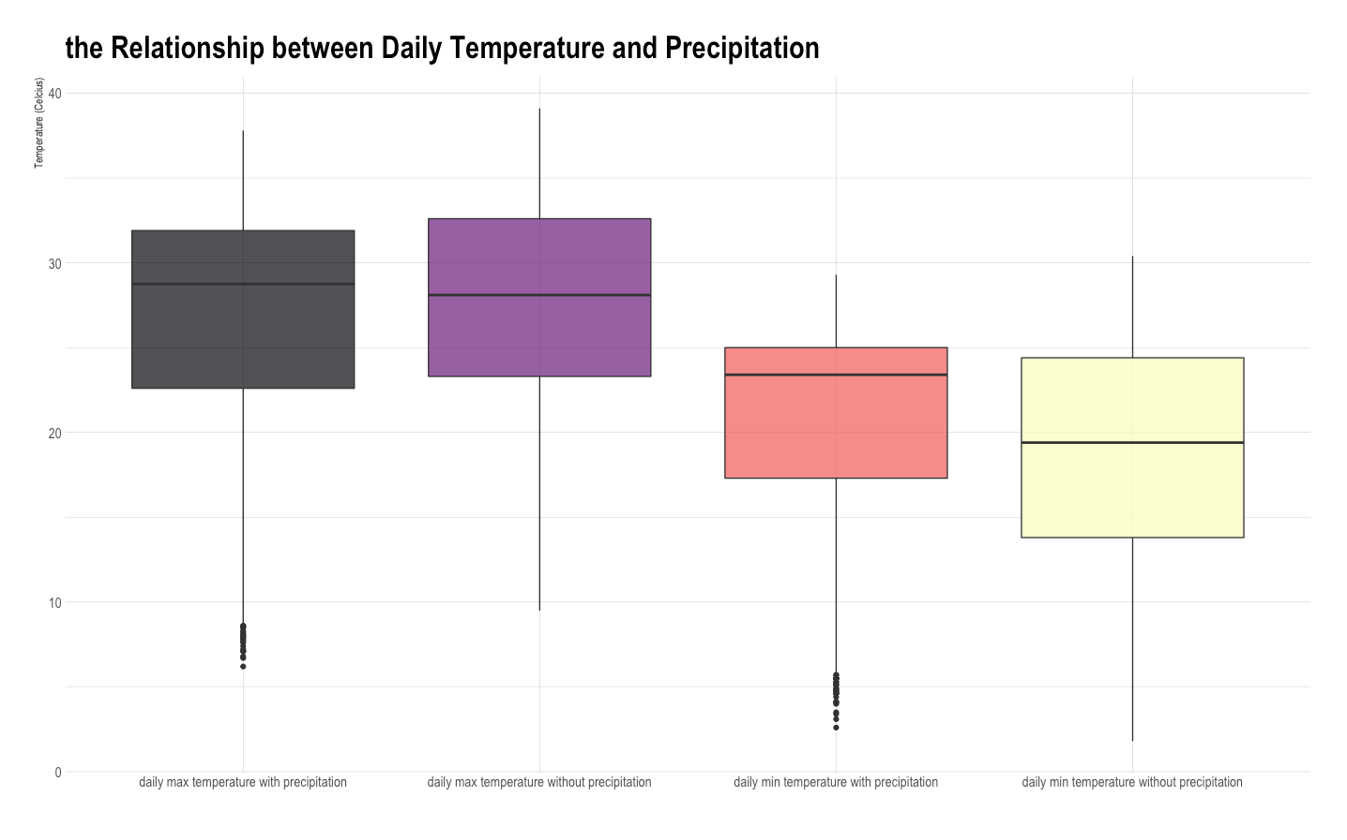
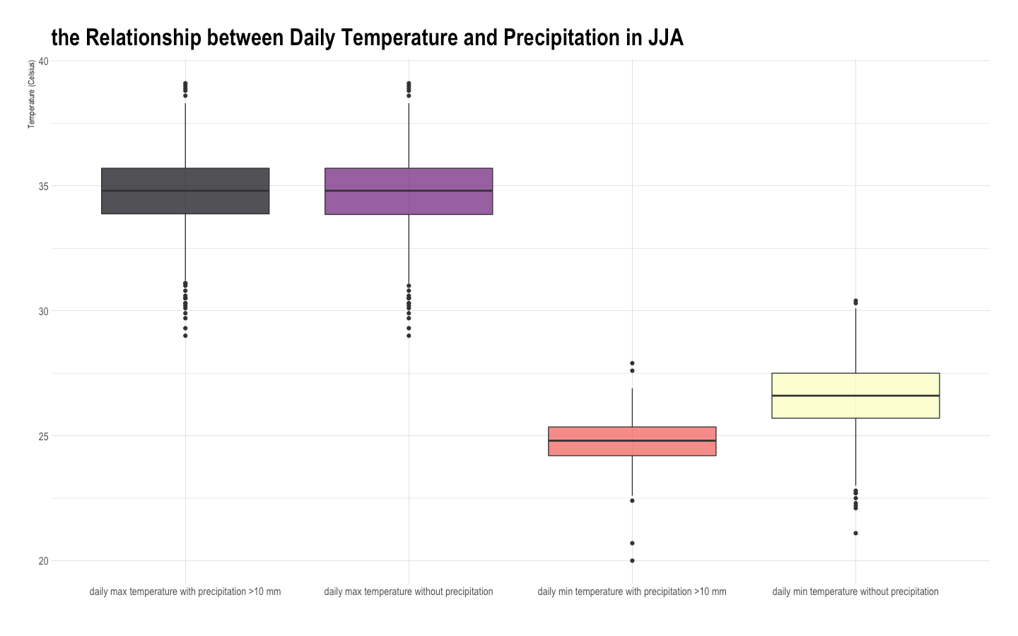
The influence of precipitation on daily maximum and minimum temperature between 2000-2020 in Guangzhou
Yedong Chen
School of Environmental Science and Engineering, Southern University of Science and Technology
BACKGROUND
In the summer in southern China, such as Guangzhou and Shenzhen, some people cannot bear the heat of the weather and look forward to a heavy rain during the day. However, after the precipitation, the heat of the sun evaporates, and it is as hot as a sauna. The other people think that rain at night can make the day cool, while rain during the day will only retain the heat of the boundary layer.
METHODOLOGY
DISCUSSION
The conclusion about daily min temperature can be described as unexpected, but the analysis is not difficult to draw the following discussion that may affect the final result: Guangzhou has a subtropical monsoon climate, with precipitation mostly concentrated in the summer season, but less precipitation in winter. Therefore, the temperature in different seasons may affect the results. In this experiment, precipitation has directly become a question of whether there is or not, and the influence of the quantity of precipitation in this analysis is ignored. So we choose JJA of the statistics and only consider daily precipitation higher than 10 mm as precipitation then we get Figure 2. For max temperature, the p-value is 0.9775, which means that there is no significant difference whether it has precipitation. For min temperature, the p-value is smaller than 2.2*10⁻¹⁶, which means the min temperature is 1.73775 degree Celsius lower if there is precipitation larger than 10 mm per day. the 95% confidence interval is [-1.926528, -1.548971]
Independent two-Sample t-test is used to test whether two independent samples come from a population with the same mean. The essence is to perform a t-test on the difference between the two sample means. Here we use it to compare whether the temperature in Guangzhou has difference comparing to precipitation situation, we take 2000-2020 overall 7814 sets of statistics in Guangzhou from NOAA and giving the hypothesis as following:
H0: Mean Temperature in days within precipitation is the same as those days without precipitation (μ1=μ2).
H1: Mean Temperature in days within precipitation is not the same as those days without precipitation (μ1≠μ2).
RESULTS
The Results are shown in Figure 1.
When comparing the daily max temperature, the p-value is 7.542*10⁻⁵, we should reject the null hypothesis and accept the alternative hypothesis, the daily max temperature is 0.75545 degree Celsius lower comparing precipitation days, the 95% confidence interval is [-1.1292708, -0.3816415]
When comparing the daily min temperature, the p-value is smaller than 2.2*10⁻¹⁶, we should reject the null hypothesis and accept the alternative hypothesis, the daily min temperature is 1.93150 degree Celsius higher comparing precipitation days, the 95% confidence interval is [1.567964, 2.295021]
OBJECTIVES
Explore whether precipitation has a great influence on the highest temperature during the day or the lowest temperature at night, as well as the average effect of precipitation on temperature.
ACKNOWLEDGEMENT
· Thanks for National Oceanic Atmospheric Administration (NOAA) giving us the statistics of station CHM00059287 located in Guangzhou, China. · Appreciations to Instructor Lei Zhu in School of Environmental Science and Engineering, who told us method using R.
Figure 1: Temperature in Four Types of Conditions
CONCLUSION
In the long-term series in Guangzhou, precipitation has a significant effect on reducing the daily maximum temperature. In the JJA time series in Guangzhou, precipitation has a significant on reducing the daily minimum temperature, while has no significant effect on daily maximum temperature.
Figure 2: Temperature in Four Types of Conditions in JJA (only precipitation >10 mm counts)

