Slide 1
Team Froyo
Megan McCarty, Julius Remigio, Ryan Riopelle, Syed Nazrul, Michael Galarnyk

Slide 2
Objective
Analyze the IRI Marketing Dataset in an effort to identify trends and influential features in the sale of yogurt. Develop the capability for proactive evaluation of marketing resources through the use of predictive modeling
Desired Capability:
Predict the impact of new promotions on future sales
Allow focused marketing by identify the driving demographics in yogurt sales
Aid inventory decision by understanding geographic sales trends
Predictions of future sales to inform better business decisions
Business Understanding
Data Understanding
Data Preparation
Modeling
Evaluation
Deployment

Slide 3
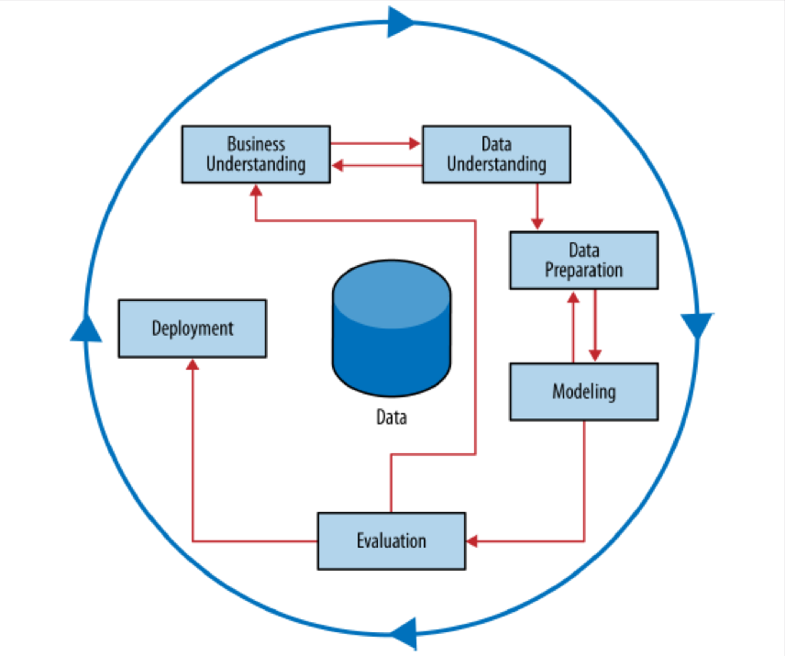
Methodology
Cross Industry Standard Process for Data Mining (CRISP-DM)
Business Understanding
Data Understanding
Data Preparation
Modeling
Evaluation
Deployment
CRISP Data Mining Process
Business Understanding
Data Understanding
Data Preparation
Modeling
Evaluation
Deployment

Slide 4
Assess Situation
IRI Marketing Data Set
Dataset containing store sales and consumer panel data for 30 product categories.
Enables modeling of important economic and marketing metrics for companies and policy makers.
Yogurt Relevant Data
Consumer Demographic Data (Demos)
Drug and Grocery Stores
Consumer Panelist Data
Delivery Stores
Resources
Used h5 files due to
Skillset of team (not SQL experts) and manageability (1.8 GB compressed)
Many of benefits of database without requiring use of external resources such as a server
Works directly with Pandas
Python Machine Learning Packages
Risks and Contingencies
Size of grocery store data was too large for personal laptop RAM. We used representative samples.
Unable to link all keys between tables so performed analysis on subsets that could be merged. Analysts accepted potential information loss as small risk
IRI data my not accurately represent the markets for which data is provided and may skew some of our conclusions.
Scikit-learn can’t handle categorical data well which we mitigated by binary encoding.
Business Understanding
Data Understanding
Data Preparation
Modeling
Evaluation
Deployment

Slide 5
Data Mining Goals
Primary Goal: Discover underlying trends in the data that can be used to build a predictive model
Stores
Promotions
Panelists
Products
Prove that the promotions, displays and/or price reductions has a statistically significant impact on sales
Identify panelists demographics that contribute to higher yogurt sales
Identify single or combinations of yogurt attributes that tend to sell better or worse
Determine if there exists geographic trends in the sales data
Time Series
Determine if there exists daily, weekly, monthly or yearly sales patterns
Business Understanding
Data Understanding
Data Preparation
Modeling
Evaluation
Deployment

Slide 6
Project Plan
ETL
ID and Review data files needed for analysis
Clean, Merge and Consolidate data by type and similarity
Store cleanse data in H5 file for analysis
Mini-CRISP
Perform a smaller CRISP on each data element
Data Understanding, Data Preparation and Modeling
Integrate
Improve smaller models by merging data sets and exploiting Mini-CRISP provided insights
Incorporate outside data to improve models
Merge
Build a larger sales model utilizing all previously work
Create useful Metadata to track lineage
Business Understanding
Data Understanding
Data Preparation
Modeling
Evaluation
Deployment

Slide 7
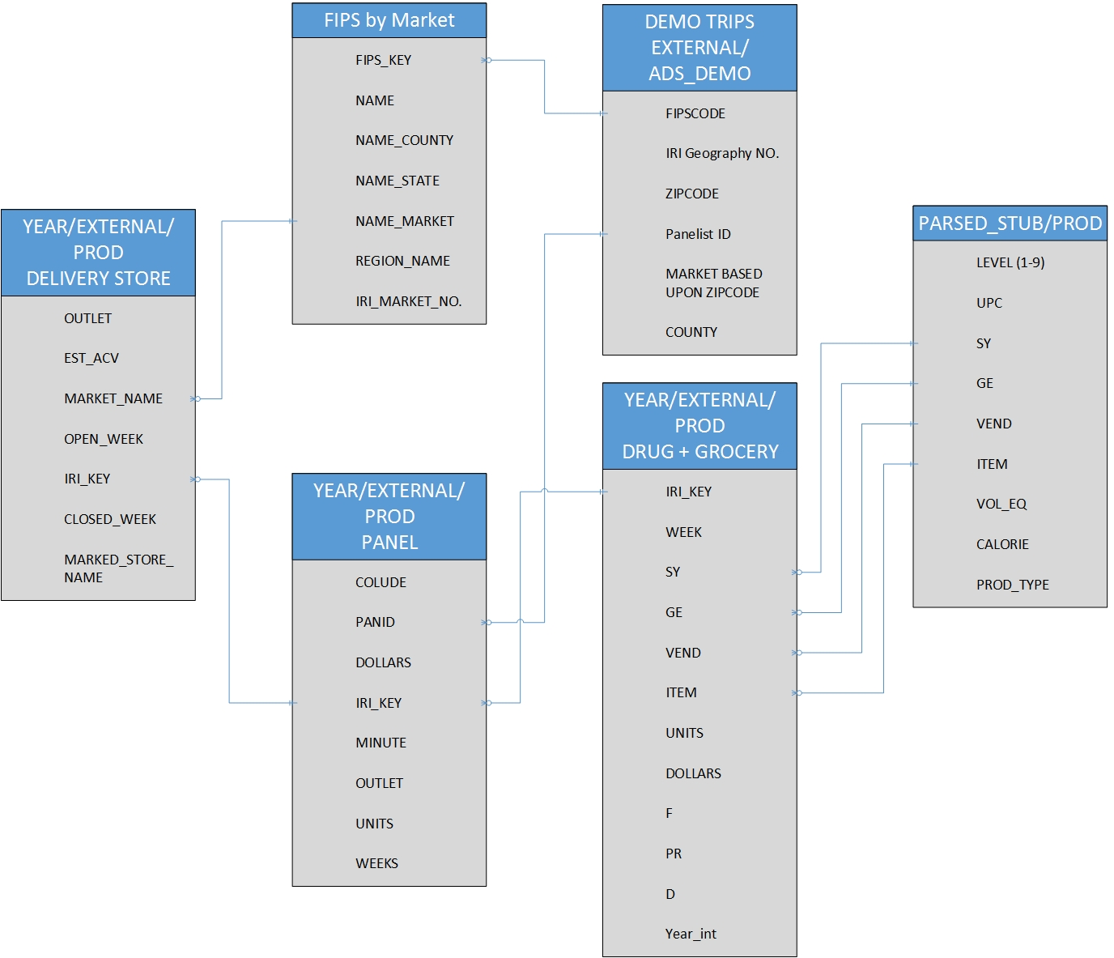
Data Description
Store Descriptors
US County Codes (FIPS)
Panelist Demographics
Panelist Sales
Store Sales Data
Product Descriptors
Business Understanding
Data Understanding
Data Preparation
Modeling
Evaluation
Deployment
Relationships between various Data Categories
Notes:
A big component of data was

Slide 8
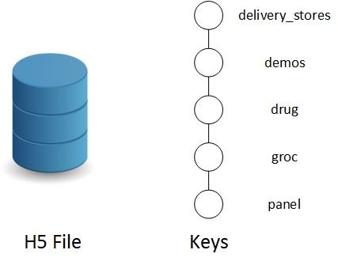
Big D. Challenges
Disparity
Similar files distributed over various folders
Different version of similar data
Different file formats and headers
Volume
140 GB Uncompressed ➞ 1.8 GB Compressed
141,394,709 rows just for grocery yogurt sales
Variety
3,649 files ➞ 1 file
Demographics, Panelists, Trips, Stores, Sales, Products, etc.
Organization of Single H5 File
Business Understanding
Data Understanding
Data Preparation
Modeling
Evaluation
Deployment

Slide 9
Data Exploration – Demographics Random
Can we predict who will purchase yogurt?
Yes, Accuracy: 0.58 (+/- 0.07)
Cross Validated
Top 5 Features:
Has a TV
Has Cable
Family Size
Number of Dogs
Number of Cats
Business Understanding
Data Understanding
Data Preparation
Modeling
Evaluation
Deployment

Slide 10
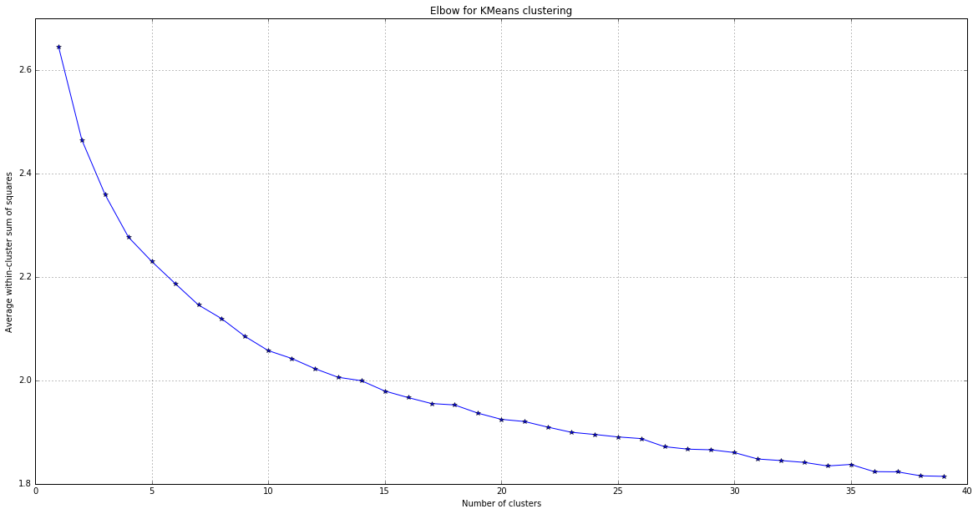
Data Exploration – Demographics K-Means
K-Means
Elbow Curve for K-Means Clustering
Can we identify groups of people who purchase yogurt?
Identified 12 clusters
Clusters were not stable
Average within Cluster Sum of Squares
Number of Clusters
Business Understanding
Data Understanding
Data Preparation
Modeling
Evaluation
Deployment

Slide 11
Data Exploration – Data Preparation random
Demographic info about panelists
74,592 samples
8 features
11 files
Panelist purchases
1,609,107 samples
32 features
33 files
Product features – UPCs and product descriptors
16,475 samples
22 features
3 files
Business Understanding
Data Understanding
Data Preparation
Modeling
Evaluation
Deployment

Slide 12
Data Exploration – Data Preparation K-Means
Demographic info about panelists
74,592 samples
8 features
11 files
Panelist purchases
1,609,107 samples
32 features
33 files
Business Understanding
Data Understanding
Data Preparation
Modeling
Evaluation
Deployment

Slide 13
Data Quality – Issues with Data Preparation (random forest)
Demographics data
Inconsistent headers across multiple files had to be mapped
1st two years of data had many features with missing data
Standardized features had to be mapped back to nominal descriptors
Multiple versions of panelists with different demographics
Many similar columns, i.e. TV, Education
Panelist Purchases for Yogurt
Not all transactions contained a yogurt purchase
Product Features
Only used to verify yogurt purchases
Business Understanding
Data Understanding
Data Preparation
Modeling
Evaluation
Deployment

Slide 14
Data Quality – Data Preparation K-Means
Cleaned and merged source files, handle missing values
Ignored 1st two years of demographic data
Dropped samples with NaN
Feature Engineering
Binarized nominal data
Normalized numeric data
Joined Panelist and Demo data
K-Means with 12 clusters
Applied cluster labels onto dataset
Grouped dataset by cluster and identified most prevelant features
Business Understanding
Data Understanding
Data Preparation
Modeling
Evaluation
Deployment

Slide 15
Data Quality – Data Preparation
Cleaned and merged source files, handle missing values
Ignored 1st two years of demographic data
Feature Engineering
Binarized nominal data
Normalized numeric data
Combined data sets
Created Labels for classification
Identified who did and did not purchase yogurt
Use Random Forest to build model
Business Understanding
Data Understanding
Data Preparation
Modeling
Evaluation
Deployment

Slide 16
Data Exploration Sales Promotions
Are sales advertisements, displays and price reductions successful?
Sales Promotions | Percentage of Successful Weeks
Large advertisement | 36%
Medium Advertisement | 33%
Advertisement with Retailer Coupon | 50%
Any Advertisement | 38%
Minor Display | 31%
Major Display | 47%
Any Display | 43%
Price Reduction | 29 %
”Success” = Sales during the week a promotion/display/price reduction was run is more than 1 standard deviation from the mean.

Slide 17
Data Preparation Sales Promotions
To facilitate modeling in sklearn, binary encoded the advertisement and display categorical data fields
Merged IRI Week Converter files to obtain the calendar week, month and year of each sale.
Calculated the mean and standard deviation of weekly sales for each store/product pair. Then created binary promotion sales “success” label.
Merge drug store and grocery store data. Then added two new binary columns to indicate outlet of the record
Business Understanding
Data Understanding
Data Preparation
Modeling
Evaluation
Deployment

Slide 18
Data Preparation Products
Identified which product attributes where more than 50% of the records had missing data. Removed these from model consideration and accepted the potential information loss.
To facilitate modeling in sklearn, binary encoded categorical data fields
Business Understanding
Data Understanding
Data Preparation
Modeling
Evaluation
Deployment

Slide 19
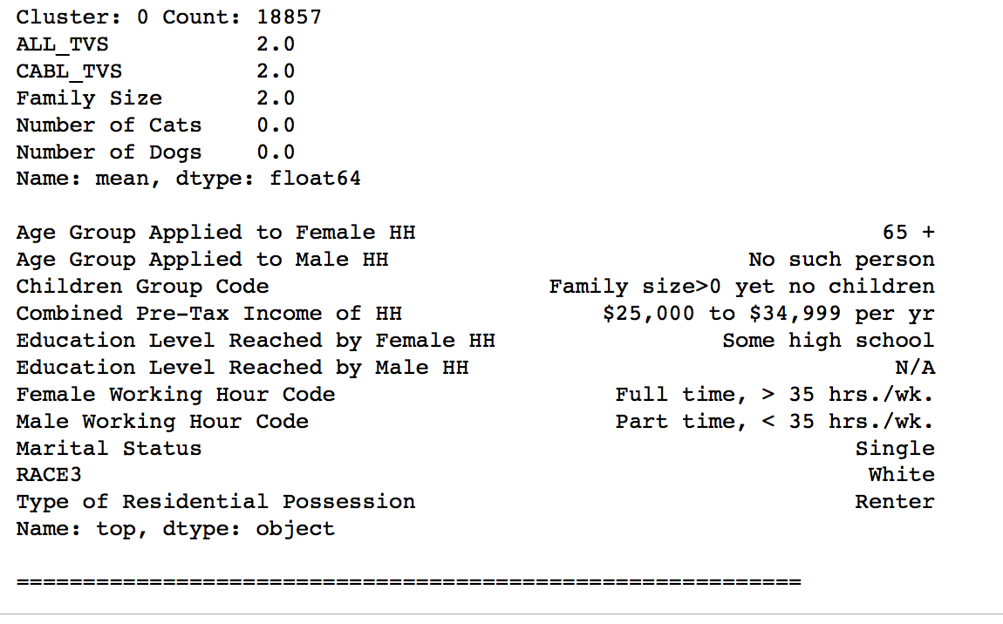
Data Quality – Data Preparation K-Means
Sample cluster:

Slide 20
Modeling (Julius) Predict Sales by Demographics
Features: Binarized demographics information
Label: If consumer purchased yogurt (binary)
Random Forest Classifier scored 75% (after tuning)
Average 10-Fold CV score was 53%
Business Understanding
Data Understanding
Data Preparation
Modeling
Evaluation
Deployment

Slide 21
Modeling (Megan) Predict Sales Promotion Success
Random Forrest Classifier
Features: binary encoded advertisement, display and price reduction fields
Label: Promotion was successful or Not (binary)
Parameters tuned using GridSearchCV: number of estimators and max depth
10-fold Cross Validation: 78% Accuracy
Attempt to increase model prediction capability by integrating other data elements were unsuccessful.
Other elements considered and rejected: product attributes, store geography, time of year, price
Business Understanding
Data Understanding
Data Preparation
Modeling
Evaluation
Deployment

Slide 22
Modeling (Sadat) Predict Units Sold (Classification)
Features: Binarized sales promotions, population, median household income and unit price.
Label: If store sold more than 11 units that week (binary)
Selection: Lasso CV (34 features out of engineered 518)
Models (after tuning):
Classifiers | Random Forest | Linear SVC
Score | 80%+ | 72%+
10 Fold CV | Unstable | Stable
Business Understanding
Data Understanding
Data Preparation
Modeling
Evaluation
Deployment

Slide 23
Modeling (Megan) Predict Units Sold (Regression)
Per the project plan, analysts attempted to incorporate influential data entities into a single sales prediction model.
LASSO, RIDGE and SVR regression models were attempted to predict unit sales utilizing multiple of our identified influential data elements
Modeling attempts were unsuccessful, best accuracy was only 43.84%
Business Understanding
Data Understanding
Data Preparation
Modeling
Evaluation
Deployment

Slide 24
Modeling Predict Sales Promotion Success
Random Forrest Classifier
Features: binary encoded advertisement, display and price reduction fields
Label: Promotion was successful or Not (binary)
Parameters tuned using GridSearchCV: number of estimators and max depth
10-fold Cross Validation: 78% Accuracy
Attempt to increase model prediction capability by integrating other data elements were unsuccessful.
Other elements considered and rejected: product attributes, store geography, time of year, price
Business Understanding
Data Understanding
Data Preparation
Modeling
Evaluation
Deployment

Slide 25
Modeling Predict Units Sold
Per the project plan, analysts attempted to incorporate influential data entities into a single sales prediction model.
LASSO, RIDGE and SVR regression models were attempted to predict unit sales utilizing multiple of our identified influential data elements
Modeling attempts were unsuccessful, best accuracy was only 43.84%
Business Understanding
Data Understanding
Data Preparation
Modeling
Evaluation
Deployment

Slide 26
Megan: Results align with objectives and success criteria
Business Understanding
Data Understanding
Data Preparation
Modeling
Evaluation
Deployment
Notes:
Quick review of what we have. Model that predicts if a sales promotion will be successful, clustering of demographics,
Compare with objectives we laid out and what we succeeded with and what we didn’t.

Slide 27
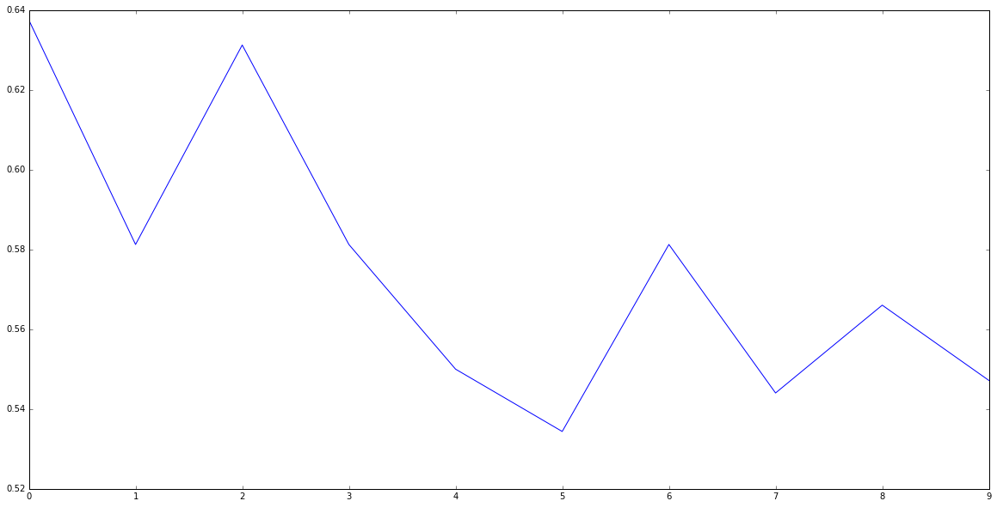
Random Forest Classifier 10k Cross Validation

