Slide 1
Team Froyo
Megan McCarty, Julius Remigio, Ryan Riopelle, Syed Nazrul, Michael Galarnyk

Slide 2
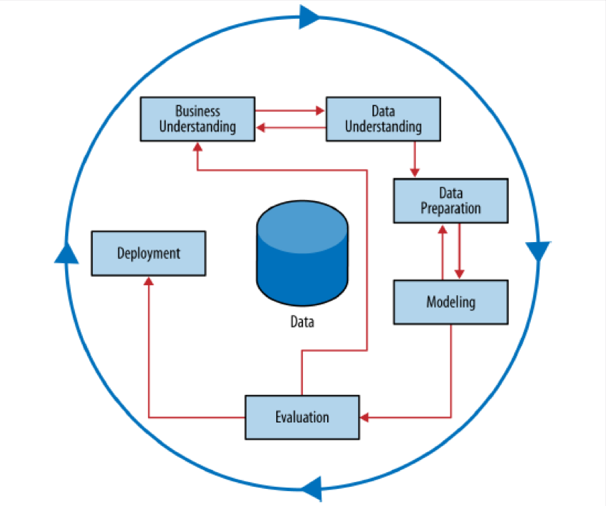
Methodology
Cross Industry Standard Process for Data Mining (CRISP-DM)
Business Understanding
Data Understanding
Data Preparation
Modeling
Evaluation
Deployment
CRISP Data Mining Process

Slide 3
Objective
Analyze the IRI Marketing Dataset in an effort to identify trends and influential features in the sale of yogurt. Develop the capability for proactive evaluation of marketing resources through the use of predictive modeling
Desired Capability:
Predict the impact of new promotions on future sales
Allow focused marketing by identify the driving demographics in yogurt sales
Aid inventory decision by understanding geographic sales trends
Predictions of future sales to inform better business decisions

Slide 4
Assess Situation
IRI Marketing Data Set
Dataset containing store sales and consumer panel data for 30 product categories.
Enables modeling of important economic and marketing metrics for companies and policy makers.
Yogurt Relevant Data
Drug and Grocery Store Weekly Yogurt Sales Data
Consumer Panelist Transaction Data
Consumer Panelist Demographic Data
Yogurt Product Attribute Data
Store Attribute Data
Resources
Python Machine Learning Packages
Hierarchical Data Format files (HDF5)
Benefits of database without requiring external server resources
Risks and Contingencies
Size of grocery store data was too large for personal laptop RAM. We used representative samples.
Unable to link all keys between tables so performed analysis on subsets that could be merged. Analysts accepted potential information loss as small risk
IRI data my not accurately represent the markets for which data is provided and may skew some of our conclusions.
Scikit-learn can’t handle categorical data well which we mitigated by binary encoding.

Slide 5
Data Mining Goals
Primary Goal: Discover underlying trends in the data that can be used to build a predictive model
Stores
Promotions
Panelists
Products
Prove wither the promotions, displays and/or price reductions has a statistically significant impact on sales
Identify panelists demographics that contribute to higher yogurt sales
Identify single or combinations of yogurt attributes that tend to sell better or worse
Determine if there exists geographic trends in the sales data
Time Series
Determine if there exists daily, weekly, monthly or yearly sales patterns

Slide 6
Project Plan
ELT
Mini-CRISP
Integrate
Merge
Identify and review data files required for analysis
Clean, merge and consolidate data by type and similarity
Create useful Metadata to track lineage
Store clean data in HDF5 file
Perform small CRISP on each data element
Data Understanding, Data Preparation and Modeling
Improve models by merging data sets and exploiting Mini-CRISP provided insights
Incorporate outside data if needed to improve model
Utilize al insights and model from previous work to build yogurt sales prediction model

Slide 7
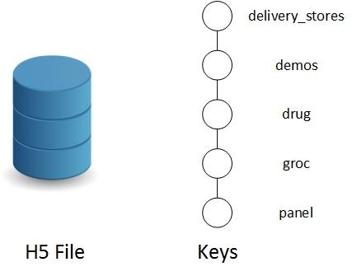
Big D. Challenges
Disparity
Similar files distributed over various folders
Different version of similar data
Different file formats and headers
Volume
140 GB Uncompressed ➞ 1.8 GB Compressed
141,394,709 rows just for grocery yogurt sales
Variety
3,649 files ➞ 1 file
Demographics, Panelists, Trips, Stores, Sales, Products, etc.
Organization of Single H5 File

Slide 8
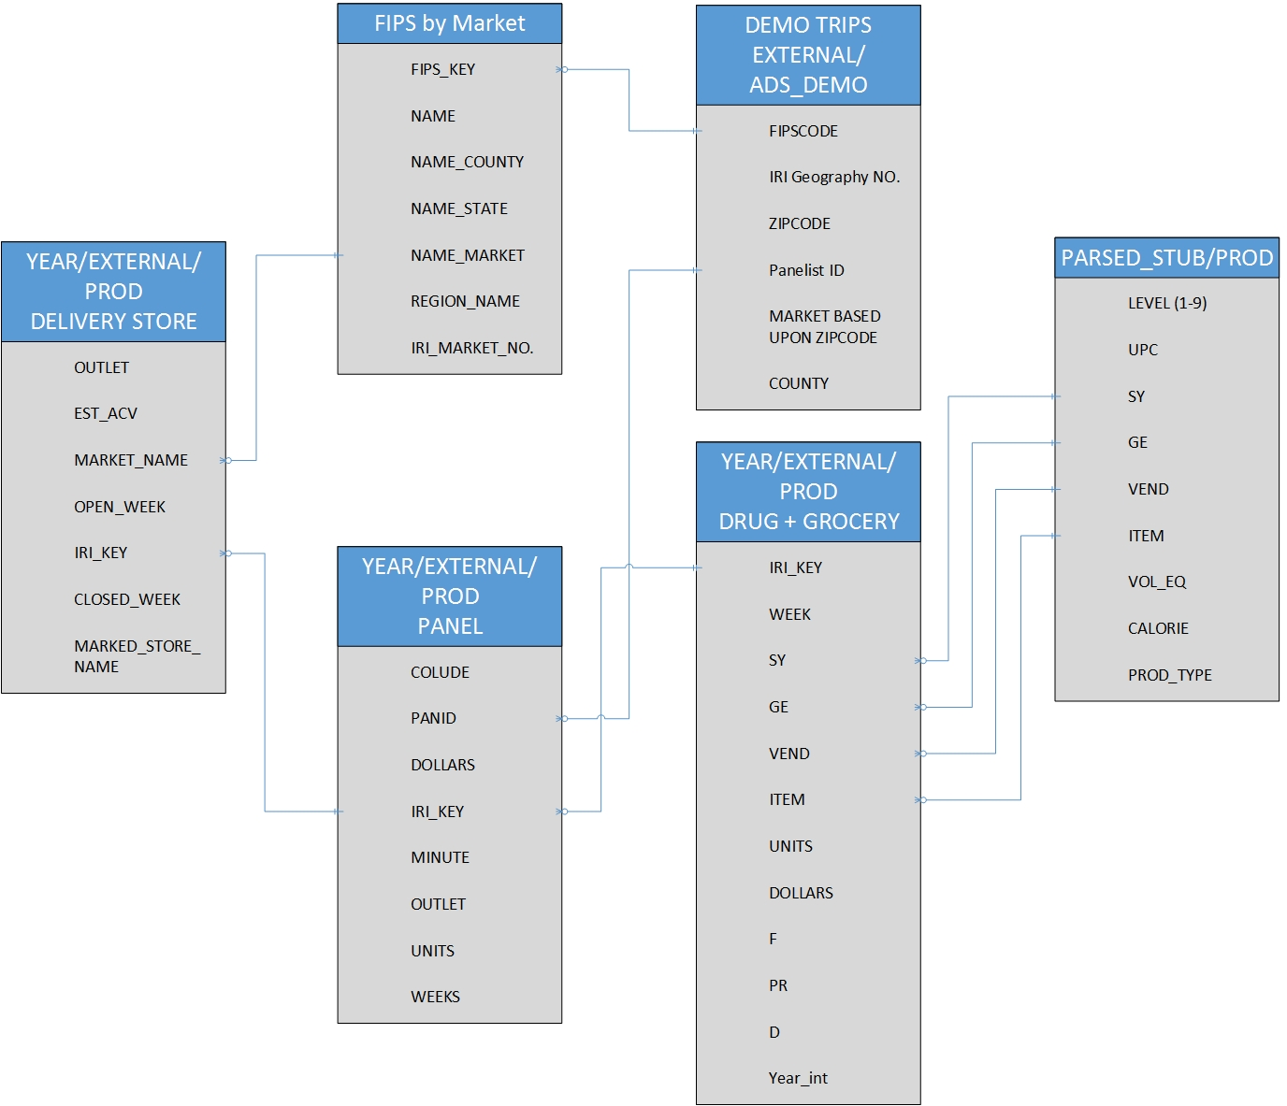
Data Description
Store Descriptors
US County Codes (FIPS)
Panelist Demographics
Panelist Sales
Store Sales Data
Product Descriptors
Relationships between various Data Categories
Notes:
A big component of data was

Slide 9
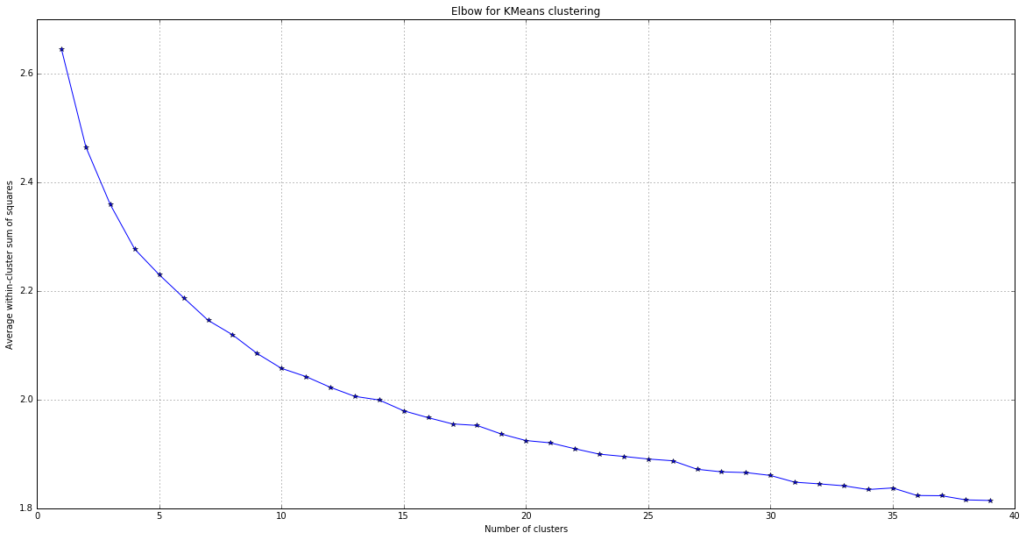
Panelists Demographics Mini-CRISP
Business Understanding:
Can we predict who purchases yogurt?
Data Understanding:
K-Means Clustering used to categorize panelists into market groups
12 Clusters were identified
Unable to achieve stable clustering
Elbow Curve for K-Means Clustering
Average within Cluster Sum of Squares
Number of Clusters

Slide 10
Panelists Demographics Mini-CRISP
Data Preparation:
Not all panelists were yogurt consumers. Merged panelist transactions with products table to identify those panelists who were yogurt consumers and those that were not.
Modeling:
Random Forrest Classification
Features selected from panelist demographic data.
Label is either panelist purchases yogurt or they do not
Model Accuracy 75% after parameter tuning
Evaluation:
10-fold Cross validation was 58% (+/- 7%)
Top 5 Features:
Has a TV
Has Cable
Family Size
Number of Dogs
Number of Cats

Slide 11
Sales Promotions Mini-CRISP
Business Understanding:
Can we predict the success of a sales promotion?
Data Understanding:
Promotion Success = Sales during the week where an advertisement, display or price reduction was run are more than one standard deviation from the mean
Sales Promotions | Percentage of Successful Weeks
Large advertisement | 36%
Medium Advertisement | 33%
Advertisement with Retailer Coupon | 50%
Any Advertisement | 38%
Minor Display | 31%
Major Display | 47%
Any Display | 43%
Price Reduction | 29 %

Slide 12
Panelists Demographics Mini-CRISP
Data Preparation:
Calculate the mean weekly sales for each product in each store. Identify those weeks with successful promotions
Modeling:
Important features were the various sales promotion fields. Attempts to improve model by incorporating product attributes, store attributes, price, outlet, time of year were unsuccessful
Random Forrest Classification
Label was successful promotion or not
Grid Search Parameter Tuning
Evaluation:
10 fold cross validation
Model Accuracy 78%

Slide 13
Geography, Products, Sales Date Data Exploration
The team examined yogurt product attributes, stores geography and sales dates for potential modeling
C?
Data Understanding:
K-Means Clustering used to categorize panelists into market groups
12 Clusters were identified
Unable to achieve stable clustering
Elbow Curve for K-Means Clustering
Average within Cluster Sum of Squares
Number of Clusters

Slide 14
Unit Sales Prediction CRISP
Business Understanding:
Can we predict next week yogurt sales?
Data Understanding:
The team examined yogurt product attributes, stores geography and sales dates for underlying sales trends
Identified trends include:
States with higher mean yogurt sales than others
Drop in yogurt sales during fall and winter months

Slide 15
Unit Sales Prediction CRISP
Data Preparation:
Merge multiple datasets that were identified as contributors to yogurt sales
Modeling:
Two Modeling Methods were used: Classification and Regression
Regression
Build model that predicts the weekly unit sales
Lasso, Ridge and SVR
Feature selection and parameter tuning performed
Classification
Build model that predicts wither next week’s sales will be higher than national mean
Random Forrest, SVC
Feature selection and parameter tuning performed

Slide 16
Unit Sales Prediction CRISP
Evaluation:
Regression
Despite feature selection and parameter tuning efforts, attempts to build a regression model were unsuccessful
Only 44% Maximum Accuracy Achieved
Classification
Model | Random Forest | Linear SVC
Score | 80%+ | 72%+
10 Fold CV | Unstable | Stable

Slide 17
Conclusion
Project Results:
Predict the impact of new promotions on future sales
Explore the driving demographics in yogurt sales
Understanding geographic sales trends
Prediction of future sales

