Slide 1
Team Froyo
Megan McCarty, Julius Remigio, Ryan Riopelle, Syed Nazrul, Michael Galarnyk

Slide 2
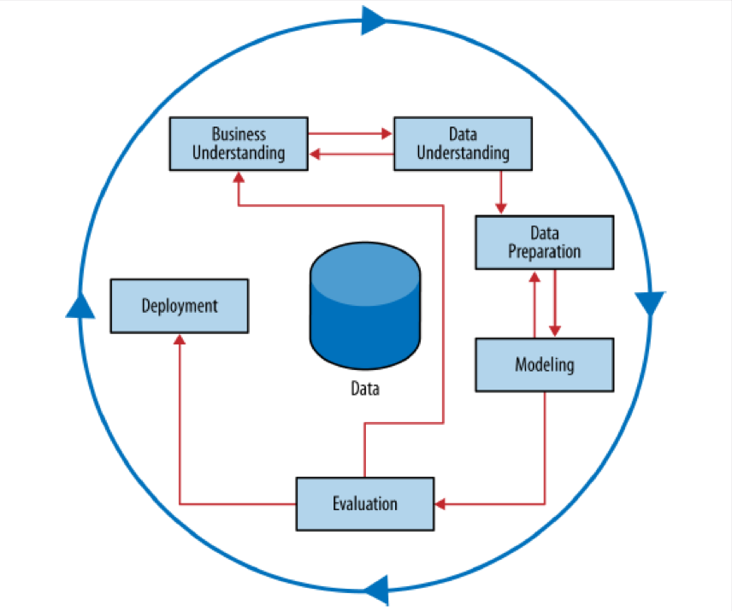
Methodology
Cross Industry Standard Process for Data Mining (CRISP-DM)
CRISP Data Mining Process

Slide 3
Business Understanding
Data Understanding
Data Preparation
Modeling
Evaluation
Deployment
Business Understanding
Objectives
Data Mining Goals
Project Plan
Assess Situation

Slide 4
Objective
Analyze the IRI Marketing Dataset in an effort to identify trends and influential features in the sale of yogurt. Develop the capability for proactive evaluation of marketing resources through the use of predictive modeling
Desired Capability:
Predict the impact of new promotions on future sales
Allow focused marketing by identify the driving demographics in yogurt sales
Aid inventory decision by understanding geographic sales trends
Predictions of future sales to inform better business decisions

Slide 5
Assess Situation
IRI Marketing Data Set
Dataset containing store sales and consumer panel data for 30 product categories.
Enables modeling of important economic and marketing metrics for companies and policy makers.
Yogurt Relevant Data
Consumer Demographic Data (Demos)
Drug and Grocery Stores
Consumer Panelist Data
Delivery Stores
Resources
Used h5 files due to
Skillset of team (not SQL experts) and manageability (1.8 GB compressed)
Many of benefits of database without requiring use of external resources such as a server
Works directly with Pandas
Python Machine Learning Packages
Risks and Contingencies
Size of grocery store data was too large for personal laptop RAM. We used representative samples.
Unable to link all keys between tables so performed analysis on subsets that could be merged. Analysts accepted potential information loss as small risk
IRI data my not accurately represent the markets for which data is provided and may skew some of our conclusions.
Scikit-learn can’t handle categorical data well which we mitigated by binary encoding.

Slide 6
Data Mining Goals
Primary Goal: Discover underlying trends in the data that can be used to build a predictive model
Stores
Promotions
Panelists
Products
Prove that the promotions, displays and/or price reductions has a statistically significant impact on sales
Identify panelists demographics that contribute to higher yogurt sales
Identify single or combinations of yogurt attributes that tend to sell better or worse
Determine if there exists geographic trends in the sales data
Time Series
Determine if there exists daily, weekly, monthly or yearly sales patterns

Slide 7
Project Plan
ETL
ID and Review data files needed for analysis
Clean, Merge and Consolidate data by type and similarity
Store cleanse data in H5 file for analysis
Mini-CRISP
Perform a smaller CRISP on each data element
Data Understanding, Data Preparation and Modeling
Integrate
Improve smaller models by merging data sets and exploiting Mini-CRISP provided insights
Incorporate outside data to improve models
Merge
Build a larger sales model utilizing all previously work
Create useful Metadata to track lineage
CRISP-DM

Slide 8
Business Understanding
Data Understanding
Data Preparation
Modeling
Evaluation
Deployment
Data Understanding
Initial Data Collection
Explore Data
Verify Data Quality
Describe Data

Slide 9
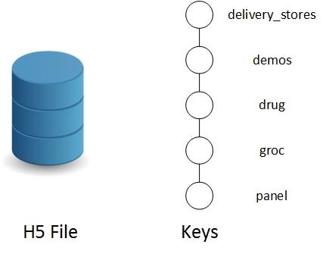
Big D. Challenges
Disparity
Similar files distributed over various folders
Different version of similar data
Different file formats and headers
Volume
140 GB Uncompressed ➞ 1.8 GB Compressed
141,394,709 rows just for grocery yogurt sales
Variety
3,649 files ➞ 1 file
Demographics, Panelists, Trips, Stores, Sales, Products, etc.
Organization of Single H5 File

Slide 10
Data Exploration – Demographics Random
Can we predict who will purchase yogurt?
Yes, Accuracy: 0.58 (+/- 0.07)
Cross Validated
Top 5 Features:
Has a TV
Has Cable
Family Size
Number of Dogs
Number of Cats

Slide 11
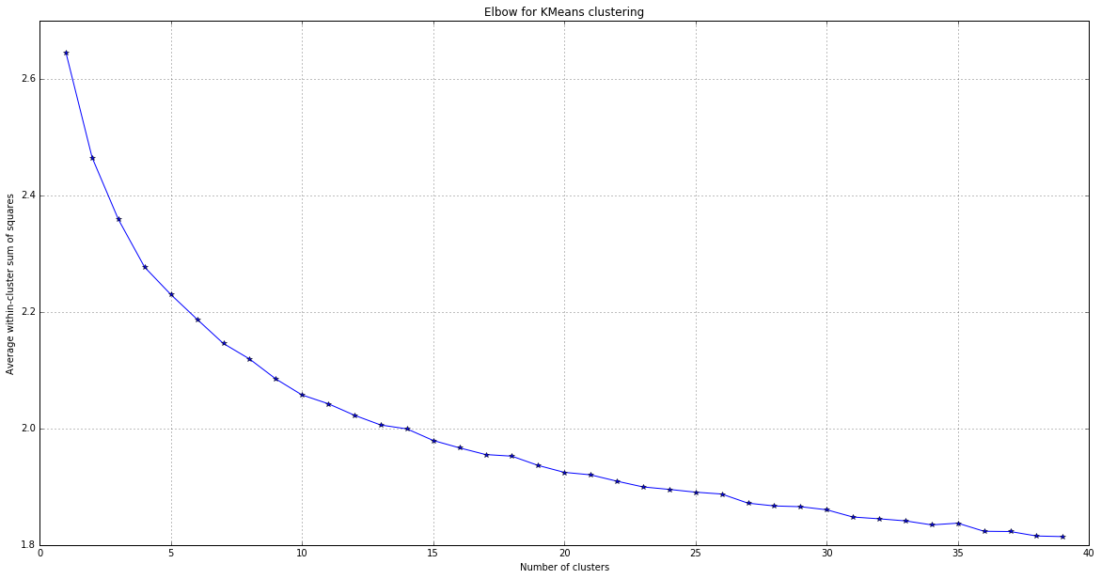
Data Exploration – Demographics K-Means
K-Means
Elbow Curve for K-Means Clustering
Can we identify groups of people who purchase yogurt?
Identified 12 clusters
Clusters were not stable
Average within Cluster Sum of Squares
Number of Clusters

Slide 12
Data Exploration – Data Preparation random
Demographic info about panelists
74,592 samples
8 features
11 files
Panelist purchases
1,609,107 samples
32 features
33 files
Product features – UPCs and product descriptors
16,475 samples
22 features
3 files

Slide 13
Data Exploration – Data Preparation K-Means
Demographic info about panelists
74,592 samples
8 features
11 files
Panelist purchases
1,609,107 samples
32 features
33 files

Slide 14
Data Quality – Issues with Data Preparation (random forest)
Demographics data
Inconsistent headers across multiple files had to be mapped
1st two years of data had many features with missing data
Standardized features had to be mapped back to nominal descriptors
Multiple versions of panelists with different demographics
Many similar columns, i.e. TV, Education
Panelist Purchases for Yogurt
Not all transactions contained a yogurt purchase
Product Features
Only used to verify yogurt purchases

Slide 15
Data Quality – Data Preparation K-Means
Cleaned and merged source files, handle missing values
Ignored 1st two years of demographic data
Dropped samples with NaN
Feature Engineering
Binarized nominal data
Normalized numeric data
Joined Panelist and Demo data
K-Means with 12 clusters
Applied cluster labels onto dataset
Grouped dataset by cluster and identified most prevelant features

Slide 16
Data Quality – Data Preparation
Cleaned and merged source files, handle missing values
Ignored 1st two years of demographic data
Feature Engineering
Binarized nominal data
Normalized numeric data
Combined data sets
Created Labels for classification
Identified who did and did not purchase yogurt
Use Random Forest to build model

Slide 17
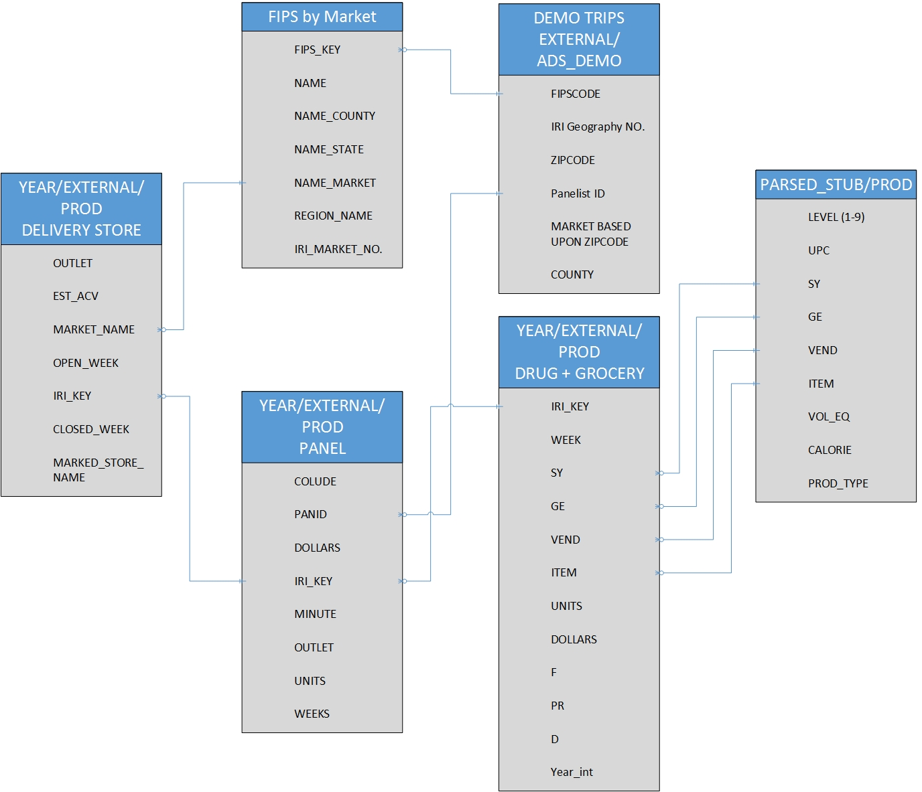
Data Description
Store Descriptors
US County Codes (FIPS)
Panelist Demographics
Panelist Sales
Store Sales Data
Product Descriptors
Relationships between various Data Categories
Notes:
A big component of data was

Slide 18
Data Exploration
Everyone:
Basic summary statistics for the different types of data
Just create your own slide and I will organize later

Slide 19
Data Exploration Sales Promotions
Are sales advertisements, displays and price reductions successful?
Sales Promotions | Percentage of Successful Weeks
Large advertisement | 36%
Medium Advertisement | 33%
Advertisement with Retailer Coupon | 50%
Any Advertisement | 38%
Minor Display | 31%
Major Display | 47%
Any Display | 43%
Price Reduction | 29 %
”Success” = Sales during the week a promotion/display/price reduction was run is more than 1 standard deviation from the mean.

Slide 20
Data Preparation Sales Promotions
To facilitate modeling in sklearn, binary encoded the advertisement and display categorical data fields
Merged IRI Week Converter files to obtain the calendar week, month and year of each sale.
Calculated the mean and standard deviation of weekly sales for each store/product pair. Then created binary promotion sales “success” label.
Merge drug store and grocery store data. Then added two new binary columns to indicate outlet of the record

Slide 21
Data Preparation Products
Identified which product attributes where more than 50% of the records had missing data. Removed these from model consideration and accepted the potential information loss.
To facilitate modeling in sklearn, binary encoded categorical data fields

Slide 22
Data Quality
Everyone
Issues with the data (i.e. missing fields, incorrect UPCs, data deviated from IRI documentation descriptions, etc)

Slide 23
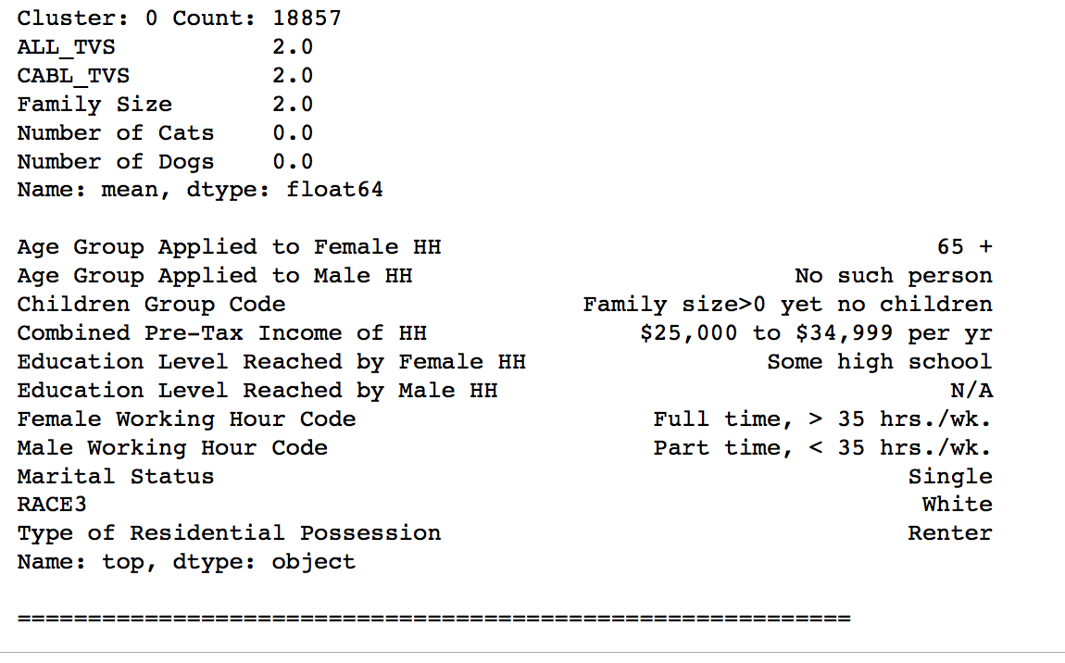
Data Quality – Data Preparation K-Means
Sample cluster:

Slide 24
Everyone: Create your own slides for this section, covering all of the bullet points. I will organize later
Business Understanding
Data Understanding
Data Preparation
Modeling
Evaluation
Deployment
Data Preparation
Selection
Feature Engineering
Data Integration (merge)
Cleaning

Slide 25
Megan, Julius and Sadat: Create your own slides for this section, covering all of the bullet points. I will organize later
Business Understanding
Data Understanding
Data Preparation
Modeling
Evaluation
Deployment
Modeling
Select Modeling Techniques
Model Tuning
Feature Selection

Slide 26
Modeling Predict Sales Promotion Success
Random Forrest Classifier
Features: binary encoded advertisement, display and price reduction fields
Label: Promotion was successful or Not (binary)
Parameters tuned using GridSearchCV: number of estimators and max depth
10-fold Cross Validation: 78% Accuracy
Attempt to increase model prediction capability by integrating other data elements were unsuccessful.
Other elements considered and rejected: product attributes, store geography, time of year, price

Slide 27
Modeling Predict Units Sold
Per the project plan, analysts attempted to incorporate influential data entities into a single sales prediction model.
LASSO, RIDGE and SVR regression models were attempted to predict unit sales utilizing multiple of our identified influential data elements
Modeling attempts were unsuccessful, best accuracy was only 43.84%

Slide 28
Assumptions Sadat
Annual sales were similar every year. Hence, only data before 2007 was used.
The sample of randomly selected 10,000 rows of grocery data is representative of the entire dataset

Slide 29
Feature Engineering Sadat
D (Display) was changed to 0 for “no display” and 1 for “display used”.
PR (Price Reduction) was used while F was dropped
Dummy variables were created of product data like fat content, calorie level, type of yogurt and packaging.
Unit Price of each product was calculated Formula: DOLLARS / UNITS
Population and Median Household Income of each state was added to our dataset. Binarized the columns by setting 1 for above median value and 0 for below.
Units sold per week binarized to 1 for more than 11 units sold and 0 for below. This will be our label for classification.

Slide 30
Feature Selection Sadat
518 in our model after feature engineering
L1 penalty or Lasso was used for feature selection
34 out of 518 features were selected

Slide 31
Models Sadat
Linear SVC
Score 72%+
10-Fold CV: Stable
34 features
Random Forest Classifier
Score : 80%+
10-Fold CV: Unstable
34 features

Slide 32
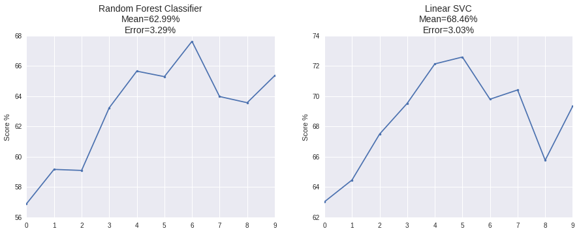
Model Stability Sadat

Slide 33
Megan: Results align with objectives and success criteria
Business Understanding
Data Understanding
Data Preparation
Modeling
Evaluation
Deployment
Evaluation
Review Process
Next Steps
Alignment of results with objectives
Notes:
Quick review of what we have. Model that predicts if a sales promotion will be successful, clustering of demographics,
Compare with objectives we laid out and what we succeeded with and what we didn’t.

Slide 34
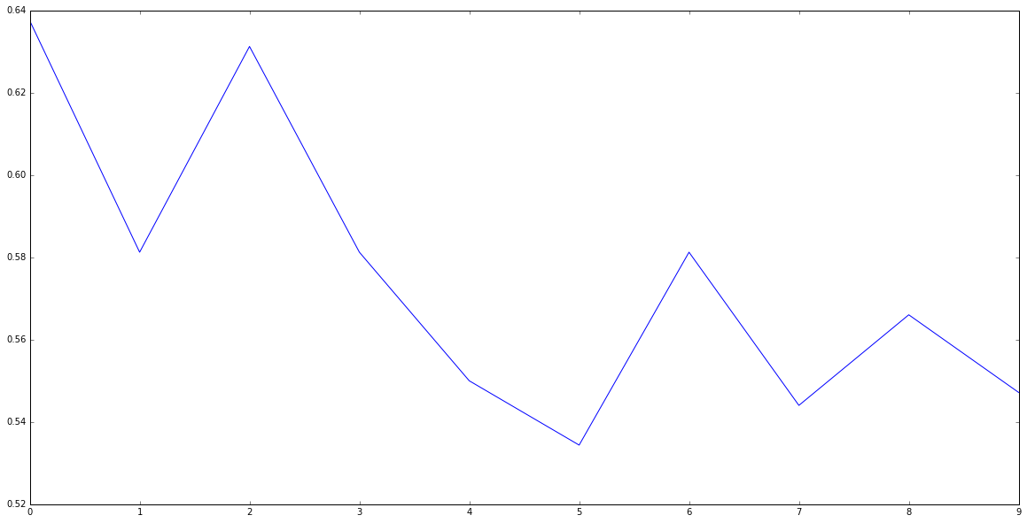
Random Forest Classifier 10k Cross Validation

Slide 35
Megan: How would the business use this?
Business Understanding
Data Understanding
Data Preparation
Modeling
Evaluation
Deployment
Deployment
Business Use

