Slide 1
리눅스/유닉스 소개
Notes:
09/06/09

Slide 2







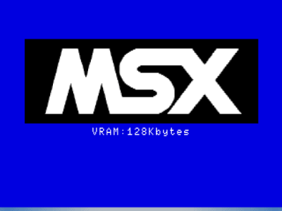

Various Operating Systems
Notes:
09/06/09

Slide 3
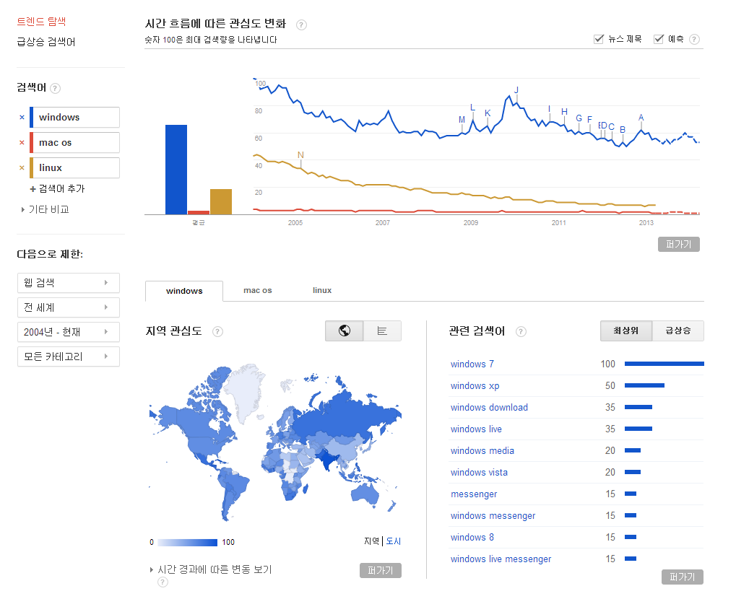
Google Trends
Notes:
09/06/09

Slide 4
UUNIX/Linux Philosophy
Simple, simplicity
A program does one thing
Write programs to work together
Write programs to handle text streams, because that is a universal interface
Doug Mcllroy (1978)

Slide 5
Unix Advantages
Unix can run on virtually any computer (IBM, Sun, Compaq, Macintosh, etc)
Unix is free or nearly free
    Linux/open source software movement
    RedHat, FreeBSD, MKLinux, LinuxPPC, etc.
Unix is very stable
Every program is independent.
Notes:
09/06/09

Slide 6
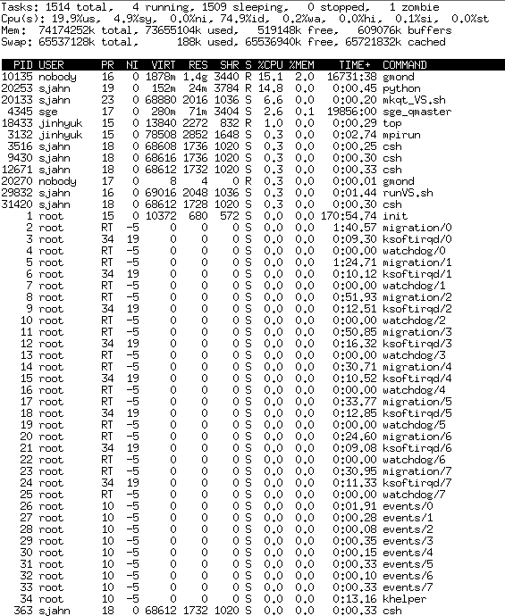
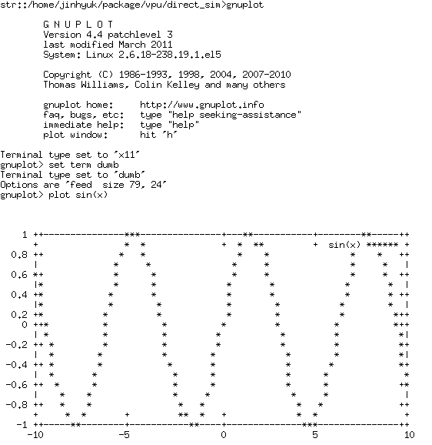
Drawbacks
CUI (Command User Interface)
NOT user-friendly
Difficult to learn, even more difficult to truly master
Notes:
09/06/09

Slide 7
Open Source
Almost all of the bioinformatics software that you need to do complex analyses is free for UNIX computers
The Open Source software ethic is very strong among biologists
  Bioinformatics.org
  Bioperl.org
  Open-bio.org
New algorithms generally appear first as free software (a publication requirement)
Notes:
09/06/09

Slide 8
Free Software
Linux operating system, MySQL database
Perl - programming language
Blast and Fasta - similarity search
Clustal - multiple alignment
Phylip - phylogenetics
Phred/Phrap/Consed - sequence assembly and SNP detection
EMBOSS - a complete sequence analysis package created by the EMBL (like GCG)
Gooooooooogling !!!!
Notes:
09/06/09

Slide 9
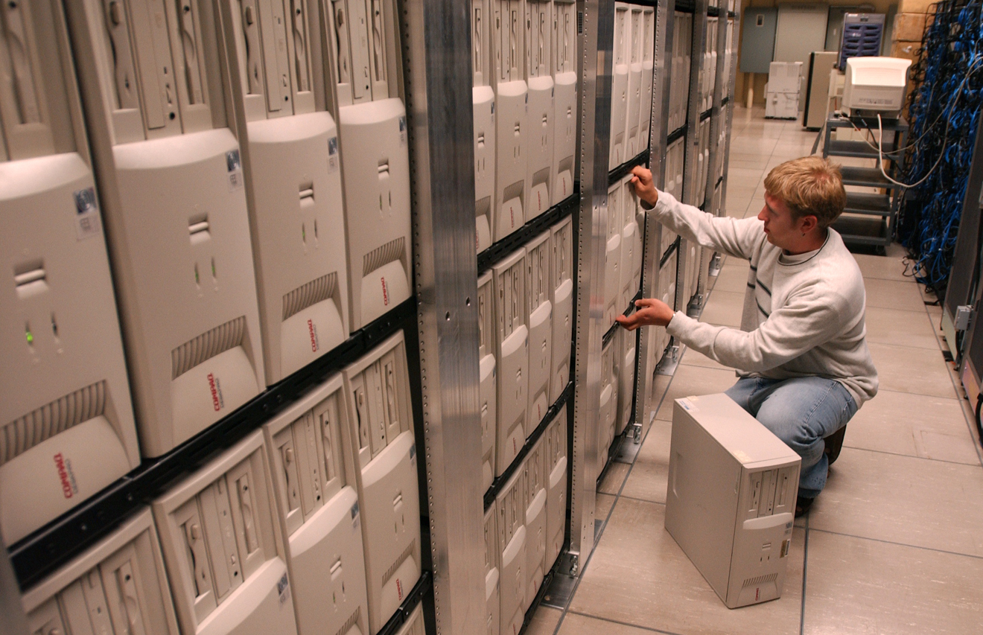
Not Free
Hardware
Server/cluster ~ $20-50K (100 cores)
PC ~ $ 2 K ( 8 cores)
Manpower
Notes:
09/06/09

Slide 10
The Unix Shell
Interpreter
입력: 키보드
다양한 종류의 SHELL
( csh, ksh, tcsh, sh, bash 등)
Shell scripts (순차적 명령어 실행 모음 파일)
Notes:
09/06/09

Slide 11
Unix Commands
Unix commands are short and cryptic like
vi or rm.
    Computer geeks like it that way; you will get used to it
Every command has a host of modifiers which are generally single letters preceded by a hyphen:
ls -l or mv -R
    Capital letters have different functions than small letters, often completely unrelated.
    A command also generally requires an argument, meaning some file on which it will act:
cat -n mygene.seq
Notes:
09/06/09

Slide 12
Wildcards
You can substitute the * as a wildcard symbol for any number of characters in any filename
If you type just * after a command, it stands for all files in the current directory:
lpr * will print all files
You can mix the * with other characters to form a search pattern:
ls a*.txt will list all files that start with “a” and end in “.txt”
The “?” wildcard stands for any single character:
cp draft?.doc will copy draft1.doc, draft2.doc, draftb.doc, etc.
Notes:
09/06/09

Slide 13
Control Characters
You type Control characters by holding down the ‘control’ key while also pressing the specified character
While you are typing a command:
    ctrl-W erases the previous word
    ctrl-U erases the whole command line
Control commands that work (almost) any time
    ctrl-S suspends (halts) output scrolling up on your terminal screen
    ctrl-Q resumes the display of output on your screen
    ctrl-C will abort any program
Notes:
09/06/09

Slide 14
Getting Help in Unix
Unix is not a user-friendly computer system.
  While not actively user-hostile, it is perfectly happy to sit there and taunt you with a blank screen and a blinking > cursor.
There is a rudimentary Help system which consists of a set of "manual” pages for every Unix command
The man pages tell you which options a particular command can take, and how each option modifies the behavior of the command
Type man and the name of a command to read the manual page for that command.
Notes:
09/06/09

Slide 15
> man ls
Reformatting page. Please wait... completed
ls(1) ls(1)
NAME
ls - Lists and generates statistics for files
SYNOPSIS
ls [-aAbcCdfFgilLmnopqrRstux1] [file...|directory...]
STANDARDS
Interfaces documented on this reference page conform to industry standards
as follows:
ls: XPG4, XPG4-UNIX
Refer to the standards(5) reference page for more information about indus-
try standards and associated tags.
OPTIONS
-a Lists all entries in the directory, including the entries that begin
with a . (dot). Entries that begin with a . are not displayed unless
you refer to them specifically, or you specify the -a option.
-A [Compaq] Lists all entries, except . (dot) and .. (dot-dot). If you
issue the ls command as the superuser, it behaves as if you specified
this option.
-b [Compaq] Displays nonprintable characters in octal notation.
-c Uses the time of last inode modification (file created, mode changed,
and so on) for sorting when used with the -t option. Displays the time
of last inode modification (instead of the time at which the file's
contents were last modified) when used with the -l option. This option
has effect only when used with either -t or -l or both.
manaacsba (10%)
Notes:
09/06/09

Slide 16
Unix Filenames
Unix is cAsE sEnsItiVe
UNIX filenames contain only letters, numbers, and the _ (underscore), . (dot), and - (dash) characters
Unix does not allow two files to exist in the same directory with the same name.
    Whenever a situation occurs where a file is about to be created or copied into a directory where another file has that exact same name, the new file will overwrite (and delete) the older file.
    Unix will generally alert you when this is about to happen, but it is easy to ignore the warning.
Notes:
09/06/09

Slide 17
Filename Extensions
Most UNIX filenames start with a lower case letter and end with a dot followed by one, two, or three letters: myfile.txt
    However, this is just a common convention and is not required.
    It is also possible to have additional dots in the filename
The part of the name following the dot is called the “extension.”
The extension is often used to designate the type of file.
Notes:
09/06/09

Slide 18
Some Common Extensions
By convention:
  files that end in .txt are text files
  files that end in .c are source code in the "C” language
  files that end in .html are HTML files for the Web
  Compressed files have the .zip or .gz extension
Unix does not require these extensions (unlike Windows), but it is a sensible idea and one that you should follow
Notes:
09/06/09

Slide 19
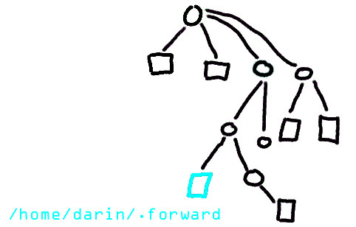
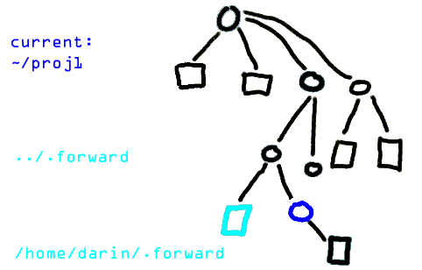
Files and Directories:
Naming something gives you power over it.
Absolute Addressing (절대경로)
Addressing relative to your current dir. (상대경로)
Notes:
09/06/09

Slide 20
Your Home Directory
When you login to the server, you always start in your Home directory
Create sub-directories to store specific projects or groups of information, just as you would place folders in a filing cabinet
Do not accumulate thousands of files with cryptic names in your Home directory
~/
/home/darin
Notes:
09/06/09

Slide 21
File & Directory Commands
This is a minimal list of Unix commands that you must know for file management:
ls (list) mkdir (make directory)
cd (change directory) rmdir (remove directory)
cp (copy) pwd (present working directory)
mv (move) more (view by page)
rm (remove) cat (view entire file on screen)
All of these commands can be modified with many options. Learn to use Unix ‘man’ pages for more information.
Notes:
09/06/09

Slide 22
Navigation
pwd (present working directory) shows the name and location of the directory where you are currently working: > pwd
/u/browns02
      This is a “pathname,” the slashes indicate sub-directories
      The initial slash is the “root” of the whole filesytem
ls (list) gives you a list of the files in the current directory: > ls
assembin4.fasta Misc test2.txt
bin temp testfile
  Use the ls -l (long) option to get more information about each file
> ls -l
total 1768
drwxr-x--- 2 browns02 users 8192 Aug 28 18:26 Opioid
-rw-r----- 1 browns02 users 6205 May 30 2000 af124329.gb_in2
-rw-r----- 1 browns02 users 131944 May 31 2000 af151074.fasta
Notes:
09/06/09

Slide 23
Sub-directories
cd (change directory) moves you to another directory
>cd Misc
> pwd
/u/browns02/Misc
mkdir (make directory) creates a new
sub-directory inside of the current directory > ls
assembler phrap space
> mkdir subdir
> ls
assembler phrap space subdir
rmdir (remove directory) deletes a sub-directory, but the sub-directory must be empty
> rmdir subdir
> ls
assembler phrap space
Notes:
09/06/09

Slide 24
Shortcuts
There are some important shortcuts in Unix for specifying directories
    . (dot) means "the current directory"
    .. means "the parent directory" - the directory one level above the current directory, so cd .. will move you up one level
    ~ (tilde) means your Home directory, so cd ~ will move you back to your Home.
      Just typing a plain cd will also bring you back to your home directory
Notes:
09/06/09

Slide 25
Unix File Protections
File protection (also known as permissions) enables the user to set up a file so that only specific people can read (r), write/delete (w), and execute (x) it
Write and delete privilege are the same on a Unix system since write privilege allows someone to overwrite a file with a different one.
Notes:
09/06/09

Slide 26
File Owners and Groups
Unix file permissions are defined according to ownership. The person who creates a file is its owner.
    You are the owner of files in your Home directory and all its sub-directories
In addition, there is a concept known as a Group.
    Members of a group have privileges to see each other's files.
    We create groups as the members of a single lab - the students, technicians, postdocs, visitors, etc. who work for a given PI.
Notes:
09/06/09

Slide 27
View File Permissions
Use the ls -l command to see the permissions for all files in a directory:
> ls -l
drwxr-x--- 2 browns02 users 8192 Aug 28 18:26 Opioid
-rw-r----- 1 browns02 users 6205 May 30 2000 af124329.gb_in2
-rw-r----- 1 browns02 users 131944 May 31 2000 af151074.fasta
  The username of the owner is shown in the third column. (The owner of the files listed above is browns02)
  The owner belongs to the group “users”
The access rights for these files is shown in the first column. This column consists of 10 characters known as the attributes of the file: r, w, x, and -
r indicates read permission
w indicates write (and delete) permission
x indicates execute (run) permission
- indicates no permission for that operation
Notes:
09/06/09

Slide 28
> ls -l
drwxr-x--- 2 browns02 users 8192 Aug 28 18:26 Opioid
-rw-r----- 1 browns02 users 6205 May 30 2000 af124329.gb_in2
-rw-r----- 1 browns02 users 131944 May 31 2000 af151074.fasta
The first character in the attribute string indicates if a file is a directory (d) or a regular file (-)
The next 3 characters (rwx) give the file permissions for the owner of the file
The middle 3 characters give the permissions for other members of the owner's group
The last 3 characters give the permissions for everyone else (others)
The default protections assigned to new files on our system is: -rw-r----- (owner=read and write,
group =read, others=nothing)
Notes:
09/06/09

Slide 29
Change Protections
Only the owner of a file can change its protections
To change the protections on a file use the chmod (change mode) command
[Beware, this is a confusing command.]
  First you have to decide for whom you will change the access permissions:
        the file owner (u)
        the members of your group (g)
        others (o) (ie. anyone with an RCR account)
  Next you have to decide if you are adding (+), removing (-), or setting (=) permissions.
Taken all together, it looks like this:
> chmod u=rwx g+r o-x myfile.txt
This will set the owner to have read, write, and execute permission;
add the permission for the group to read;
and remove the permission for others to execute the file named myfile.txt.
Notes:
09/06/09

Slide 30
Commands for Files
Files are used to store information, for example, data or the results of some analysis.
  You will mostly deal with text files
  Files on the RCR Alpha are automatically backed up to tape every night
cat dumps the entire contents of a file onto the screen.
  For a long file this can be annoying, but it can also be helpful if you want to copy and paste (use the buffer of your telnet program)
Notes:
09/06/09

Slide 31
more
Use the command more to view at the contents of a file one screen at a time:
> more t27054_cel.pep
!!AA_SEQUENCE 1.0
P1;T27054 - hypothetical protein Y49E10.20 - Caenorhabditis elegans
Length: 534 May 30, 2000 13:49 Type: P Check: 1278 ..
1 MLKKAPCLFG SAIILGLLLA AAGVLLLIGI PIDRIVNRQV IDQDFLGYTR
51 DENGTEVPNA MTKSWLKPLY AMQLNIWMFN VTNVDGILKR HEKPNLHEIG
101 PFVFDEVQEK VYHRFADNDT RVFYKNQKLY HFNKNASCPT CHLDMKVTIP
t27054_cel.pep (87%)
  Hit the spacebar to page down through the file
  “b” moves back up a page
  At the bottom of the screen, more shows how much of the file has been displayed
Notes:
09/06/09

Slide 32
Copy & Move
cp lets you copy a file from any directory to any other directory, or create a copy of a file with a new name in one directory
    cp filename.ext newfilename.ext
    cp filename.ext subdir/newname.ext
    cp /u/jdoe01/filename.ext ./subdir/newfilename.ext
mv allows you to move files to other directories, but it is also used to rename files.
  Filename and directory syntax for mv is exactly the same as for the cp command.
    mv filename.ext subdir/newfilename.ext
  NOTE: When you use mv to move a file into another directory, the current file is deleted.
Notes:
09/06/09

Slide 33
Delete
Use the command rm (remove) to delete files
There is no way to undo this command!!!
  We have set the RCR server to ask if you really want to remove each file before it is deleted.
  You must answer “Y” or else the file is not deleted.
> ls
af151074.gb_pr5 test.seq
> rm test.seq
rm: remove test.seq? y
> ls
af151074.gb_pr5
Notes:
09/06/09

Slide 34
getting recursive
remove a directory and its contents:
rm -r <directory>
copy a directory and its contents:
cp -r <directory>
Notes:
09/06/09

Slide 35
(un)aliasing
create shortcuts for yourself
~>alias ll “ls -la”
Use alias with no arguments to discover current aliases
~>alias
rm rm -i
ll ls -la
Type “unalias rm” to remove alias.
Notes:
09/06/09

Slide 36
PATH: a very important shell variable
>echo $PATH
/home/d/da/darin/bin:/opt/local/bin:/opt/local/bin/pbmutils:/usr/bin:/usr/sbin:/opt/SUNWspro/bin:/usr/ccs/bin:/opt/local/X11/bin:/usr/dt/bin:/usr/openwin/bin:/opt/local/gnu/bin:/opt/local/games/bin:/usr/ucb:./
If a program (like ls) is in one directory found in your path, then typing it (~>ls <enter>) will execute it.
Otherwise you can type the full absolute address to execute a program (~>/usr/bin/ls <enter>)
Notes:
09/06/09

Slide 37
finding things in your PATH.
Type “which <command>” to find the location of the program which would be run when you type <command>.
If you don’t remember if it was chgrp or chgroup, type “ch<control-d> or <tab>” to get a list of commands that starts with ch.
when all else fails, use “find” to find a file.
~>find <start dir> -name “*.doc”
Notes:
09/06/09

Slide 38
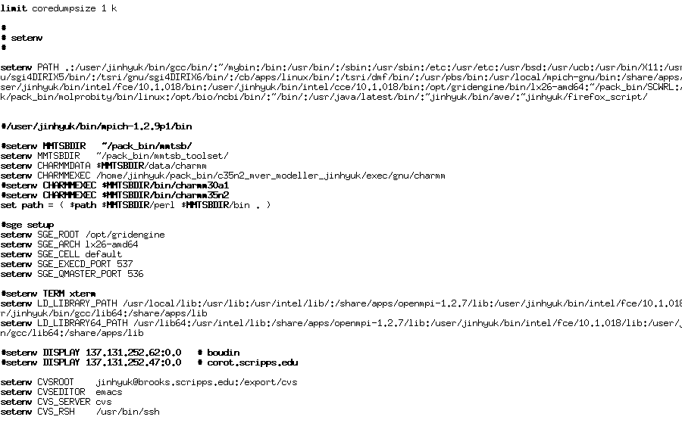
Login scripts
Most people have a script that executes when they log in. It is commonly used to set up one’s PATH and aliases.
~/.cshrc (csh or tcsh) ~/.bashrc (bash) ~/.login
Notes:
09/06/09

Slide 39
using secure copy: scp
copy local to remote
scp <source file> user@machine:<path>
copy remote to local
scp user@machine:<path> <source file>
Notes:
09/06/09

Slide 40
STD*
All terminal programs have:
  standard output, which is usually your screen
  standard input, which is usually your keyboard
  standard error, which is also the screen
Notes:
09/06/09

Slide 41
redirect output to a file with >
If you type who at the prompt, you will get a list of who is logged into the system.
If you type who >f, a file named f will be created and the standard output of who will be placed in that file instead of to your screen.
Notes:
09/06/09

Slide 42
> vers >>
By default, who >f will overwrite the file f.
Use who >>f to append to f rather than overwriting it.
Notes:
09/06/09

Slide 43
redirecting input from a file with <
The program sort will sort its standard input and then print it on standard out.
To sort the lines of file1 and display:
sort < file1
To sort the lines of file1 and save in file2:
sort < file1 > file2
Notes:
09/06/09

Slide 44
The output of one program can be the input to another.
who | sort
The output of who is sorted and shown on your terminal screen.
Notes:
09/06/09

Slide 45
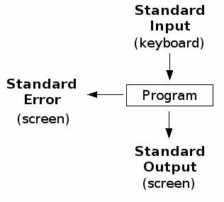
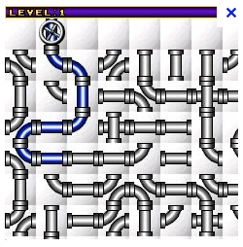
COMMAND (명령어)
PIPE (파이프)

Slide 46
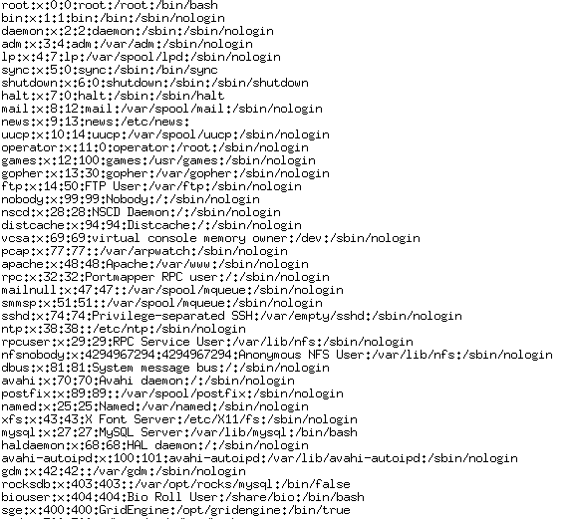

cat /etc/passwd | grep -i "tcsh" | awk -F: '{print $1}' | sort

Slide 47
grep
grep shows only those lines containing its search pattern.
To see all lines in a file containing ‘bob’:
grep ‘bob’ < file1
Notes:
09/06/09

Slide 48
The cat command
the arguments to cat are concatenated together and displayed on stdout. To view a file:
cat file1
if no arguments, cat puts on stdout whatever you type on stdin, so this does the same thing:
cat < file1
Notes:
09/06/09

Slide 49
To start a process in the background, use “&”.
example:
big_program > output &
big_program will not have input!
Notes:
09/06/09

Slide 50
managing jobs
To suspend the currently active program, use <control-z>.
To return to the program you just suspended, type “fg”
To put the program you just suspended in the background, type “bg”
Notes:
09/06/09

Slide 51
To see a list of your programs running, type “ps”.
>ps
PID TTY TIME CMD
866 pts/1 00:00:00 tcsh
872 pts/1 00:00:00 ps
Notes:
09/06/09

Slide 52
use kill to end a process
>ps
PID TTY TIME CMD
866 pts/1 00:00:00 tcsh
874 pts/1 00:00:00 cat
875 pts/1 00:00:00 ps
>kill 874
[1] Terminated cat
Notes:
09/06/09

Slide 53
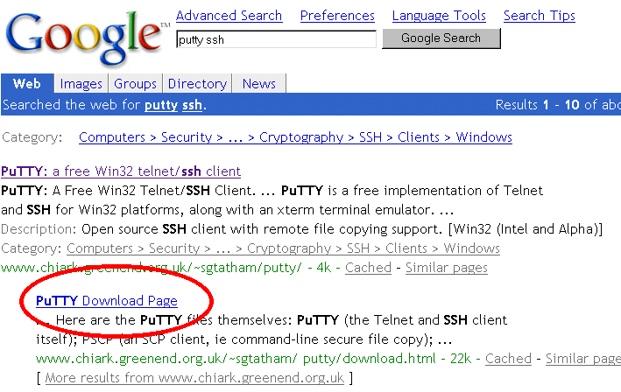
서버 접속 프로그램
Notes:
09/06/09

Slide 54
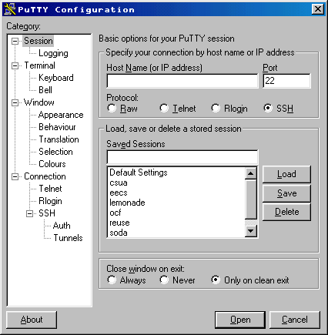
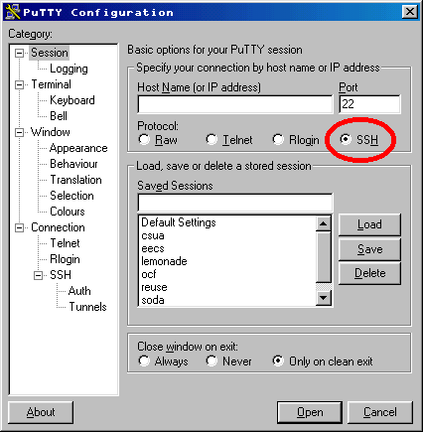
Notes:
09/06/09

Slide 55
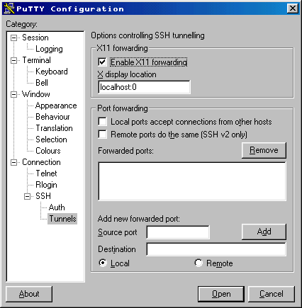
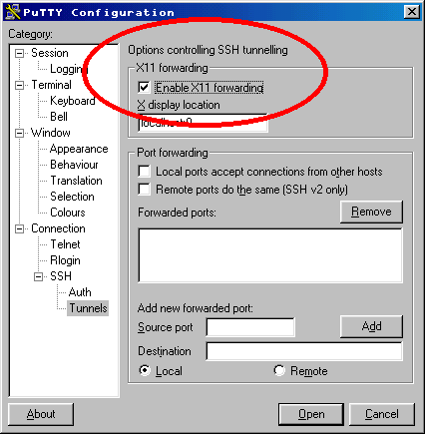
Notes:
09/06/09

Slide 56
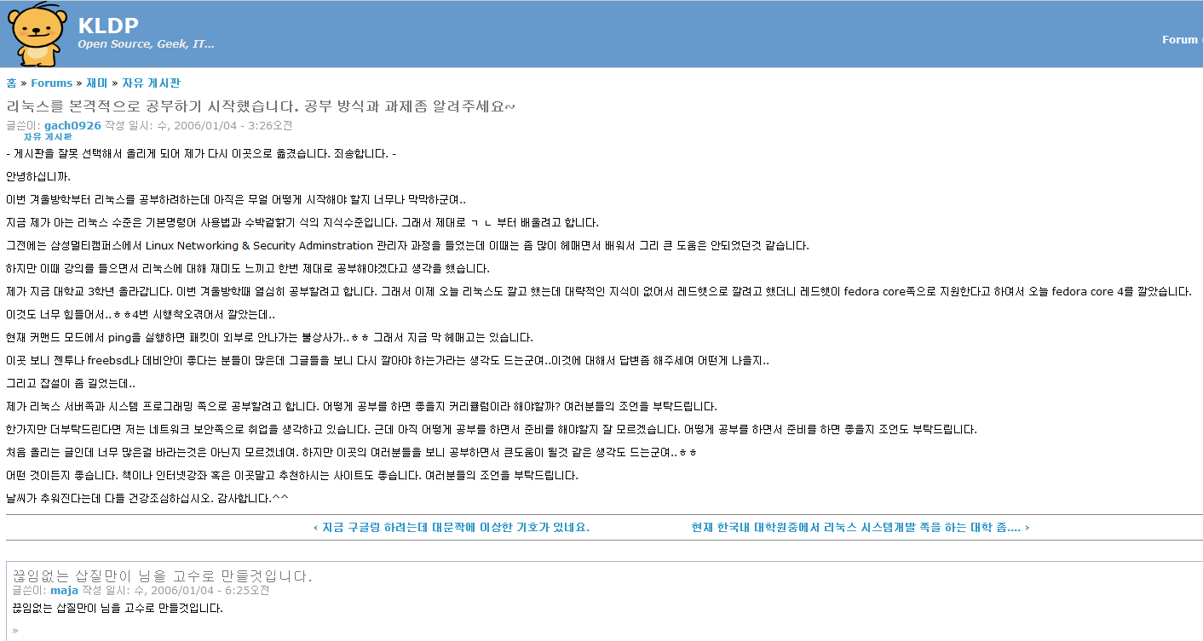

Slide 57
UNIX/LINUX 명령어 정리

Slide 58
Linux Commands
Linux File Management and Viewing
File and Directory management
cd Change the current directory. With no arguments "cd" changes to the users home directory. (cd <directory path>)
chmod Change the file permissions.
Ex: chmod 751 myfile : change the file permissions to rwx for owner, rx for group and x for others
Ex: chmod go=+r myfile : Add read permission for the group and others (character meanings u-user, g-group, o-other, + add permission,-remove,r-read,w-write,x-exe)
Ex: chmod +s myfile - Setuid bit on the file which allows the program to run with user or group privileges of the file.
Notes:
09/06/09

Slide 59
Linux Commands
Linux File Management and Viewing
chown Change owner.
Ex: chown <owner1> <filename> : Change ownership of a file to owner1.
chgrp Change group.
Ex: chgrp <group1> <filename> : Change group of a file to group1.
cp Copy a file from one location to another.
Ex: cp file1 file2 : Copy file1 to file2
Ex: cp –R dir1 dir2 : Copy dir1 to dir2
Notes:
09/06/09

Slide 60
Linux Commands
Linux File Management and Viewing
ls List contents of a directory.
Ex: ls, ls –l , ls –al, ls –ld, ls –R
(-rwxrwxr-x 1 juan juan 0 Sep 26 12:25 foo )
|more will list page wise
mkdir Make a directory.
Ex: mkdir <directory name> : Makes a directory
Ex mkdir –p /www/chache/var/log will create all the directories starting from www.
mv Move or rename a file or directory.
Ex: mv <source> <destination>
Notes:
09/06/09

Slide 61
Linux Commands
Linux File Management and Viewing
find Find files (find <start directory> -name <file name> -print)
Ex: find /home –name readme -print
(Search for readme starting at home and output full path.)
“/home" = Search starting at the home directory and proceed through all its subdirectories
"-name readme" = Search for a file named readme
"-print" = Output the full path to that file
locate File locating program that uses the slocate database.
Ex: locate –u to create the database,
locate <file/directory> to find file/directory
Notes:
09/06/09

Slide 62
Linux Commands
Linux File Management and Viewing
pwd Print or list the present working directory with full path.
rm Delete files (Remove files). (rm –rf <directory/file>)
rmdir Remove a directory. The directory must be empty. (rmdir <directory>)
touch Change file timestamps to the current time. Make the file if it doesn't exist. (touch <filename>)
whereis Locate the binary and man page files for a command. (whereis <program/command>)
which Show full path of commands where given commands reside. (which <command>)
Notes:
09/06/09

Slide 63
Linux Commands
Linux File Management and Viewing
File viewing and editing
emacs Full screen editor.
pico Simple text editor.
vi Editor with a command mode and text mode. Starts in command mode.
gedit GUI Text Editor
tail Look at the last 10 lines of a file.
Ex: tail –f <filename> ,
Ex: tail -100 <filename>
head Look at the first 10 lines of a file. (head <filename>)
Notes:
09/06/09

Slide 64
Linux Commands
Linux File Management and Viewing
File compression, backing up and restoring
compress Compress data.
uncompress Expand data.
cpio Can store files on tapes. to/from archives.
gzip - zip a file to a gz file.
gunzip - unzip a gz file.
tar Archives files and directories. Can store files and directories on tapes.
Ex: tar -zcvf <destination> <files/directories> - Archive copy groups of files. tar –zxvf <compressed file> to uncompress
zip – Compresses a file to a .zip file.
unzip – Uncompresses a file with .zip extension.
Notes:
09/06/09

Slide 65
Linux Commands
Linux File Management and Viewing
cat View a file
Ex: cat filename
cmp Compare two files.
cut Remove sections from each line of files.
diff Show the differences between files.
Ex: diff file1 file2 : Find differences between file1 & file2.
echo Display a line of text.
Notes:
09/06/09

Slide 66
Linux Commands
Linux File Management and Viewing
grep List all files with the specified expression.
(grep pattern <filename/directorypath>)
Ex: ls –l |grep sidbi : List all lines with a sidbi in them.
Ex: grep " R " : Search for R with a space on each side
sleep Delay for a specified amount of time.
sort Sort a file alphabetically.
uniq Remove duplicate lines from a sorted file.
wc Count lines, words, characters in a file. (wc –c/w/l <filename>).
Notes:
09/06/09

