Slide 1


Team XYZ
Smart Tech - Challenge 4 Malware Hunt

Slide 2
Team Members
Wooyeon Jo
Muhammad Ahsan
Muhammad Shahryar Yaqub

Slide 3
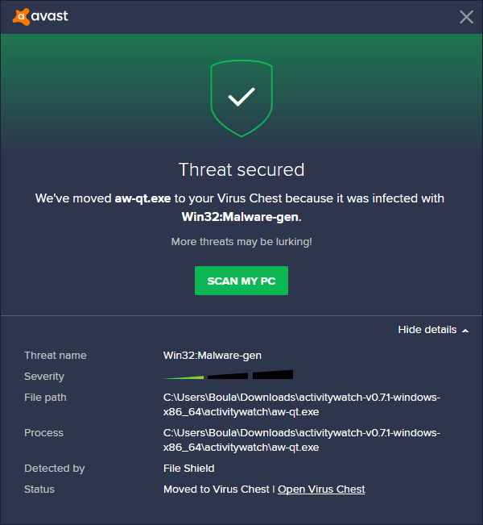
Problem Statement
Current scanning tools provide limited information to the end user. Giving options like delete/quarantine infected files etc.
Create a plugin that would generate useful insights strengthening the existing system.
Making a more user-focused experience with insights to help familiarize them to take well-informed action against the malware.

Slide 4
Solution - Image-based Malware classifier
Detect and classify malware
Use code block analysis and heuristics to generate comprehendible malware images.
Automatically generate user-friendly malware report

Slide 5


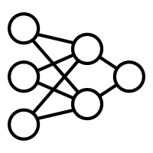



Classification Framework
Malware Dataset
Bin to Image
Dataset Training
Malicious file
Bin to Image
Trained Model
Prediction
Classifier
Malware Type

Slide 6
CNN model
Data Preprocessing
Binary Converted to grayscale image file
Each image is fragmented
Model Configuration
Conv2D layer with 32 filters is used to extract features from the images.
MaxPooling2D layer reduces the size of the images.
Flatten layer converts the 2D array to a 1D array.
Dense layers are used to create the neural network, with 'relu' activation function.
The output layer corresponds to the number of classes and uses the 'softmax' activation function to output probability values.
Data augmentation
Data augmentation techniques such as shifting, shearing is applied / rotation, zooming, and horizontal flipping are SKIPPED. (Because we are handling a program binaries)
Model Compilation
The model is compiled using the 'adam' optimizer and 'sparse_categorical_crossentropy' loss function.

Slide 7
Classification Results
Model Training
Dataset – 8 types of malwares [1,2]
No of files – 100 +
Each malware image is fragmented to size (64,64)
The batch size is set to 64, and training is conducted for 5-10 epochs.
We reduced the number of epochs due to limited time and resources available for training
Model Evaluation:
The model is evaluated using the test data (20% randomly chosen).
Testing Accuracy > 80% (In Literature > 95% [3])
[1] https://github.com/Endermanch/MalwareDatabase
[2] https://github.com/cryptwareapps/Malware-Database
[2] S. Tobiyama, Y. Yamaguchi, H. Shimada, T. Ikuse and T. Yagi, "Malware Detection with Deep Neural Network Using Process Behavior," 2016 IEEE 40th Annual Computer Software and Applications Conference (COMPSAC), Atlanta, GA, USA, 2016, pp. 577-582, doi: 10.1109/COMPSAC.2016.151.

Slide 8
Code Block analysis
Worm
Trojan
Key Logger
Ransomware
Decompile the binary file
Analyze using heuristics to identify code segments with different behavior.
Label these segments and generate a dataset for each category.
Test the incoming file for the presence of each malware category/
For example, if there is malware with worm and keylogger capability the file would be automatically labeled by the trained ML model.
Post-process the image with the predicted labels and color code it.
Virus

Slide 9
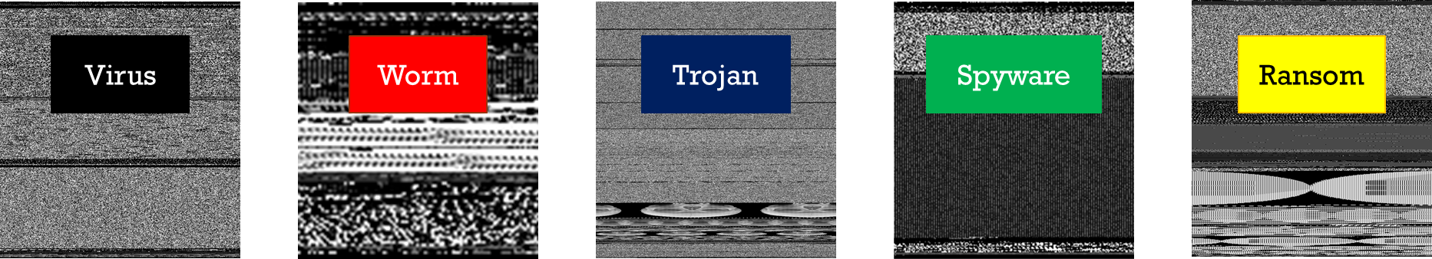



CBA image generation
Analyzed Malwares In DB
Malware Image
Coded Image
Heuristics

Slide 10
Proof of concept - Classifier based on CNN
CNN-based classification based on multiple malware types
80% training, 20% testing
3 case studies
3-class classification on largest dataset
Worm, Trojan, Ransomware (389,050 image frags)
Valid Accuracy: 88.1%
5-class classification on typical malwares
Virus, Worm, Trojan, Ransomware, Spyware (417,322 frags)
Valid Accuracy: 82.1%
5-class classification including prankware type malwares
Trojan, Ransomware, Rogue, Jokes, Enderware (471,195 frags)
Valid Accuracy: 86.7%

Slide 11
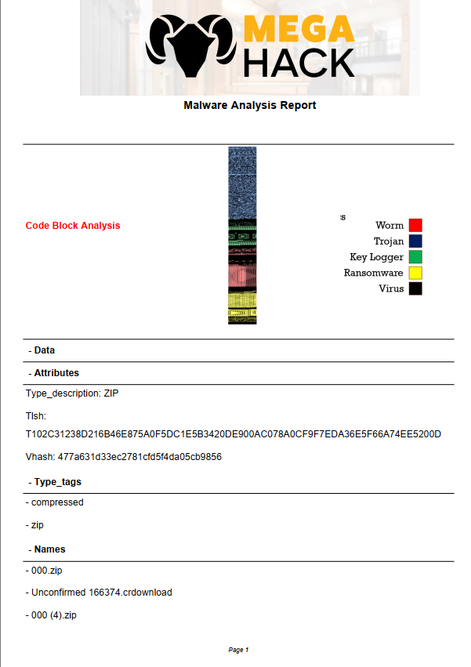
Malware Report
The Automated Script generate a detailed malware report
The report includes details such as
CBA generated image
Detection Ratio
Multiple Antivirus Results
File Hashes
File Characteristics
Community feedback
Behavioral Analysis
Historical Data

Slide 12

Goals
 | Goals
 | Enhance malware detection
 | Malware location
 | Develop heuristics
 | Classify Malware
 | Automate Reporting
 | Integration with current tools
 | Scalability

Slide 13
Deliverables
Code file for malware classifier
Python script to automatically generate the report
Detailed project report

Slide 14




