Slide 1

AAF Analyzer Overview
September 2007 Update
Jim Trainor
AMW Association

Slide 2
AAF Analyzer Overview
AAFRequirements.xml encodes
requirements extracted from:
AAF Object Spec. 1.1
AAF Edit Protocol
Test coverage report documenting which requirements are covered by test implementations.
AAFAnalyzer
AAF File
AAF File test results reported against requirements.
The AAFAnalyzer tests an AAF file to determine how closely it follows the Edit Protocol. Results are reported against a set of requirements encoded in an xml file. The analyzer reports which requirements are covered by test implementations to help manage development as the analyzer itself, and the requirements, evolve.

Slide 3
Analyzer Processing Outline
Read AAFRequirements.xml
Read all objects in the AAF and store in a tree structure representing object containment.
Resolve source references. Insert edges between objects in the containment tree to represent references. The data structure is now directed graph.
Verify the graph is acyclic, and perform a dependency analysis to identify unreferenced Composition Mob objects.
The data structure now ready for more detailed test execution.

Slide 4
Analyzer Processing Outline
Example tests:
  Visit all SourceMob objects and verify that their names are valid and unique within the file.
  Visit all OperationGroup objects and verify the effect is defined by the Edit Protocol.
  Visit all TimelineMobSlot objects and verify the edit rate is one of those specified by the Edit Protocol
  Verify mob dependency chains by parsing each chain starting at each unreferenced CompositinoMob.
Etc, etc, until all testable requirements are covered.

Slide 5
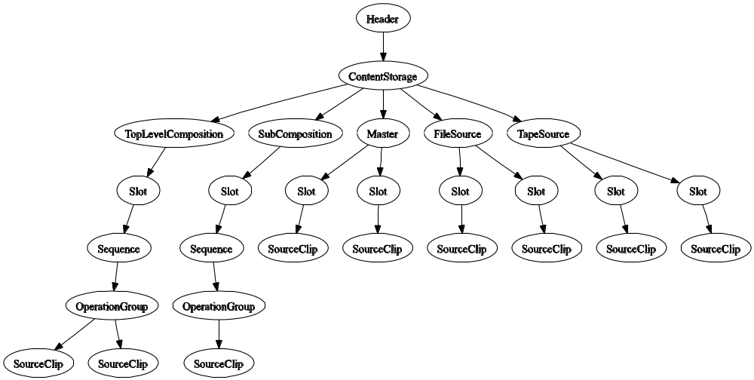
AAF Object Containment Tree
First processing step: read entire file and build tree of contained objects.
Dump the tree of contained object starting at the header with the command: AAFAnalyzer –dump header file.aaf

Slide 6
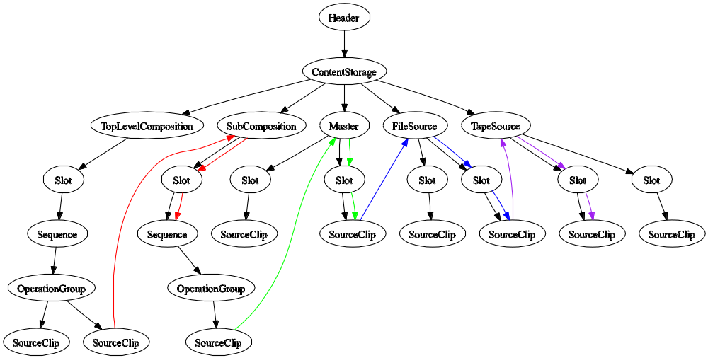
Reference Edges Added
Second step: resolve source references by adding “reference” edges. The resulting graph is analyzed to ensure it is acyclic and to identify unreferenced Composition Mob objects..
Zero valued (end of chain) and unresolved (out of file) source references are identified at this point.
Dump the top level compositions, including resolved references, using the command: AAFAnalyzer –dump comp file.aaf

Slide 7
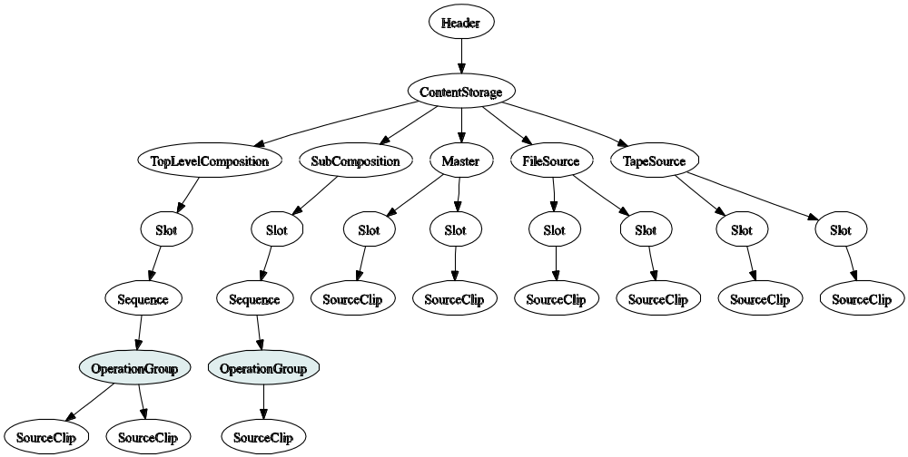
Visit Objects to Implement Tests
- Visited Objects
Tests are implemented by performing traversals over this tree and visiting objects of the desired type(s).
Simple tests don’t care about reference information and can operate on the object containment tree alone.
For example, a test can traverse the tree and only visit the OpererationGroup objects to verify effect definitions and parameters.

Slide 8
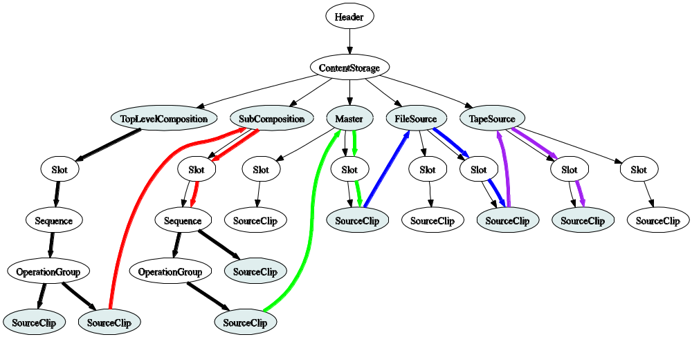
Tests Can Follow Source References
- Visited Objects
- Traversed Edges
The analyzer’s core code makes it easy for a test to traverse only contained objects, or contained and referenced objects, as is appropriate. Test implementations choose the traversal type and which objects to visit.
For example, the mob derivation chain parser test starts at the unreferenced composition Mob objects and traverses the graph of referenced objects visiting Mob and SourceClip objects to verify that the derivation chains are correctly ordered and terminated.

Slide 9
Requirements
Test results are reported against requirements extracted from the AAF Edit Protocol specification, and to a lesser extent from the AAF Object Model 1.1 specifcation.
To produce the analyzer, and for the purpose of producing a larger compliance reporting system, the type of requirements expressed in these documents have been classified as follows:
Requirement Type | Description | Example
definition | Defines how a feature of the edit protocol is implemented using the AAF object model. These requirements cannot be tested per se. | “A top-level composition shall be specified using a CompositionMob with Mob::UsageCode property equal to Usage_TopLevel.”, Edit Protocol Section 6.3.
application | Specifies the desired behavior of the application that is importing or exporting an AAF file. These requirements cannot be tested by a file analyzer. They can only be tested in the context of the application. | “Upon import, an Edit Protocol compliant application shall clearly report any alteration to the composition during the [import] process according to fallback behaviors that are described in this document.”, Edit Protocol section 4.2.2.
File | Specifies the content of an AAF file. These requirements can be tested by a file analyzer independent of the application that produced the file. | “A top-level composition shall not be referenced by another Mob in the AAF file.”, Edit Protocol Section 6.3.

Slide 10
Requirements
Individual requirements are encoded in an XML file. The analyzer reads this file and reports test results against these requirements.
Isolating the requirements in this way achieves the following:
  Unambiguous reporting against specific aspects of the specifications.
  Helps ensure the test requirements don’t diverge uncontrollably from the formal specifications.
  Eased ability to encode, track, and report against, new requirements, and modifications to the original requirements, that arise out of necessity over time.
  Improved ability to manage the development of the analyzer (and other compliance reporting tools) to ensure that the tests that are implemented fully cover the requirement set.

Slide 11
Requirements
Example requirement extracted from section 6.3 of the Edit Protocol and encoded in XML:
<requirement type="file" category="compositional”>
<id>REQ_EP_025</id>
<name>Top-level Composition Unreferenced</name>
<desc>A top-level composition shall not be referenced by another Mob in the AAF file.</desc>
<ref>
<doc>&DOC_AAF_EP;</doc>
<version>&VER_EP_1.0;</version>
<section>6.3</section>
</ref>
</requirement>

Slide 12
Requirements
Here is an example of a requirement that arose out an unavoidable need to report an error for a condition that isn’t explicitly described in any specification:
<requirement type="file" category="ad-hoc“ action="reconcile">
<id>REQ_EP_257</id>
<name>Slot Must Exist In Referenced Mob</name>
<desc>A source reference must specify a Slot ID that exists in the referenced Mob.</desc>
<note>This requirement is not explicitly stated by the EP specification or 1.1 object model spec.</note>
</requirement>
Note, the requirement has an attribute action=“reconcile”. This was introduced to track the fact that this requirement must be reconciled with a formal specification.

Slide 13
Annotated Requirements
Some requirements are annotated to reflect an addition to, or clarification of, the original text. The underlying test code supports the annotation. These changes need to be incorporated back into the formal specification. For example:
<requirement type="file" category="compositional" action="reconcile">
<id>REQ_EP_028</id>
<name>Top-Level Composition Contents</name>
<desc>A top-level composition shall contain one or more timecode tracks and include a Primary timecode track. Timecode tracks shall use the MobSlot::PhysicalTrackNumber property to distinguish their type, as shown in Section 6.3 of the AAF Edit Protocol.</desc>
<annotate>Any physical track number from section 6.3 is valid, including the reserved values.</annotate>
<ref>
<doc>&DOC_AAF_EP;</doc>
<version>&VER_EP_1.0;</version>
<section>6.3</section>
</ref>
</requirement>
Annotations that exist currently are as a direct result of the resolution of EP issue tracking items on SourceForge.

Slide 14
Getting The Analyzer
The source code is available in the AAF source tree on SourceForge.
  AAF/Utilities/AAFAnalyzer
Currently not part of the main AAF SDK build. See build instructions here:
  AAF/Utilities/AAFAnalyzer/Doc/INSTALL
  Tested on Windows and Linux.
A prebuilt Windows version is temporarily available here:
  http://www.jptrainor.com/aafanalyzer

Slide 15
Analyzer Sample Output
A developer should run the analyzer from the command line to get a summary report of failures and warnings. For example:
C:\> “c:\Program Files\AAFAnalyzer\AAFAnalyzer.exe” sequence.aaf
FAIL : REQ_EP_101, Essence Track Names
Desc : The MobSlot::Name property shall be a valid name identifying the essence track. Where multiple essence tracks are exported, each shall have a different Name.
Doc : AAF Edit Protocol (2005-04-08) Section 7.5
Reason : MobSlot with ID = 2 named "boxing.avi" in MasterMob named "boxing.avi" is not uniquely named within the mob.
FAIL : REQ_EP_255, Protocol Label
Desc : Header::OperationalPattern should be equal to OpEditProtocol.
Doc : AAF Edit Protocol (2005-04-08) Section 15
Reason : Header::OperationalPattern property is not present.
FAIL : REQ_EP_257, Slot Must Exist In Referenced Mob
Desc : A source reference must specify a Slot ID that exists in the referenced Mob.
Reason : Unable to resolve slot id 256 in the mob named "boxing.avi”.
FAIL : REQ_EP_262, Valid Derivation Chain Termination
Desc : The derivation must have a valid end state.
Reason : File Source "boxing.avi" cannot be the last object in a derivation chain.

Slide 16
Covered File Requirements
The analyzer does only collect and report failure and warning results.
It also collects explicit pass results for every test that passes.
  For example, if a TimelineMobSlot has MarkIn and MarkOut points and MarkOut > MarkIn, it will create a pass result for REQ_EP_108.3 “Marked Region Length”. Else, it will create a fail result for that requirement.
In cases where there is nothing to test we wish to note something about the file contents, the analyzer will create a “noted” result.
  For example, if only MarkIn is present then there is nothing to test. The analyzer will, however, create a test result with status “noted” against REQ_EP_108.1 “Mark IN Position”.

Slide 17
Covered File Requirements
Recording passed and noted results provides the analyzer with the ability to report the features of the edit protocol that are represented by a particular file.
The goal is to provide the capability to collect sets of sample files that are known, through analysis, to cover all Edit Protocol file requirements.
  Or a subset of those requirements that have been identified as relevant to a particular application.
Use the analyzer’s –verbose option to see all results including noted and passed results.

Slide 18
Source Forge EP Tracker
Issues involving the Analyzer itself, and the Edit Protocol specification are tracked on the AAF SourceForge “AAF Analyzer EP Requirements” tracker.
The easiest way to look at these is to sort by descending priority.
  They have been assigned priorities as described by tracker item 1790400 “NOTE: Priority Classification”.
  Errors in the AAFAnalyzer are highest priority, next come missing test implementations, finally come tracking items where the only (remaining) work involves updating a specification document.
To resolve these tracking issues one or both of the following must happen:
  The issue must be resolved in the AAF Analyzer source code (including AAFRequirements.xml file).
  Related specification documents must be updated, and AAFRequirements.xml should be updated to match the spec by incorporating annotations in the the requirement description, and removing the reconcile attribute.
Don’t close a tracking item until both actions have been taken!
  Do modify the tracking item’s priority as progress is made resolving an issue.

