Slide 1
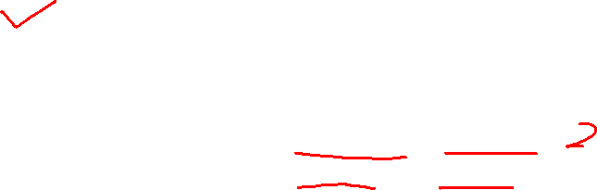
주간업무 내용
2, 4, 5, 7 group energy group structure test
  Group, 반사체 모델에 따라서 general 하게 보정인자가 잘 개선하는 지 확인 하기 위함.
[ 군 구조 ]
2 group (upper, eV) | 4 group (upper, eV) | 5 group (upper, eV) | 7 group (upper, eV)
2.000e+7 | 2.000e+7 | 2.000e+7 | 2.000e+7
 |  | 2.231e+6 | 2.231e+6
 | 9.119e+3 | 9.119e+3 | 9.119e+3
 |  |  | 1.301e+2
 | 3.928e+0 | 3.928e+0 | 3.928e+0
6.251e-1 | 6.251e-1 | 6.251e-1 | 6.251e-1
 |  |  | 1.457e-1
1.000e-4 | 1.000e-4 | 1.000e-4 | 1.000e-4

Slide 2
2 group

Slide 3
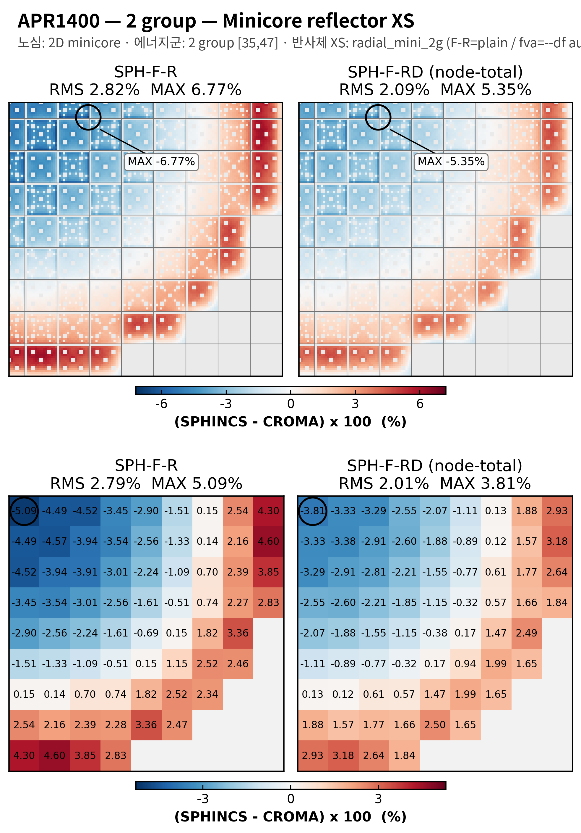
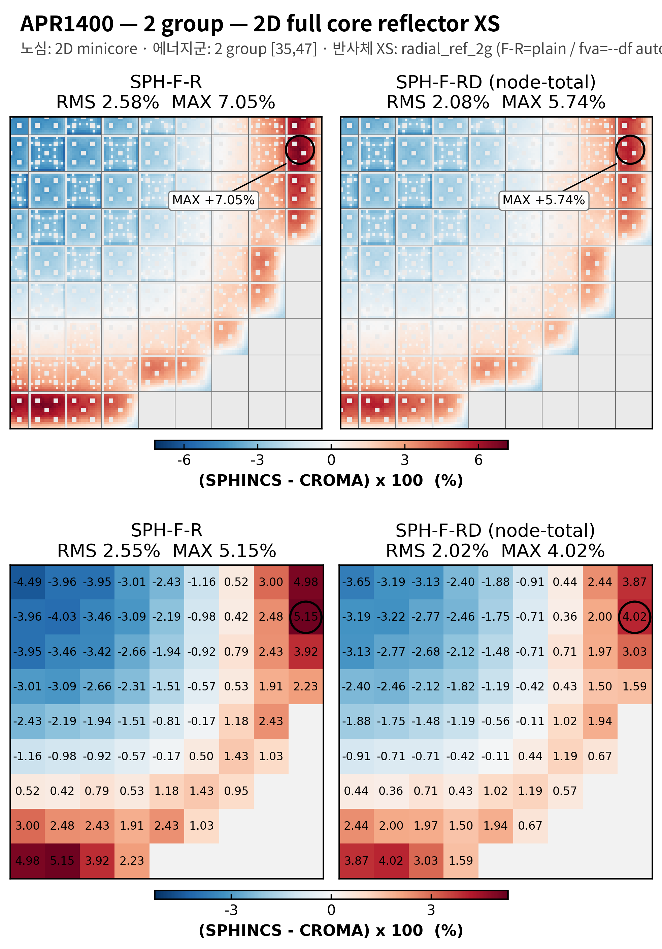
2 group structure test
2D APR1400
APR1400, 2group, minicore reflector XS
APR1400, 2group, 2D full core reflector XS

Slide 4
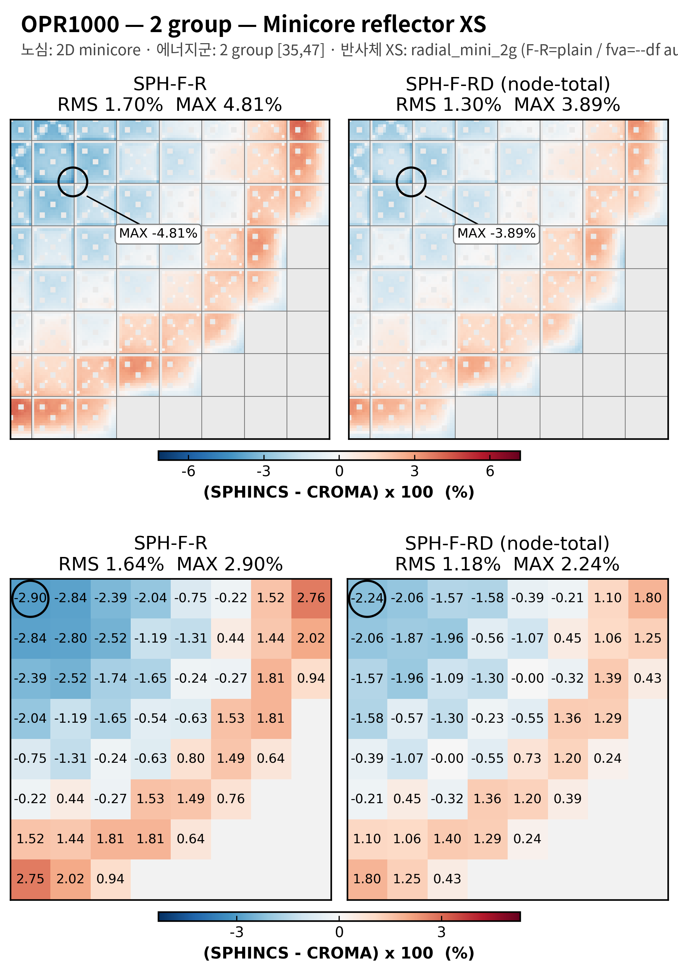
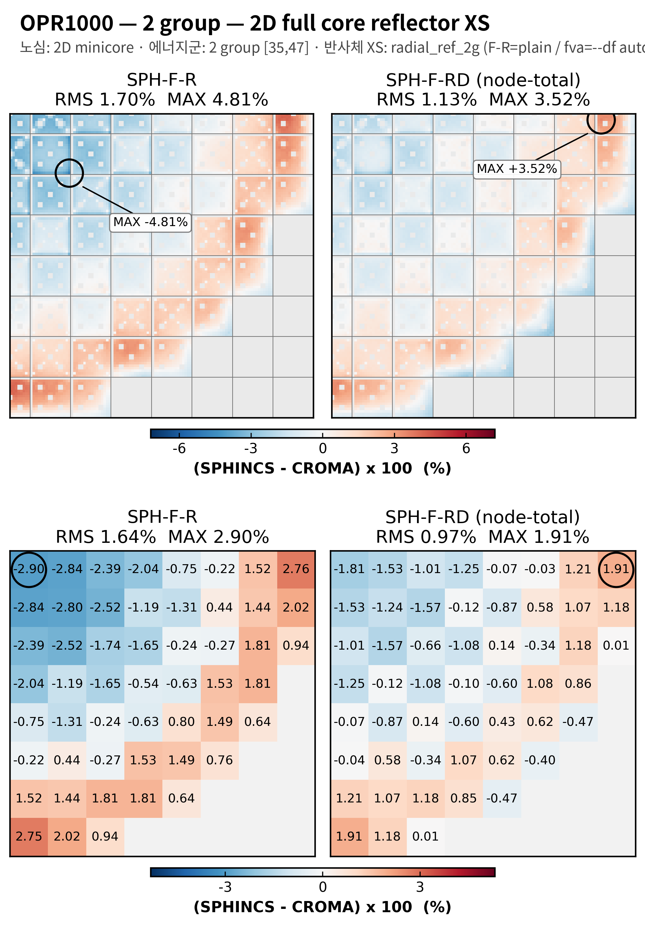
2 group structure test
2D OPR1000
OPR1000, 2group, minicore reflector XS
OPR1400, 2group, 2D full core reflector XS

Slide 5
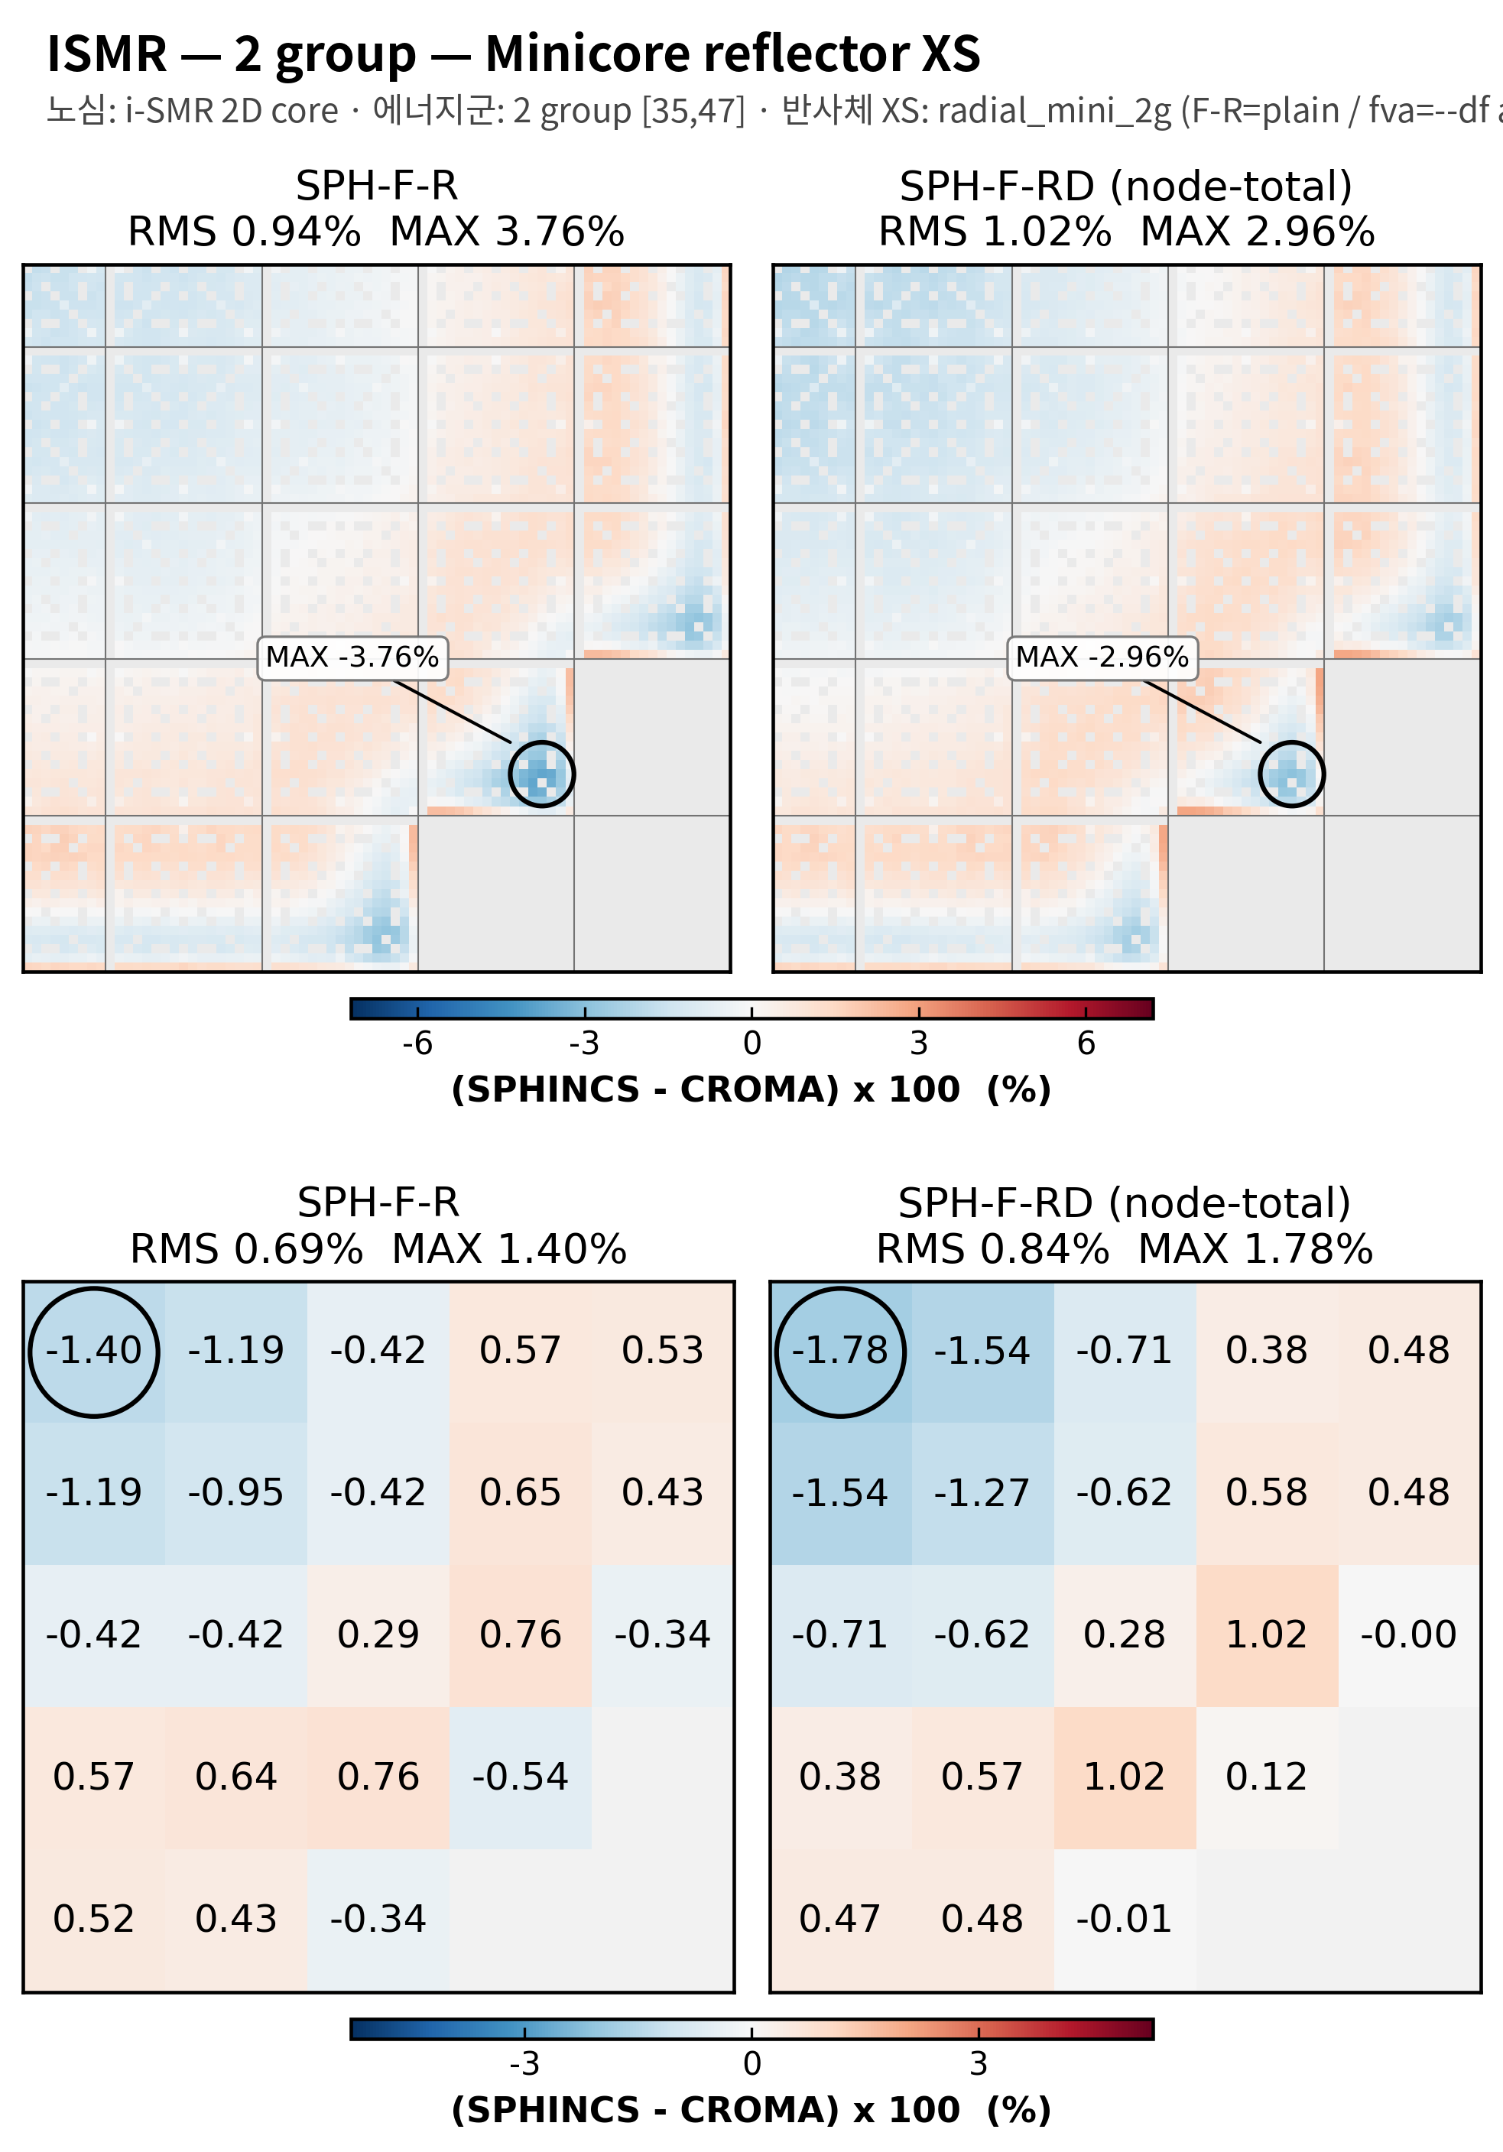
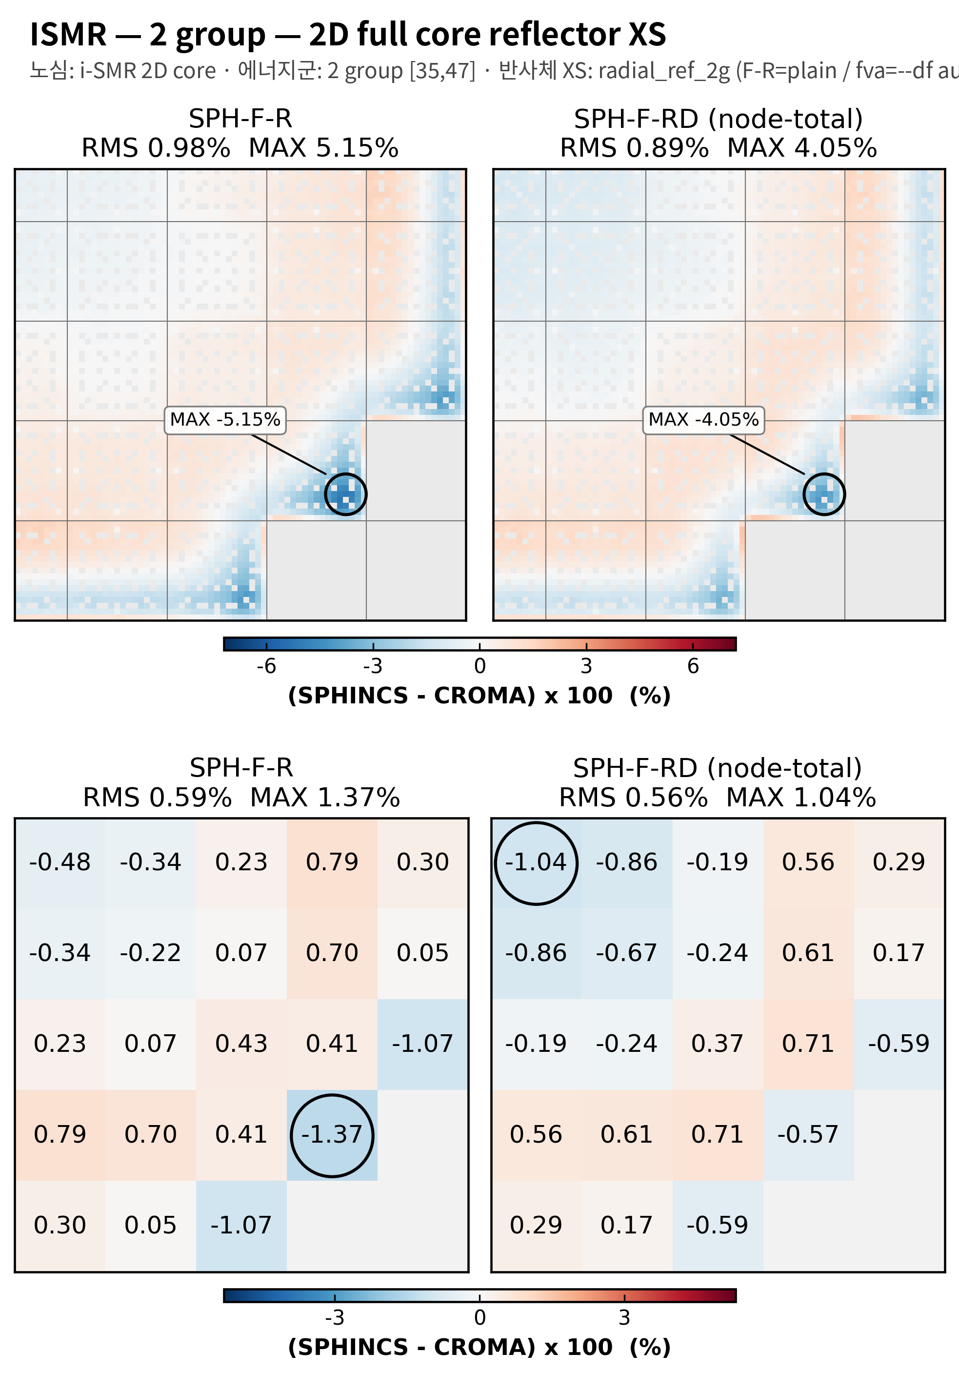
2 group structure test
2D i-SMR
i-SMR, 2group, minicore reflector XS
i-SMR, 2group, 2D full core reflector XS

Slide 6
4 group

Slide 7
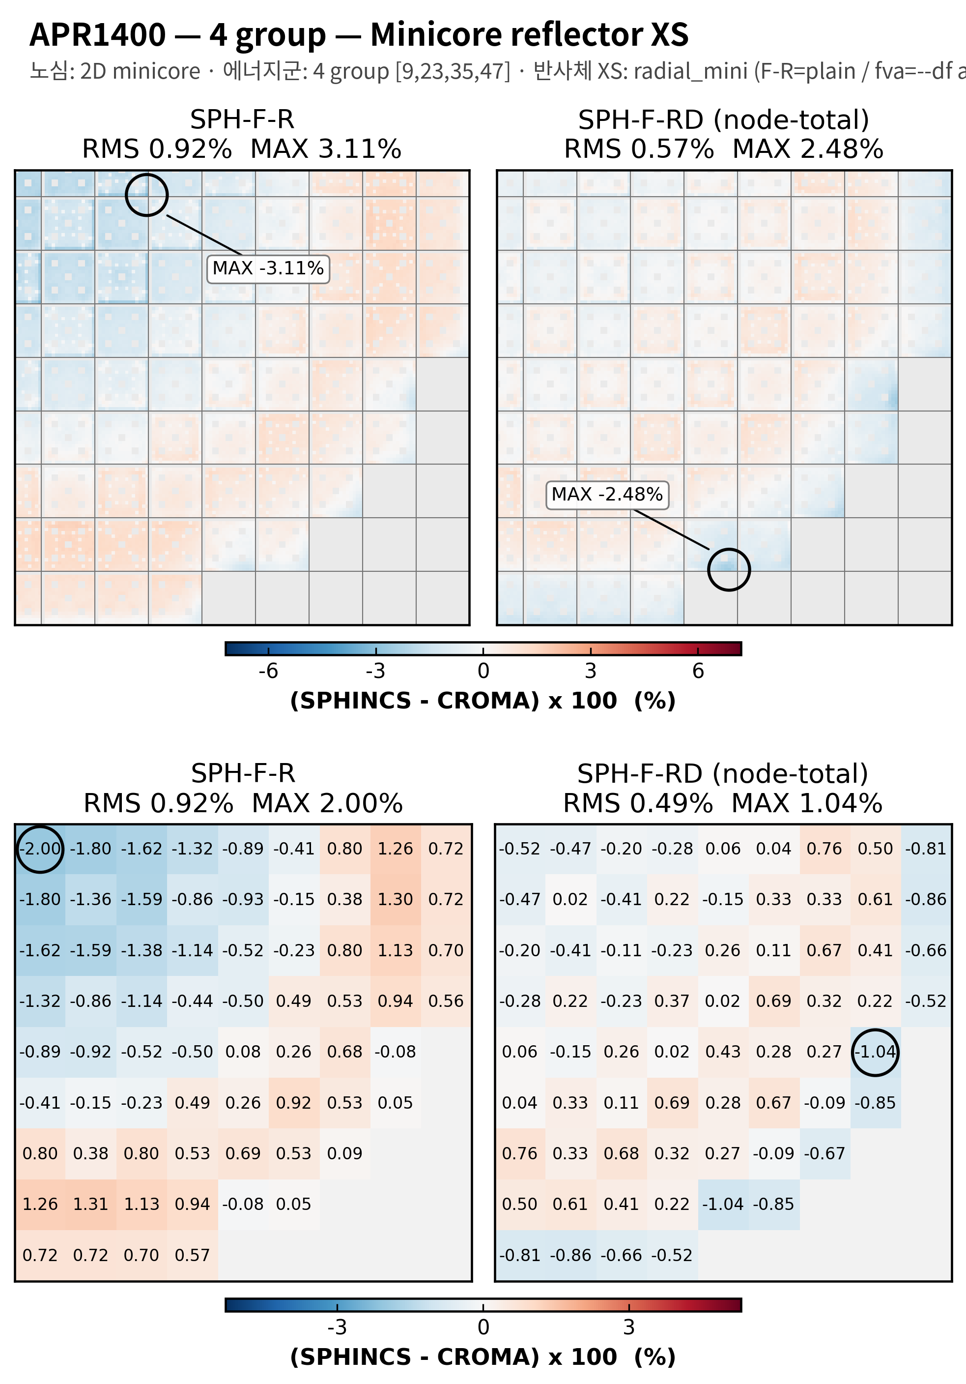
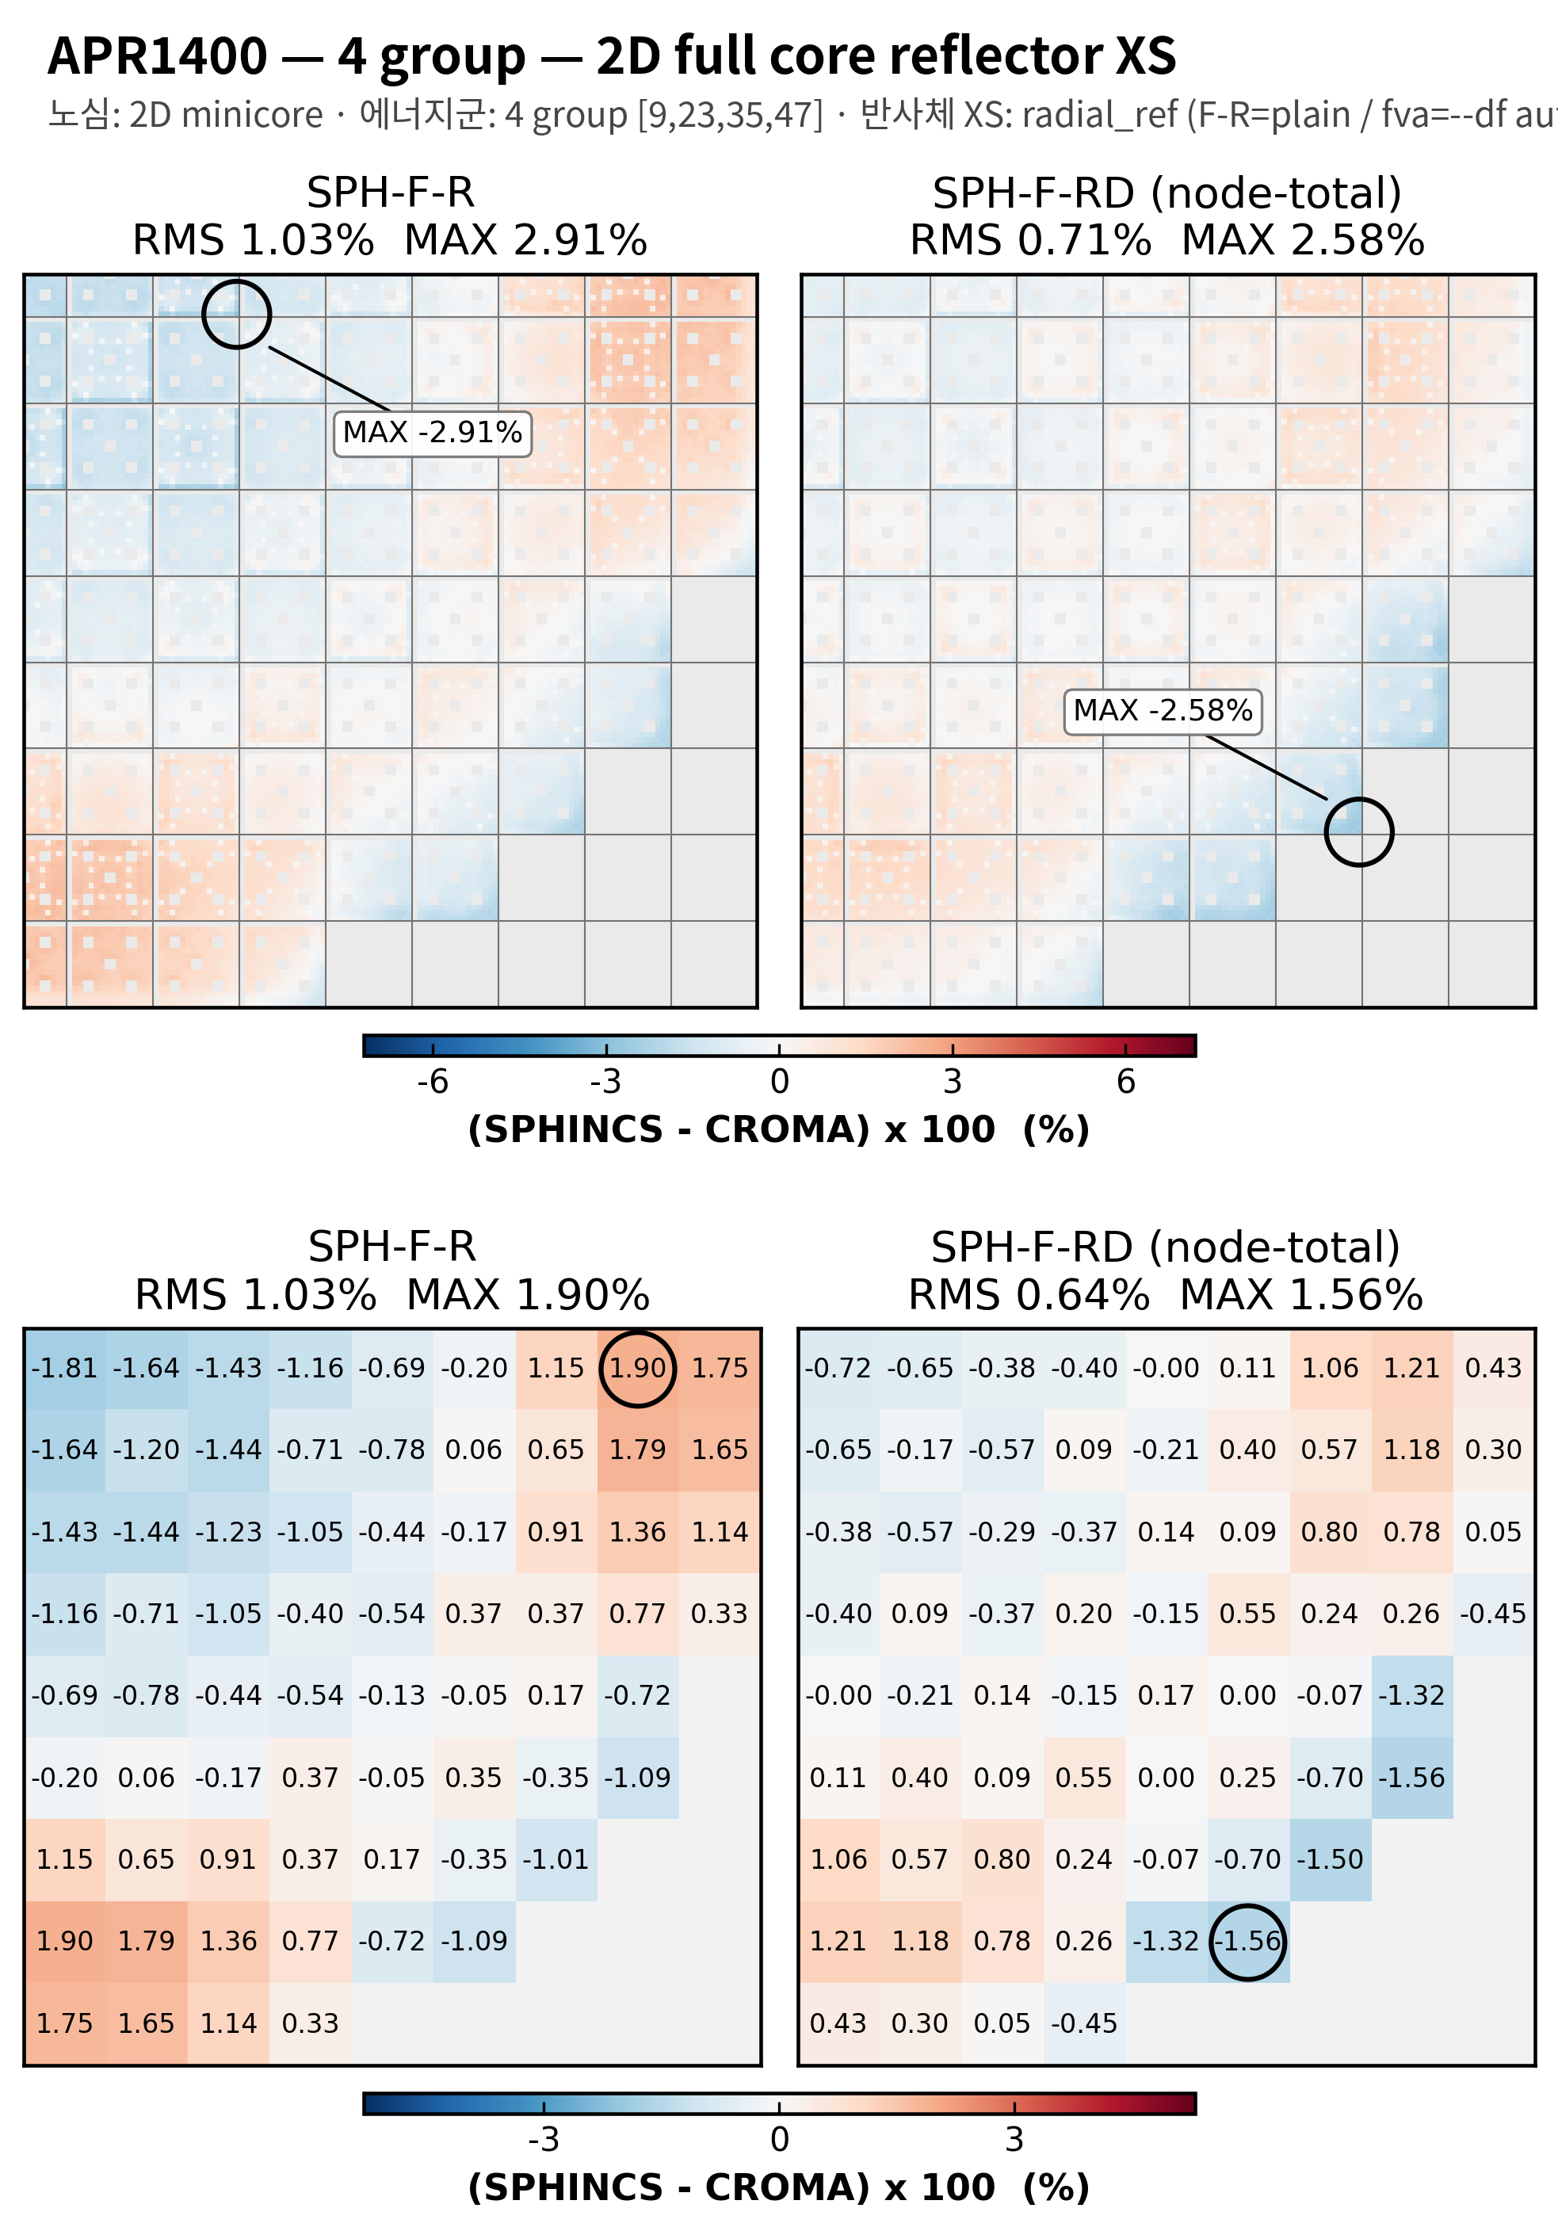
4 group structure test
2D APR1400
APR1400, 4group, minicore reflector XS
APR1400, 4group, 2D full core reflector XS

Slide 8
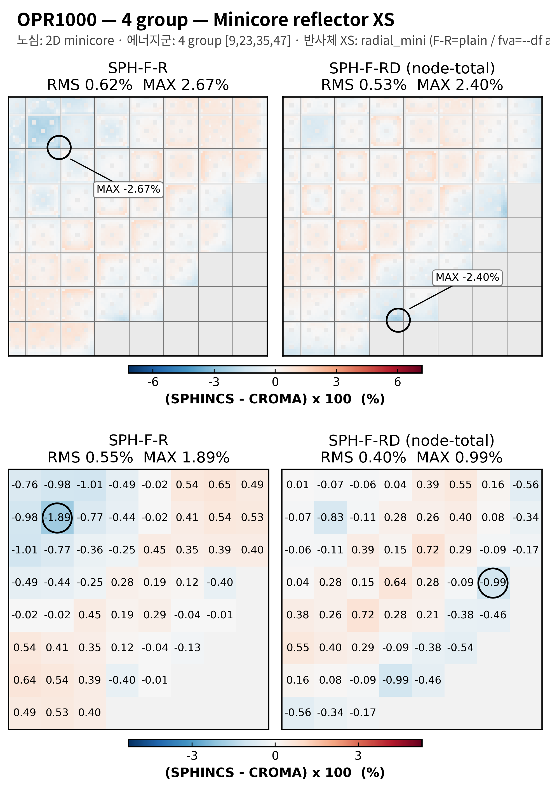
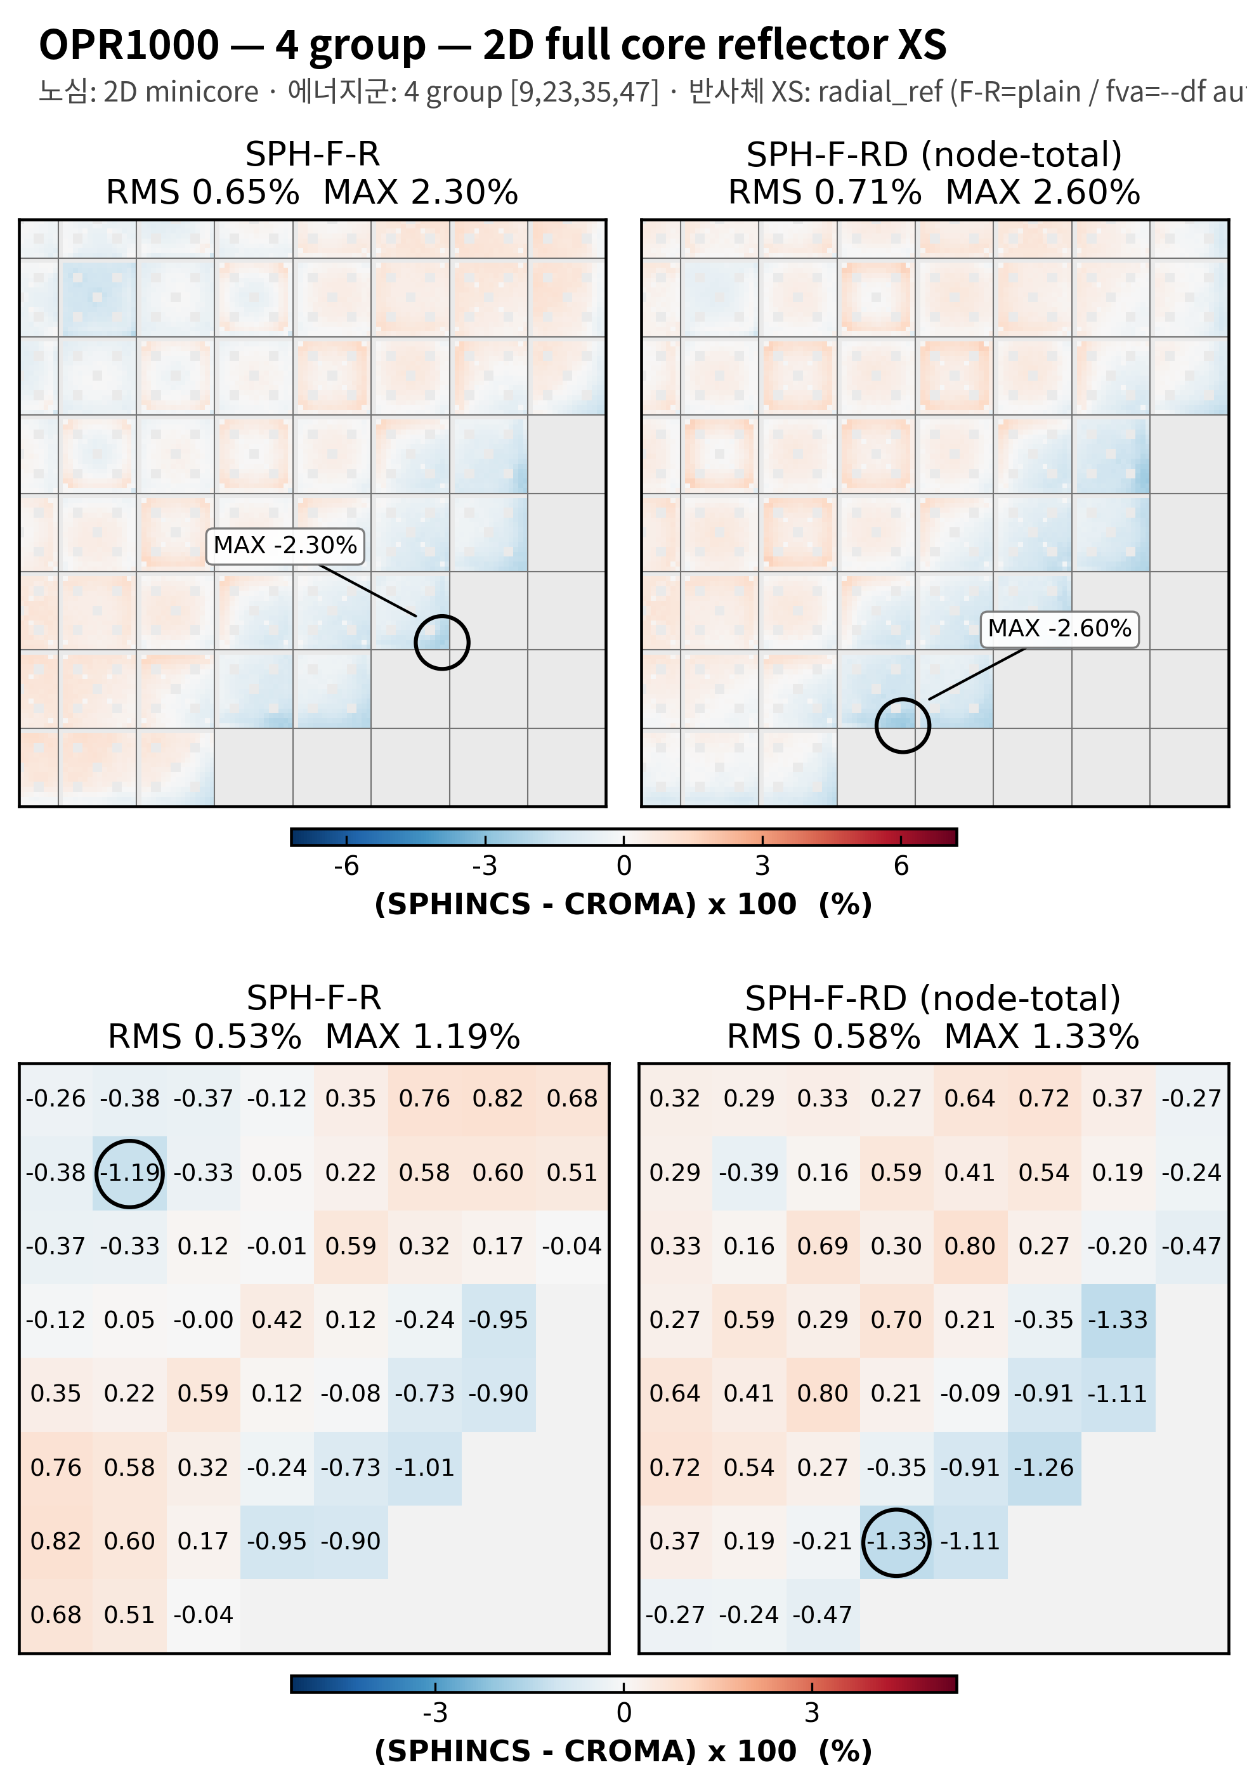

4 group structure test
2D OPR1000
OPR1000, 4group, minicore reflector XS
OPR1400, 4group, 2D full core reflector XS

Slide 9
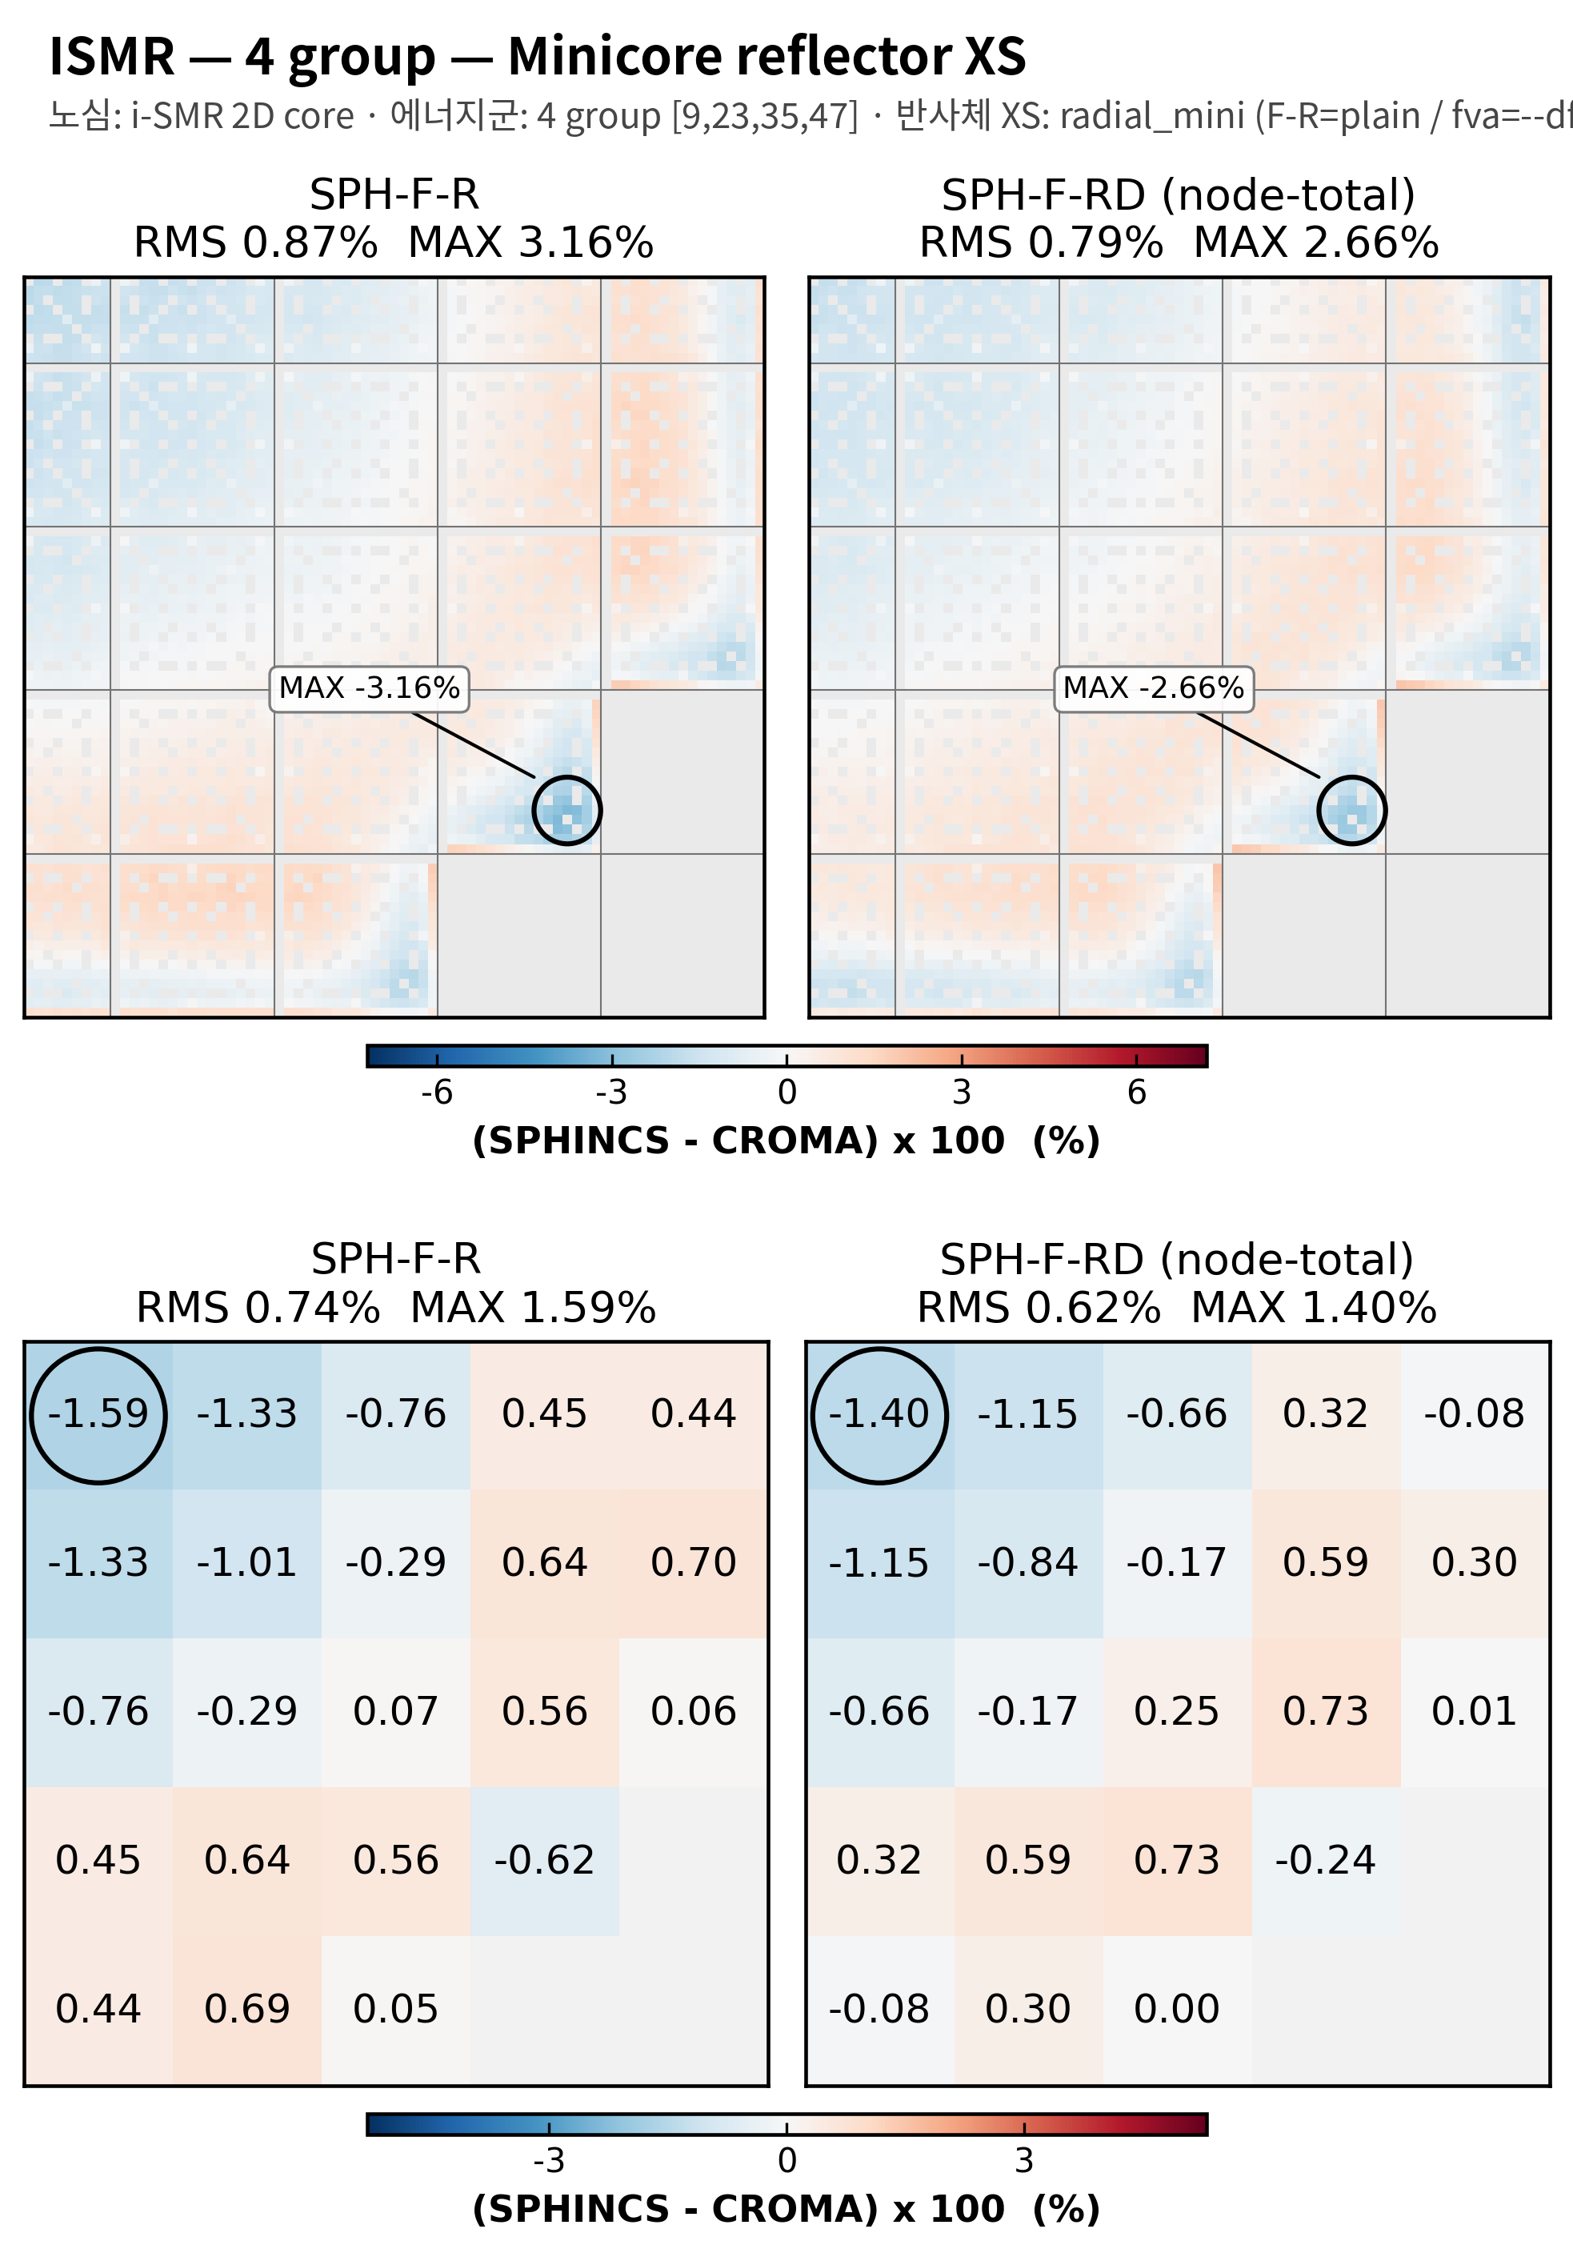
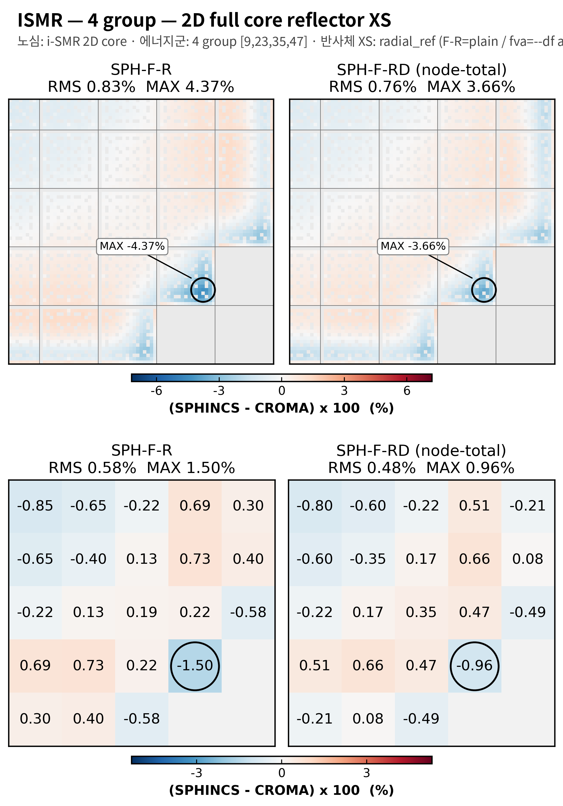
4 group structure test
2D i-SMR
i-SMR, 4group, minicore reflector XS
i-SMR, 4group, 2D full core reflector XS

Slide 10
5 group

Slide 11
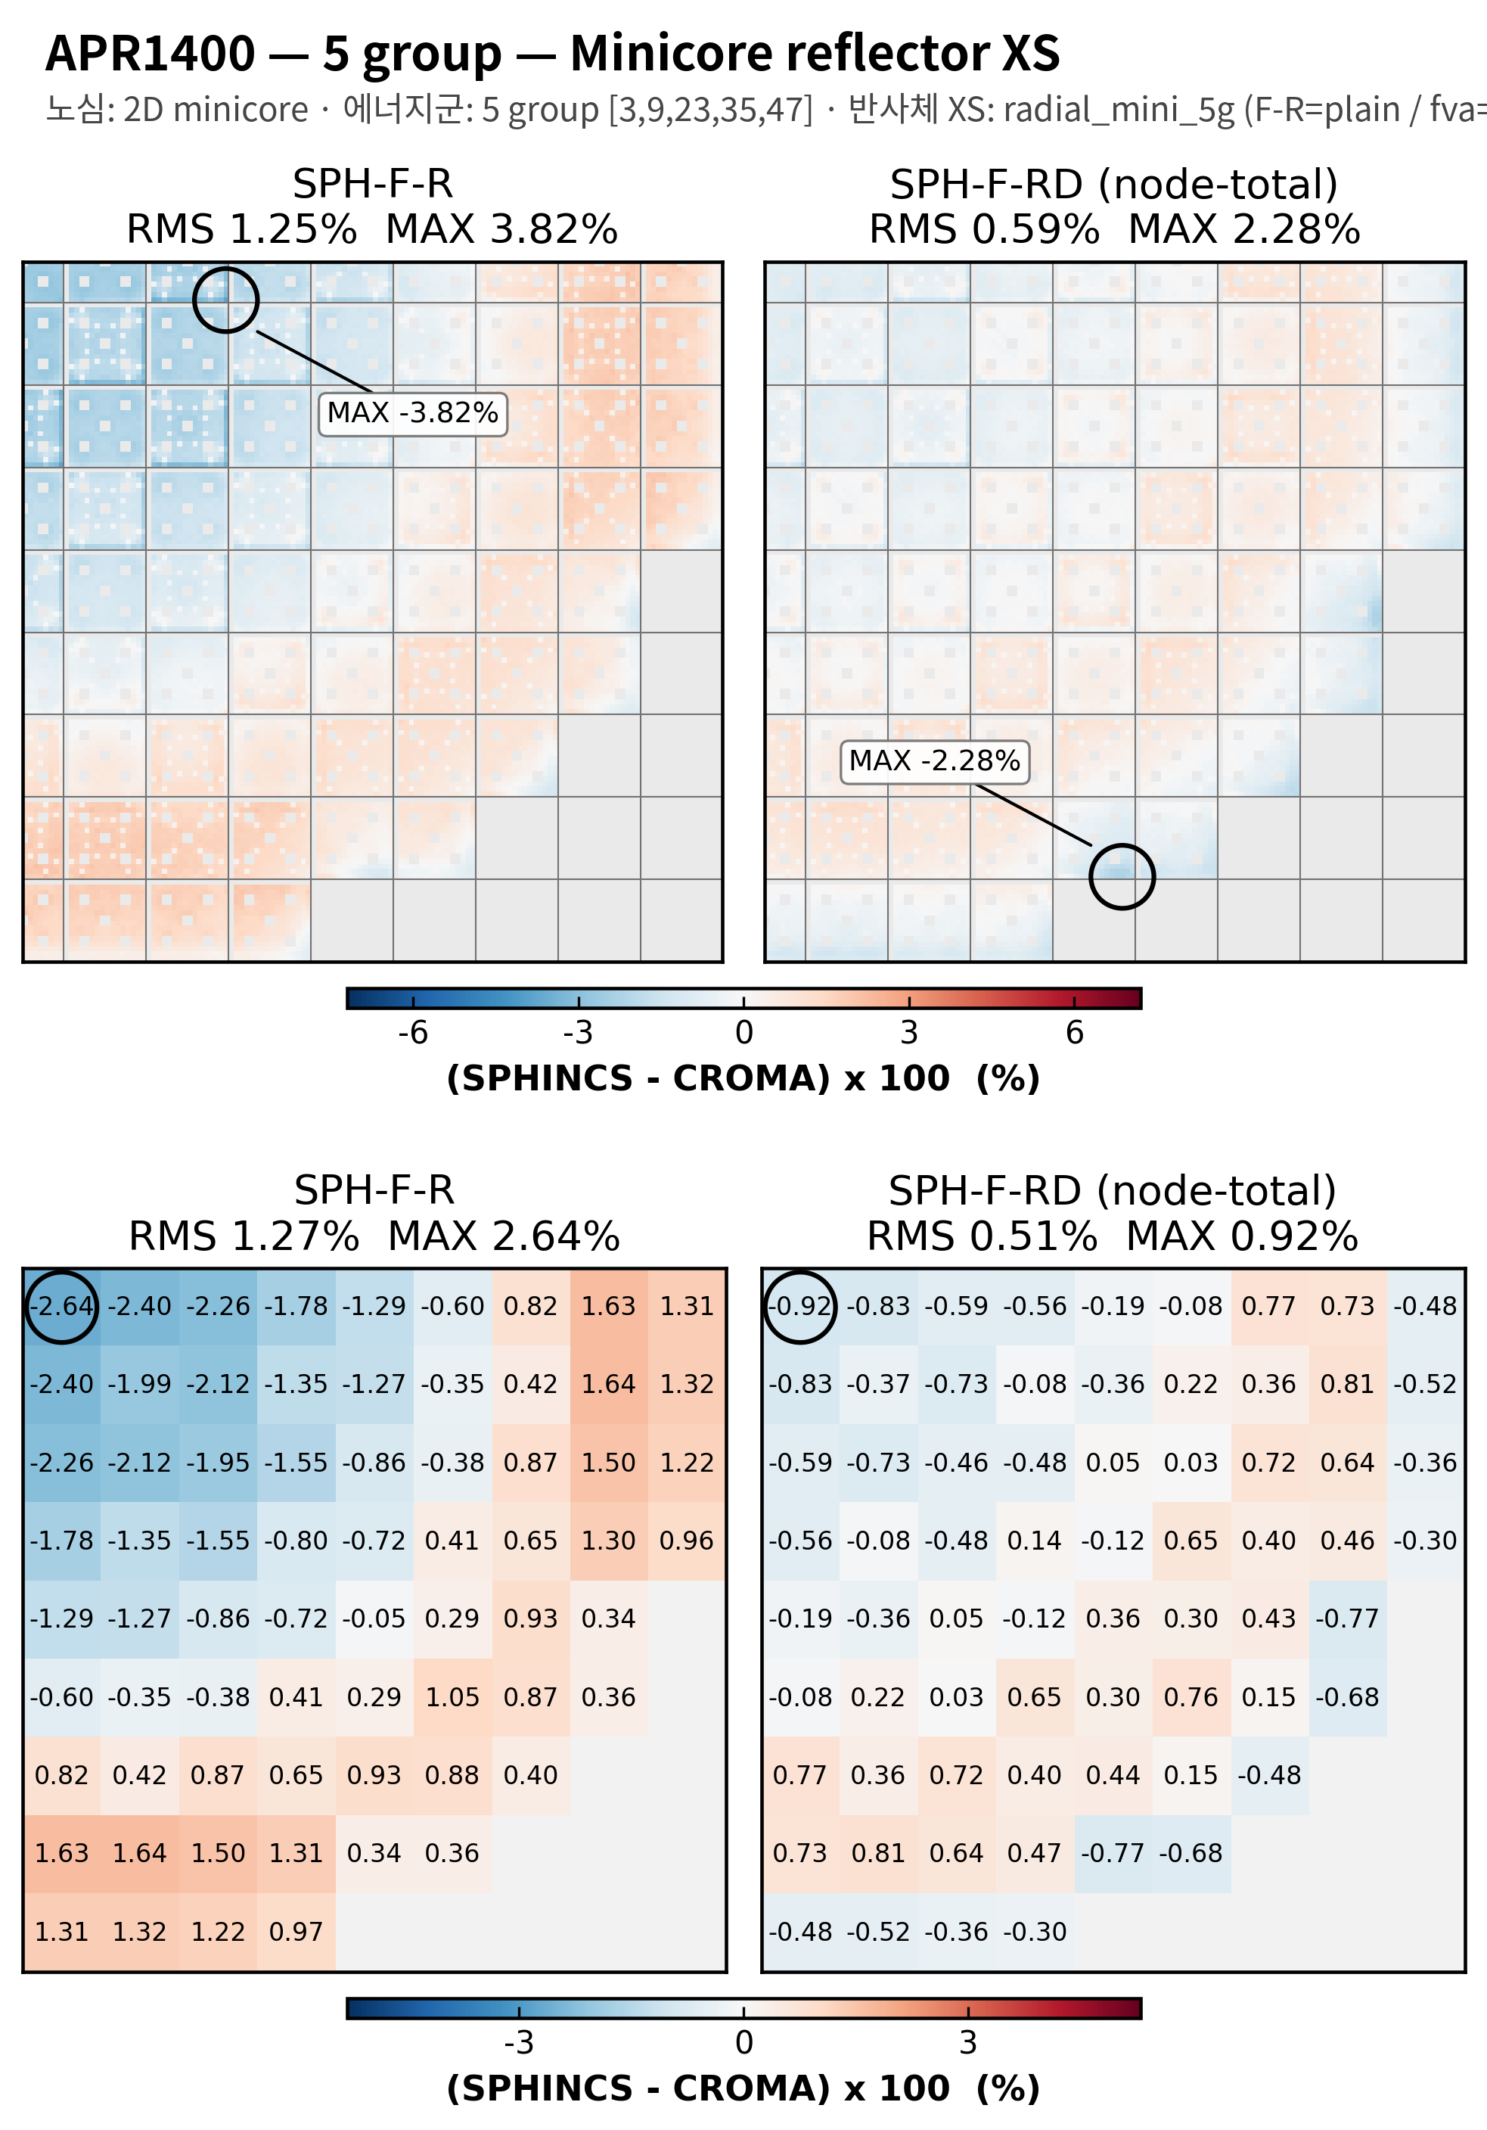
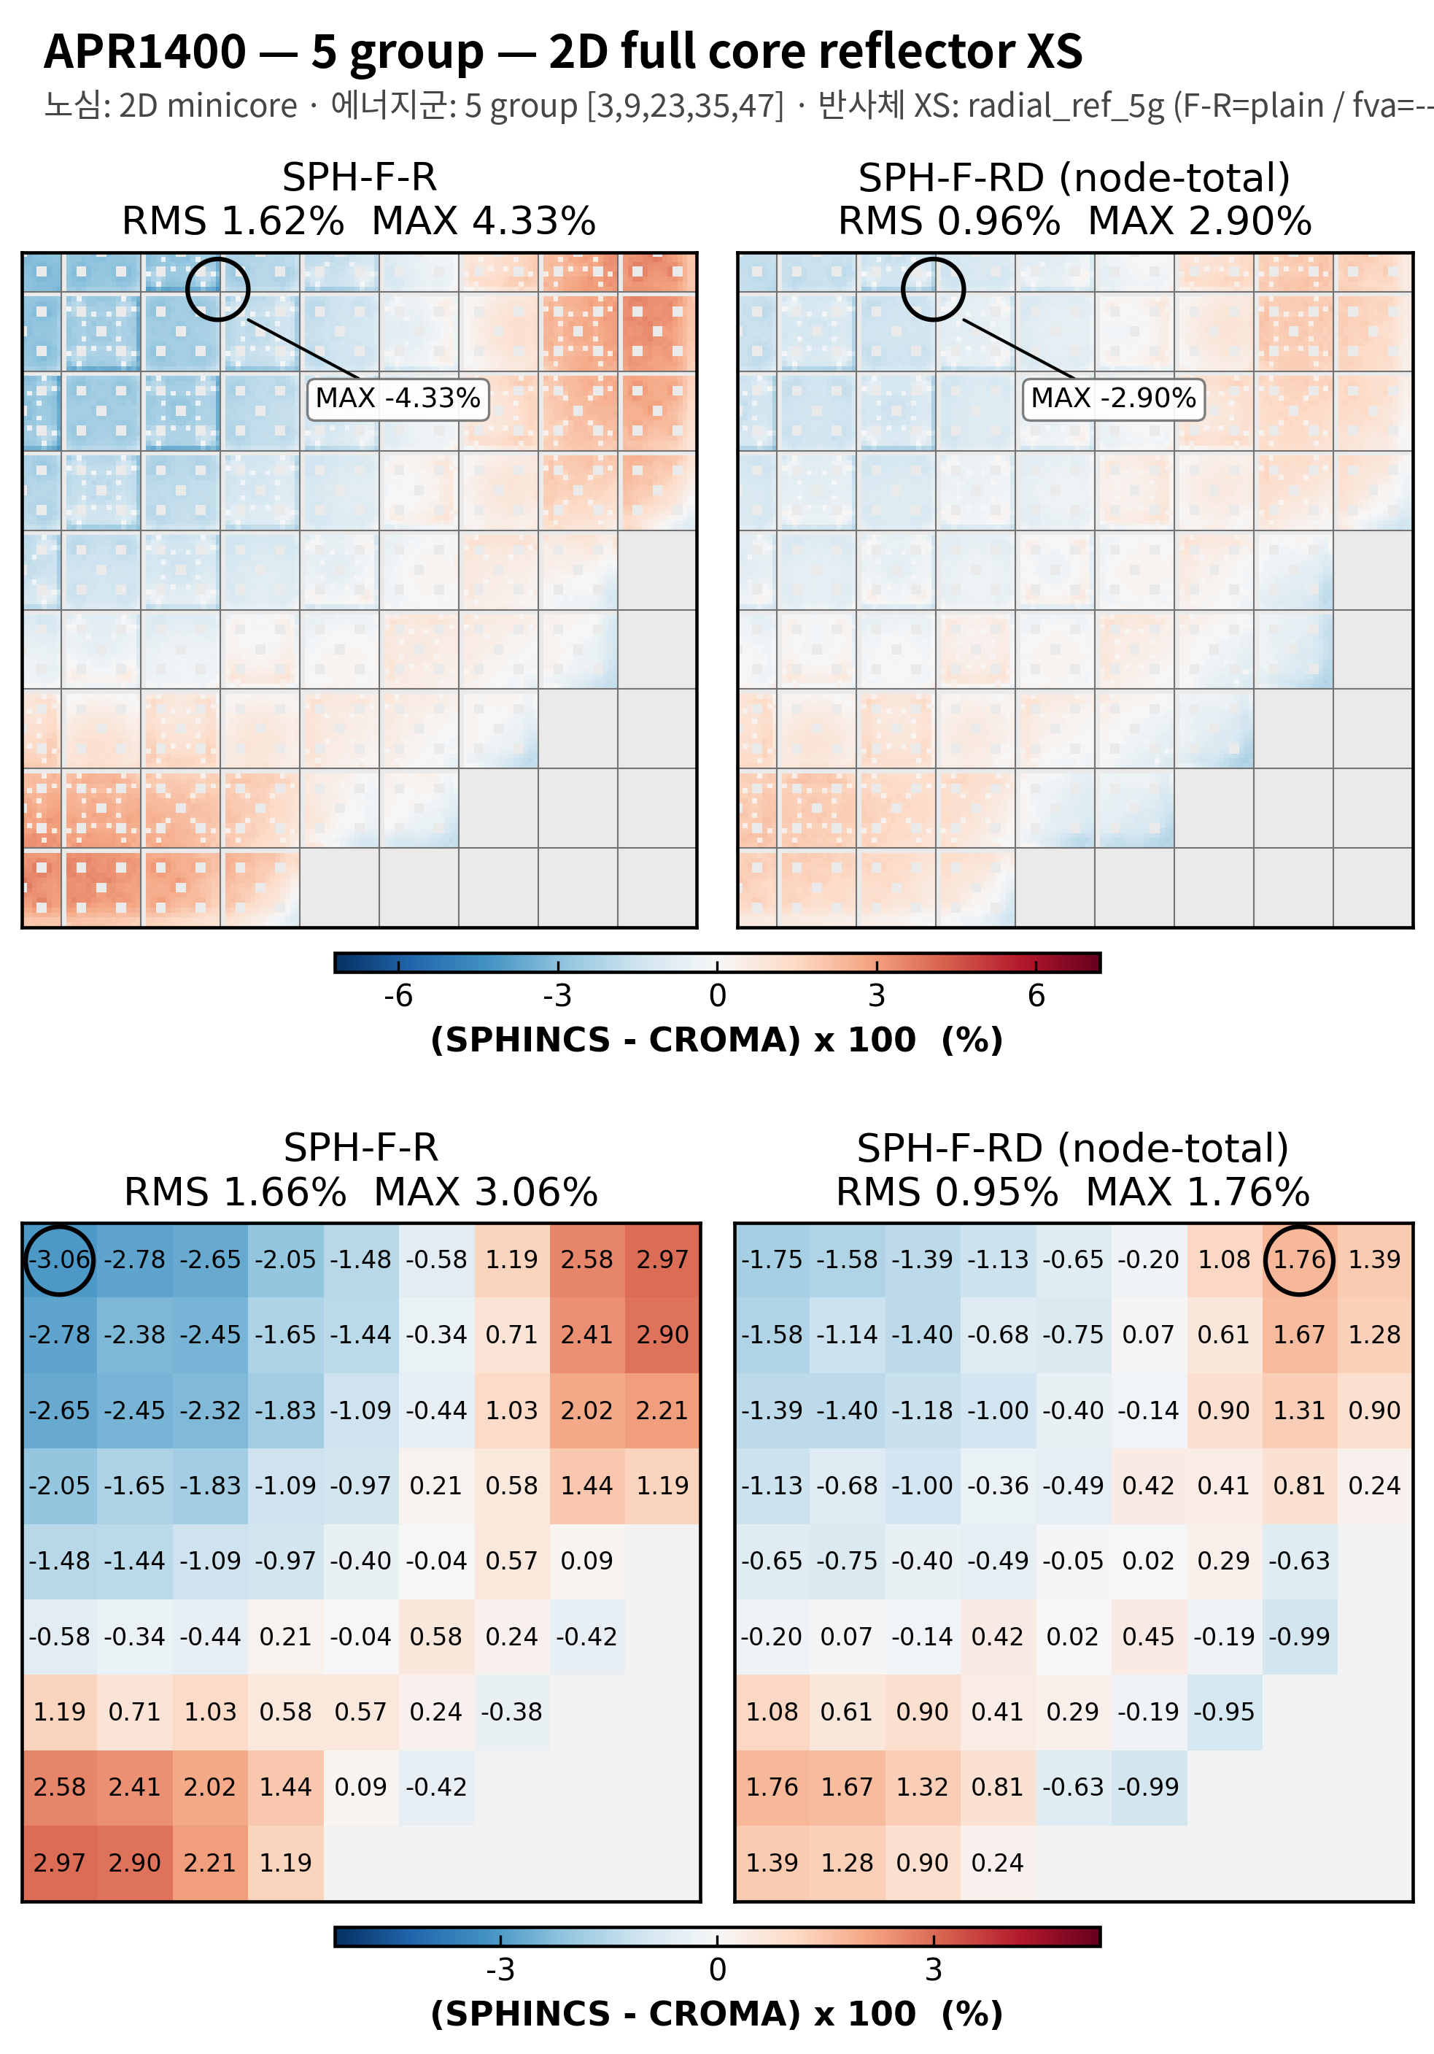

5 group structure test
2D APR1400
APR1400, 5group, minicore reflector XS
APR1400, 5group, 2D full core reflector XS

Slide 12
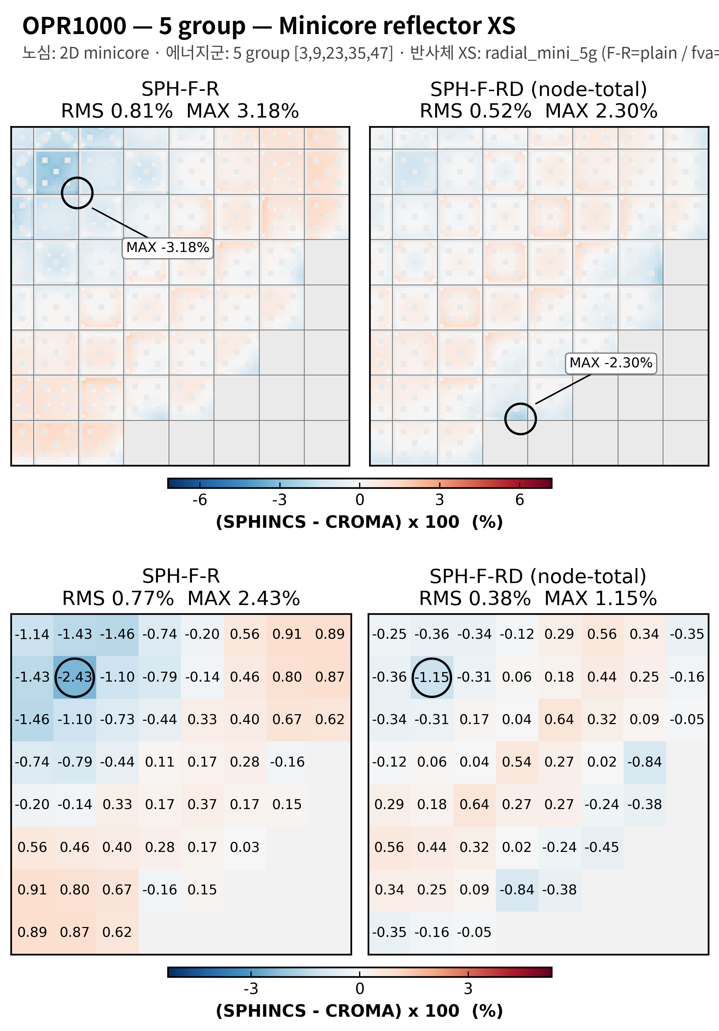
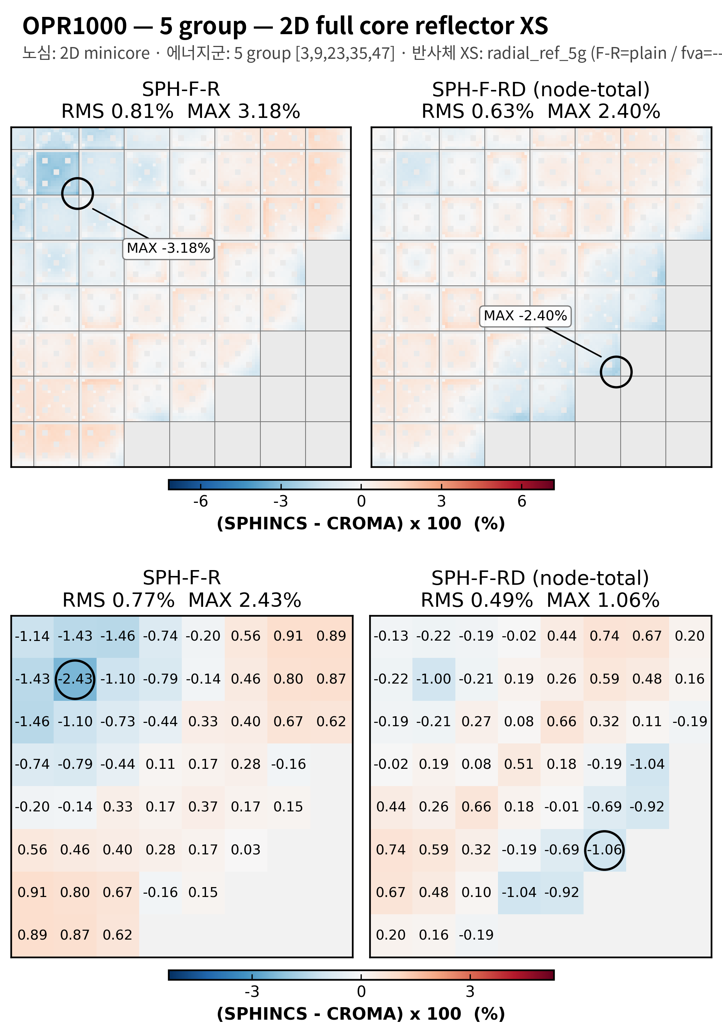
5 group structure test
2D OPR1000
OPR1000, 5group, minicore reflector XS
OPR1400, 5group, 2D full core reflector XS

Slide 13
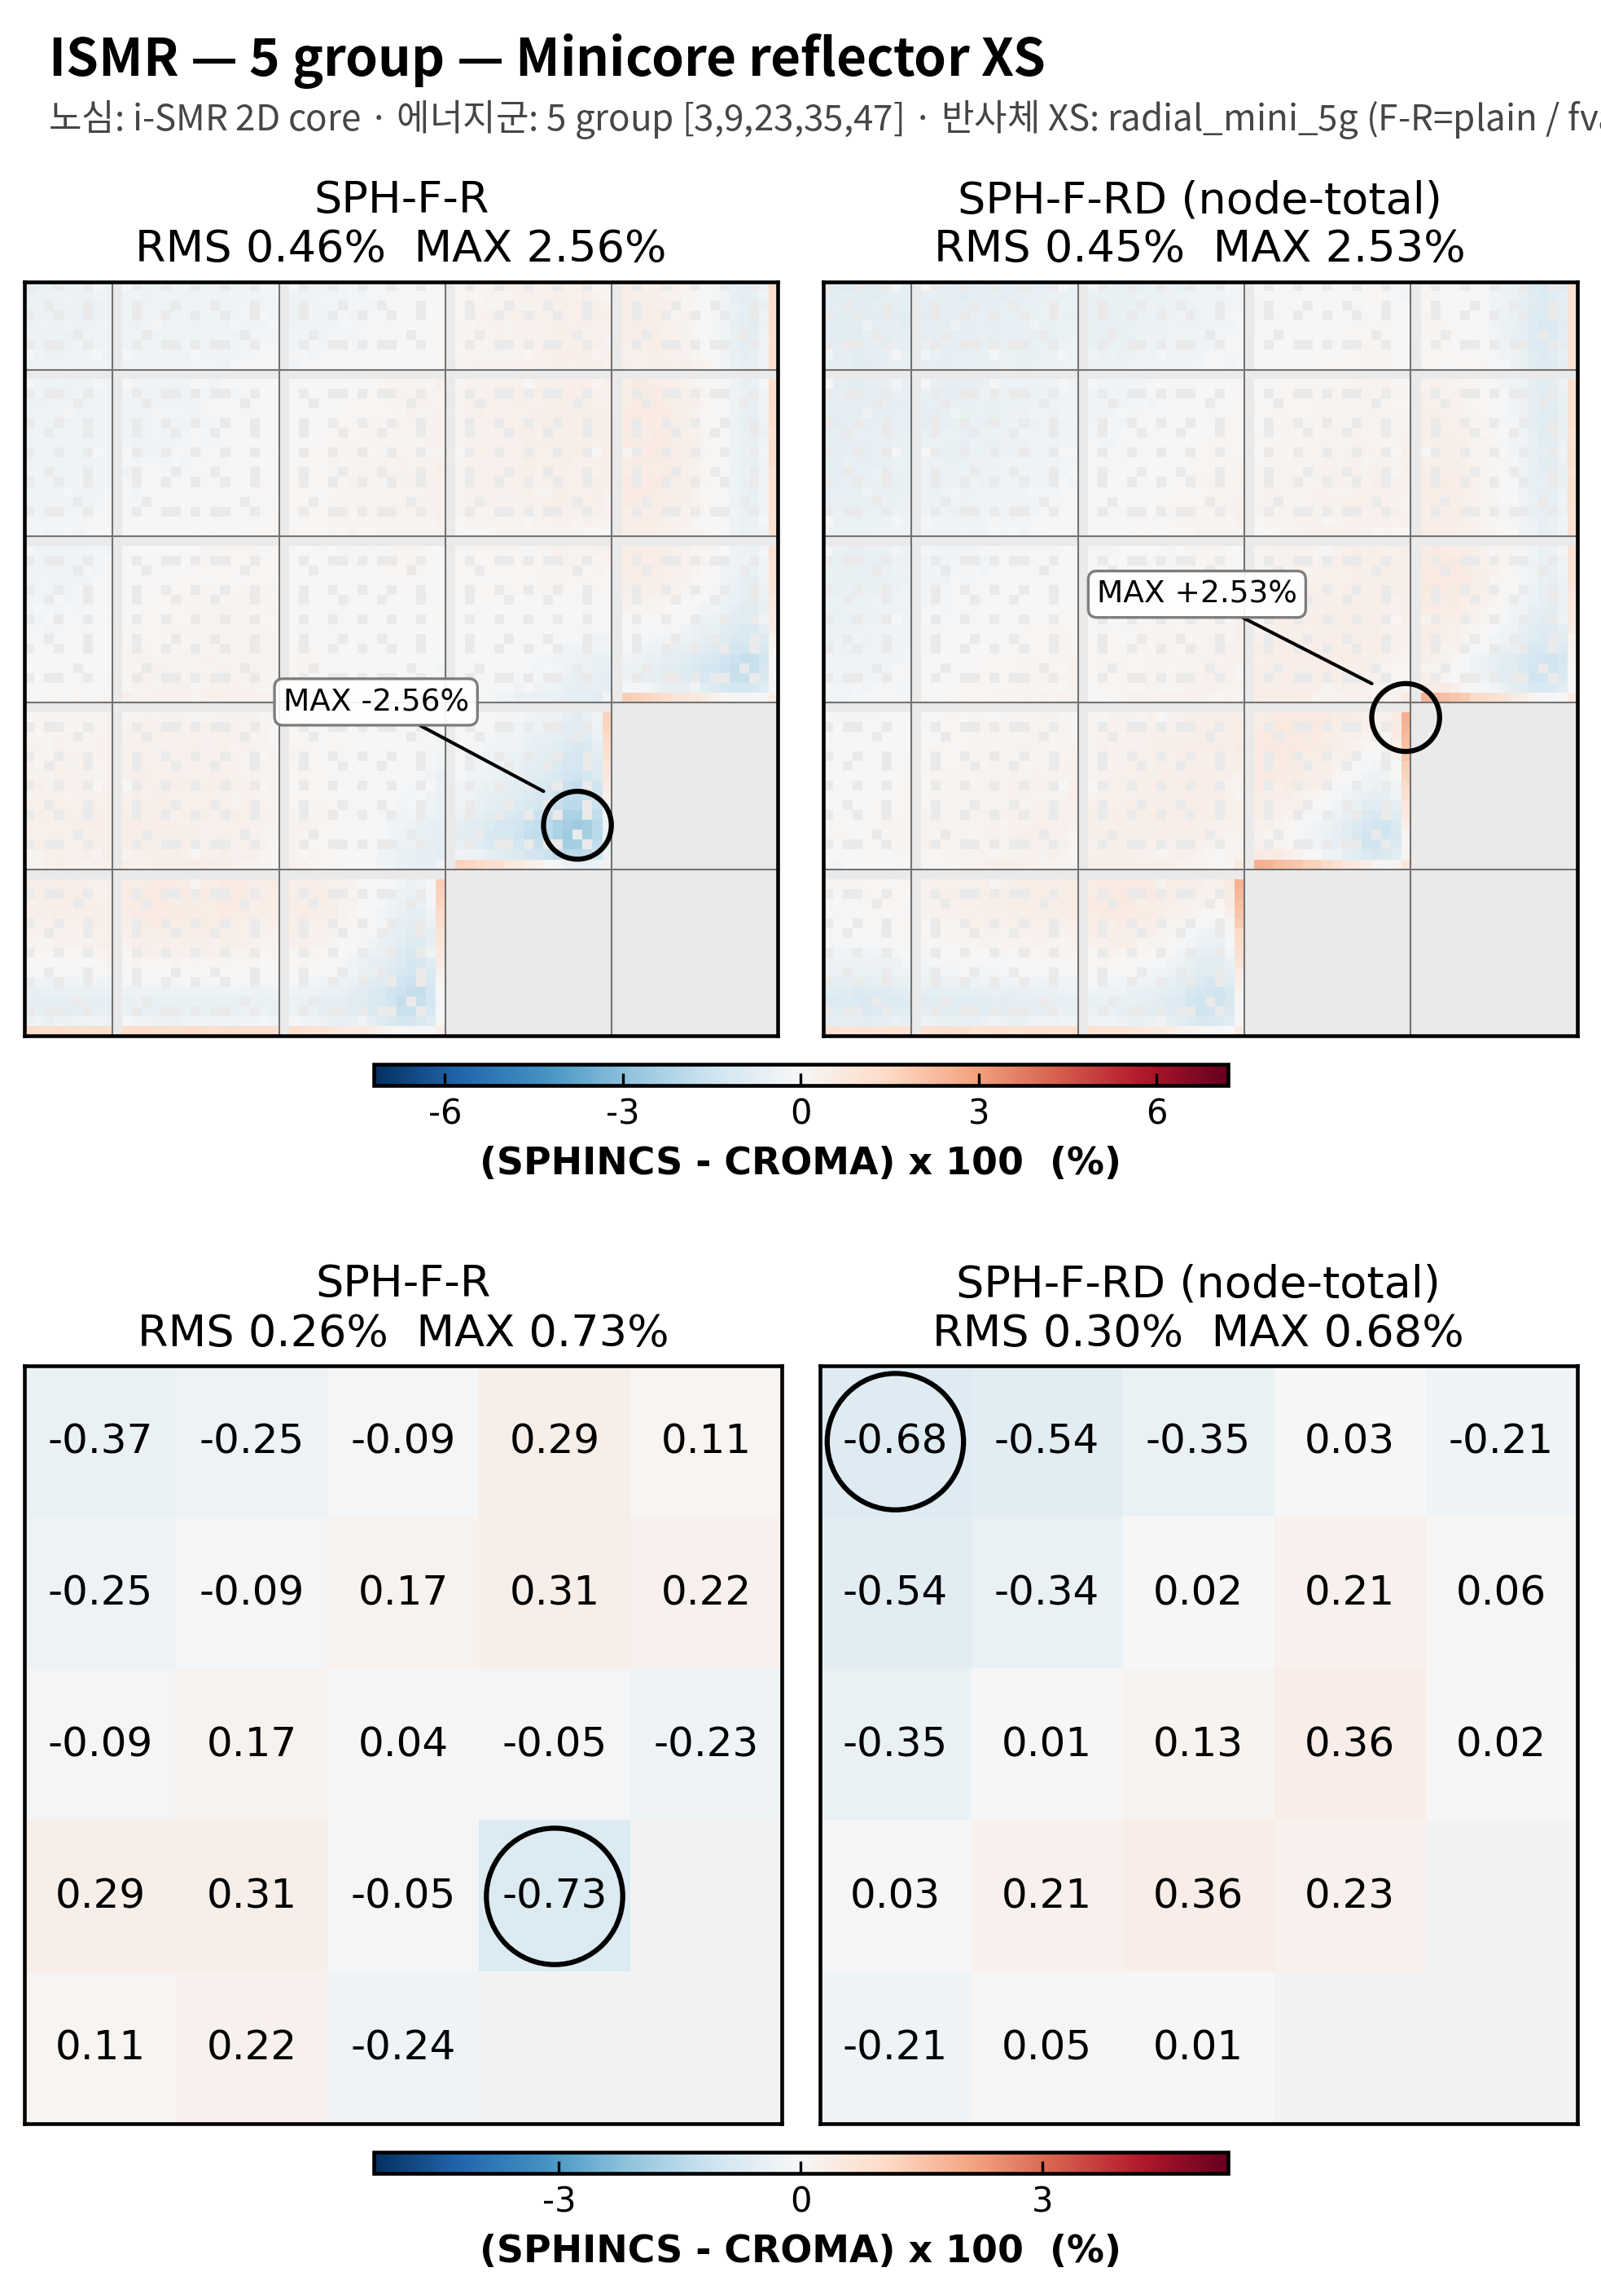
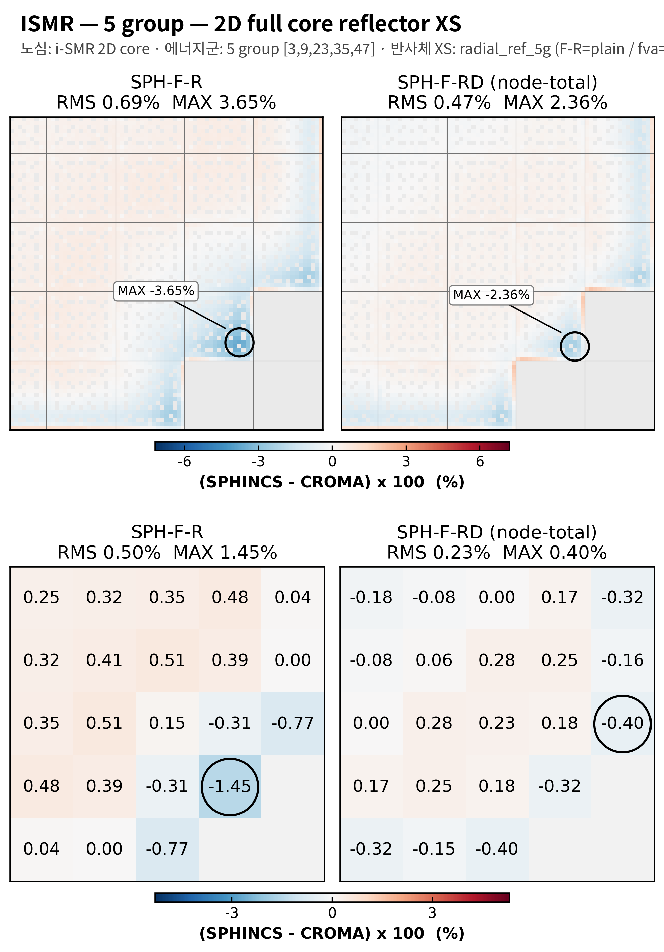
5 group structure test
2D i-SMR
i-SMR, 5group, minicore reflector XS
i-SMR, 5group, 2D full core reflector XS

Slide 14
7 group

Slide 15
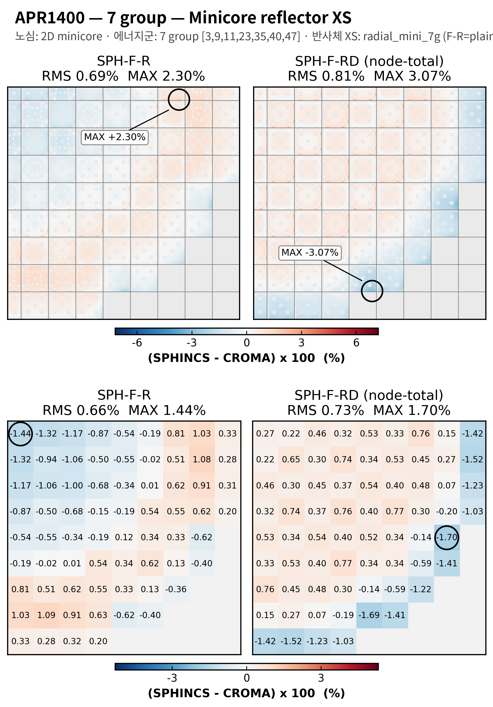
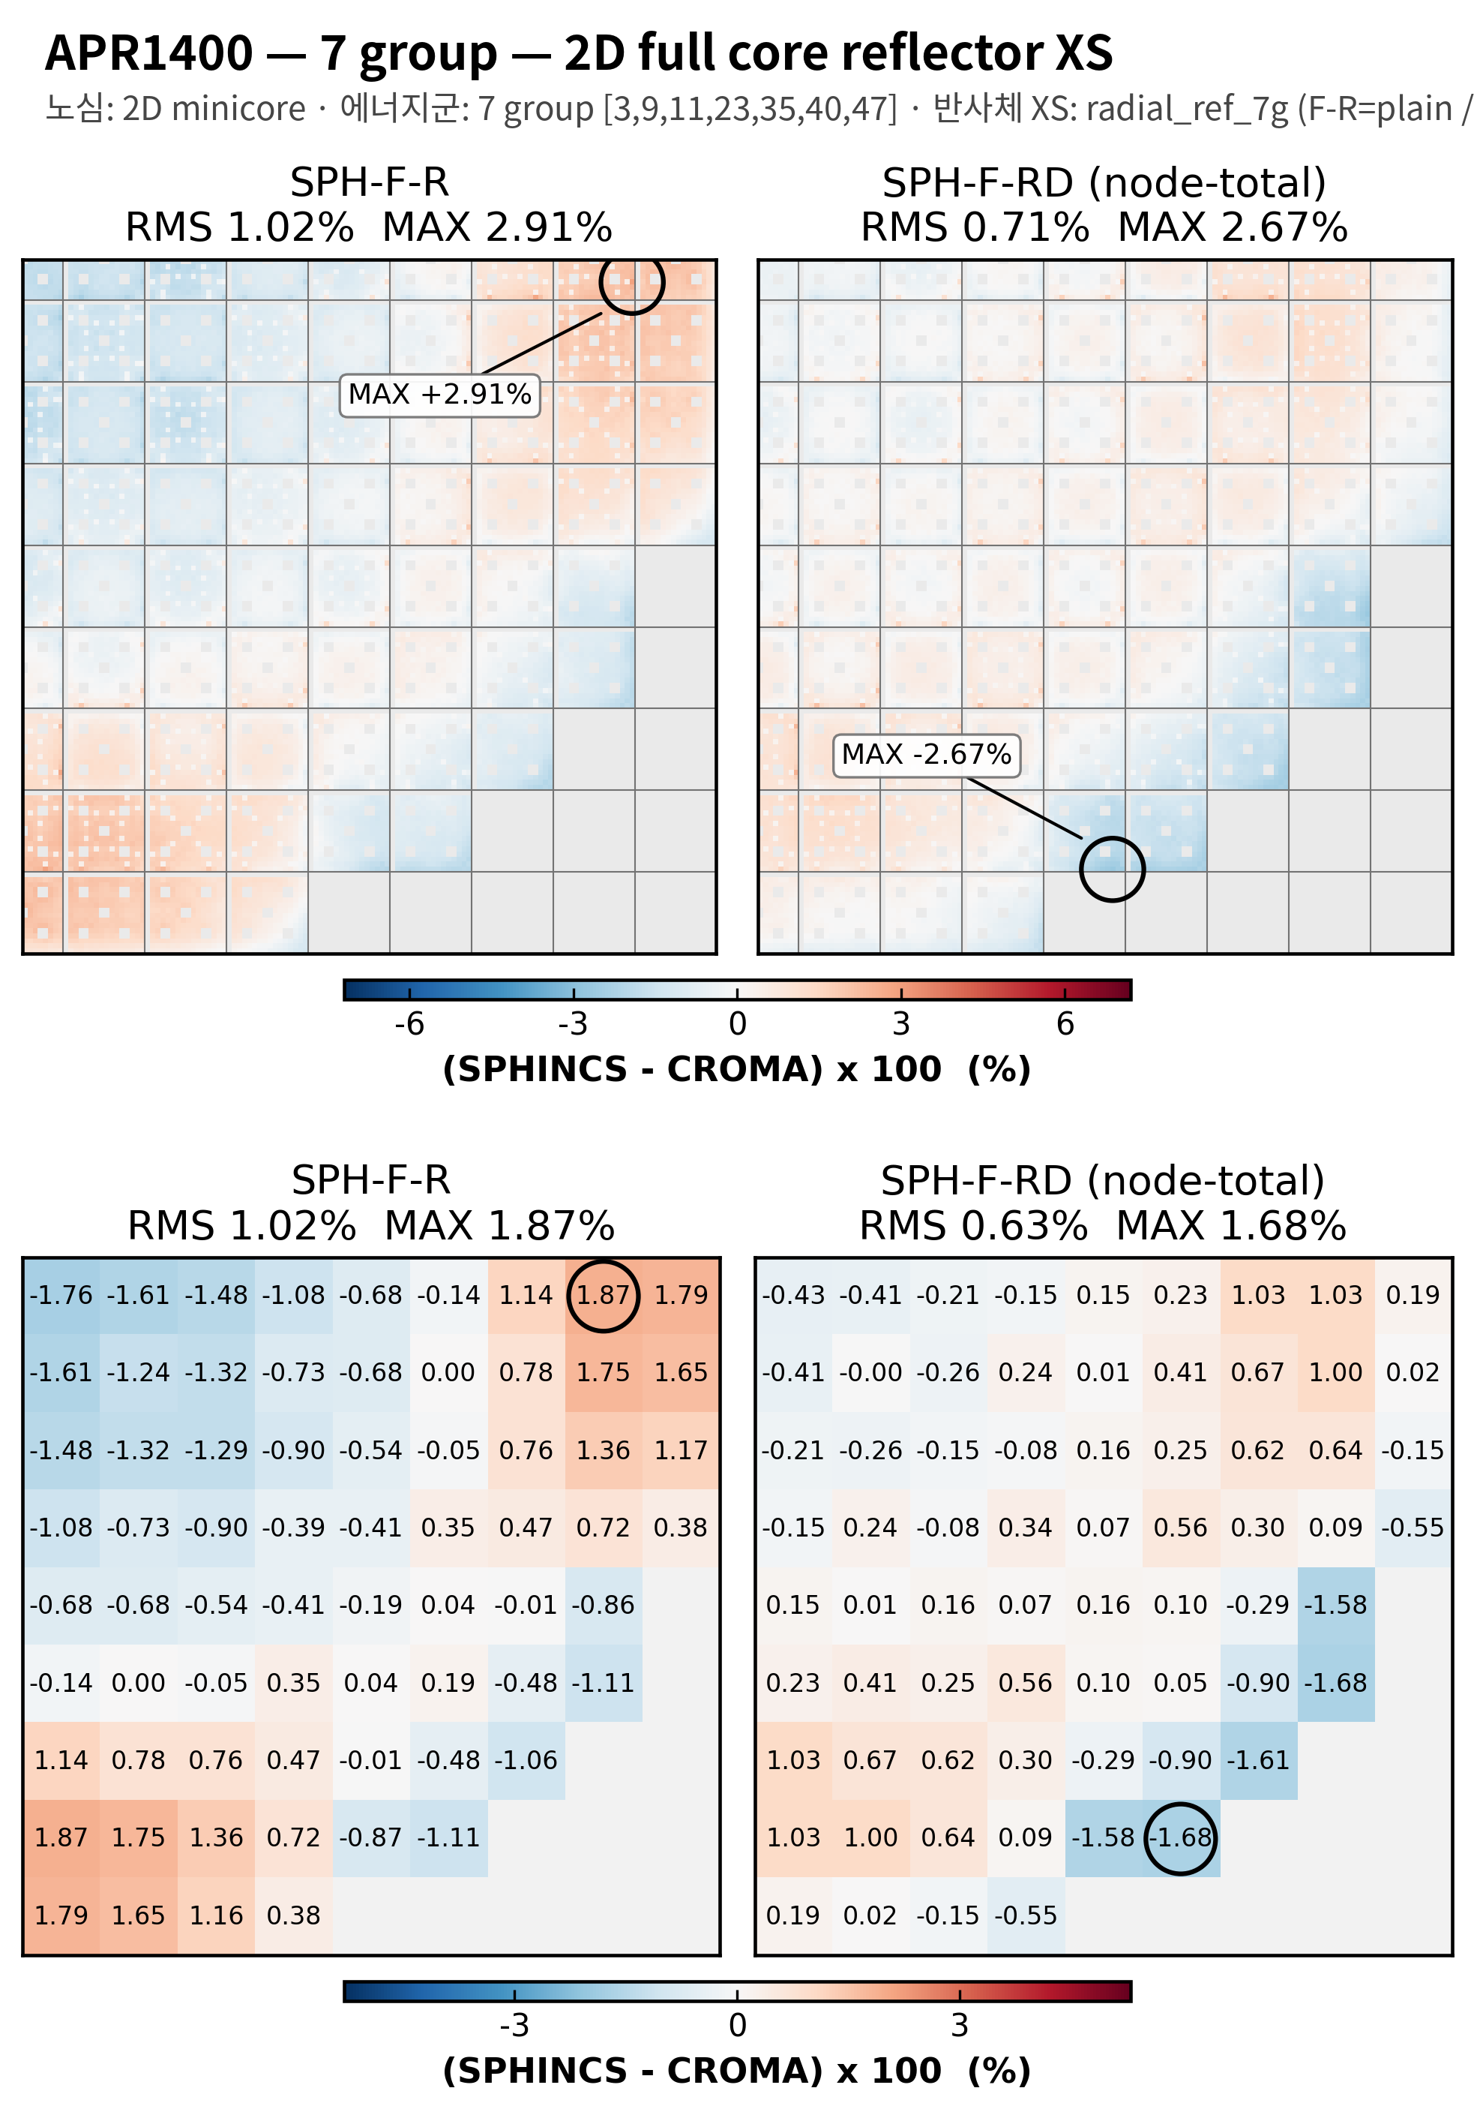

7 group structure test
2D APR1400
APR1400, 7group, minicore reflector XS
APR1400, 7group, 2D full core reflector XS

Slide 16
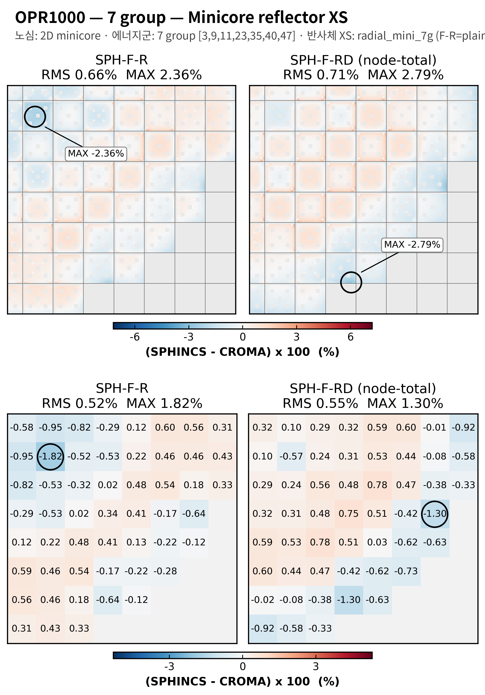
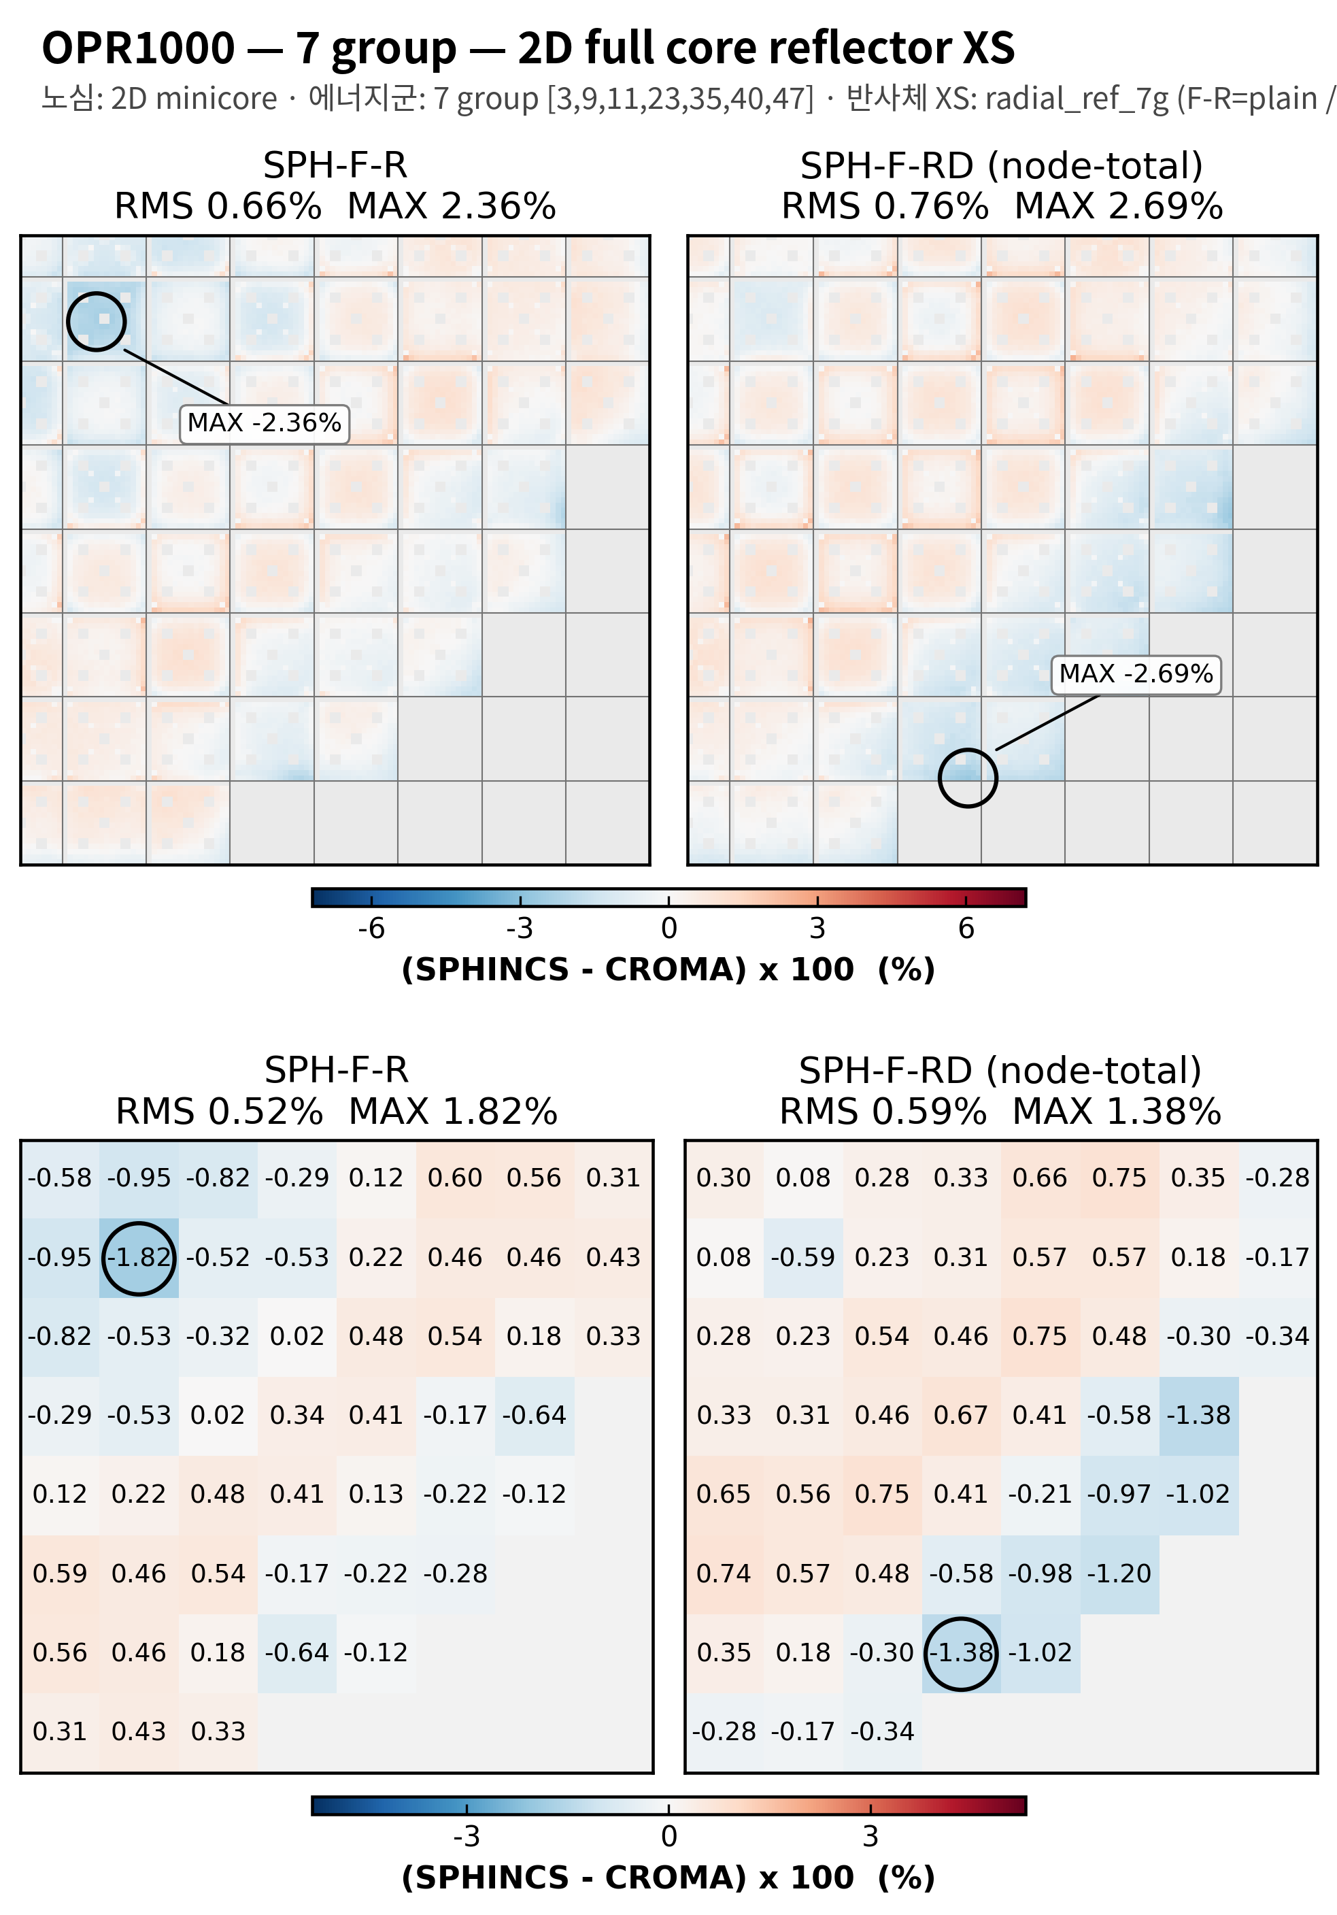
7 group structure test
2D OPR1000
OPR1000, 7group, minicore reflector XS
OPR1400, 7group, 2D full core reflector XS

Slide 17
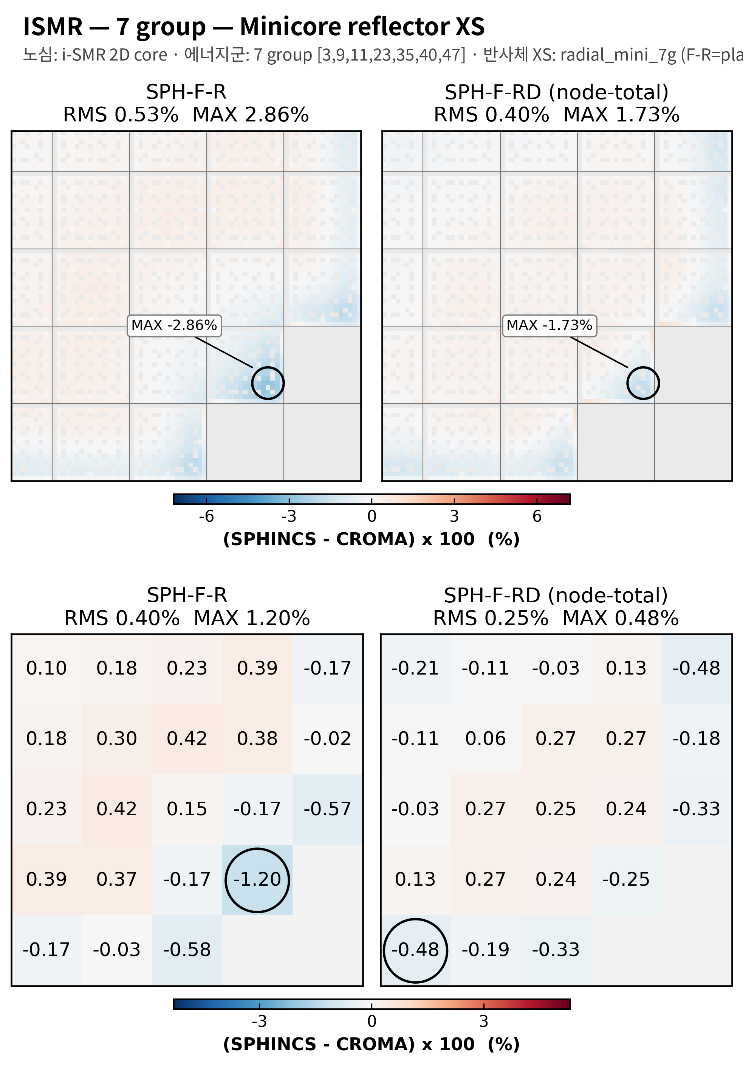
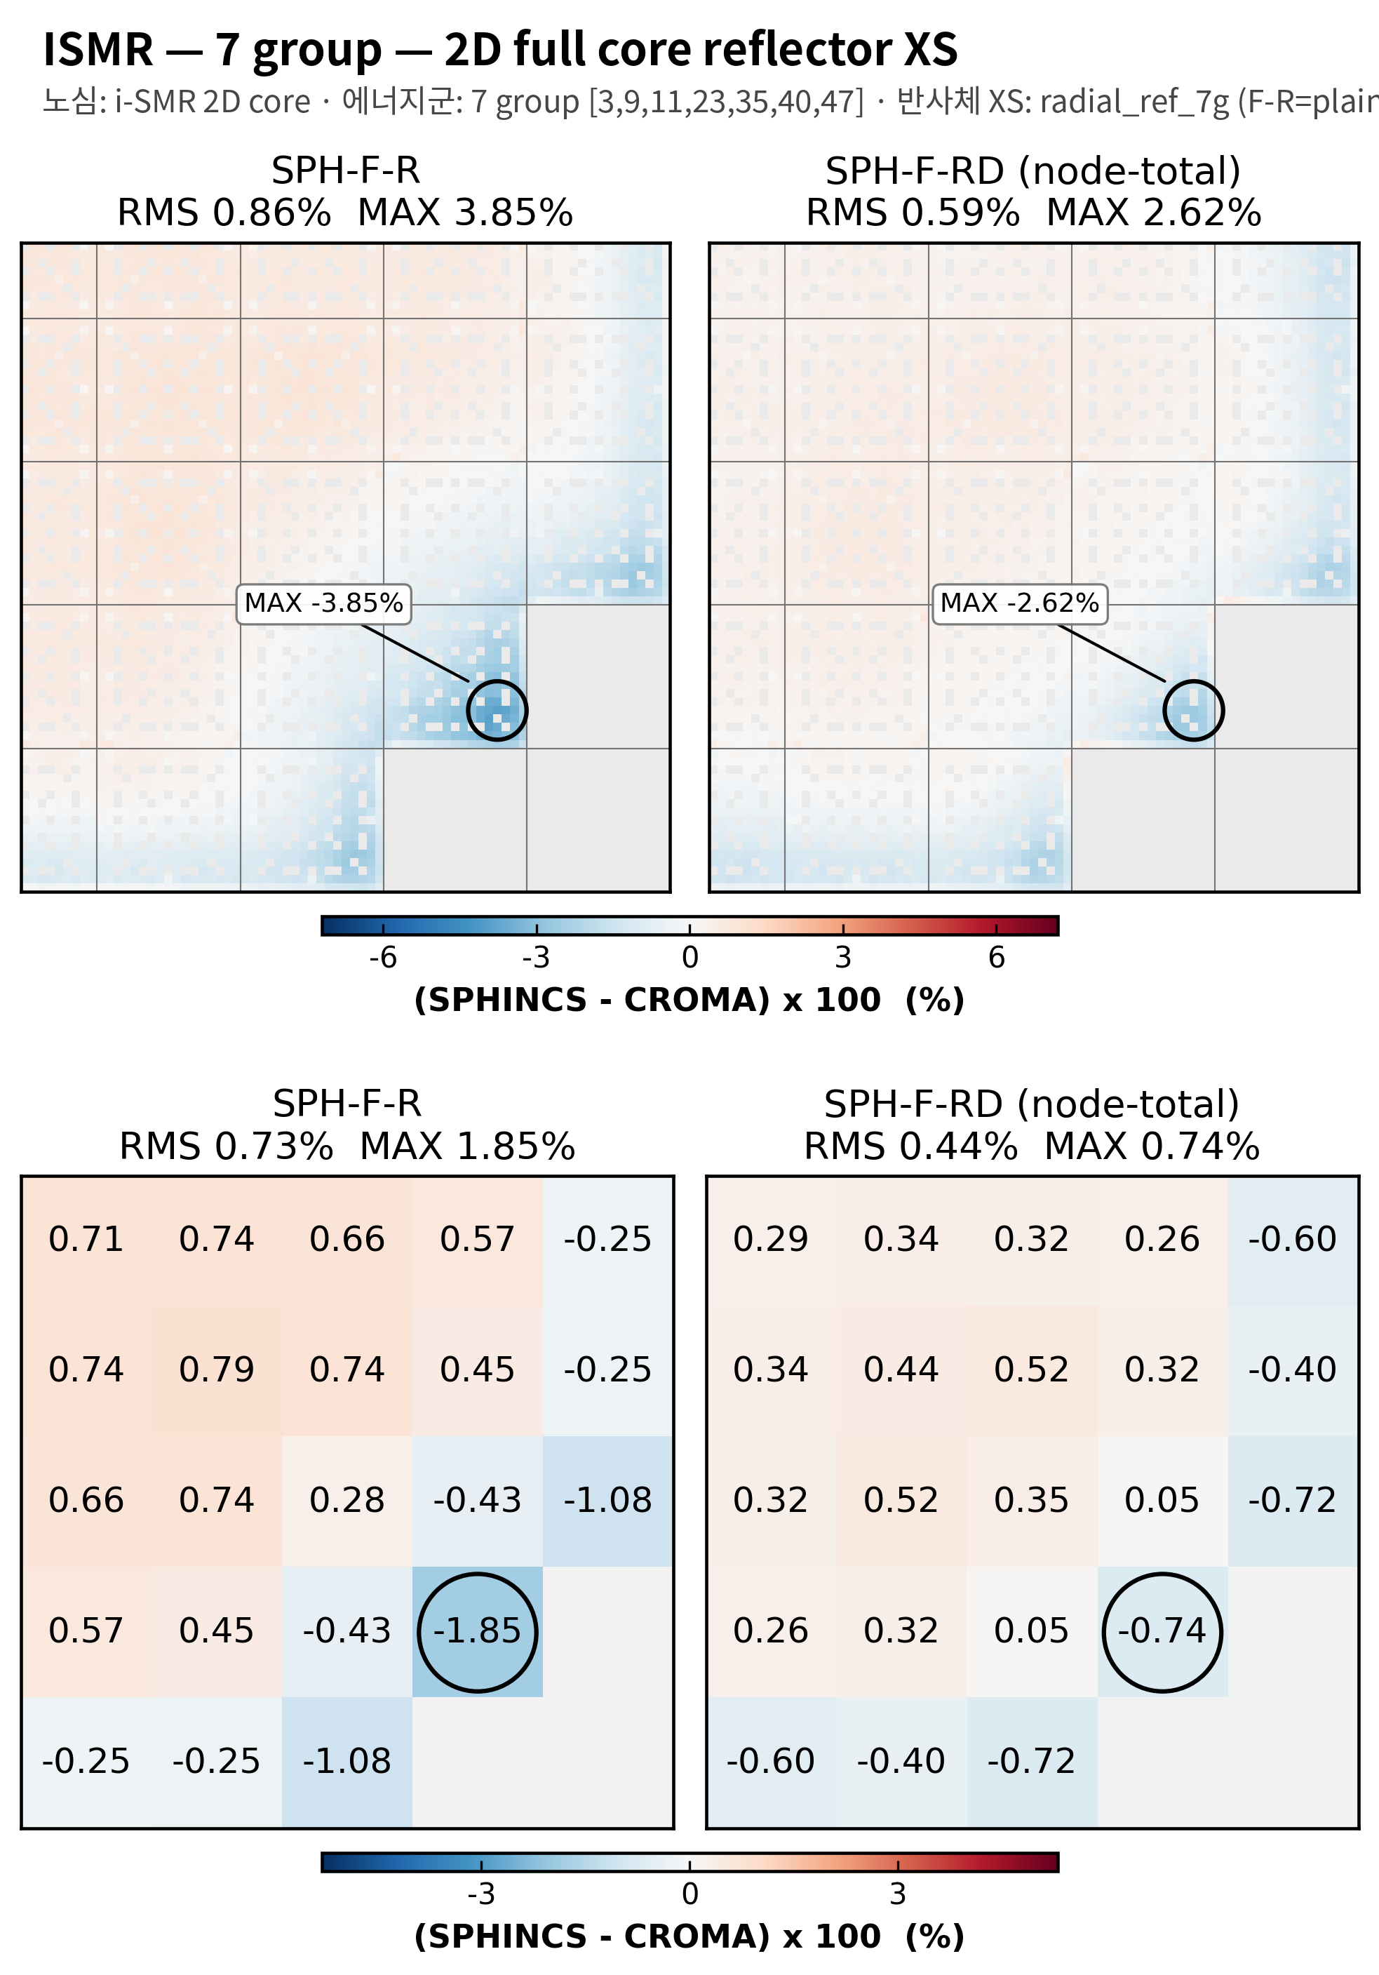

7 group structure test
2D i-SMR
i-SMR, 7group, minicore reflector XS
i-SMR, 7group, 2D full core reflector XS

Slide 18
i-SMR rodded

Slide 19
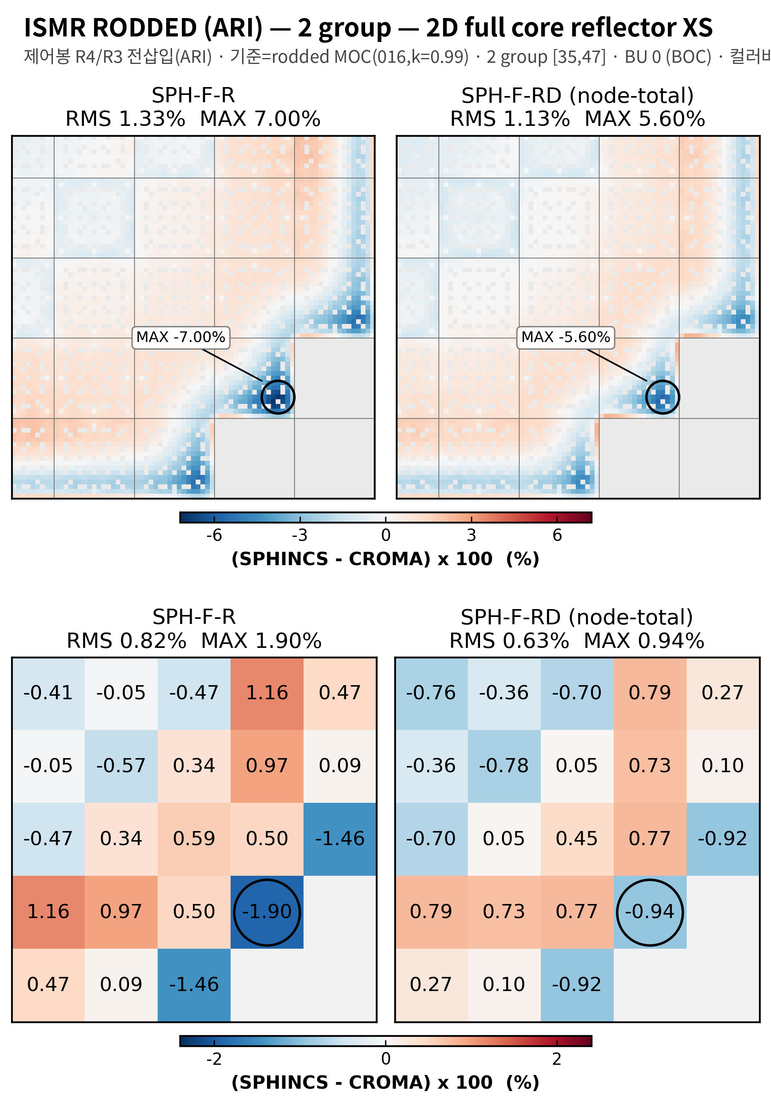
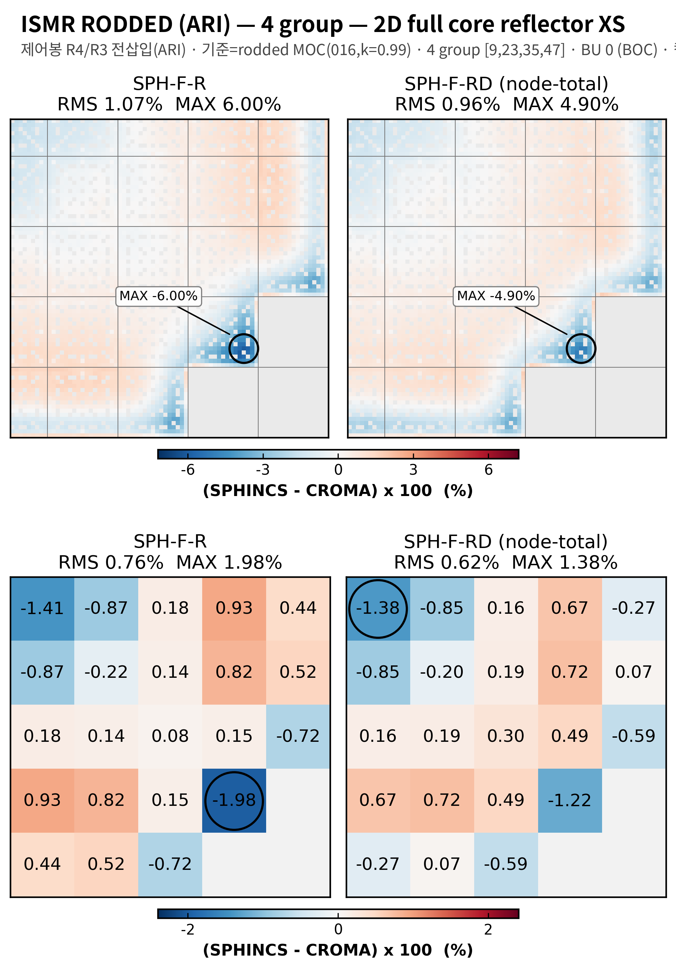
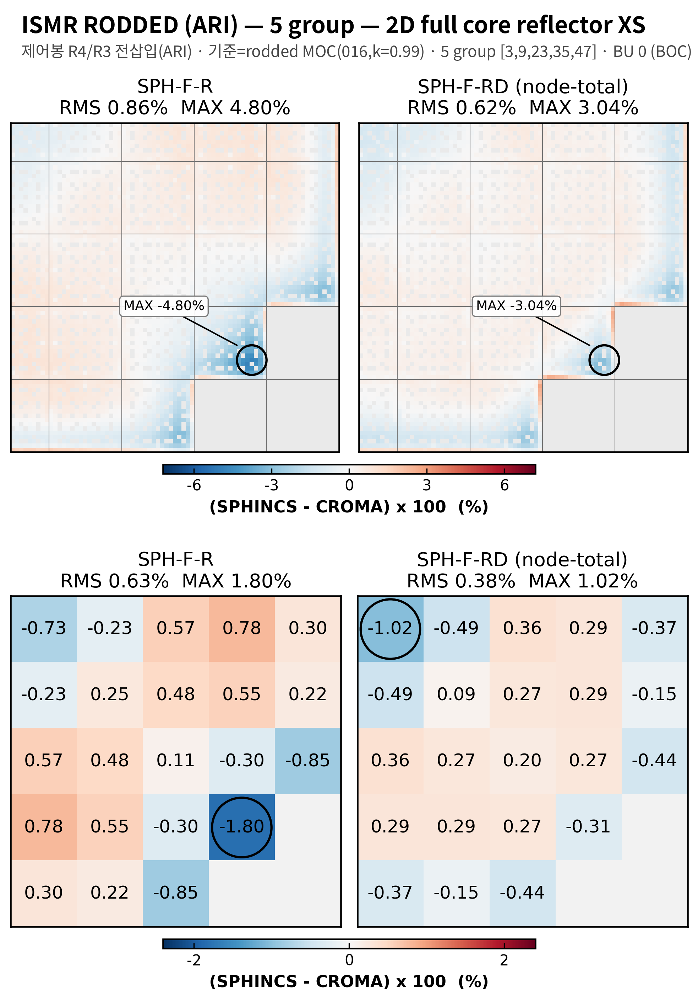
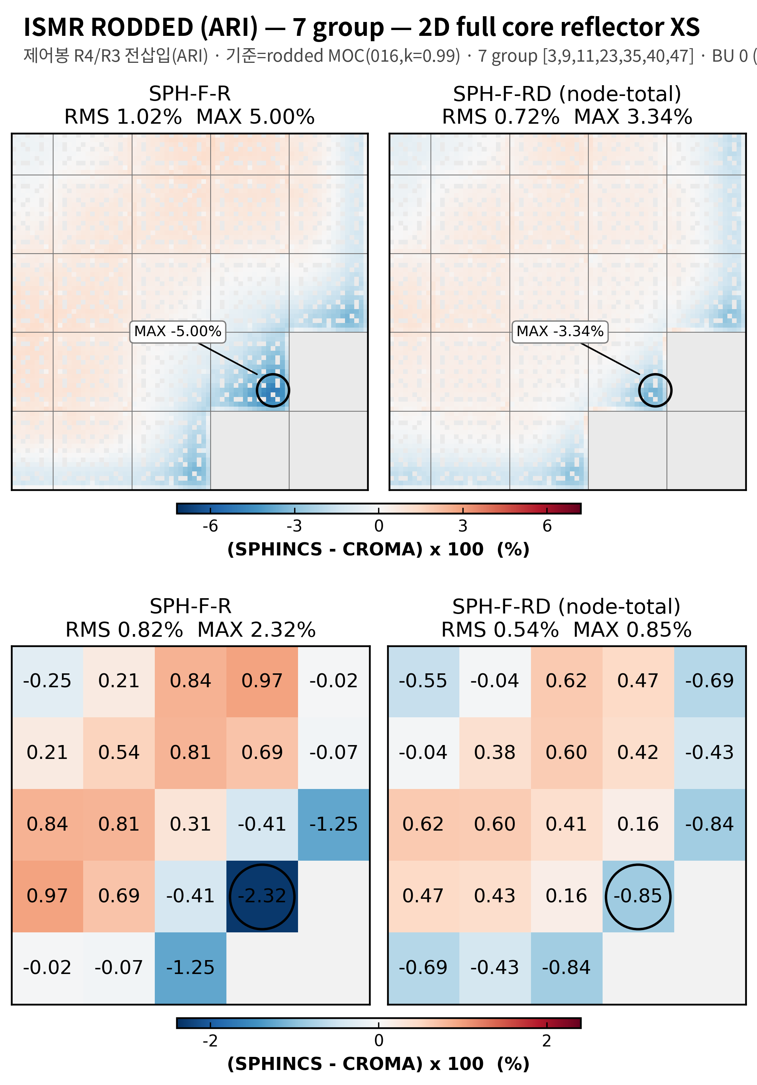
group structure test
2D i-SMR rodded 비교 (2, 4, 5, 7 군)
i-SMR rooded (ARI), 2 group,
2D full core reflector XS
i-SMR rooded (ARI), 4 group,
2D full core reflector XS
i-SMR rooded (ARI), 5 group,
2D full core reflector XS
i-SMR rooded (ARI), 7 group,
2D full core reflector XS

Slide 20

결론 및 향후 계획
결론: 반사체 보정인자가 대부분 케이스(7g OPR / APR 제외)에서 RMS, MAX를 개선하였음.
향후 계획
  2, 4, 5, 7 group pin-wise XS으로 --hom으로 2group nodal XS으로 균질화 하고 해가 같은지 확인
  9월 넷째 주 부터 논문 작성 시작
  Reload 모델 생성 및 비교 (참고)
    PRAGMA로 3D 연소계산 수행 (ARO), (몇주기까지?)
    노심계산: CROMA XS (FA, radial), PRAGMA XS (axial)

