Slide 1
MESSAGE TRANSFER PART
By
N.Daniel Raj

Slide 2
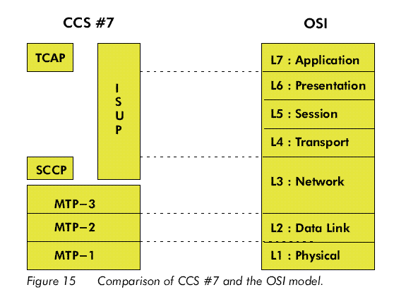
CCS #7 Vs. OSI

Slide 3
Why Layered Structure?
The purely telephone network is evolving into a general purpose network capable of transporting all kinds of user information
In order to cope with this changing environment, a very flexible signaling system is required, which can perform signaling functions for all kinds of telecom applications, already existing, or even future applications yet to be defined.

Slide 4

Why Layered Structure ?
In order to obtain this flexibility in CCS#7, a modular and layered structure is required.
CCS #7 divides the functionality into two
  Message Transfer Part (Common)
  User Part(Different)
The same common MTP module is extracted and servers as a transport system even for different user parts.

Slide 5
CCS #7 Vs. OSI

Slide 6
Message Transfer Part
The overall functionality of MTP is to server as a transport system, providing reliable transfer of signaling messages.
MTP-1
  Takes care of pure transmission of bits from Signaling Point to Signaling Point
MTP-2
  Error Detection and correction
MTP-3
  Performs two major functions
    Signaling Message Handling Functions
    Signaling Network Management Functions

Slide 7
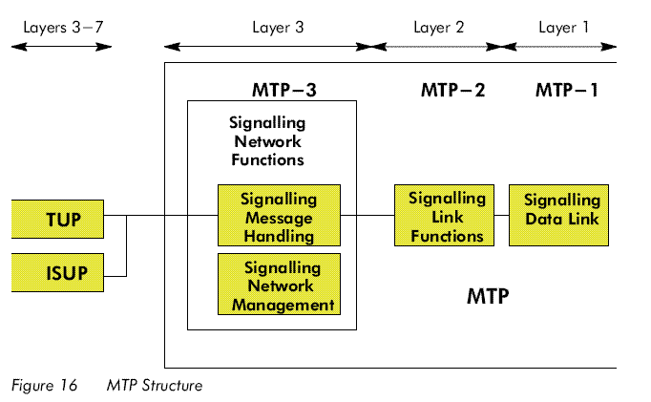
MTP Structure

Slide 8
MTP Functionalities
MTP can send information messages to any destination inside the national CCS #7 network where call originated or to any location in the CCS#7 international network.
It provides error free transportation of signaling information across the entire network
MTP has ability to react to system and network failures and can take necessary actions.
MTP can provide information exchange in a digital but also in a analogue transmission environment.

Slide 9
MTP-1
CCS #7 will make use of existing bit-transport equipment, provided in the telephone network on the inter-exchange level.They are called Signaling Data Links.
A signaling data link is a bi-directional transmission path for signaling, comprising 2 data channels operating together in opposite direction at the same data rate.
A signaling data link can be analogue or digital. It can be a terrestrial or a satellite transmission link.

Slide 10
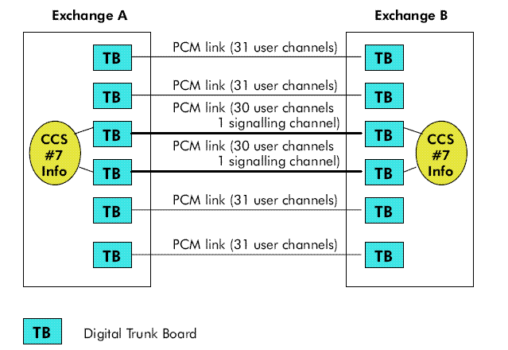
Digital Signaling Data Link
In a digital environment, 64kbit/sec digital paths will normally be used.

Slide 11
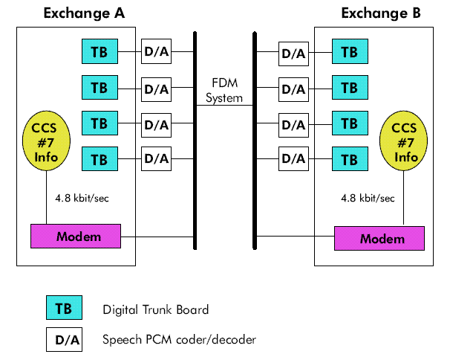
Analogue Signaling Data Link

Slide 12
MTP-2
Functionality
  Signal Unit Delimitation (flag)
  Signal Unit Alignment
  Error Detection
  Error Correction
    Basic Error Correction method(BER)
    Preventive Cyclic Retransmission method(PCR)
  Initial Alignment (link)
  Signaling Link Error Monitoring
    Signaling Unit Error Rate Monitor(SUERM)
    Alignment Error Rate Monitor(AERM)
  Flow Control

Slide 13
Signaling Units
A signal unit is nothing more than a packet, to be transmitted over the CCS #7 network.
Message Signal Units(MSU’s)
  It will transport information sent from a certain User Part of a signaling point to a user part of another signaling point.
Link Status Signal Units(LSSU’s)
  Flow Control- in case of congestion busy status will be sent
  During the initial alignment phase
Fill-in Signal Units(FISU’s)
  These units are sent when there is no payload’
  They don’t contain any information(they are empty)

Slide 14
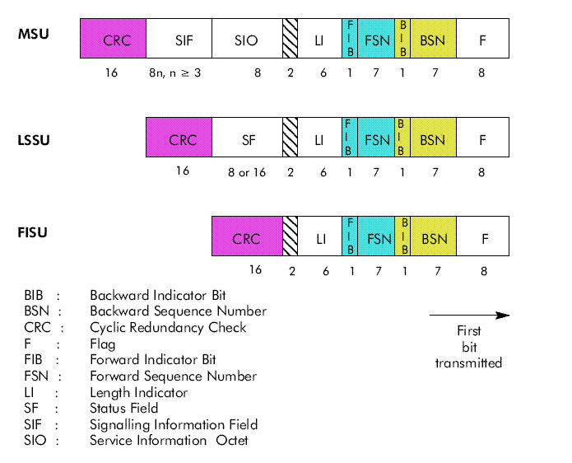
Signaling Units

Slide 15
MTP-2 Procedures
Signal Unit Delimitation
  8 bit flag 01111110
  Bit stuffing
  One’s density violation (more than 6 consecutive 1s)
Signal Unit Alignment
  A link is in alignment when signal units are received in sequence without ones-density violation and with proper no. of octets( its should be multiple of 8 n less than 272 octets)
  When there is excessive no. of alignment errors, the link is taken out of service.

Slide 16
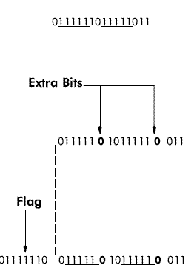
Bit Stuffing
Detection of 5 consecutive 1s ➔insert a 0
This is done before a flag is inserted
Not applicable for flag bits.

Slide 17

MTP-2 Procedures
Error Detection
  We use 16-bit Cyclic Redundancy Check
Error Correction
  Basic Error Correction Method
  Preventive Cyclic Retransmission Method

Slide 18
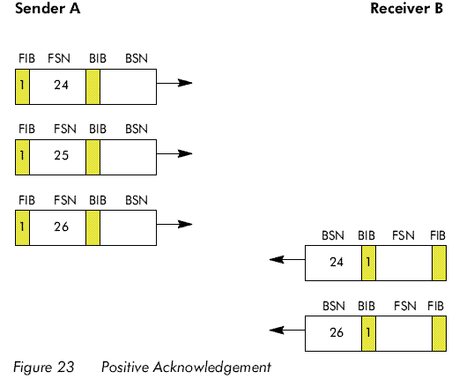
Basic Error Correction Method

Slide 19
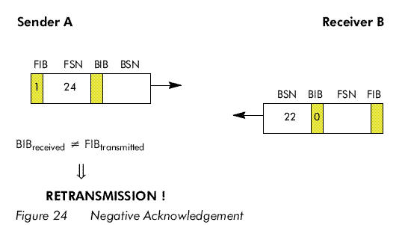
Basic Error Correction Method

Slide 20
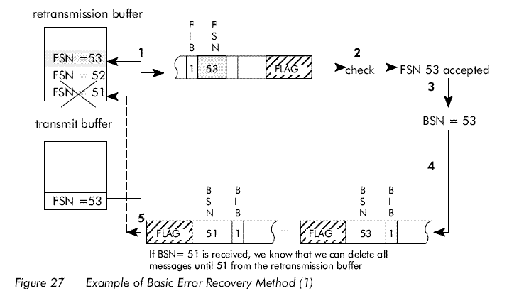
Basic Error Correction Method

Slide 21
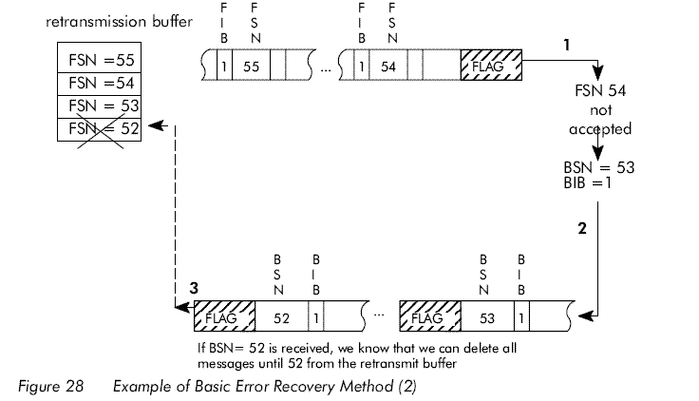
Basic Error Correction Method

Slide 22
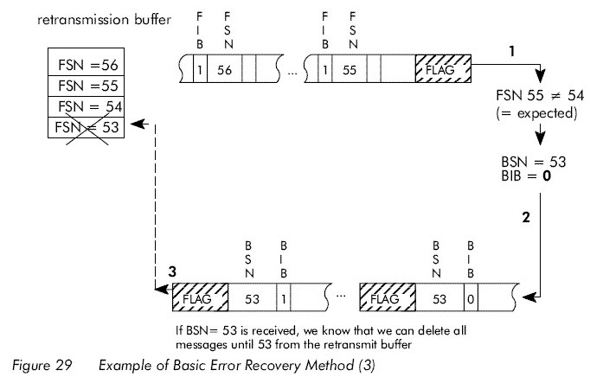
Basic Error Correction Method

Slide 23
Preventive Cyclic Retransmission Method
This method is used on lines in which the propagation delay is in excess of 15msec
In contrast to the previous method this method only positive ack exists.
If no new msgs are available then retransmission takes place.
Always new msgs has high priority than the msgs in re-transmission buffer.
If the re-transmission buffer is full then a forced retransmission takes place.
FISU’s will be sent when there are no msgs in transmission and retransmission buffers.

Slide 24
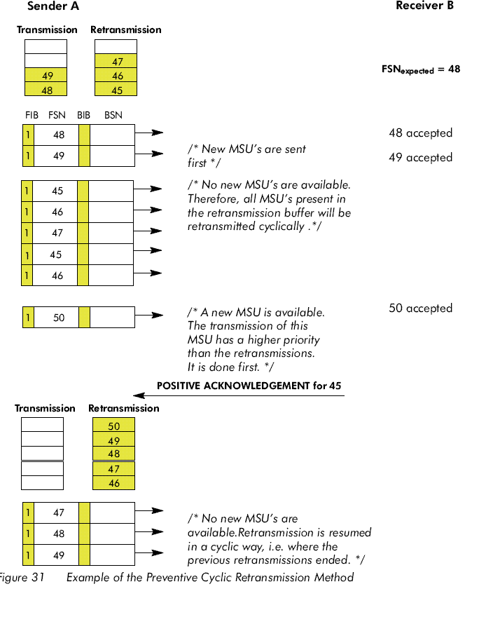
Example of PCR

Slide 25
MTP-2 Procedures
Initial Alignment
  This proc. Is applicable for activation and restoration of a signaling link. Its purpose is to reestablish the timing and alignment of signal units so that the affected signaling point can detect the Flag.
  Two alignments possible
    Normal- when other links are associated with the affected link
    Emergency- when no other link is associated to the affected link.
  There are five stages entered during alignment idle, not aligned, aligned, proving, aligned ready

Slide 26
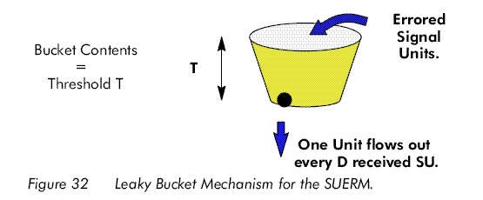
MTP-2 Procedures
Signaling Link Error Monitoring
  Signal Unit Error Rate Monitor(SUERM)
    This is used when the link is in service

Slide 27
MTP-2 Procedures
  - Alignment Error Rate Monitor(AERM)
    This monitor is only used during the alignment procedure(normal or emergency)
    The counter is started from zero and is incremented for every errored signal units.
    After a threshold T(T=4 for normal & 1 for emergency) proving period is aborted and realignment restarts.
Flow Control
  After a congestion is detected at the receiving end of the signaling link, an LSSU status indication “B”(Busy) is sent from the receiving end to the other side.
  LSSU always have the highest priority of all Signal Units.

Slide 28
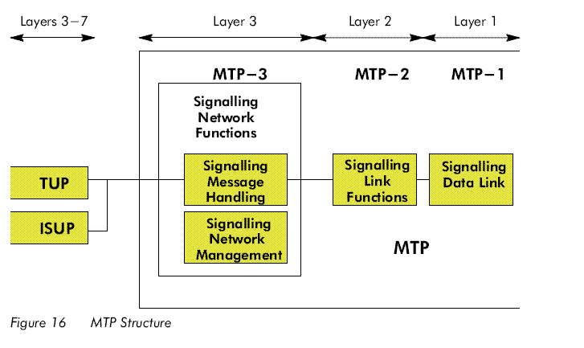
MTP-3

Slide 29
MTP-3
Signaling Message Handling Functions
  It ensures that a msg originated by a particular User Part at an originating Signaling Point is delivered to the same user part at the destination Signaling Point.
  Delivery may be direct or indirect(via another STP)
Signaling Network Management Functions
  Reconfigures signaling network in case of failures
  Controls traffic in case of congestion
  Can by pass faulty links or STP
  And can also activate or align new signaling links

Slide 30
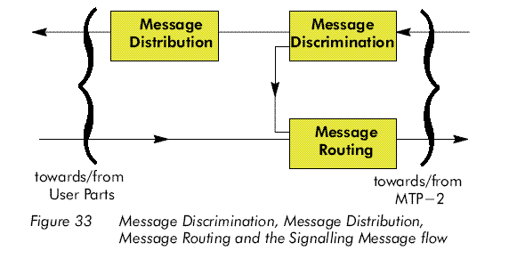
Signaling Message Handling Functions

Slide 31

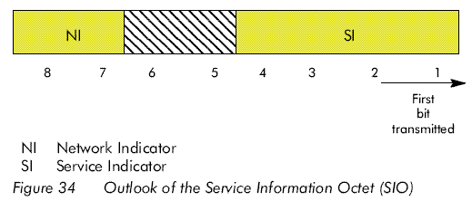
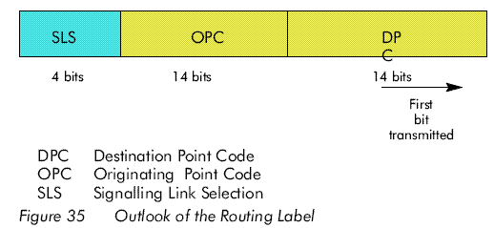
Parameters

Slide 32
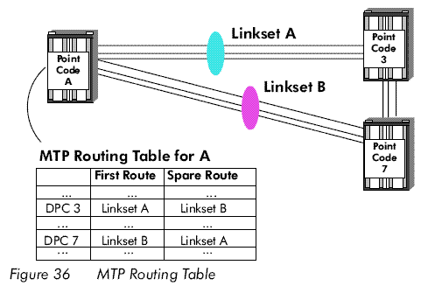
DPC- Destination Point Code
This is a 14 bit unique identification of the destination(exchange )in a CCS#7 network.
Routing

Slide 33
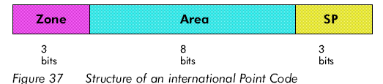
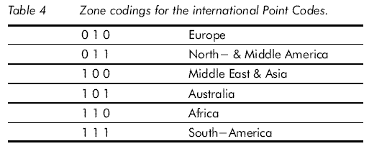
DPC- Destination Point Code
Range
  The Range of DPC is Only 2¹⁴ =16 384
  So we go for NI(Network Indicator)
Structure Of International Point Code

Slide 34
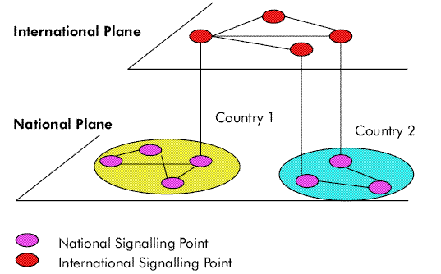

OPC-Originating Point Code

Slide 35
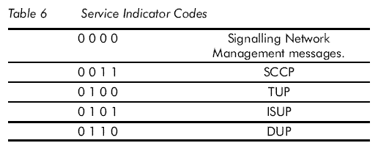
OPC-Originating Point Code

Slide 36
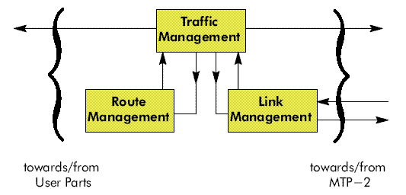
Signaling Network Management Functions

Slide 37
Traffic Management Functions
Changeover
Changeback
Forced Rerouting
Controlled Rerouting
MTP Restart
Management Inhibiting
Signaling Traffic Flow Control

Slide 38
Link Management Functions
Signaling link activation
Signaling link deactivation
Signaling link restoration
Link set activation
Automatic allocation of signaling terminals and signaling data links.

Slide 39
Route Management Functions
Transfer Prohibited Procedure
Transfer Allowed Procedure
Transfer Restricted Procedure
Signaling Route-set Test Procedure
Transfer Controlled Procedure
Signaling Route-set Congestion Test Procedure

