Slide 1

Text MINING
Dominik Nerger
Source: http://vignette1.wikia.nocookie.net/southpark2/images/c/c1/South_Park_Season_14.png/revision/latest?cb=20140423142814&path-prefix=de

Slide 2
Overview
1
Introduction
2
Data set & pre-processing
3
Results
4
Conclusion

Slide 3
Overview
1
Introduction
2
Data set & pre-processing
3
Results
4
Conclusion

Slide 4
Introduction
Analyze South Park
Focus on Season 18
Answer who, what, when, why
Programming language: R
Libraries:
TM (Text Mining library)
NLP/Apache OpenNLP (NER-Tagging)
smf (Structural Topic Model)
and many more

Slide 5
Overview
1
Introduction
2
Data set & pre-processing
3
Results
4
Conclusion

Slide 6
Data set & pre-processing
18 seasons, 257 episodes, 70879 Lines
Reduced size of Corpus by 30% after pre-processing
Crawled from: http://southpark.wikia.com
Worked on own crawl, filtering necessary
Tables change between seasons
Unnecessary information
Provided by: https://github.com/BobAdamsEE/SouthParkData

Slide 7
Overview
1
Introduction
2
Data set & pre-processing
3
Results
3.1
Wordclouds & Relations of characters
3.2
NER-Tagging
3.3
Sentiment Mining
3.4
Non-negative matrix factorization
3.5
Structural Topic Model
4
Conclusion

Slide 8
Overview
1
Introduction
2
Data set & pre-processing
3
Results
3.1
Wordclouds & Relations of characters
3.2
NER-Tagging
3.3
Sentiment Mining
3.4
Non-negative matrix factorization
3.5
Structural Topic Model
4
Conclusion

Slide 9
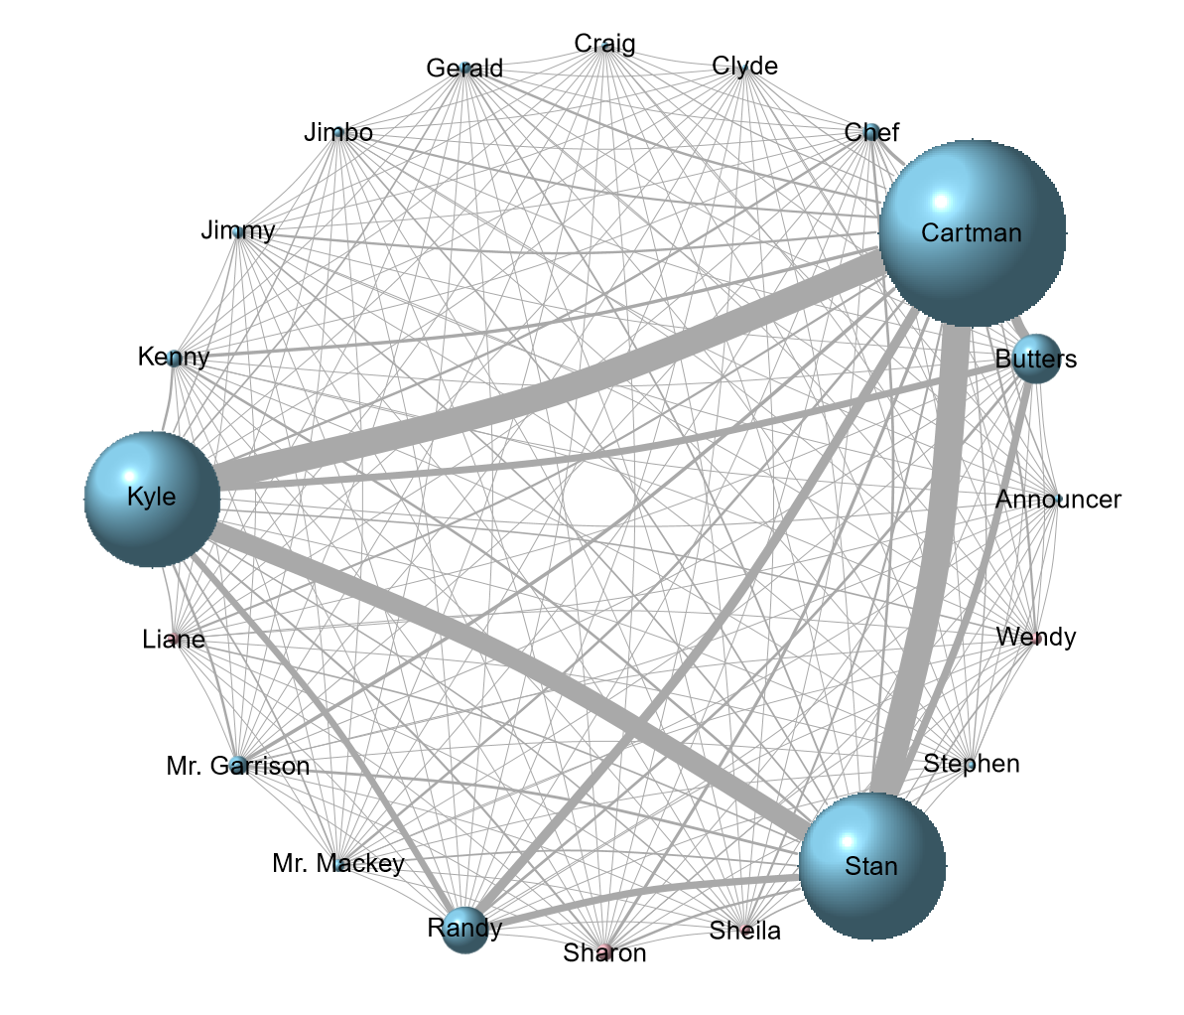
Co-occurence of Characters

Slide 10
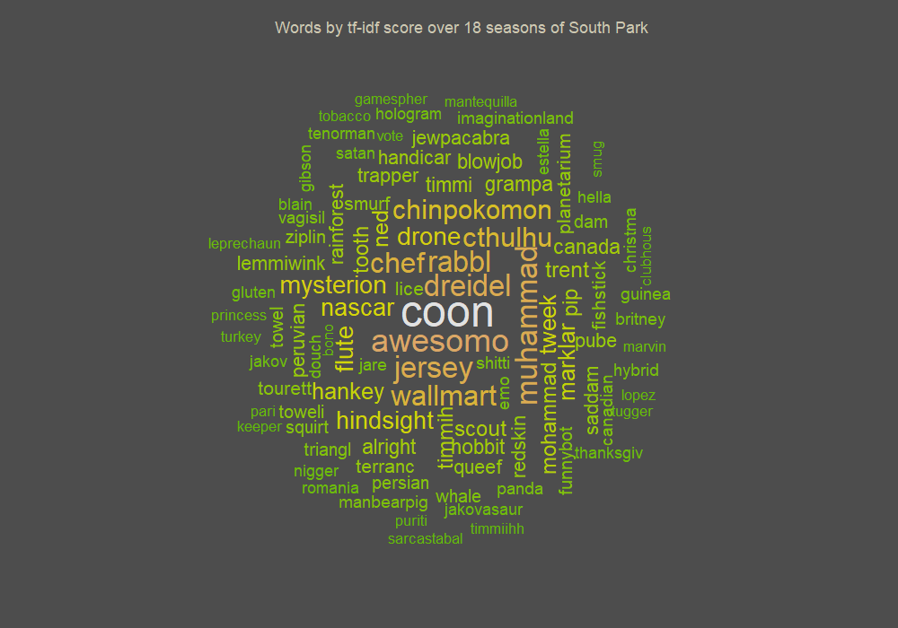
Wordcloud TF-IDF

Slide 11
Overview
1
Introduction
2
Data set & pre-processing
3
Results
3.1
Wordclouds & Relations of characters
3.2
NER-Tagging
3.3
Sentiment Mining
3.4
Non-negative matrix factorization
3.5
Structural Topic Model
4
Conclusion

Slide 12
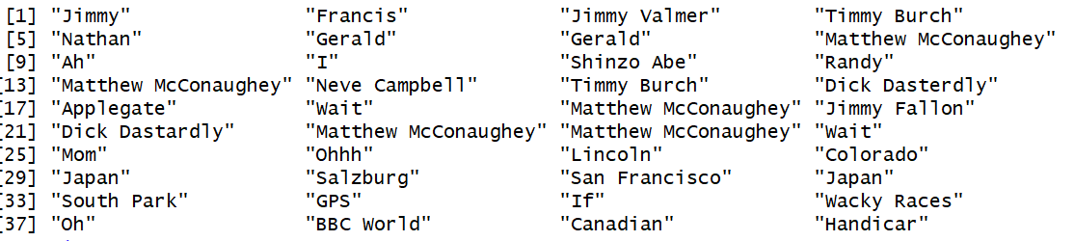
Named Entity Recognition
Annotated Sentiments & Entities (Persons, Locations, Organizations)
Entities for Season 18 Episode 4:
Notes:
openNLP

Slide 13
Overview
1
Introduction
2
Data set & pre-processing
3
Results
3.1
Wordclouds & Relations of characters
3.2
NER-Tagging
3.3
Sentiment Mining
3.4
Non-negative matrix factorization
3.5
Structural Topic Model
4
Conclusion

Slide 14
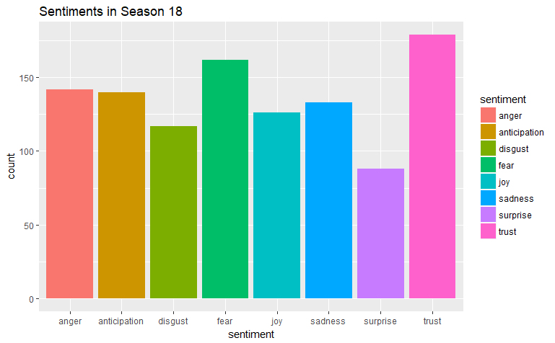
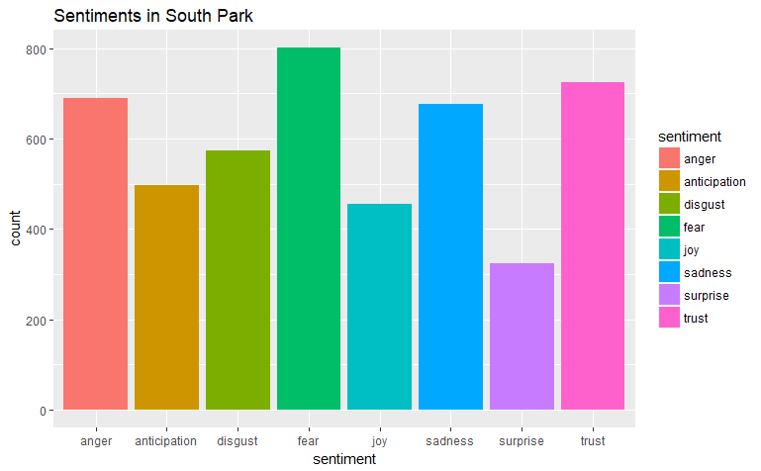
Sentiment Mining
NRC Lexicon
Positive/negative sentiment timeline
Aggregation of other sentiments

Slide 15
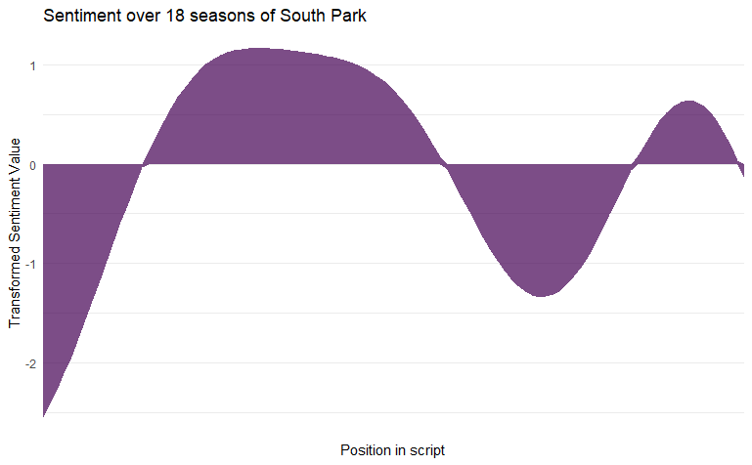
Sentiment Mining
Notes:
Fourier tranformation

Slide 16
Overview
1
Introduction
2
Data set & pre-processing
3
Results
3.1
Wordclouds & Relations of characters
3.2
NER-Tagging
3.3
Sentiment Mining
3.4
Non-negative matrix factorization
3.5
Structural Topic Model
4
Conclusion

Slide 17
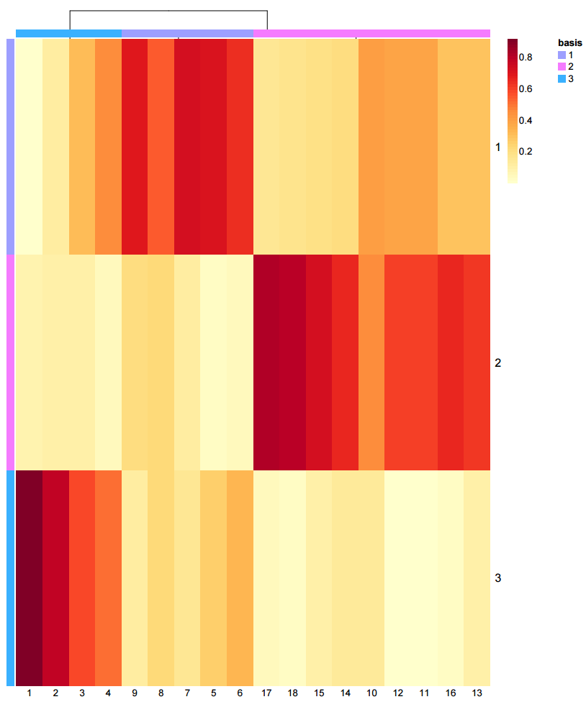
Non-negative Matrix Factorization
Data cluster of related
seasons
18 Seasons, 3 Topics
Clusters:
[1:4]
[5:9]
[10:18]

Slide 18
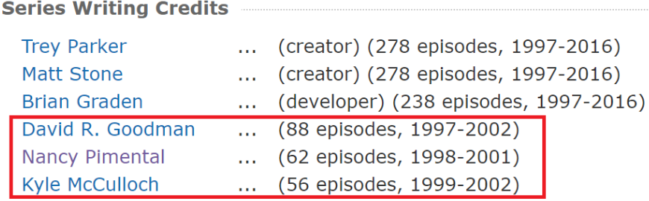
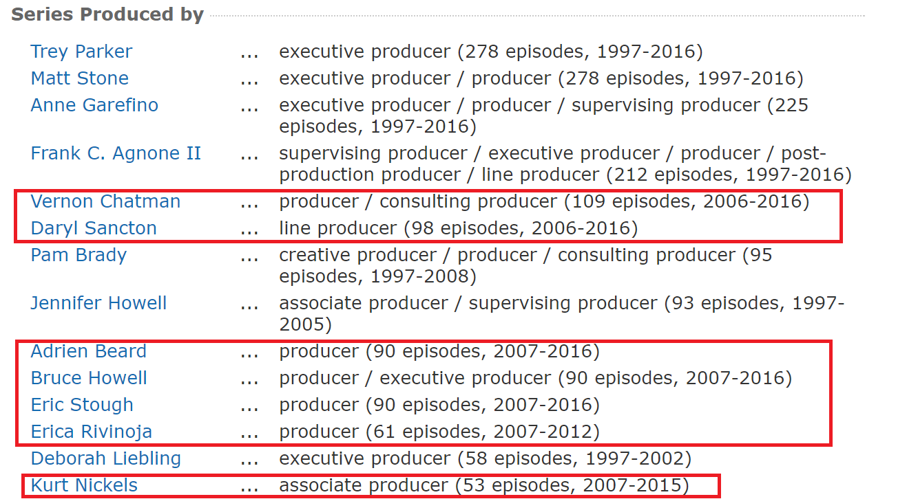
Non-negative Matrix Factorization
Major changes in writing (2001/2002) and producing (2006)
Correlates to different clusters from NMF
Season 5 in 2001
Season 10 in 2006
Conclusion: change of writing style

Slide 19
Overview
1
Introduction
2
Data set & pre-processing
3
Results
3.1
Wordclouds & Relations of characters
3.2
NER-Tagging
3.3
Sentiment Mining
3.4
Non-negative matrix factorization
3.5
Structural Topic Model
4
Conclusion

Slide 20
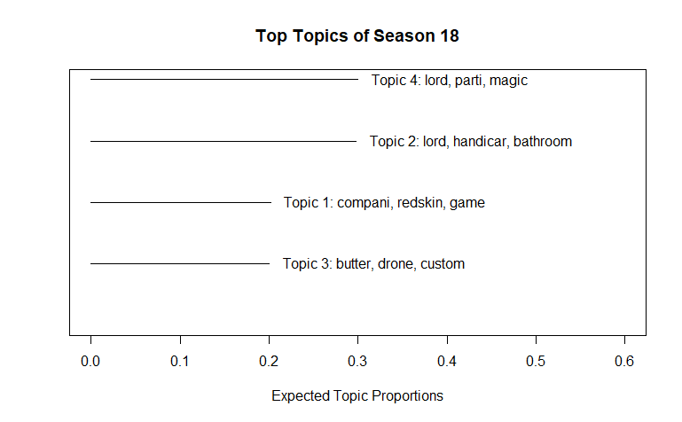
Structural Topic Model
LDA with meta data

Slide 21
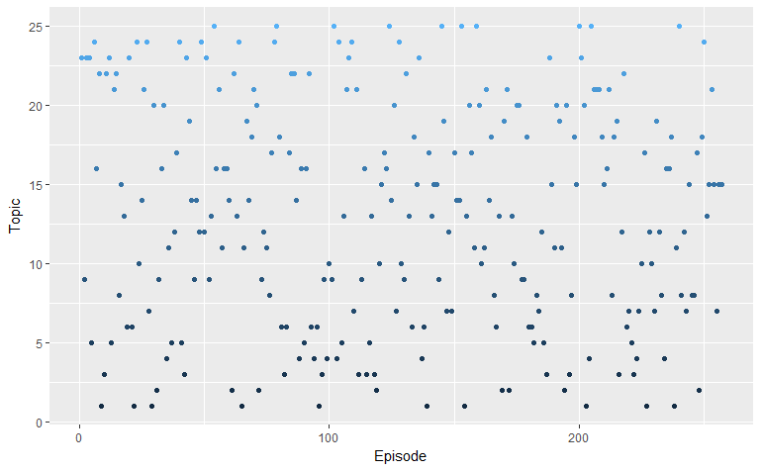
Structural Topic Model

Slide 22
Overview
1
Introduction
2
Data set & pre-processing
3
Results
4
Conclusion

Slide 23

Conclusion
Extracted topics and corresponding episodes (what & when)
Sentiment timeline (why & when)
Future work
- Change visualization
of topic timeline
- Incorporate persons
Source:http://1.images.southparkstudios.com/shared/homepage/promos/sp_fbw-gamesPage.jpg?quality=0.8

Slide 24

Thank you!

