Slide 1

Quick Methods for Recreating a DEM when Reprojecting a LiDAR Point Cloud
Doug Newcomb M.A
Stephen Mather M.A.

Slide 2
Why recreate the DEM?
Reprojection can change the DEM values
You can change resolution and method of creation to better match other layers ( Satellite imagery, Land cover, etc).
The “Official” DEM can have weird artifacts or inaccurate water levels for impoundments.

Slide 3
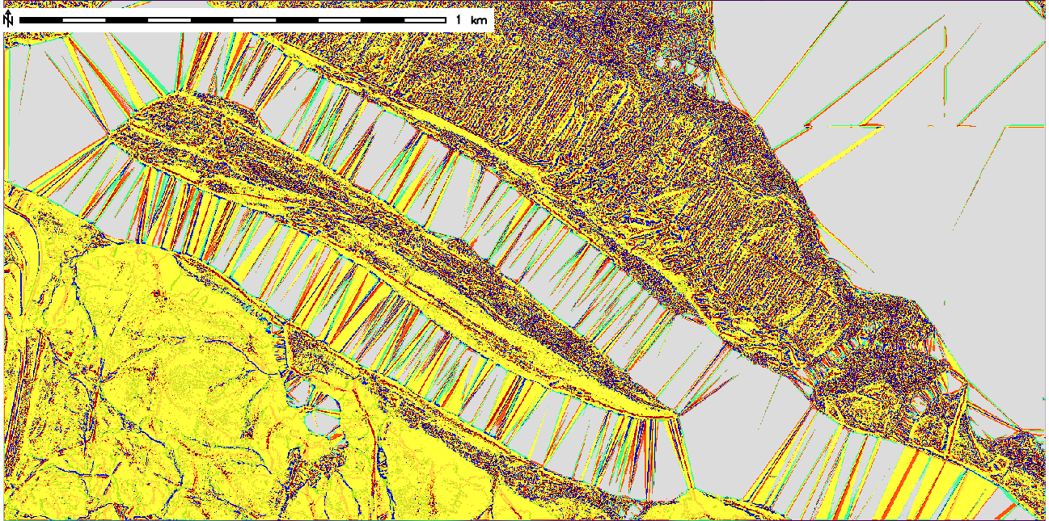
Triangles in “flat” water bodies
(Roanoke Rapids Reservoir, NC)

Slide 4
Problems with recreating the DEM with just Inverse Distance Weighting(IDW)
OK for small gaps and near the edge of the holes.
Uncertainty grows with distance from the edges
Ridge or pit in the center.
Need flat water bodies and building foundations.

Slide 5
Challenges
Speed and memory – Vector surface interpolation methods (v.surf.rst, etc)
  are great for small areas,
  slow and more memory intensive for landscape level areas.
Need vector breaklines for all gaps to force vector methods to flat surface
Fully raster method?

Slide 6
Raster Approach
Mean value of ground point per raster cell
Distance – limited IDW interpolation to fill small gaps
For large gaps, extract strip of elevations for shoreline
Stats of Z values of the shoreline
Apply single statistical derived value to remaining gaps.
Identify areas where approximation may be problematic

Slide 7
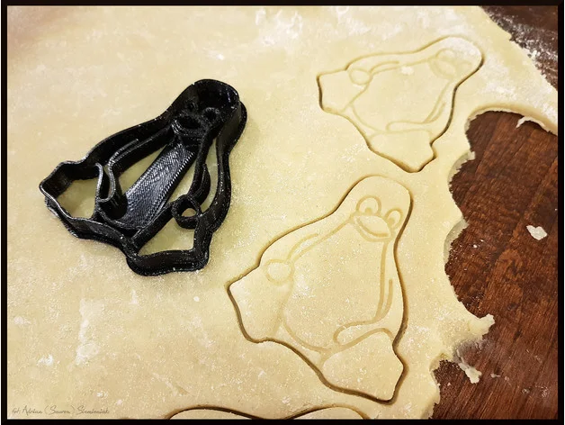
Just think Cookie Cutter
* Cutter pattern available on Thingverse

Slide 8
Start with the Ground points
Create mean Z value raster that leaves NODATA holes ( GRASS, PDAL,etc.)
Used GRASS GIS – r.in.lidar class = 2 method = mean ( in North Carolina 2014,15,16,17 data include 13 for roads)
Mean value moderates outliers in each cell

Slide 9
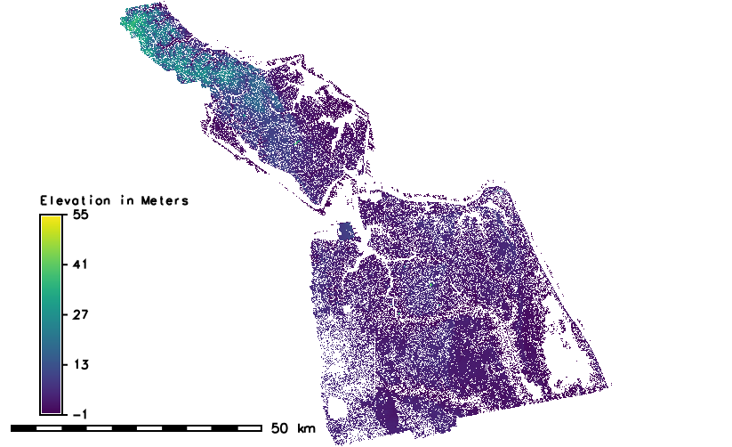
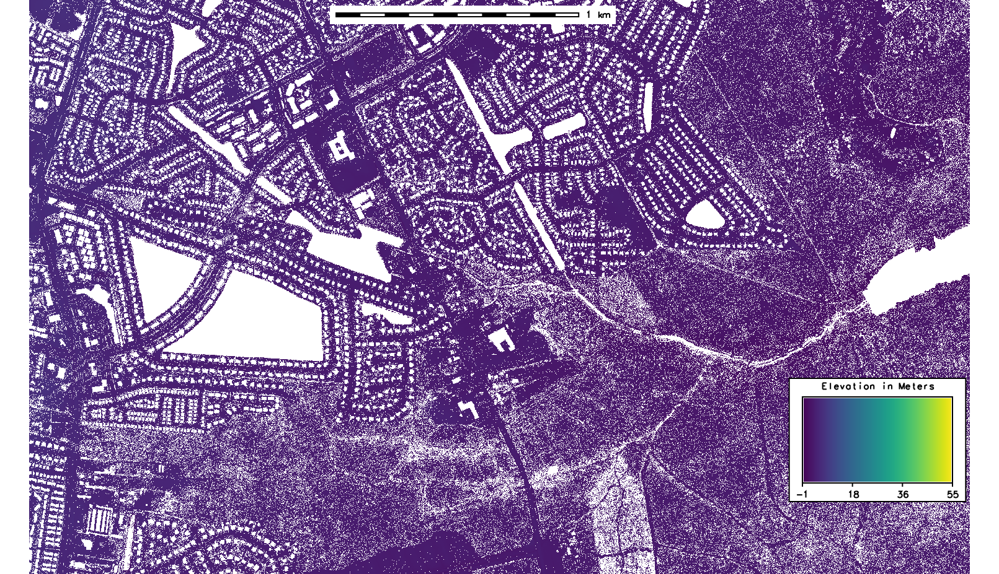
2013 Virginia Beach, Virginia collection, 1m Dem Mean Ground Points. 1399 tiles in one r.in.lidar command.
Post spacing of “unobscured areas” 0.7m, 19 cm vertical accuracy.
(Note artificial pond, houses natural pond and forest areas in red circles )

Slide 10
“Partial” IDW interpolation
Create a mask so that only the coverage area will be processed . Vector shapefile tile indexes can used.
Use GRASS r.fill.stats ( previously r.fill.gaps addon) to partially fill large gaps.
r.fill.stats -k input=Mean_raster_grid output=oufile cells = ( 3 or 5, depending on resolution of input grid. Generally use 5 for 1m grids and 3 for 5ft grids)
Cells is the number of cells to interpolate into the gap. Only small gaps will be completely filled.
-k flag is to keep the original values of the input cells ( default is to smooth). This speeds processing by only processing gap areas.

Slide 11
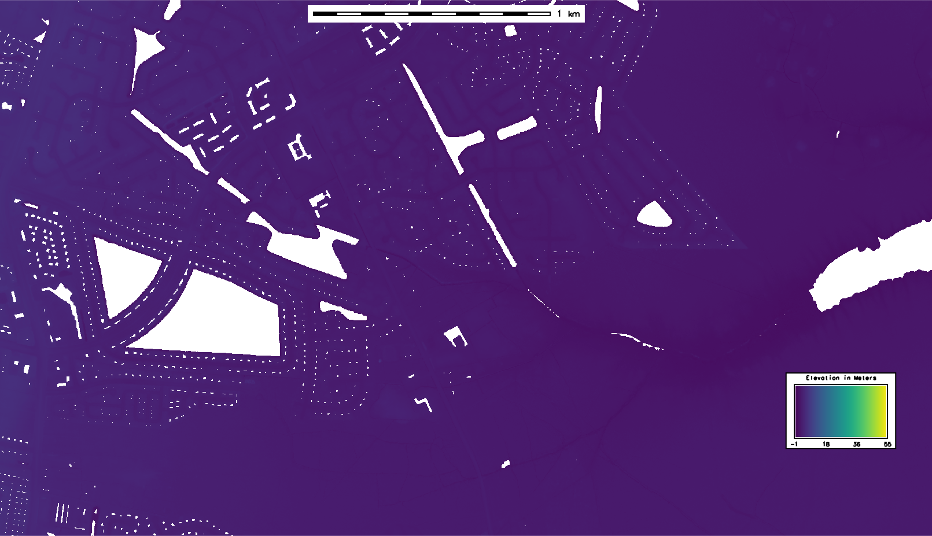
Same area following IDW interpolation (r.fill.stats -k cell=5 )

Slide 12
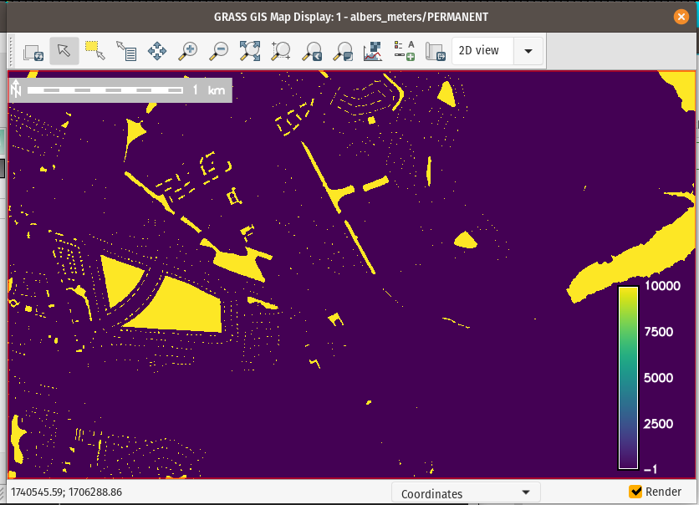
Isolate the gaps
Convert the NULL areas to value of 30000 or more using GRASS GIS r.null

Slide 13
Work from the gaps outward
Divide by 30000 and convert to integer. (Makes 1/0 grid)
Use GRASS r.reclass to convert 0 to NULL ( can use r.null again, but r.reclass is faster)
Use GRASS r.buffer to make zoned buffer back to original shoreline

Slide 14
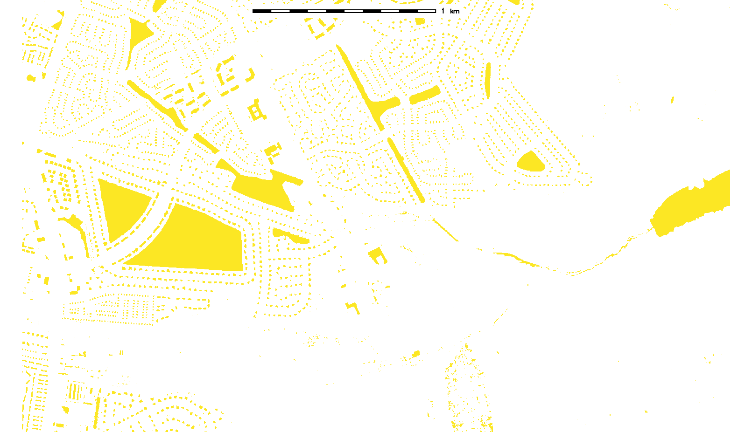
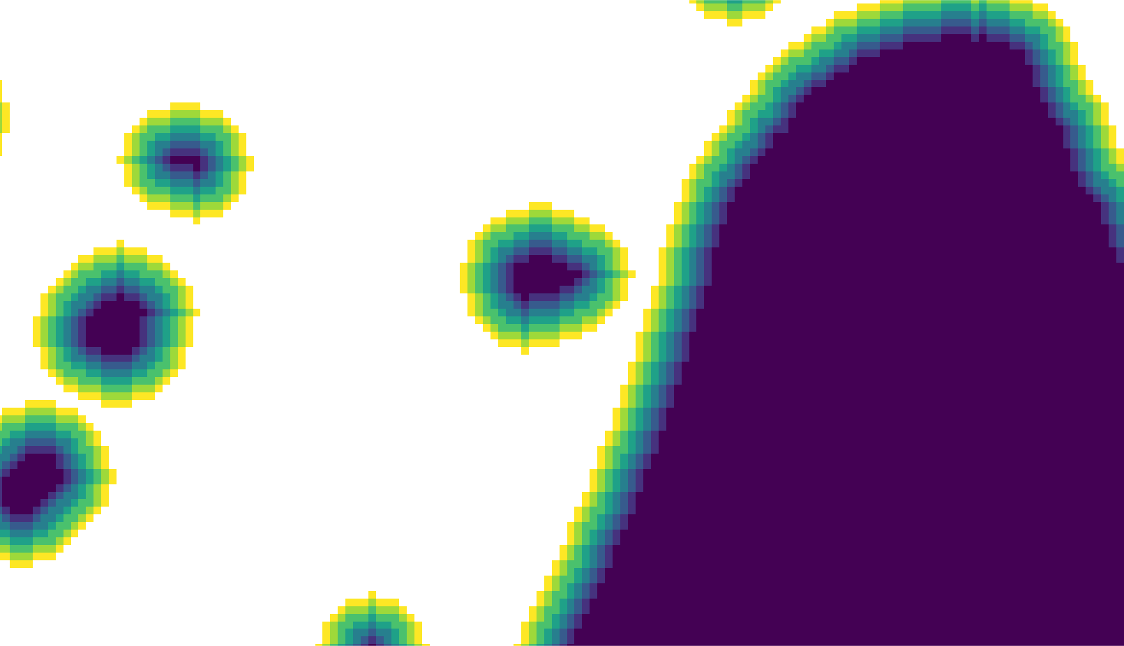
NULL areas are buffered using r.buffer
Original NULL areas
Select ring that intersects original edge before interpolation

Slide 15
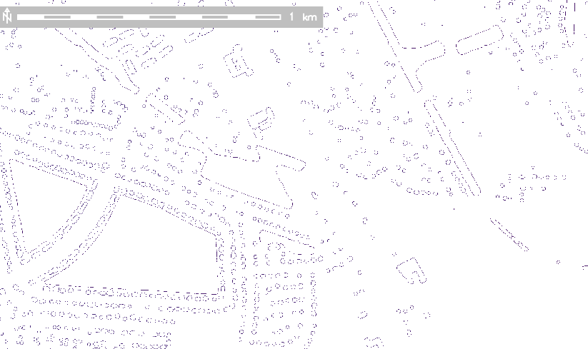
Mask to create shoreline strip
Use GRASS r.mask to select buffer ring that intersects with the original data edge next to ring.
R.mapcalc to create shoreline strip layer from partial idw layer

Slide 16
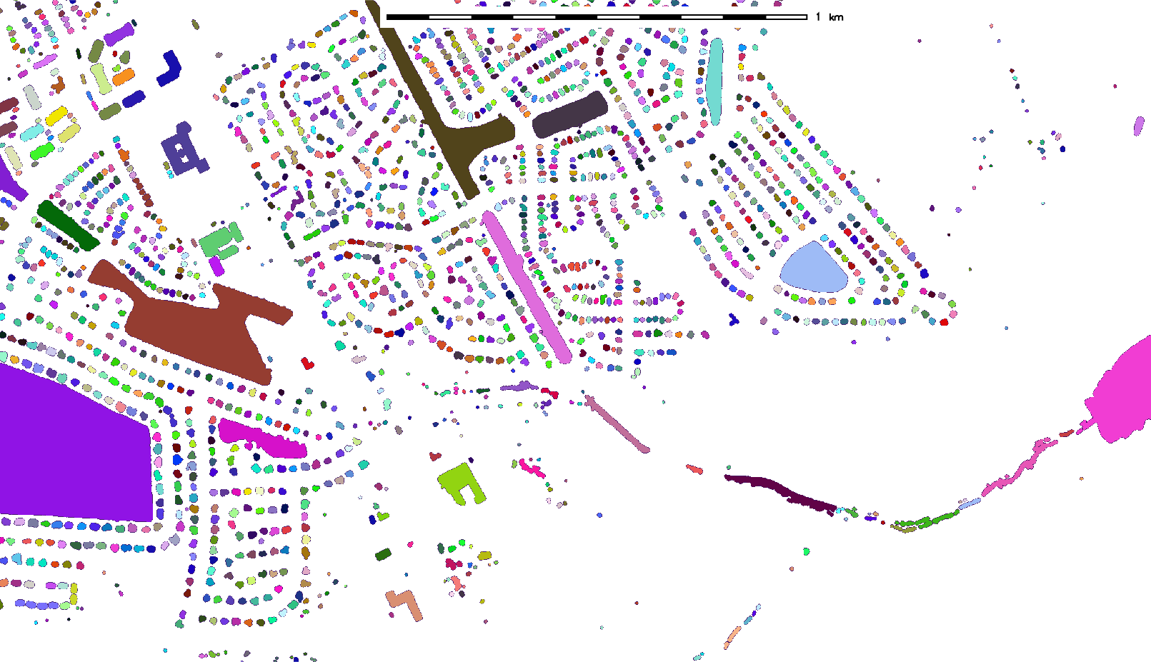
Create Raster Zones Layer
Back to buffer layer GRASS r.reclass – make buffer rings to single raster feature that overlays the edge strip.
GRASS r.clump to give each a unique value

Slide 17
Statistics time!
Run GRASS r.univar on the strip raster layer and use the clump raster as a zone raster.
Z stats for each shoreline separately.
Results are output to a csv file ( about 3.5 minutes on a layer with 900k unique rasters)

Slide 18
Select statistics that are resistant to the influence of outliers.
LiDAR points can do funny things on the edge of water
Minimum value of edge can be misleading
First quartile is more resistant to outliers
Std deviation gives shoreline Z variability

Slide 19
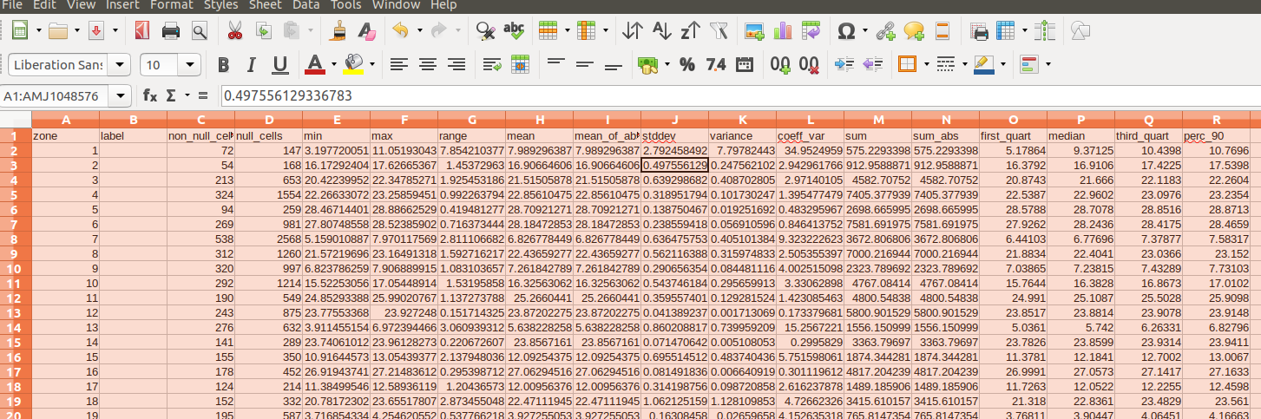
Select statistics that are resistant to the influence of outliers.

Slide 20
Convert Zone values to elevations ( *100)
Convert the data in the statistics file to a format for input into r.reclass with the format:
Zone = Int(1st quartile *100)
1 = 10201 ( for zone 1 with a 1st quartile value of 102.01 )
Convert the Zone values to elevation

Slide 21
Break out by Standard Deviation of Edge strip
Convert Standard Deviation values to Integer value range (in python)
valrang = int((float(statarr[9])/ vunit))
print statarr[0]+"Range= "+str(valrang)+"\n"
if valrang == 0: classval =statarr[0] +" = 1 Good\n"
    ( Less than 1 ft)
if valrang == 1: classval =statarr[0] +" = 2 Low Diff\n"
    (1 – 2 ft)
if valrang == 2: classval= statarr[0] +" = 3 Med Diff\n"
    (2 - 3 ft)
if valrang == 3: classval = statarr[0] +" = 4 Large Diff\n"
    ( 3 - 4 ft)
if valrang > 3: classval = statarr[0] +" = 5 High Diff\n"
    ( More than 4ft)

Slide 22
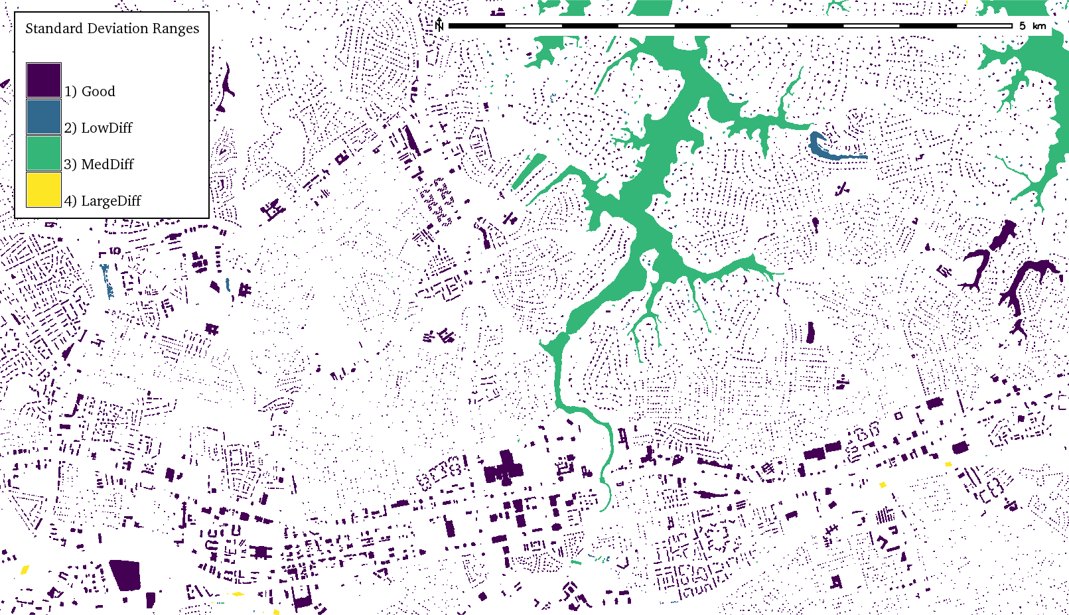
Ranges of Standard Deviation of Edge Strip values

Slide 23
Trim the new rasters and fit
Trim the rasters to water surface/building extent
Convert rasters to floating points and divide by 100.
Raster mask to cut holes in the original interpolated fill raster.
Merge the new water body raster and the trimmed interpolated raster.

Slide 24
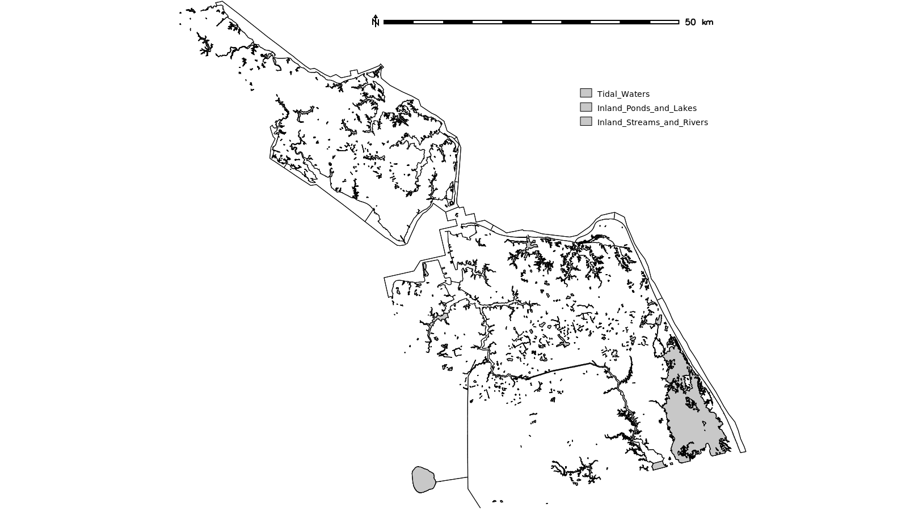
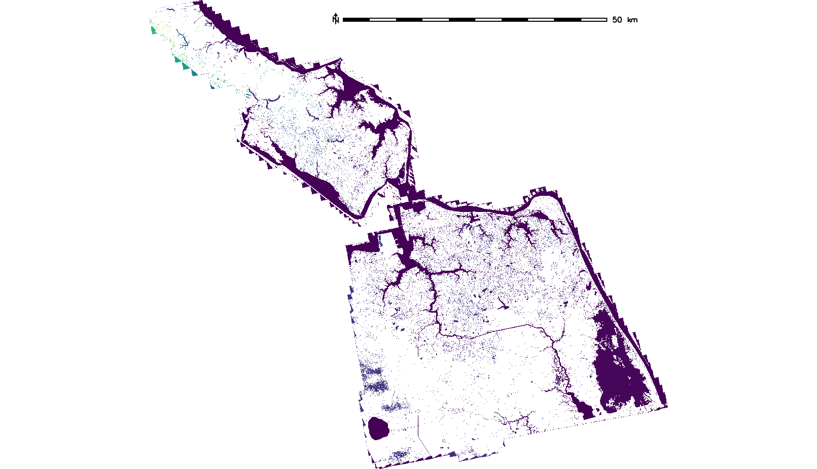
Why Not Just Reproject the Breaklines?
Standard breaklines only on waterbodies above a certain size, none of the building footprints

Slide 25
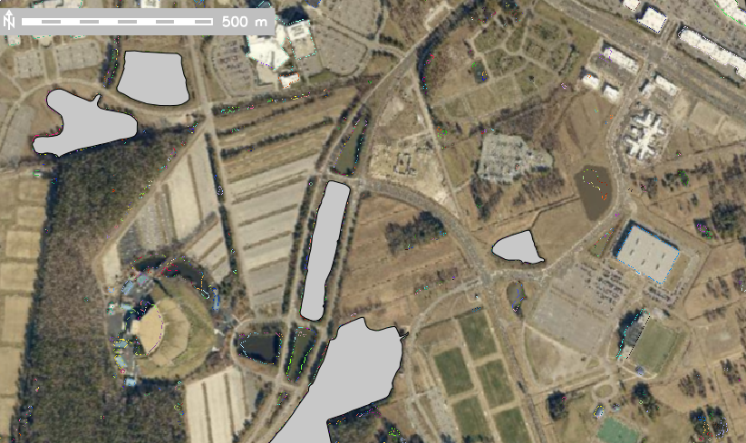
Standard Breaklines

Slide 26
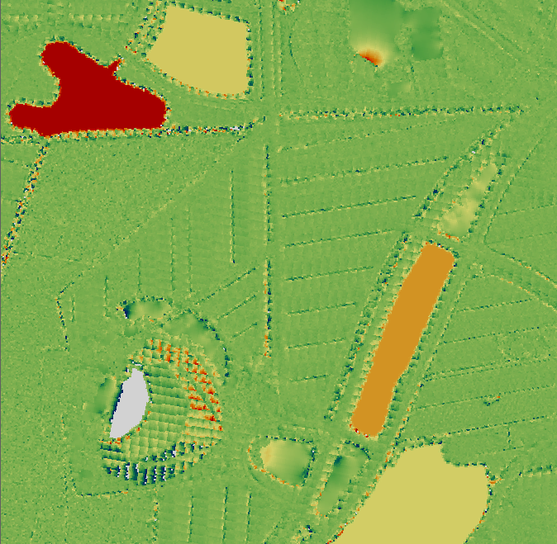
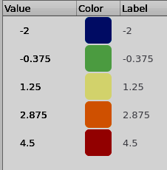
DEM Elevation difference ( feet)
1st quartile – NOAA 3m
Ground close, impoundments different
Saved for water level height comparison

Slide 27
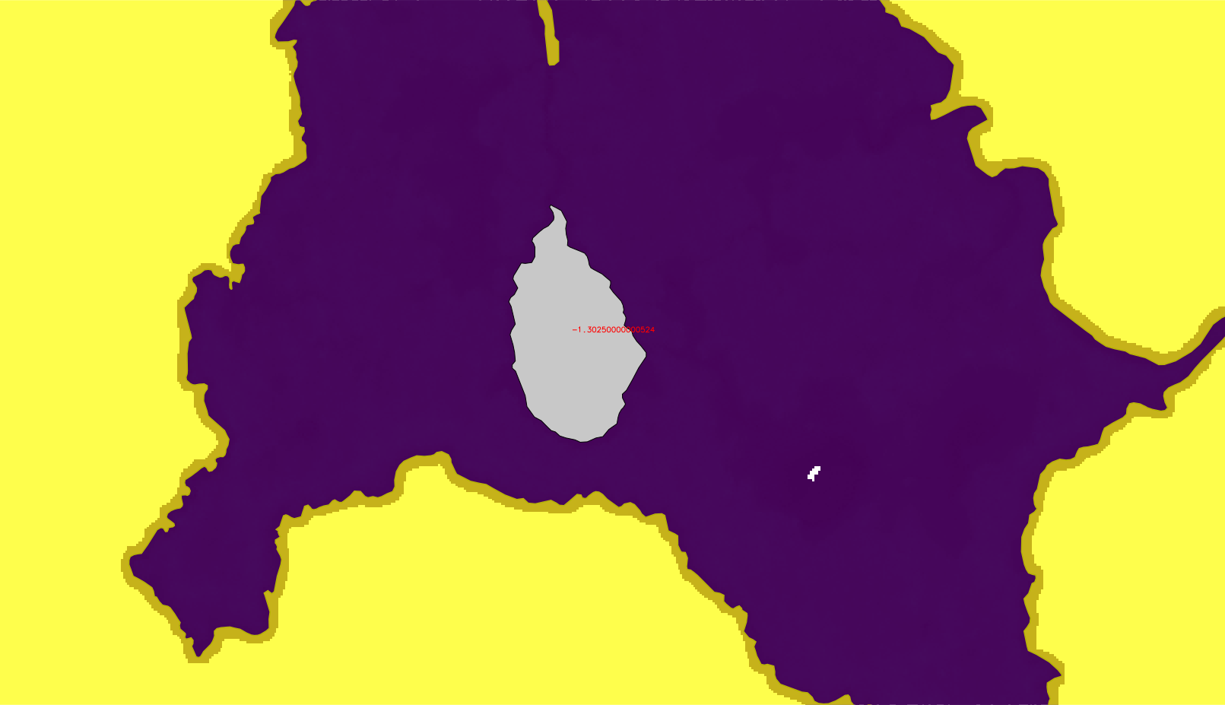
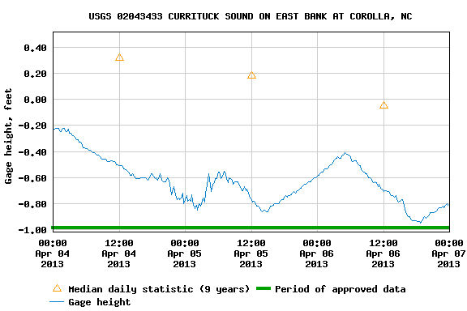
Some questions about breakline accuracy for water level at time of LiDAR flight (Island in Back Bay)
Breakline water level elevation. For Back Bay
-1.08920000000217 m
(-3.57 ft)
Breakline water level elevation. For Pond inside Island
- 1.30250000000524 m
(-4.271 ft)
Edge strip water level elevation. For Back Bay 0.06m (0.196 ft)
Std. Dev. Of values 0.265879616902516
Edge strip water level elevation. For Pond Inside Island 0.02m
(0.065 ft)
Std. Dev. Of values 0.088909137259652

Slide 28
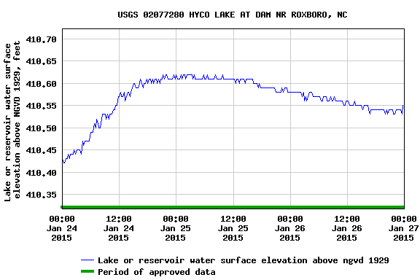
Hyco Lake, NC
Breakline water level elevation - 409.1499 NVD88
Raster interpolation water level elevation - 410.55 NVD88
Gage height NGVD29 410.6 = 409.760 NVD88 ( +/- .62 ft)

Slide 29
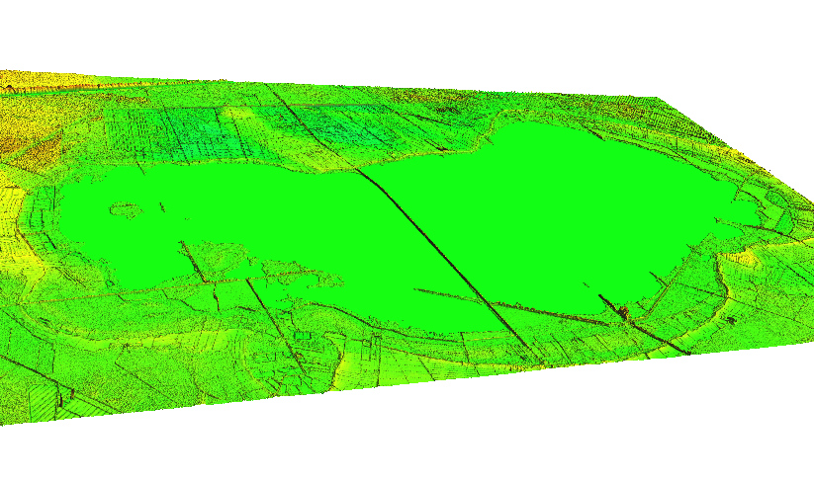
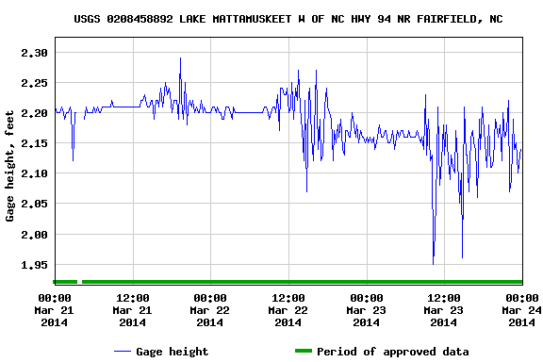
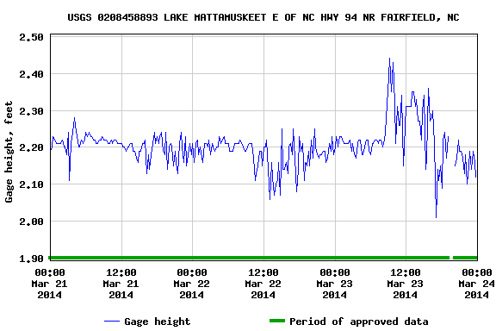
Lake Mattamuskeet, NC USGS gages on both West and East Side ( subtract 2 from gage values to get NVD88 value)
Breakline water level elevation : -.4999
Breakline water level elevation: -.6999
Raster interpolation water level elevation : .35
Raster interpolation water level elevation: .31

Slide 30
As usual,some answers,but more questions.
Interpolation is good enough for vegetative analysis.
Fast method for hydro flattening,
more complete for smaller water bodies across the landscape.
Could be as good or better than Methods over the past 10 years , needs statistical study.
Is quartile best stat, what about decile? 15%? 20%?
Next step – Double Line drainages, but that’s another presentation...

Slide 31
Over to you Stephen

Slide 32
Filling the gaps in city elevation models

Slide 33
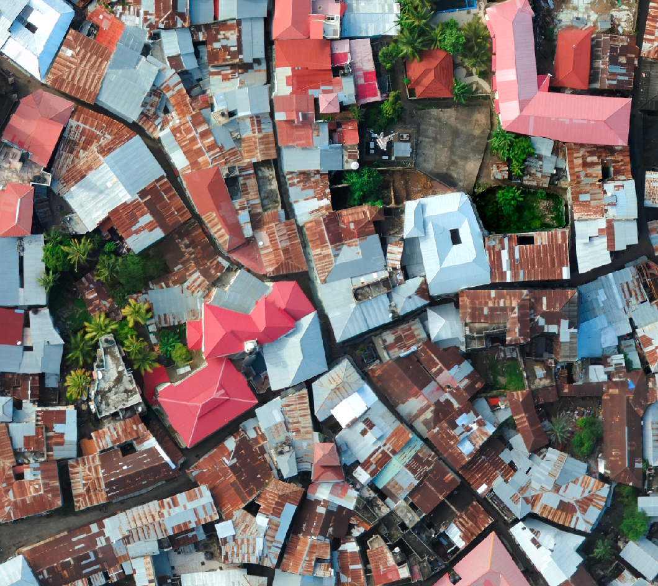
Filling the gaps in city elevation models
Photogrammetric datasets over cities are a low cost, locally producible option in low-income contexts and may compete with LiDAR under a range of conditions
Zanzibar Mapping Initiative is the largest area surveyed using low-cost drones
Optimized for orthophoto creation

Slide 34
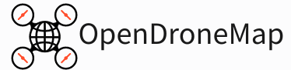
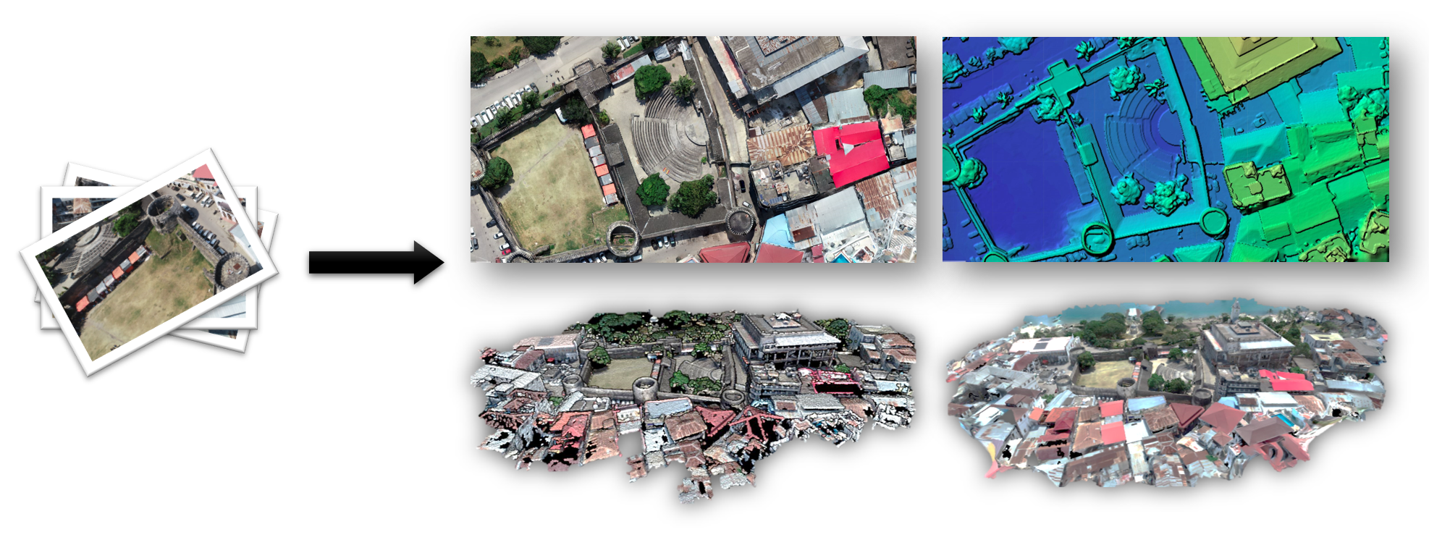

Slide 35
Filtering LiDAR Data
Zhang
Bartels
Pingel
Progressive or Simple Morphological
Cloth Simulation
Skewness Balancing

Slide 36
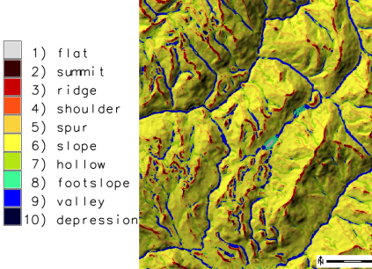
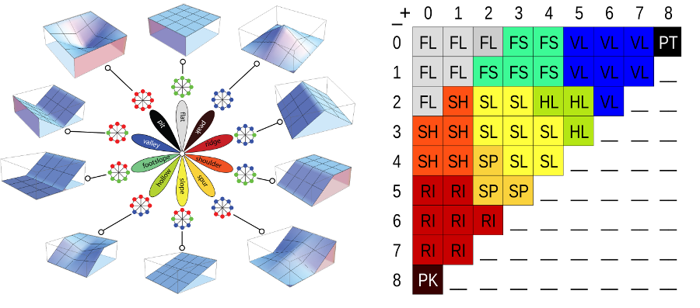
2.5D Filtering: r.geomorphon

Slide 37
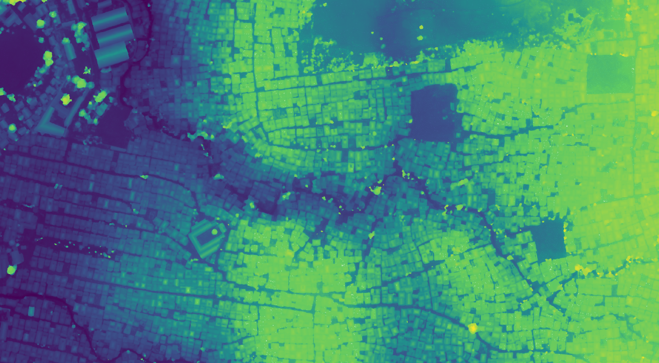
Digital Surface Model

Slide 38
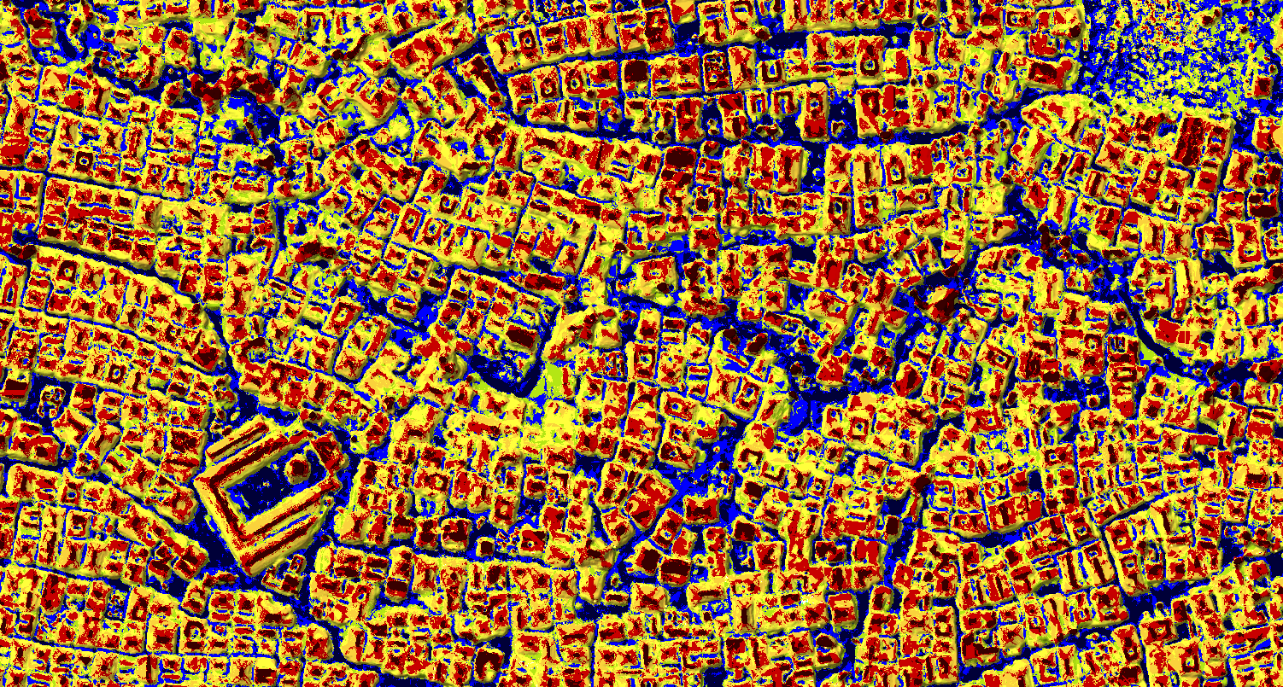
2.5D Filtering: r.geomorphon

Slide 39
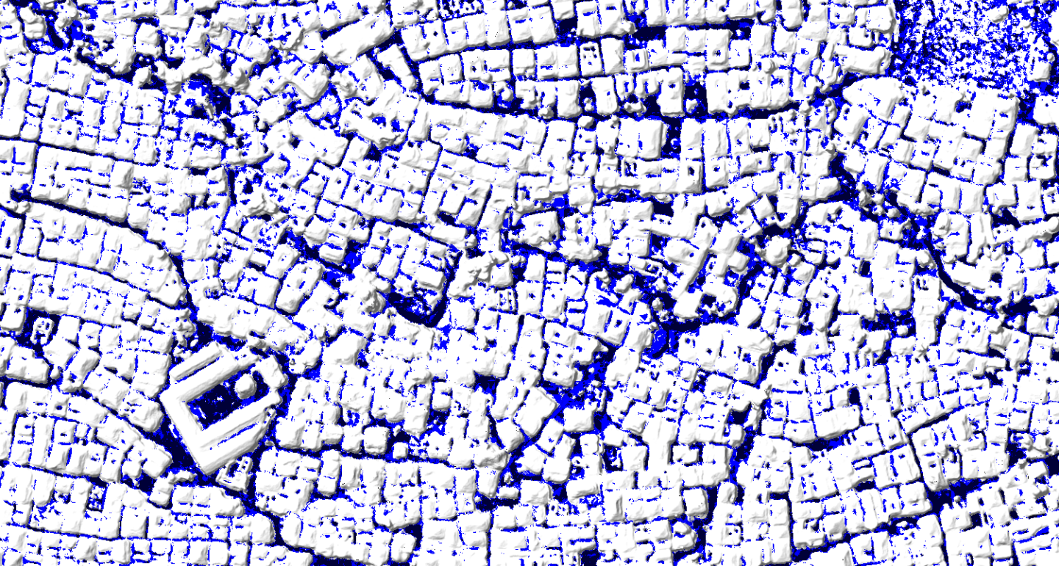
2.5D Filtering: r.geomorphon

Slide 40
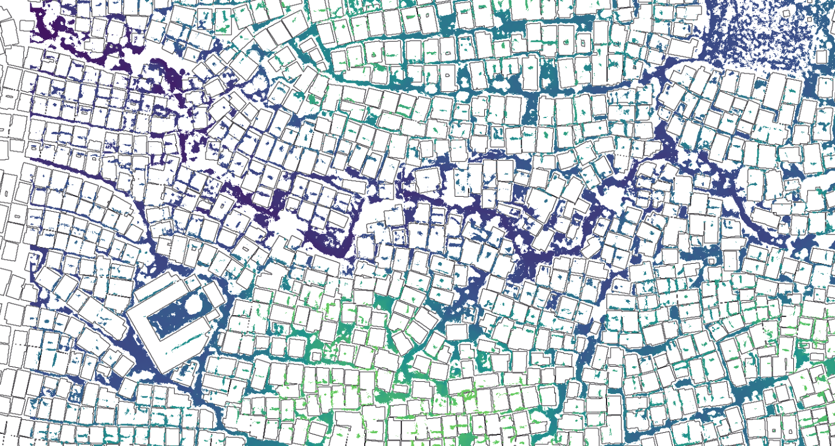
2.5D Filtering: r.geomorphon

Slide 41
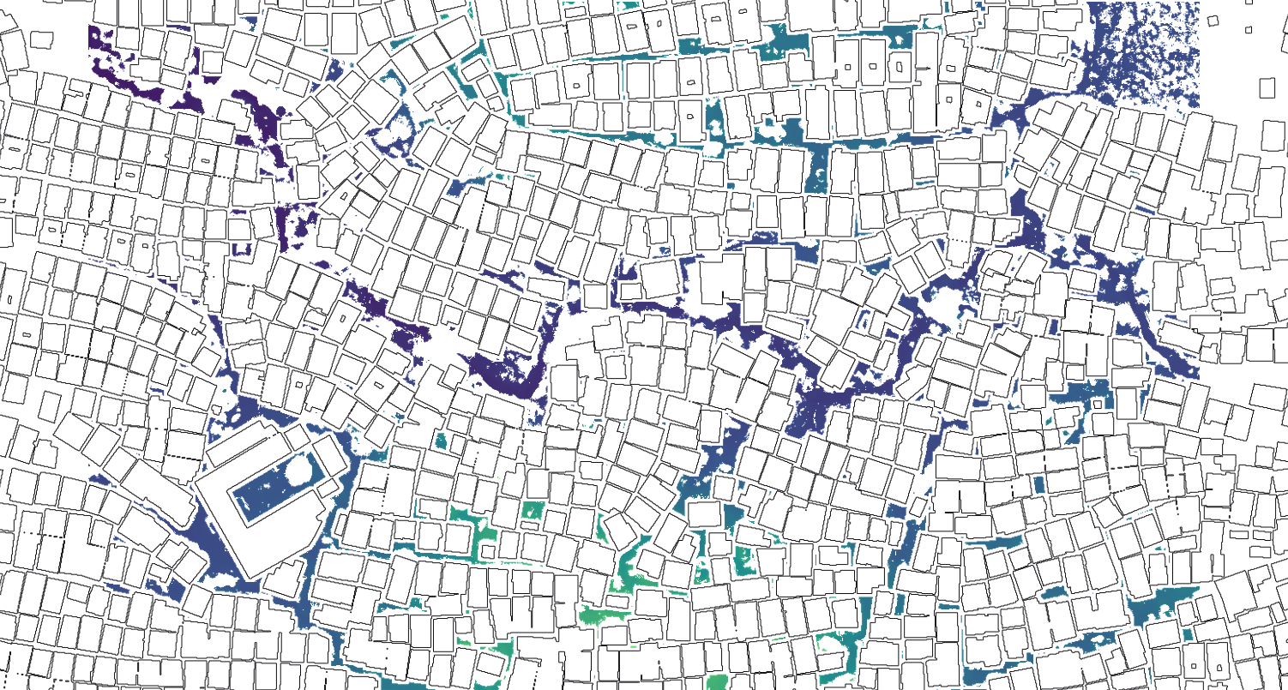
2.5D Filtering: r.geomorphon + building footprints

Slide 42
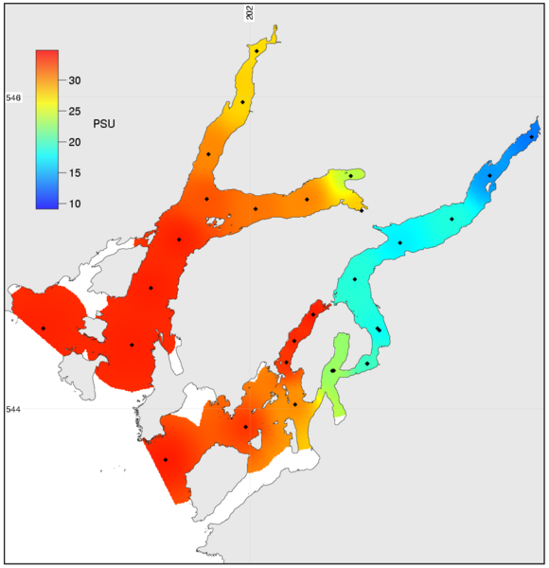
v.surf.icw
Inverse Cost Distance: respects barriers

Slide 43
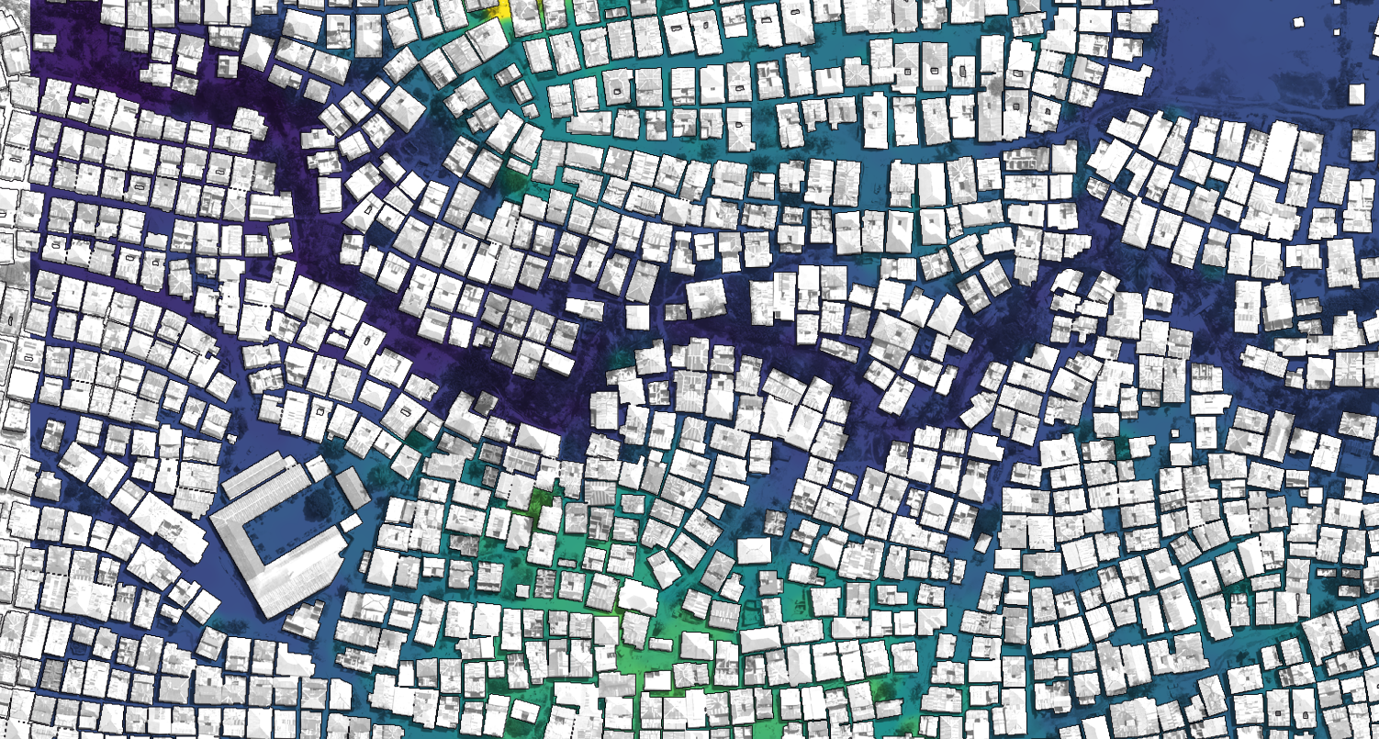
v.surf.icw

Slide 44
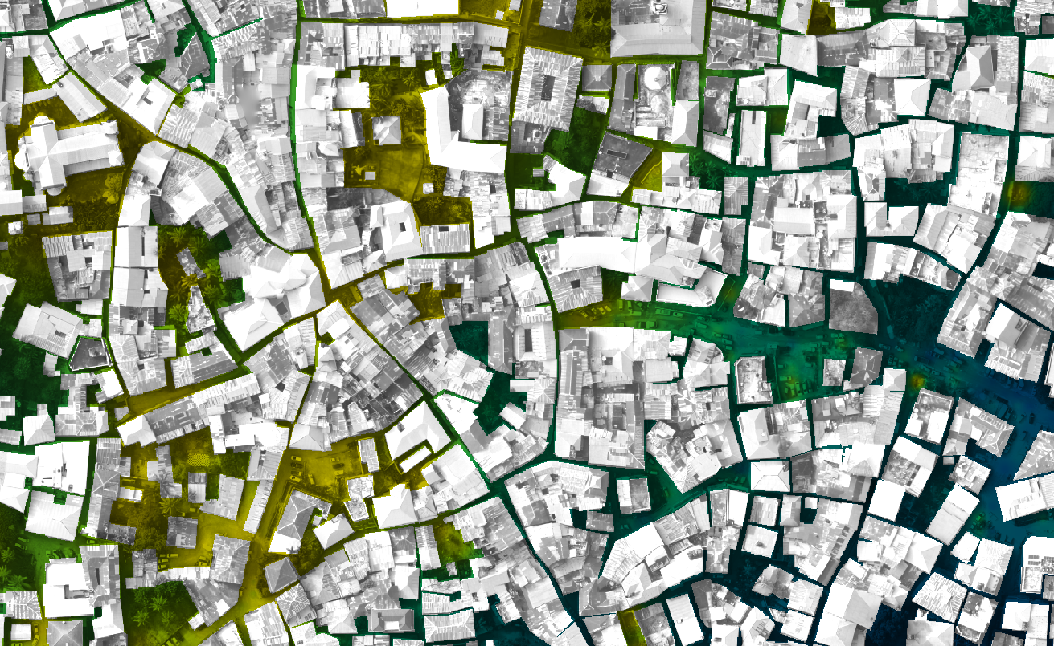
v.surf.icw

Slide 45
Quick Methods for Recreating a DEM when Reprojecting a LiDAR Point Cloud
Doug Newcomb M.A.
Stephen Mather M.A.

