Slide 1

Docker Training 1
Mehmet Cevheri BOZOĞLAN
Software Architect
R&D Team
2022

Slide 2
Agenda
Virtualization ( os(hardware), vm, docker )
Docker Architecture
Image - Dockerfile
Container
Docker Registry
Docker compose

Slide 3
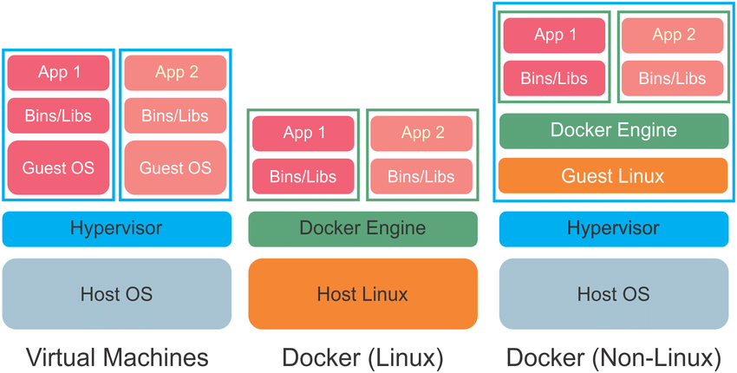
VM / Linux / Non-Linux

Slide 4
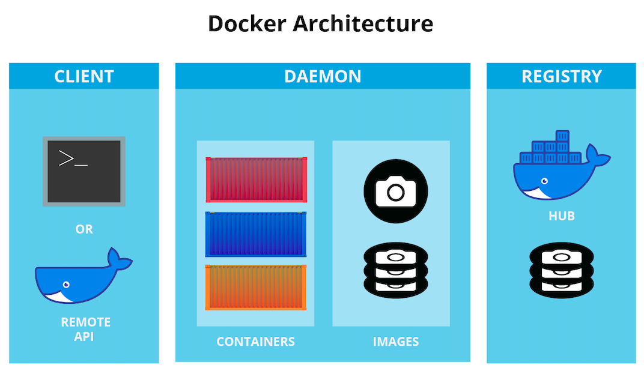

Slide 5
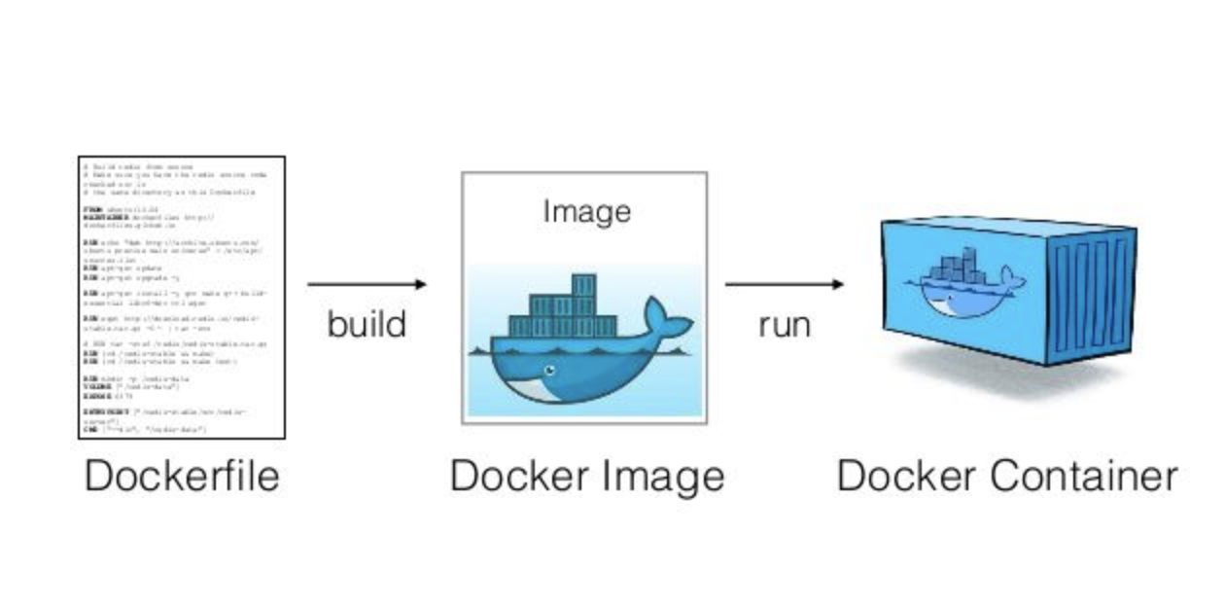
Dockerfile -> Image -> Container

Slide 6
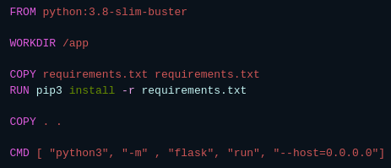
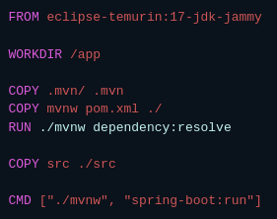
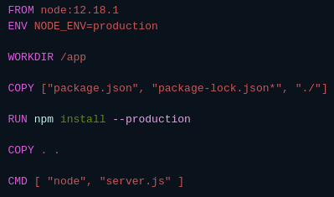
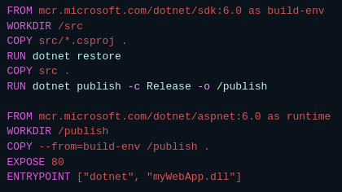
Dockerfile examples

Slide 7
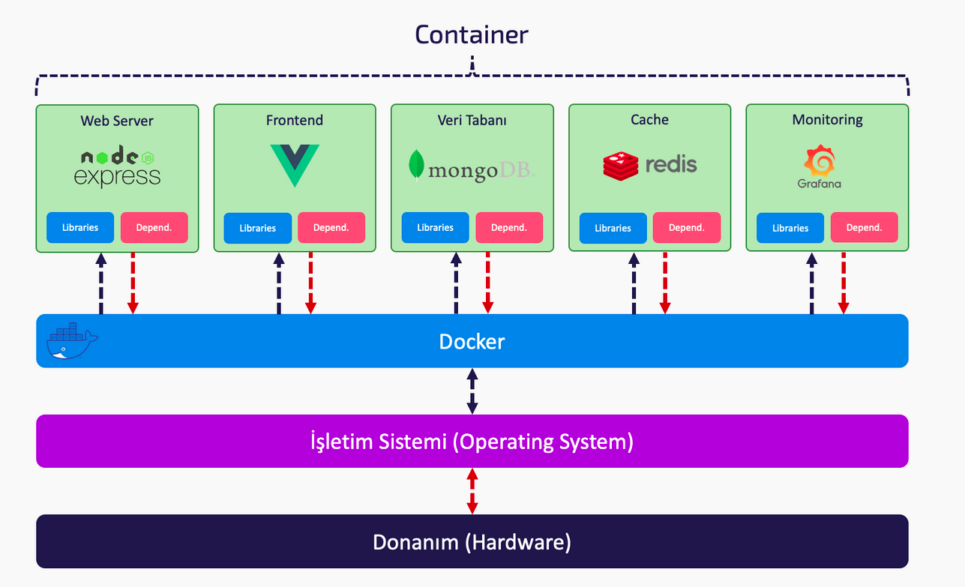

Slide 8
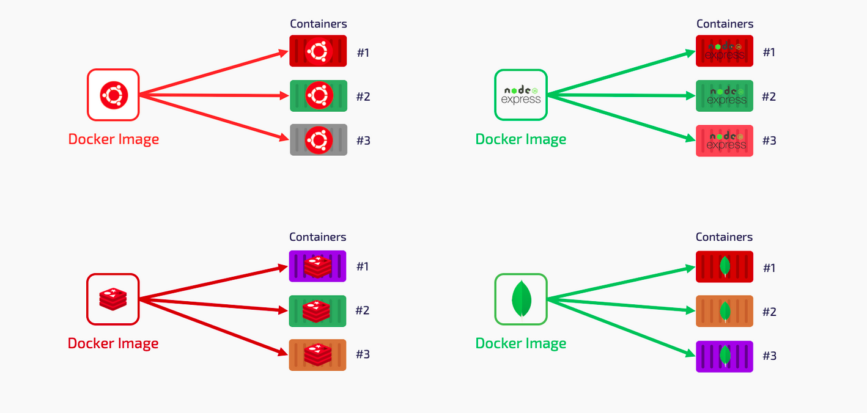

Slide 9

Docker Container Registries
Public / Private Registry
Docker Hub - mostPopular
Azure Container Registry
Red Hat Quay
Amazon ECR
Harbor
DigitalOcean
Github
Gitlab
Google Cloud
JFrog
Nexus

Slide 10
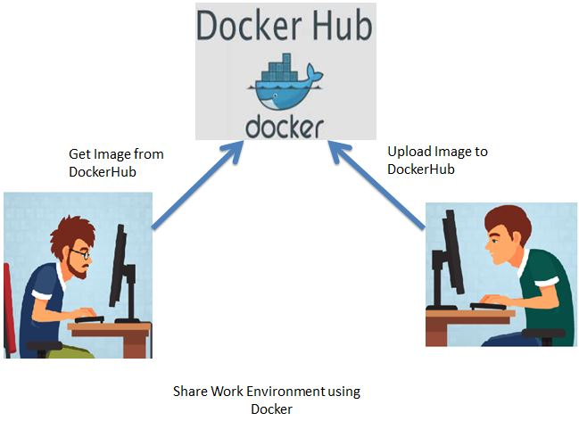
Docker Hub

Slide 11
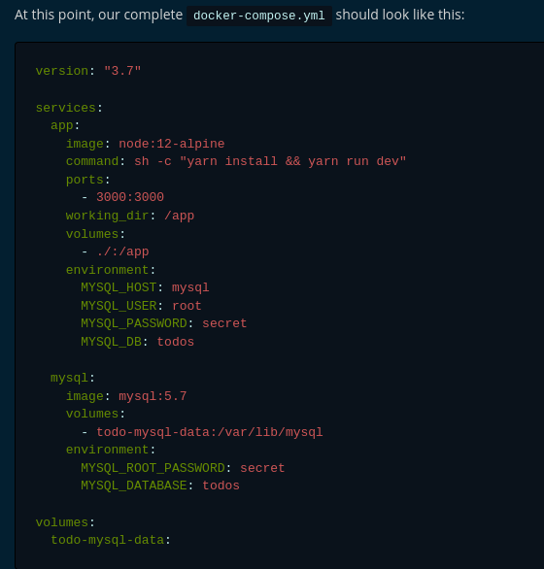
Docker
Compose
Docker Compose is a tool that was developed to help define and share multi-container applications.
With Compose, we can create a YAML file to define the services and with a single command, can spin everything up or tear it all down.
docker compose up
docker compose down

Slide 12
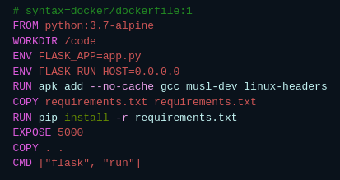
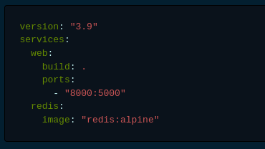
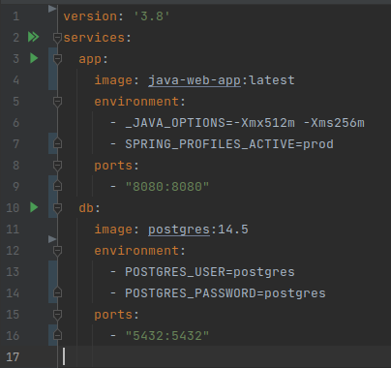
Docker Compose

Slide 13
Teşekkürler
Cevheri
2022

