Slide 1
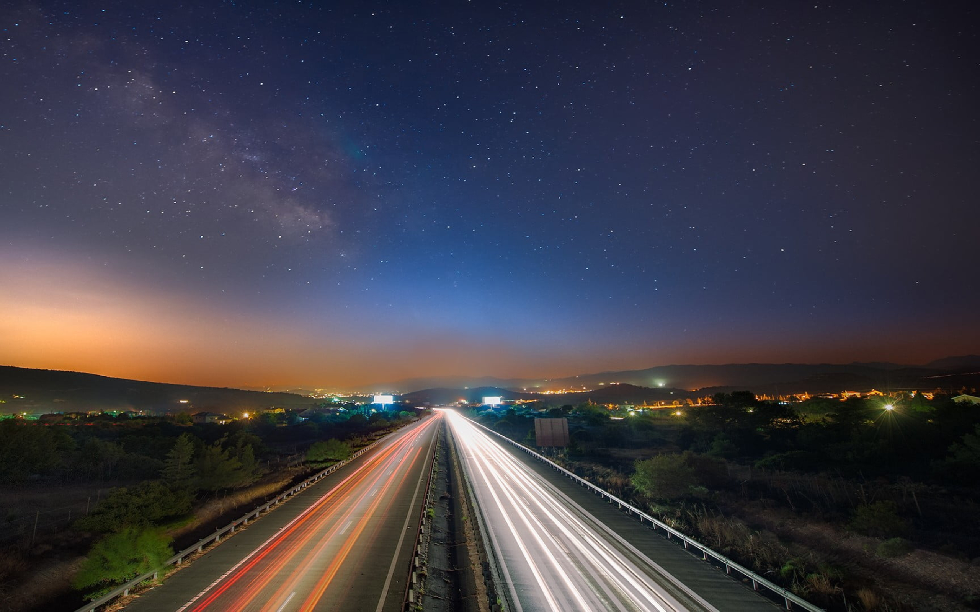
Effects of a general speed limit on multi-lane highway throughput
Diego De los Santos, Daniel Nezamabadi, Natalie Suter, Róbert Veres, Victor Vitéz

Slide 2




Effects of a general speed limit on multi-lane highway throughput
Introduction
Fundamental Questions
Expected Results
Model
IDM
MOBIL
Implementation
idk
Results
yes pls
Diego De los Santos, Daniel Nezamabadi, Natalie Suter, Róbert Veres, Victor Vitéz

Slide 3
Introduction
Fundamental Questions
Expected Results

Slide 4
The Model
Notes:
Say what we needed our model to be able to do: give each car an individual driving style -> So we chose IDM

Slide 5


Intelligent Driver Model
v0
Desired Speed
T
Time Headway

Slide 6
Intelligent Driver Model

Slide 7
MOBIL

Slide 8
Implementation
Notes:
Say what we needed our model to be able to do: give each car an individual driving style -> So we chose IDM

Slide 9
Implementation

Slide 10
Results
Notes:
Say what we needed our model to be able to do: give each car an individual driving style -> So we chose IDM

Slide 11
Results

Slide 12
Thank you for your Attention
Notes:
Say what we needed our model to be able to do: give each car an individual driving style -> So we chose IDM

Slide 13
Sources

